Slide 1

SENG 438 Software Testing, Reliability & Quality
Chapter 5A: White-box Testing
Control-flow Coverage
Department of Electrical & Computer Engineering, University of Calgary
B.H. Far （far@ucalgary.ca）
http://people.ucalgary.ca/~far

Slide 2
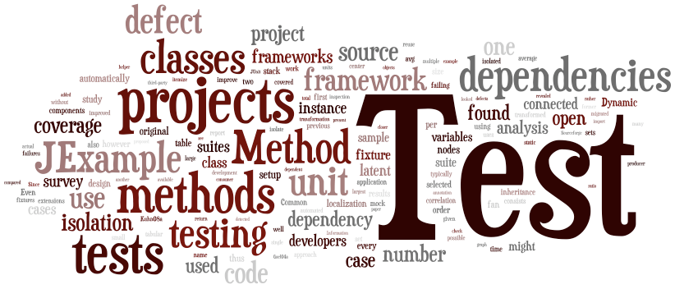
Contents
Preliminary: Control Flow Graph (CFG)
Control flow
Statement/Node/Line Coverage
Decision/Edge/Branch Coverage
Condition Coverage
Path Coverage
Cyclomatic complexity
Data flow
Coverage tools
Our focus in this week
Next week

Slide 3

Review: Black- vs. White-box
Black-box testing
Testing, either functional or non-functional, without reference to the internal structure of the component or system
Synonyms: specification-based testing
White-box testing
Procedure to derive and/or select test cases based on an analysis of the internal structure of a component or system
Synonyms: structural, glass box, open box testing
White-box
Black-box
Notes:
Exhaustive testing is impractical
We need techniques to identify test cases with the most likelihood of finding a defect out of the possible many.

Slide 4
Review: White-box
Also known as structural testing, glass box or open box testing
A software testing technique in which explicit knowledge of the internal working of SUT is used to select tests, execute tests and collect test data
Unlike black box testing that is using the program specification to examine outputs, white box testing is based on specific knowledge of the source code to define the test cases and to examine outputs

Slide 5
Review: Black- vs. White-box
How do black- and white-box testing relate to one another in real-world projects?

Slide 6
Section 1
Preliminary:
Control Flow Graph (CFG)

Slide 7
How to Represent Program Structure?
Software structure can have 3 attributes:
Control-flow structure: Sequence of execution of instructions of the program (execution of code lines)
Data flow: Keeping track of data as it is created or handled by the program
Data structure: The organization of data itself independent of the program
Dynamic
Static

Slide 8
Preliminary: Graph
Graphs are the most commonly used structure for white-box testing
A graph is
A set N of nodes, N is not empty
A set N₀ of initial nodes, N₀ is not empty
A set N_{f} of final nodes, N_{f} is not empty
A set E of edges, each edge from one node to another
( n_{i} , n_{j} ), i is predecessor, j is successor
We usually intend to “cover” the graph equivalent to a program block through testing
1
x < y
x >= y
y = 0
x = x + 1
2
3
x = y
4
Introduction to Software Testing, © Ammann & Offutt
Notes:
At the beginning we want to create this CFG and use it to write our test cases.
With gaining experience, we can look at the program code and create a mental CFG image and write tests to fulfill the coverage needs.

Slide 9
Preliminary: Path in a Graph
Path: A sequence of nodes – [n₁, n₂, …, n_{M}]
Each pair of nodes is an edge
Length: The number of edges
A single node is a path of length 0
Subpath: A subsequence of nodes in p is a subpath of p
1
2
3
A Few Paths
[ 1, 4, 8 ]
[ 2, 5, 9, 6, 2 ]
[ 3, 7, 10 ]
4
5
6
7
8
9
10
Introduction to Software Testing, © Ammann & Offutt

Slide 10
Preliminary: Test Path
Test Path: A path that starts at an initial node and ends at a final node
Test paths represent execution of test cases
Some test paths can be executed by many tests
Some test paths cannot be executed by any tests
Double-diamond graph
Four test paths
[1, 2, 4, 5, 7]
[1, 2, 4, 6, 7]
[1, 3, 4, 5, 7]
[1, 3, 4, 6, 7]
2
5
1
4
7
3
6
Introduction to Software Testing, © Ammann & Offutt

Slide 11
Testing & Covering Graphs
We use graphs in testing so as to:
Develop a model of the software as a graph
Require tests to visit or tour specific sets of nodes and edges
Structural Coverage Criteria: Defined on a graph just in terms of nodes and edges
Data Flow Coverage Criteria: Requires a graph to be annotated with references to variables
Introduction to Software Testing, © Ammann & Offutt
Notes:
Visit : A test path p visits node n if n is in p
A test path p visits edge e if e is in p
Tour : A test path p tours subpath q if q is a subpath of p

Slide 12
Testing & Covering Graphs
Graph: Usually the control flow graph (CFG)
Node (line or statement) coverage: Execute every program statement
Edge (decision or branch) coverage: Execute every branch
Loops: Looping structures such as for-loops, while-loops, etc.
Data flow coverage: Augment the CFG with extra information
branch predicates
defs are statements that assign values to variables
uses are statements that use variables
Introduction to Software Testing, © Ammann & Offutt
Notes:
What about condition coverage? And path coverage?

Slide 13
Control Flow Graph (CFG) /1
Control flow structure is usually modeled by a directed graph (di-graph)
CFG = {N, A}
Each node n in the set of nodes (N) corresponds to a program statement.
Each directed arc (or directed edge) a in the set of arcs (A) indicates flow of control from one statement of program to another.
Procedure nodes: nodes with out-degree 1.
Predicate nodes: nodes with out-degree other than 1 and 0.
Start node: nodes with in-degree 0.
Terminal (end) nodes: nodes with out-degree 0.
This is where a branch
Is created

Slide 14
CFG - Example
a
if a then
if b then X
Y
while e do U
else
if c then
repeat V until d
endif
endif
1
2
b
c
3
10
X
4
V
5
12
Y
13
11
6
d
U
7
e
14
8
9

Slide 15
CFG vs. Flowchart
Are CFG and flowchart the same?
Can I use flowchart for testing a program?
Yes, if you want … but note that …
In flow graphs, we don't show the details of what is in a process block whereas in flow charts every part of the process block is defined and drawn
In flow charts, different types of nodes are represented by different symbols in flow charts, but we do not use different symbols in control flow graphs
The flow graph focuses on control flow of the program whereas the flowchart focuses on process steps
Flow charts can be used for test case design; they can be used for testing, e.g. path coverage; but we can simply use CFG instead

Slide 16
CFG vs. Activity Diagram
UML Activity Diagram: can be used to model/draw CFGs

Slide 17
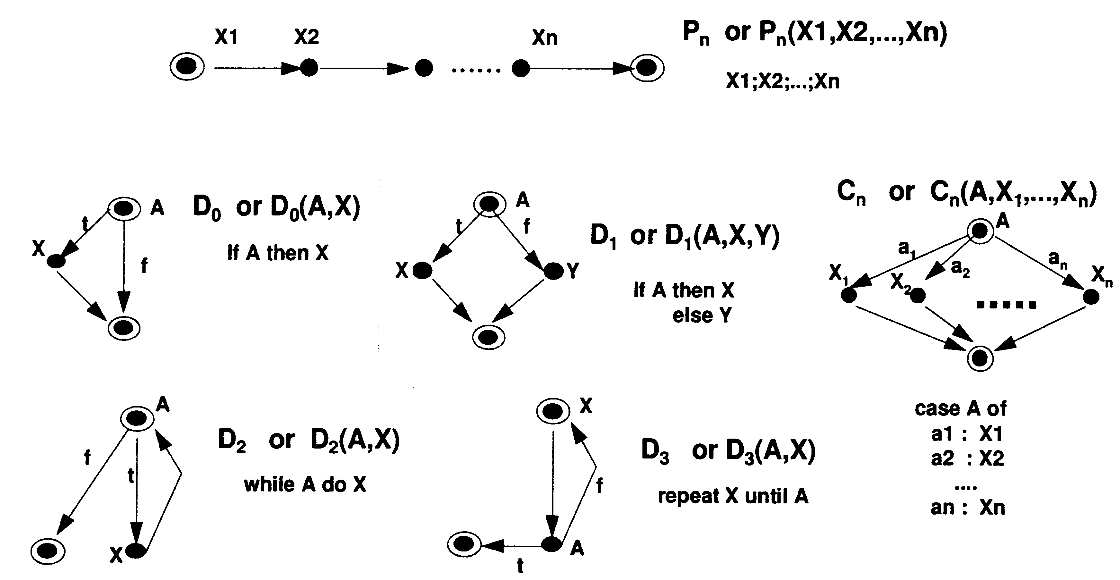
Common CFG Program Models

Slide 18
Prime Flow Graphs
Prime flow graphs are flow graphs that cannot be decomposed non-trivially by sequencing and nesting
Examples (according to [FeP97]):
Pn (sequence of n statements)
D0 (if-condition)
D1 (if-then-else-branching)
D2 (while-loop)
D3 (repeat-loop)
Cn (case)

Slide 19
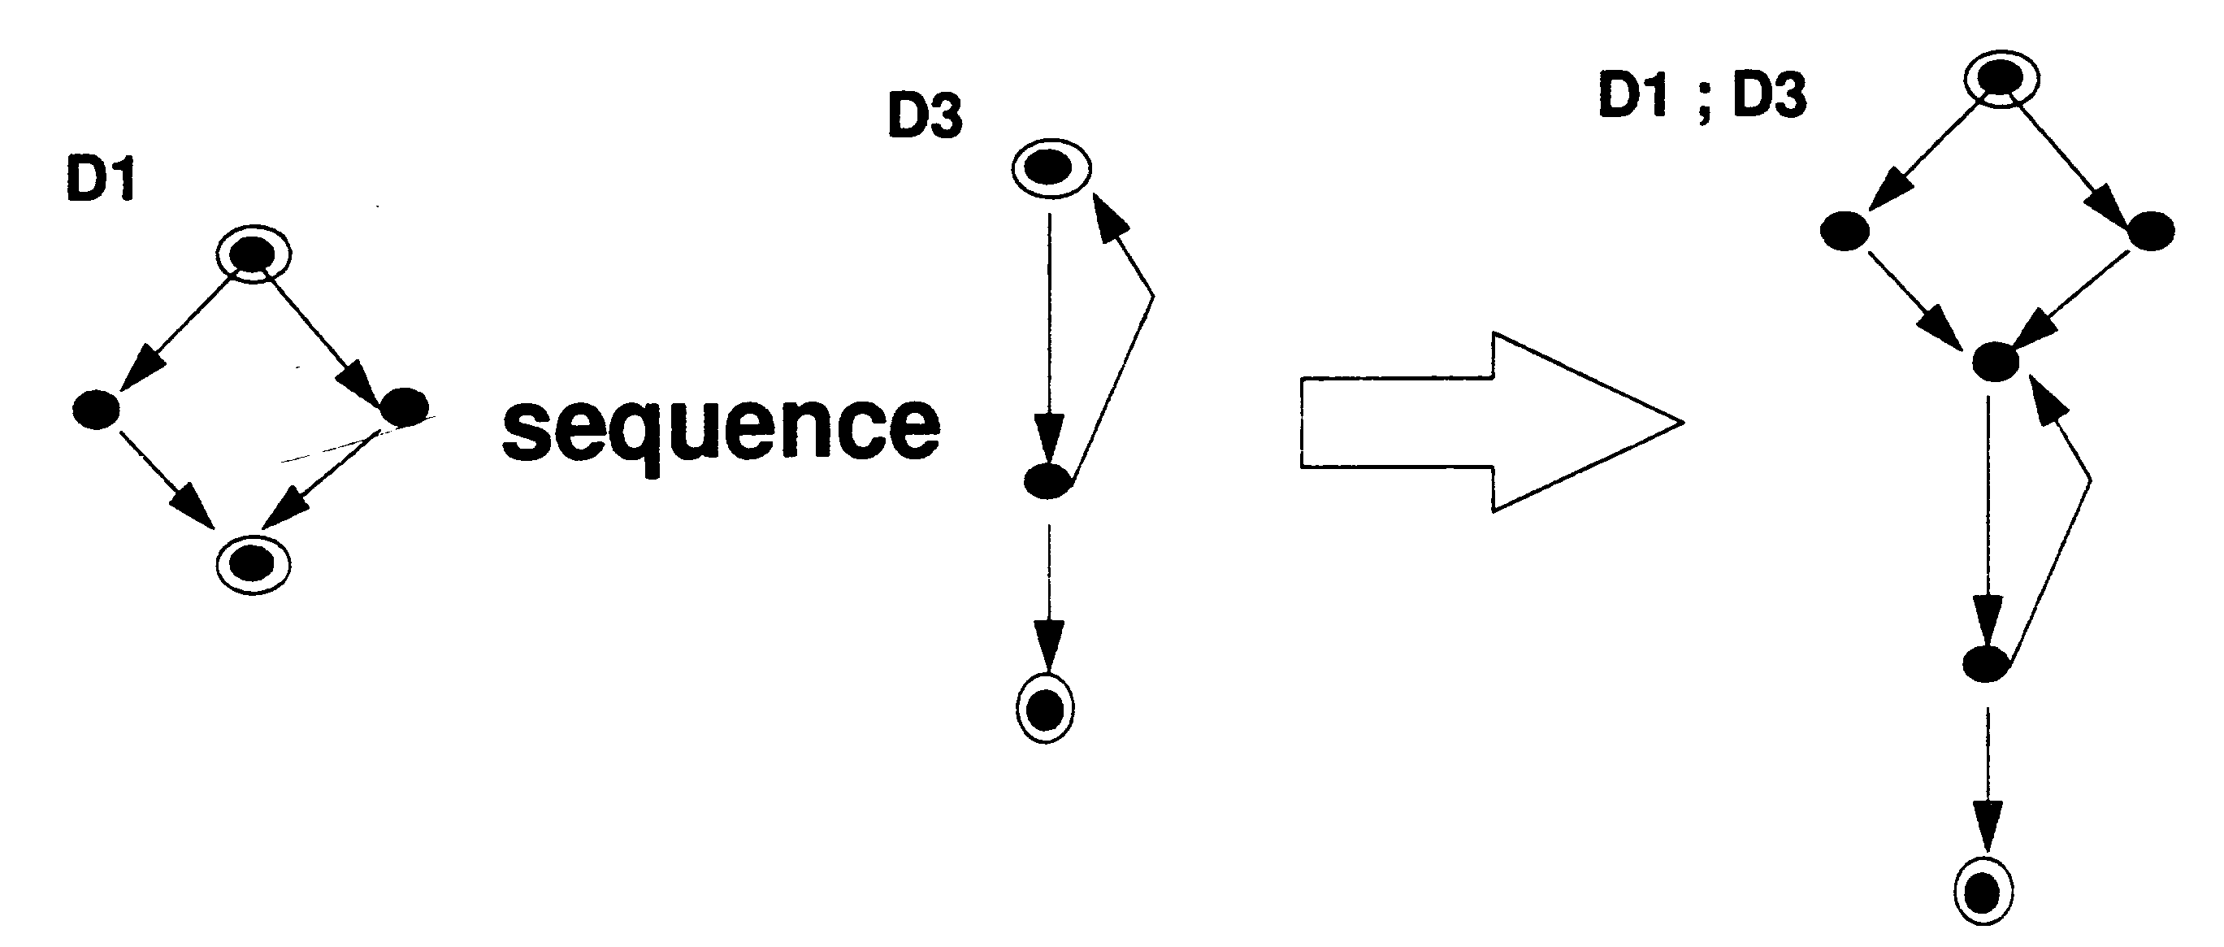
Sequencing & Nesting /1
Let F1 and F2 be two flowgraphs. Then, the sequence of F1 and F2, (shown by F1; F2) is a flowgraph formed by merging the terminal node of F1 with the start node of F2.

Slide 20
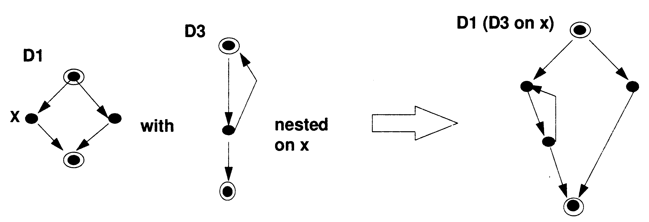
Sequencing & Nesting /2
Let F1 and F2 be two flowgraphs. Then, the nesting of F2 onto F1 at x, shown by F1(F2) is a flowgraph formed from F1 by replacing the arc from x with the whole of F2.

Slide 21
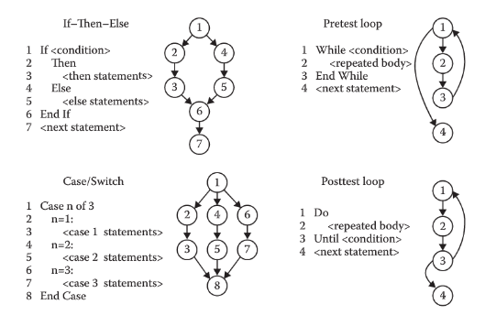
Common CFG Patterns

Slide 22
Example: Triangle Program
Problem Statement
The triangle program accepts three integers, a, b, and c, as input. These are taken to be sides of a triangle. The integers a, b, and c must satisfy the following conditions:
C1) a < b +c C2) b < a + c C3) c < a + b
The output of the program is the type of triangle determined by the three sides:
If all three sides are equal, the program output is Equilateral
If exactly one pair of sides is equal, the program output is Isosceles
If no pair of sides is equal, the program output is Scalene
If any of conditions is not met, the program output is NotATriangle

Slide 23
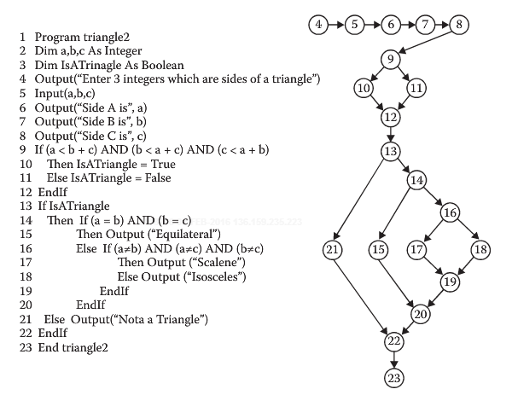
Example: CFG for Triangle
Notes:
Try to write tests for code coverage, branch coverage, path coverage, condition coverage without using the graph. It could be hard and somehow ad-hoc isn’t it?
Now use the graph for example, to write branch coverage tests. You know which part of the code should be focused on and tested, don’t you?

Slide 24
Constructing CFG
Relatively easy to map a program to its equivalent CFG
As mentioned earlier
Nodes (three kinds):
Statement nodes: represent single entry single exit sequence of statements
Predicate nodes: represent conditions for branching
Auxiliary nodes: for completing the graph
Edges: represent possible flow of control

Slide 25
Constructing CFG
The if statement
We need to identify
the exact conditions
for predicate nodes
if (x < y)
{
y = 0;
x = x + 1;
}
else
{
x = y;
}
1
x < y
x >= y
We do not need to
identify the job done
by statement nodes
y = 0
x = x + 1
2
3
x = y
4
1
if (x < y)
{
y = 0;
x = x + 1;
}
x < y
y = 0
x = x + 1
2
x >= y
3
Introduction to Software Testing, © Ammann & Offutt

Slide 26
Constructing CFG
The if return statement
if (x < y)
{
return;
}
print (x);
return;
1
x < y
2
x >= y
return
3
print (x)
return
No edge from node 2 to 3.
The return nodes must be distinct.
Introduction to Software Testing, © Ammann & Offutt

Slide 27
Constructing CFG
The while Loop
Loops require “extra” nodes to be added
Nodes that do not represent statements or basic blocks
x = 0
1
x = 0;
while (x < y)
{
y = f(x, y);
x = x + 1;
}
dummy node
2
x < y
x >= y
3
4
y =f(x,y)
x = x + 1
Introduction to Software Testing, © Ammann & Offutt

Slide 28
Constructing CFG
The for Loop
implicitly initializes loop
x = 0
1
2
for (x = 0; x < y; x++)
{
y = f (x, y);
}
x < y
x >= y
y = f (x, y)
3
5
4
x = x + 1
implicitly increments loop
Introduction to Software Testing, © Ammann & Offutt

Slide 29
Constructing CFG
The do Loop
x = 0;
do
{
y = f (x, y);
x = x + 1;
} while (x < y);
println (y)
x = 0
1
2
y = f (x, y)
x = x+1
x >= y
x < y
3
Introduction to Software Testing, © Ammann & Offutt

Slide 30
Constructing CFG
The do Loop with break and continue
x = 0;
while (x < y)
{
y = f (x, y);
if (y == 0)
{
break;
} else if (y < 0)
{
y = y*2;
continue;
}
x = x + 1;
}
print (y);
1
x = 0
2
3
y =f(x,y)
y == 0
4
break
5
y < 0
6
y = y*2
continue
7
x = x + 1
print (y)
8
Introduction to Software Testing, © Ammann & Offutt

Slide 31
Constructing CFG
The switch (case) structure
xread (c) ;
switch (c)
{
case ‘N’:
z = 25;
case ‘Y’:
x = 50;
break;
default:
x = 0;
break;
}
print (x);
1
read ( c );
c == ‘N’
c == ‘Y’
default
2
3
4
z = 25;
x = 0;
break;
x = 50;
break;
5
print (x);
Cases without breaks fall through to the next case
Introduction to Software Testing, © Ammann & Offutt

Slide 32
Constructing CFG
The exception (try-catch) structure
try
{
s = br.readLine();
if (s.length() > 96)
throw new Exception
(“too long”);
if (s.length() == 0)
throw new Exception
(“too short”);
} (catch IOException e) {
e.printStackTrace();
} (catch Exception e) {
e.getMessage();
}
return (s);
1
s = br.readLine()
IOException
2
3
e.printStackTrace()
length <= 96
length > 96
throw
4
5
length != 0
length == 0
7
throw
6
e.getMessage()
8
return (s)
Introduction to Software Testing, © Ammann & Offutt

Slide 33
Section 2
Control Flow Coverage

Slide 34
Contrlo Flow Based Testing
Step 1: From the source code create a control flow graph (CFG)
Manually or automated
Step 2: Design test cases to cover certain elements of CFG
Nodes, edges, conditions, paths, etc.
Step 3: Decide upon appropriate coverage metrics to report test results
Statement, decision, condition, path coverage metrics
Step 4: Execute tests, collect and report coverage data

Slide 35
Control Flow Criteria
We can use different control-flow criteria:
Statement/Block/Node/Line coverage
Decision/Edge/Branch coverage
Condition coverage
Path coverage
We can even analyze/measure complexity of the code and use it to create test cases
Cyclomatic complexity
Discussed in detail next…

Slide 36

Coverage Metrics
For each criterion we must define a metrics to measure it
Test coverage measures the amount of testing performed by a set of test
Wherever we can count things and can tell whether or not each of those things has been tested by some test, then we can measure coverage and is known as test coverage
Notes:
IEEE Unit Testing Standard is 100% Statement Coverage and 100% Branch Execution
(IEEE Std. 982.1-1988, § 4.17, “Minimal Unit Test Case Determination”)

Slide 37


Coverage Metrics Examples
We can calculate or verify coverage manually or use dedicated tools

Slide 38
1. Statement Coverage
Rationale (why do we need it): Faults cannot be discovered if code lines containing them are not executed
Statement coverage criterion: Equivalent to covering all nodes in CFG
Executing a statement is a weak guarantee of correctness, but rather easy to achieve
In general, several inputs execute the same statements
An important question in practice is: How can we minimize (the number of) test cases so we can achieve a given statement coverage percentage?
Notes:
Weak measure but most popular in industry.
Note we are always using the code and our test suite together.

Slide 39
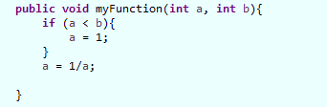
Statement Coverage
Statement coverage criteria may lead to incompleteness (i.e. does not guarantee finding faults)
Example 1:
TC: (a = 1, b = 2) will give 100% statement coverage
Why 100% line coverage may not catch the fault here?
Conclusion: statement coverage does not guarantee bug-free software
Notes:
Let’s walk through the code and track the coverage.
What if TC: (a=0, b=2)?

Slide 40
Statement Coverage Exercise
Percentage of code covered by the tests
Test Suite
1: PrintSum (int a, int b){
2: int result=a+b;
3: if (result>0)
4: printcol(“red”, result);
5: else if (result<0)
6: printcol(“blue”, result);
7: }
TC1:
a=3, b=9
TC2:
a=-5, b=-8
TC1
TC2
0%
25%
50%
75%
100%
Note: this is usually done automatically by a test coverage tool
Notes:
Conclusion: Statement coverage can reveal missing test cases.
Why we need 2 test cases here? Because cyclomatic complexity of program is 2 (one decision node), reflecting two branches in the program to be tested.

Slide 41
2. Decision (Branch) Coverage
Branch coverage relates to decisions in a program
e.g. an IF statement has always two branches
Example: Branch coverage for the example given TC: (a = 1, b = 2)
1:
2:
The else-branch with zero executions is in red. Executed branch is in green. Therefore branch coverage for the code excerpt is 50%.

Slide 42
Decision (Branch) Coverage
Given control flow graph (CFG) of a program
Select a test set such that, by executing the program for each test case in the set, each edge of CFG’s decision node is traversed at least once
We need to exercise all decision that traverse the control flow of the program with True and False values
x ≠ y
x = y
x<=y
x > y

Slide 43
Edge (Branch) vs. Node (Statement)
Example
TS1:
TC1:<x=1, expected output=1>
Achieves 100% line coverage
Only 50% decision coverage
TS2:
TC1:<x=1, expected output=1>
TC2:<x=-2, expected output=2>
Achieves 100% line coverage
Also 100% decision coverage
Subsumes statement coverage
1: public static int abs(int x){
2: if (x>0)
3: return x;
4: else
5: return -x;
6: }
1
L2
x > 0
2
x <= 0
L3
L5
3

Slide 44
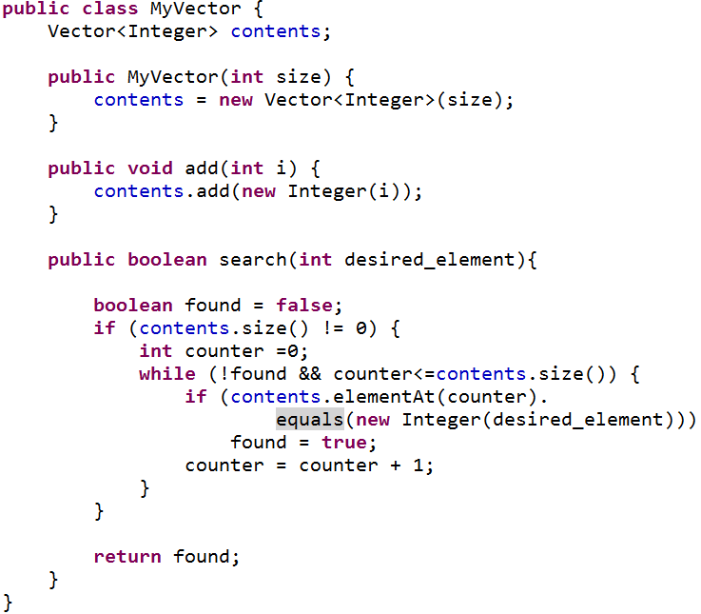
Example 1: Search Program
Example of a common mistake in a search algorithm
The range may go out of bound in certain cases
Fault: Should have been <
Notes:
Here is an example of a common mistake in a search algorithm. If the desired element = last element, we exit the loop before we find it.

Slide 45
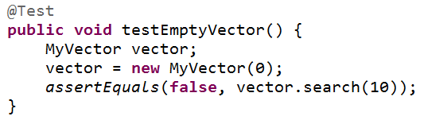
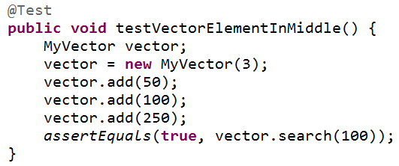
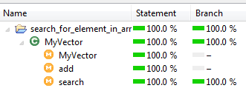
Example 1: Test Cases
We design a test set with two test cases:
TC1: A vector with 0 items
TC2: A vector with 3 items
Coverage of above test suite: 100% statement and 100% branch coverage
The edge coverage criterion is fulfilled but the out of bound fault is NOT discovered by the test set
Conclusion: branch coverage does not guarantee bug-free software
Notes:
Did it find the fault? No. So need for more rigorous metrics
For the second test case, the “while” loop body executes the “if-then” branch, therefore the edge coverage criterion is fulfilled but the out of bound error is NOT discovered by the test set

Slide 46
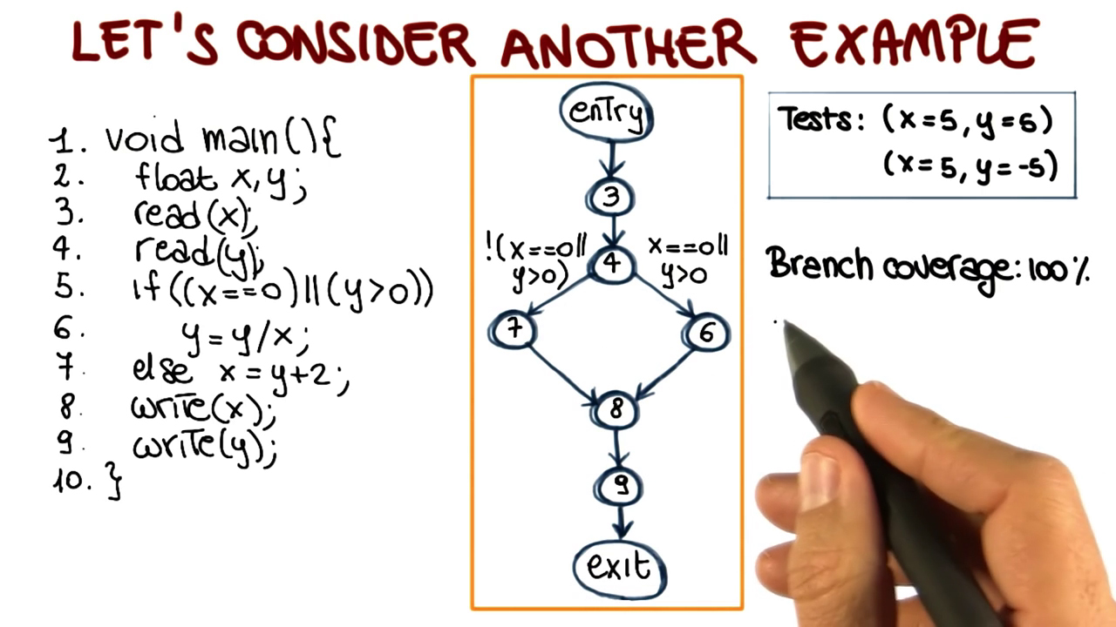
Branch Coverage: Example 2
In this example both statement and branch coverage will be 100% but still the test suite cannot catch the divide by zero fault
We need a more rigorous metrics to catch the bug:
Condition Coverage:
make each condition True or False

Slide 47
3. Condition Coverage
Condition coverage is a more powerful test coverage criteria
Condition Coverage (CC) Criterion: Design a test set such that each individual condition in the program to be both True and False (regardless of the truth or falsity of predicates combining those conditions) → this may cause branch coverage suffer though
We should usually consider both branch (decision) and condition coverage together
How? by executing the program for each element in the set, all possible values of the constituents of compound conditions (defined below) are exercised at least once
Compound conditions: C1 and C2 or C3 … where Ci’s are relational expressions or Boolean variables (atomic conditions)

Slide 48
Condition Coverage - Example
Same example above, different test suite
Condition coverage will be 100% however, branch (decision) coverage is only 50% (why?)
Therefore:
We need to consider both branch and condition coverage!
Tests: (x=0, y=-5)
(x=5, y=5)
Notes:
If we look at the first condition x=0 it is both true for the first and false for second one. As for the second condition y > 0 is false for the first and true for the second test case. Therefore, we have achieved 100% coverage with these two tests.

Slide 49
Condition Coverage
Condition Coverage can uncover hidden edges
Two equivalent programs: you would write the left one
Edge coverage
would not necessarily cover the “hidden” edges in the right one
Example: C2 = false might not be covered
Condition coverage would cover C2 = false

Slide 50
Condition vs. Decision Coverage
For a compound predicate: (a∨b)∨c
Decision coverage test suite T={TC1, TC2}, i.e. make the compound predicate True and False
TC1= <a=T, b=F, c=F>
TC2= <a=F, b=F, c=F>
Condition coverage test suite
T={TC3, TC4}, i.e. make individual
conditions True and False
TC3= <a=T, b=F, c=T>
TC4= <a=F, b=T, c=F>
100% decision coverage
1
!(a OR b) OR c
(a OR b) OR c
2
3
4
50% condition coverage

Slide 51
Condition-Decision Coverage
Better choice: Both conditions and decisions should be covered for (T and F)
Multiple C/DC (all combinations)
e.g. (a∨b)∨c
{TTT, TTF, TFT, TFF, FTT, FTF, FFT, FFF}
No scalable
Exponential

Slide 52
Condition Coverage
An example Decision: C1 and C2 or C3 … where Ci’s are relational expressions or Boolean variables (atomic conditions)
In our example:
We should exercise each atomic condition to T and F
Decisions with one condition? 2 tests
Decisions with more than one condition? Several test

Slide 53
Condition Coverage
Our test suite:
TC1: A vector with 0 items
TC2: A vector with 3 items
How many conditions? Any unreachable one?
How many condition cases are covered by the above two test cases?

Slide 54
Condition Coverage: Let’s make it 100%
Our test suite:
TC1: A vector with 0 items
TC2: A vector with 3 items
What TC(s) to add?
We should add a TC to make this False

Slide 55
Multiple Condition
Using condition coverage on some compound condition C implies that each simple condition within C has been evaluated to true and false
However, it does not imply that all combinations of the values of the individual simple conditions in C have been exercised
Number of test cases with condition coverage:
2 *n n: number of conditions
Number of test cases with multiple condition coverage:
2 **n n: number of conditions

Slide 56
Modified Condition-Decision (MC/DC)
Modified Condition-Decision (MC/DC) Criterion: Effectively test “important combinations” of conditions
Only combinations of values such that every atomic condition C_{i} toggles (impacts) the overall condition’s truth value (True and False), i.e., the outcome of a decision changes as a result of changing each single condition
Minimum set size = N+1 (Linear)
MC/DC subsumes decision coverage
Effective use in industry: The international standard DO-178B for Airborne Systems Certification (since 1992) requires testing the airborne software systems with MC/DC criterion
Notes:
J. J. Chilenski and S. P. Miller. Applicability of modified condition/decision coverage to software testing. Software Engineering Journal, pages 193--200, September 1994.
This criterion requires enough test cases to verify every condition can affect the result of its encompassing decision. It was created at Boeing and is required for aviation software by RCTA/DO-178B.
A, B, C are boolean variables/expressions (e.g., relational expression)
Each pair contains a case where the truth value is T / F and the overall expression yields T / F

Slide 57
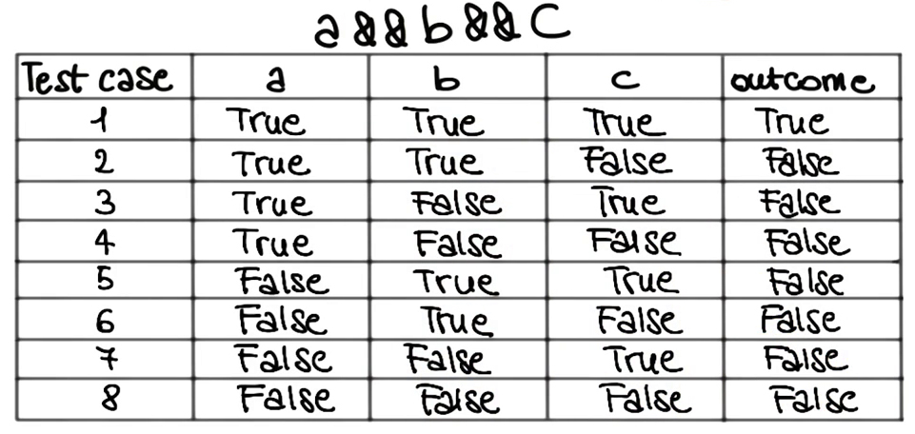
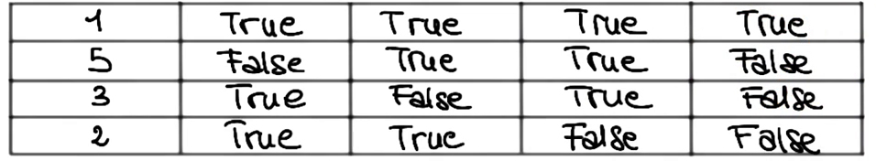
Exercise - MC/DC
Example: (a∧b∧c), in a while loop, let’s look at its truth table and derive the test cases…
a affects t₁ and t₅
b affects t₁ and t₃
c affects t₁ and t₂
Overall 4 test cases
Condition criterion: 8 cases 8
Modified criterion: 4 cases
Notes:
J. J. Chilenski and S. P. Miller. Applicability of modified condition/decision coverage to software testing. Software Engineering Journal, pages 193--200, September 1994.
This criterion requires enough test cases to verify every condition can affect the result of its encompassing decision. It was created at Boeing and is required for aviation software by RCTA/DO-178B.
A, B, C are boolean variables/expressions (e.g., relational expression)
Each pair contains a case where the truth value is T / F and the overall expression yields T / F

Slide 58
Example - MC/DC
Example: A∧(B∨C), e.g., in a while loop, let’s look at its truth table and derive the test cases…
Condition criterion : 8 cases
Modified criterion: 4 cases
Notes:
J. J. Chilenski and S. P. Miller. Applicability of modified condition/decision coverage to software testing. Software Engineering Journal, pages 193--200, September 1994.
This criterion requires enough test cases to verify every condition can affect the result of its encompassing decision. It was created at Boeing and is required for aviation software by RCTA/DO-178B.
A, B, C are boolean variables/expressions (e.g., relational expression)
Each pair contains a case where the truth value is T / F and the overall expression yields T / F

Slide 59
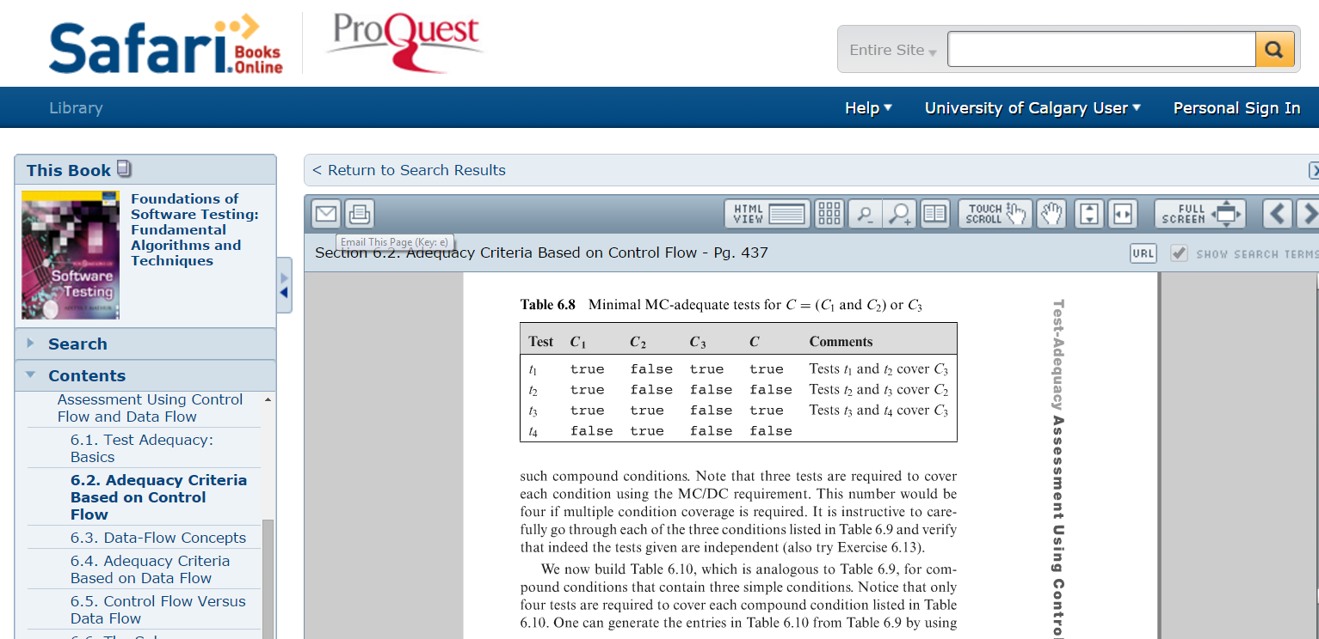
Examples with MC/MD
You can find several examples in the reference book …

Slide 60
4. Path Coverage
Path Coverage Criterion: Select a test set such that by executing the program for each test case, all paths leading from the initial to the final node of program’s control flow graph are traversed
In practice, however, the number of paths is too large, if not infinite (e.g., when we have loops)
Some paths are infeasible (e.g., not practical given the system’s business logic)
It may be important to determine “critical paths”, leading to more system load, security intrusions, etc.
x ≠ y
x = y
x<=y
x > y

Slide 61
Path Coverage Metrics
Path coverage counts the number of full paths from input to output through a program that get executed
Full path coverage will lead to full branch coverage
Notes:
Path coverage counts the number of full paths from input to output through a program that get executed
Branch coverage counts the number of branches that were tested at any point in time

Slide 62
Path Coverage - Example
Let’s compare how the following two test sets cover this CFG:
T1 (test set) =
{ TC11:<x=0, z =1>,
TC12:<x =1, z=3>
}
T2 (test set) =
{ TC21:<x=0, z =3>,
TC22:<x =1, z=1>
}

Slide 63
Path Coverage - Example
T1’s coverage
T1 = {TC11:<x=0, z =1>,
TC12:<x =1, z=3>}
T1 executes all edges but…!
Do you see any testing issue (uncovered paths which can be sources of failure)?
T1 executes all edges and all conditions but does not test risk of division by 0. (See the red “path”)

Slide 64
Path Coverage - Example
T2’s coverage
T2 = {TC21:<x=0, z =3>,
TC22:<x =1, z=1>}
T2 would find the problem (triggering division by 0) by exercising the remaining possible flows of control through the program fragment

Slide 65
Path Coverage - Example
T1 (test set) = {TC11:<x=0, z =1>,
TC12:<x =1, z=3>}
T1 executes all edges but do
not show risk of division by 0
T2 (test set) = {TC21:<x=0, z =3>, TC22:<x =1, z=1>}
T2 would find the problem by
exercising the remaining
possible flows of control
through the program fragment
Observation:
T1 and T2 → all paths covered

Slide 66
Path Coverage - Loops
In practice, however, the number of paths can be too large, if not infinite (e.g., when we have loops) → Impractical
A pragmatic heuristic: Look for conditions that execute loops
Zero times
A maximum number of times
An average number of times (statistical criterion)
For example, in the array search algorithm
Skipping the loop (the table is empty)
Executing the loop once or twice and then finding the element
Searching the entire table without finding the desired element

Slide 67
Path Coverage - Loops
Example: Power function

Slide 68
Path Coverage - Loops
Example: Power function - comparison with “all branches” and “all statements”
All statements
– One test case is enough
Y<0 : 1 ◊ 2 ◊ (3 ◊ 2)+ ◊ 4 ◊ 5 ◊ 6
All branches
– Two test cases are enough
Y<0 : 1 ◊ 2 ◊ (3 ◊ 2)+ ◊ 4 ◊ 5 ◊ 6
Y>0 : 1 ◊ 2 ◊ (3 ◊ 2)* ◊ 4 ◊ 6
All paths
– Infeasible path
1 ◊ 2 ◊ 4 ◊ 5 ◊ 6, Why infeasible?
The way Y and W relate
– Potentially large number of paths (depends on Y)
As many ways to iterate
2 ◊ (3 ◊ 2)* as values of abs(Y)

Slide 69
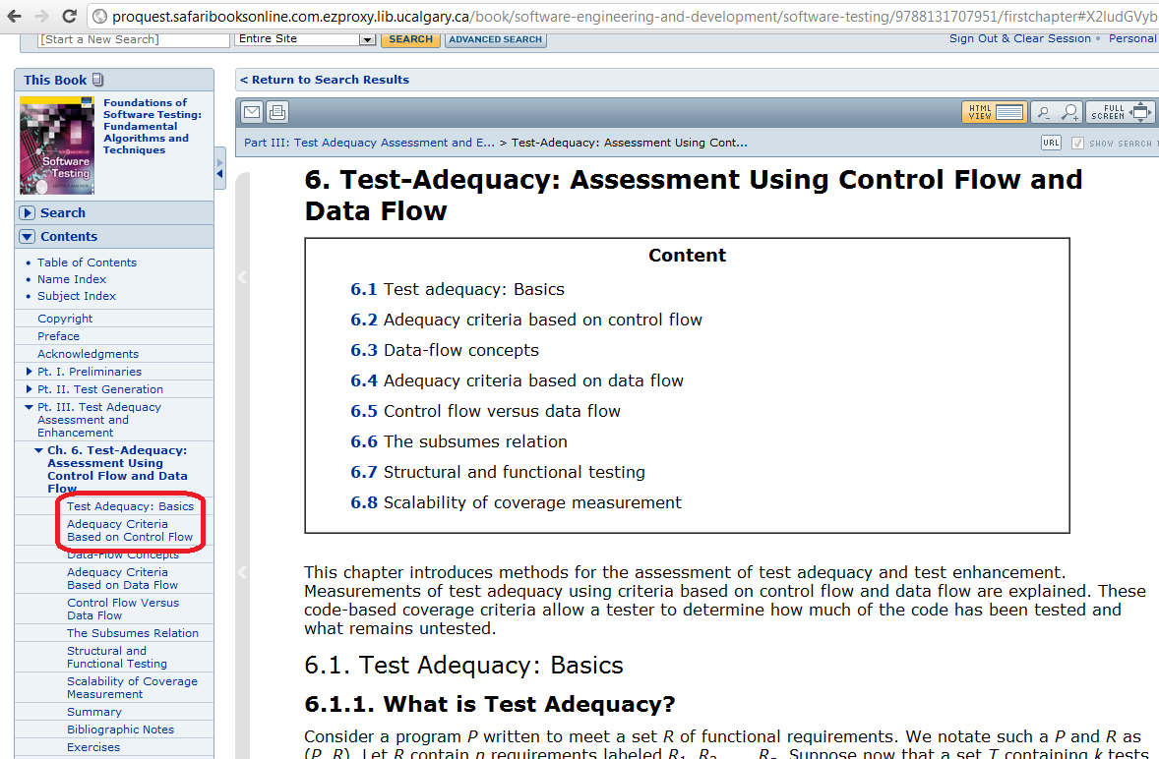
Summary - Control Flow
Further Reading on Control-flow metrics:

Slide 70
Subsumption
Subsumption:
Coverage criterion C₁ subsumes C₂ if-and-only-if every test set that satisfies C₁ also satisfies C₂ e.g., branch coverage subsumes statement coverage
MC/DC
subsumes
Branch & Condition Coverage
subsumes
subsumes
Branch Coverage
subsumes
Statement
Coverage
Condition
Coverage
If you have reached 100% branch coverage, you can deduct that you have also reached 100% statement coverage
But, if you have reached a certain amount of branch coverage, you cannot deduct that you have the same amount of statement coverage
MC/DC is the strongest coverage testing criterion

Slide 71
Control Flow Coverage - Reachability
Not all statements are reachable in real-world programs
It is not always possible to decide automatically if a statement is reachable and the percentage of reachable statements
When one does not reach a 100% coverage, it is therefore difficult to determine the reason
Tools are needed to support this activity but it cannot be fully automated
Research focuses on search algorithms to automate coverage
Control flow testing is generally more applicable to testing in the small
See coverage tools

Slide 72
Exercise - Coverage
Does (x, true, true, true) lead to 100% statement coverage?
Does (x, true, true, true) lead to 100% branch coverage?
Does (x, true, true, true) and (x, false, false, false) lead to 100% branch coverage?
How many separate paths in this program?
Calculate path coverage using
(x, true, true, true) and
(x, false, false, false)
public int returnInput(int input, boolean condition1, boolean condition2, boolean condition3) { int x = input; int y = 0; if (condition1) x++; if (condition2) x--; if (condition3) y=x; return y; }
Q1 answer is Yes
Q2 answer is No only 50%
Q3 answer is Yes
Q4 answer is 8
Q5 answer is 2/8
Notes:
Q1 answer is Yes
Q2 answer is No only 50%
Q3 answer is Yes
Q4 answer is 8
Q5 answer is 2/8
As you probably see the above two testcases cover only two paths t-t-t and f-f-f while in fact there are 8 separate paths: 1-2-3 t -t -t - covered with testcase 1 t -t -f t -f -t t -f -f f -t -t f -t -f f -f -t f -f -f - covered with testcase 2

Slide 73
Section 3
Cyclomatic Complexity

Slide 74
Cyclomatic Complexity
A program’s complexity can be measured by the cyclomatic number of the program flowgraph
The cyclomatic number can be calculated in 3 different ways:
Flowgraph-based
Code-based
The numbers of regions of the flow graph

Slide 75
Cyclomatic Complexity /1
For a program with the program flowgraph G, the cyclomatic complexity v(G) is measured as:
v(G) = e - n + 2p
e : number of edges
Representing branches and cycles
n : number of nodes
Representing block of sequential code
p : number of connected components
For a single component, p=1

Slide 76
Cyclomatic Complexity /2
For a program with the program flowgraph G, the cyclomatic complexity v(G) is measured as:
v(G) = 1 + d
d : number of predicate nodes (i.e., nodes with out-degree other than 1)
d represents
number of loops in the graph
or
number of decision points in the program
i.e., Complexity of program depends only on predicate nodes (decision points).

Slide 77
Cyclomatic Complexity /3
Cyclomatic Complexity for a flow graph is the numbers of regions of the flow graph

Slide 78
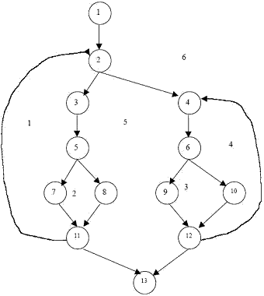
Cyclomatic Complexity
Region, R= 6 Number of Nodes = 13 Number of edges = 17 Number of Predicate Nodes = 5
Cyclomatic Complexity, V( C) :
V( C ) = R = 6;
Or
V(C) = Predicate Nodes + 1 = 5+1 = 6
Or
V( C)= E-N+2 = 17-13+2 = 6
Example

Slide 79
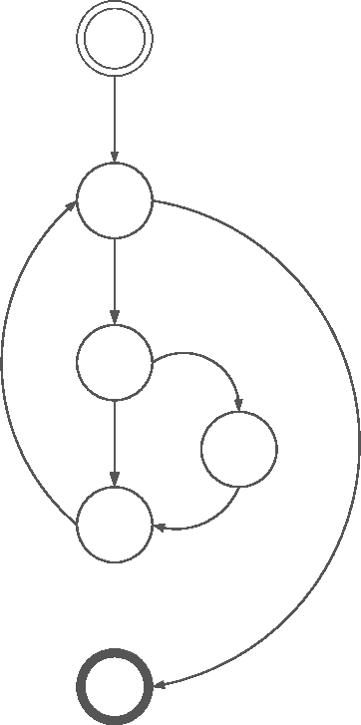
Cyclomatic Complexity: Example
v(G) = e - n + 2p
v(G) = 7 - 6 + 2 × 1
v(G) = 3
Predicate
nodes
(decision
points)
Or
v(G) = 1 + d
v(G) = 1 + 2 = 3

Slide 80
Example: Code Based
#include <stdio.h>
main()
{
int a ;
scanf (“%d”, &a);
if ( a >= 10 )
if ( a < 20 ) printf ("10 < a< 20 %d\n" , a);
else printf ("a >= 20 %d\n" , a);
else printf ("a <= 10 %d\n" , a);
}
v(G) = 1+2 = 3

Slide 81
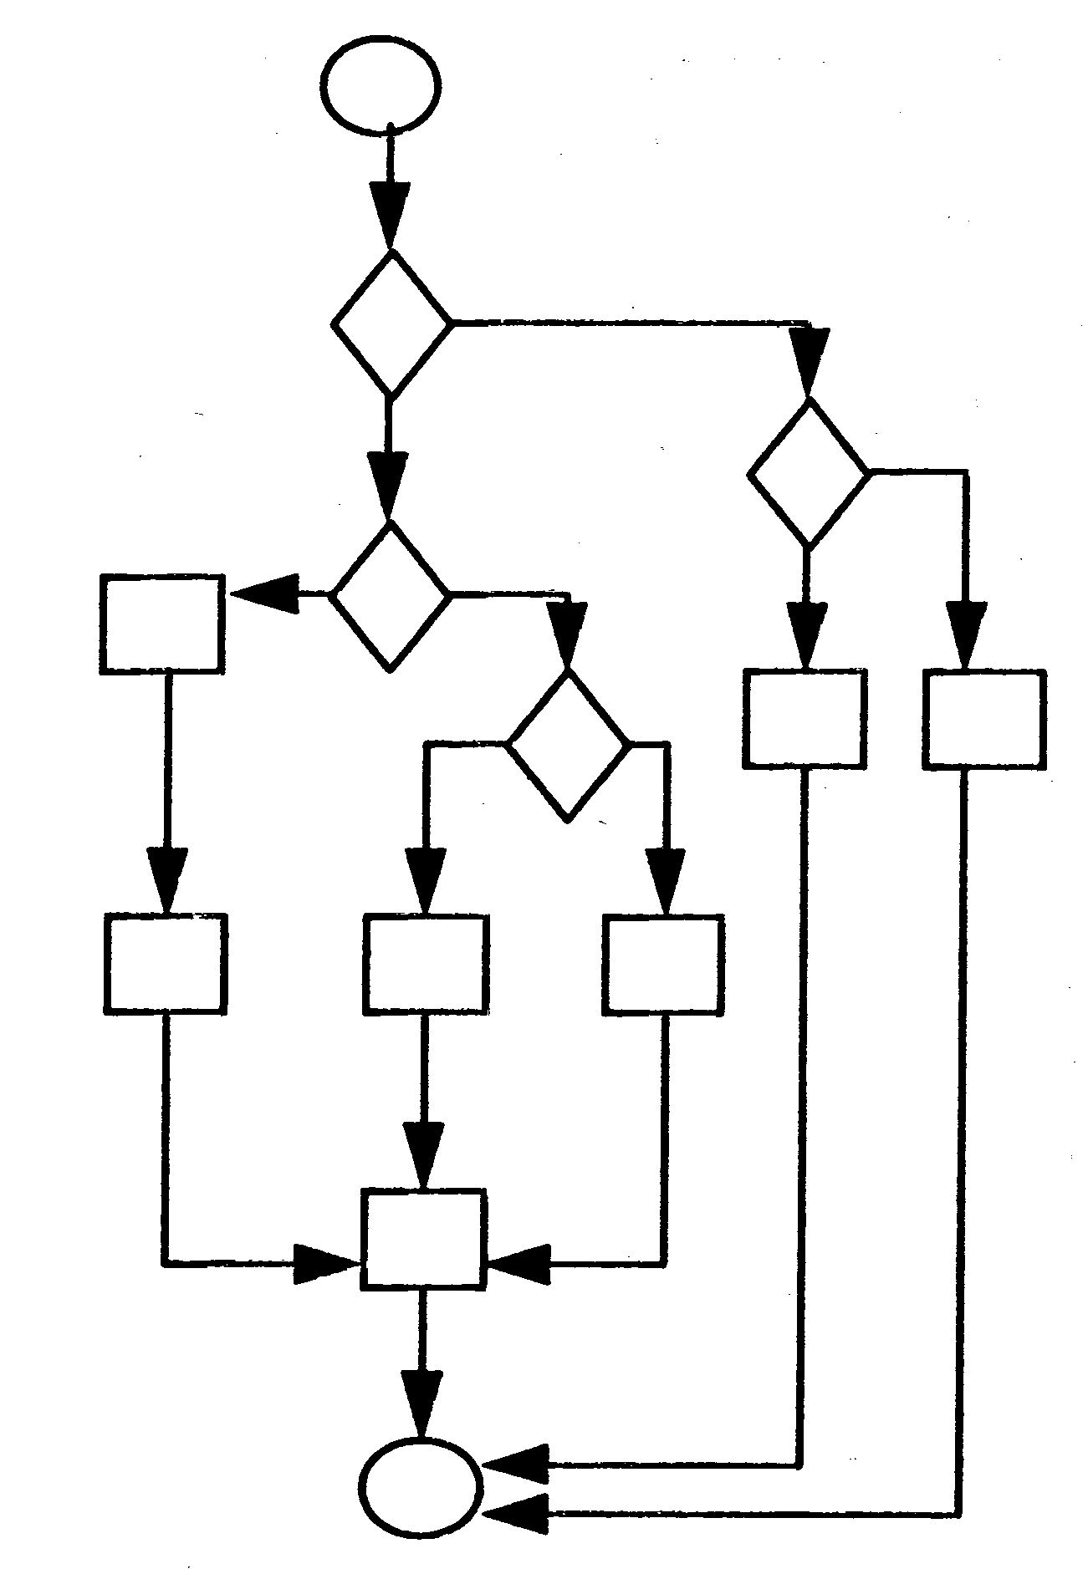
Example: Graph Based
v(G) = 16 – 13 + 2 = 5
or
v(G) = 4 +1 = 5

Slide 82
Example 1
01. import java.util.*;
02. public class CalendarTest
03. {
04. public static void main(String[] args)
05. {
06. // construct d as current date
07. GregorianCalendar d = new GregorianCalendar();
08. int today = d.get(Calendar.DAY_OF_MONTH);
09. int month = d.get(Calendar.MONTH);
10. // set d to start date of the month
11. d.set(Calendar.DAY_OF_MONTH, 1);
12. int weekday = d.get(Calendar.DAY_OF_WEEK);
13. // print heading
14. System.out.println("Sun Mon Tue Wed Thu Fri Sat");
15. // indent first line of calendar
16. for (int i = Calendar.SUNDAY; i < weekday; i++ )
17. System.out.print(" ");
18. do
19. {
20. // print day
21. int day = d.get(Calendar.DAY_OF_MONTH);
22. if (day < 10) System.out.print(" ");
23. System.out.print(day);
24. // mark current day with *
25. if (day == today)
26. System.out.print("* ");
27. else
28. System.out.print(" ");
29. // start a new line after every Saturday
30. if (weekday == Calendar.SATURDAY)
31. System.out.println();
32. // advance d to the next day
33. d.add(Calendar.DAY_OF_MONTH, 1);
34. weekday = d.get(Calendar.DAY_OF_WEEK);
35. }
36. while (d.get(Calendar.MONTH) == month);
37. // the loop exits when d is day 1 of the next month
38. // print final end of line if necessary
39. if (weekday != Calendar.SUNDAY)
40. System.out.println();
41. }
42. }
01. import java.util.*;
02. public class CalendarTest
03. {
04. public static void main(String[] args)
05. {
06. // construct d as current date
07. GregorianCalendar d = new GregorianCalendar();
08. int today = d.get(Calendar.DAY_OF_MONTH);
09. int month = d.get(Calendar.MONTH);
10. // set d to start date of the month
11. d.set(Calendar.DAY_OF_MONTH, 1);
12. int weekday = d.get(Calendar.DAY_OF_WEEK);
13. // print heading
14. System.out.println("Sun Mon Tue Wed Thu Fri Sat");
15. // indent first line of calendar
16. for (int i = Calendar.SUNDAY; i < weekday; i++ )
17. System.out.print(" ");
18. do
19. {
20. // print day
21. int day = d.get(Calendar.DAY_OF_MONTH);
22. if (day < 10) System.out.print(" ");
23. System.out.print(day);
24. // mark current day with *
25. if (day == today)
26. System.out.print("* ");
27. else
28. System.out.print(" ");
29. // start a new line after every Saturday
30. if (weekday == Calendar.SATURDAY)
31. System.out.println();
32. // advance d to the next day
33. d.add(Calendar.DAY_OF_MONTH, 1);
34. weekday = d.get(Calendar.DAY_OF_WEEK);
35. }
36. while (d.get(Calendar.MONTH) == month);
37. // the loop exits when d is day 1 of the next month
38. // print final end of line if necessary
39. if (weekday != Calendar.SUNDAY)
40. System.out.println();
41. }
42. }
Determine cyclomatic complexity for the following program:
v = 1+d
v = 1+6 = 7

Slide 83
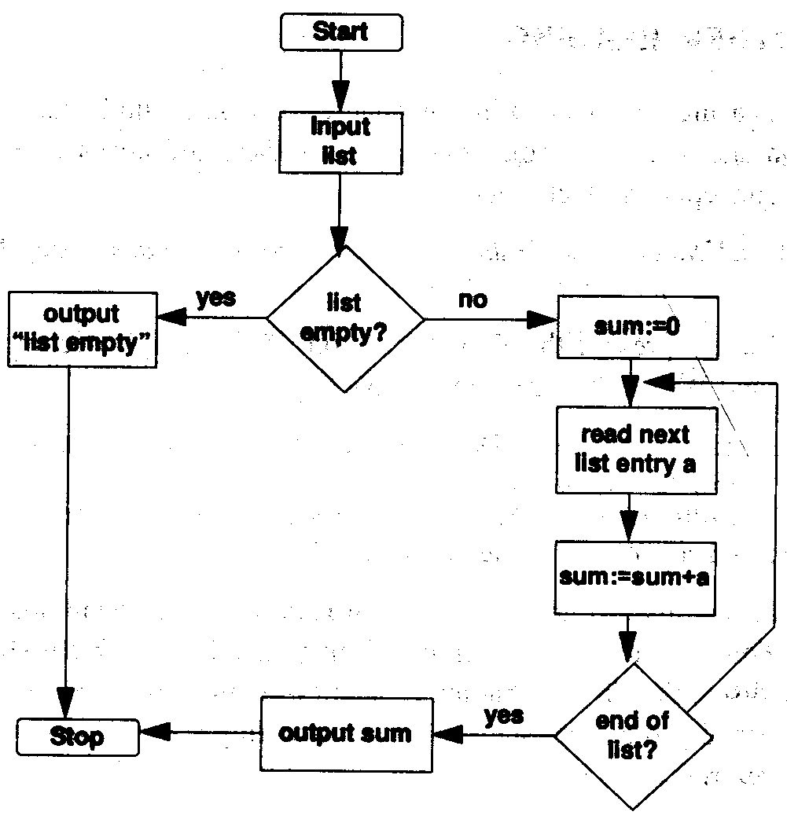
Example 2
Determine cyclomatic complexity for the following flow diagram:
v = 1+d v = 1+2 = 3
or
v = e – n + 2
v = 11 – 10 + 2 = 3

Slide 84
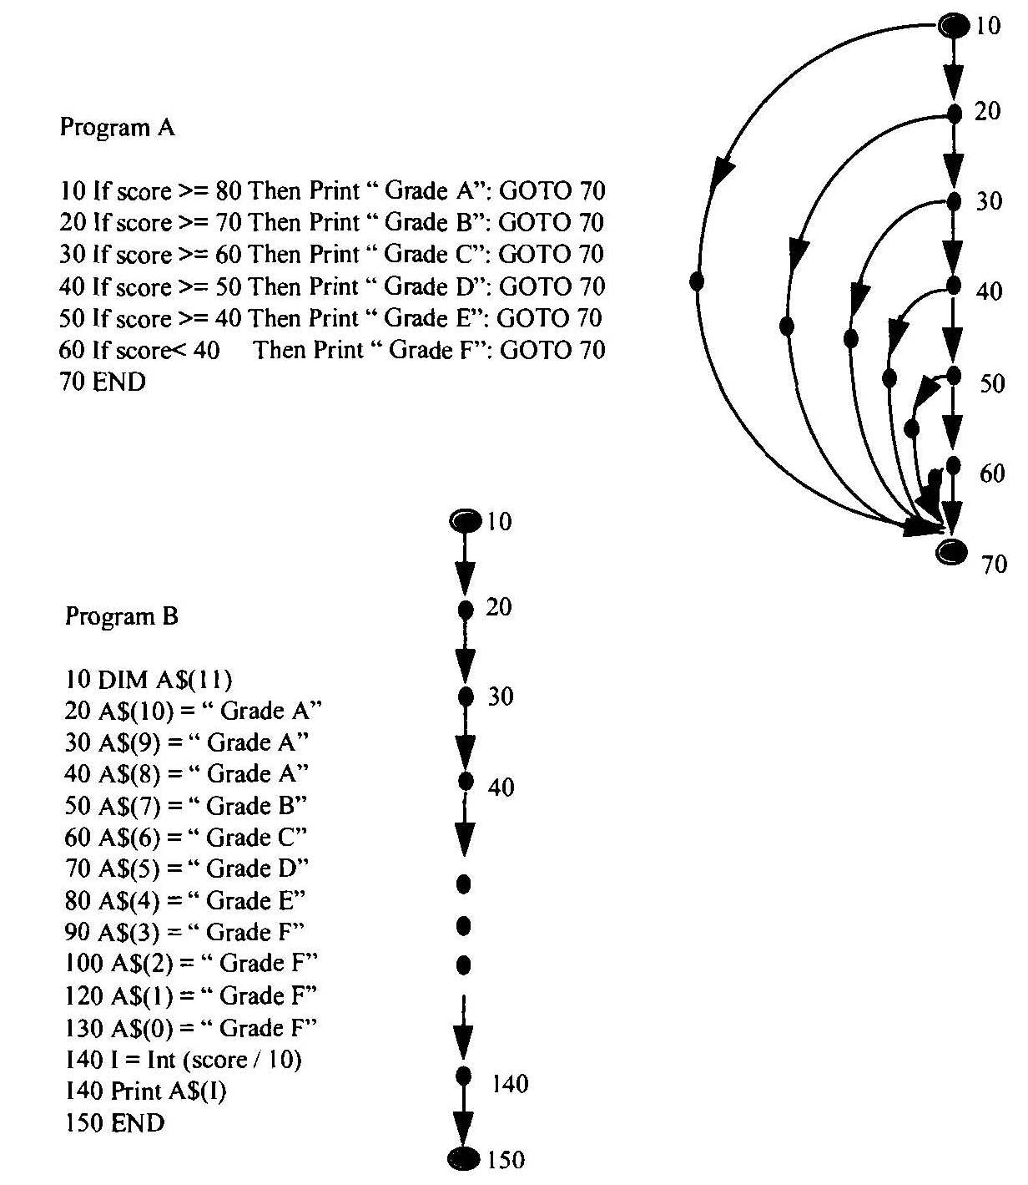
Example 3
Two functionally equivalent programs that are coded differently
Calculate cyclomatic complexity for both
V_{A} = 7
V_{B} = 1
There is always a trade-off between control-flow and data structure. Programs with higher cyclomatic complexity usually have less complex data structure. Apparently program B requires more effort that program A.

