Slide 1
SENG 438 Software Testing, Reliability & Quality
Chapter 5B: White-box Testing
Data-flow Coverage & Coverage Tools
Department of Electrical & Computer Engineering, University of Calgary
B.H. Far （far@ucalgary.ca）
http://people.ucalgary.ca/~far

Slide 2
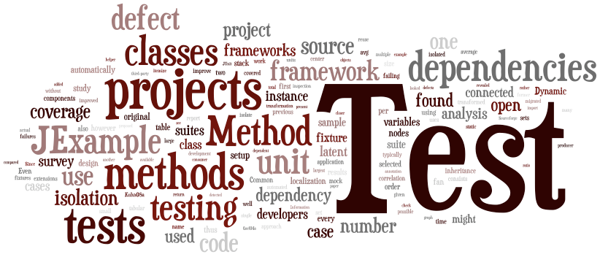
Contents
Preliminary
Control flow
Statement/Node/Line Coverage
Decision/Edge/Branch Coverage
Condition Coverage
Path Coverage
Data flow
Coverage tools
Our focus in this Chapter

Slide 3
What We’ve Learnt So Far?
Statement/Decision/Condition/Path coverage → using control flow graph
Acceptance criteria:
Statement, decision, basic and compound condition adequacy, MC/DC, path adequacy
Deficiencies:
Node and edge coverage don’t test interactions
Path-based criteria require impractical number of test cases and only a few paths uncover additional faults
Need to distinguish “important” paths

Slide 4
Section 4
Data Flow Coverage
How to enhance a test suite by finding
“meaningful” paths to test?

Slide 5
Motivation
Intuition: Statements interact through data flow
Value computed in one statement, used in another
Bad value computation revealed only when it is used

Slide 6
Data Flow: What is?
Suppose we define x in S2 and have ref to it in S6
The two branches tested do not exercise the relationship between the definition of x in S2 and the use of x in S6
Does this cause a problem?
x : =
2
5
1
4
7
3
6
:= x
Branches tested:
1, 2, 4, 5, 7
1, 3, 4, 6, 7
We need to know where the value for a given variable is defined and where it is used (correctly)

Slide 7
Data-flow-based Testing
Basic idea: test the connections between variable definitions (“write”) and variable uses (“read”)
Starting point: variation of the control flow graph annotated with location of defined and used variables
Set def(n): contains variables that are defined at node n (i.e., they are written)
Set use(n): variables that are read

Slide 8
Example 1
01. import java.util.*;
02. public class CalendarTest
03. {
04. public static void main(String[] args)
05. {
06. // construct d as current date
07. GregorianCalendar d = new GregorianCalendar();
08. int today = d.get(Calendar.DAY_OF_MONTH);
09. int month = d.get(Calendar.MONTH);
10. // set d to start date of the month
11. d.set(Calendar.DAY_OF_MONTH, 1);
12. int weekday = d.get(Calendar.DAY_OF_WEEK);
13. // print heading
14. System.out.println("Sun Mon Tue Wed Thu Fri Sat");
15. // indent first line of calendar
16. for (int i = Calendar.SUNDAY; i < weekday; i++ )
17. System.out.print(" ");
18. do
19. {
20. // print day
21. int day = d.get(Calendar.DAY_OF_MONTH);
22. if (day < 10) System.out.print(" ");
23. System.out.print(day);
24. // mark current day with *
25. if (day == today)
26. System.out.print("* ");
27. else
28. System.out.print(" ");
29. // start a new line after every Saturday
30. if (weekday == Calendar.SATURDAY)
31. System.out.println();
32. // advance d to the next day
33. d.add(Calendar.DAY_OF_MONTH, 1);
34. weekday = d.get(Calendar.DAY_OF_WEEK);
35. }
36. while (d.get(Calendar.MONTH) == month);
37. // the loop exits when d is day 1 of the next month
38. // print final end of line if necessary
39. if (weekday != Calendar.SUNDAY)
40. System.out.println();
41. }
42. }
01. import java.util.*;
02. public class CalendarTest
03. {
04. public static void main(String[] args)
05. {
06. // construct d as current date
07. GregorianCalendar d = new GregorianCalendar();
08. int today = d.get(Calendar.DAY_OF_MONTH);
09. int month = d.get(Calendar.MONTH);
10. // set d to start date of the month
11. d.set(Calendar.DAY_OF_MONTH, 1);
12. int weekday = d.get(Calendar.DAY_OF_WEEK);
13. // print heading
14. System.out.println("Sun Mon Tue Wed Thu Fri Sat");
15. // indent first line of calendar
16. for (int i = Calendar.SUNDAY; i < weekday; i++ )
17. System.out.print(" ");
18. do
19. {
20. // print day
21. int day = d.get(Calendar.DAY_OF_MONTH);
22. if (day < 10) System.out.print(" ");
23. System.out.print(day);
24. // mark current day with *
25. if (day == today)
26. System.out.print("* ");
27. else
28. System.out.print(" ");
29. // start a new line after every Saturday
30. if (weekday == Calendar.SATURDAY)
31. System.out.println();
32. // advance d to the next day
33. d.add(Calendar.DAY_OF_MONTH, 1);
34. weekday = d.get(Calendar.DAY_OF_WEEK);
35. }
36. while (d.get(Calendar.MONTH) == month);
37. // the loop exits when d is day 1 of the next month
38. // print final end of line if necessary
39. if (weekday != Calendar.SUNDAY)
40. System.out.println();
41. }
42. }
L7,L8,L9: define objects and variables
L16 variable i is both defined and used
L21 day defined
L22 and L25 day used
Etc.
There is a possibility in some
programs that a “used” value
is modified somewhere on the
way between “def” and “use”
and that may cause a program
failure

Slide 9

Need for Data Flow Testing
Let’s see the need for data-flow-based testing
1: int calculate(int x, int y)
2: {
3: double z=0;
4: if (x<>0) // x neq 0
5: z=z+y;
6: else
7: z=z-y;
8: if (y<>0) // y neq 0
9: z=z/x;
10: else
11: z=z*x;
12: return z;
13: }
Here is a MC/DC-adequate test set
i.e., coverage=100%
Exercise: Verify that it is MC/DC-adequate
Note where the value for x is defined and then used may belong to different paths not traversed by the test suite
Notes:
MC/DC-adequate: all conditions are tested; all branches are tested; all combinations of branches and conditions are tested using the minimal subset of test.
int calculate(int x, int y)
{
double z=0;
if (x<>0) // x neq 0
z=z+y;
else
z=z-y;
if (y<>0) // y neq 0
z=z/x;
else
z=z*x;
return z;
}

Slide 10
Need for Data Flow Testing
The given test suite does not reveal the fault (the chance for division by zero)
Neither of the two test cases forces the use of x at L9, defined on L1, and with value of x=0
In larger programs this will be more problematic
1: int calculate(int x, int y)
2: {
3: double z=0;
4: if (x<>0) // x neq 0
5: z=z+y;
6: else
7: z=z-y;
8: if (y<>0) // y neq 0
9: z=z/x;
10: else
11: z=z*x;
12: return z;
13: }
← Use x
← Use x

Slide 11
Need for Data Flow Testing
To do so, we need a test case that causes condition at L8 to be true, and x=0
An MC/DC-adequate test does not force the execution of this path with x=0 and hence the “divide by zero” defect will not be detected
Again, consider large systems with > thousands LOC
1: int calculate(int x, int y)
2: {
3: double z=0;
4: if (x<>0) // x neq 0
5: z=z+y;
6: else
7: z=z-y;
8: if (y<>0) // y neq 0
9: z=z/x;
10: else
11: z=z*x;
12: return z;
13: }
← Use x
← Use x
Therefore, %100 MC/DC coverage cannot
guarantee that the program dose not fail

Slide 12
Data Flow Analysis - Definition
In Data Flow Analysis, we focus on paths that are significant for the data flow in the program
Focus of testing is on the assignment of values to objects/variables and their uses
Analysis of occurrences of variables:
Definition occurrence: a value is written (bound) to a variable
Use occurrence: value of a variable is read (referred)
Predicate use (p-use): a variable is used to decide whether a predicate evaluates to true or false
Computational use (c-use): compute a value for defining other variables or output values
Notes:
Informal definitions …

Slide 13
Data Flow Analysis - Example
Let’s see an example
public int factorial(int x){
int i, result = 1;
for (i=2; i<=x; i++) {
result = result * i;
}
return result;
}
Def-Use Table
Variable | Def-line | Use-line
x | 1 | 3 (Predicate)
result | 2 | 4 (Computation)
result | 2 | 6 (Occurrence)
result | 4 | 4 (Computation)
result | 4 | 6 (Occurrence)
i | 3 | 3 (Computation)
i | 3 | 4 (Computation)

Slide 14
Def and Use
Goal: Try to ensure that values of the declared variables are assigned and used correctly
def: a location where a value for a variable is stored use: a location where a variable’s value is accessed (read – evaluate – compute)
def(n): The set of variable defined by node n
use(n): the set of variable used by node n
We usually differentiate between computational (c-use) and predicate (p-use) type

Slide 15
Def and Use Path
A definition-clear path (def-clear) p with respect to x is a sub-path where x is not defined at any of the nodes in p
A du-path is a simple path where the initial node of the path is the only defining node of x in the path
Reach: if there is a def-clear path from the nodes m to p with respect to x, then the def of x at m reaches the use at p
Example for z:
- du-path: q₀,q₁,q₂
- def-clear: q₁,q₂,q₄
- q₀ reaches q₂
Notes:
• DU path: a definition-clear path on the CFG starting from a definition to a use of a same variable
• Definition clear: Value is not replaced on path, i.e. only predicate and occurrence use.
• Note – loops could create infinite DU paths between a def and a use
• DU pair: a pair of definition and use for some variable, such that at least one DU path exists from the definition to the use

Slide 16
Def and Use Coverage
All-Defs-Coverage (ADC):
Some def-clear sub-path from each definition to some use reached by that definition
value of x is not replaced on path
x = ... is a definition of x
= x ... is a use of x

Slide 17
All-Defs Coverage Example
Requires:
d₁(x) to a use
Satisfactory Path:
[1, 2, 4, 6]
[1, 3, 4, 6]
x defined
x used
Q. Why 5 is not part of ADC satisfactory path?
A. Because value of x is overwritten in earlier
nodes 2 or 3

Slide 18
Def and Use Coverage
All-Uses Coverage (AUC)
Some definition-clear subpath from each definition to each use reached by that definition and each successor node of the use

Slide 19
All-Uses Coverage Example
Requires:
d₁(x) to u₂(x)
d₁(x) to u₃(x)
d₁(x) to u₅(x)
Satisfactory Path:
[1, 2, 4, 5, 6]
[1, 3, 4, 6]

Slide 20
Def and Use Coverage
All-Du-Paths Coverage (ADUPC):
All def-clear sub-paths that are cycle-free or simple-cycles from each definition to each use reached by that definition and each successor node of the use

Slide 21
All-Du-Path Coverage Example
Requires:
All d₁(x) to u₂(x): [1,2]
All d₁(x) to u₃(x) : [1,3]
All d₁(x) to u₅(x) : [1,2,4,5], [1,3,4,5]
Satisfactory Path:
[1, 2, 4, 5, 6]
[1, 3, 4, 5, 6]

Slide 22
Exercise: Def and Use
Assume y is already initialized
1: s:= 0;
2: x:= 0;
3: while (x<y) {
4: x:=x+3;
5: y:=y+2;
6: if (x+y<10)
7: s:=s+x+y;
else
8: s:=s+x-y;
9: endif
10: }

Slide 23
Exercise: Reach
A definition of variable s at node n₁ reaches node n₂ if and only if there is a path between n₁ and n₂ that does not contain a definition of s
1: s:= 0;
2: x:= 0;
3: while (x<y) {
4: x:=x+3;
5: y:=y+2;
6: if (x+y<10)
7: s:=s+x+y;
else
8: s:=s+x-y;
9: endif
10: }
This is called a Def-Use table

Slide 24
Exercise: Def and Use Pairs
This is called a CFG
DU pair tests:
TC1: x=0, y=3 (for L7)
TC2: x=0, y=6 (for L8)
This is called a Def-Use table

Slide 25
Data Flow Based Testing
Adequacy Criteria
All DU pairs: Each DU pair is exercised by at least one test case
All DU paths: Each simple (non looping) DU path is exercised by at least one test case
Remember that for each DU pair there can be several DU paths
All definitions: For each definition, there is at least one test case which exercises a DU pair containing it
(Every defined value is used somewhere)
Corresponding coverage fractions can also be defined
All DU paths > All DU pairs > All definitions

Slide 26
Data Flow Based Testing
How to enhance test suite using Data Flow based testing?
If a variable is defined at node-m and used at node-n, then the path between node m and n should be tested
If a variable is modified (c-use) within the path between m and n, say in node-q, then we should have separate tests for
m to q (called def-coverage)
q to n and m to n (called use-coverage)
The def+use coverage is combining both
You can use the program itself, DFD and Def-Use table for this purpose

Slide 27
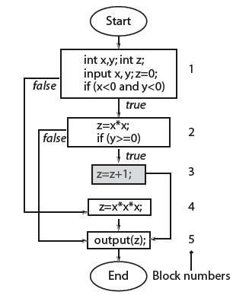
Data Flow Graph (DFG): Example
Let’s derive the DFG for this given flowchart
First the def-use table
Then, the data flow graph (DFG)

Slide 28
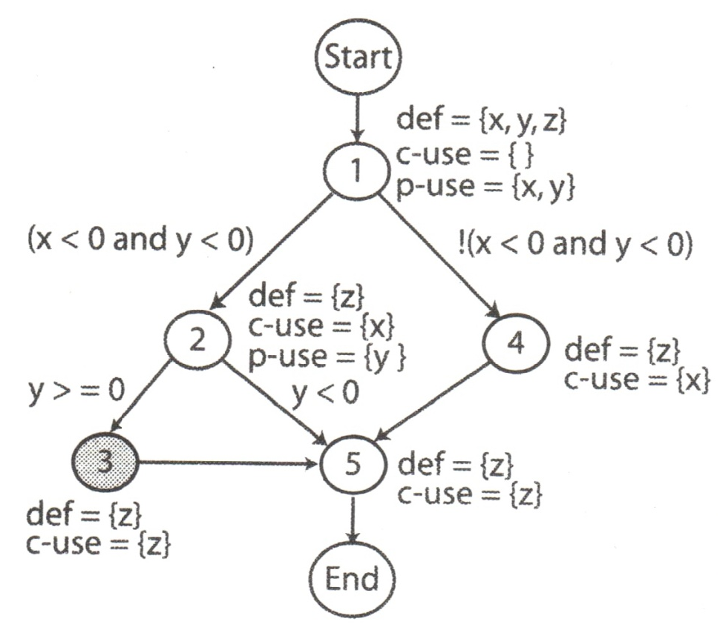
Definition-clear (def-clear) Path
Any path starting from a node at which a variable is defined and ending at a node at which that variable is used, without redefining the variable anywhere else along the path, is a def-clear path for that variable
This is called a DFG
Therefore, any values set for z at L1 is redefined at L2, L3, L4 and L5.
But anything defined at L2 or L4, is still alive at L5
c-use: computational use
p-use: predicate use

Slide 29
Definition-clear (def-clear) Path
Example:
Path 2-5 is def-clear for variable z defined at node 2 and used at node 5
Path 1-2-5 is NOT def-clear for variable z defined at node 1 and used at node 5 (since it is redefined at node 2)
The definition of z at node 2 is live at node 5,
… while the definition of z at node 1 is not live at node 5
c-use: computational use
p-use: predicate use

Slide 30
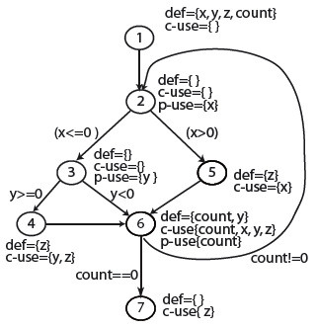
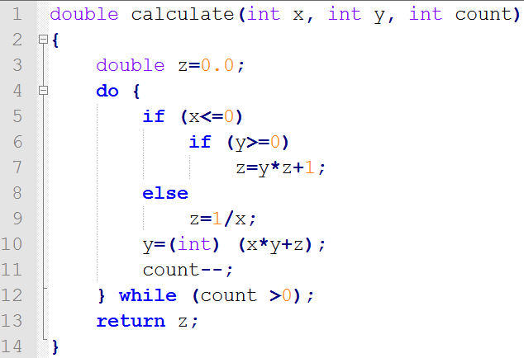
Example 2: Def-clear Path
Draw DFG for the program given below
Find the def-clear paths for x and y and z
Which definitions are live at node 4?
L5
L9
L6
L7
L10
L11-12
L13
Program 6.16 from the reference book (by Mathur)
Notes:
Anything set for x at node 1, is still unchanged at node 5, We have excluded x=0 between node 2-5, that is good.
But if you set the node 2 a wrong predicate to be evaluated (as: x<0 and x>=0), it will cause division by zero.

Slide 31
Example 2: Def-use Pairs
Definitions of a variable at L₁₁ and its use at L₁₂ constitute a def-use pair
(L₁₁ and L₁₂ can be the same, e.g., y=++x;)
L5
L9
L6
L7
L10
L11-12
L13

Slide 32
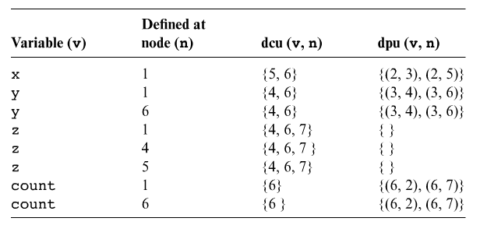
Example 2: Def-use Measure
Definition c-use pairs dcu(di(x)): denotes the set of all nodes using variable x from the live definitions of the variable at a given previous node i, di(x)
L5
L9
L6
L7
L10
L11-12
L13
Therefore, tests for (1-5), (1-6) and (5-6) should be added
Notes:
Therefore, tests for (1-5), (1-6) and (5-6) should be added.

Slide 33
Example 2: Def-use Measure
Definition p-use pairs dpu(di(x)): denotes the set of all edges (k, l) such that there is a def-clear path from node i to edge (k, l) and x is used at node k
L5
L9
L6
L7
L10
L11-12
L13
Therefore, tests for (2-3) and
(2-5) should be added

Slide 34
Example 2: Def-use Measure
Let’s derive:
dn(v)
dcu(v, n)
dpu(v, n)
L5
L9
L6
L7
L10
L11-12
L13

Slide 35
Example 2: Answer

Slide 36
Data-flow Coverage Measure
To calculate data-flow test coverage, we should measure how many c-uses and p-uses we have in total
CU: total number of c-uses in a program
PU: total number of p-uses
Given a total of n variables v₁, v₂…v_{n}
Loop for variables
Loop for all nodes defining a variable

Slide 37

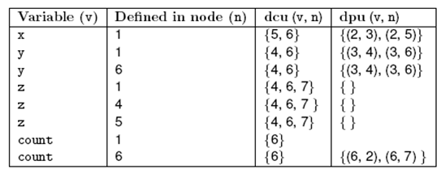
Data-flow Coverage: Example
Calculate CU and PU
Total:
17
8

Slide 38
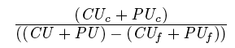
All-uses Coverage Measure
All-uses coverage is computed as
Where CU is the total c-uses, CU_{c} is the number of c-uses covered, PU_{c} is the number of p-uses covered, CU_{f} the number of infeasible c-uses and PU_{f} the number of infeasible p-uses
It is considered adequate with respect to the all-uses coverage criterion if the c-use coverage is %100

Slide 39
All-uses Coverage – Example
Exercise: For the following DFG, show by analysis whether T={TC1, TC2} is adequate w.r.t. to all-uses coverage. Calculate all-uses coverage ratio. If coverage ratio is not 100%, what def-use pairs need to be covered, and what test cases should be added to cover them?
TC1:<x=5, y=-1, count=1>
TC2:<x=-2, y=-1, count=3>

Slide 40
Infeasibility
Suppose cond has not changed between 1 and 5
Or the conditions could be different, but the first implies the second
Then (3,6) is not a (feasible) DU pair
But it is difficult or impossible to determine which pairs are infeasible
Infeasible test obligations are a problem
No test case can cover them

Slide 41
Infeasibility
The path-oriented nature of data flow analysis makes the infeasibility problem especially relevant
Combinations of elements matter!
Impossible to (precisely) distinguish feasible from infeasible paths
More paths = more work to check manually.
In practice, reasonable coverage is often, not always achievable
Number of paths is linear (often) or exponential (worst case)
All DU paths is more often impractical

Slide 42
Summary - Data Flow
Data flow testing attempts to distinguish “important” paths: Interactions between statements
Intermediate between simple statement and branch coverage and more expensive path-based structural testing
Cover Def-Use (DU) pairs: From computation of value to its use
Intuition: Bad computed value is revealed only when it is used
Levels: All DU pairs, all DU paths, all defs (some use)
Limits: Aliases, infeasible paths
Worst case is bad (undecidable properties, exponential blow up of paths), so pragmatic compromises are required

Slide 43
Section 5
Coverage Tools

Slide 44
Measuring Test Coverage
One advantage of coverage criteria is that it can be measured automatically
To control testing progress
To assess testing completeness in terms of remaining faults and reliability
High coverage is not a guarantee of fault-free software, just an element of information to increase our confidence → statistical models

Slide 45
Analysis of Coverage Data
Regardless of criterion used for WB testing, only higher coverage rates contribute to finding more faults ← e.g. try at least 60-80% coverage to find reasonable number of faults

Slide 46
Test Coverage: Benefits
If you haven’t exercised part of the code, it could contain a bug
Any coverage criteria performs better than random test selection – especially DU-coverage
Helps us in measuring how much unit testing has been done and how much is left
Significant improvements occurred as coverage increased from 90% to 100%
Helps us in test case design (deriving test cases)
We can prioritize the most critical modules (units) of the system and target higher coverage for those critical modules, would mean more rigorous testing for them

Slide 47
Test Coverage: Caveats
Coverage tests that the code has been exercised (mostly in unit testing level), and that each unit has been verified
But it does not tell us that we have built what the customer wanted
If the logical structure of the code contains errors such as a missed case in a switch statement, the absence of code may not be detected
100% coverage alone is not a reliable indicator of the effectiveness of a test set – especially statement coverage
Yet, 100% coverage is often unrealistic, especially for fine-grained coverage measures (e.g., condition coverage)
Effort to achieve high coverage may be unjustified in large scale projects, in terms of time spent and producing unreliable test cases
60%-80% coverage is a “rule of thumb” (according to several surveys)

Slide 48
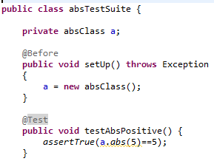
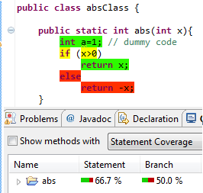

Test Coverage Measurement
Two usages:
Will help us derive test cases
And to also know the progress of test activities
Tests
Manual Tests
2/3

Slide 49
Test Coverage Tools
Most established languages have solid test coverage tools available for them, but the depth of functionality differs significantly from one to another
Python has sys.settrace to tell you directly which lines are executing
Emma (for Java) has a ClassLoader which re-writes byte-code on the fly

Slide 50
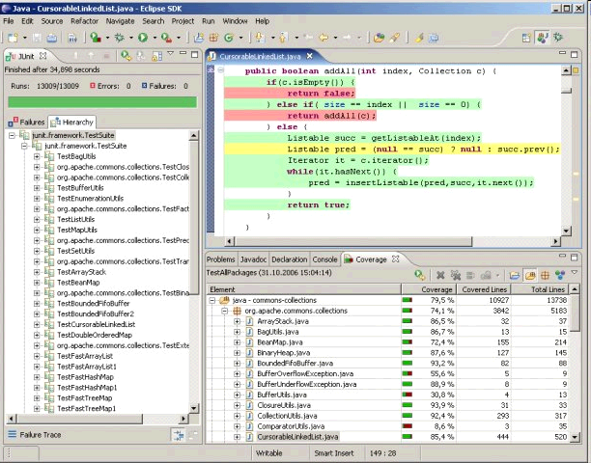
Code Coverage Tools
Emma (command line) and EclEmma

Slide 51
Emma
Open-source tool
Supports class, method, block, and line coverage
Eclipse plug-in EclEmma also available
http://www.eclemma.org
Uses byte-code instrumentation
Classes can be instrumented in advance, or during class loading
Tool keeps a metadata file to associate byte-code with source code

Slide 52
CodeCover
CodeCover is an open-source code coverage tool for Java under Eclipse
It can be used inside Eclipse
There are many other code coverage tool out there, but this is one of the lightest and powerful ones
See the list @ http://java-source.net/open-source/codecoverage
http://www.codecover.org

Slide 53
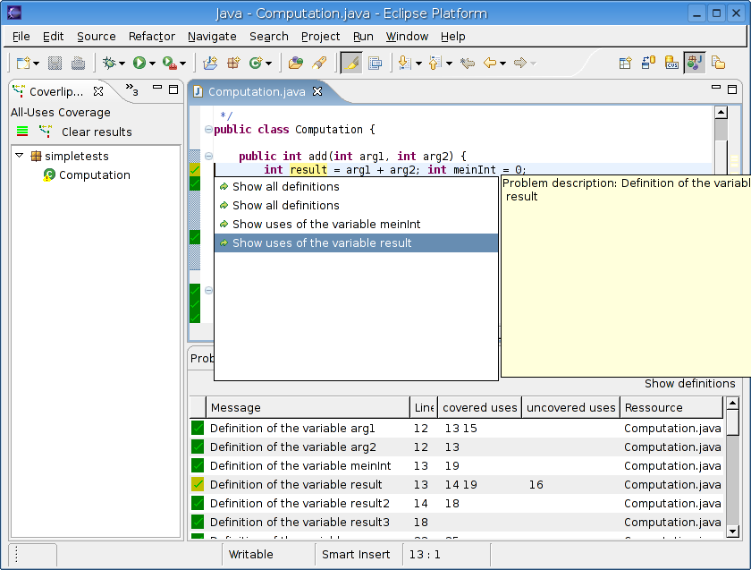
Code Coverage Tools - CoverLipse
CoverLipse (supports data-flow based testing)

Slide 54
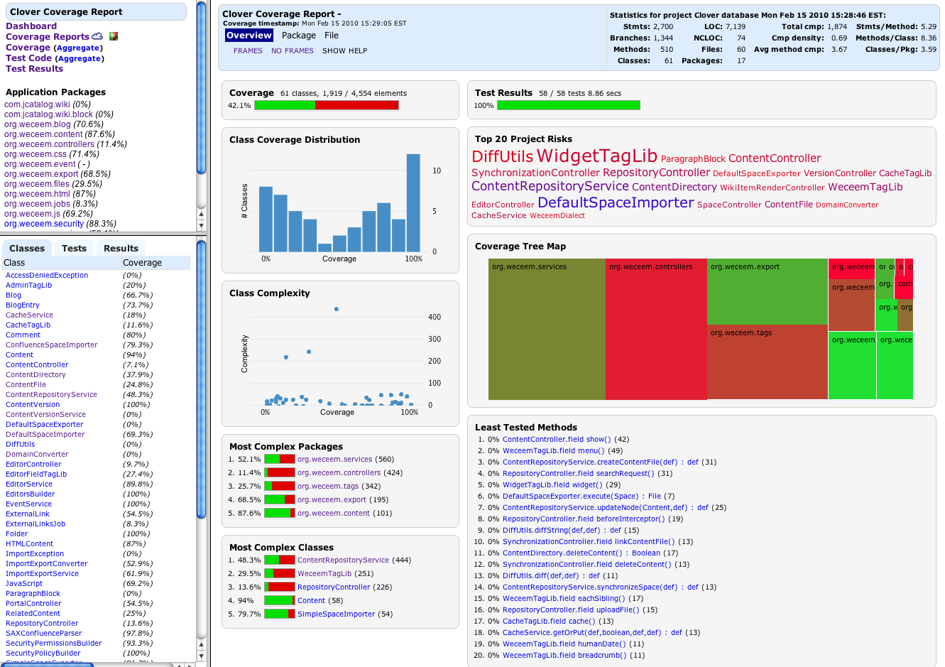
Code Coverage Tools - Clover

Slide 55

Comparison of Coverage Tools

Slide 56
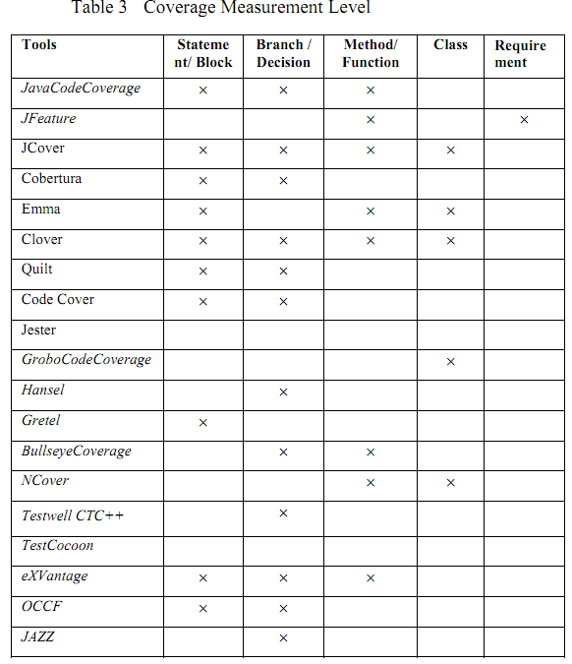
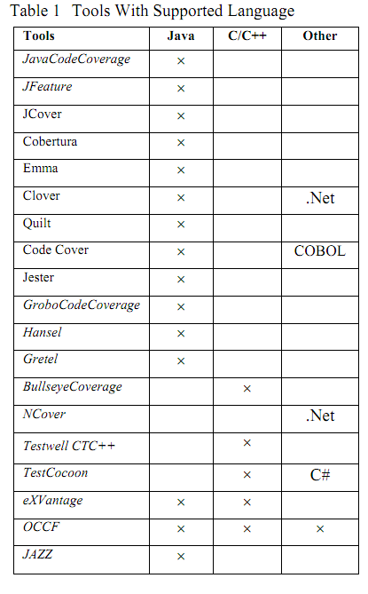
Comparison of Coverage Tools

Slide 57
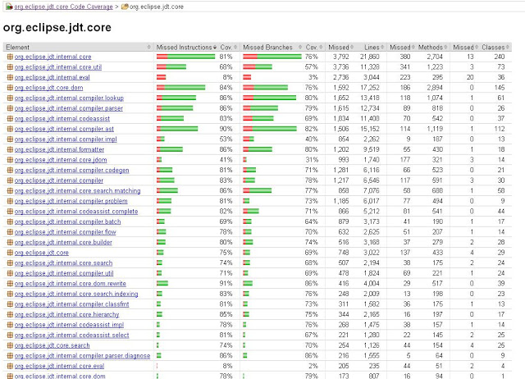
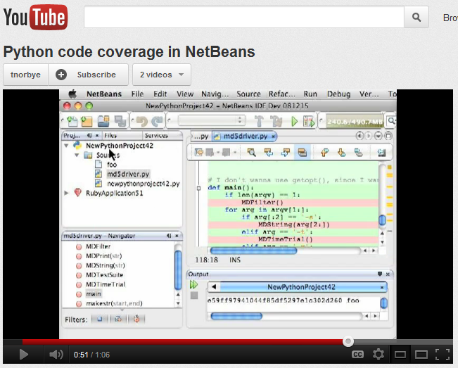
Resources
Code Coverage and Test Tools
www.opensourcetesting.org
Code Coverage of Eclipse Code-base
http://relengofthenerds.blogspot.com/2011/03/sdk-code-coverage-with-jacoco.html
Demo of test coverage for Python code
www.youtube.com/watch?v=jGJa_2UyHrY (video)
Etc.

Slide 58
Conclusion
Coverage is a measure of WB testing effort to detect potential faults
100% statement coverage means that you tested for every bug that can be revealed by simple execution of a line of code
100% branch coverage means you will find every fault that can be revealed by testing each branch
100% coverage means that you tested for every possible fault, which is obviously impossible for larger projects

