Slide 1
ANALYSIS OF REVENUE OF BIGGEST COMPANIES IN THE WORLD
BY
MOSES ADEWOLE OYABIYI
AUGUST, 2023

Slide 2
OUTLINE
Introduction
Data Description
Tool for Data Analysis
Explorative Data Analysis
Insights from Data Analysis
Conclusion
References

Slide 3
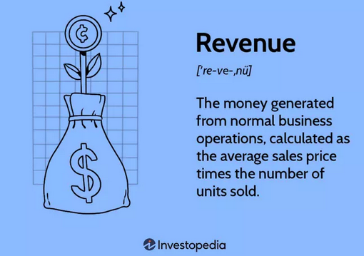
INTRODUCTION
The list of the world's most profitable companies offers a glimpse of which countries wield the most economic power and the sectors with the most economic influence.
Revenue is known as the top line because it appears first on a company's income statement.
Net income, also known as the bottom line, is revenues minus expenses.
There is a profit when revenues exceed expenses.

Slide 4
INTRODUCTION Cont’d
Types of Revenue
Operating Revenue
Non -operating Revenue
Unpredictable
One time gain
Sales of an asset
Cost of litigation
Windfall from investment
etc.

Slide 5
DATA DESCRIPTION AND TOOLS FOR ANALYSIS
DATASET DESCRIPTION
Number of Column: 10
Date Source: kagle.com
Data Name: basket_analysis.csv
TOOLS USED FOR ANALYSIS
Jupiter Lab
Python Libraries
Pandas
Datetime
Matplotlib
Mlxtend
Random
Seaborn
Numpy
• MS Excel

Slide 6
EXPLORATIVE DATA ANALYSIS (EDA)

Slide 7
ANALYSIS
Table 1: Data Type
Column Name | Data Type (Raw) | Data Type (cleaned)
Company Name | object | object
Country Founded | object | object
Year Founded | object | Object
Revenue 2018 | object | float64
Revenue 2019 | object | float64
Revenue 2020 | object | float64
Net Income 2018 | object | float64
Net Income 2019 | object | float64
Net Income 2020 | object | float64
Industry | object | object
Revenue Growth 2019 |  | float64
Revenue Growth 2020 |  | float64

Slide 8
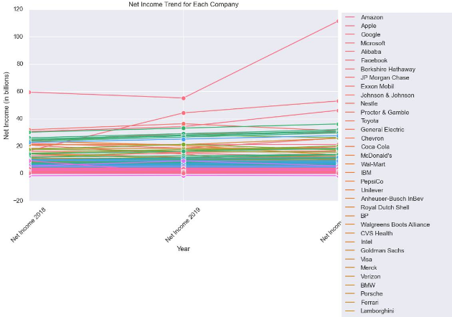
Net Income Trend for each Company

Slide 9
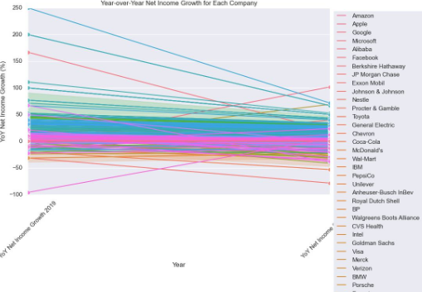
Year over year Net Income Growth for each Company

Slide 10
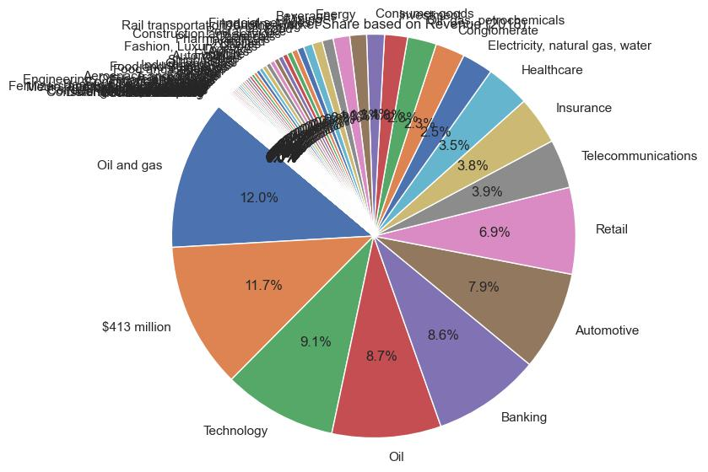
Industry Market Share Based on Revenue in 2018

Slide 11
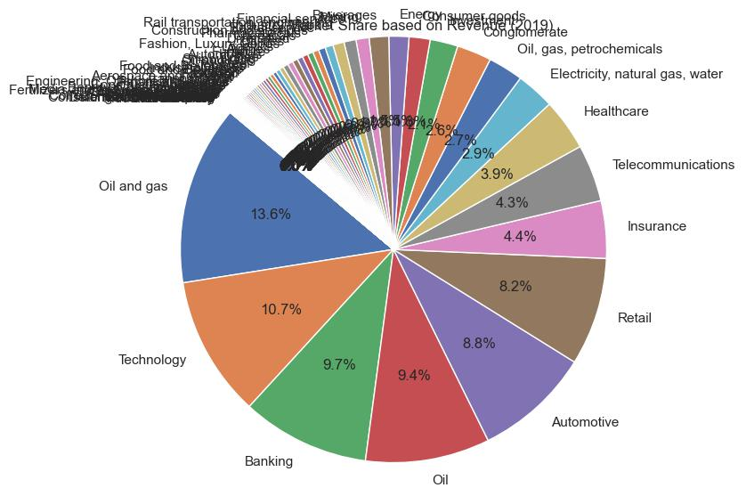
Industry Market Share Based on Revenue in 2019

Slide 12

Industry Market Share Based on Revenue in 2020

Slide 13
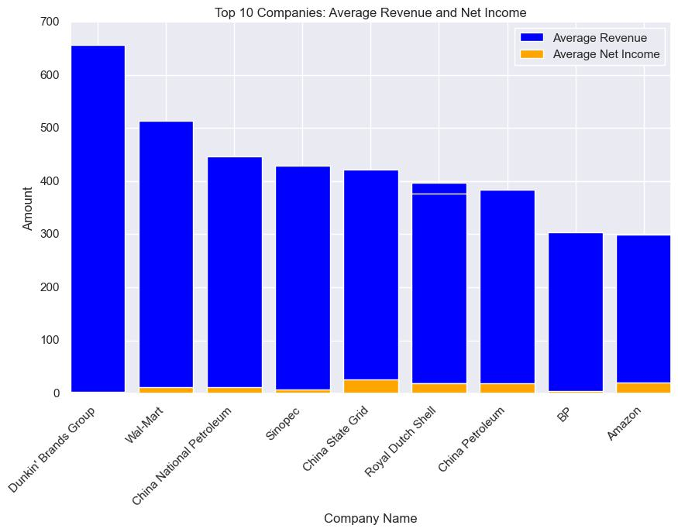
Top 10 Companies Average Revenue and Net Income (2018 – 2020)

Slide 14
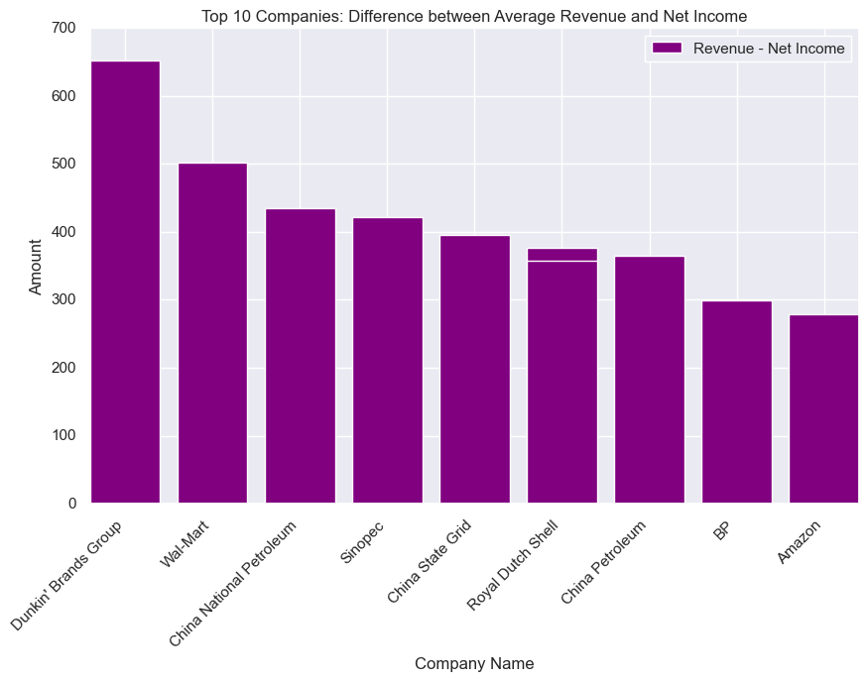
Top 10 Companies: Difference between Average Revenue and Net Income (2018 – 2020)

Slide 15
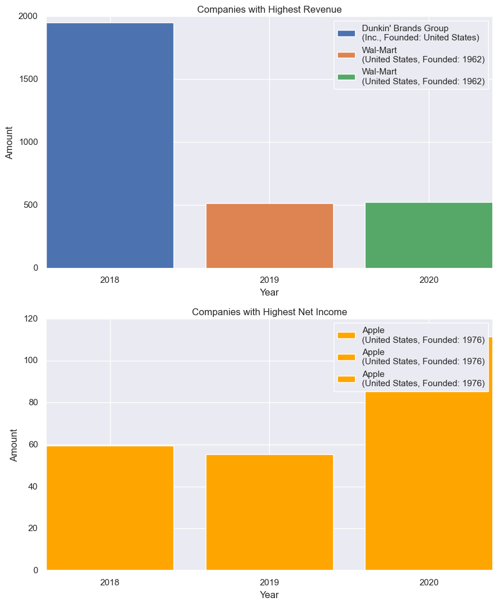
Company with Highest Revenue and Net Income (2018 – 2020)

Slide 16
COUNTRY AND COUNTRY ANALYSIS

Slide 17
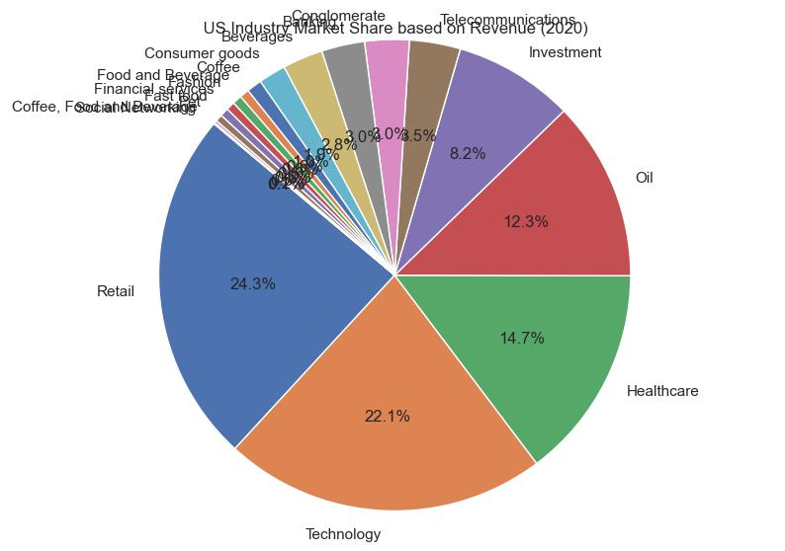
US Industries Revenue Shares in 2020

Slide 18
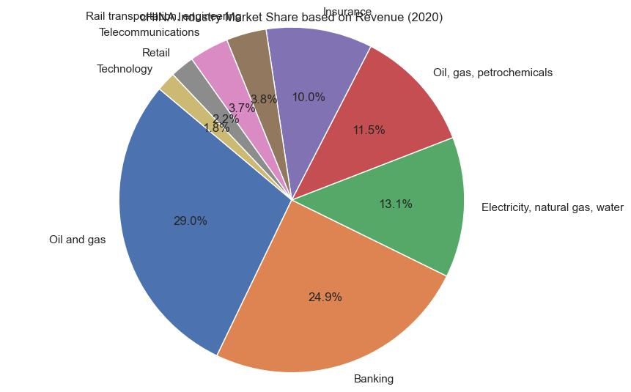
China Industries Revenue Shares in 2020

Slide 19
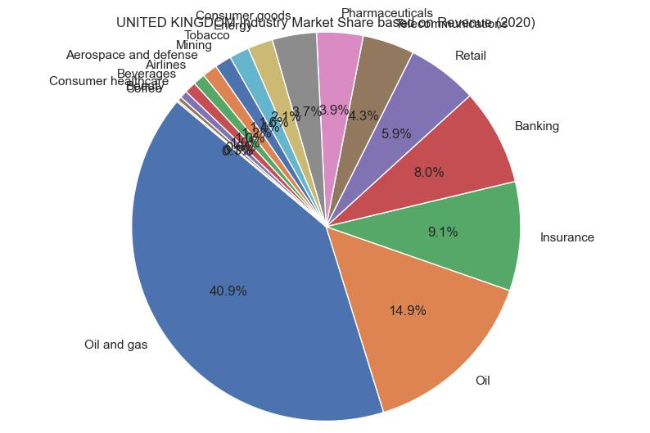
United Kingdom Industries Revenue Shares in 2020

Slide 20
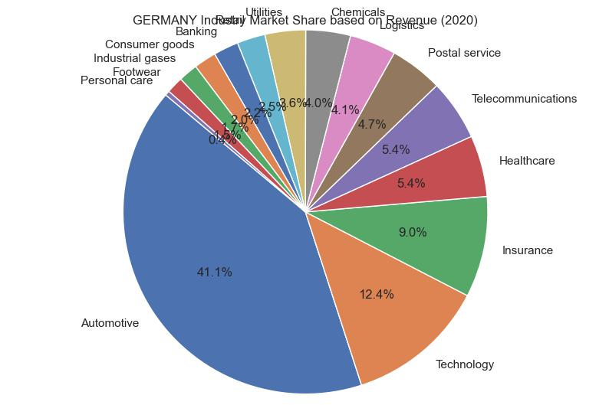
Germany Industries Revenue Shares in 2020

Slide 21
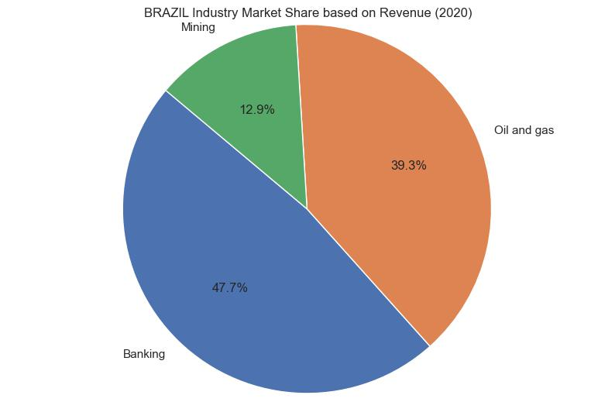
Brazil Industries Revenue Shares in 2020

Slide 22
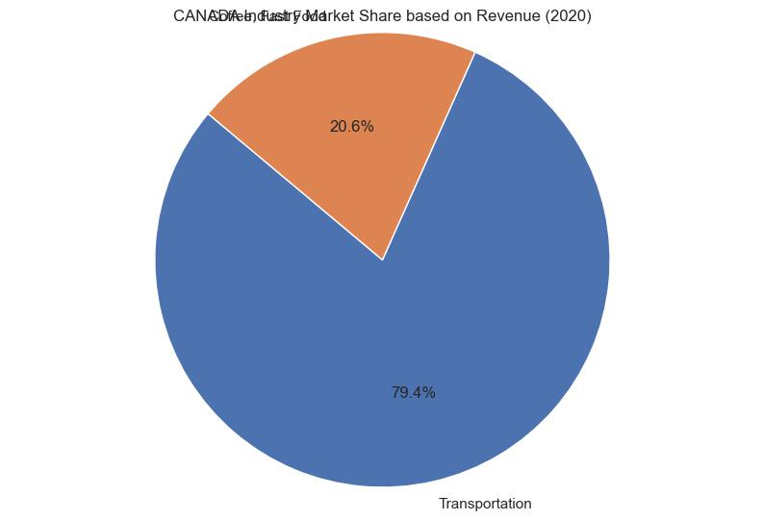
Canada Industries Revenue Shares in 2020

Slide 23
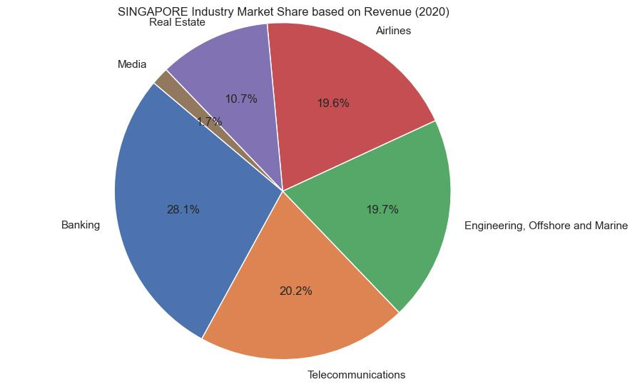
Singapore Industries Revenue Shares in 2020

Slide 24
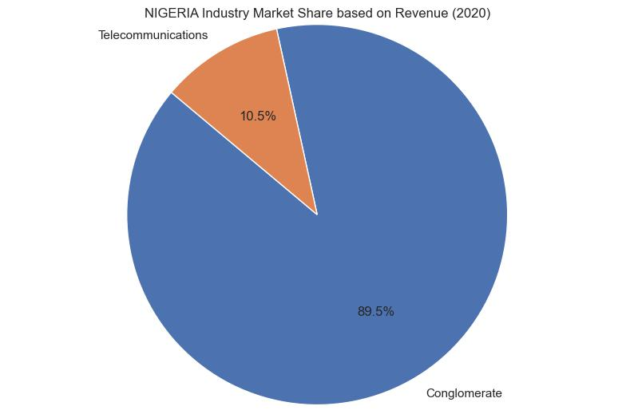
Nigeria Industries Revenue Shares in 2020

Slide 25
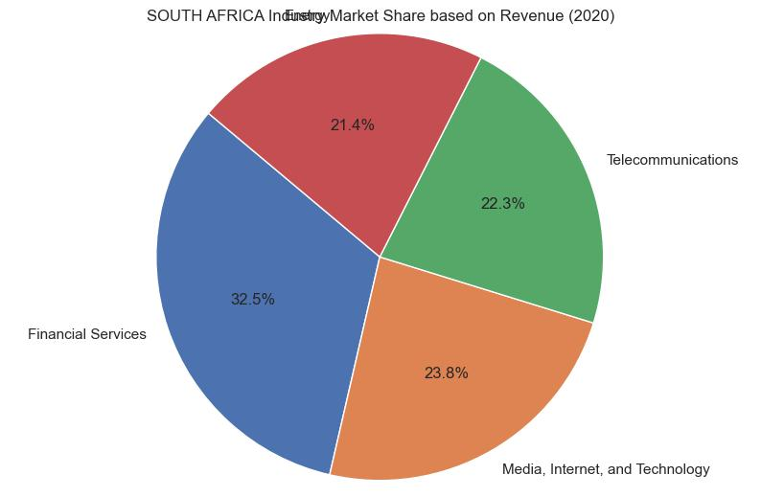
South Africa Industries Revenue Shares in 2020

Slide 26
INSIGHTS

Slide 27
INSIGHTS
Table 2: Top 10 Companies Average Revenue (2018 – 2020)
Company Name | Country Founded | Year Founded | Average Revenue
Dunkin' Brands Group Inc. | United States |  | 656.200000
Wal-Mart | United States | 1962 | 513.033333
China National Petroleum | China | 1988 | 446.600000
Sinopec | China | 1998 | 429.100000
China State Grid | China | 2002 | 421.666667
Royal Dutch Shell | United Kingdom | 1907 | 396.600000
China Petroleum | China | 1988 | 383.600000
Royal Dutch Shell | Netherlands | 1907 | 376.900000
BP | United Kingdom | 1909 | 303.500000
Amazon | United States | 1994 | 299.833333

Slide 28
INSIGHTS
Table 3: Top 10 Companies Average Net Income (2018 – 2020)
Company Name | Country Founded | Year Founded | Average Net Income ($Bil)
Apple | United States | 1976 | 75.366667
Microsoft | United States | 1975 | 37.966667
Google | United States | 1998 | 37.066667
Industrial and Commercial Bank of China | China | 1984 | 33.200000
JP Morgan Chase | United States | 2000 | 33.200000
China Construction Bank | China | 1954 | 29.100000
Agricultural Bank of China | China | 1979 | 28.100000
Berkshire Hathaway | United States | 1839 | 27.700000
Ping An Insurance | China | 1988 | 27.500000
Bank of China | China | 1912 | 26.600000

Slide 29
INSIGHTS
Table 4: Ranking of Industry Share in Nine Countries
S/N | Country | First Ranking | Second Ranking
1 | Germany | Automotive (41.1%) | Technology (12.4%)
2 | Unitec State | Retail (24.3%) | Technology (22.1%)
3 | Japan | Oil and Gas (29.9%) | Banking (24.9%)
4 | United Kingdom | Oil and Gas (40.9%) | Oil (14.9%)
5 | Brazil | Banking (47.7%) | Oil and Gas (39.3%)
6 | Canada | Transportation (79.4%)
7 | Singapore | Banking (28.1%) | (Telecom (20.2%)
8 | South Africa | Financial Services (32.5%) | Media, Internet and Tech
9 | Nigeria | Conglomerate(Dangote - 89.5%) | Telecom (MTN - 10.59%)

Slide 30
INSIGHTS
Table 5: Industry Market Share Based on Revenue
 | 2018 | 2019 | 2020
1 | Oil and Gas (12.0%) | Oil and gas (13.6%) | Oil and Gas (14.0%)
2 | Technology (9.1.0%) | Technology (10.7%) | Technology (11.0%)
3 | Oil (8.7%) | Banking (9.7%) | Banking (10.0%)
4 | Baking (8.6%) | Oil (9.4%) | Retail (8.0%)
5 | Automotive (7.5%) | Automotive (8.8%) | Oil (8.4%)
6 | Retail (6.9%) | Retail (8.2%) | Automotive (8.3%)
7 | Telecom (3.9%) | Insurance (4.4%) | Healthcare (4.4%)
8 | Insurance (3.8%) | Telecom (4.3%) | Insurance (4.4%)
9 | Healthcare (3.5%) | Healthcare (3.9%) | Telecom (4.3%)

Slide 31
CONCLUSION
Majority of biggest companies with high revenue belong to United States and China
Dunkin’ Brands Group Inc., Wall – Mart from United States and China National Petroleum stood out among other companies in terms of Average Revenue between 2018 – 2020
However, Apple, Microsoft and Google all from United States stood out as topmost companies in terms of Average Net income between 2018 – 2020
Oil and Gas sector take the highest industry market share based on revenue in 2018, 2019 and 2020 respectively
Technology sector was the second in term of high revenues accruement in 2018, 2019 and 2020 respectively
Ranking of industry share in nine countries shows that automobile, technology, oil and gas, retail, banking, financial services, telecommunication, transportation, media, internet and tech are industries with high revenues in the reported years

Slide 32
REFERENCES
PwC network (2021). Global Top 100 companies by Market capitalization. www.pwc.com.
https://www.investopedia.com
https://www.kaggle.com

