Slide 1
MARKET BASKET ANALYSIS
MOSES ADEWOLE OYABIYI
JULY, 2023

Slide 2
OUTLINE
Introduction
Data Description
Tool for Data Analysis
Explorative Data Analysis
Association Rule Mining
Insights from Data Analysis
Conclusion
References

Slide 3
INTRODUCTION
Market Basket Analysis (MBA) is a data mining method focusing on discovering purchase patterns of the customers by extracting association or co-occurrences from a store’s transactional data.
Market basket analysis encompasses a broad set of analytic techniques aimed at uncovering the associations and connections between specific objects, discovering customer behaviors and relation between items.

Slide 4
INTRODUCTION Cont’d
Association rule mining (ARM)
This rule identifies the association or relationship between a large set of data items and forms the base for market basket analysis.
Applications
Supermarkets
mail order,
telemarketing production
fraud detection of credit card
e-commerce.

Slide 5

INTRODUCTION Cont’d
Finding relationships between the objects in a data set is helpful. This is accomplished by the analysis of recurring patterns and numerous measures, including support, confidence, life, leverage, and conviction.
Lift
Lift is obtained first because it provides information on whether an association exist or not or if the association is positive or negative. If the value for lift suggests that there is an existence of association rule, then we obtain the value for support.

Slide 6
INTRODUCTION Cont’d
Support
Support of an item or item set is the fraction of transactions in our dataset that contain that item or item set. It is an important measure because a rule that have low support may occur simply by chance. A low support rule may also be uninteresting from a business perspective because it may not be profitable to promote items that are seldom bought together. For these reasons, support is often used to eliminate uninteresting rules.

Slide 7

INTRODUCTION Cont’d
Confidence
Confidence is defined as the conditional probability that shows that the transaction containing the LHS will also contain RHS. Association analysis results should be interpreted with caution. The inference made by an association rules does not necessarily imply causality. Instead, it suggests a strong co-occurrence relationship between the items in the antecedent and consequent of the rule.

Slide 8
INTRODUCTION
Antecedent and Consequent
In every association rule, an antecedent and a consequent, also called rule body and rule head accordingly. The generated association rule relates the rule body with the rule head. LHS is the Antecedent and RHS is the Consequent.
If lift is greater than 1, it suggests that the presence of the items on the LHS has increased the probability that the items on the RHS will occur on this transaction.
If the lift is below 1, it suggests that the presence of the items on the LHS make the probability that the items on the RHS will be part of the transaction lower.
If the lift is 1, it suggests that the presence of items on the LHS and RHS are independent: knowing that the items on the LHS are present makes no difference to the probability that items will occur on the RHS.

Slide 9
DATA DESCRIPTION AND TOOLS FOR ANALYSIS
TOOLS USED FOR ANALYSIS
DATASET DESCRIPTION
Jupiter Lab
Python Libraries
Pandas
Datetime
Matplotlib
Mlxtend
Random
Seaborn
Numpy
• MS Excel
Number of Transaction: 999
Number of Items: 16
Number of transactions: 15,984
Date Source: kagle.com
Data Name: basket_analysis.csv

Slide 10
EXPLORATIVE DATA ANALYSIS (EDA)

Slide 11
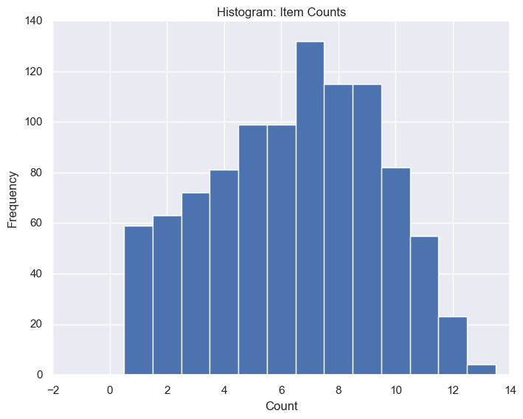

Slide 12
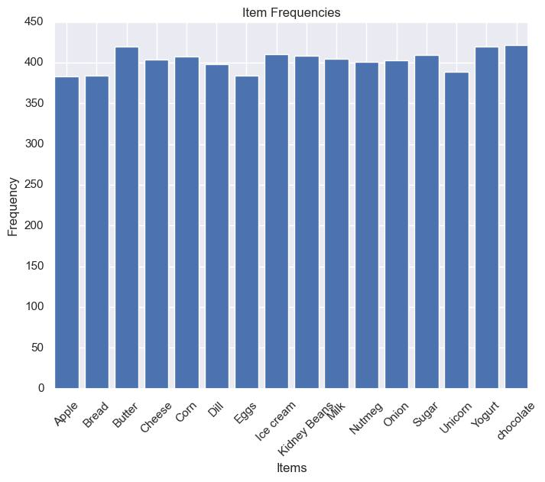

Slide 13
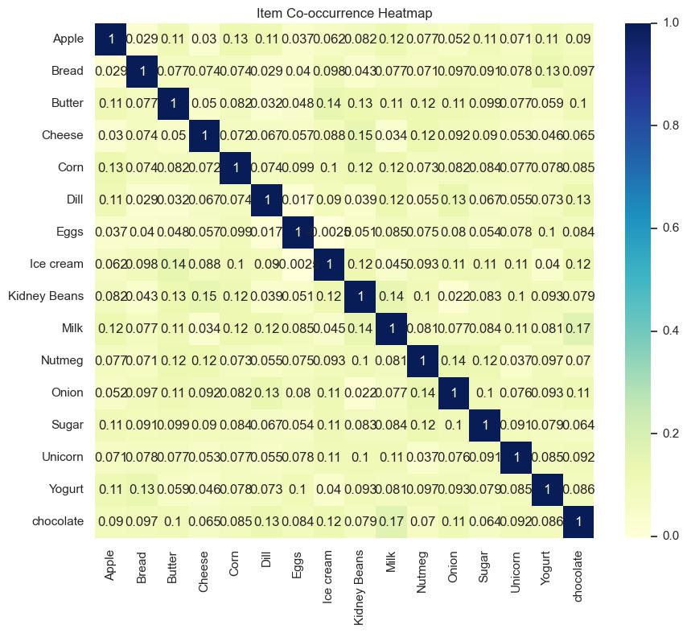

Slide 14
Table 1: Mean of Items in the data
Item | Mean
Apple | 0.383383
Bread | 0.384384
Butter | 0.42042
Cheese | 0.404404
Corn | 0.407407
Dill | 0.398398
Eggs | 0.384384
Ice cream | 0.41041
Kidney Beans | 0.408408
Milk | 0.405405
Nutmeg | 0.401401
Onion | 0.403403
Sugar | 0.409409
Unicorn | 0.389389
Yogurt | 0.42042
chocolate | 0.421421

Slide 15
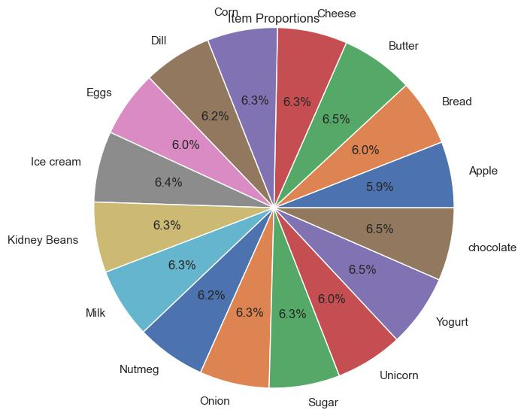

Slide 16
ASSOCIATION
RULE MINING

Slide 17
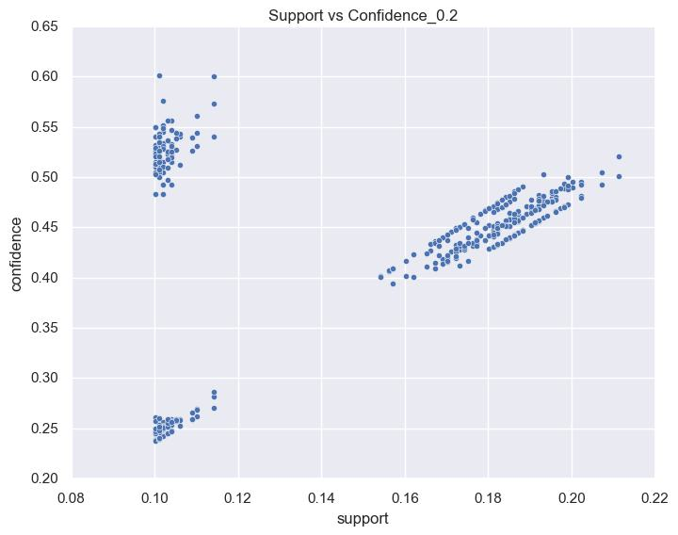

Slide 18
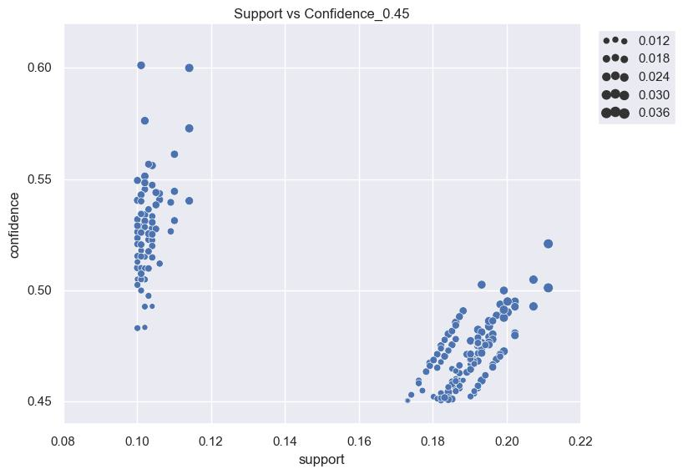

Slide 19
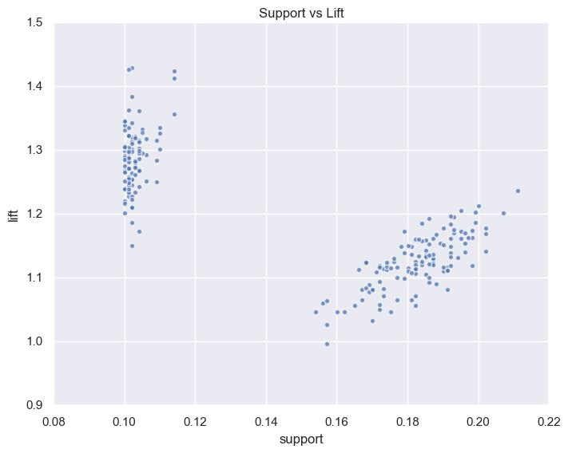

Slide 20
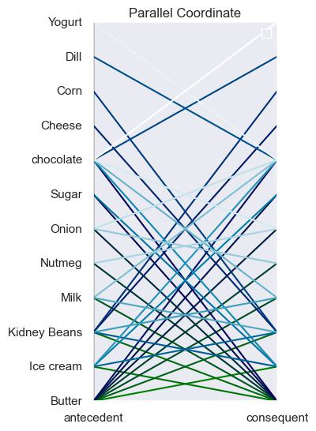

Slide 21
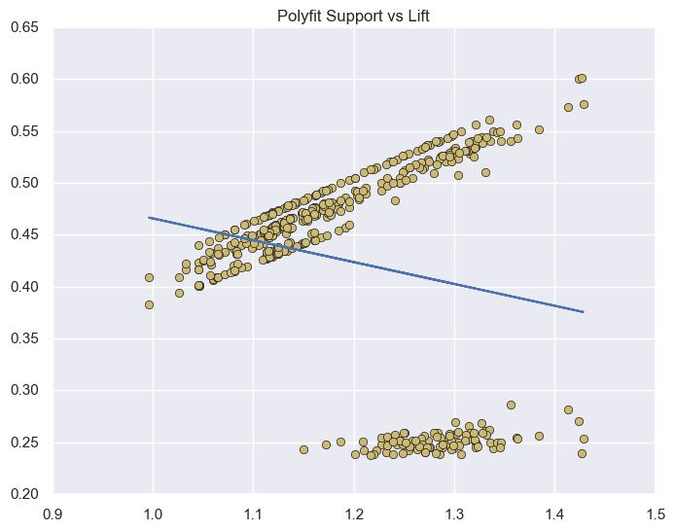

Slide 22
INSIGHTS

Slide 23
INSIGHTS
Highest Mean Values: The items with the highest mean values in the data set are "chocolate" (0.421421) and "Butter" (0.42042).
Lowest Mean Values: The item with the lowest mean value in the data set is "Apple" (0.383383)
Correlation: The strongest positive correlation is observed between the items Butter and Ice cream, with a correlation coefficient of approximately 0.142750.
Some other notable positive correlations include:
Kidney Beans and Cheese (0.145244)
Milk and Chocolate (0.166497)
Onion and Dill (0.131060)

Slide 24
INSIGHTS
Increasing the confidence threshold from 0.2 to 0.45 can be justified based on:
Stronger Association
Reliable Rules
Precision
Minimizing False Discoveries
To control the trade-off between the number of rules
selected and their reliability
Highest Support Values
Bread, Butter, Cheese, Corn, Dill: Support = 0.028698
(they frequently occur together in the dataset)

Slide 25
INSIGHTS
Here are some product combinations with good lift values based on the given dataset:
Butter -> Ice cream (Lift: 1.200889)
Ice cream -> Butter (Lift: 1.200889)
Butter -> Kidney Beans (Lift: 1.177626)
Kidney Beans -> Butter (Lift: 1.177626)
Butter -> Milk (Lift: 1.162857)
Milk -> Butter (Lift: 1.162857)
Nutmeg -> Butter (Lift: 1.174457)
Butter -> Nutmeg (Lift: 1.174457)
Butter -> Onion (Lift: 1.162726)
Onion -> Butter (Lift: 1.162726)
Butter -> Sugar (Lift: 1.139853)
Sugar -> Butter (Lift: 1.139853)
Butter -> Chocolate (Lift: 1.141262)
Chocolate -> Butter (Lift: 1.141262)

Slide 26
INSIGHTS
High confidence values, indicating a strong likelihood of the consequent item being purchased when the antecedent item is purchased.
Butter -> Ice cream: Confidence = 0.504878
Kidney Beans -> Butter: Confidence = 0.495098
Butter -> Kidney Beans: Confidence = 0.495098
Milk -> Butter: Confidence = 0.488889
Nutmeg -> Butter: Confidence = 0.493766
Butter -> Nutmeg: Confidence = 0.493766
Butter -> Onion: Confidence = 0.469048
Onion -> Butter: Confidence = 0.488834
Butter -> Sugar: Confidence = 0.466667
Sugar -> Butter: Confidence = 0.479218

Slide 27
INSIGHTS
Products that have an association with butter in the given dataset, along with their corresponding confidence values:
Butter -> Ice cream (Confidence: 0.492857)
Butter -> Kidney Beans (Confidence: 0.480952)
Butter -> Milk (Confidence: 0.488889)
Butter -> Nutmeg (Confidence: 0.493766)
Butter -> Onion (Confidence: 0.469048)
Butter -> Sugar (Confidence: 0.466667)
Butter -> Chocolate (Confidence: 0.480952)

Slide 28
INSIGHTS
Products that have an association with ice cream in the given dataset, along with their corresponding confidence values:
Ice cream -> Butter (Confidence: 0.492857)
Ice cream -> Kidney Beans (Confidence: 0.478049)
Ice cream -> Sugar (Confidence: 0.476773)
Ice cream -> Chocolate (Confidence: 0.492683)
Ice cream -> Milk (Confidence: 0.520988)

Slide 29
CONCLUSION
The highest purchased products are butter, yogurt and chocolate
These is a strong association between butter and ice cream, Kidney Beans and milk
These is a moderate association between butter and chocolate, Onion, Sugar, and Cheese.
These is a strong association between ice cream and butter
These is a moderate association between ice cream and kidney bean, sugar and chocolate
Products that do not need much attention in this store are onion, corn and dill

Slide 30
CONCLUSION
Products that the store should give more attention to in order to make large sales are butter, ice cream, kidney bean, cheese and chocolate
Five most associated products:
(Milk, Yogurt)
(Yogurt, Milk)
(Milk, Butter)
(Butter, Milk)
(Kidney Beans, Cheese)

Slide 31
REFERENCES
Agrawal, R., Srikant, R.. (1994).Fast Algorithms for Mining Association Rules. In Proc. Of the 20th Int’l Conference on Very Large Databases, Santiago, Chile
Liao, S. H., Chu, P. H., & Hsiao, P. Y. (2012). Data mining techniques and applications - A decade review from 2000 to 2011. Expert Systems with Applications.
Mushtaq, A. (2015). Data Mining For Marketing. Journal of Marketing and Consumer Research, 9, 17–29.
https://www.kaggle.com

