Slide 2
The Layers of the Web Stack
Client Side Tools (JavaScript, CSS, HTML)
Handled by some service providers
Server Side Tools (Languages, Frameworks)
Hosting and Database Software
Often abstracted by cloud service provider
Operating System
Hardware

Slide 3



Easy and Painless Development

Slide 4
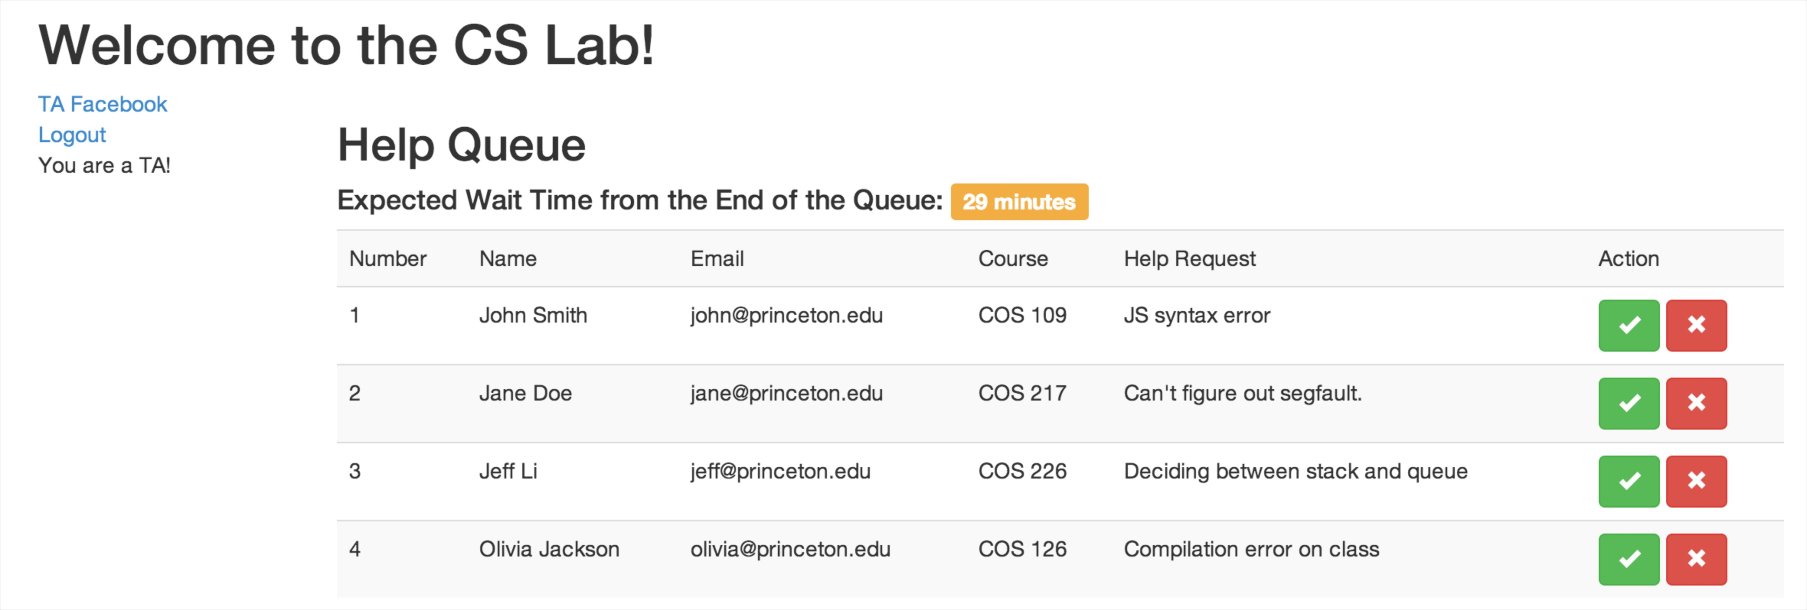
The TA View
Wait Estimate
Close/Cancel
Login Status
Information on Students in the Queue

Slide 5
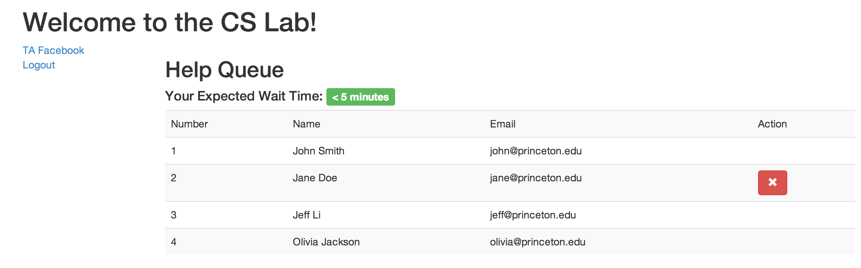
The Student View
Wait Estimates are Position and Status Aware
Users Can Only Modify Themselves

Slide 6
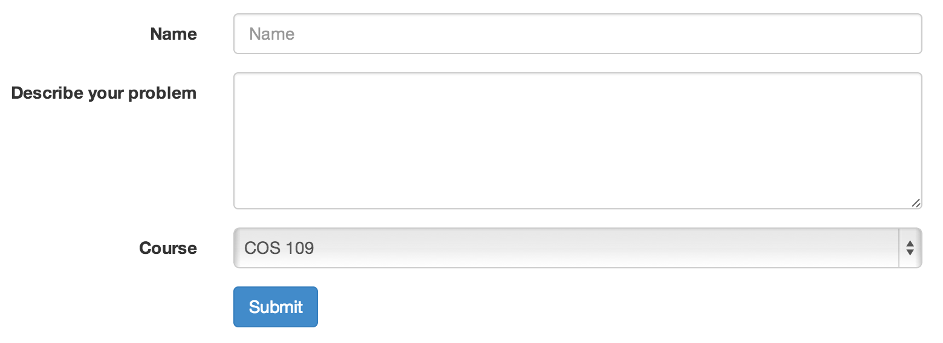
Entry Form

Slide 7
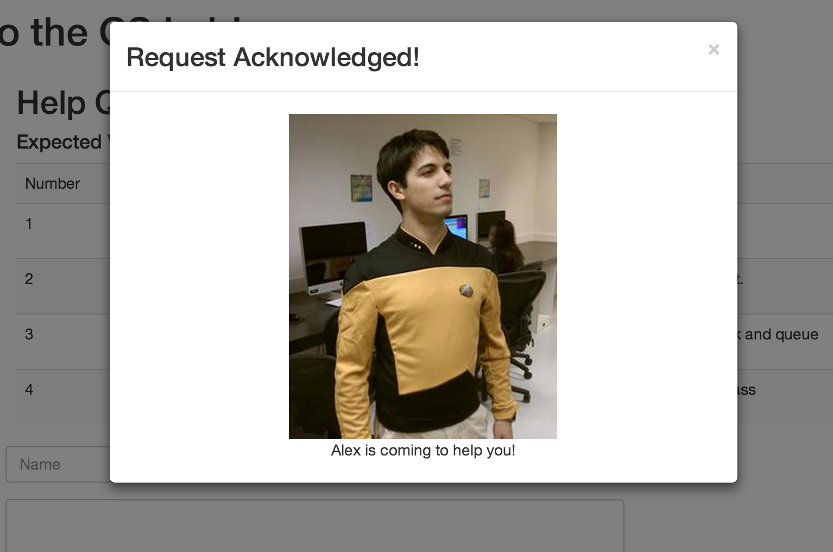
Student Notification

Slide 8
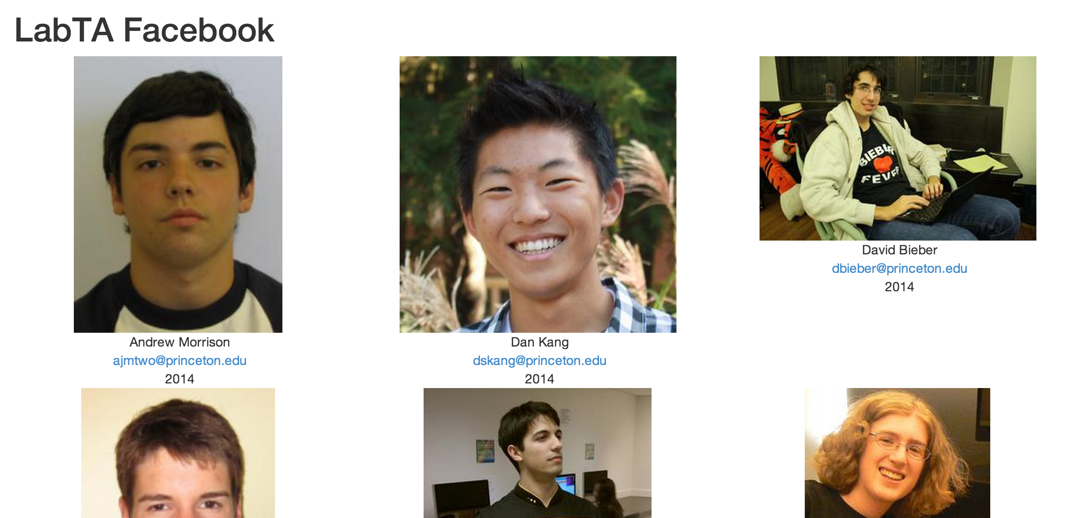
TA Facebook
Basic Info
Fun Profile Pictures!

Slide 9
Design
Server-to-Client
Model
ChannelManager
LabTA
Controller
jQuery Event Handlers
HelpRequest
Client-to-Server
QueueManager
View
Main Page
And
TAFacebook
Page Data
Static Templates
JavaScript
Modification
of DOM

