Slide 1
Version Control with Git

Slide 2
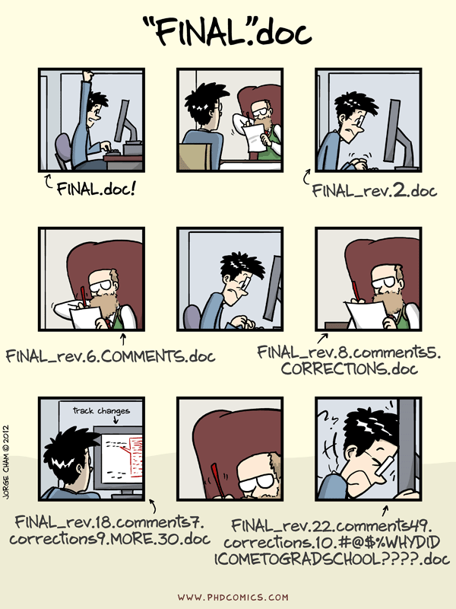

Slide 3
Opening
Wolfman and Dracula have been hired by Universal Missions to figure out where the company should send its next planetary lander. They want to be able to work on the plans at the same time, but they have run into problems doing this in the past. If they take turns, each one will spend a lot of time waiting for the other to finish. On the other hand, if they work on their own copies and email changes back and forth they know that things will be lost, overwritten, or duplicated.

Slide 4
https://github.com/mattphotonman/2014-03-17-nyu-exercises

Slide 5
git clone https://github.com/<username>/2014-03-17-nyu-exercises.git

Slide 6
Python

