Slide 1
MAE 224
Lab 4 Lift and Drag
2021.3.22

Slide 2

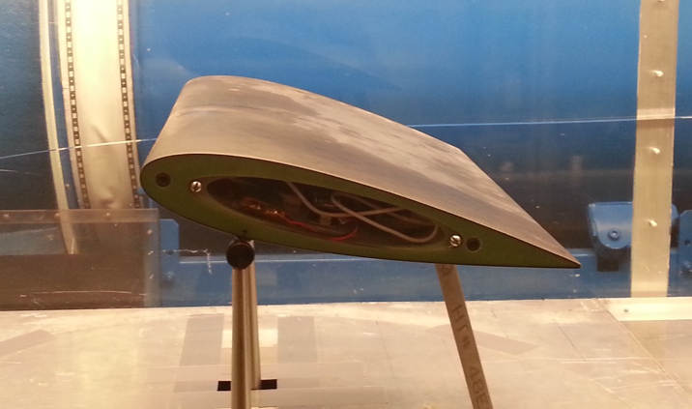
Lab4 Objectives
Understand lift and drag on an airfoil
QBlade Simulation
Compare simulation and experiment

Slide 3
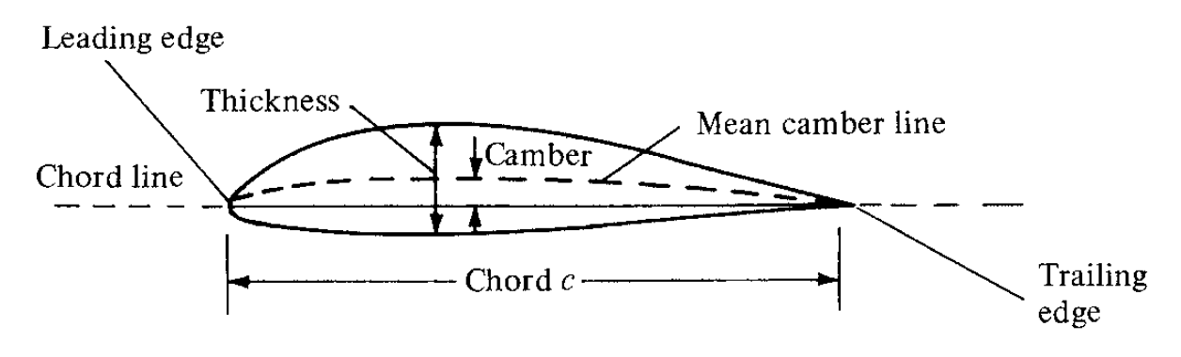
Terminology
Span s = width of airfoil (into the page)
α
relative wind velocity
α: Angle of attack (AOA)
Will be explained more carefully in QBlade session
Notes:
To begin with, a few definitions.
An airfoil is a cross-section through a blade or wing, usually teardrop-shaped like here.
We refer to the front and the back as the leading edge and the trailing edge.
The chord line is the line through the center of the airfoil, so the chord is always equidistant from the top and the bottom.
The camber of the airfoil describes how curved the airfoil is, meaning how far the chord line is from a straight line that connects the leading edge to the trailing edge.
A symmetric airfoil has zero camber.

Slide 4
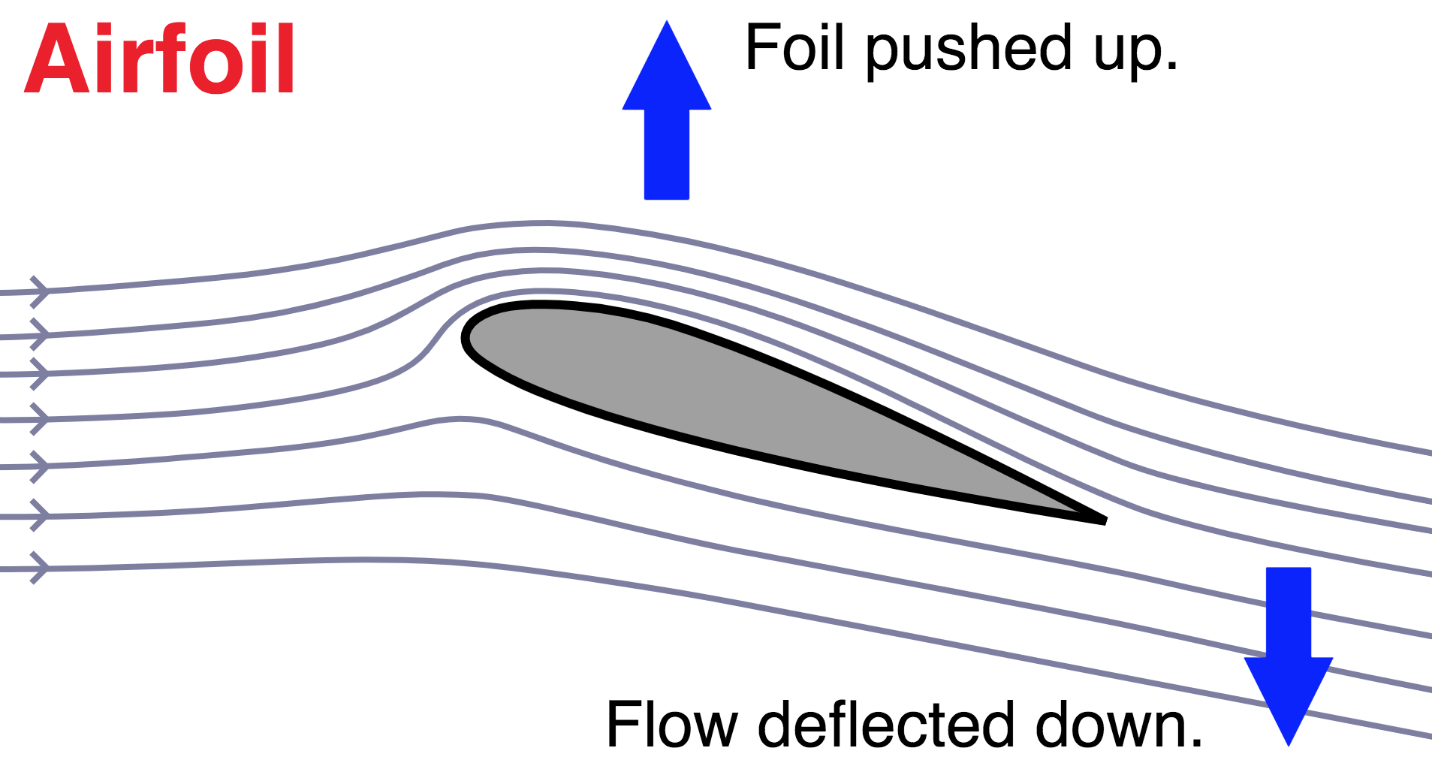
Lift Force on Airfoil
Momentum change in flow
Notes:
The cool thing about airfoils is that if we hold them at a slight angle to the incoming flow, they lift up.
The point of this lab is to understand what is actually happening to the flow.
There are two ways to think about lift, and one or the other might make more sense to you intuitively.
The first is the idea that the airfoil is deflecting momentum in the flow. We have all these fluid particles coming more or less horizontally at the airfoil, but then the way the airfoil is shaped, it causes them to flow diagonally downwards, so momentum is redirected down. And if the airfoil is generating a downward force on the flow around it, then the flow is generating an equal and opposite force on the airfoil, so an upward force.

Slide 5
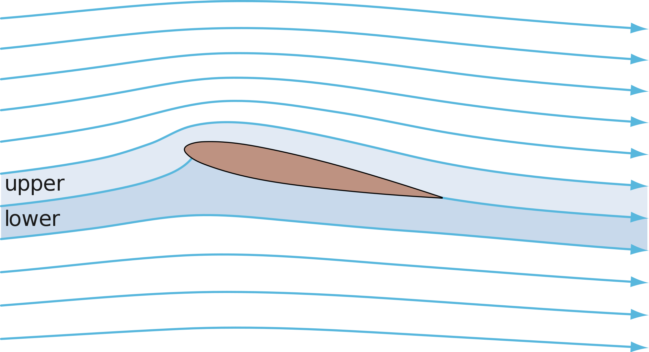
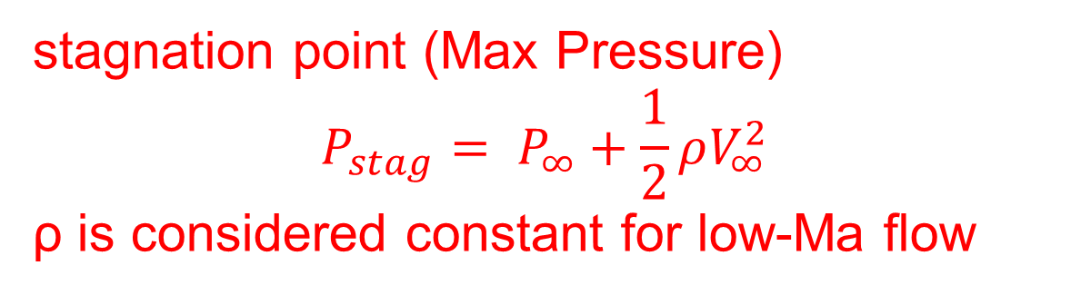
Less space for the same amount of fluid
Higher velocity in the tight area (conservation of mass)
Lower pressure in the tight area (Bernoulli)
Initial amount of space
stagnation point (Max Pressure)
$${P_{stag}= P}_{∞}+\frac{1}{2}ρV_{∞}^{2}$$
ρ is considered constant for low-Ma flow
Let’s assume inviscid flow first (no tangential viscous force)
Notes:
If we consider the flow to be inviscid, no viscous force.
The second explanation is maybe slightly less intuitive. In this case we look at the streamlines around the airfoil, and we need to know that fluid particles never cross a streamline, so between two streamlines there are always the same number of fluid particles.
We see that the fluid that goes over the top of the airfoil gets squished together, the streamlines are closer together, so there is suddenly less space for the same amount of fluid. The fluid particles have to stay between their streamlines, so the only way to satisfy conservation of mass is for the fluid moves faster in the area where the streamlines are tighter together.
And from Bernoulli’s equation we know that if the velocity increases, the pressure decreases.
A drop in pressure causes suction, so the airfoil is being pulled upwards by the low pressure.
On the bottom side of the airfoil, the opposite happens, the flow actually has slightly more space, so it can slow down, meaning that the pressure increases and pushes the airfoil up.

Slide 6
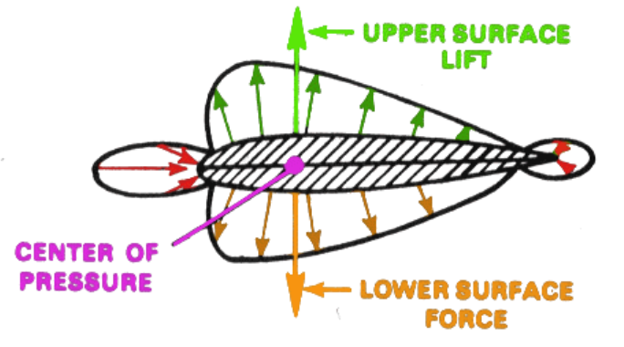
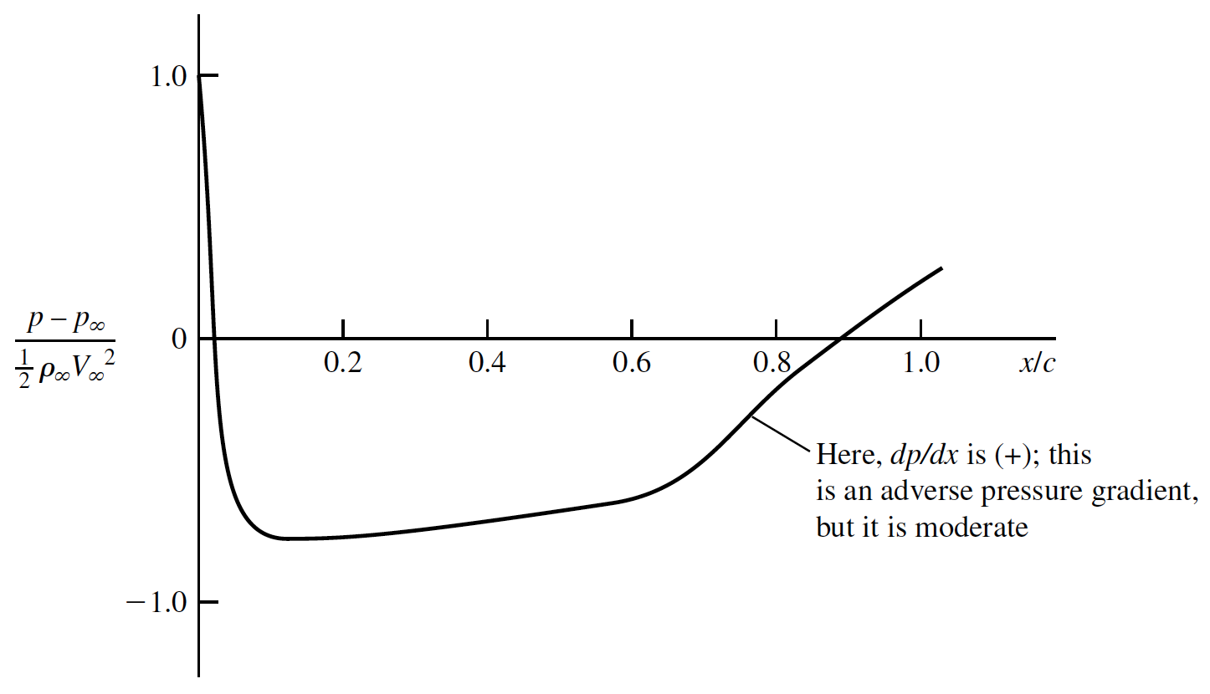
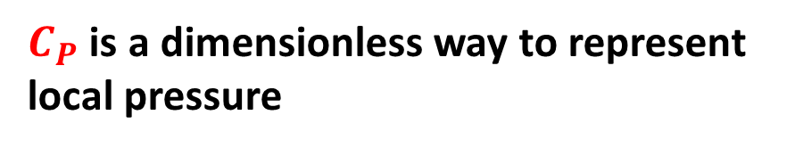
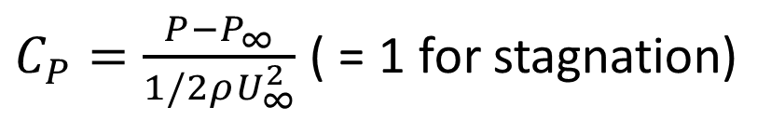
Pressure Distribution
According to velocity distribution and Bernoulli’s equation
Pressure distribution should be symmetric
Think about non-zero AOA
Pressure distribution on
symmetric airfoil at AOA of 0
$C_{P}=\frac{P−P_{∞}}{1/2ρU_{∞}^{2}}$ ( = 1 for stagnation)
$C_{P}$ is a dimensionless way to represent local pressure
In this case, zero lift but non-zero drag
x: position along the chord
c: chord length
Notes:
Since we are now only considering inviscid flow, the forces are essentially the normal pressure forces. We can visualize the pressure distribution by plotting the pressure along the surface of the airfoil.
As part of this lab, you will be asked to make some plots like this yourself.
On the x-axis we have the position along the chord, from the leading edge at 0 to the trailing edge at 1. On the y-axis we have the the pressure coefficient. Pressure coefficient is non dimensional way of representing the local pressure relative to the free stream pressure. P is the local pressure, U_inf is the freestream velocity, $ρ$ is fluid density, and $P_{∞}$ is free stream static pressure.
Then if we follow the top surface of the airfoil, we come to the region where the flow gets squished together, so it accelerates and creates a suction, which means the pressure coefficient is negative.
The further back we then go on the airfoil surface, the less suction there is, i.e. the higher the pressure coefficient becomes. We call this an adverse pressure gradient.

Slide 7
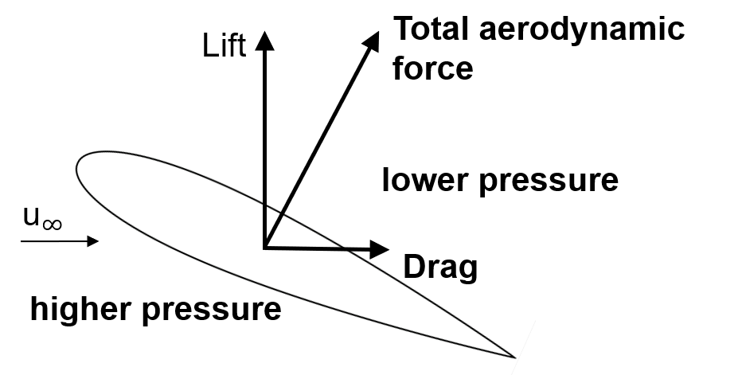
Drag Force on Airfoil
The aerodynamic force on an airfoil is the result of redirecting fluid momentum.
The tangential component of the aerodynamic force is called drag and the perpendicular component is called lift.
Notes:
Similarly

Slide 8
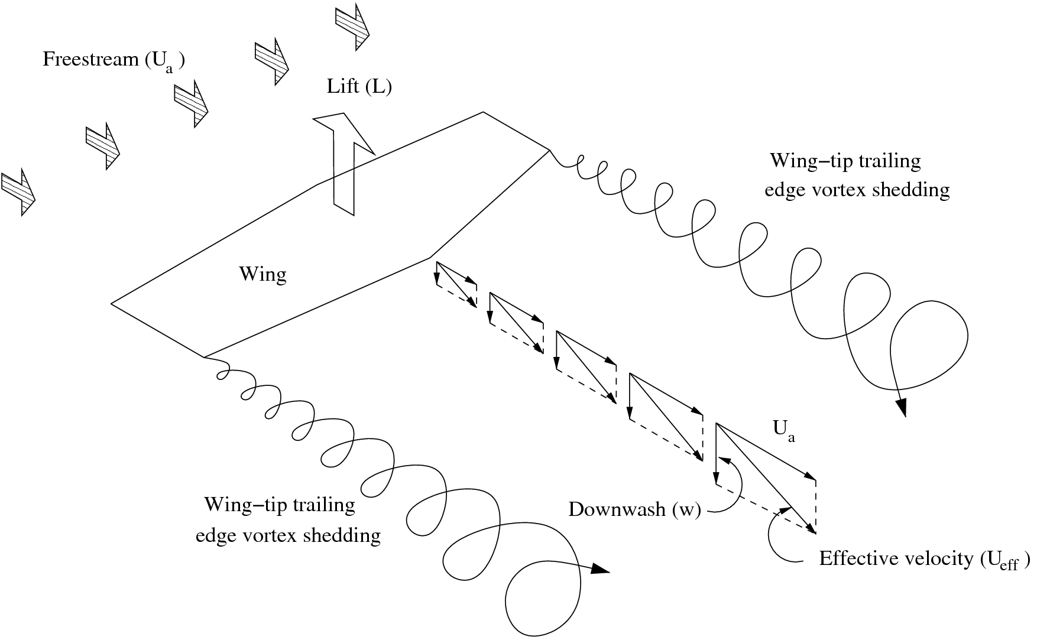
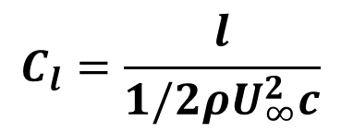
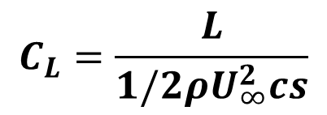
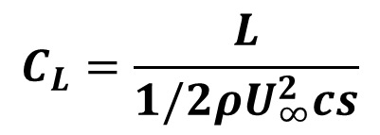
Lift Coefficient
$$C_{L}=\frac{L}{1/2ρU_{∞}^{2}cs}$$
Lift coefficient is defined as
L is the total lift force, U∞ is the approach velocity, c is the chord length, s is the span (width)
$$C_{L}=\frac{L}{1/2ρU_{∞}^{2}cs}$$
For a 3D, real-life airfoil:
For a 2D or airfoil section:
(section lift coefficient)
$$C_{l}=\frac{l}{1/2ρU_{∞}^{2}c}$$
L: total lift force (Unit: N)
l: lift force on section (Unit: N/m)
Difference depends on whether L = l*s
3-D airfoil is influenced by having a finite span where tip vortices form and cause the velocity distribution along the wing to deviate from the 2-D section
Not much difference if the airfoil is wide
8
Notes:
the lower L here stands for the total lift force on this section, then its unit is newton over length, not newton any more.

Slide 9
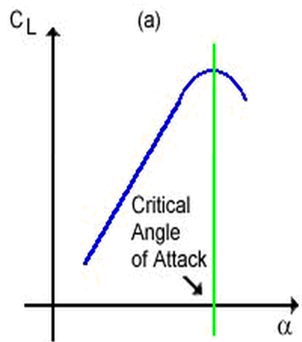
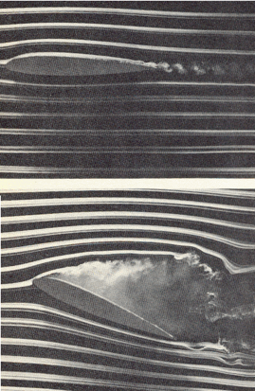
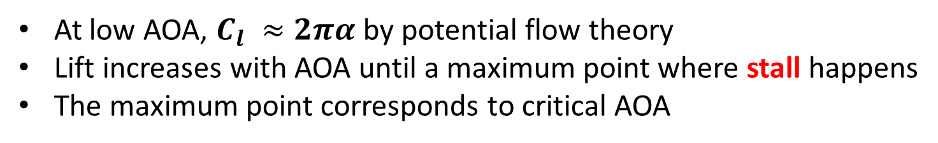
Lift Coefficient
At low AOA, $C_{l} ≈2πα$ by potential flow theory
Lift increases with AOA until a maximum point where stall happens
The maximum point corresponds to critical AOA
Detached Flow
Attached Flow
Stall or Flow Separation
Detached Flow
Explain later
9

Slide 10
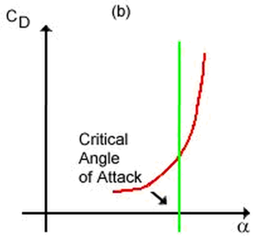
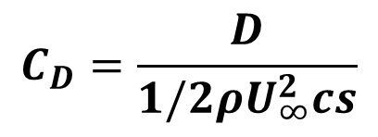
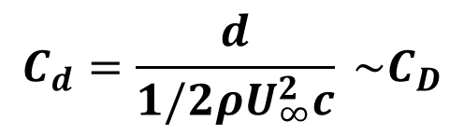
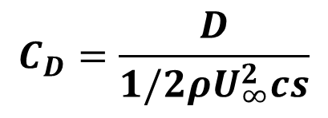
Drag Coefficient
$$C_{D}=\frac{D}{1/2ρU_{∞}^{2}cs}$$
Drag coefficient is defined as
D is the total drag force, U∞ is the approach velocity, c is the chord length, s is the span (width)
$$C_{D}=\frac{D}{1/2ρU_{∞}^{2}cs}$$
For a 3D, real-life airfoil:
For a 2D or airfoil section:
(section drag coefficient)
$$C_{d}=\frac{d}{1/2ρU_{∞}^{2}c} \sim C_{D}$$
Drag always increases with AOA
Increases more rapidly after critical AOA
10
Notes:
the lower l here stands for the total lift force on this section, then its unit is newton over length, not newton any more.

Slide 11
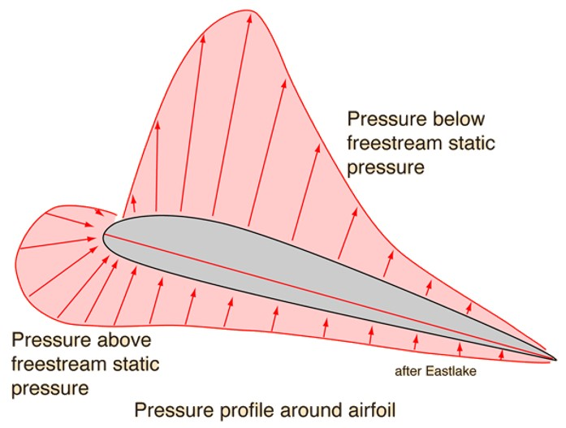
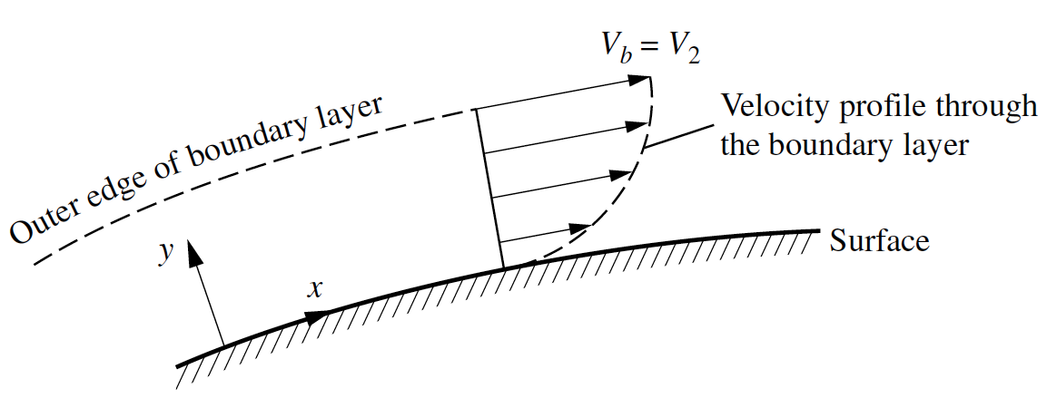
Now let us consider viscous forces: Boundary Layer (Lab3)
Previously, we only considered the pressure forces normal to the surface
Now we consider viscous forces tangential to the surface
Airfoil surface slows down flow in boundary layer
Airfoil Surface
Non-slip Condition
Flow exerts equal and opposite force on airfoil surface: called Skin Friction Drag
Airfoil
11
Notes:
Previously, we only considered the pressure forces normal to the surface
Now we consider viscous forces tangential to the surface
In the boundary layer, the flow near the surface is slowed down by the airfoil surface. The flow in terms exerts an equal but opposite force on the airfoil, which is called skin friction drag. It is tangential to the surface.

Slide 12
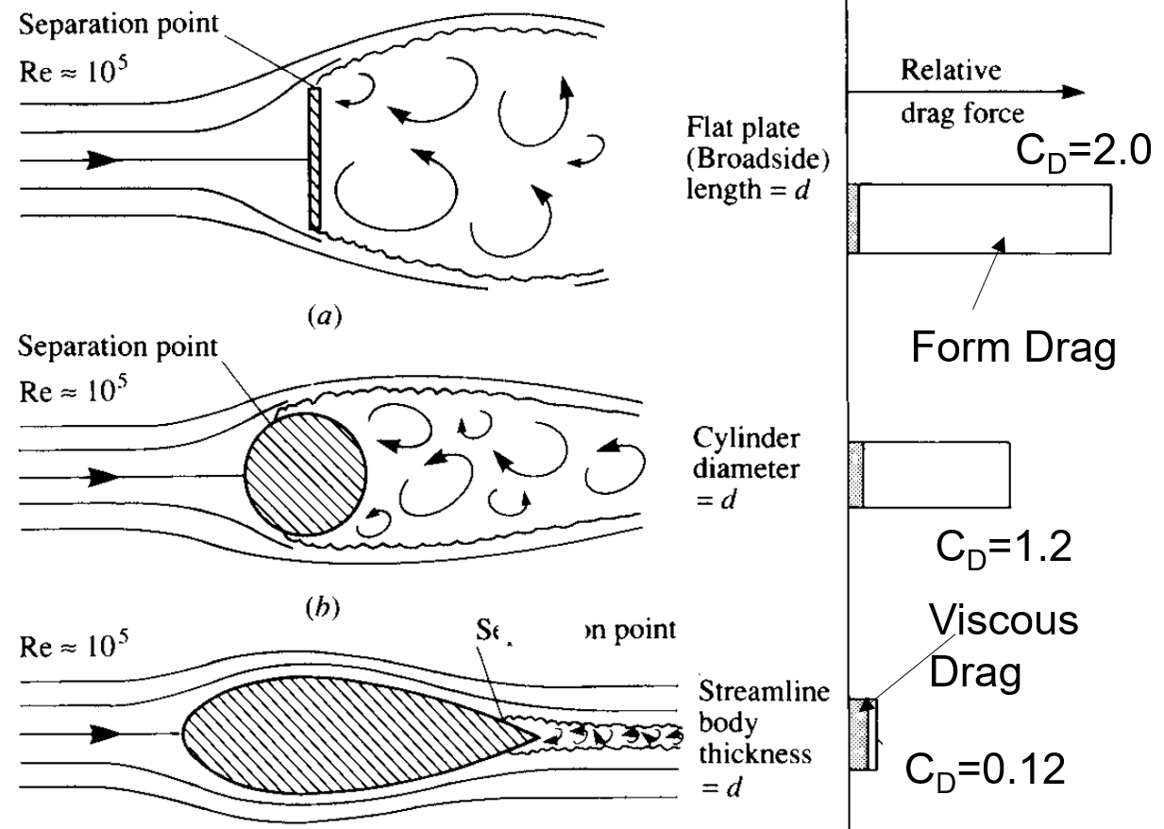
Viscous Effects: Boundary Layer
Drag: Form Drag (or pressure drag) and Viscous Drag
Magnitude of viscous drag depends on shape and AOA
Viscous drag is important for airfoil in an attached flow (low AOA), but form drag becomes more important as AOA increases.
12
Notes:
Any object you expose to a flow will have both types of drag, but the relative importance of both types varies by shape.
All shapes have the same height, i.e. the same area facing the flow, but have different total surface areas and differently sized wakes
The more surface area a shape has, the more skin friction it has
The more streamlined a body is, the smaller its wake is, so the lower the pressure drag.

Slide 13
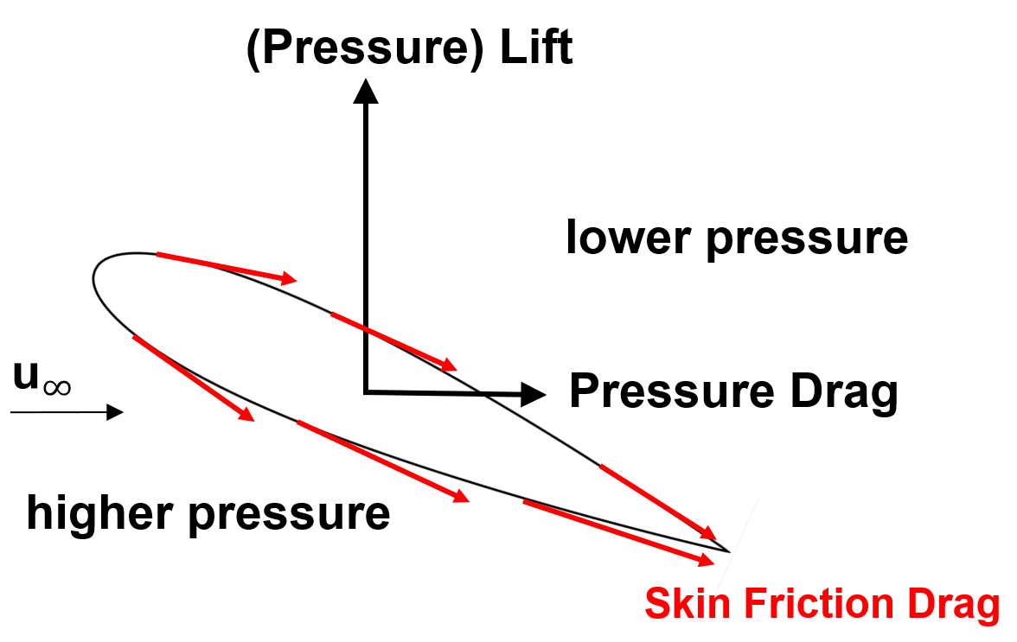
Viscous Effects: Boundary Layer
Drag: Form Drag (or pressure drag) and Viscous Drag
Lift:
Generally, for airfoil, the attached B.L. reduces the total lift force by a modest amount and also modifies the pressure distribution along the surface.
Viscous effects are typically more important for drag force.
Viscous effects cannot be accounted by taking pressure measurement alone, but can be included in force measurement. (Our Lab)
13

Slide 14
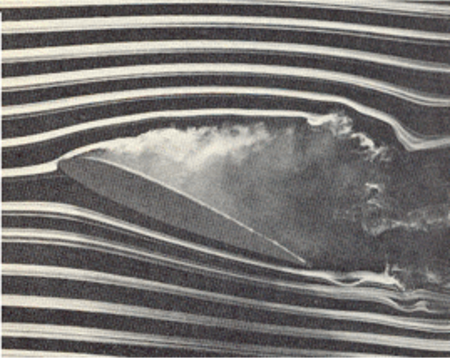
What is stall?
Watch the video here (start at 1:00) :
https://www.youtube.com/watch?v=6UlsArvbTeo
Detached Flow
Stall or Flow Separation
14

Slide 15
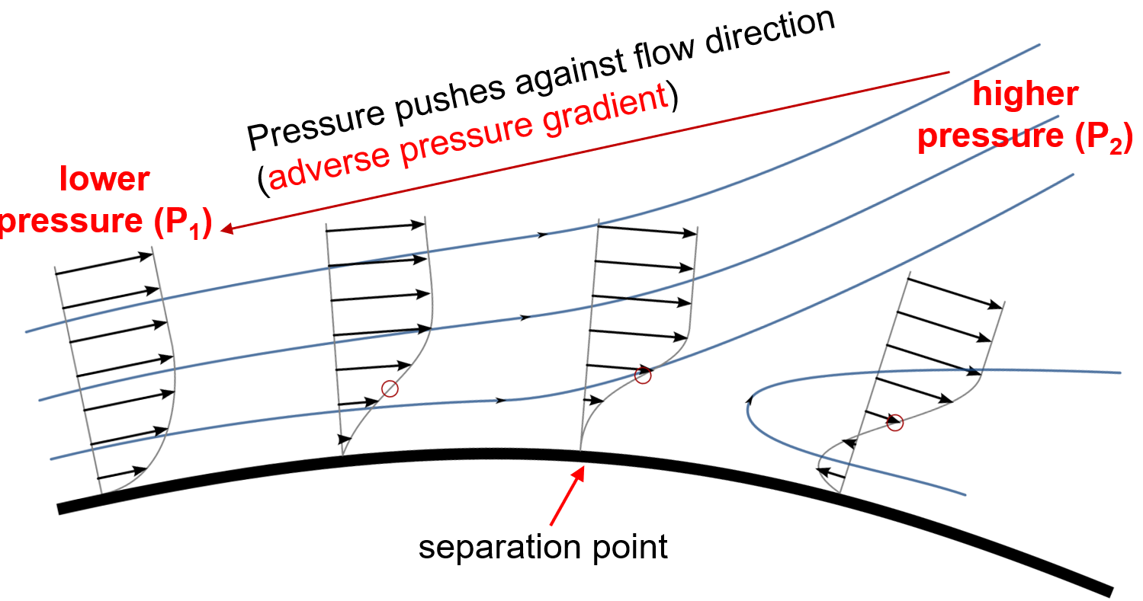
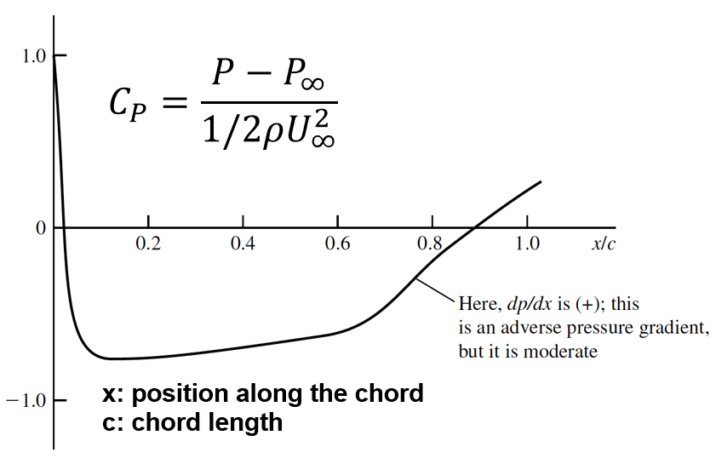
Why stall?
The left figure shows P_{local} - P∞
P∞ > P₂ > P₁
Point 1
Point 2
Reversal
15
Notes:
Usually fluid flows from high pressure to low pressure, which is called pressure-driven flow
But in this case, the flow is going from low pressure at the front to high pressure at the back, and it doesn’t really do that.
So the pressure gradient behaves like resistance and starts to slow down the flow more and more, and if we look at the velocity distribution in the boundary layer, we see that the velocity near the wall becomes lower and lower.
If the adverse pressure gradient is not very high, its all good, nothing happens. But if the pressure gradient is very strong, then it slows down the flow in the boundary layer so much that it stops completely and then reverses direction.
The point where it stops completely is called the separation point, and everything behind that is called separated flow. In summary, the flow is detached or separated when the adverse pressure gradient is too high.

Slide 16
Lab4 Plan
Week 1 (half of the lab): QBlade Simulation
Week 2: Learn how to do experiments, process data and compare with simulation
For details, please refer to the lab4 wiki page
Notes:
We will talk about more details in experiment next week.

Slide 17
Any Questions?

Slide 18
Backup

Slide 19
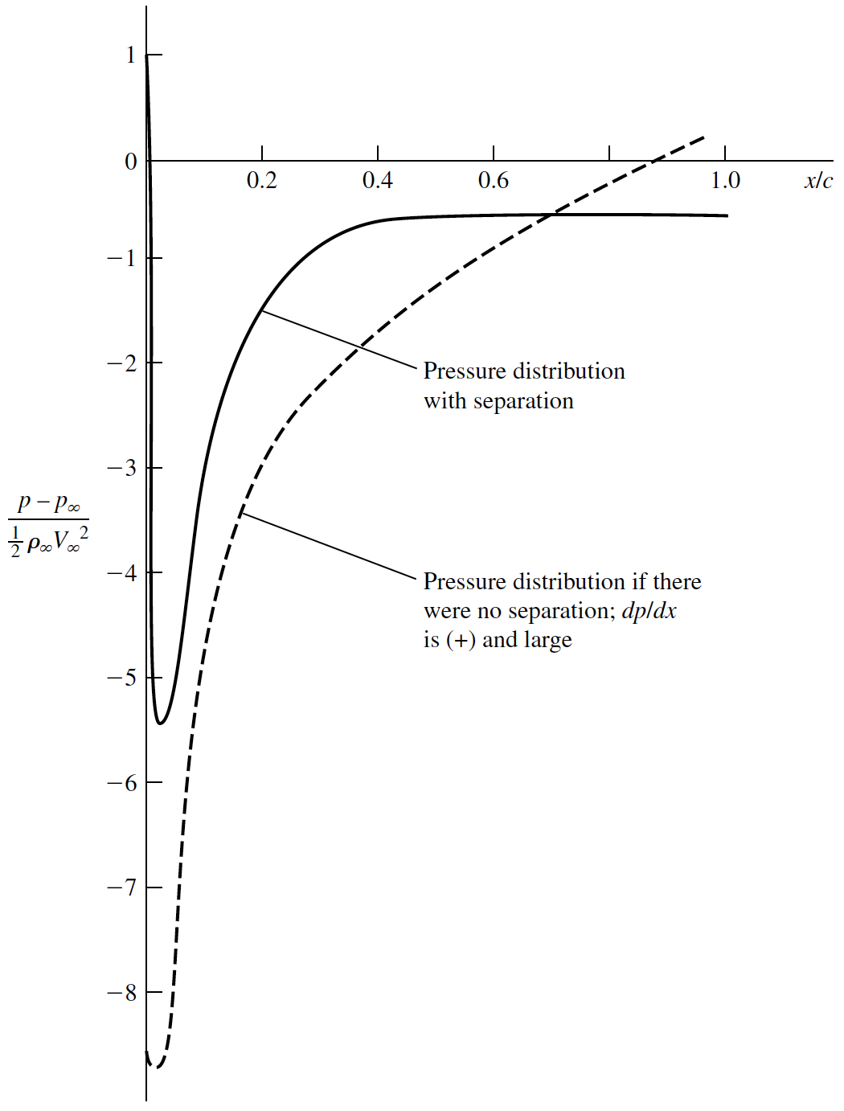
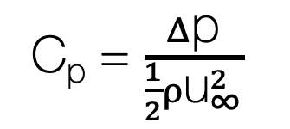

Why does the lift decrease?
Flat c_{p}
= separated flow
pressure distribution with separation
C_{p} = $\frac{Δ\text{p}}{\frac{1}{2}ρ{\text{u}}_{∞}^{2}}$
pressure distribution if there were no separation
$$\frac{dp}{dx}>0$$
Notes:
The second question was, why does the lift coefficient decrease when the airfoil stalls.
To answer that, we need to look at the pressure coefficient along the top surface of the airfoil again.
Here, we are considering an airfoil at a high angle of attack, where the flow is separated.
The solid line shows the real pressure along the surface, and the dotted line shows the hypothetical pressure if the flow could somehow still stay attached to the surface.
We discussed earlier that the lift force is caused by the difference in pressure between the top and bottom sides of the airfoil, and in particular by the low pressure at the front where the streamlines get squished together.
If you look at the two lines in the plot, you can see that the pressure is much lower in the hypothetical attached flow, compared to the separated flow, so the lift that would result from that very low pressure would be much more than the lift that results from the separated flow.
Also, note how flat the pressure distribution of the separated flow is towards the back of the airfoil. A constant c_{p} value on the top of your airfoil is always a sign that the flow is separated in that region because the pressure in the messy part of the flow is pretty constant everywhere.

Slide 20
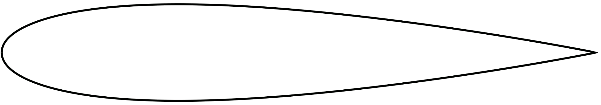

(Pressure) Lift
lower pressure
$${\text{u}}_{∞}$$
Pressure Drag
higher pressure
Skin Friction Drag

Slide 21
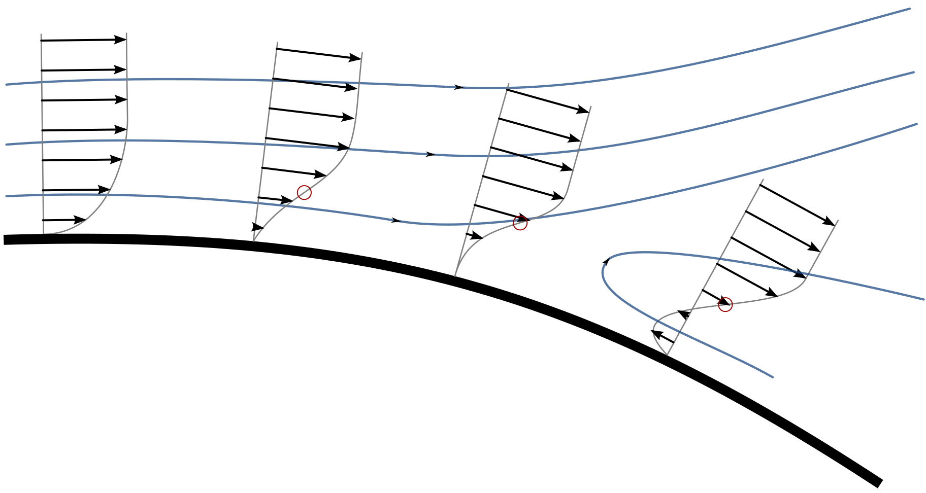
Pressure pushes against flow direction
(adverse pressure gradient)
higher pressure (P₂)
lower pressure (P₁)
separation point
Notes:
The main difference here is that in the boundary layers in lab 3, the pressure was constant everywhere, but along the surface of the airfoil the pressure changes, as we discussed earlier, and in particular over most of the top surface of the airfoil, the pressure is increasing.
Usually things like to flow from high pressure to low pressure, like we saw for example in the pipe flow lab.
But in this case, the flow is going from low pressure at the front to high pressure at the back, and it doesn’t really like to do that.
So the pressure gradient starts to slow down the flow more and more, and if we look at the velocity distribution in the boundary layer, we see that the velocity close to the wall becomes lower and lower.
If the adverse pressure gradient is not very high, its all good, nothing happens.
But if the pressure gradient is very intense, then it slows down the flow in the boundary layer so much that it stops completely and then reverses direction.
The point where it stops completely is called the separation point, and everything behind that is called separated flow and is really messy.
So now we answered the first question: the flow separates when the adverse pressure gradient becomes too high

Slide 22

Symmetric Airfoil at AOA of 0
$$C_{P}=\frac{P−P_{∞}}{1/2ρU_{∞}^{2}}$$
x: position along the chord
c: chord length

