Slide 1
The Machine Learning Landscape
Vineet Bansal
Research Software Engineer, Center for Statistics & Machine Learning
vineetb@princeton.edu
Oct 31, 2018

Slide 2


What is ML?
“A field of study that gives computers the ability to learn without being explicitly programmed.”
A machine-learning system is trained rather than explicitly programmed.
Notes:
Using a set of observations to uncover an underlying process.
ML assumes that a pattern exists, but we cannot pin it down mathematically.
ML reverse engineers the process – start from data, find out what rules would be consistent with the data.
ML is a very broad subject – goes from very abstract theory to extreme practical i.e. rules of thumb
Stats vs ML
Underlying process is a probability distribution – observations are samples generated by that distribution.
Mathematical field – put assumption that you need to prove results in rigorous detail.
ML tries to make the least assumptions, cover the most territory – not a purely math/applied discipline, somewhere in the middle.
e.g. Linear Regression under statistics makes a lot of math/assumptions
If the particular set of assumptions takes you sufficiently far from the math in other disciplines – then you call it a different type.

Slide 3
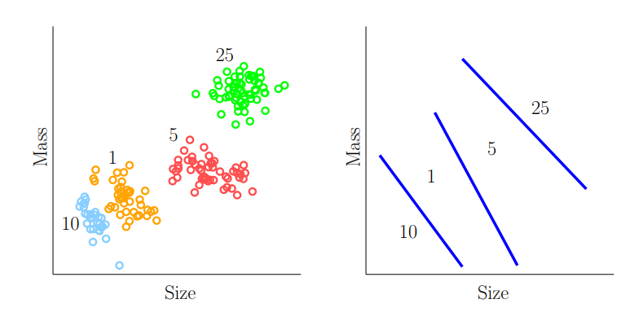
Types of ML Systems
Supervised Learning - Training Data contains desired solutions, or labels
Features
Notes:
As if a supervisor is helping you out with the correct output.
Vending machine – make the system recognize the coins

Slide 4
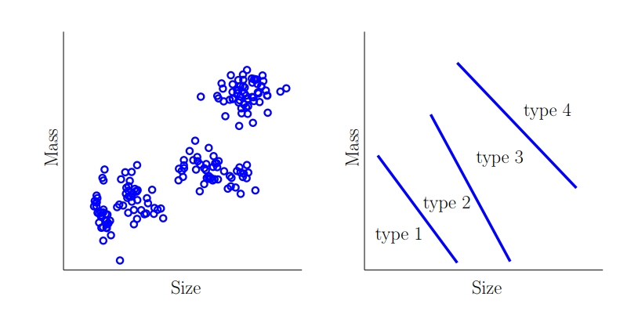
Types of ML Systems
Unsupervised Learning - Training Data is unlabeled
Notes:
Situation is not totally hopeless.
If I didn’t tell you what the denominations are, then it’s the blue graph.
The data made you do something that is significant – come up with boundaries.
In unsupervised learning, the number of clusters is unknown -> Type 1,2 may be the same category

Slide 5
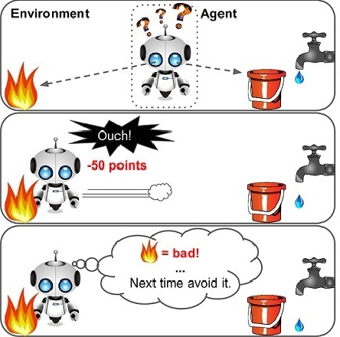
Types of ML Systems
Reinforcement Learning - Training Data does not contain target output, but instead contains some possible output together with a measure of how good that output is.
<input>, <correct output>
↓
<input>, <some output>, <grade for this output>
Notes:
Situation not as bad as unsupervised learning
Game – propagate back the credit for winning/losing according to a sophisticated formula back to the move.

Slide 6
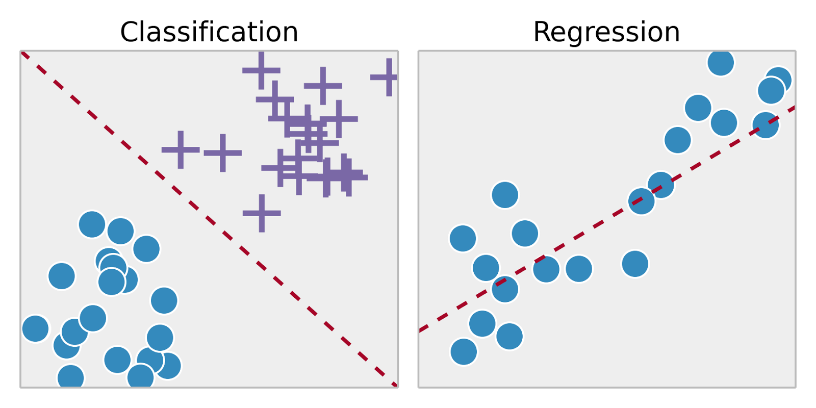
Classification vs Regression

Slide 7
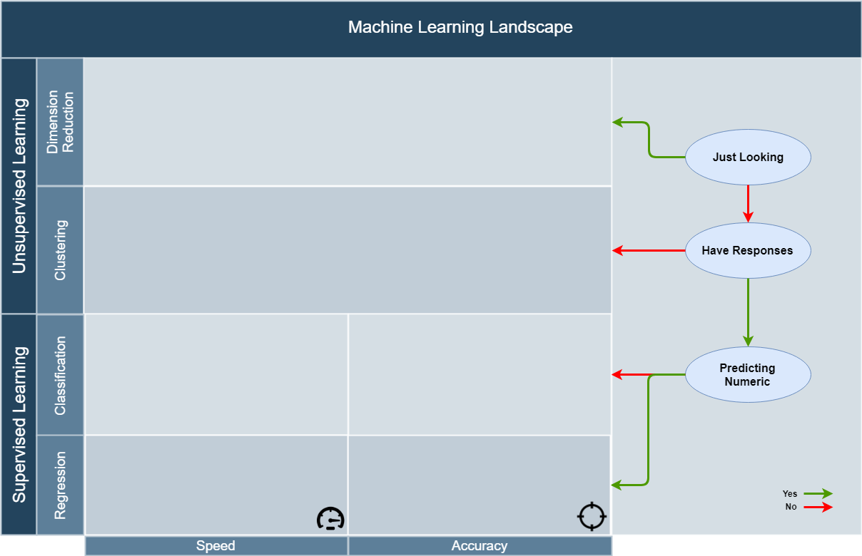
ML Landscape
Notes:
Situation not as bad as unsupervised learning
Game – propagate back the credit for winning/losing according to a sophisticated formula back to the move.

Slide 8
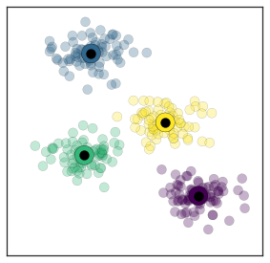
Unsupervised Learning - Clustering
Clustering
Color “clusters” of points in a homogenous cloud of data.
Use Cases
Behavioral Segmentation in Marketing
Useful as a pre-processing step before applying other classification algorithms.
Cluster ID could be added as feature for each data point.
Notes:
Using a set of observations to uncover an underlying process.
ML assumes that a pattern exists, but we cannot pin it down mathematically.
ML reverse engineers the process – start from data, find out what rules would be consistent with the data.
ML is a very broad subject – goes from very abstract theory to extreme practical i.e. rules of thumb
Stats vs ML
Underlying process is a probability distribution – observations are samples generated by that distribution.
Mathematical field – put assumption that you need to prove results in rigorous detail.
ML tries to make the least assumptions, cover the most territory – not a purely math/applied discipline, somewhere in the middle.
e.g. Linear Regression under statistics makes a lot of math/assumptions
If the particular set of assumptions takes you sufficiently far from the math in other disciplines – then you call it a different type.

Slide 9
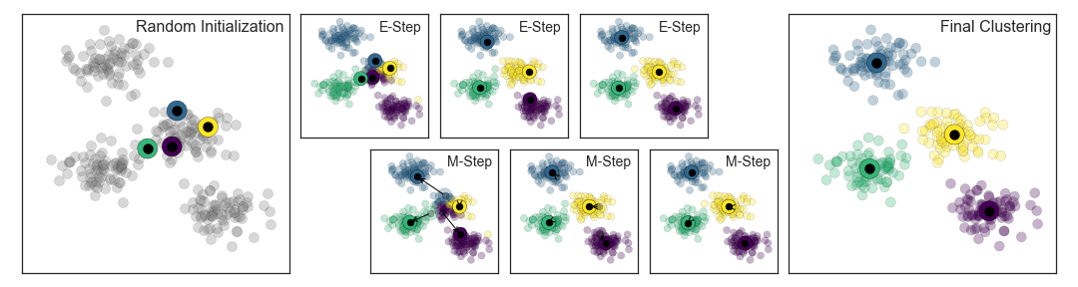
Unsupervised Learning - Clustering
k-means Algorithm
Guess some cluster centers
Repeat until converged
E-Step: assign points to the nearest cluster center
M-Step: set the cluster centers to the mean
Notes:
Using a set of observations to uncover an underlying process.
ML assumes that a pattern exists, but we cannot pin it down mathematically.
ML reverse engineers the process – start from data, find out what rules would be consistent with the data.
ML is a very broad subject – goes from very abstract theory to extreme practical i.e. rules of thumb
Stats vs ML
Underlying process is a probability distribution – observations are samples generated by that distribution.
Mathematical field – put assumption that you need to prove results in rigorous detail.
ML tries to make the least assumptions, cover the most territory – not a purely math/applied discipline, somewhere in the middle.
e.g. Linear Regression under statistics makes a lot of math/assumptions
If the particular set of assumptions takes you sufficiently far from the math in other disciplines – then you call it a different type.

Slide 10
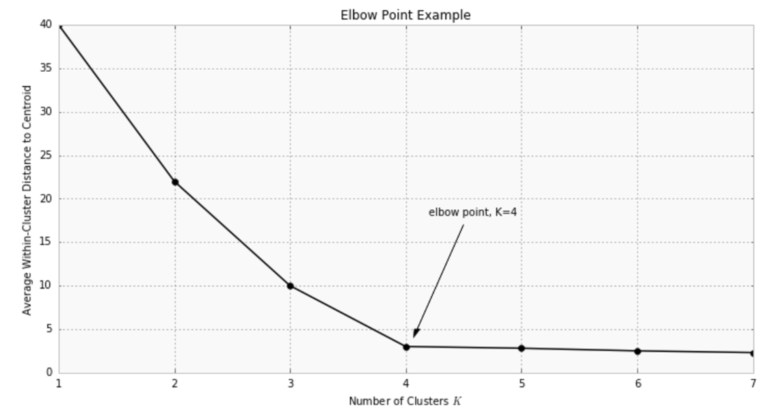
Unsupervised Learning - Clustering
Choosing k
Notes:
Using a set of observations to uncover an underlying process.
ML assumes that a pattern exists, but we cannot pin it down mathematically.
ML reverse engineers the process – start from data, find out what rules would be consistent with the data.
ML is a very broad subject – goes from very abstract theory to extreme practical i.e. rules of thumb
Stats vs ML
Underlying process is a probability distribution – observations are samples generated by that distribution.
Mathematical field – put assumption that you need to prove results in rigorous detail.
ML tries to make the least assumptions, cover the most territory – not a purely math/applied discipline, somewhere in the middle.
e.g. Linear Regression under statistics makes a lot of math/assumptions
If the particular set of assumptions takes you sufficiently far from the math in other disciplines – then you call it a different type.

Slide 11
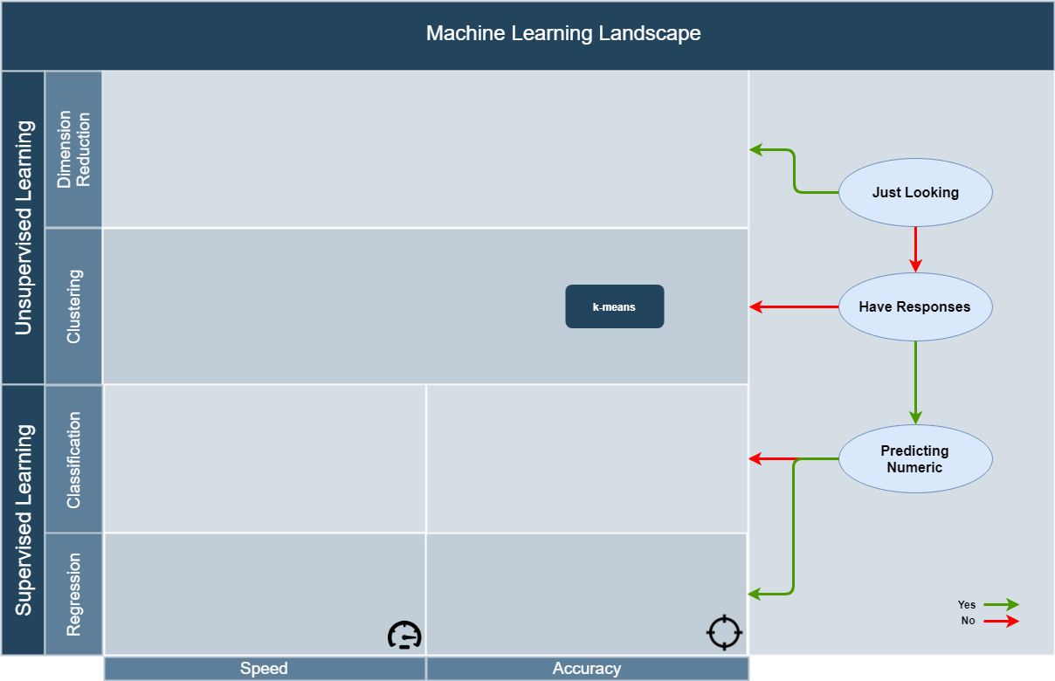
ML Landscape
Notes:
Situation not as bad as unsupervised learning
Game – propagate back the credit for winning/losing according to a sophisticated formula back to the move.

Slide 12
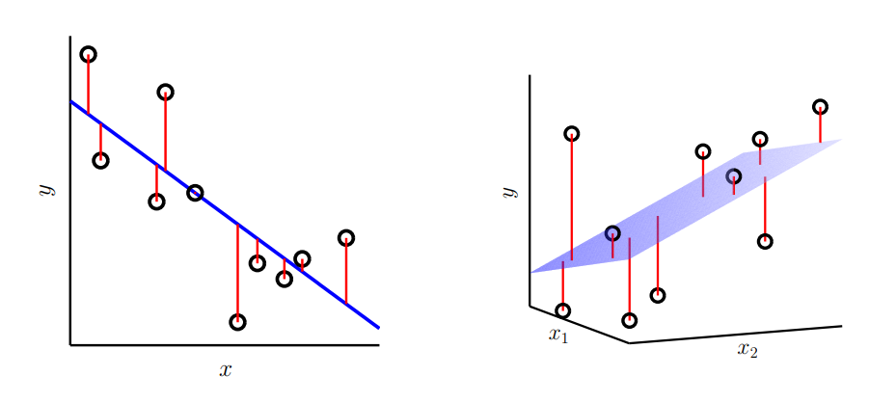
Linear Regression

Slide 13
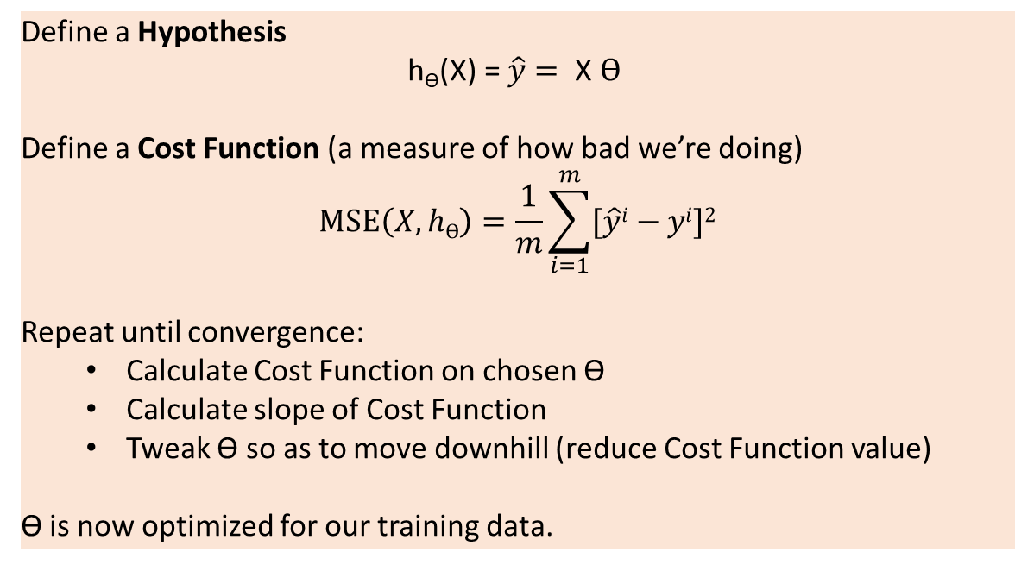
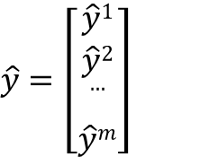
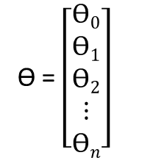
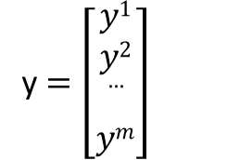
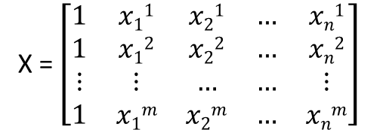
Linear Regression
X = $\left[\begin{matrix}1 & x11 & x21 & … & xn1 \\ 1 & x12 & x22 & … & xn2 \\ ⋮ & ⋮ & … & … & ⋮ \\ 1 & x1m & x2m & … & xnm\end{matrix}\right]$
Define a Hypothesis
$$\text{h}\text{ϴ}\text{(}\text{X}\text{) = }\hat{y}= \text{X} ϴ$$
Define a Cost Function (a measure of how bad we’re doing)
$$MSE\left(X, hϴ\right)=\frac{1}{m}\sum_{i=1}^{m}{[\hat{y}i}−yi]2$$
Repeat until convergence:
Calculate Cost Function on chosen ϴ
Calculate slope of Cost Function
Tweak ϴ so as to move downhill (reduce Cost Function value)
ϴ is now optimized for our training data.
y $=\left[\begin{matrix}y1 \\ y2 \\ … \\ ym\end{matrix}\right]$
ϴ = $\left[\begin{matrix}ϴ0 \\ ϴ1 \\ ϴ2 \\ ⋮ \\ ϴn\end{matrix}\right]$
$\hat{y}$ $=\left[\begin{matrix}\hat{y}1 \\ \hat{y}2 \\ … \\ \hat{y}m\end{matrix}\right]$

Slide 14
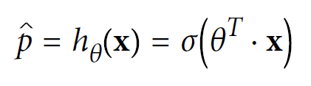
Logistic Regression
Used to estimate the probability that an instance belongs to a particular class.

Slide 15
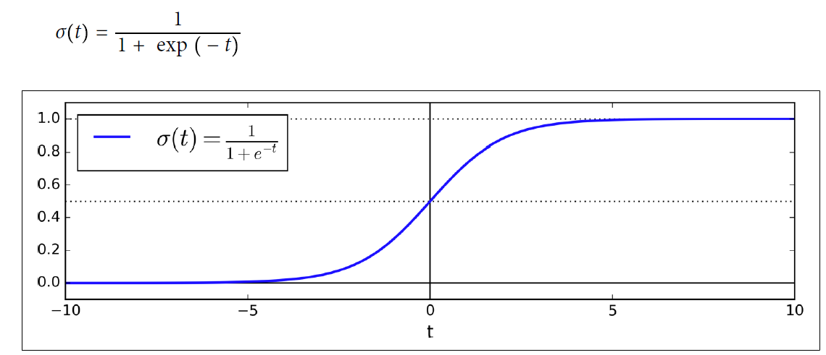
Logistic Regression

Slide 16
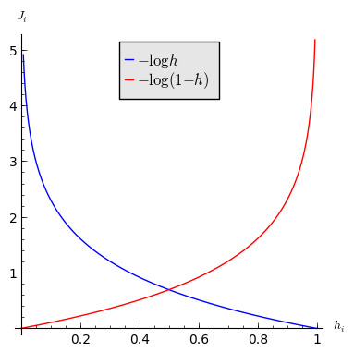
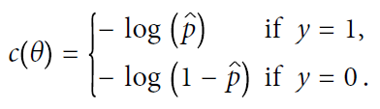

Logistic Regression
No closed-form solution, but we can use Gradient Descent!

Slide 17
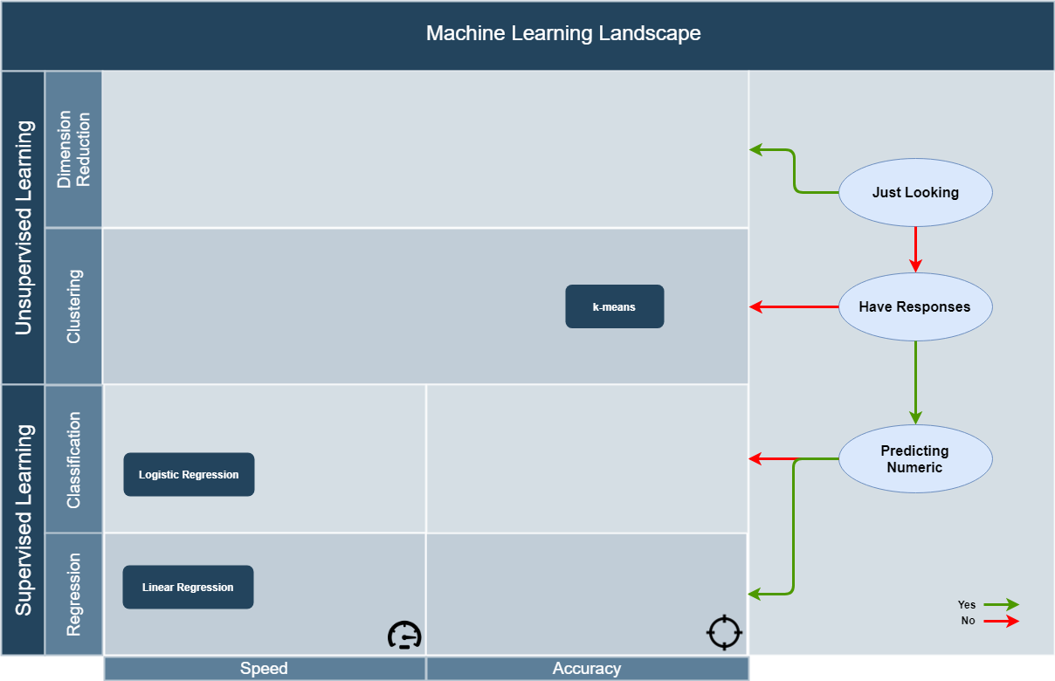
ML Landscape
Notes:
Situation not as bad as unsupervised learning
Game – propagate back the credit for winning/losing according to a sophisticated formula back to the move.

Slide 18
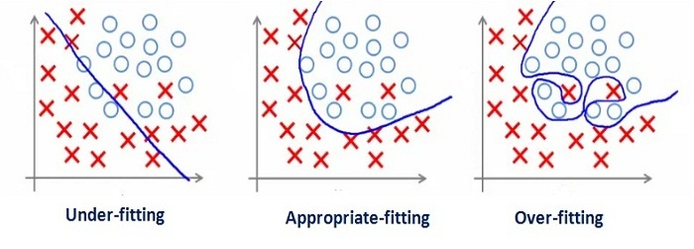
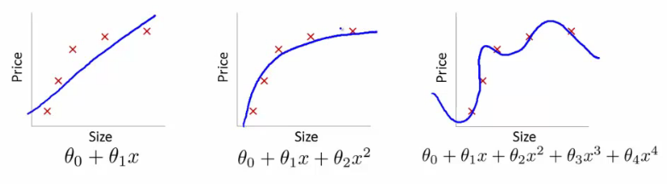
Overfitting and Underfitting

Slide 19
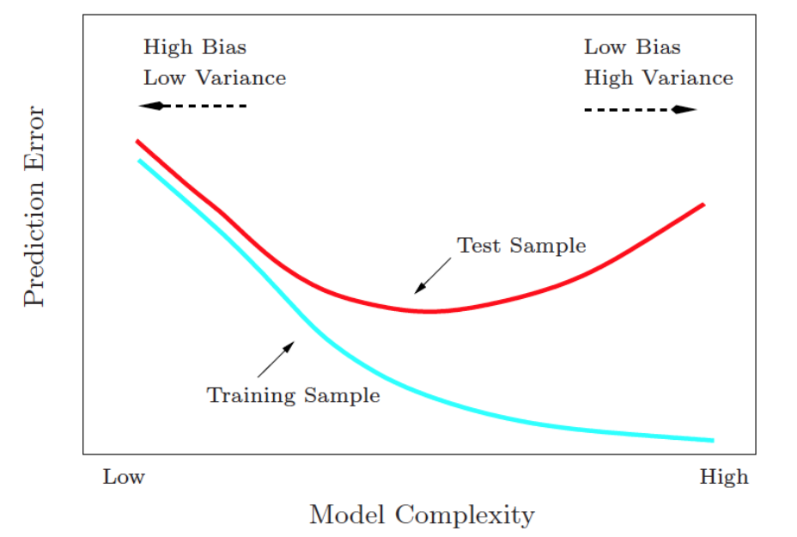
Bias-Variance Tradeoff

Slide 20
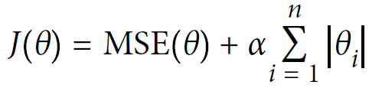
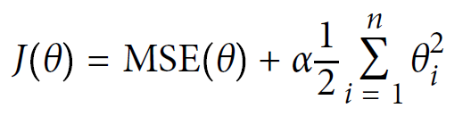
Regularization
How to ensure that we’re not overfitting to our training data?
Impose a small penalty on model complexity.
l1 penalty (Lasso Regression)
l2 penalty (Ridge Regression)

Slide 21
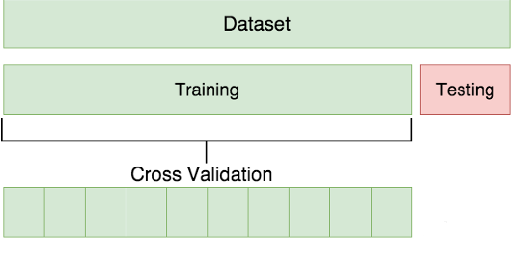
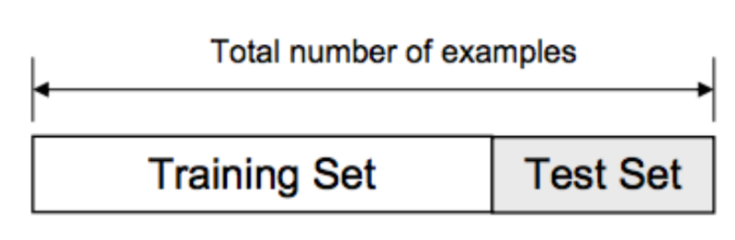
Testing and Validation

Slide 22
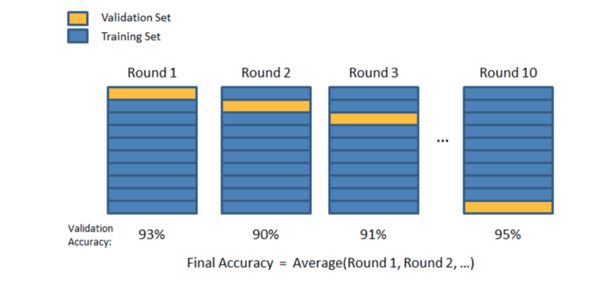
K-fold Cross Validation

Slide 23
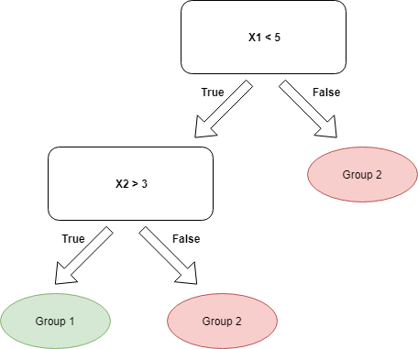
Decision Tree
Basic Idea
Construct a tree to ask a series of questions from your data.
Notes:
Using a set of observations to uncover an underlying process.
ML assumes that a pattern exists, but we cannot pin it down mathematically.
ML reverse engineers the process – start from data, find out what rules would be consistent with the data.
ML is a very broad subject – goes from very abstract theory to extreme practical i.e. rules of thumb
Stats vs ML
Underlying process is a probability distribution – observations are samples generated by that distribution.
Mathematical field – put assumption that you need to prove results in rigorous detail.
ML tries to make the least assumptions, cover the most territory – not a purely math/applied discipline, somewhere in the middle.
e.g. Linear Regression under statistics makes a lot of math/assumptions
If the particular set of assumptions takes you sufficiently far from the math in other disciplines – then you call it a different type.

Slide 24
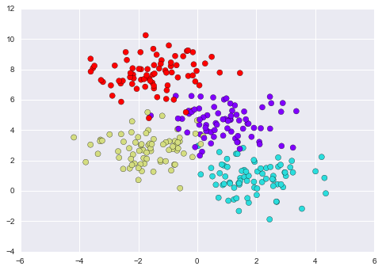
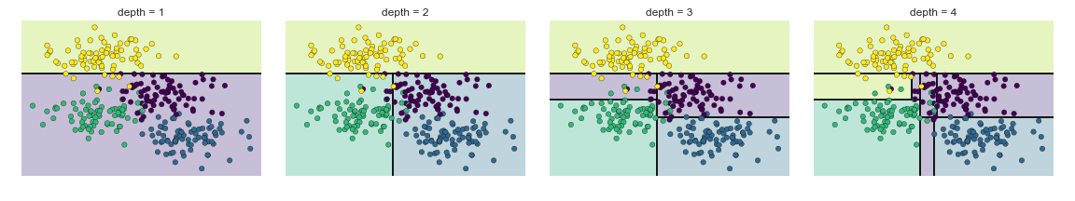
Decision Tree
Let’s see how it works on a real dataset.
Notes:
Using a set of observations to uncover an underlying process.
ML assumes that a pattern exists, but we cannot pin it down mathematically.
ML reverse engineers the process – start from data, find out what rules would be consistent with the data.
ML is a very broad subject – goes from very abstract theory to extreme practical i.e. rules of thumb
Stats vs ML
Underlying process is a probability distribution – observations are samples generated by that distribution.
Mathematical field – put assumption that you need to prove results in rigorous detail.
ML tries to make the least assumptions, cover the most territory – not a purely math/applied discipline, somewhere in the middle.
e.g. Linear Regression under statistics makes a lot of math/assumptions
If the particular set of assumptions takes you sufficiently far from the math in other disciplines – then you call it a different type.

Slide 25
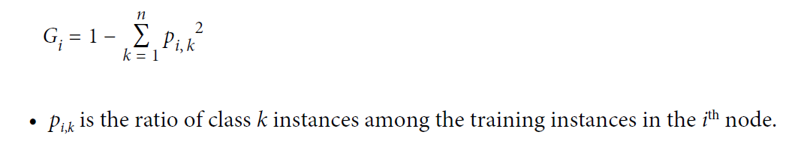
Decision Tree
How is the tree built?
Define a Cost Function that measures the impurity of a node.
A node is pure (impurity = 0) if all training instances it applies to belong to the same class.
One possible impurity measure is Gini:
Search for a feature and threshold that minimizes our Cost Function.
Gini scores of subsets thus produced are weighted by their size.
Greedy Algorithm – may not produce the optimum tree.
CART Algorithm. ID3 Algorithm for non-binary trees.
Notes:
Using a set of observations to uncover an underlying process.
ML assumes that a pattern exists, but we cannot pin it down mathematically.
ML reverse engineers the process – start from data, find out what rules would be consistent with the data.
ML is a very broad subject – goes from very abstract theory to extreme practical i.e. rules of thumb
Stats vs ML
Underlying process is a probability distribution – observations are samples generated by that distribution.
Mathematical field – put assumption that you need to prove results in rigorous detail.
ML tries to make the least assumptions, cover the most territory – not a purely math/applied discipline, somewhere in the middle.
e.g. Linear Regression under statistics makes a lot of math/assumptions
If the particular set of assumptions takes you sufficiently far from the math in other disciplines – then you call it a different type.

Slide 26
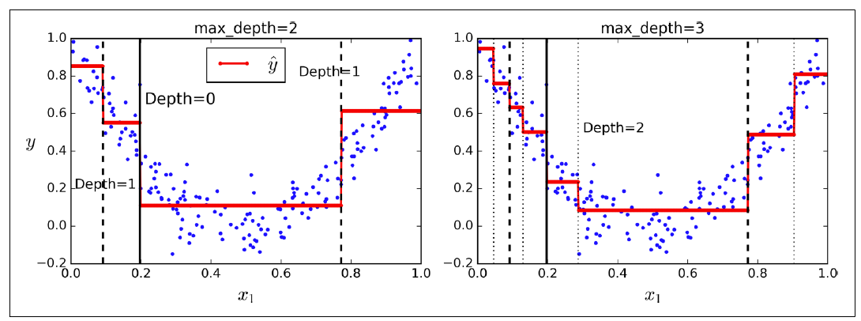
Decision Tree
Decision Trees can be used for regression!
Minimize MSE instead of impurity.
Notes:
Using a set of observations to uncover an underlying process.
ML assumes that a pattern exists, but we cannot pin it down mathematically.
ML reverse engineers the process – start from data, find out what rules would be consistent with the data.
ML is a very broad subject – goes from very abstract theory to extreme practical i.e. rules of thumb
Stats vs ML
Underlying process is a probability distribution – observations are samples generated by that distribution.
Mathematical field – put assumption that you need to prove results in rigorous detail.
ML tries to make the least assumptions, cover the most territory – not a purely math/applied discipline, somewhere in the middle.
e.g. Linear Regression under statistics makes a lot of math/assumptions
If the particular set of assumptions takes you sufficiently far from the math in other disciplines – then you call it a different type.

Slide 27
Decision Tree
Advantages
White Box – easily interpretable
Disadvantages
Prone to overfitting
Regularize by setting maximum depth
Comes up only with orthogonal boundaries
Sensitive to training set rotation – Use PCA!
Notes:
Using a set of observations to uncover an underlying process.
ML assumes that a pattern exists, but we cannot pin it down mathematically.
ML reverse engineers the process – start from data, find out what rules would be consistent with the data.
ML is a very broad subject – goes from very abstract theory to extreme practical i.e. rules of thumb
Stats vs ML
Underlying process is a probability distribution – observations are samples generated by that distribution.
Mathematical field – put assumption that you need to prove results in rigorous detail.
ML tries to make the least assumptions, cover the most territory – not a purely math/applied discipline, somewhere in the middle.
e.g. Linear Regression under statistics makes a lot of math/assumptions
If the particular set of assumptions takes you sufficiently far from the math in other disciplines – then you call it a different type.

Slide 28
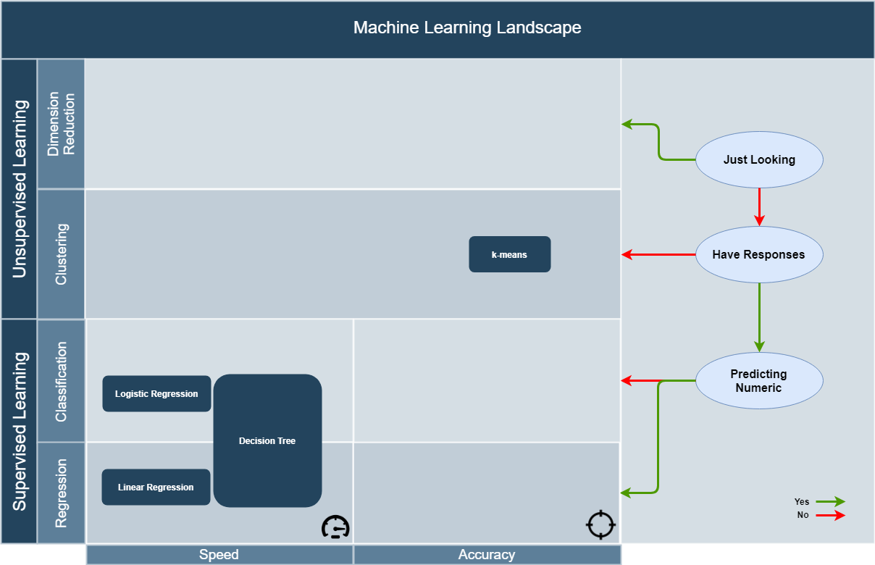
ML Landscape
Notes:
Situation not as bad as unsupervised learning
Game – propagate back the credit for winning/losing according to a sophisticated formula back to the move.

Slide 29
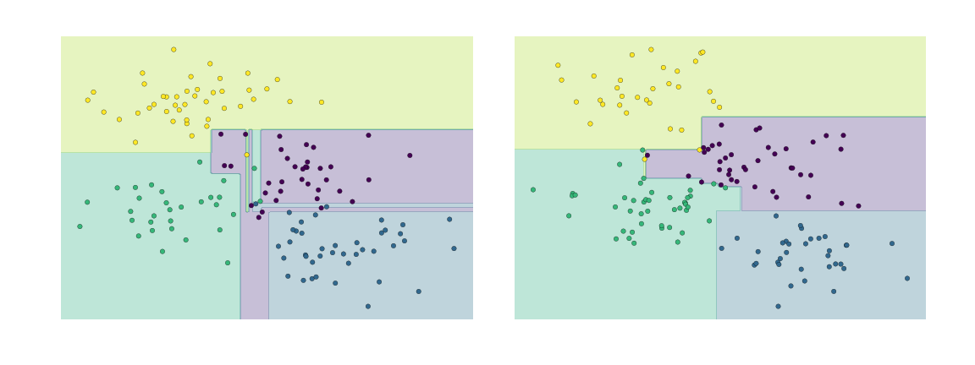
Ensemble Methods
Basic Idea
Two Decision Trees by themselves may overfit. But combining their predictions may be a good idea!
Notes:
Using a set of observations to uncover an underlying process.
ML assumes that a pattern exists, but we cannot pin it down mathematically.
ML reverse engineers the process – start from data, find out what rules would be consistent with the data.
ML is a very broad subject – goes from very abstract theory to extreme practical i.e. rules of thumb
Stats vs ML
Underlying process is a probability distribution – observations are samples generated by that distribution.
Mathematical field – put assumption that you need to prove results in rigorous detail.
ML tries to make the least assumptions, cover the most territory – not a purely math/applied discipline, somewhere in the middle.
e.g. Linear Regression under statistics makes a lot of math/assumptions
If the particular set of assumptions takes you sufficiently far from the math in other disciplines – then you call it a different type.

Slide 30
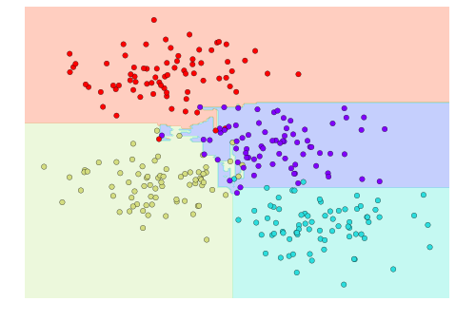
Ensemble Methods
Basic Idea
Two Decision Trees by themselves may overfit. But combining their predictions may be a good idea!
Notes:
Using a set of observations to uncover an underlying process.
ML assumes that a pattern exists, but we cannot pin it down mathematically.
ML reverse engineers the process – start from data, find out what rules would be consistent with the data.
ML is a very broad subject – goes from very abstract theory to extreme practical i.e. rules of thumb
Stats vs ML
Underlying process is a probability distribution – observations are samples generated by that distribution.
Mathematical field – put assumption that you need to prove results in rigorous detail.
ML tries to make the least assumptions, cover the most territory – not a purely math/applied discipline, somewhere in the middle.
e.g. Linear Regression under statistics makes a lot of math/assumptions
If the particular set of assumptions takes you sufficiently far from the math in other disciplines – then you call it a different type.

Slide 31
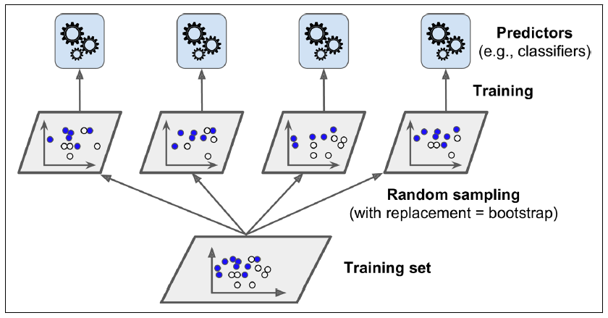
Bagging
Bagging = Bootstrap Aggregation
Use the same training algorithm for every predictor, but train them on different random subsets of the training set.
Random Forest is an Ensemble of Decision Trees, generally trained via the bagging method.
Notes:
Using a set of observations to uncover an underlying process.
ML assumes that a pattern exists, but we cannot pin it down mathematically.
ML reverse engineers the process – start from data, find out what rules would be consistent with the data.
ML is a very broad subject – goes from very abstract theory to extreme practical i.e. rules of thumb
Stats vs ML
Underlying process is a probability distribution – observations are samples generated by that distribution.
Mathematical field – put assumption that you need to prove results in rigorous detail.
ML tries to make the least assumptions, cover the most territory – not a purely math/applied discipline, somewhere in the middle.
e.g. Linear Regression under statistics makes a lot of math/assumptions
If the particular set of assumptions takes you sufficiently far from the math in other disciplines – then you call it a different type.

Slide 32
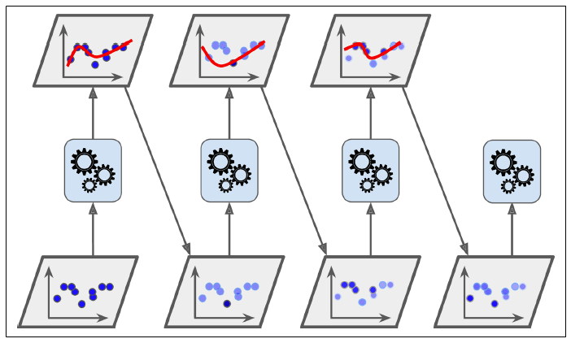
Boosting
Basic Idea
Train several weak learners sequentially, each trying to correct the errors made by its predecessor.
Adaptive Boosting (ADABoost)
Give more relative weight to the misclassified instances.
Notes:
Using a set of observations to uncover an underlying process.
ML assumes that a pattern exists, but we cannot pin it down mathematically.
ML reverse engineers the process – start from data, find out what rules would be consistent with the data.
ML is a very broad subject – goes from very abstract theory to extreme practical i.e. rules of thumb
Stats vs ML
Underlying process is a probability distribution – observations are samples generated by that distribution.
Mathematical field – put assumption that you need to prove results in rigorous detail.
ML tries to make the least assumptions, cover the most territory – not a purely math/applied discipline, somewhere in the middle.
e.g. Linear Regression under statistics makes a lot of math/assumptions
If the particular set of assumptions takes you sufficiently far from the math in other disciplines – then you call it a different type.

Slide 33
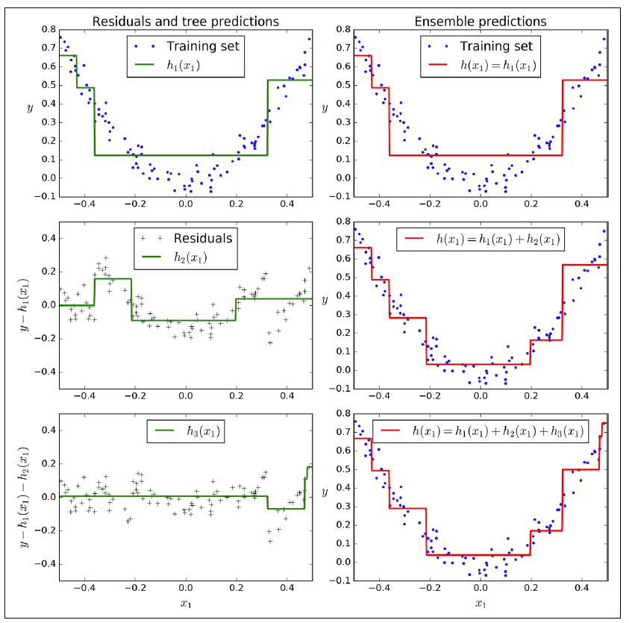
Boosting
Gradient Boosting
Try to fit a new predictor to the residual errors made by the previous predictor.
Best Performance
Random Forests and Gradient Boosting Methods (implemented in the xgBoost library) have been winning most competitions on Kaggle recently on structured data.
Deep Learning (especially Convolutional Networks) is the clear winner for unstructured data problems (perception/speech/vision etc.)
Notes:
Using a set of observations to uncover an underlying process.
ML assumes that a pattern exists, but we cannot pin it down mathematically.
ML reverse engineers the process – start from data, find out what rules would be consistent with the data.
ML is a very broad subject – goes from very abstract theory to extreme practical i.e. rules of thumb
Stats vs ML
Underlying process is a probability distribution – observations are samples generated by that distribution.
Mathematical field – put assumption that you need to prove results in rigorous detail.
ML tries to make the least assumptions, cover the most territory – not a purely math/applied discipline, somewhere in the middle.
e.g. Linear Regression under statistics makes a lot of math/assumptions
If the particular set of assumptions takes you sufficiently far from the math in other disciplines – then you call it a different type.

Slide 34
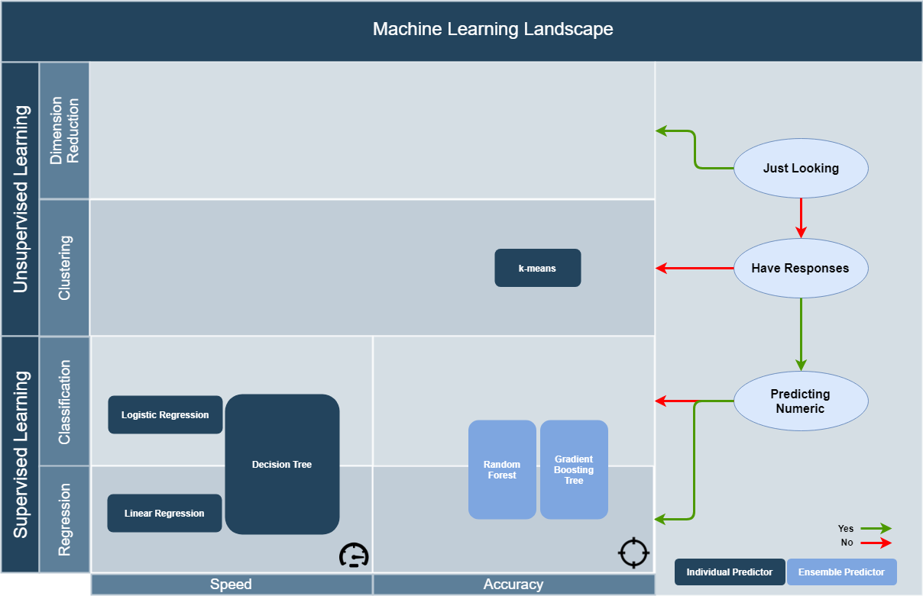
ML Landscape
Notes:
Situation not as bad as unsupervised learning
Game – propagate back the credit for winning/losing according to a sophisticated formula back to the move.

Slide 35
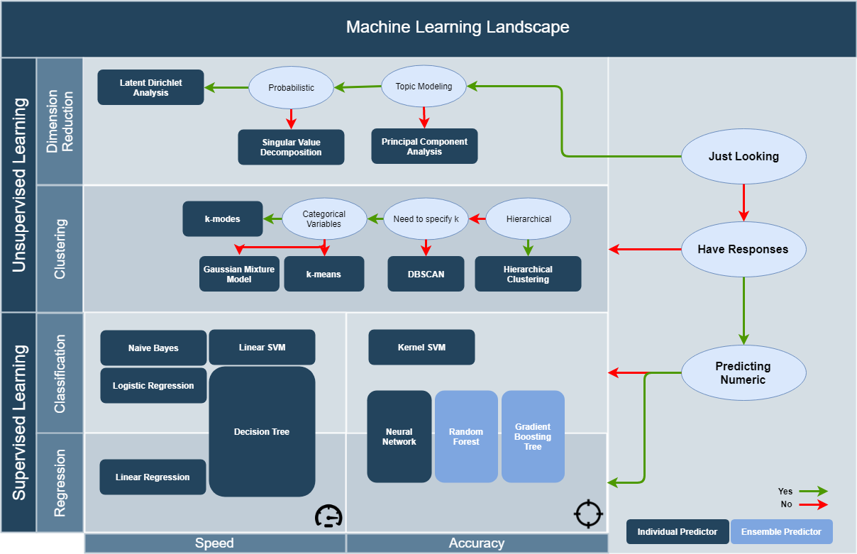
ML Landscape
Notes:
Situation not as bad as unsupervised learning
Game – propagate back the credit for winning/losing according to a sophisticated formula back to the move.

Slide 36
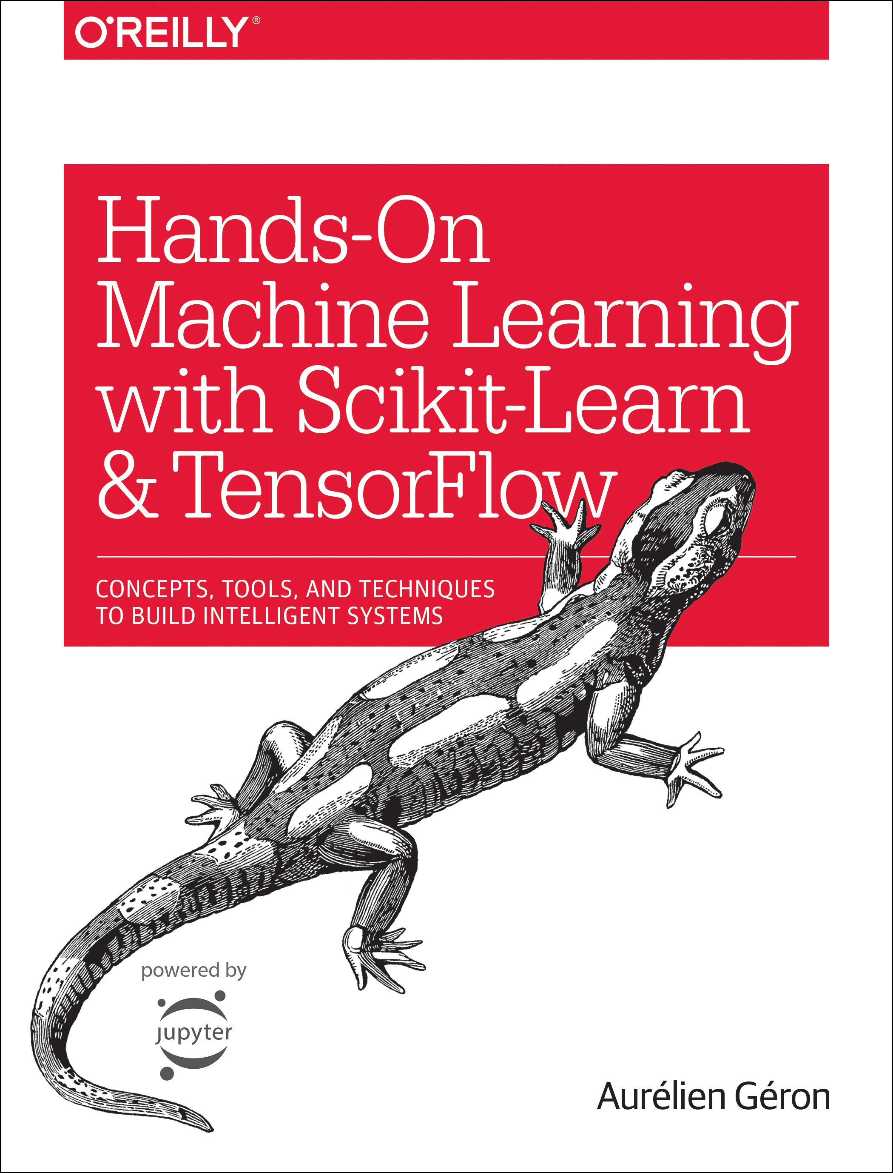
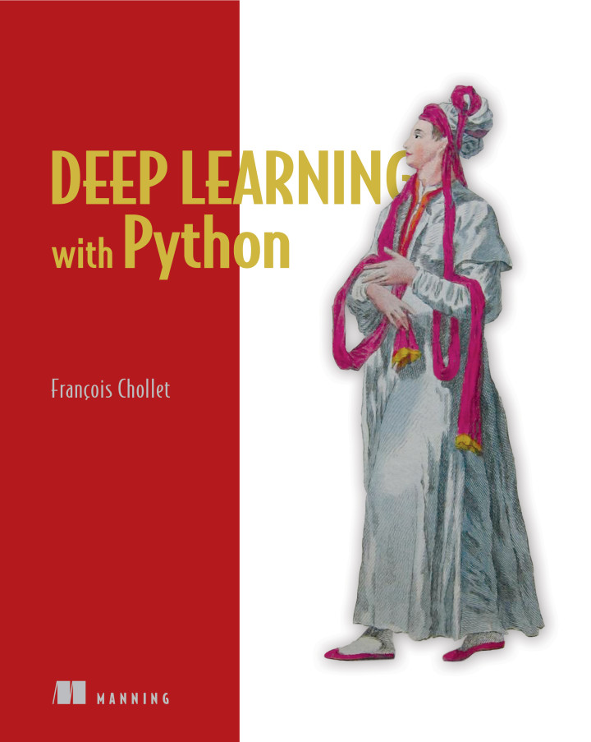
Where to go from here?

