Slide 1
CBEMD Parallelized Molecular Dynamics in Various Thermodynamic Ensembles
Nathan A. Mahynski, George A. Khoury, Carmeline J. Dsilva, Arun Prabhu, Francesco Ricci, Junyoung Park

Slide 2
Overview
Software package to perform parallelized Molecular Dynamics (MD)
Simulate motions at a microscopic level, relate to macroscopic properties
Diffusion coefficients, specific heats, chemical potentials
Evaluate properties that would be difficult to do experimentally
Applications to material science, pharmaceuticals, thermodynamics, fluid mechanics
Power is in its simplicity

Slide 3
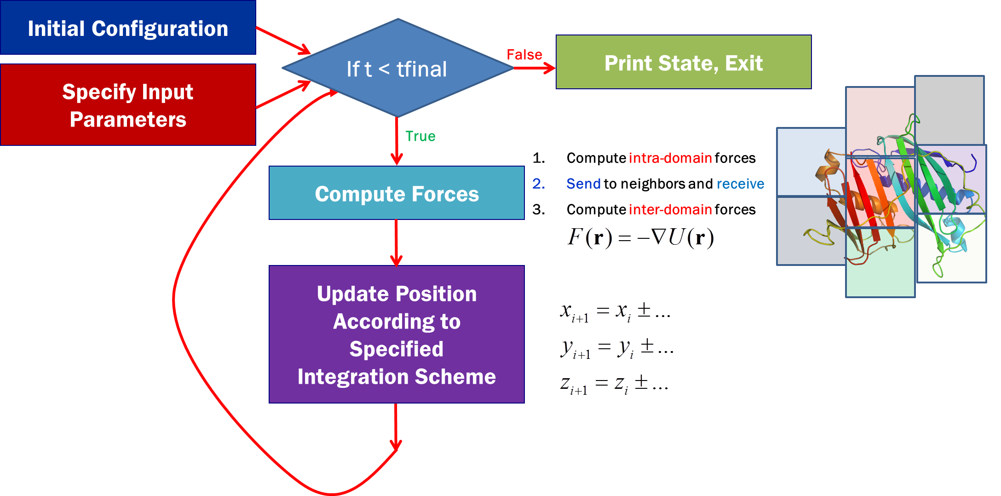
CBEMD Flowchart
Notes:
Figure 1: Visual representation of the ﬂow of the molecular dynamics program. First, the initial system
conﬁguration and other parameters of the simulation are provided, one of which is t final , the time for which
to run the simulation. For each integration step, the forces on each particle are calculated and used to update
the positions of the particles.

Slide 4
CBEMD Architectural Decisions
C++
Majority of code exploiting OOP, MPI parallelization,
Convenient libraries like boost
Googletests for testing main programs
Driver program
Python
“User-friendly” interface to setup and run simulations
SWIG to call C++ functions from Python
Python unittests to test interface

Slide 5
Features
Pair Potentials
Bond Potentials
Integrators (Ensembles)
NVE, NVT, NPT
Notes:
Before any programming is done, we will design an eﬃcient interface to facilitate group work. The general
components will consist of classes for the major components involved in MD including:

Slide 6
Features
Run for arbitrary length of time on an arbitrary number of processors.
Interface with VMD or other visualization programs that exist
Binary & XML
Force calculations will be able to be performed in parallel

Slide 7
Examples
class System {
public:
System();
~System();
int set_box (const double* new_box); //!< Set the global system box size
void set_T (const double T) {Temp_ = T;} //!< Set the system temperature
void set_P (const double P) {Press_ = P;} //!< Set the system pressure
int natoms () const {return atoms_.size();} //!< Return the number of atoms
int add_atom_type (const string atom_name); //!< Index an atom name
int add_bond_type (const string bond_name); //!< Index a bond name
int add_ppot_type (const string ppot_name); //!< Index a pair potential's name
double T() const {return Temp_;} //!< Report the temperature of the system
double P() const {return Press_;} //!< Report the pressure of the system
vector <double> box() const {return box_;} //!< Report system size
int add_atoms (Atom *new_atoms); //!< Add atom(s) to the system
int delete_atoms (const vector <int> indices); //!< Pop atoms with local indices from local storage
inline Potential* ppot (const int type1, const int type2) const {return pmatrix_[type1][type2];}
inline Potential* ppot (const Atom* a1, const Atom* a2) const {return pmatrix_[a1->type][a2->type];}
private:
…
};

Slide 8
Examples
struct Atom {
double pos[3]; //!< Cartesian coordinates
double vel[3]; //!< Cartesian velocities
double force[3]; //!< Cartesian force, (fx, fy, fz)
double mass; //!< Atomic mass (in reduced units)
double diam; //!< Atomic diameter (in reduced units)
int type; //!< Internally indexed type of this atom
int sys_index; //!< Global atom index, i.e. unique in the system
int nbonds; //!< Number of bonds the atom has
int bonds[MAX_BONDS]; //!< Global indices of bonds, fixed size for MPI passing
};
void create_MPI_ATOM () {
int num_types = 2;
MPI_Datatype oldtypes[num_types];
MPI_Aint offsets[num_types], extent;
int blockcounts[num_types];
MPI_Type_extent (MPI_DOUBLE, &extent);
offsets[0] = 0;
blockcounts[0] = 11;
oldtypes[0] = MPI_DOUBLE;
offsets[1] = (11*extent);
blockcounts[1] = (3+MAX_BONDS);
oldtypes[1] = MPI_INT;
MPI_Type_struct (num_types, blockcounts, offsets, oldtypes, &MPI_ATOM);
MPI_Type_commit (&MPI_ATOM);
}

Slide 9
Questions?
?++

