Slide 1
CBEMD Parallelized Molecular Dynamics in Various Thermodynamic Ensembles
Nathan A. Mahynski, George A. Khoury, Carmeline J. Dsilva, Arun Prabhu, Francesco Ricci, Junyoung Park
and the Ghost of Christmas Past

Slide 2
Overview
Software package to perform parallelized Molecular Dynamics (MD)
Simulate motions at a microscopic level, relate to macroscopic properties
Diffusion coefficients, specific heats, chemical potentials
Evaluate properties that would be difficult to do at more extreme experimental conditions
Applications to material science, pharmaceuticals, thermodynamics, fluid mechanics
Power is in its simplicity

Slide 3
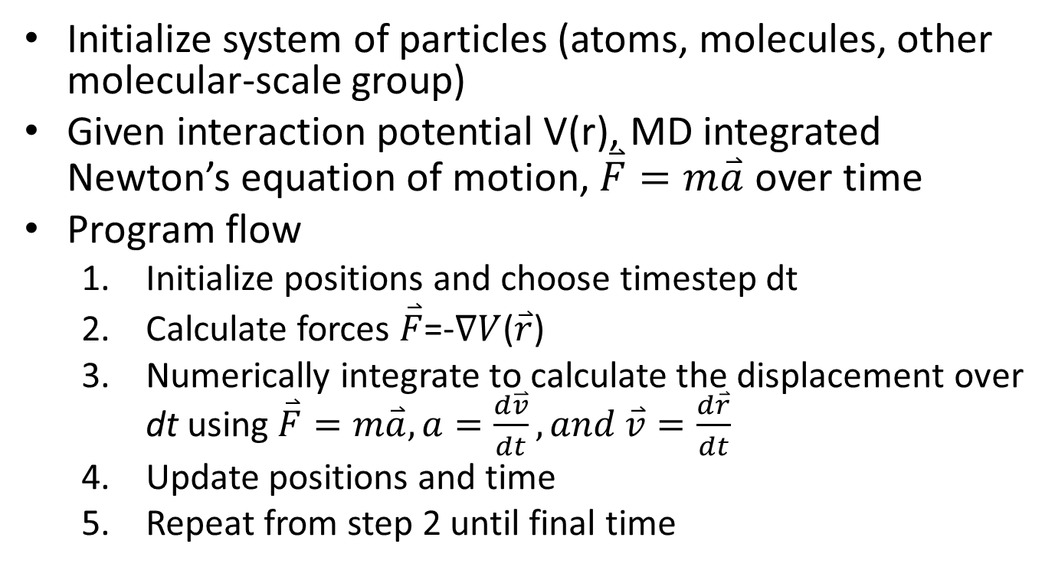
Background on MD
Initialize system of particles (atoms, molecules, other molecular-scale group)
Given interaction potential V(r), MD integrated Newton’s equation of motion, $\overset{⃑}{F}=m\overset{⃑}{a}$ over time
Program flow
Initialize positions and choose timestep dt
Calculate forces $\overset{⃑}{F}$=-$∇V$($\overset{⃑}{r}$)
Numerically integrate to calculate the displacement over dt using $\overset{⃑}{F}=m\overset{⃑}{a}, a=\frac{d\overset{⃑}{v}}{dt}, and \overset{⃑}{v}=\frac{d\overset{⃑}{r}}{dt}$
Update positions and time
Repeat from step 2 until final time

Slide 4
Background on MD
Users need to provide
Initial configuration (coordinates and velocities) of particles
Choice of relevant potential function
Van der Waals, electrostatics
Timestep ~ femtosecond and simulation length

Slide 5
Ensembles in MD
NVE: (Microcanonical) Constant Energy (E), Volume (V), and number of particles (N)
NVT (Canonical)
Constant Temperature (T)
NPT (isothermal-isobaric)
Constant Pressure (P)
Most similar to experimental conditions

Slide 6
MD Packages that Exist
HOOMD
LAMMPS
GROMACS
NAMD
CHARMM
AMBER

Slide 7
CBEMD Architectural Decisions
C++
Majority of code exploiting OOP, MPI parallelization,
Linked to boost to handle string manipulation features for data parsing
Googletests for testing main programs
Driver program
Python
“User-friendly” interface to setup and run simulations
SWIG to call C++ functions from Python
Python unittests to test interface

Slide 8
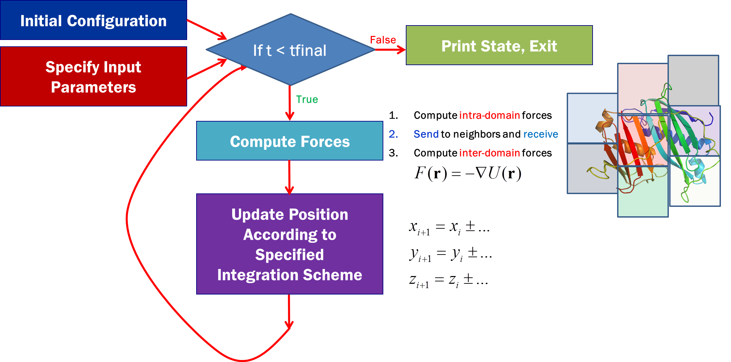
CBEMD Flowchart
Notes:
Figure 1: Visual representation of the ﬂow of the molecular dynamics program. First, the initial system
conﬁguration and other parameters of the simulation are provided, one of which is t final , the time for which
to run the simulation. For each integration step, the forces on each particle are calculated and used to update
the positions of the particles.

Slide 9
An Efficient Interface to Facilitate Groupwork
System
Class will contain all pertinent information about the simulation box such as temperature, pressure and box dimensions
Class will also store information about atoms and bonds
When using MPI, the simulation box will be decomposed into “subsystems,” each of which exists on a unique processor
Notes:
Before any programming is done, we will design an eﬃcient interface to facilitate group work. The general
components will consist of classes for the major components involved in MD including:

Slide 10
An Efficient Interface to Facilitate Groupwork
Atom
This will be a structure, i.e. no functions will be stored in this class
This is the main “workhorse” of the program
will need to be passed repeatedly between processors to communicate requisite information for the integration step
Will only store critical information and base data types easily passed through MPI
Positions, velocities, and particle types that are necessary for the force calculations
Notes:
Before any programming is done, we will design an eﬃcient interface to facilitate group work. The general
components will consist of classes for the major components involved in MD including:

Slide 11
An Efficient Interface to Facilitate Groupwork
Bond
Largest complication in MD, because global indices must be tracked to manage what atoms are bonded to each other (since atoms participating in a bond may exist on diﬀerent processors)
Abstract base class which allows users to deﬁne diﬀerent types easily, requiring only that each deﬁned type have an energy and force calculation
Parameters involved in a bond “type” will be set by the user and available on all processors at all times so such information need not be passed; the only information necessary to compute bonding contributions an array of bonded pairs of atoms and their “type.”
The bond type is an internally indexed quantity that is hidden from the user, and is accessed by a name (string)
Notes:
Before any programming is done, we will design an eﬃcient interface to facilitate group work. The general
components will consist of classes for the major components involved in MD including:

Slide 12
An Efficient Interface to Facilitate Groupwork
Integrator
Many integrators exist corresponding to different ensembles
Abstract base class, allowing the user to expand on what we develop and add new integrators in the future
We plan to implement integrators for the microcanonical (NVE), canonical (NVT), and isothermal-isobaric ensemble (NPT). For the NVE ensemble
Integrators include Verlet, Velocity Verlet, and the Leapfrog algorithm.
Thermostats and barostats (required for the NVT and NPT ensembles) include Nose-Hoover and Anderson.
Notes:
Before any programming is done, we will design an eﬃcient interface to facilitate group work. The general
components will consist of classes for the major components involved in MD including:

Slide 13
An Efficient Interface to Facilitate Groupwork
Pair Potentials
This class deﬁnes the interaction potential V between particles. As it is the most common, we will provide a shifted Lennard-Jones pair potential
Users can easily add additional pair potentials.
Notes:
Before any programming is done, we will design an eﬃcient interface to facilitate group work. The general
components will consist of classes for the major components involved in MD including:

Slide 14
Code Features
The program should be able to easily be extended to use arbitrary interparticle potentials as long as they conform to the abstract base class. As an example, we will use Lennard-Jones
The MD program should be able to print out binary ﬁles that can be visualized using VMD or other visualization programs that exist, as well as xml snapshots

Slide 15
Code Features
The MD program should be able to stably run for an arbitrary length of time on an arbitrary number of processors. The MD program should be able to print out binary ﬁles that can be visualized using VMD or other visualization programs that exist, as well as xml snapshots
Force calculations will be able to be performed in parallel

Slide 16
Code Features
The MD program should able to be started using two mechanisms. First, through reading an xml-based input ﬁle, or by using a python script with an easily usable user interface
The MD program should write a checkpoint ﬁle after every so many iterations so that a simulation can pick up where it left oﬀ in case of power failure, system failure, or running out of walltime
The ﬁnal version should be able to handle bonds of an arbitrary nature as long as they conform to the bond abstract base class. Because of this feature, our MD code can be extended to arbitrarily complex molecules

Slide 17
Questions?
?++

