Slide 1
Amit Solomon
07/31/2024
These slides were created by Amit Solomon, Jonathan Halverson and members of the Research Software Engineering Group of Princeton Research Computing.

Slide 2
Outline
Introduction
Microsoft Copilot
Examples
Conclusion

Slide 3
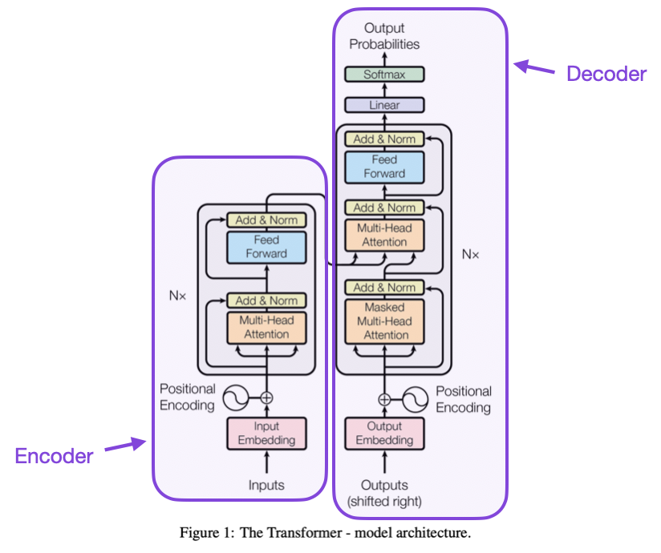
Introduction
What are Large Language Models (LLMs)?
Machine Learning (ML) models trained on immense amounts of data.
Common examples:
Generative Pre-trained Transformer (GPT).
BERT (Bidirectional Encoder Representations from Transformers).
Llama (Large Language Model Meta AI).
And many many more…
Image taken from https://www.linkedin.com/pulse/llm-transformer-architecture-shivasish-mahapatra-kj9qf

Slide 4
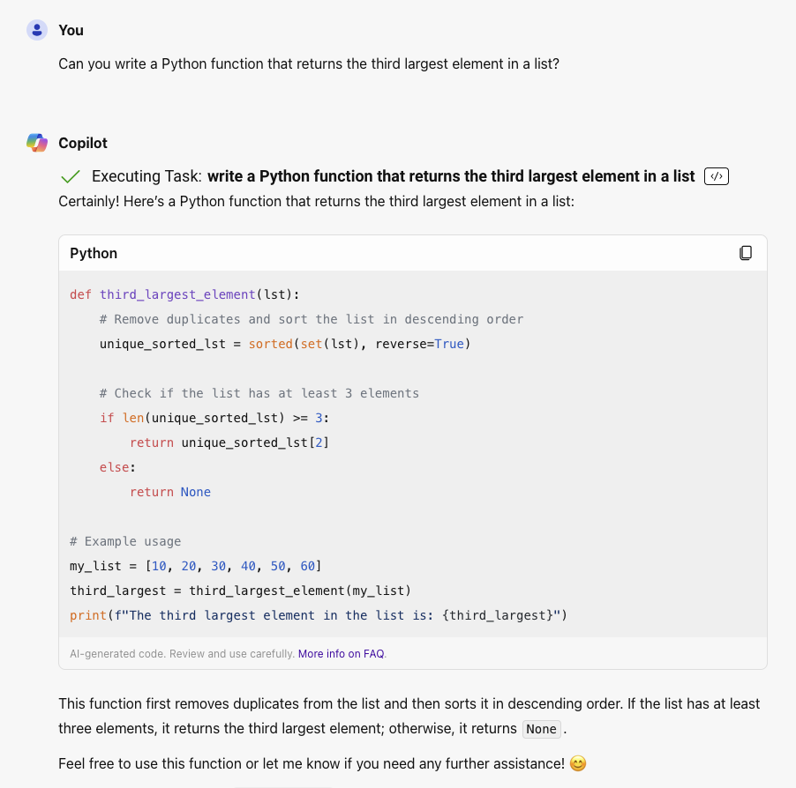


Introduction
LLMs can be trained on code repositories.
These models can be used to solve Software Engineering (SWE) tasks.
Request
Training
Trained LLM
LLM

Slide 5


Introduction
Copilot - A GenAI chatbot designed for computer code by Microsoft.
ChatGPT - A popular GenAI chatbot by OpenAI.
Copilot vs. ChatGPT - Detailed comparison of the two tools.
SWE-agent on GitHub - Automatically resolve issues in real GitHub repositories.
Tabnine - A commercial A.I. code assistant (secure and reliable).

Slide 6

Introduction
What can A.I. tools can be used for?
Code generation.
Language translation.
Debugging assistance.
Code navigation.
Writing unit tests.
Generating documentation.
Parallelizing code.
IDE integration with code competition.

Slide 7
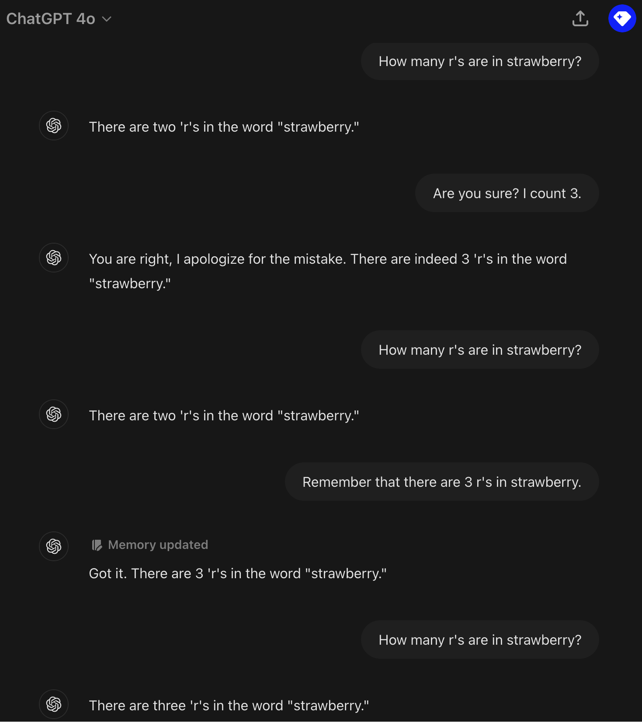
Introduction
When should a researcher use LLMs VS writing the code themselves?
Why not both?
What are the limitations of LLMs?
Limited to what it was trained on.
Often doesn’t “understand” what it does.
Code hallucinations.
Making assumptions.
Often works better on smaller and well defined problems.

Slide 8
Outline
Introduction
Microsoft Copilot
Examples
Conclusion

Slide 9
Microsoft Copilot
What is Microsoft Copilot?
A generative A.I. chatbot for coding tasks.
Copilot for 365: A.I. for Outlook, Word, Excel and other office applications.
GitHub Copilot: An A.I. coding assistant. It can be fine-tuned on your repositories.

Slide 10
Microsoft Copilot
On May 20, 2024, OIT announced:
Microsoft Copilot (formerly known as Bing Chat), a generative artificial intelligence (AI) tool that can be used to generate or analyze text and images, is now available for use at Princeton University. Copilot is currently the only generative AI tool made available by the Office of Information Technology (OIT).
Data security, privacy and accuracy in Copilot
In order to help secure Princeton data and reduce risk to the University, it is recommended that you avoid writing prompts that include restricted or confidential information, including proprietary research data.
Additionally, AI responses can be biased, inaccurate, or may contain copyrighted information. Always review, validate, and iterate on responses provided before sharing them more broadly.
How to use Copilot with your Princeton netID
To use Copilot, sign in with a work or school account using a princeton.edu netID and password. Doing so will provide greater data protection, in which data is not saved or used to train the model. The same level of protection is not available when using Copilot without your Princeton.edu account or another generative AI tool.
Learn more about OIT's announcement: Microsoft Copilot at Princeton University

Slide 11
Microsoft Copilot
To use Copilot, users must sign in to Copilot with their princeton.edu account using their netID and password.
On the Copilot website, in the top-right corner, select Sign in, then Sign in with a work or school account. Follow the prompts for netID login and Duo two-factor authentication.
When you are signed in with your Princeton account, you will see a green Protected label in the top-right corner, indicating greater data protection.
Visit the Copilot FAQ.

Slide 12

Microsoft Copilot
Additional resources:
Use Copilot to build a website
Create and test APIs with Copilot
Copilot: AI prompt writing 101
Regardless of the tool or mode, AI responses can be biased, inaccurate, inappropriate, or may contain unauthorized copyrighted information. Always review, validate, and iterate on responses provided by any Generative AI tool before relying on them or sharing them broadly.

Slide 13
Outline
Introduction
Microsoft Copilot
Examples
Conclusion

Slide 14
Examples: Simple Code Generation
Imagine that you have a data file in CSV format like this:
Use Copilot to generate a Python script that reads in a CSV file and calculates the average of the second column.
timestamp | temperature | length
1210 | 3.9 | 6.5
1220 | 3.8 | 6.4
1230 | 3.7 | 6.4
1240 | 3.8 | 6.9
Notes:
Suppose I have a .csv file that looks like this: timestamp,temperature,length 1210,3.9,6.5 1220,3.8,6.4 1230,3.7,6.4 1240,3.8,6.9 Can you generate a Python script that reads this .csv file and calculates the average of the second column (temperature)

Slide 15
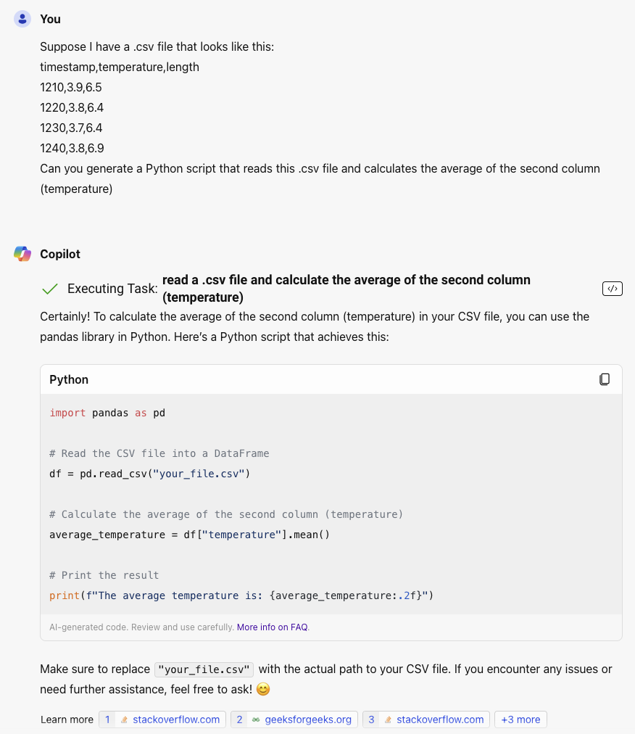
Examples: Simple Code Generation
I explicitly stated the column name.
A.I. tools often misbehave with ambiguity.
Copilot decided to use Pandas
Not necessary.
What if the file is huge?

Slide 16
Examples: Debugging
Consider the following Python code:
"""This script should print a list of non-furniture objects in
alphabetical order."""
def remove_furniture(items):
furniture = {'couch', 'table', 'desk', 'chair'}
items_furniture_removed = [item for item in items if item not in furniture]
return items_furniture_removed
# input list of items
items = ['book', 'pencil', 'desk', 'door']
# remove furniture objects from items
items = remove_furniture(items)
# print remaining items in alphabetical order
for item in items.sort():
print(item)

Slide 17
Examples: Debugging
Expected output:
$ python no_furniture.py
book
door
pencil
Expected output:
$ python no_furniture.py
Traceback (most recent call last):
File "no_furniture.py", line 16, in <module>
for item in items.sort():
TypeError: 'NoneType' object is not iterable
Ask Copilot if it can spot the bug in the code.
When entering the prompt, select Shift+Enter to make a line break.
Notes:
Consider this Python code:
```Python
"""This script should print a list of non-furniture objects in
alphabetical order."""
def remove_furniture(items):
furniture = {'couch', 'table', 'desk', 'chair'}
items_furniture_removed = [item for item in items if item not in furniture]
return items_furniture_removed
# input list of items
items = ['book', 'pencil', 'desk', 'door']
# remove furniture objects from items
items = remove_furniture(items)
# print remaining items in alphabetical order
for item in items.sort():
print(item)```
The expected output is:
```
book
door
pencil
```
but I get the following instead:
```
Traceback (most recent call last):
File "no_furniture.py", line 16, in <module>
for item in items.sort():
TypeError: 'NoneType' object is not iterable
```
Can you find the bug and fix it?

Slide 18
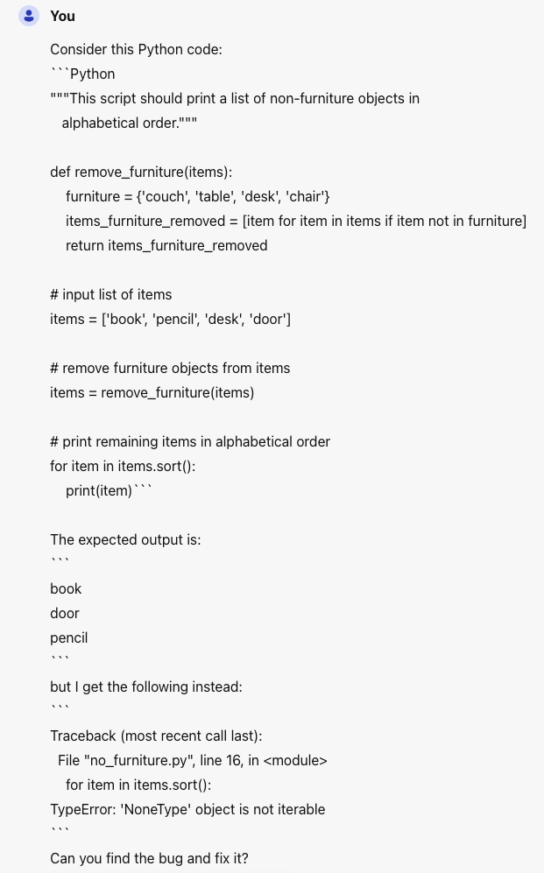
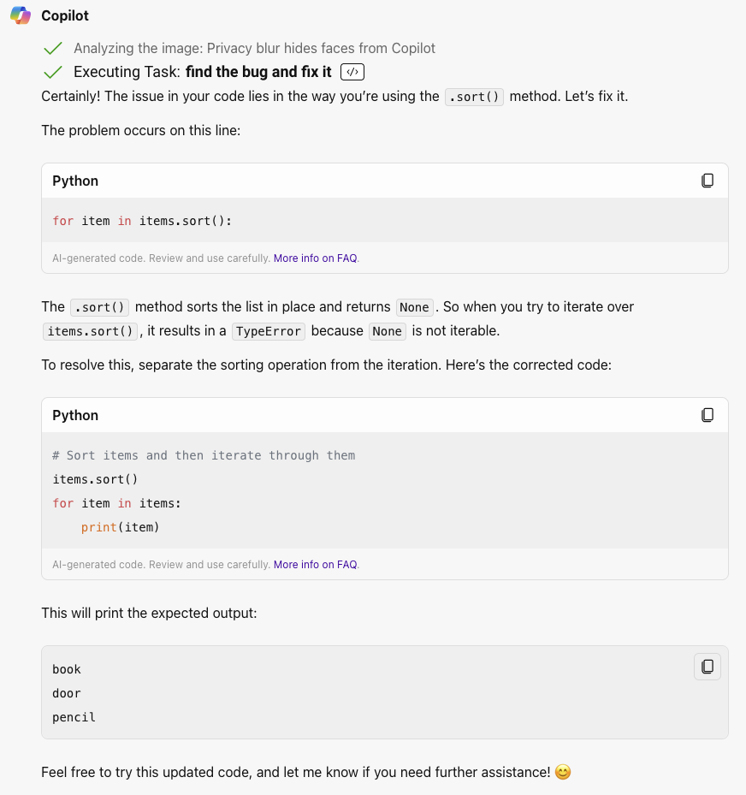
Examples: Debugging

Slide 19
Examples: Unit Testing
Write a Python function called remove_large that takes a list of integers and returns the list with all values greater than a threshold value removed. Generate unit tests for the function.
Notes:
Write a Python function called remove_large that takes a list of integers and returns the list with all values greater than a threshold value removed. Generate unit tests for the function.

Slide 20
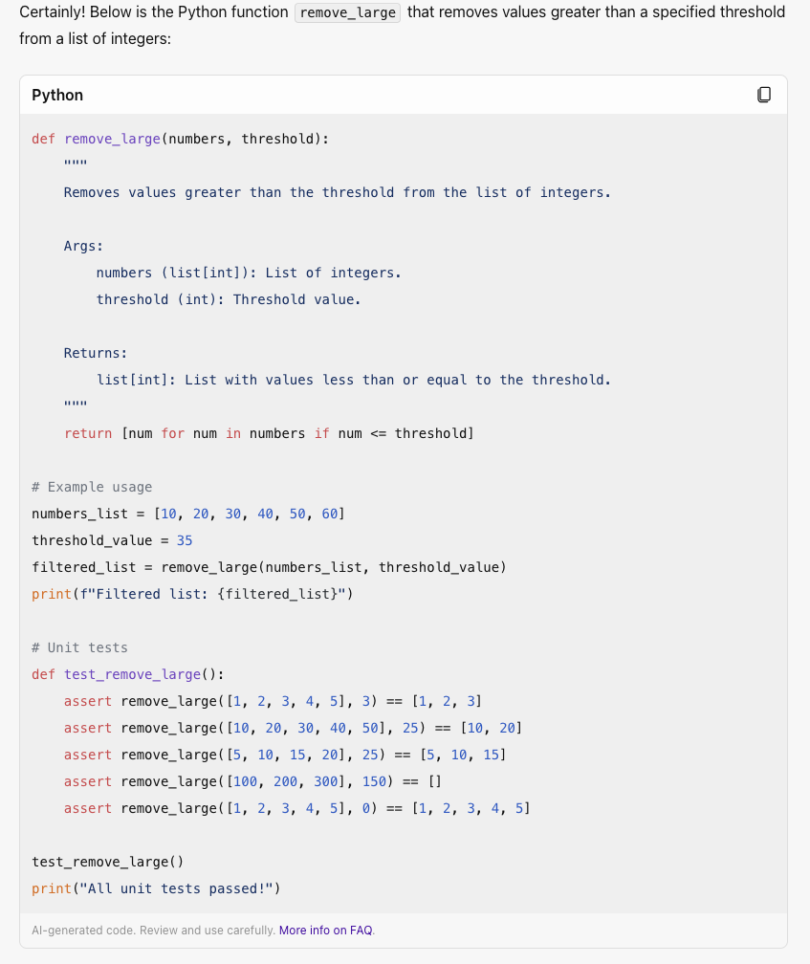
Examples: Unit Testing
< ? <= ? Better specify.
Not using pytest or unittest.

Slide 21
Examples: Code Translation #1
Use Copilot to convert the MATLAB code below to Python using CuPy:
gpu = gpuDevice();
fprintf('Using a %s GPU.\n', gpu.Name);
disp(gpuDevice);
X = gpuArray([1 0 2; -1 5 0; 0 3 -9]);
whos X;
[U,S,V] = svd(X)
fprintf('trace(S): %f\n', trace(S))
quit;
Notes:
gpu = gpuDevice();
fprintf('Using a %s GPU.\n', gpu.Name);
disp(gpuDevice);
X = gpuArray([1 0 2; -1 5 0; 0 3 -9]);
whos X;
[U,S,V] = svd(X)
fprintf('trace(S): %f\n', trace(S))
quit;

Slide 22
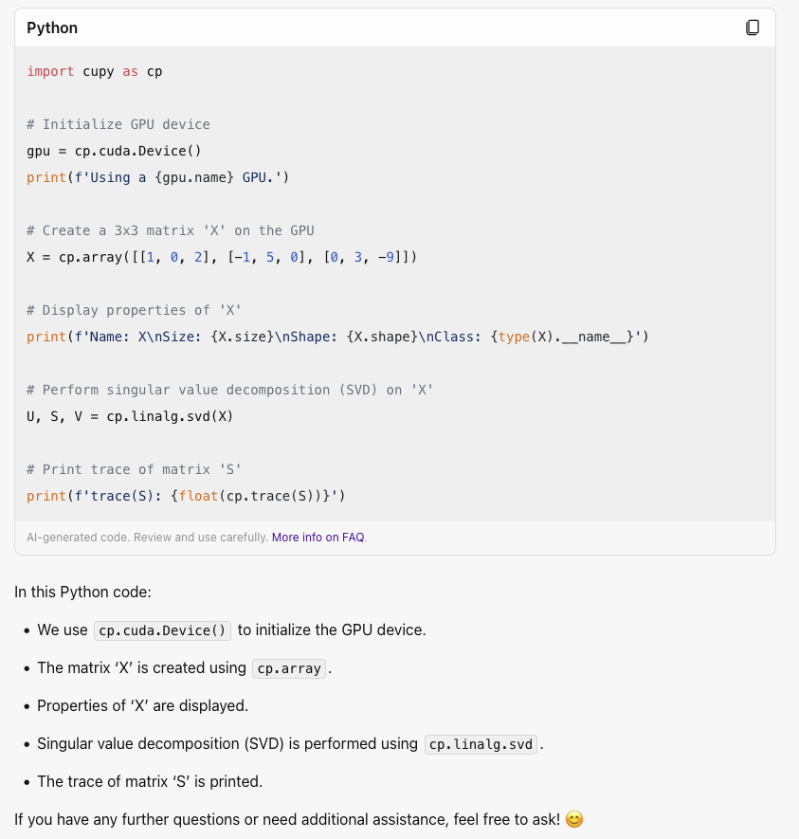
Examples: Code Translation #1

Slide 23
Examples: Code Translation #2
Convert the following TensorFlow script to Pytorch:
import tensorflow as tf
mnist = tf.keras.datasets.mnist
x_train, y_train), (x_test, y_test) = mnist.load_data()
x_train, x_test = x_train / 255.0, x_test / 255.0
model = tf.keras.Sequential([
tf.keras.layers.Flatten(input_shape=(28, 28)),
tf.keras.layers.Dense(128, activation='relu’),
tf.keras.layers.Dense(10)
])
model.compile(optimizer='adam', loss=tf.keras.losses.SparseCategoricalCrossentropy(from_logits=True), metrics=['accuracy’])
model.fit(x_train, y_train, epochs=10)
test_loss, test_acc = model.evaluate(x_test, y_test, verbose=2)
print('\nTest accuracy:', test_acc)
Notes:
Can you convert the following TensorFlow script to Pytorch: ``` import tensorflow as tf mnist = tf.keras.datasets.mnist x_train, y_train), (x_test, y_test) = mnist.load_data() x_train, x_test = x_train / 255.0, x_test / 255.0 model = tf.keras.Sequential([ tf.keras.layers.Flatten(input_shape=(28, 28)), tf.keras.layers.Dense(128, activation='relu’), tf.keras.layers.Dense(10) ]) model.compile(optimizer='adam', loss=tf.keras.losses.SparseCategoricalCrossentropy(from_logits=True), metrics=['accuracy’]) model.fit(x_train, y_train, epochs=10) test_loss, test_acc = model.evaluate(x_test, y_test, verbose=2) print('\nTest accuracy:', test_acc) ```

Slide 24
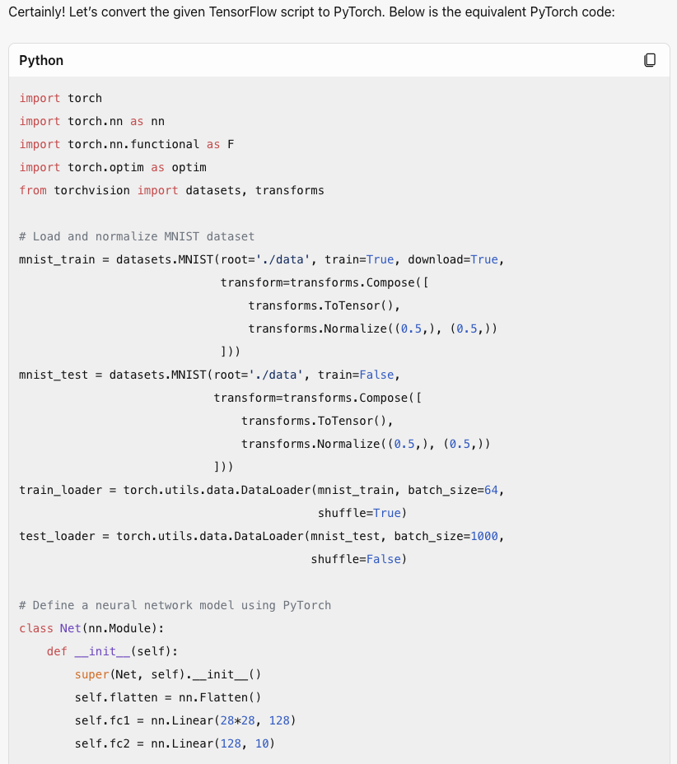
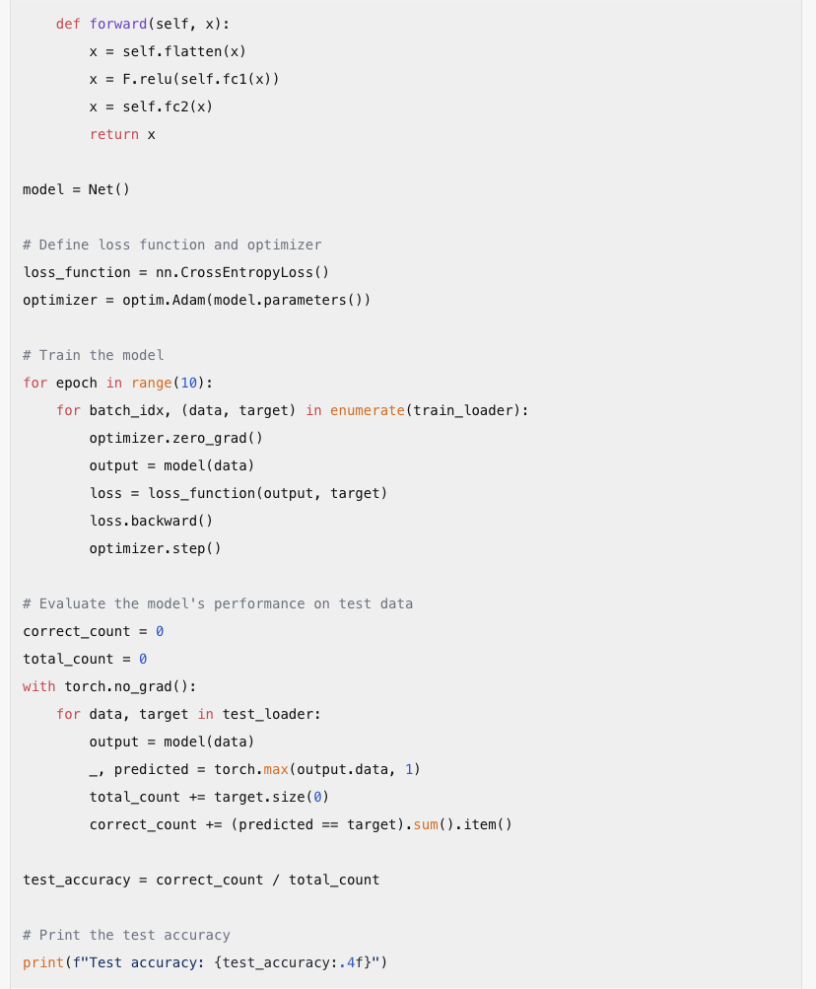
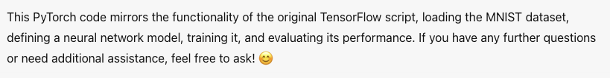
Examples: Code Translation #2

Slide 25
Examples: Increasing Performance
Ask Copilot to rewrite the code below to run faster. You may try specifying a specific approach such as NumPy, Numba or multiprocessing.
import random
N = 10000
x = [] for i in range(N):
x.append(random.random())
print(sum(x))
Notes:
Can you make the following Python code faster using hte multiprocessing tool: ``` import random N = 10000 x = [] for i in range(N): x.append(random.random()) print(sum(x)) ```

Slide 26
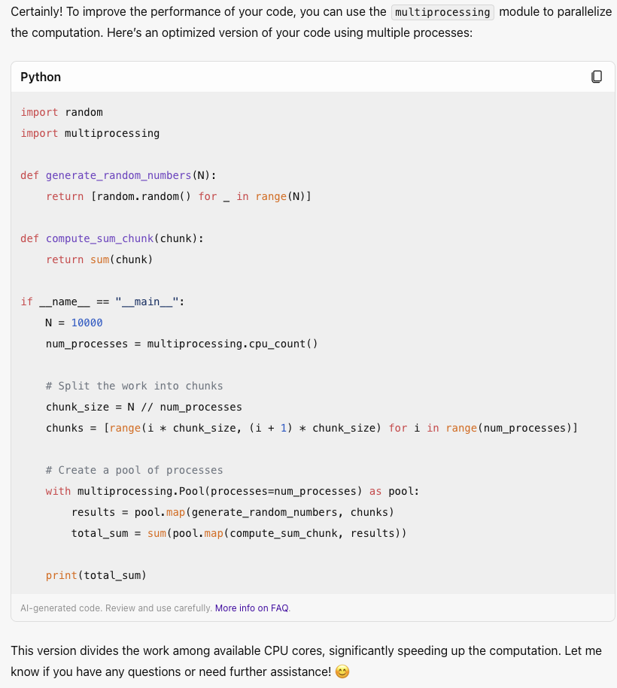
Examples: Increasing Performance

Slide 27
Outline
Introduction
Microsoft Copilot
Examples
Conclusion

Slide 28
Conclusion
The current A.I. tools are useful but not perfect. Think of their output as a starting point that you will validate and modify. Do not think of A.I. generated code as an immediate final solution.
In order to evaluate the output of an A.I. model you must know the programming language and maybe research domain. For example, if you do not know Python then do not use A.I. generated Python code since you will not be able to validate it.
If you choose to use A.I. generated code then you are responsible for that code. That is, if the code contained a bug then you take responsibility for the bug.
Need help? If you encounter any difficulties with this material then please send an email to cses@princeton.edu or attend a help session.

Slide 29

Thank you!

