Slide 1
Back-Projection on GPU: Improving the Performance
Wenlay “Esther” Wei
Advisor: Jeff Fessler
Mentor: Yong Long
April 29, 2010

Slide 2
Overview
CPU vs. GPU
Original CUDA Program
Strategy 1: Parallelization Along Z-Axis
Strategy 2: Projection View Data in Shared Memory
Strategy 3: Reconstructing Each Voxel in Parallel
Strategy 4: Shared Memory Integration Between Two Kernels
Strategies Not Used
Conclusion

Slide 3
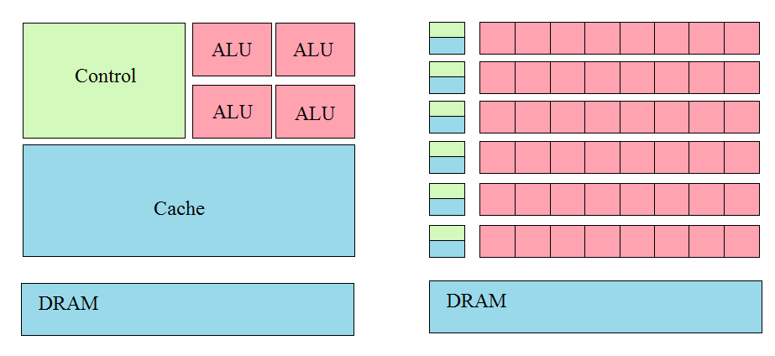
CPUs vs. GPUs
CPUs are optimized for sequential performance
Sophisticated control logic
Large cache memory
GPUs are optimized for parallel performance
Large number of execution threads
Minimal control logic required
Most applications use both GPU and CPU
CUDA

Slide 4
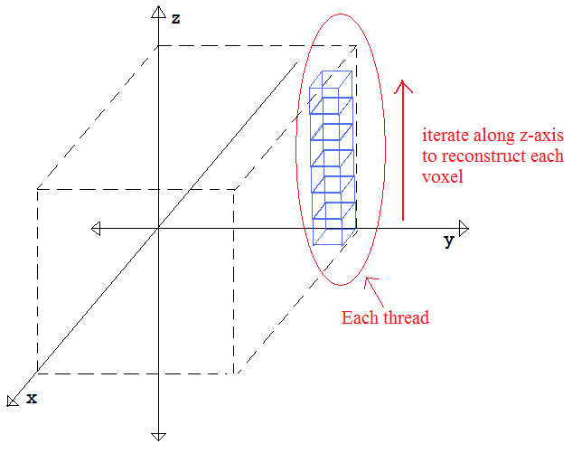
Original CUDA Program
Back-projection of FDK cone-beam image reconstruction algorithm on GPU
One kernel of nx-by-ny
Each thread reconstructs one “bar” of voxels with the same (x,y) coordinates
The kernel is executed for each projection view
Back-projection result is added onto the image
2.2x speed-up for 128x124x120-voxel
image
My goal is to accelerate this algorithm
Notes:
Because voxels with the same (x,y) coordinates share a lot of same computations such as s-indices on detector

Slide 5
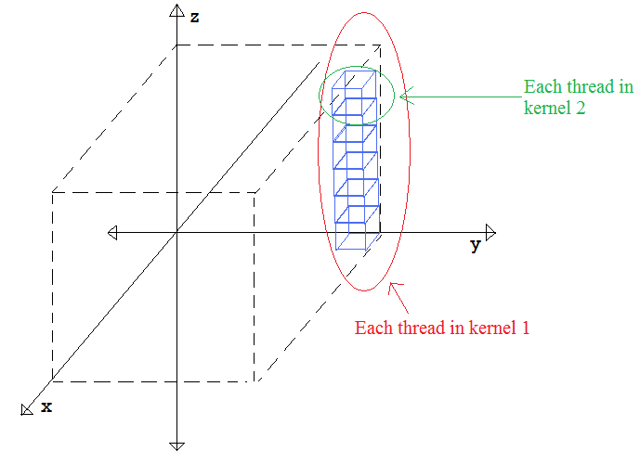
Strategy 1: Parallelization Along Z-Axis
Eliminates sequential components
Avoids repeating the computations
Additional kernel is needed
Parameters that shared between two kernels are stored in global memory

Slide 6
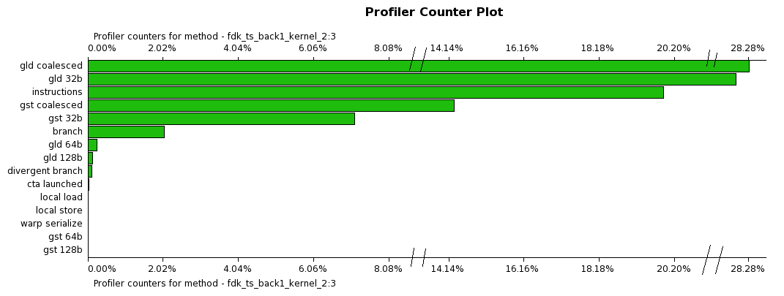
Strategy 1 Analysis
2.5x speed-up for 128x124x120-voxel image
Global memory accesses prevents an even greater speed-up

Slide 7
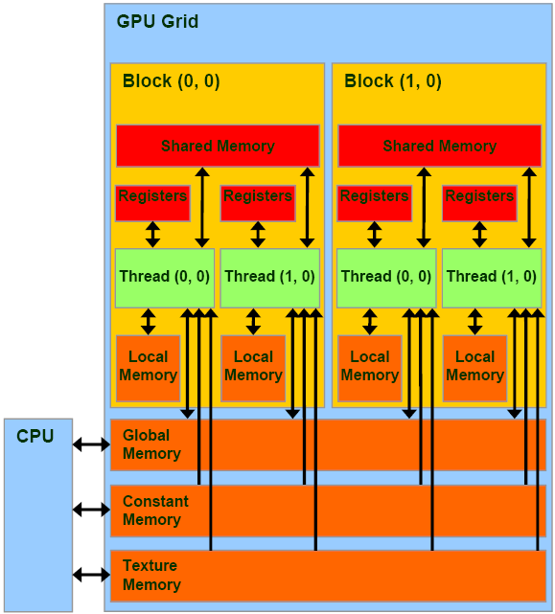
Strategy 2: Projection View Data in Shared Memory
Modified version of previous strategy
Threads that share the same projection view data are grouped in the same block
Every thread is responsible for copying a portion of data to shared memory
Each thread must copy four pixels from the global memory otherwise the results would be approximate

Slide 8
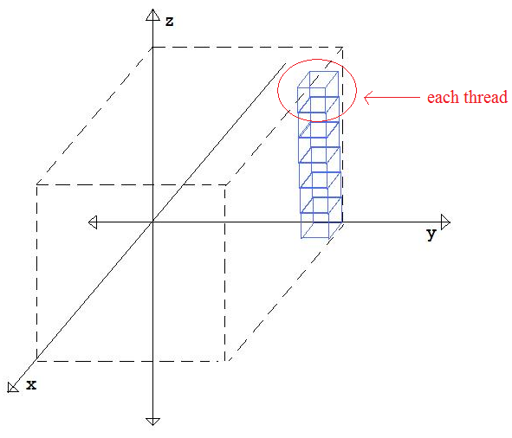
Strategy 3: Reconstructing Each Voxel in Parallel
Global memory loads and stores are costly operations
Necessary for Strategy 1 to pass parameters between kernels
Trade global memory accesses with the repeated instructions
Perform reconstruction on
each voxel in parallel

Slide 9
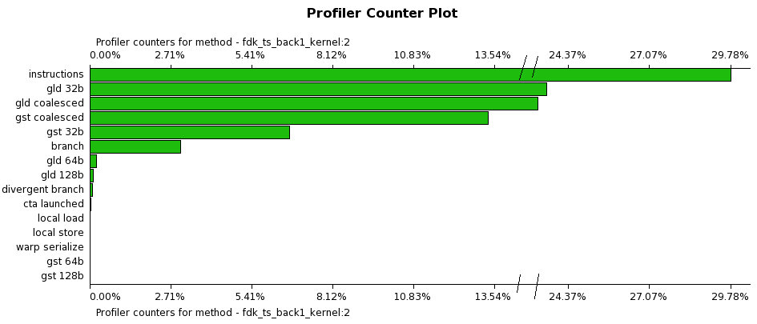
Strategy 3: Analysis
Does compensate for the processing time of repeated computation
Does not improve the performance overall
2.5x speed-up for 128x124x120-voxel image

Slide 10
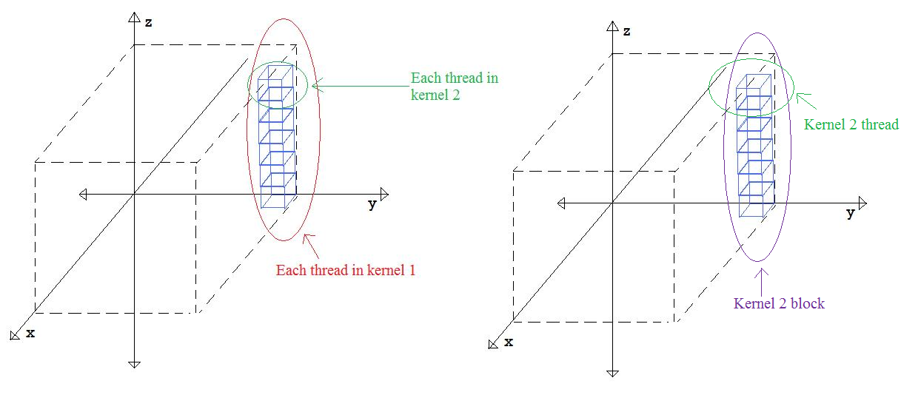
Strategy 4: Shared Memory Integration Between Two Kernels
Modify Strategy 1 to reduce the time spent on global memory accesses
Threads sharing the same parameters from kernel 1 reside in the same block in kernel 2
Only the first thread has to load the data from global memory into shared memory
Synchronize threads within a block after memory load

Slide 11
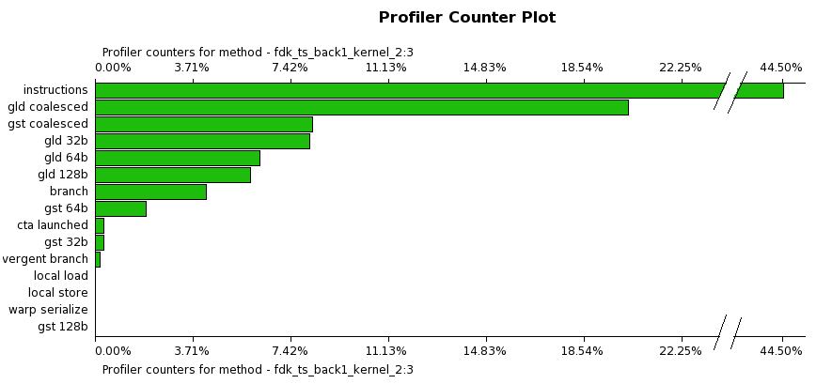
Strategy 4 Analysis
7x speed-up for 128x124x120-voxel image
8.5x speed-up for 256x248x240-voxel image

Slide 12
Strategies Not Used #1
Resolving Thread Divergence
Single-instruction, multiple thread (SIMT) style
32-thread warps
Diverging threads within a warp will execute each set of instructions in a sequential manner
Thought thread divergence would be a problem and was seeking solutions
Occupied less than 1% of GPU processing
One of the reasons could be that most of the threads follow the same path when branching

Slide 13
Strategies Not Used #2
Constant Memory
Read-only memory, readable from all threads in a grid
Faster access than global memory
Considered copying all the projection view data into constant memory
There are only 64 kilobytes of constant memory in the GeForce GTX 260 GPU
A 128x128 projection view uses that much memory

Slide 14
Conclusion
Must eliminate as many sequential processes as possible
Must avoid repeating multiple computations
Must keep number of global memory accesses should to the minimum necessary
One of the solutions is to use shared memory
Strategize the usage of shared memory in order to actually improve the performance
Must consider if the strategy would work on the specific example we are working on
Gather information on the performance

Slide 15
References
Kirk, David, and Wen-mei Hwu. Programming Massively Parallel Processors: a Hands-on Approach. Burlington, MA: Morgan Kaufmann, 2010. Print.
Fessler, J. "Analytical Tomographic Image Reconstruction Methods." Print.
Special thanks to Professor Fessler, Yong Long and Matt Lauer

Slide 16

Thank You For Listening
Does anyone have questions?

