Slide 1
Fishermen & Their Feelings:
When do they count?
2nd Year Talk
Emma Fuller
April 2, 2013

Slide 2
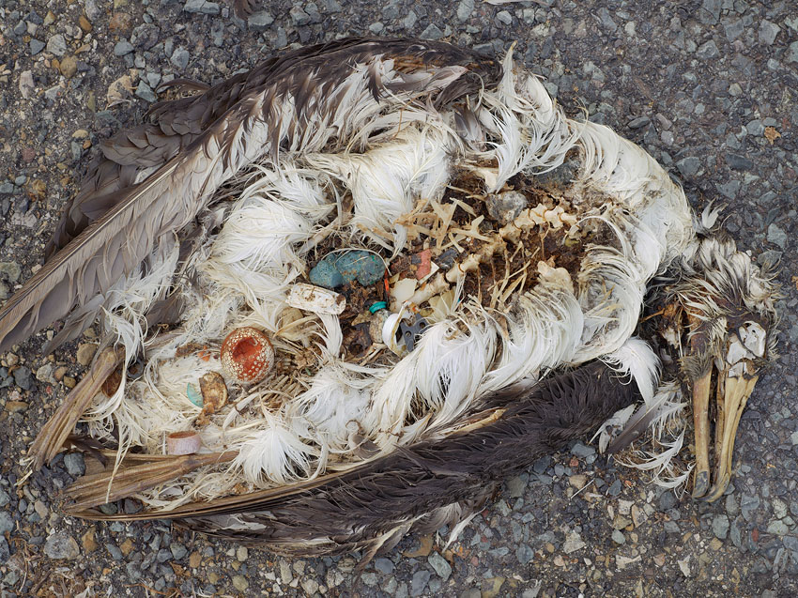

Human Impact is Everywhere
Chris Jordan
Notes:
Examples include: habitat destruction, invasive species (diseases), climate change, direct harvest (ivory, timber, fishing), and pollution

Slide 3
harvesting
Notes:
And so as we’ve gotten more knowledgable about the interactions within ecological systems, the anthropogenic pressure continues to be treated mainly as an exogenous variable. One that is external to the system. Impacts treated as exogenous variables

Slide 4








Notes:
Increasingly there are calls for quantitatively linking both ecological and economic processes to make explicit the connections and feedbacks between human and non-human communities and improve management.
And indeed, some of the biggest environmental NGOs have pivoted to consider the ways that people interact with ecological communities via ecosystem services. (two examples of NGOs which changed their missions to be more human-centric)

Slide 5
Outline
Fishing as a case study
When should human behavior be included?
Plan of attack
Notes:
In this talk the questions I’m considering are why should human behavior be included when thinking about ecological models,
I’ll argue that fishing provides an ideal case study
If human behavior should be included, when it should be included,
And my plan of attack

Slide 6
Fishing as a case study
resource manager

Slide 7
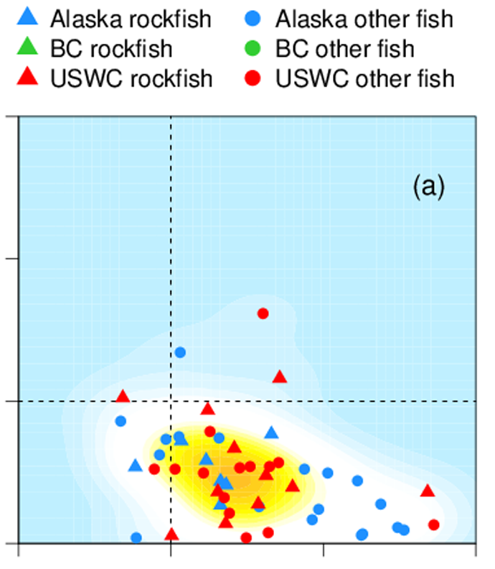
Human behavior irrelevant
3+
2
F/F_t
1
1
2
3+
B/B_t
Melnychuck et al. (2013)
Notes:
Indeed, a recent meta analysis by Melnychuck et al. found that the biological condition of the west coast groundfish stalks were unaffected by the type of management in place. They concluded that as long as scientifically established quotas are set and enforced, particular management type is not important from a biological perspective.
(y axis is ratio of fish to fishing target, x axis is ratio actual biomass to biomass target, thus x,y=1 is a system that is meeting management goals).

Slide 8
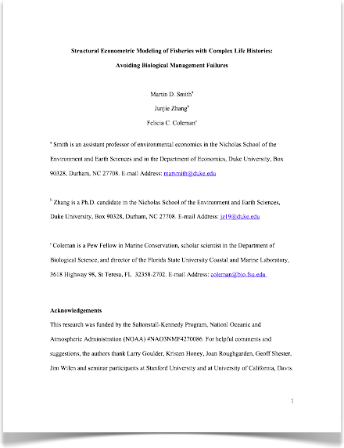
Human behavior matters
Notes:
Yet another paper by Smith et al. 2008 finds just the opposite. Here Smith et al. look at the gag fishery in the Gulf of Mexico. They compare two models: a biological model using age structure and the same model but coupled to a model of fishermen harvest behavior. The management policy in question was closing of the fishery during the peak spawning season of gag, where the big fish are most vulnerable to fishing.

Slide 9
Human behavior matters
Seasonal Closure Management Goal
Protect vulnerable spawning fish
Raise the number of large fish in the population
Result
Number of trip days increase
Fishermen fish more during available spawning season
Reduce number of large fish in the population
Smith et al. (2008)
Notes:
According to the biological model, this management policy reduced catch, increased the number of large fish in the population, and increased stock abundance. When you include harvesting behavior endogenously, however, the opposite is true. In the econometric model, fishermen are predicted to fish much more intensively in the remaining spawning season, and generally more throughout the year. So much so that the spawning season closure negates itself, and the stock equilibrates to a lower level then if there were no closure at all.
Thus there’s an unanswered question here, when does human behavior matter in fisheries?
This question is not new, however. CPUE is a metric that is both commonly used in stock assessments, and heavily depends on fishermen behavior.

Slide 10
Previous work?
Maine lobster Fishery |  | Pacific Tuna fishery
Ecology
sedentary |  | highly mobile
Management
multi-level, strong local governance |  | top-down
Gear
lobster traps |  | purse-seine
Information
Restricted |  | Code-groups
(Palmer 1991, Acheson 1975) |  | (Gaertner & Dreyfus-Leon 2004)
Notes:
But the problem is that it’s very case (and discipline)-specific. And that’s a problem in trying to make comparisons. Here are two well-studied examples, the Maine lobster fishery and the Pacific Tuna fishery. In categorizing different system characteristics, the differences are apparent. Lobster are sedentary, tuna are highly migratory. The management in place is at multiple levels in the lobster communities: you have lobster gangs at local level, with regional councils up to the federal government. The tuna fishery is very top down. There are international governing bodies to deal with the huge range tuna have, but in general quite top down. The gear that’s used is very different: traps versus (here) purse seines (big nets you draw around fish schools and scoop them all up (hence why dolphins can get in trouble). And the way information on fish location is shared is very different, in lobster fisheries information is very secret, and in tuna fisheries you can get the existence of a group of people that share information with each other.

Slide 11
General Framework
Ecology
Management
Gear
Information
resource manager
search for evolutionarily stable harvesting strategies and how they vary with system characteristics
Notes:
how do links between the subsystems change (harvesting behavior) change as characteristics within either of the two subsystems are varied. These characteristics can be broadly classified into one of four categories: ecology (the spatial distribution of the fish, life history, physical habitat), management (whether there’s effort controls or total catch restrictions, whether ITQs are in place, or marine protected areas are present, in other words, what the temporal or spatial restrictions are), the gear the fishermen use, and in particular their fish finding technology, and the information they have access too (this could be personal information in the form of experience, present knowledge based on what they see around them on the water, observing other fishermen or directed information, when fishermen share information about their own experiences on where fish are.
There are 3 different scales to view this at: there is the interaction between the fishermen and their physical environment. There’s how fishermen iteract with each other, and how fishermen interact with management. So this helps to break down the scenarios and allows them to be comparable to one another.

Slide 12
How?
Analytical modeling starting with social foraging theory

Slide 13
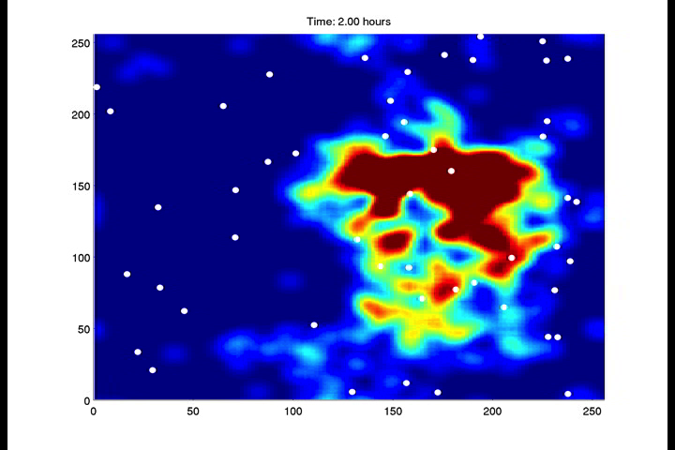
How?
Agent-based model with James Watson

Slide 14
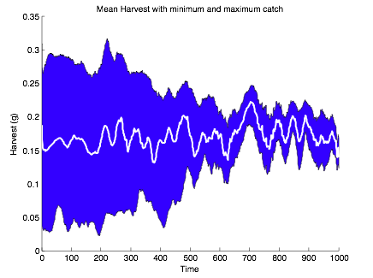
How?
Agent-based model with James Watson

Slide 15
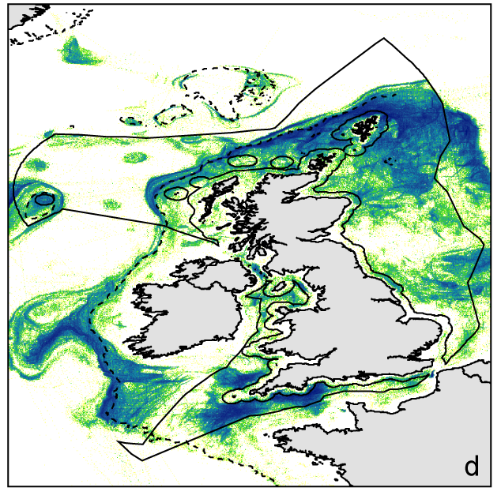
How?
Testing general predictions with empirical data
Log Books
Observer Data
Vessel Monitoring System
Witt et al. (2007)
Notes:
I am going to punt a little bit here, I have a lab tea coming up in a couple of weeks where I’ll discuss modeling more in depth.
The idea is to do two types of modeling: analytical modeling using social foraging theory as starting point. This theory is useful because fishermen can be thought of as predators, but predators who’s payoffs depend on the strategies that other fishermen are using.
The second way is using agent-based modeling. Working with James Watson, we simulate fishermen fishing, making cost-benefit decisions on where they want to go and interacting with each other.
Ultimately in searching for evolutionarily stable harvesting strategies we want to know if we see signatures of them in real life. Working with James, Simon, and others on the CNH grant, will hopefully help understand empirical fishing records.
But I’ll go into this in more detail at lab tea in May!

Slide 16
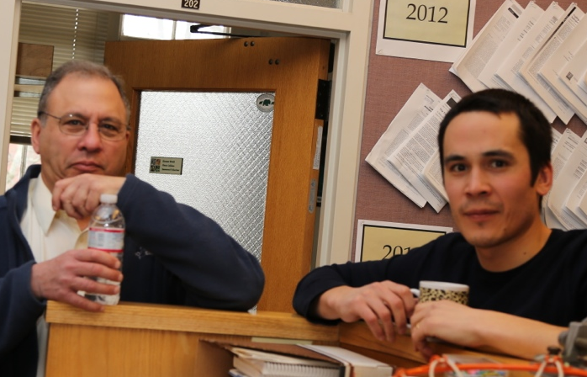


Thanks!
Simon and committee (Pacala, Wilcove, Pringle)
James Watson and rest of Levin Lab
2nd years

Slide 17
Previous work?
Total catch
Days at sea
Notes:
CPUE uses measures of fishermen effort like days at sea, and assumes that the amount of catch you get for a standard unit of effort (say one day) is proportional to the total abundance of fish in population. As you might imagine this depends on how a fishermen spends his day. And if all days aren’t uniform, then some catches may be more or less. In other words, change in CPUE could reflect either a change in the species abundance or a change in fishermen behavior.
Starting as early as 1984, there were rumblings that this assumption was unlikely to be true. And much effort has gone into standardizing the measure of effort for changes in gear (upgrades to technology) and the behavior of fishermen.
But as such, this has motivated work to understand fine scale behavior of fishermen. And from the other side, anthropologists have long been interested in fishermen communities, including how they harvest fish. Thus there is a sizeable literature about how fishermen interact with the marine environment.

