Slide 1
Go where the crowds are:
Social information and fishing strategy in the US west coast pink shrimp fishery
4/7/2016
Emma Fuller

Slide 2
Intro

Slide 3
Intro
How people allocate effort matters (conservation, policy efficacy, etc.)
location choice models are the primary way people predict how people will (re)allocated effort. These methods have reinforced importance of human behavior in predicting changes after management (Wilen, Smith)
typically use patch characteristics to predict, sometimes allow heterogeneity among vessels and use vessel characteristics (holland).
social science work, and ecology suggest that information from conspecifics likely to be important (Wilson 1990, ecology?)
here I take advantage of a novel combination of data to investigate whether social information is used in pink shrimp foraging.

Slide 4
Intro
Pink shrimp a compelling fishery: no stock assessment, use fishery-dependent data. Especially thought to be a relationship between area fished and stock abundance (Hannah 1990-ish).
Theoretical work predicts that this type of fishery should involve opportunism, and previous empirical studies (and my interviews) document existing information sharing (Wilson 1990).

Slide 5
Intro
Here I build a dataset of fishing patterns by sewing together where vessels go (VMS), when they fish (observer) and what they catch (fish tickets) to get a full picture of the fishing patterns from 2009-2013 for more than 50% of the vessels participating in pink shrimp.
Using this unique dataset, I show that total allocation of effort across patches is best predicted by previous fishing patterns the previous day rather than resource abundance.
I also show that how responsive vessels are to “social” information is correlated with an increase in average revenue.

Slide 6
Methods

Slide 7
Methods
Data
Fish tickets
Observer data
VMS

Slide 8
Methods
Sewing
Linking VMS to fish tickets
Behaviorally segmented VMS data using fish tickets and observer and filter and train (respectively)
Using fishing activity data from above, defined fishing grounds, hereafter “patches”

Slide 9
Methods
Measuring resource abundance
For each trip, use fish tickets to find total pounds caught, spread lbs evenly across all fishing points.
For each patch, find median amount of lbs/hr caught that day in that patch.
Technically not resource abundance but some combination of resource abundance + catchability. Hereafter refers to it as resource abundance.

Slide 10
Methods
Measuring “social”
Patch level: Calculate daily number of vessel hours that occur in each patch
Vessel level:
Filtering for “high quality trips” and only used those for individual behavior
Calculate percentage of time for each trip a vessel was fishing in a patch with another trip.
Then to determine if this is more than is expected at random, use maximum distance traveled on trip to determine all patches “could” have gone to, use time series of occupation and shuffle to randomly reassign occupancy status. Then let trip continue as seen and calculate percentage of time vessel spent fishing on an occupied trip.

Slide 11
Methods
To determine which explains vessel activity, resources or vessel presence:
calculate correlations for each patch between median pounds caught during a day (t) and number of vessel hours spent next day (t+1).
calculate correlations for each patch between number of vessel hours spent during a day (t) and number of vessel hours next day (t+1).

Slide 12
Methods
To determine if “social” boats are more successful do simple model fitting and see if other aspects of trip (type of gear used, latitude, vessel length, n_trips, percent specialist) can predict how well a vessel does on average. And whether adding how “social” they are improves this fit.

Slide 13
Results

Slide 14
Results
(sewing)
VMS determined duration of trip (days)
observer recorded duration of trip (days)
Notes:
Fig 1. Observer recorded duration of trip versus my duration of trip, accuracy looks good, using observer data as a check for duration of trips, largely good.
maybe also delta days from date given by observer versus mine) - also what’s the discrepancy between fish ticket landing dates and Obs return dates?
Matching VMS to fish ticket data: matched XX% of fishing trips responsible for YY% of lbs and revenue landed during this period.

Slide 15
Results
(sewing)
Notes:
Fig 2. Behavioral segmentation: was able to segment data with XX% accuracy, example fishing trip that’s been segmented. Here red represents fishing behavior and black represents transiting behavior.

Slide 16
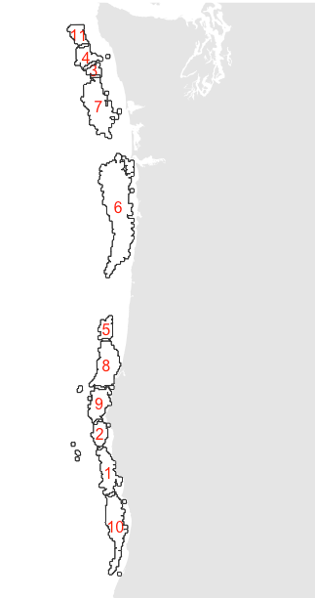
Results
(sewing)
Notes:
Fig 3. Defining fishing ground: found 11 discrete patches (here after fishing patches). Patches varied in size from patches 6, 7 and 10 as compared to 11, 2, 5, for example.

Slide 17
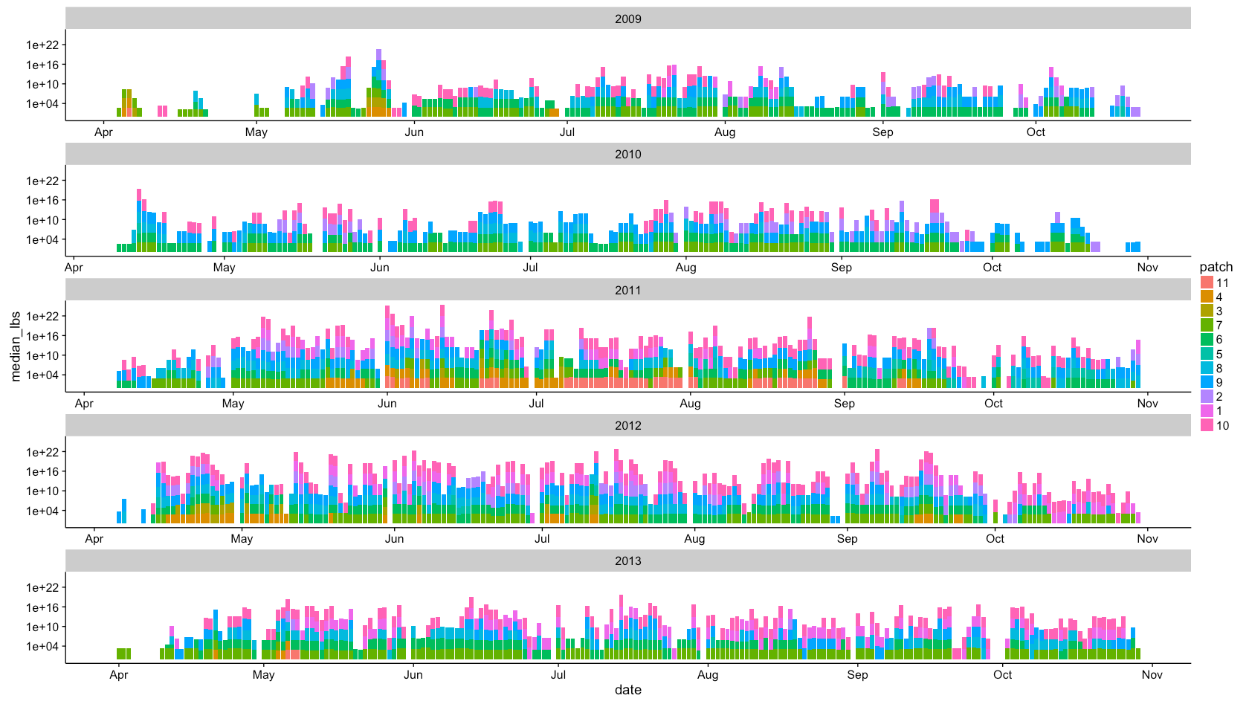
Results
(resource abundance)
Notes:
Fig 4. Measuring resource abundance at each patch. Color of bar represents which patch, which are ordered from north to south (orange to magenta). Days where no one fished on a patch are blank.
Able to get daily medians of resource abundance for all patches. Varied between 15 and 60,000 lbs/hr. Median was ~1,237 lbs/hr but huge amount of variation (sd ~ 2995 lbs/hr)

Slide 18
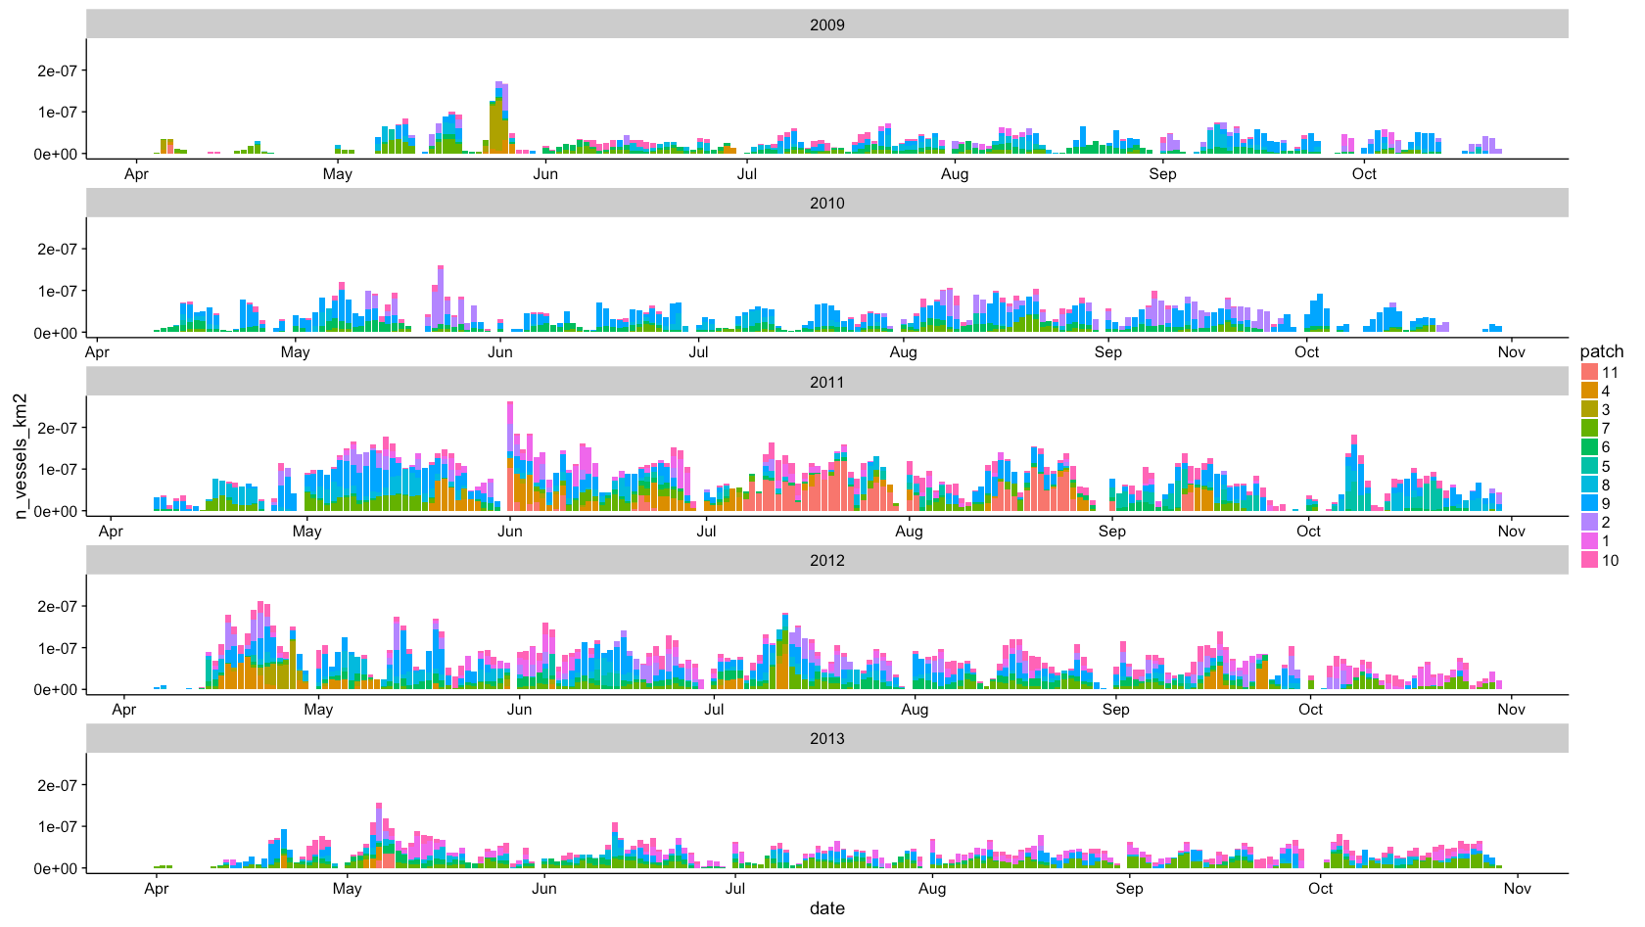
Results
(measuring social)
Notes:
Fig 5. Measuring “social” at patch level. Color of bar represents which patch, which are ordered from north to south (orange to magenta). Days where no one fished on a patch are blank. Y axis is number of vessel hours on patch during that day divided by the total area of the patch (to control for the fact that some patches are many times the size).
Patch level occupancy ranged between 0 and 170. Median number of vessel hours was 0, sd 21.5

Slide 19
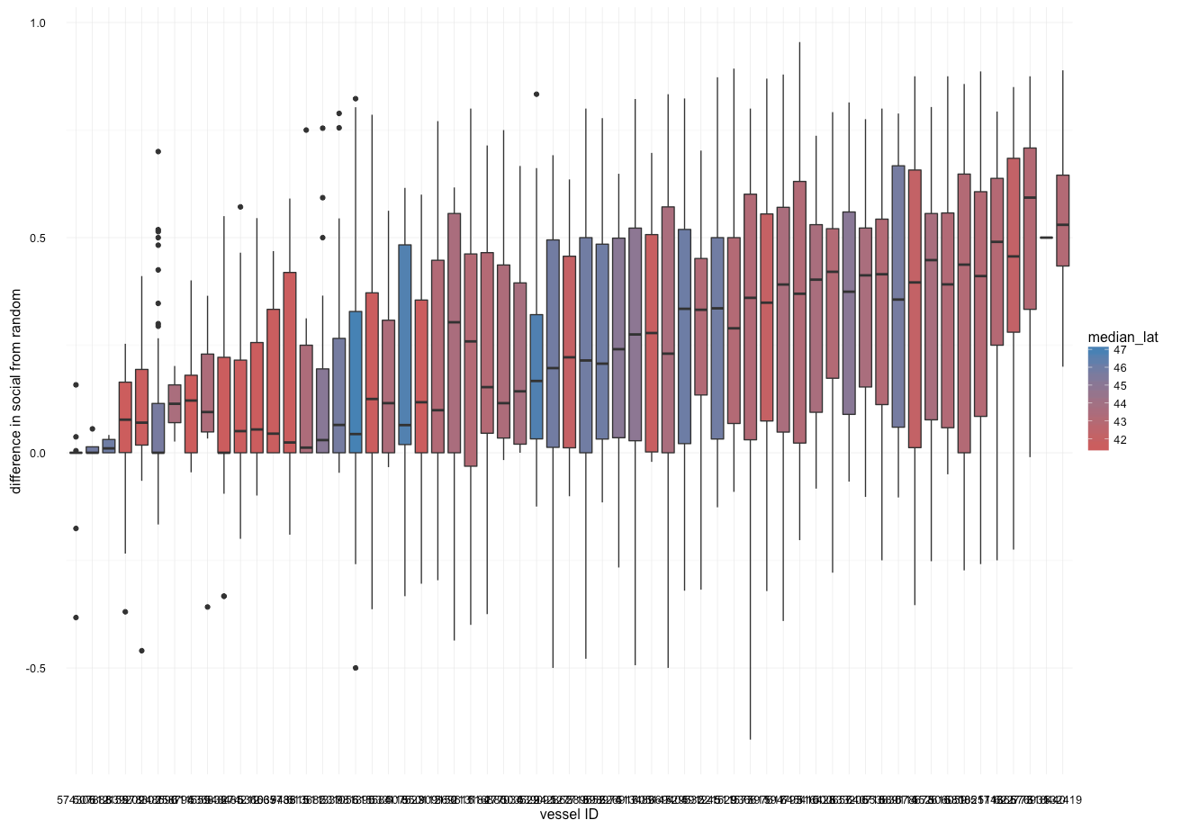
Results
(measuring social)
Notes:
Fig 6. Measuring “social” at individual level. For each vessel distribution of “social” scores for each trip. Social score > 0 means vessels were fishing on occupied patches more often than expected by chance, social score < 0 of trips where vessels were fishing on unoccupied patches more often than expected by chance. Social scores = 0 is fishing on patches (occupied or unoccupied) no different than what would be expected by chance. Individual level sociability : ranged between 0 and .59, median was 0.22 (sd 0.16) so vessels tended to be on patches with other vessels more often than expected by chance.

Slide 20
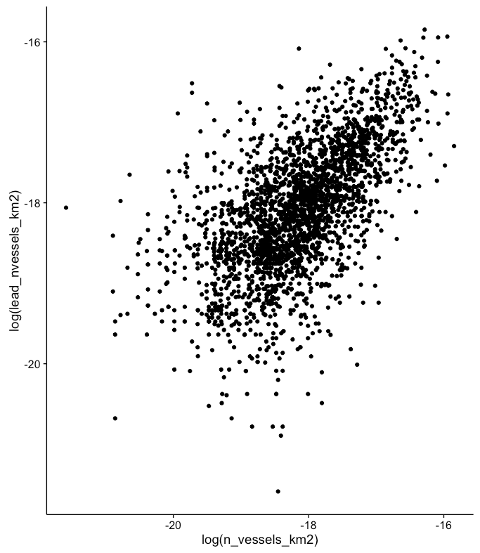
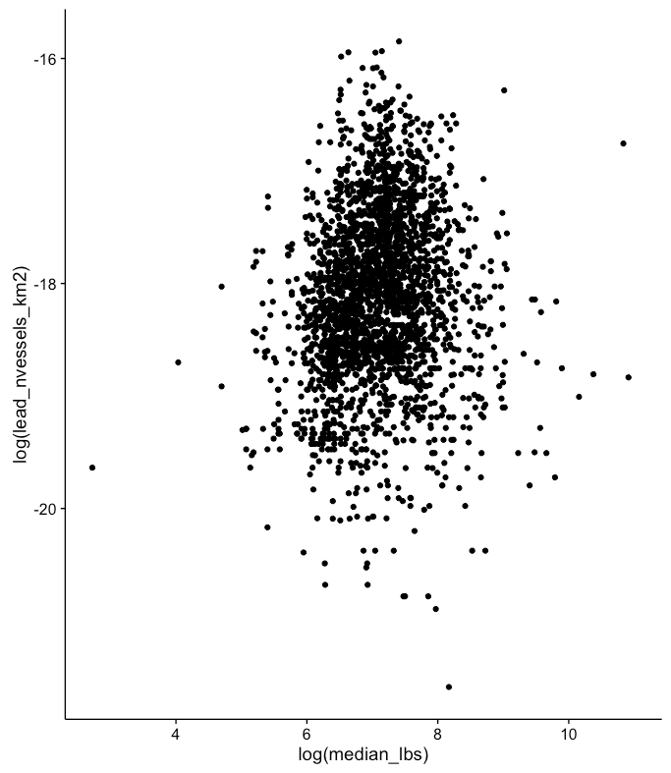
Results
(comparing social to resources)
A
B
Notes:
Fig 7. Here the log number of vessel hours at time t+1 is plotted against (A) the log number of vessel hours at t and (B) the log median lbs at time t. Correlations between patch occupancy at time t and t+1 more tightly correlated than correlations between median catch at t versus patch occupancy at t+1 (0.59, p-value < 2.2e-16; 0.11, 1.699e-08).

Slide 21
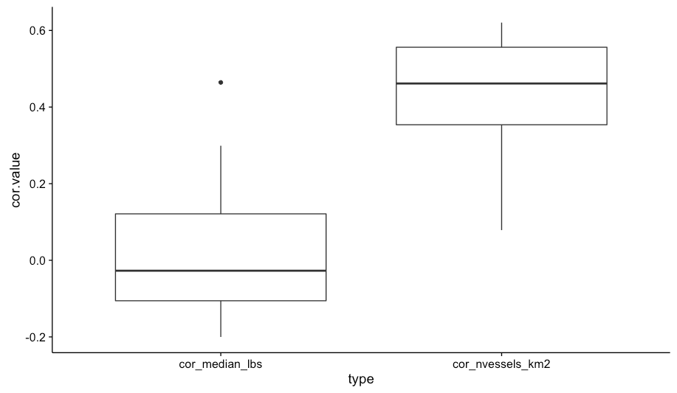
Results
(comparing social to resources)
A
B
Notes:
Fig 8. Calculating correlations between patch occupancy median revenue (A) and patch occupancy and prior patch occupancy (B) for each patch. Find that patch occupancy in the prior time was much more correlated than average pounds caught per hour in patch regardless of patch identity.

Slide 22
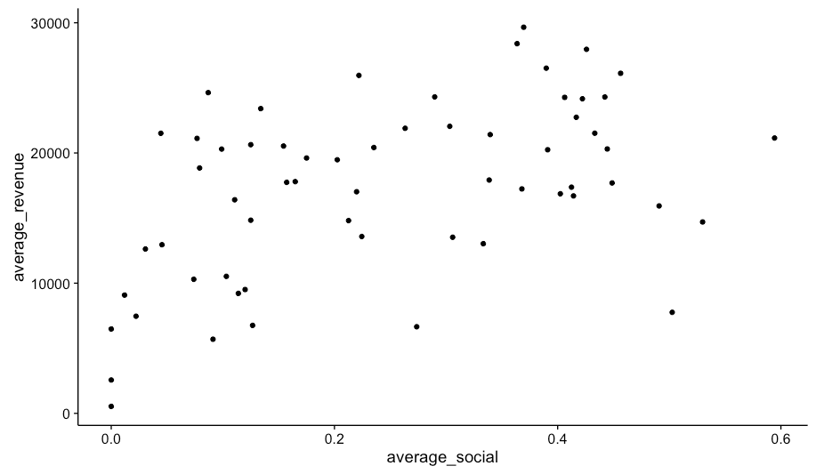
Results
(being social makes you more successful)
Notes:
Fig 9. Find that average responsiveness to social information positively correlated with average revenue per trip.
Social term adds significant information to regression (AIC/R2) and is significant predictor, although weak relative to other variables).

Slide 23
Results
(being social makes you more successful)
Model | AIC | R2 | Delta AIC
lm9 <- lm(average_revenue ~ median_lat + percent_DST + average_social + ntrips + average_social*ntrips + average_social*median_lat + ntrips*median_lat, vessel_averages) | 1199.011 | 0.66 | 0
lm6 <- lm(average_revenue ~ median_lat + percent_DST + average_social + ntrips + average_social*ntrips, vessel_averages) | 1201.237 | 0.62 | 2.23
lm8 <- lm(average_revenue ~ median_lat + percent_DST + average_social + ntrips + average_social*ntrips + average_social*median_lat, vessel_averages) | 1202.101 | 0.63 | 3.09
lm5 <- lm(average_revenue ~ median_lat + percent_DST + average_social + ntrips, vessel_averages) | 1205.196 | 0.59 | 6.19
lm7 <- lm(average_revenue ~ median_lat + percent_DST + ntrips, vessel_averages) | 1207.172 | 0.56 | 8.16
lm3 <- lm(average_revenue ~ median_lat + percent_DST + average_social, vessel_averages) | 1211.566 | 0.53 | 12.56
lm4 <- lm(average_revenue ~ median_lat + percent_DST + average_social + average_social*median_lat, vessel_averages) | 1213.09 | 0.53 | 14.08
lm2 <- lm(average_revenue ~ median_lat + percent_DST, vessel_averages) | 1217.201 | 0.46 | 18.19
lm1 <- lm(average_revenue ~ median_lat, vessel_averages) | 1242.569 | 0.16 | 43.56
Notes:
Table 1. Results of model fitting, best fit model is highlight in bold.

Slide 24
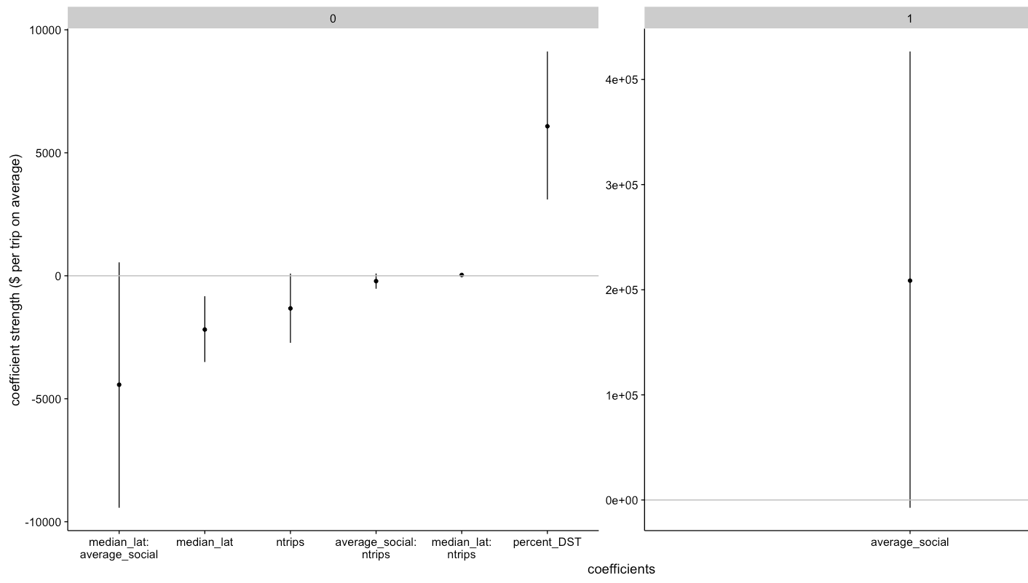
Results
(being social makes you more successful)
Notes:
Fig 10. Coefficient strengths for best fit model. Not the different scales between the facets.

Slide 25
Discussion

Slide 26
Discussion
Sewed together a novel set of data, can get rich ecological and social dynamics for existing fisheries management data.
Disclaimers: lack of ability to discern non-random sociability at crowded patches (i.e. in the north). Might result in underestimating sociability in north versus south.
Results are the first time, to my knowledge, social information empirically demonstrated in commercial fisheries context
Suggests that social information relevant for location choice models and better predicting effort reallocation
Confirms theoretical predictions about foraging strategy and suggests that such work should be able to be accomplished in other fisheries with similar data availability (i.e. groundfish trawl)

