Slide 1
What effect did catch shares have on fisheries participation along the US west coast at the vessel and port level?

Slide 2
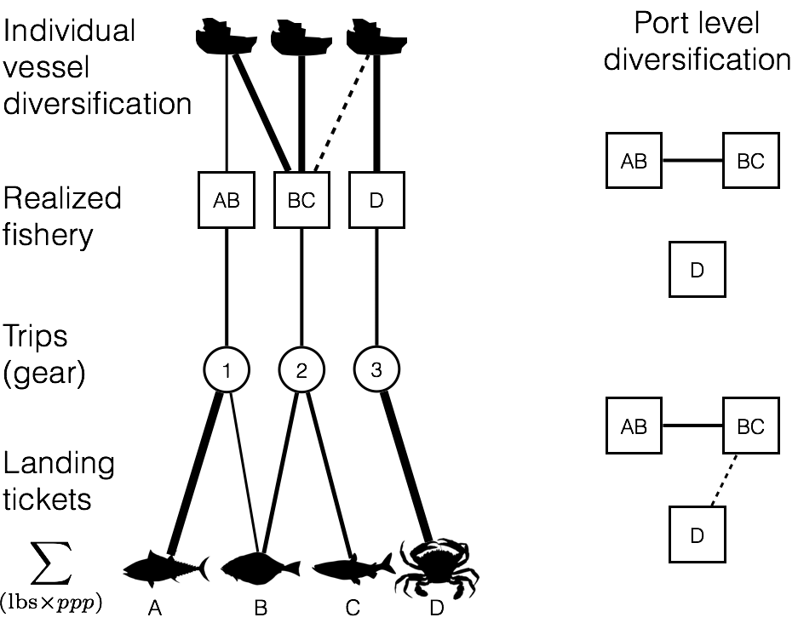
Notes:
(analysis pipeline)
Fig 1: A) To calculate revenue diversity we use catch data available in landing tickets to first tabulate revenue received for each species in a trip. Using these revenue profiles we group trips together based on characteristic catch assemblages creating realized fisheries. For vessel-level diversification, we use the realized fisheries to calculate the effective shannon index to measure revenue diversity. B) For port level diversity we how realized fisheries are connected by vessel participation. If vessels fish in two fisheries, this connects them.

Slide 3
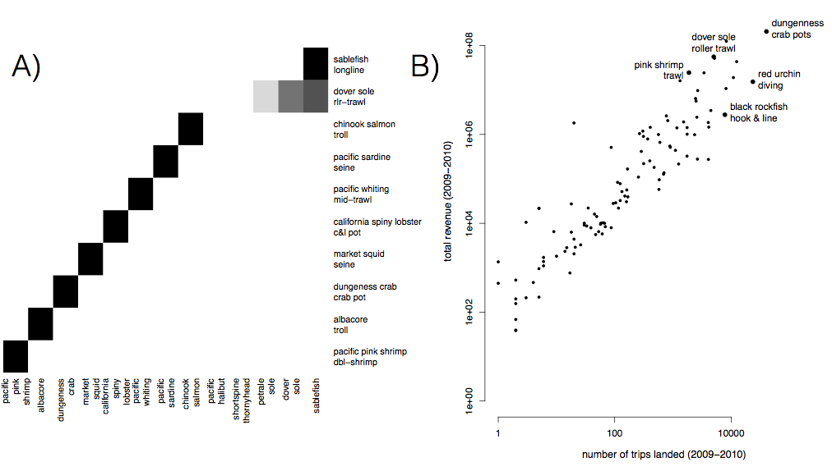
Notes:
A) Realized fisheries are often distinguished by a single species (i.e. pink shrimp) but can also characterized by assemblages of species (dover sole roller trawl). Here we plot the top ten realized fisheries by revenue on the US west coast with the darkness of the cell proportional to the relative proportion of revenue due to each species. Eight of these fisheries are characterized by a single species, while dover sole roller trawl and sablefish longline is characterized by multiple species. B) The realized fisheries vary by an order of magnitude in effort and revenue

Slide 4
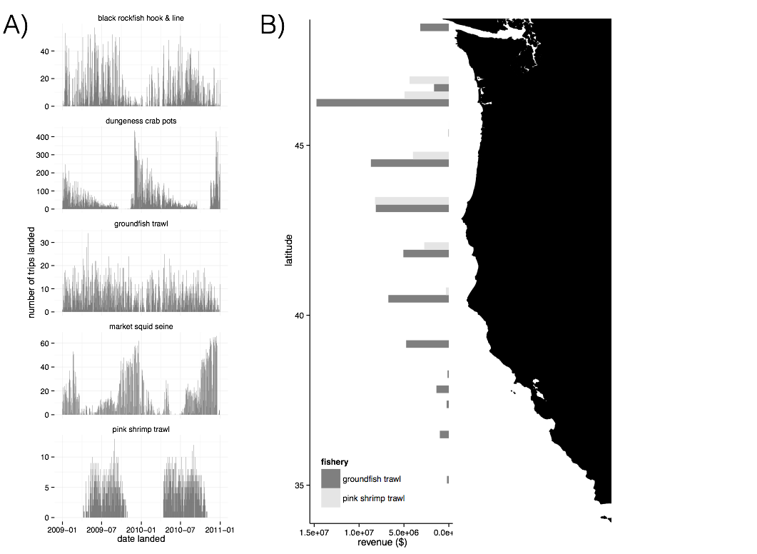
Notes:
Figure 2:. A) These fisheries also demonstrate different levels of temporal structure: they vary from strictly seasonal (i.e. pink shrimp trawl) to year round (groundfish trawl). B) Finally these fisheries also exhibit varying degrees of spatial structure, here we plot two realized fisheries as examples highlighting how spatially disaggregated they can be.

Slide 5
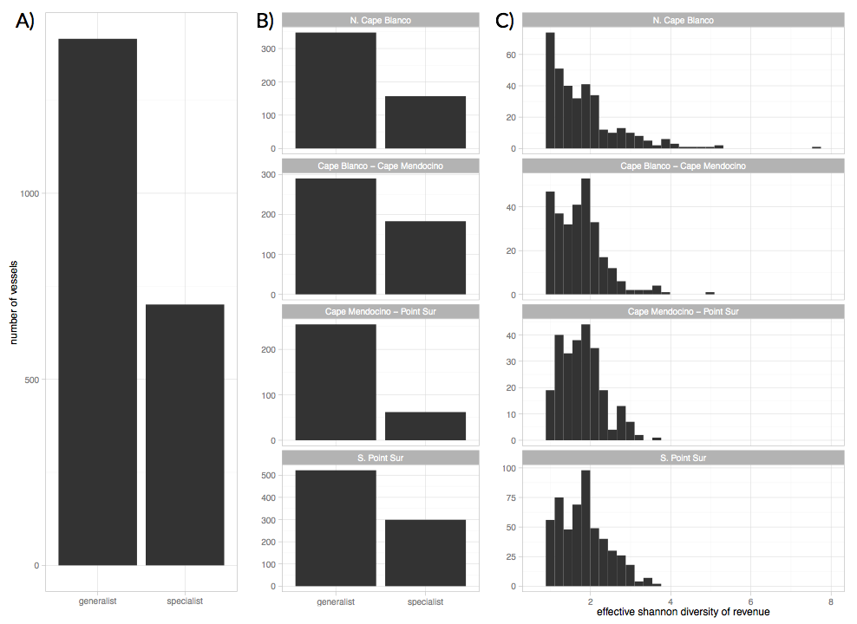
Notes:
Fig 3: A) For 3 out of the four management regions on the west coast, generalists (vessels which land > 1 realized fishery) outnumber the specialists (vessels which land in a single realized fishery). B) The distribution of diversity varies among the generalists, from vessels that are highly specialized by have a few landings in additional fisheries (to left) to those that fish in many fisheries evenly (to right).

Slide 6
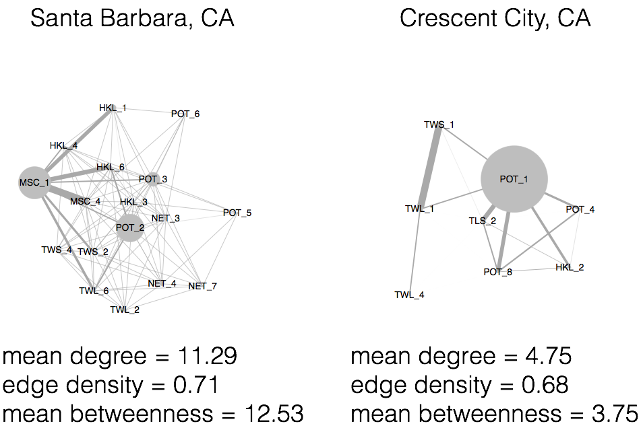
Notes:
Fig 4: Examples of port level participation networks. Here nodes represent a realized fishery, and strength of connections between nodes represent the number of vessels which land both of these fisheries. We measure the diversity of these port participation networks by using measures of the the interconnectedness of these networks.

Slide 7
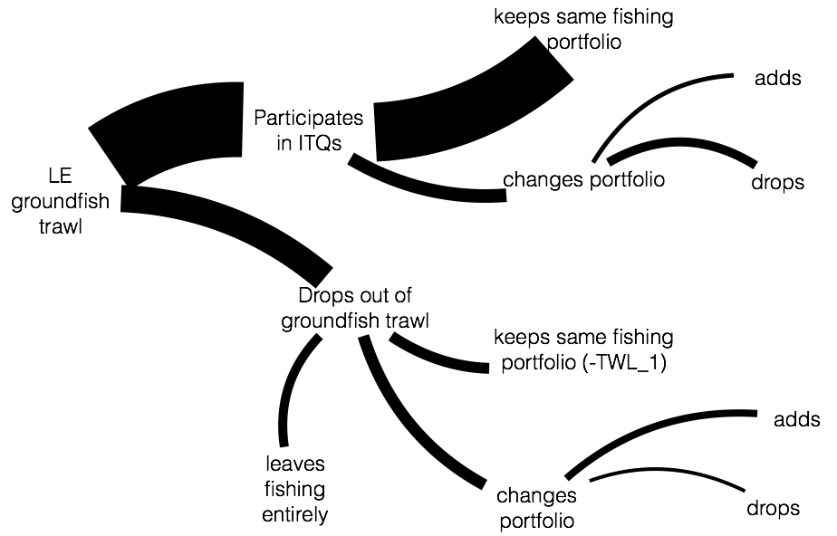
ITQs implemented
Notes:
Proposed figure: Here we should how vessels fishing in limited entry groundfish responded after ITQ implementation. Here the width of the connections are proportional to the number of vessels at each decision point. We find that a majority of vessels continued fishing in limited entry groundfish and maintained their fishing portfolio. About a third of vessels previously fishing groundfish left the fishery with ITQ implementation, and adapation strategies are more diverse. Vessels were evenly split among living the fishery entirely, maintaing their original fishing portfolio (excepting groundfish trawl) and changing their portfolio. Those that did change their portfolio tended to compensate by adding fisheries.

Slide 8
Notes:
Figure 5: We find that a vessel’s participation in IFQs is significantly associated with an increase in revenue diversity. At the port level, we find no indication that IFQ landings affect interconnectedness of fisheries.

