Slide 1
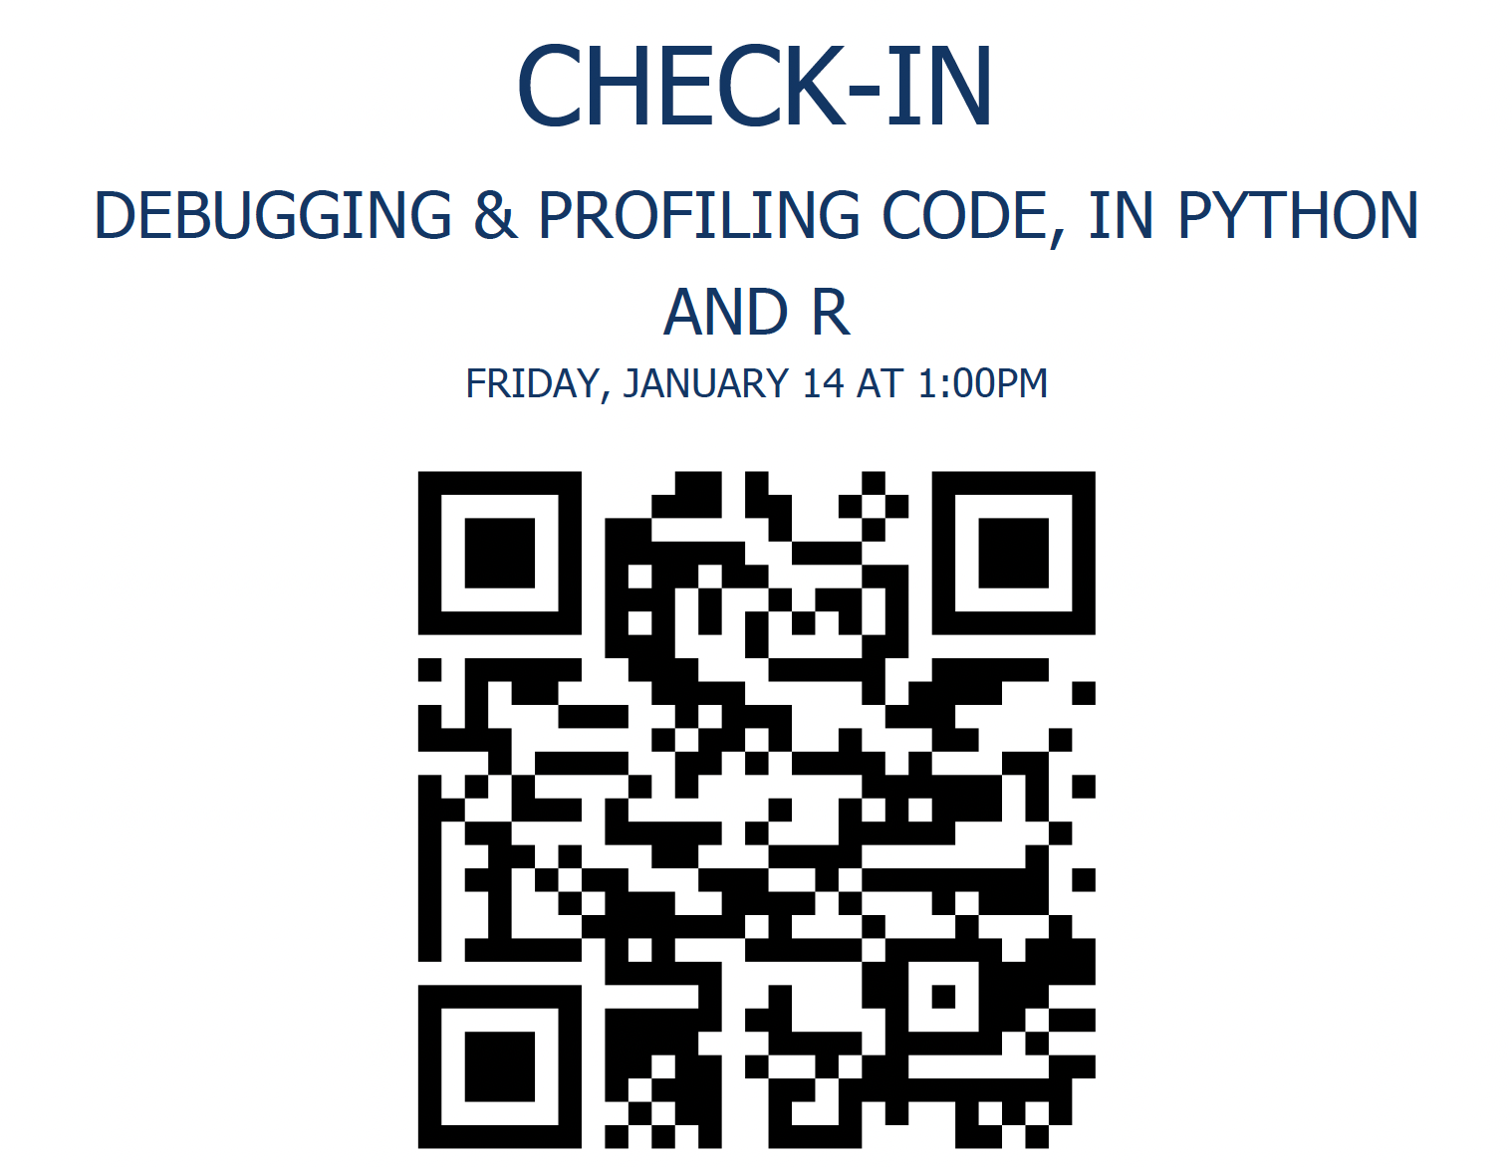
Debugging & Profiling Code, in Python and R
Abhishek Biswas
Research Software Engineer, Princeton University
ab50@princeton.edu
Wintersession / PICSciE Training Workshops
Attendance : http://cglink.me/2gi/c1340958101282849

Slide 2
Objectives
Overview of code structuring and debugging
Overview of Integrated Development Environments (IDE)
Python – PyCharm
R – RStudio
Debugging typical software errors
Program crashes, Incorrect output
Profiling
Inefficient resource utilization (Time, Memory, CPU)

Slide 3
Design is Important
Good code design will make finding bugs easier
Easier to track down bugs in modules
Easier to write targeted testing code
Easier to replace and fix the bug
Less chances of introducing more bugs

Slide 4
Print Statements and Comments
Printing and logging messages are the most basic and useful tool
Can’t figure out how to setup a debugger
Parallel execution
Help isolate the portion of the code
Commenting out code
Comment out portions of code and see if it runs
Again, helps isolate the problem

Slide 5
PDB – commandline debugging
Program crashes produce a stack trace with line numbers
Python provides a command like debugger too
pdbpp is a more user-friendly version
Let’s do the first demo!
Traceback (most recent call last):
File "no_furniture.py", line 16, in <module>
for item in items.sort():
TypeError: 'NoneType' object is not iterable

Slide 6
Breakpoints, Watches and Evaluation
Breakpoints allow you to halt the flow of execution
Stop a few lines before the error
The error in most cases happens before the line that triggers it
Watches allow you to look at the values of the variables
Evaluate allows you to insert and run new code to check things

Slide 7
IDEs Help Design and Navigate
Help you manage your files
Separate out modules
Clearly save src, test and metadata files
They help you navigate through your code
Learn the shortcuts
Help you setup debugging environment
Help you setup build and release processes

Slide 8
Exercise 1: PyCharm Setup
Download Python Project:
Link: https://tinyurl.com/5fc4byb6
Download and extract the project directories
Start Anaconda Navigator and launch PyCharm
Go to File > New Project
Navigate to the “python_debug” project directory
Create project using existing files
Understand project structure
Set source root as the “src” directory (right click option)

Slide 9
Exercise 2 : Fix The Tests!
Fix the failing test cases…
Useful links
https://byjus.com/maths/area-of-shapes
https://byjus.com/volume-formulas
https://byjus.com/surface-area-formulas

Slide 10
Conditional Breakpoints
Sometimes breakpoints need to be conditional
Useful when breaking at a certain iteration
Breaking on a certain call of the function
Run the “triangle_area_many.py” example
Figure out which of the 10000 triangles is failing!

Slide 11
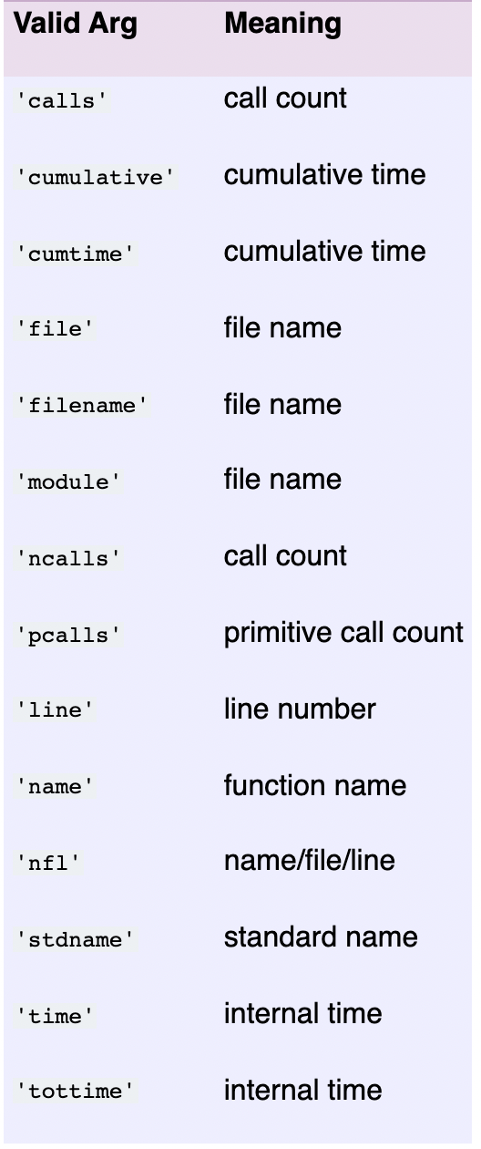
Exercise 2: Profiling Python Code
Create a new python project using to “python_profile” directory
python -m cProfile -s tottime search.py
simple_search
sort_search
best_search
Why is simple_search faster?
Profile the code
What is taking so long?

Slide 12
Did anyone run the tests for search?
Check correctness before profiling!

Slide 13
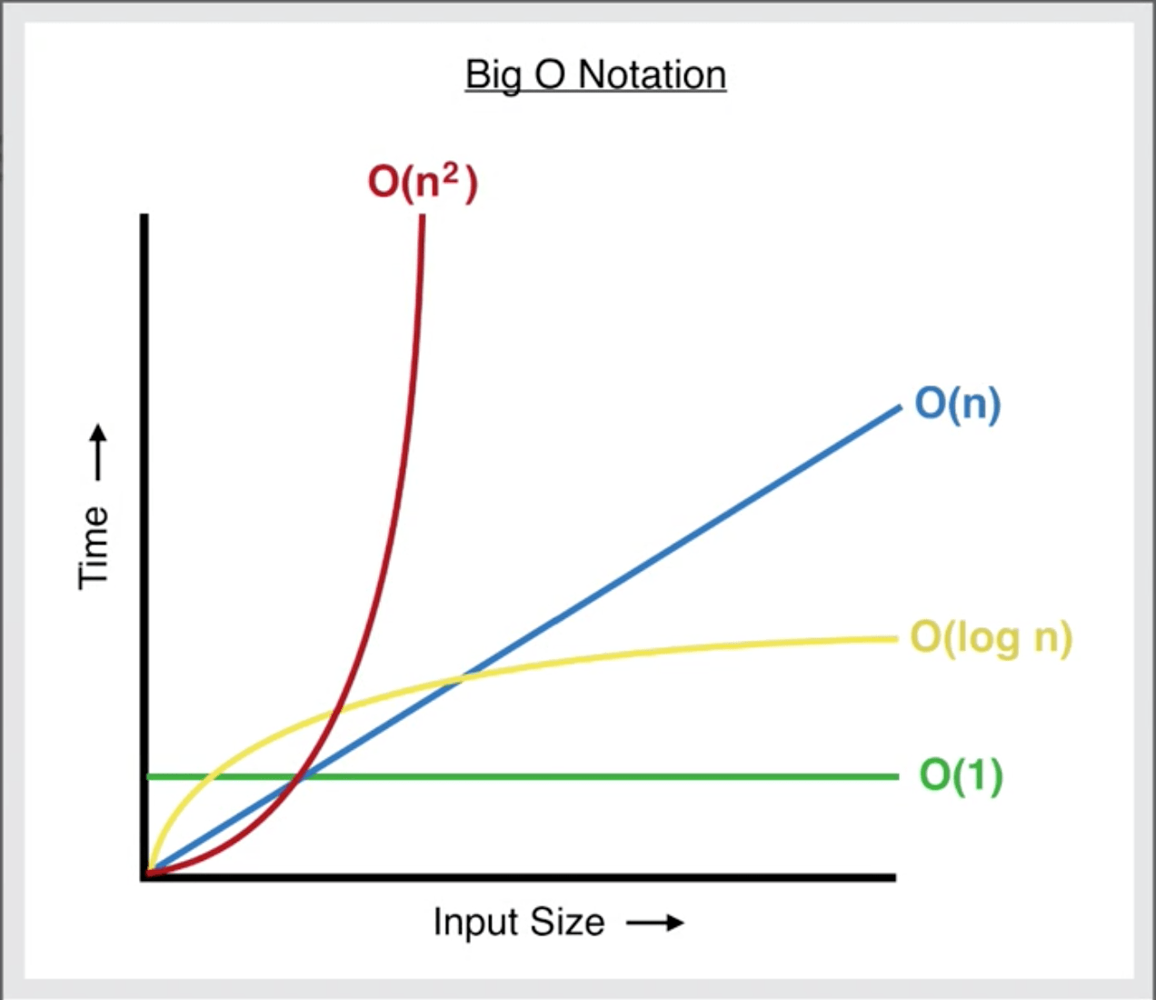
Generating Growth Curves
Profiling is used to generate growth curves
Let’s look at 3 sorting algorithms
python sort.py

Slide 14
Python Memory Profiling
Memory profiling show the instructions that significantly increase the memory usage
memory_profiler module allows users to decorate functions
Shows total memory usage and lines that add to memory footprint
python mem_profile.py

Slide 15
Exercise 3 : Rstudio Debugging
Download the file:
Navigate to the R_debug folder
Click on the files to open Rstudio
Click on Source button to run the scripts
Try to fix the infinite loop!
random_debug.R

Slide 16
Exercise 4 : Rstudio Profiling
Download the file:
Navigate to the R_profile folder
Click on the files to open Rstudio
Click on Source button to run the scripts
Let’s benchmark some sorting and dataframe operations

Slide 17
Profvis Interactive Profiling
Produces an interactive graph
Statistical profiling using Rprof
10ms intervals
The flame graph shows the lines of code where time was spent

Slide 18
Have a great weekend!

Slide 19
Handling C++
C++ is somewhat different because it is compiled
Some errors are found much earlier
The build process needs to be setup
Compiler
Compiler options
Debug/Release builds
Errors messages can be less obvious

Slide 20
Exercise 4 : C++ Setup
Log onto Adroit
ssh -X adroit.princeton.edu
Download the C++ code
curl -L -o cpp_debug.zip https://tinyurl.com/y3k73w6y
unzip cpp_debug.zip
cd cpp_debug

Slide 21
Exercise 4 : C++ Compile and Run
Compile the code
g++ -g -O0 -o serial_cpp serial.cpp
Request a task node on Adroit
salloc --nodes=1 --ntasks=1 --time=05:00 --x11
Load the Arm DDT debugger
module load ddt/20.0.1
ddt

