Slide 1



Slide 2
Convolutional Neural Networks Introduction to Machine Learning Princeton University Wintersession
Gage DeZoort | Vineet Bansal, Jon Halverson
1/23/23

Slide 3
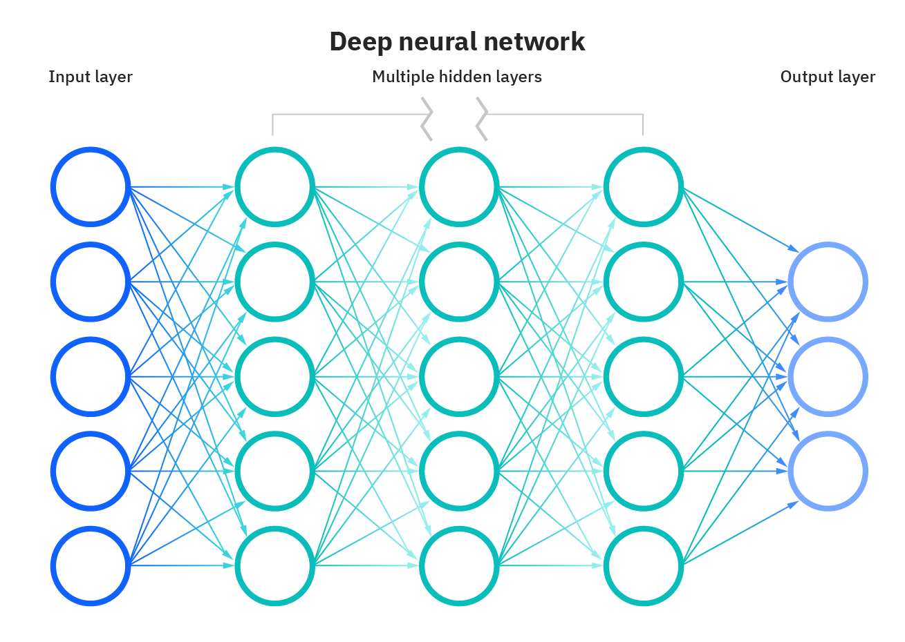
What are Neural Networks? - United Kingdom | IBM

Slide 4
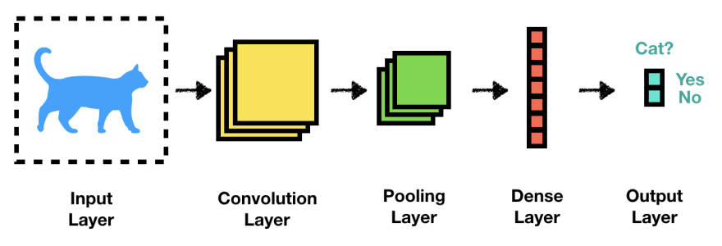
Convolutional Neural Networks
Convolutional Neural Network: A Step By Step Guide | by Shashikant | Towards Data Science

Slide 5
Convolutional Neural Networks
2D image (no flattening!)
new stuff
deep neural network
Convolutional Neural Network: A Step By Step Guide | by Shashikant | Towards Data Science

Slide 6
Learning on Images
Extract features with convolutional filters (or kernels)
MNIST: 28x28x1 image
vdumoulin/conv_arithmetic: A technical report on convolution arithmetic in the context of deep learning (github.com)
Convolutional neural networks. (jeremyjordan.me)

Slide 7
Convolutional Filters
Example of additive filtering
Feature Map
(2x2x1)
Convolution Filter / Convolving Kernel
(3x3x1)
Input Image (4x4x1)
vdumoulin/conv_arithmetic: A technical report on convolution arithmetic in the context of deep learning (github.com)
A Comprehensive Guide to Convolutional Neural Networks — the ELI5 way | by Sumit Saha | Towards Data Science

Slide 8
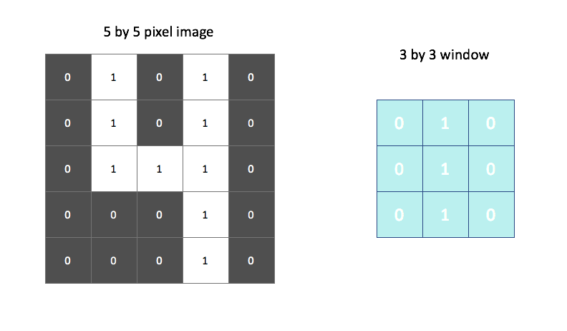
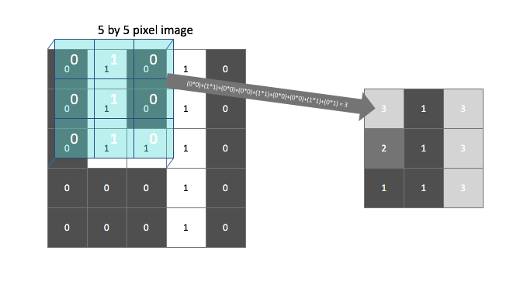
Learning on Images
Searching for vertical lines with a 3x3 filter
Note: filters are learned from the data!
Convolutional neural networks. (jeremyjordan.me)

Slide 9
Filter specifications
Feature Map
(5x5x1)
Feature Map
(2x2x1)
Filter
(3x3x1), Stride 2
Filter
(3x3x1), Stride 1
Input image
(5x5x1)
Input image
(5x5x1) with padding
Stride > 1 → Downsampling
Half padding (shown above) maintains input dimensions, full padding (one more layer of padding) increases it
vdumoulin/conv_arithmetic: A technical report on convolution arithmetic in the context of deep learning (github.com)

Slide 10
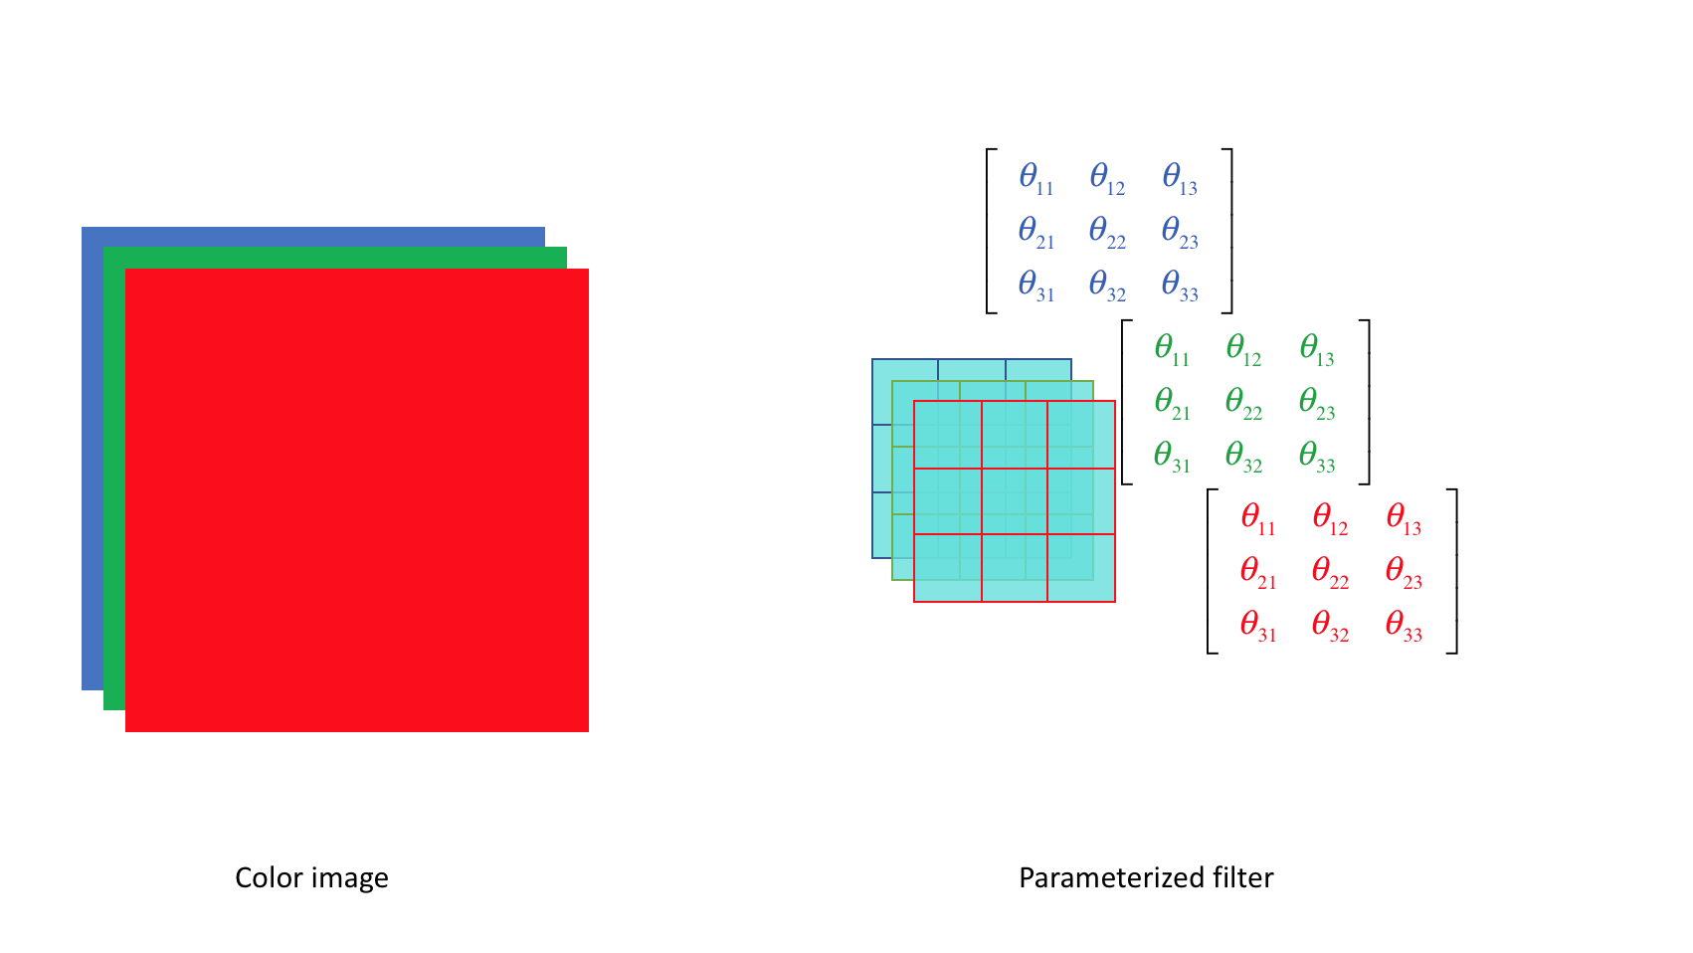
Color Images
MNIST was greyscale → 1 value per pixel
Input sizes: (28x28x1)
RBG Images → 3 values per pixel
Input sizes, e.g. (128x128x3)
Filters must have 3 channels!
Convolutional neural networks. (jeremyjordan.me)

Slide 11
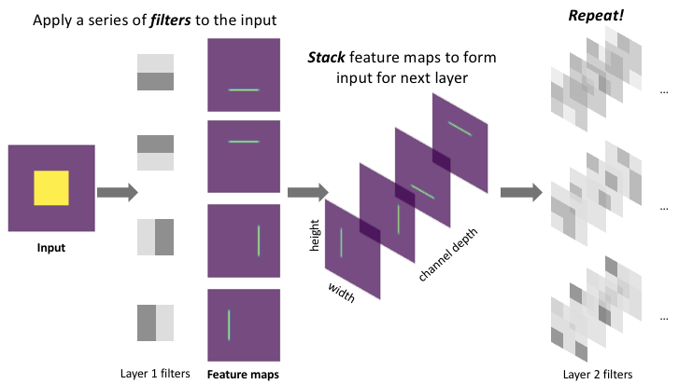
Stacking Filters
Multiple filters are stacked to extract different features from the input image
Convolutional neural networks. (jeremyjordan.me)

Slide 12
Convolutional Neural Networks
Feature extraction
Convolutional Neural Network: A Step By Step Guide | by Shashikant | Towards Data Science

Slide 13
Convolutional Neural Networks
Feature extraction
Compression
Convolutional Neural Network: A Step By Step Guide | by Shashikant | Towards Data Science

Slide 14
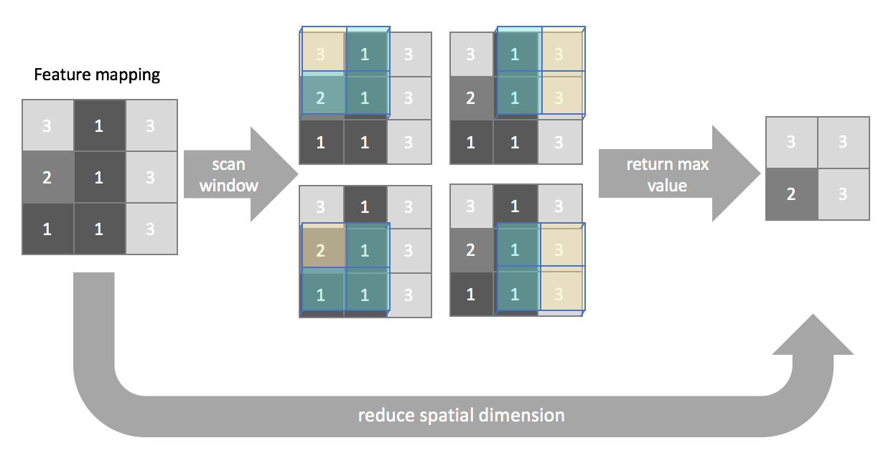
Pooling
Max pooling is the most common (robust to noise)
Stride in convolutional layers is “learned pooling”
Convolutional neural networks. (jeremyjordan.me)

Slide 15
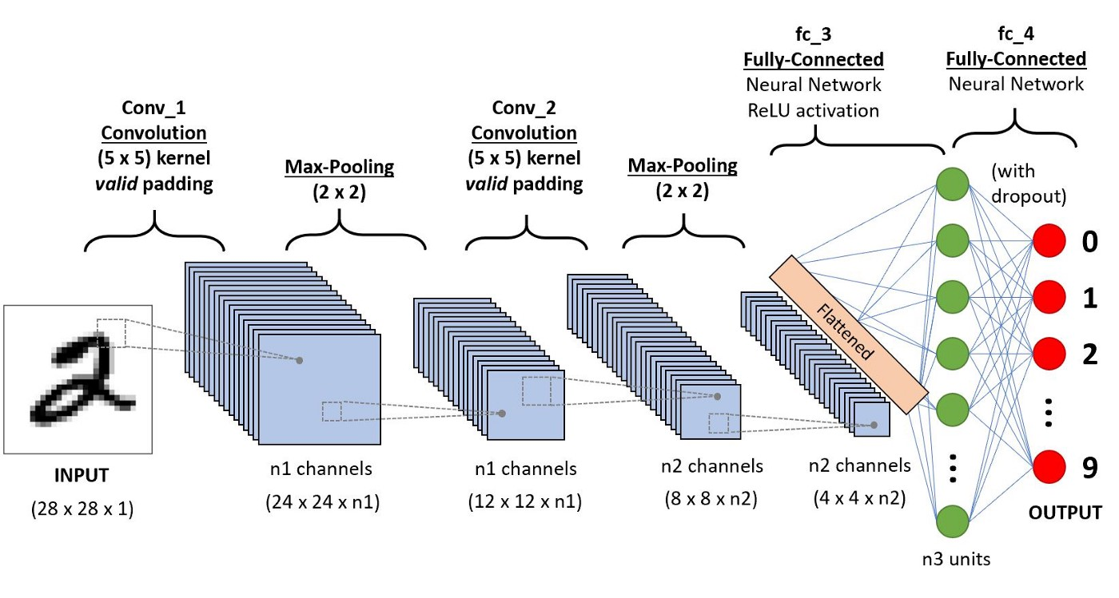
A Comprehensive Guide to Convolutional Neural Networks — the ELI5 way | by Sumit Saha | Towards Data Science

Slide 16
Navigate to Day 5:
PrincetonUniversity/intro_machine_learning (github.com)
… or use the Colab notebook directly:
Music:
https://www.youtube.com/watch?v=aFH1ryYTDB4
Time for some NN practice!

