Slide 1
Tutorial:
Optimal Learning in the Laboratory Sciences
Building a belief model
December 10, 2014
Warren B. Powell
Kris Reyes
Si Chen
Princeton University
http://www.castlelab.princeton.edu
Slide 1
Notes:
1

Slide 2
Lecture outline
Building a belief model
© 2010 Warren B. Powell
Slide 2

Slide 3
Building a belief model
Belief models
A belief model captures what you know about how your process responds to the parameters you control (temperature, concentration, shape, size, density).
The belief model formalizes what you know, and what you learn from an experiment.
Types of belief models
Lookup tables (for discrete choices such as shapes of nanoparticles, type of oil, type of catalyst)
Parametric model (analytic function)
Set of differential equations
Human-drawn curves

Slide 4
Correlated beliefs
We start with a belief about each material (lookup table)
1
2
3
4
4
5
1.4 nm Fe
1 nm Fe
2nm Fe
2nm Ni
Ni 0.6 nm
10nm ALD AI203+1 nm Ni
10nm ALD AI203+1.2 nm 1BSFe
4
Notes:
4

Slide 5
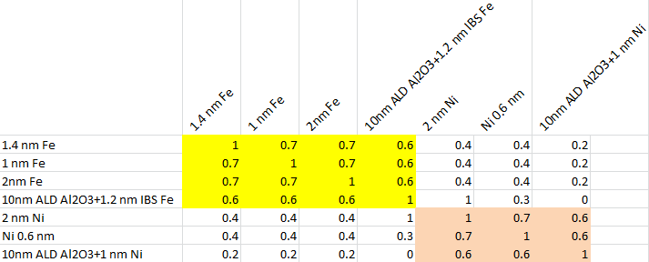
Building a belief model
Lookup table
We can organize potential catalysts into groups
Scientists using domain knowledge can estimate correlations in experiments between similar catalysts.

Slide 6
Correlated beliefs
Testing one material teaches us about other materials
1
2
3
4
4
5
1.4 nm Fe
1 nm Fe
2nm Fe
2nm Ni
Ni 0.6 nm
10nm ALD AI203+1 nm Ni
10nm ALD AI203+1.2 nm 1BSFe
6
Notes:
6

Slide 7
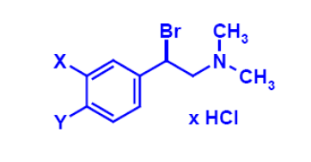
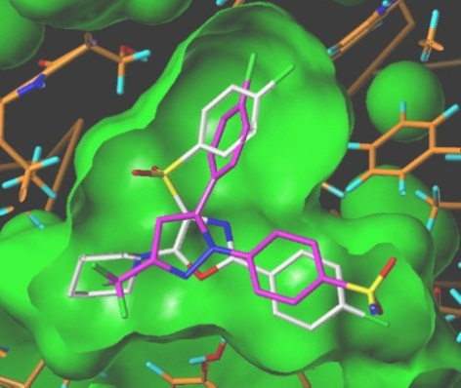

Parametric functions
Parametric belief model for molecular design
Approximating the performance of different molecules
X and Y are sites where we can hang substituents to change the behavior of the molecule
This is an example of a linear model (linear in the parameters)

Slide 8
Linear Model: Arrhenius Model
Temperature dependence on chemical reaction rate k
We might have beliefs about different slopes…

Slide 9
Linear Model: Arrhenius Model
Temperature dependence on chemical reaction rate k
We might have beliefs about different slopes…
… as well as different intercepts.

Slide 10
Linear Model: Arrhenius Model
Temperature dependence on chemical reaction rate k
We might have beliefs about different slopes…
… as well as different intercepts.
But they are likely to be correlated.

Slide 11
Parametric belief model
Other models are nonlinear (in the parameters)
For example, the following model describes the length of nanotubes in low temperatures:
We might enumerate a number of potential sets of values for all the parameters (known as “discrete priors”)

Slide 12
Building a belief model
A prior can consist of a series of hand-drawn curves:
Possible relationships
Photo-induced current
Density

Slide 13
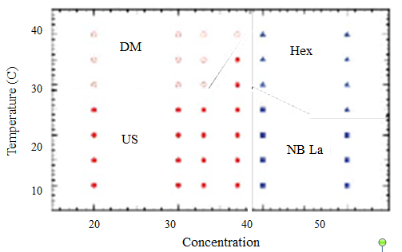
Phase Diagram
Classifying temperature/concentration regions
Different regions produce different materials
Each combination of temperature and concentration is a very expensive experiment.
How do we minimize the number of experiments to come up with a good classification?

Slide 14
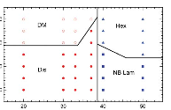

Phase Diagram
Possible combinations we might run:
40
30
20
10
DM
Hex
Temperature (C)
US
NB La
20 30 40 50
Concentration
Courtesy C. Lam, B. Olsen

Slide 15
Phase Diagram
One possible clustering:
40
30
20
10
DM
Hex
Temperature (C)
US
US
NB La
20 30 40 50
Concentration
Courtesy C. Lam, B. Olsen

Slide 16
Phase Diagram
Other clusterings:
40
30
20
10
DM
Hex
Temperature (C)
US
US
NB La
20 30 40 50
Concentration
Courtesy C. Lam, B. Olsen

Slide 17
Phase Diagram
Other clusterings:
40
30
20
10
DM
Hex
Temperature (C)
US
US
NB La
20 30 40 50
Concentration
Courtesy C. Lam, B. Olsen

Slide 18
Phase Diagram
Other clusterings:
40
30
20
10
DM
Hex
Temperature (C)
US
US
NB La
20 30 40 50
Concentration
Courtesy C. Lam, B. Olsen

Slide 19
Phase Diagram
Other clusterings:
40
30
20
10
DM
Hex
Temperature (C)
US
US
NB La
20 30 40 50
Concentration

Slide 20
Phase Diagram
Other clusterings:
40
30
20
10
DM
Hex
Temperature (C)
US
US
NB La
20 30 40 50
Concentration

Slide 21
Phase Diagram
Other clusterings:
40
30
20
10
DM
Hex
Temperature (C)
US
US
NB La
20 30 40 50
Concentration

Slide 22
Building a belief model
For each belief model:
We need to be able to compute the best possible design given our current set of beliefs (known as the prior)
We need to understand the possible outcomes of each experiment that we might want to run.
We then need to know how to update our belief model. This will give us a range of possible posteriors.
Finally, we need to compute the best possible design for each possible prior.

