Slide 1
Tutorial:
Optimal Learning in the Laboratory Sciences
A case application – Growing carbon nanotubes
December 10, 2014
Warren B. Powell
Kris Reyes
Si Chen
Princeton University
http://www.castlelab.princeton.edu
Slide 1
Notes:
1

Slide 2
Lecture outline
A case application – Carbon nanotubes
Building a belief model (the prior)
Running an experiment
Updating the belief (the posterior)
Designing a policy
Creating a prior

Slide 3
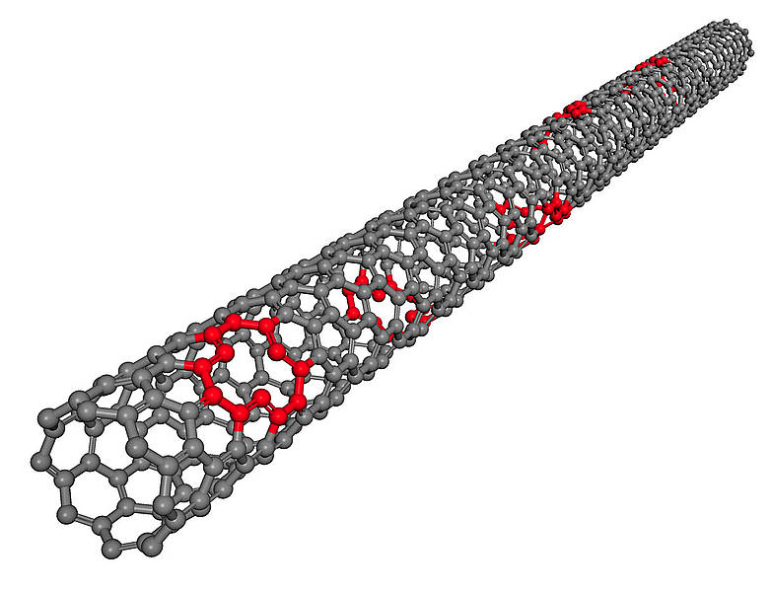
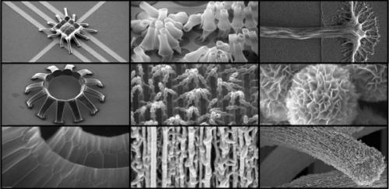
Growing Nanotubes
Nanotubes
As of 2013 carbon nanotube production exceeded several thousand tons per year
Applications: energy storage, automotive parts, boat hulls, sporting goods, water filters, thin-film electronics, coatings, actuators, etc.
Courtesy www.kintechlab.com
http://phys.org/news/2014-03-carbon-nanotubes-real-world-applications.html
Notes:
For reference: Red spots in the nanotube illustration mark defects

Slide 4
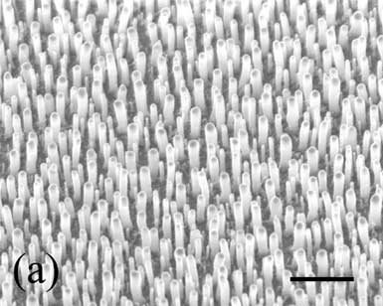
Growing Nanotubes
Find the catalysts that give the best nanotube length
Objective: optimize the nanotube length
Discrete choices: different catalysts, e.g. Fe, Ni, PHN, Al₂O₃+Fe, Al₂O₃+Ni
Budget: small number of sequential experiments
K. Kempa, Z. Ren et al., Appl. Phys. Lett. 85, 13 (2004)

Slide 5
Simple Belief Model
Point estimate: depending on the catalysts, we get different nanotube lengths
Distribution: describes our belief about the length of the bar produced by each catalyst
Which catalyst to try?
Nanotube Length
Fe
Ni
PHN
Al₂O₃+Fe
Al₂O₃+Ni

Slide 6
Simple Belief Model
Which catalyst to try?
If we try Al₂O₃+Fe, our belief of the best may stay unchanged.
Nanotube Length
Fe
Ni
PHN
Al₂O₃+Fe
Al₂O₃+Ni

Slide 7
Simple Belief Model
Which catalyst to try?
If we try Al₂O₃+Fe, our belief of the best may stay unchanged.
Nanotube Length
Fe
Ni
PHN
Al₂O₃+Fe
Al₂O₃+Ni

Slide 8
Simple Belief Model
Which catalyst to try?
If we try Al₂O₃+Fe, our belief of the best may stay unchanged.
If we try Ni, our belief of the best may change lot.
Nanotube Length
Fe
Ni
PHN
Al₂O₃+Fe
Al₂O₃+Ni

Slide 9
Simple Belief Model
Which catalyst to try?
If we try Al₂O₃+Fe, our belief of the best may stay unchanged.
If we try Ni, our belief of the best may change lot.
Nanotube Length
Fe
Ni
PHN
Al₂O₃+Fe
Al₂O₃+Ni

Slide 10
Policy
Measurement policy:
A rule for making decisions, i.e. which catalyst to try?
Different policies
Try a random one (exploration)
Try the one that looks the best (exploitation), i.e. Al₂O₃+Fe
Try the most uncertain one (variance reduction), i.e. Ni
Combine exploration and exploitation (interval estimation)
Questions:
Can we be smarter?
What is the effect of decision-making rule to the number of experiments needed to discover the best?
Notes:
KR: Changed some text

Slide 11
Prior
Simple belief model (lookup table)
Point estimate (single truth)
Nanotube Length
Fe
Ni
PHN
Al₂O₃+Fe
Al₂O₃+Ni

Slide 12
Prior
Simple belief model (lookup table)
Point estimate (single truth)
Many possible truths
Fe
Ni
PHN
Al₂O₃+Fe
Fe
Ni
PHN
Al₂O₃+Fe
Al₂O₃+Ni
Al₂O₃+Ni
Fe
Ni
PHN
Al₂O₃+Fe
Fe
Ni
PHN
Al₂O₃+Fe
Al₂O₃+Ni
Al₂O₃+Ni

Slide 13
Prior
Simple belief model (lookup table)
Point estimate
Many possible truths
Truths can be captured by a distribution called the prior.
Nanotube Length
Fe
Ni
PHN
Al₂O₃+Fe
Al₂O₃+Ni

Slide 14
How to Construct a Prior?
Literature review
Similar systems may be studied before
Material property database
E.g. NIST Property Data Summaries for Advanced Materials, AFLOWLIB, MatWeb
Previous lab data
Estimate the estimation (mean) and uncertainty (variance) using some initial experiments or similar experiments done earlier
Fundamental understanding of physics and chemistry

