Slide 1
Tutorial:
Optimal Learning in the Laboratory Sciences
Forming the decision set
December 10, 2014
Warren B. Powell
Kris Reyes
Si Chen
Princeton University
http://www.castlelab.princeton.edu
Slide 1
Notes:
1

Slide 2
Lecture Outline
Forming the decision set

Slide 3
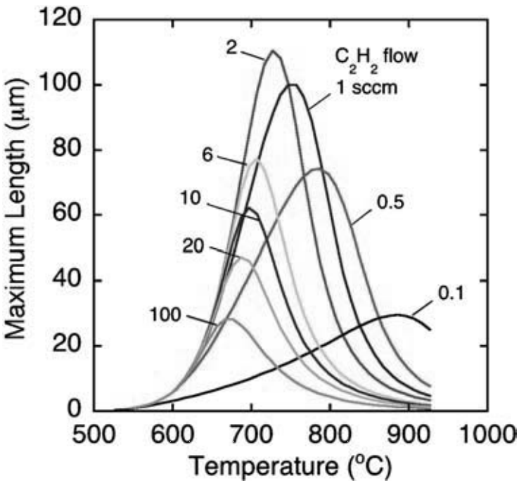
Decision Set
Discrete Decisions
E.g. different catalysts: Fe, Ni, PHN, Al₂O₃+Fe, Al₂O₃+Ni
Continuous Decisions
E.g. temperature, pressure, flow rate
Nanotube Length
Fe
Ni
PHN
Al₂O₃+Fe
Al₂O₃+Ni
Puretzky et al. Appl. Phys. A 81 (2005)

Slide 4
Decision Set
Decisions may be complex
1,000 metal organic frameworks
87,000 combinations of substituents placed at different sites
10,000 combinations of four different parameters
Temperature
Concentration
Ratio
Density
With so many choices and such small budgets, why consider all these combinations?

Slide 5
Decision Set
Decisions may be complex
1,000 metal organic frameworks
87,000 combinations of substituents placed at different sites
10,000 combinations of four different parameters
Temperature
Concentration
Ratio
Density
With so many choices and such small budgets, why consider all these combinations?

Slide 6
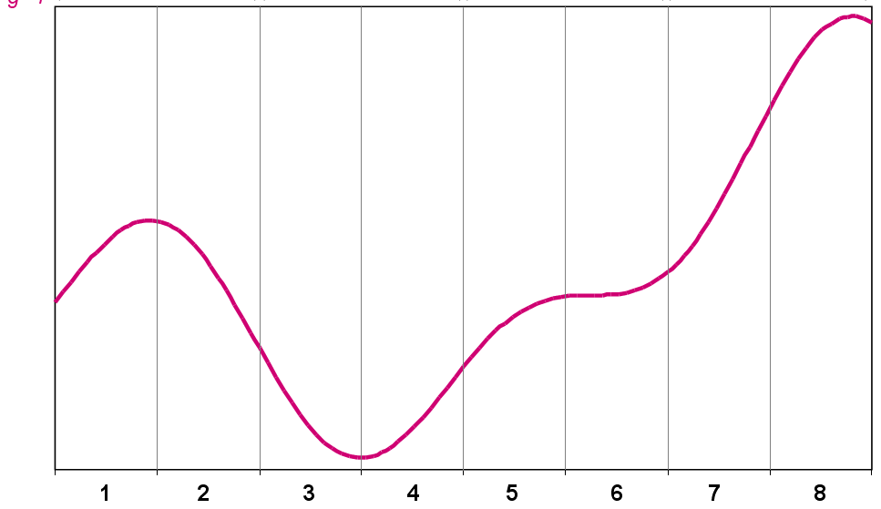
Decision Set
Considering all decisions
It is still important to explicitly consider all the possible options, even when the experimental budget is small.
We can generalize what we learn from one experiment

Slide 7

Are we thinking inside the box?
Are there only 5 possible catalysts (Fe, Ni, PHN, Al₂O₃+Fe, Al₂O₃+Ni)?
How about Co?
Are there only 3 continuous parameters?
How about humidity?
Should we only consider one small temperature range, e.g. 800-1000 Celsius?
How about 600-1500 Celsius?
Other choices or system?
How about changing substrates?

