Slide 1
Tutorial:
Optimal Learning in the Laboratory Sciences
Evaluating risk
December 10, 2014
Warren B. Powell
Kris Reyes
Si Chen
Princeton University
http://www.castlelab.princeton.edu
Slide 1
Notes:
1

Slide 2
Lecture outline
Assessing and controlling risk

Slide 3
Assessing and controlling risk
Questions facing any experimentalist:
What is the risk that you will achieve specific goals (strength, reflectivity, fluorescence, …) with a specific experimental design?
Measures of success:
Relative success – How well might you do relative to the best that can be achieved?
Absolute success – How well might you do relative to some absolute metric?
What is the most cost-effective way of minimizing risk?
Increasing the experimental budget
Reducing the noise in a single experiment
Do a better job of sequencing experiments

Slide 4
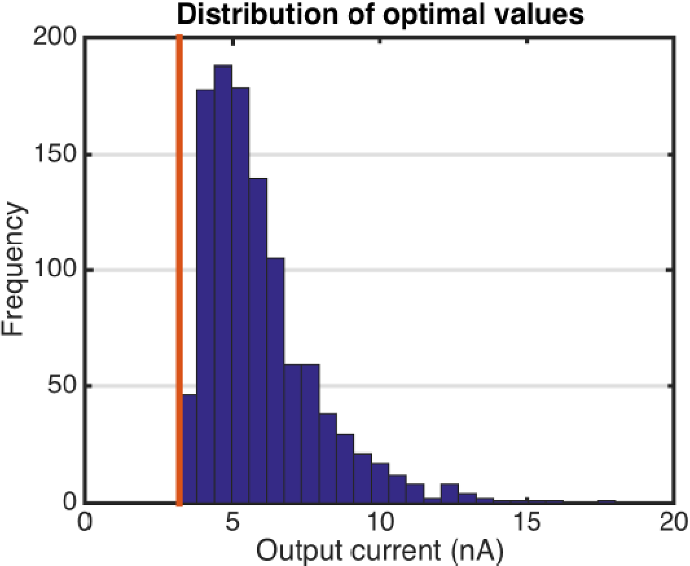
Sample application: Maximize current
We start with a distribution of the possible true values of the unknown For
For each possible truth, we find the design that produces the highest output.
This represents the best you can possibly achieve with an unlimited experimental budget.

Slide 5
Managing risk
Analysis approach:
Use “knowledge gradient” to simulate the decisions that would be made by a scientist.
Simulate the process of running an experiment many times given an assumed budget and experimental noise.
This has to be done over different values of the assumed truth.
Estimate the probability of success
Did you achieve absolute goal?
How well did you do relative to the best that could have been achieved?

Slide 6
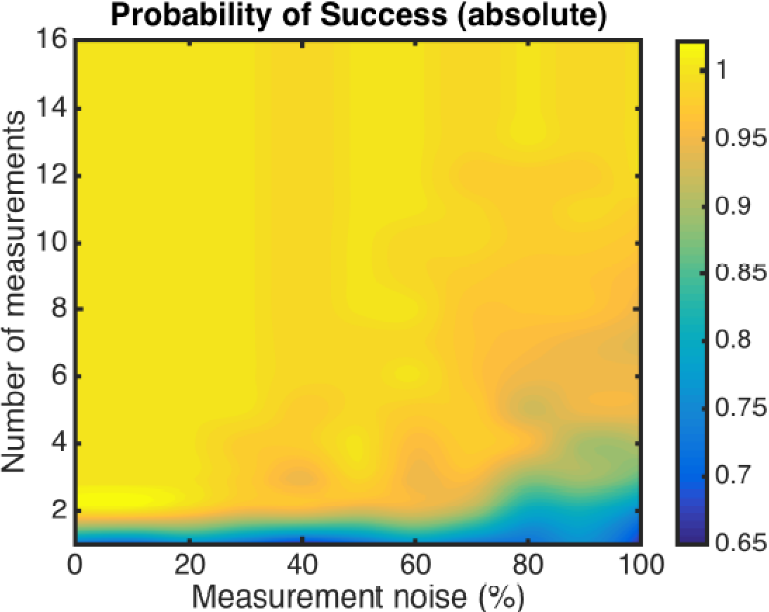
Managing risk
Target level

Slide 7
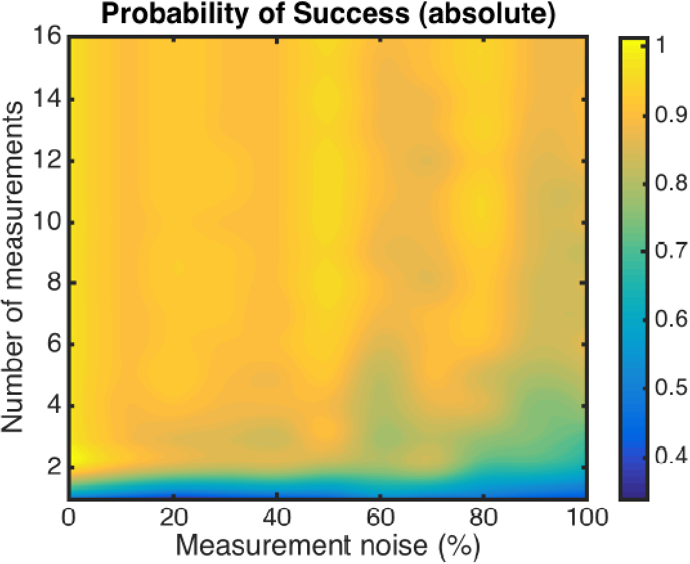
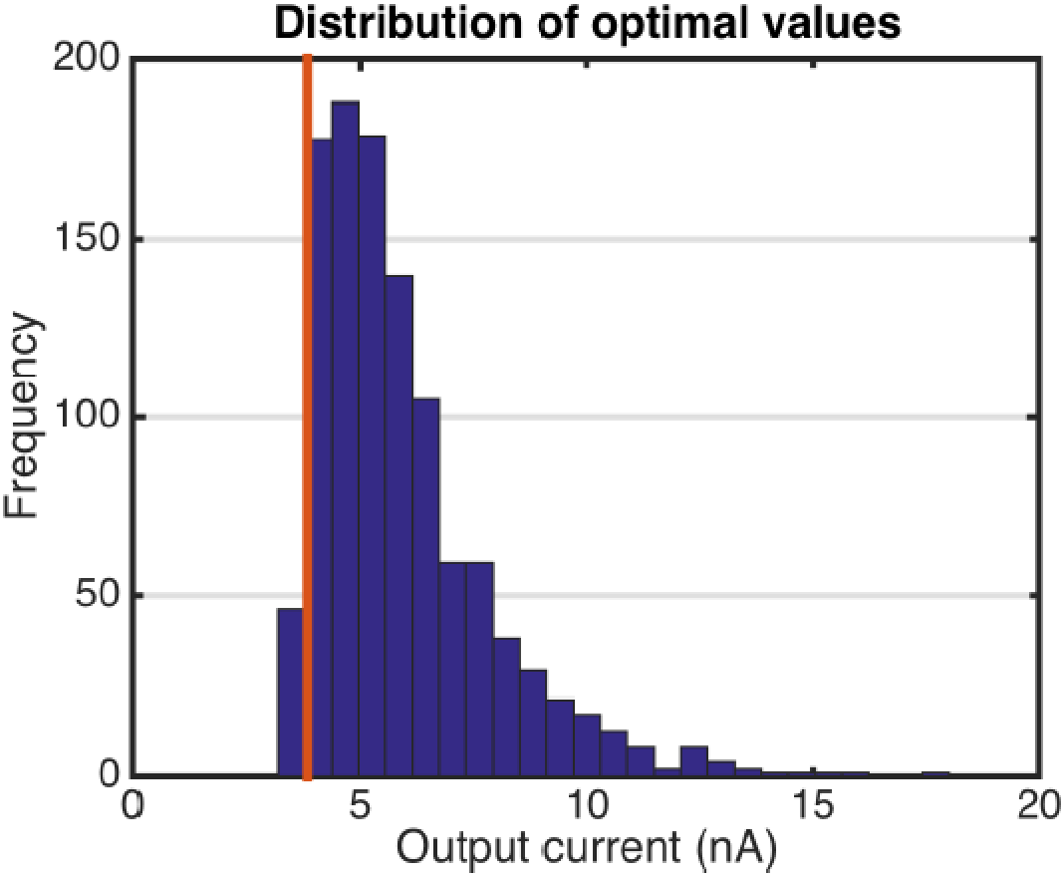
Managing risk

Slide 8
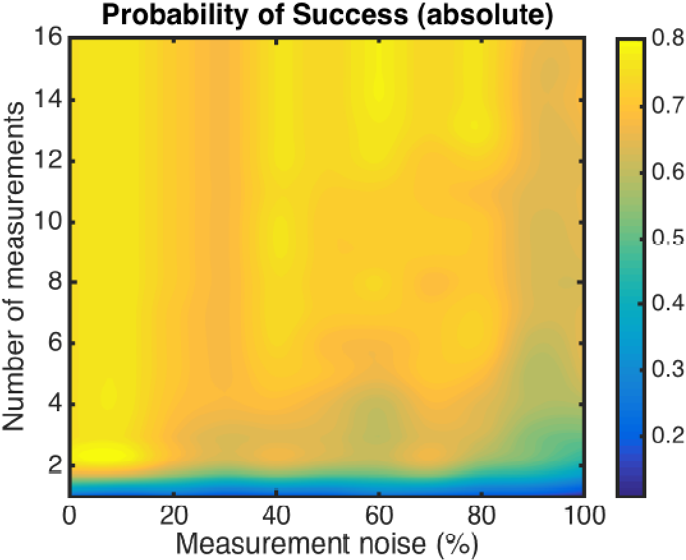
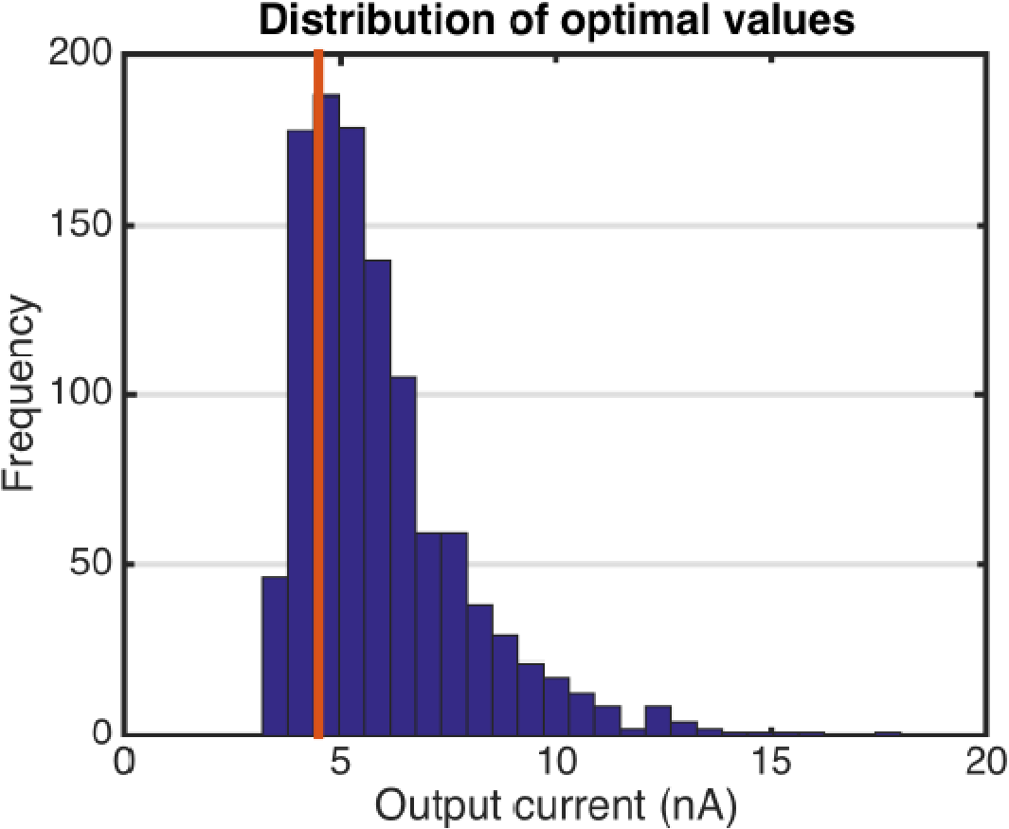
Managing risk
Notes:
However, as we increase the target, there is a chance
that the sampled truth cannot even achieve this value, let alone the possibility of the OL procedure of finding it.

Slide 9
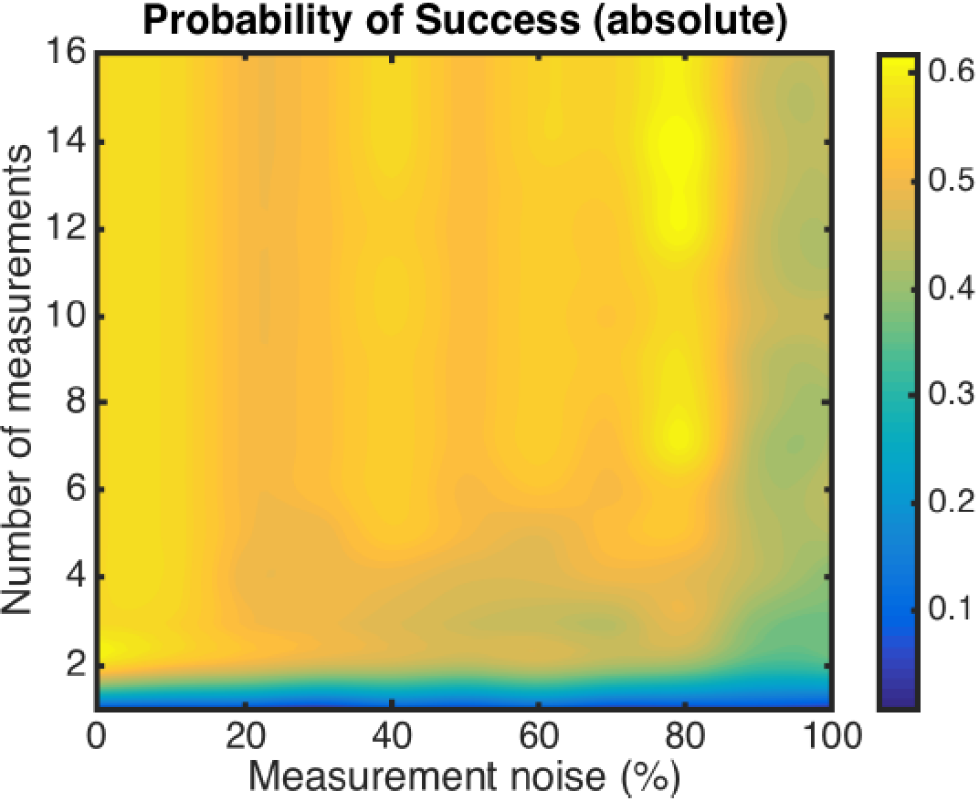
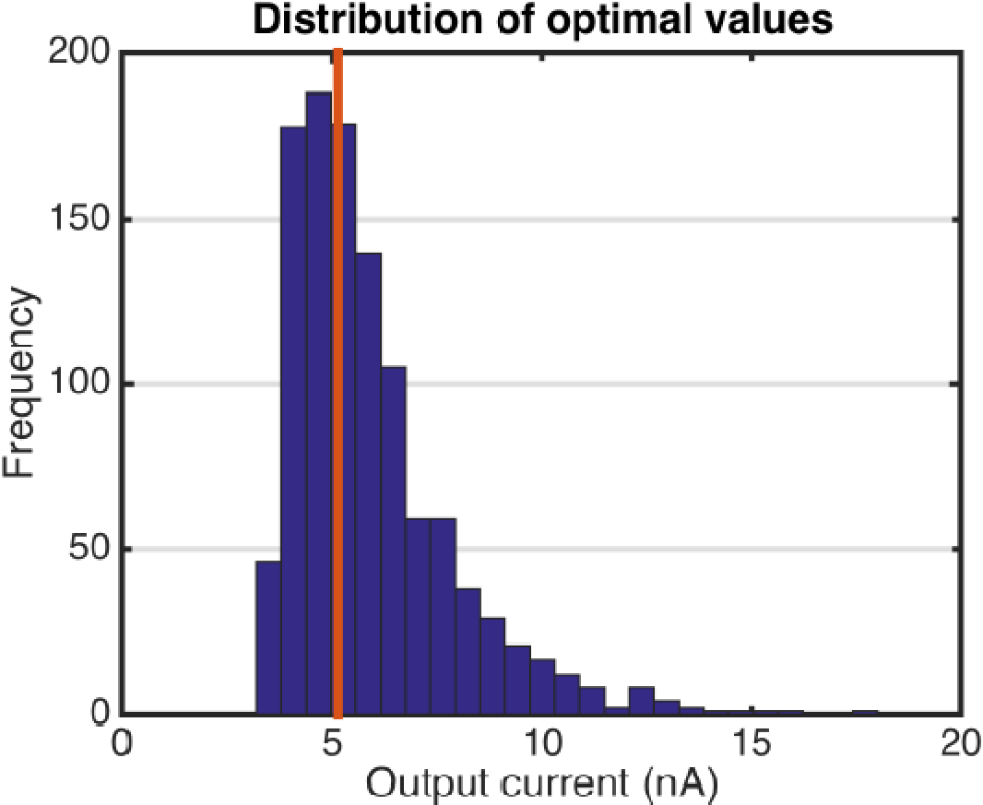
Managing risk

Slide 10
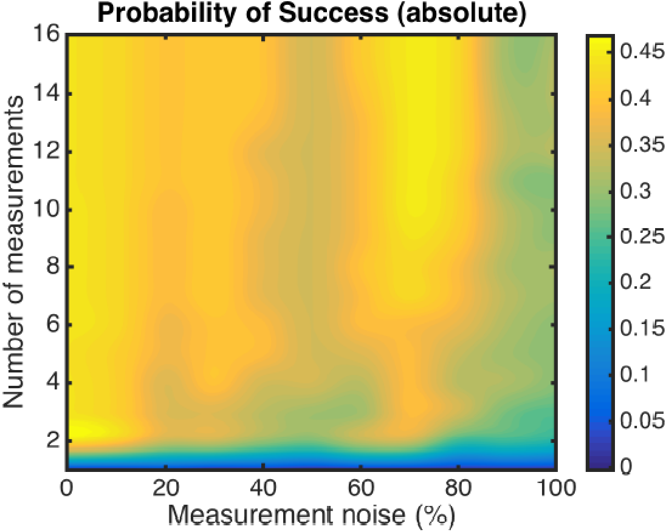

Managing risk

Slide 11
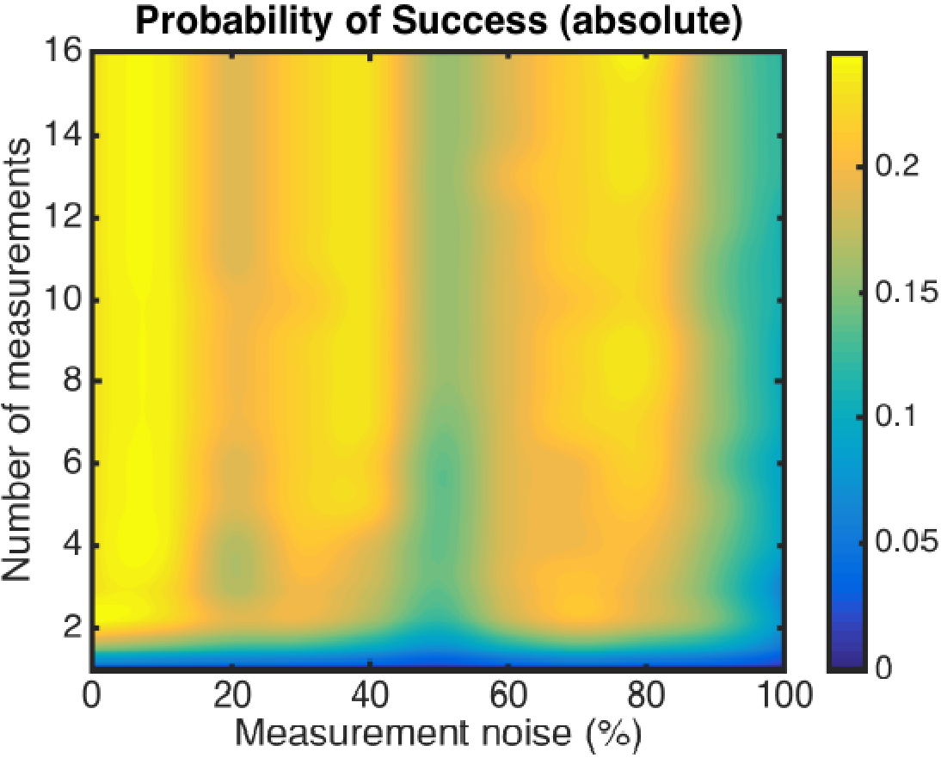
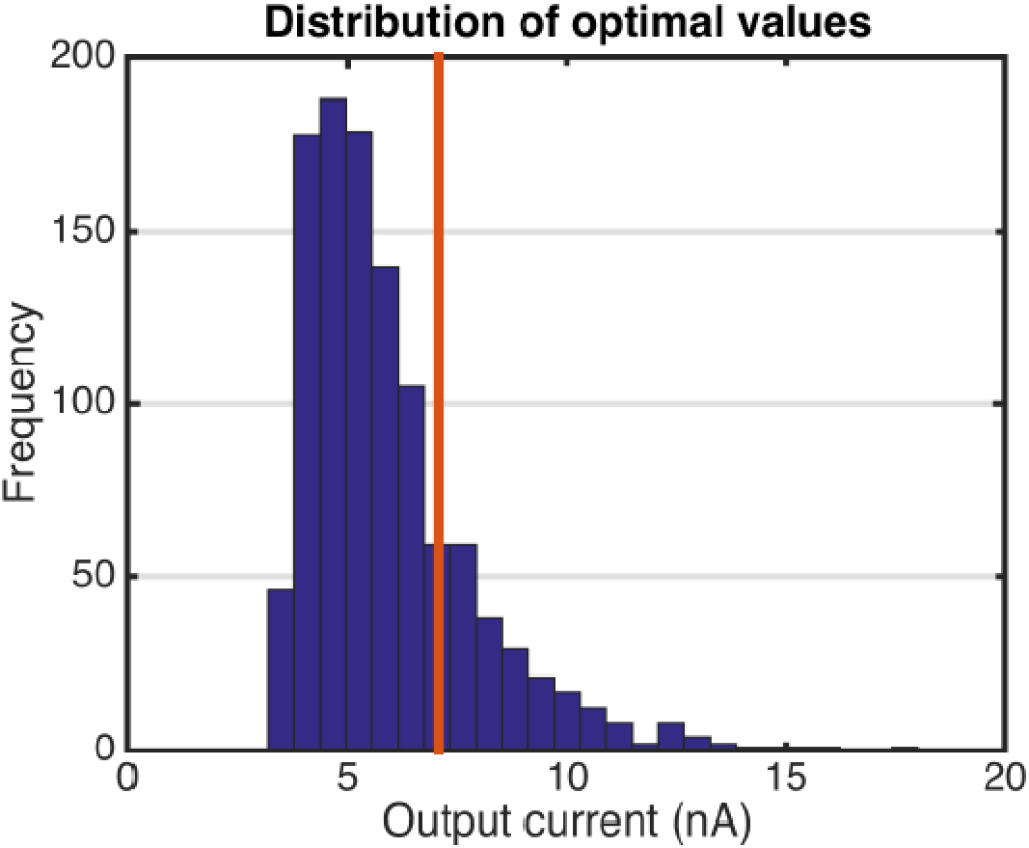
Managing risk

Slide 12
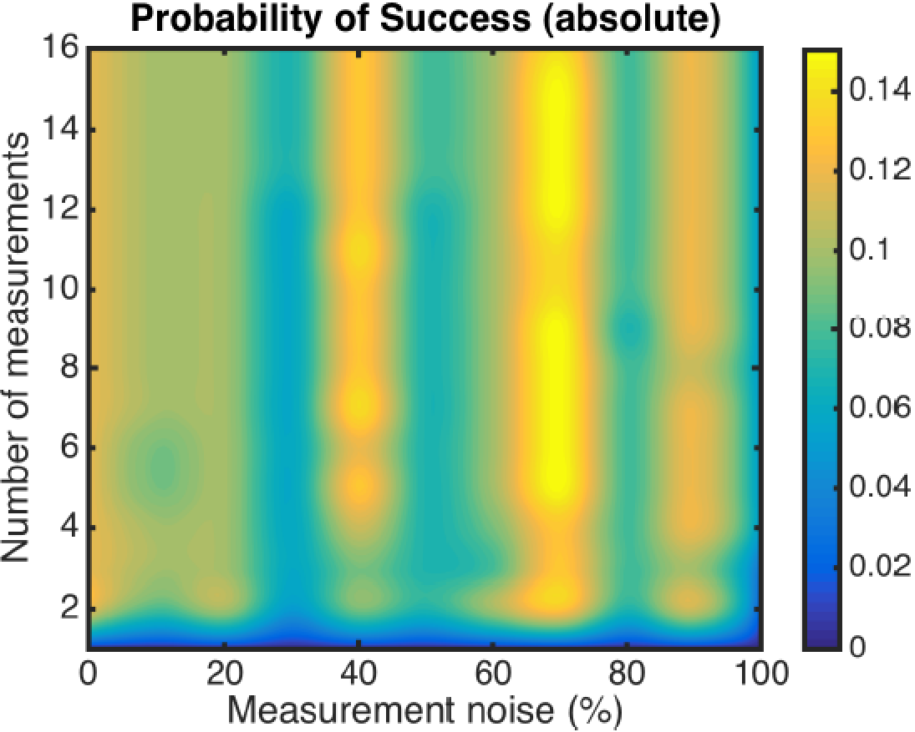
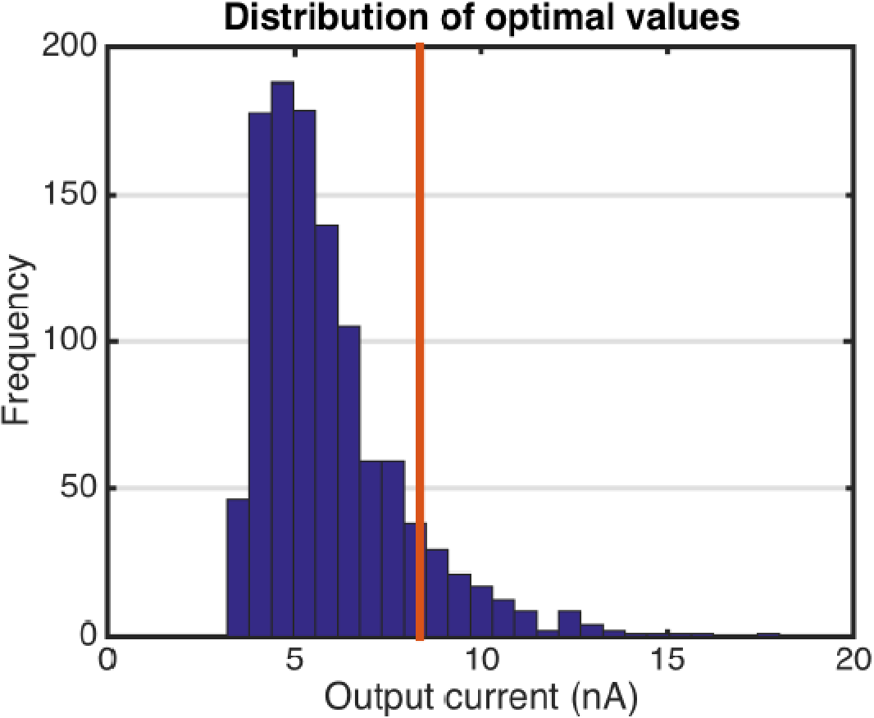
Managing risk

Slide 13
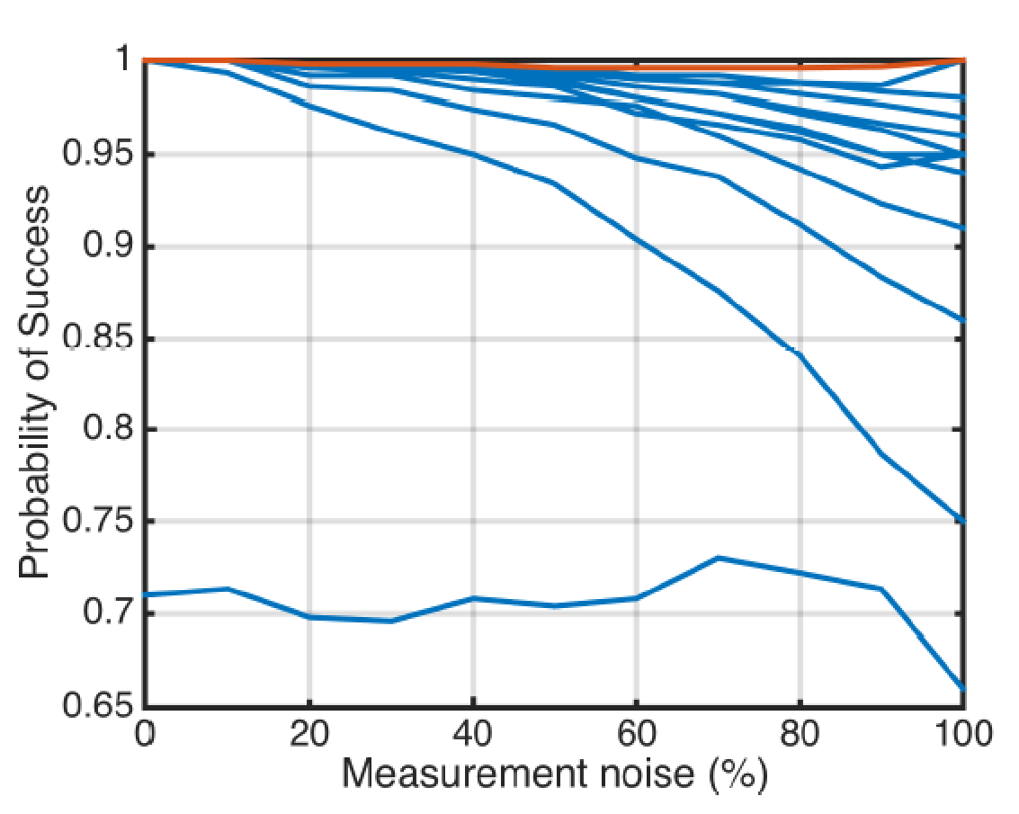
Managing risk
We can increase the likelihood of success by:
Increasing the number of experiments
Reducing the experimental noise
Implications
Managers can assess the risk from a research proposal.
Experimentalists can find the least cost way to minimize risk.
Increasing number
of experiments

