Slide 1
Tutorial:
Optimal Learning in the Laboratory Sciences
The power of interactivity
December 10, 2014
Warren B. Powell
Kris Reyes
Si Chen
Princeton University
http://www.castlelab.princeton.edu
Slide 1
Notes:
1

Slide 2
Lecture Outline
The power of interactivity

Slide 3
Interactivity
Guiding the experimental process requires balancing a number of objectives
We would like to run experiments with the highest chance of success.
We also want to learn the most to guide future experiments.
But we also have to consider the cost and complexity of an experiment.

Slide 4
Interactivity
Value of information
Prior estimate
Highest value of information
Pressure
Pressure
Temperature
Temperature
The experiment that produces the highest value of information might require using the highest temperatures and pressures.
The scientist has to balance the performance of an experiment, the value of information, and the complexity of the experiment.

Slide 5
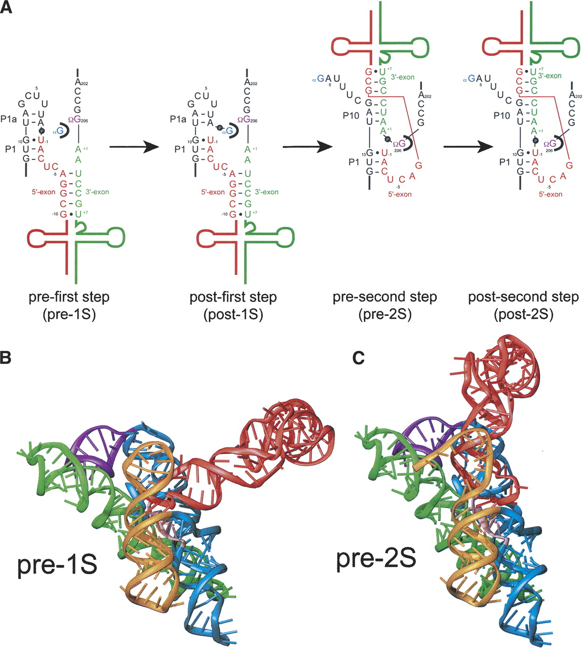
Interactivity
Designing probles for an RNA molecule
The accessibility of a region of an RNA molecule mediates interaction with other molecules.
Depends on how you define interactions, resulting in several methods for accessing accessibility.
Mechanistic
Energetic
Mechanistically accessible region
Well-protected region = inaccessible

Slide 6
Interactivity
Designing probles for an RNA molecule
New Methodology: attempt to bind probe/reporter complex with fluorescent marker. If bound, we observer strong fluorescence signal.
Probe/Reporter complex
If a probe cannot bind, then we get no fluorescence signal, indicating inaccessibility.
If probe can bind, we get fluorescence signal, indicating accessibility.

Slide 7
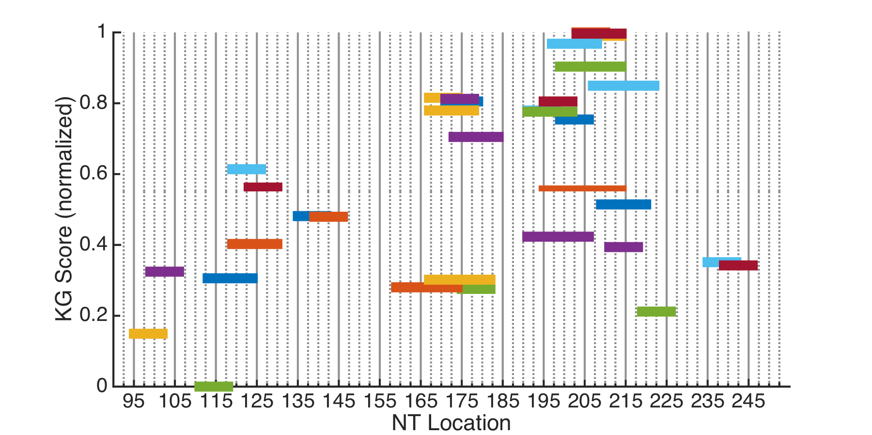
Knowledge Gradient scores
Each bar is a potential region to probe. The vertical axis is the KG score.
High confidence in prior DMS data

Slide 8
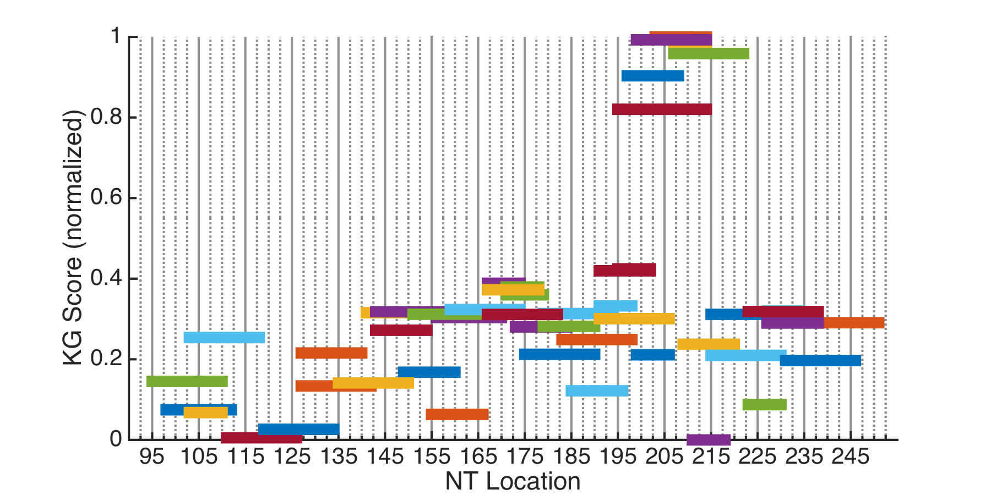
Knowledge Gradient scores
This plot tells us how much information can be gained from targeting each region.
Highest scoring regions = most information to be gained
Low confidence in prior DMS data

Slide 9
Knowledge Gradient scores
Use KG scores as a guideline to picking the next experiment.
The primer for this highest scoring probe need to be ordered
But we have this primer in stock, and it has a reasonably large KG value.

Slide 10
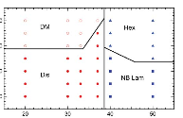
Phase Diagram
40
30
20
10
DM
Hex
Temperature (C)
US
NB La
20 30 40 50
Concentration

Slide 11
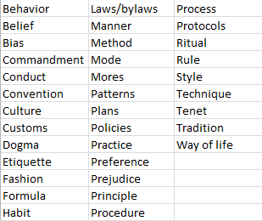
Policy function approximations
Lookup table policies arise in many settings in everyday life

