Slide 1
Tutorial:
Optimal Learning in the Laboratory Sciences
The knowledge gradient
December 10, 2014
Warren B. Powell
Kris Reyes
Si Chen
Princeton University
http://www.castlelab.princeton.edu
Slide 1
Notes:
1

Slide 2
Lecture outline
The knowledge gradient
© 2010 Warren B. Powell
Slide 2

Slide 3
Knowledge gradient
Concept:
The knowledge gradient is the marginal value of an experiment, measured in terms of how well it improves our performance metrics.
It combines the goals of exploration and exploitation into a single metric that can guide the scientist.
Some properties:
It will not recommend an experiment where we do not reduce our uncertainty
But at the same time it identifies experiments that are most likely to actually improve our performance metric. Reducing uncertainty is not enough.

Slide 4
Knowledge Gradient
Make measurement decisions by maximizing the average marginal value of information (AMVI), e.g. Al₂O₃+Fe
AMVI
Nanotube Length
Fe
Ni
PHN
Al₂O₃+Fe
Al₂O₃+Ni

Slide 5
Elements of Learning Model
Prior distribution on uncertain quantities
E.g. nanotube length vs. catalyst, temperature
nanotube length vs. kinetic parameters
Control variables (or alternatives)
E.g. catalyst, temperature, humidity
Error distribution of the measurement
E.g. how noise distributed around the truth
The posterior distribution
How did our information change our belief?
Objective function
E.g. nanotube length and number of defects

Slide 6
State of Knowledge
We start by specifying our state of knowledge (say, after n experiments):
So, we may say that our belief about the performance of each material is normally distributed with some mean and standard deviation. This is our state of knowledge, which captures the uncertainty in what we know.
Nanotube Length
Fe
Ni
PHN
Al₂O₃+Fe
Al₂O₃+Ni

Slide 7
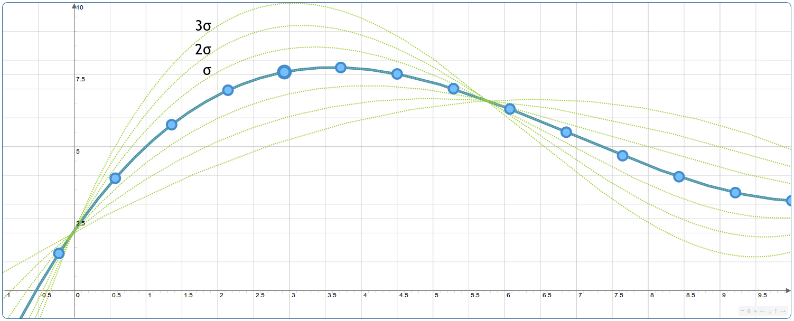
State of Knowledge
We start by specifying our state of knowledge (say, after n experiments):
Our state of knowledge may be a series of functions.
7

Slide 8
Design Decision
We then have to identify our design decision y which is how we turn our knowledge into an actual choice of how we are going to make our material.
Our knowledge may be our estimates of kinetic parameters.
The design variable y might represent choices about diameters, ratios, …
Let be our performance metric (length, lifetime, output, …). can be a utility function that combines performance with experimental cost and reliability.

Slide 9
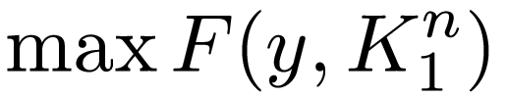
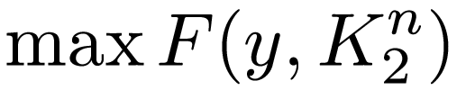
Final Desicion
If we were to stop experimenting now, we would find the value of y that produces the best performance (i.e. maximizing ).

Slide 10
The Knowledge Gradient
Now imagine that we do one more experiment where we represent our decisions using x.
This produces an updated state of knowledge
Because we have not run the experiment yet, we do not know the outcome, or our updated state of knowledge.

Slide 11
The Knowledge Gradient
We want to know how well we would do with our design given our updated state of knowledge after running our experiment with choices x, which means solving
But is uncertain (we do not know the outcome of the experiment), so we have to find
The “E” means computing an expectation, is where we average over all possible truths, and the experimental noise.

Slide 12
The knowledge gradient
The value of running an experiment is how much better our performance is likely to be from running experiment x:

Slide 13
The knowledge gradient
The value of running an experiment is how much better our performance is likely to be from running experiment x:
Current state of knowledge

Slide 14
The Knowledge Gradient
The value of running an experiment is how much better our performance is likely to be from running experiment x:
Choosing the best design given what we know now.

Slide 15
The Knowledge Gradient
The value of running an experiment is how much better our performance is likely to be from running experiment x:
Updated parameter estimates after running experiment with density x.
Proposed experiment

Slide 16
The Knowledge Gradient
The value of running an experiment is how much better our performance is likely to be from running experiment x:
Finding the new design with our new knowledge (but without knowing the outcome of the experiment)

Slide 17
The Knowledge Gradient
The value of running an experiment is how much better our performance is likely to be from running experiment x:
Averaging over the possible outcomes of the experiment (and our different beliefs about parameters)

Slide 18
The Knowledge Gradient
The value of running an experiment is how much better our performance is likely to be from running experiment x:
Finding the new design with our new knowledge (but without knowing the outcome of the experiment)
Choosing the best design given what we know now.
Current state of knowledge
Averaging over the possible outcomes of the experiment (and our different beliefs about parameters)
Updated parameter estimates after running experiment with density x.
Proposed experiment

Slide 19
The Knowledge Gradient
The value of running an experiment is how much better our performance is likely to be from running experiment x:
19

