Slide 1
Tutorial:
Optimal Learning in the Laboratory Sciences
Working with nonlinear belief models
December 10, 2014
Warren B. Powell
Kris Reyes
Si Chen
Princeton University
http://www.castlelab.princeton.edu
Slide 1
Notes:
1

Slide 2
Lecture outline
Nonlinear belief models

Slide 3
Knowledge Gradient with Discrete Priors
The knowledge gradient can be hard to compute:
This has motivated research into how to handle these problems.
The expectation can be hard to compute when the belief model is nonlinear.
The belief model is often nonlinear, such as the kinetic model for fluid dynamics.

Slide 4
Knowledge Gradient with Discrete Priors
Proposal: Assume a finite number of truths (discrete priors), e.g. L=3 possible candidate truths
Utility curve depends on kinetic parameters, e.g
We maintain the weights of each of the possible candidates to represent how likely it is the truth, e.g. p₁=p₂=p₃=1/3 means equally likely

Slide 5
Knowledge Gradient with Discrete Priors
Utility curve depends on kinetic parameters.
The weights on the candidate truths are also on the choice of kinetic parameters:

Slide 6
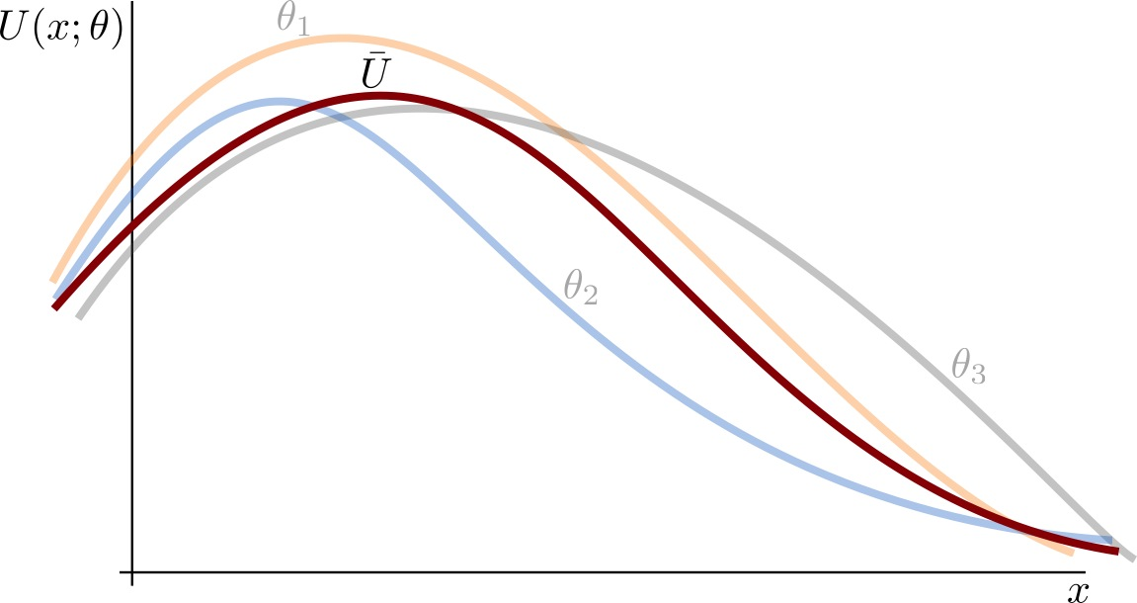
Knowledge Gradient with Discrete Priors
Estimation: a weighted sum of all candidate truths

Slide 7
Knowledge Gradient with Discrete Priors
There are many possible candidate truths
For each candidate truths, the measurements are noisy
Utility curve depends on kinetic parameters.

Slide 8
Knowledge Gradient with Discrete Priors
Suppose we make a measurement

Slide 9
Knowledge Gradient with Discrete Priors
Weights are updated upon observation
Observation
More likely based on observation.
Less likely based on
observation

Slide 10
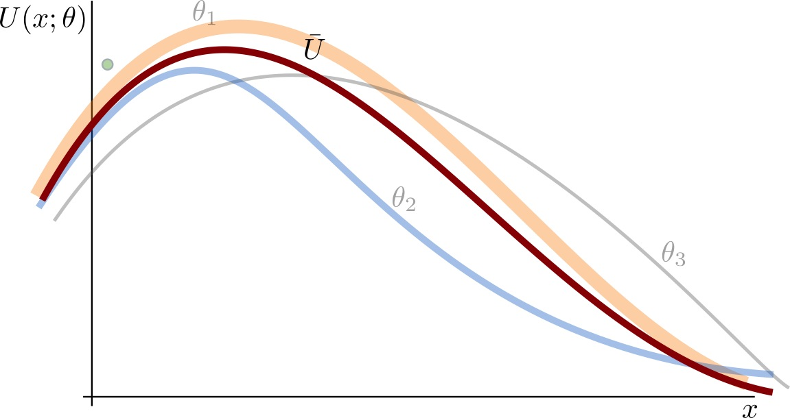
Knowledge Gradient with Discrete Priors
Estimate is then updated using our observation

Slide 11
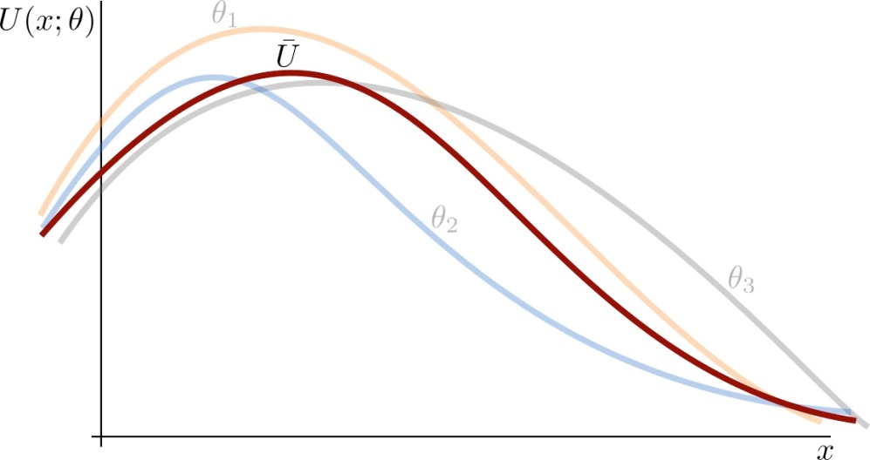
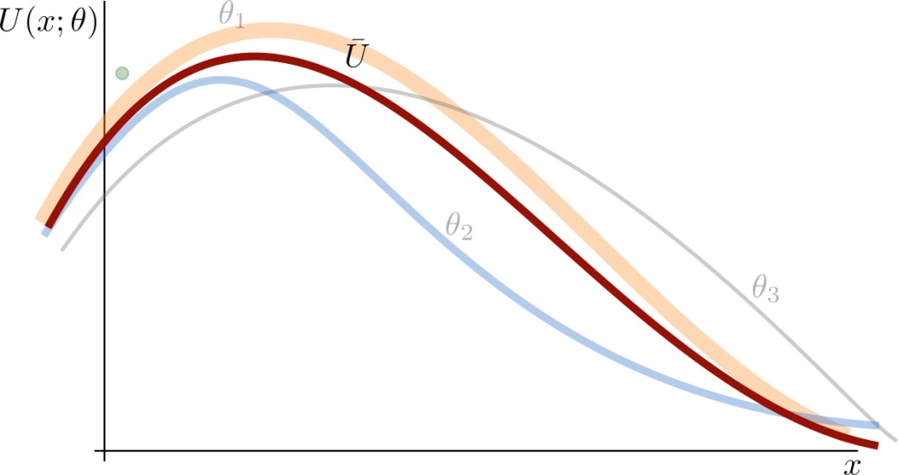
Average Marginal of Information
Best estimate: maximum utility value
Marginal value of information
Average marginal value of information: average across all candidate truths and noise
Best estimate
before the experiment
Best estimate
after the experiment

Slide 12
Knowledge Gradient with Discrete Priors
KGDP makes decisions by maximizing the average marginal of information
After several observations, the weights can tell us about the truth

Slide 13
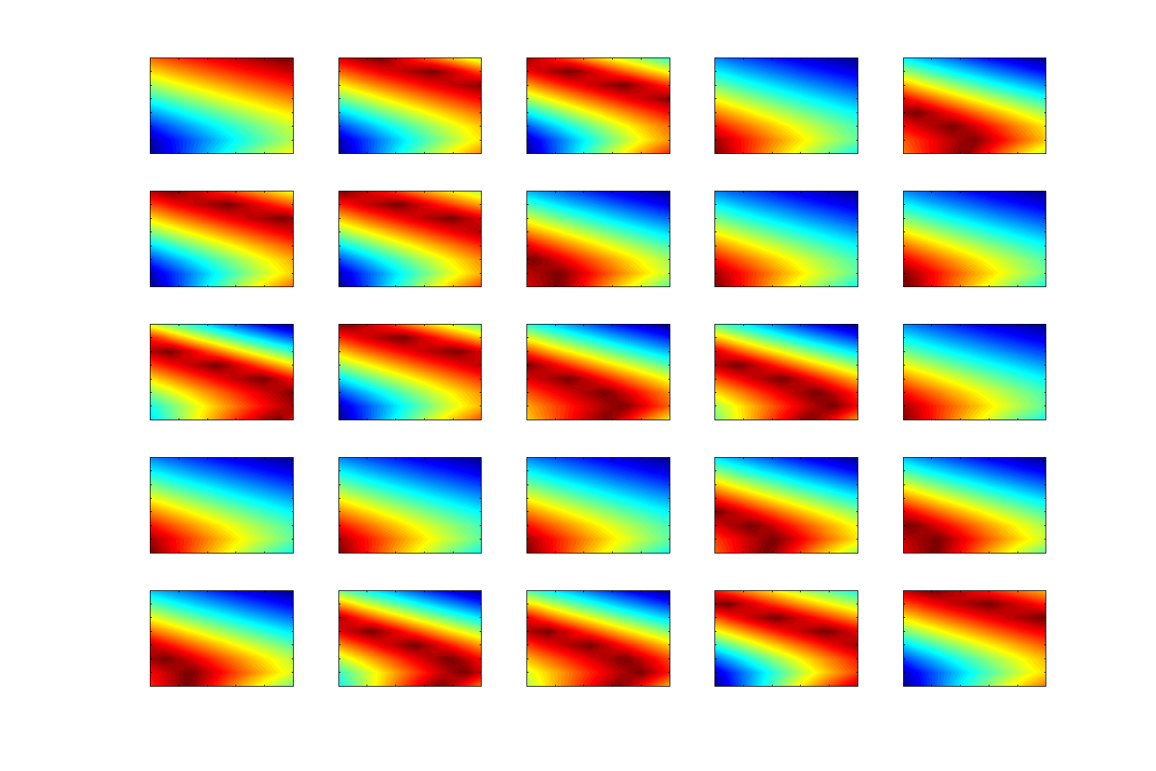
Candidate Truths (2D)
Beliefs on parameters produces family of surfaces
ϑ₁
ϑ₂
ϑ₃
ϑ₄
ϑ₅
ϑ₆
ϑ₇
ϑ₈
ϑ₉
ϑ₁₀
ϑ₁₁
ϑ₁₂
ϑ₁₃
ϑ₁₄
ϑ₁₅
ϑ₁₆
ϑ₁₇
ϑ₁₈
ϑ₁₉
ϑ₂₀
ϑ₂₁
ϑ₂₂
ϑ₂₃
ϑ₂₄
ϑ₂₅

Slide 14
Before any measurements
KG “Road Map”
Prior Estimate
Region where
we learn the most
Inner water droplet diameter (nm)
Inner water droplet diameter (nm)
Region where we learn
the least
Region that appears the best
Oil droplet diameter (nm)
Oil droplet diameter (nm)
Do we explore? The KG map shows us where we learn the most.
… or do we exploit? This is the region where we think we will get the best results (but we might be wrong).
This is the classic exploration vs. exploitation problem

Slide 15
Before any measurements
KG “Road Map”
Prior Estimate
Inner water droplet diameter (nm)
Inner water droplet diameter (nm)
Oil droplet diameter (nm)
Oil droplet diameter (nm)
Do we explore? The KG map shows us where we learn the most.
… or do we exploit? This is the region where we think we will get the best results (but we might be wrong).
This is the classic exploration vs. exploitation problem

Slide 16
Before any measurements
KG “Road Map”
Prior Estimate
Inner water droplet diameter (nm)
Inner water droplet diameter (nm)
Oil droplet diameter (nm)
Oil droplet diameter (nm)

Slide 17
After 1 measurement
KG “Road Map”
Posterior Estimate
Inner water droplet diameter (nm)
Inner water droplet diameter (nm)
Oil droplet diameter (nm)
Oil droplet diameter (nm)

Slide 18
After 2 measurements
KG “Road Map”
Posterior Estimate
Inner water droplet diameter (nm)
Inner water droplet diameter (nm)
Oil droplet diameter (nm)
Oil droplet diameter (nm)

Slide 19
After 5 measurements
KG “Road Map”
Posterior Estimate
Inner water droplet diameter (nm)
Inner water droplet diameter (nm)
Oil droplet diameter (nm)
Oil droplet diameter (nm)

Slide 20
After 10 measurements
KG “Road Map”
Posterior Estimate
Inner water droplet diameter (nm)
Inner water droplet diameter (nm)
Oil droplet diameter (nm)
Oil droplet diameter (nm)

Slide 21
After 20 measurements
KG “Road Map”
Posterior Estimate
Inner water droplet diameter (nm)
Inner water droplet diameter (nm)
Oil droplet diameter (nm)
Oil droplet diameter (nm)
Notes:
TODO:
Truth vs. Prior vs. Posterior
Error map

Slide 22
After 20 measurements
Truth
Posterior Estimate
Inner water droplet diameter (nm)
Inner water droplet diameter (nm)
Oil droplet diameter (nm)
Oil droplet diameter (nm)
Notes:
TODO:
Truth vs. Prior vs. Posterior
Error map

Slide 23
Kinetic parameter estimation
Besides learning where optimal utility is, the KG policy can help learn kinetic parameters.
Distribution on candidate truths induces a distribution on their respective parameters.
Notes:
k^0_ripe, k^0_coalesce are temperature independent prefactors
E_ripe and E_coalesce are activation energy barriers
\grad C is the payload concentration gradient

Slide 24
Uniform prior distribution
Uniform distribution of possible parameter vectors…
Candidate Probability
… translates to random sample of a uniform distribution for an individual parameter.
Parameter Probability
Notes:
k^0_ripe, k^0_coalesce are temperature independent prefactors
E_ripe and E_coalesce are activation energy barriers
\grad C is the payload concentration gradient

Slide 25
Kinetic parameter estimation
Probability
Probability
Probability
Probability
Prior distribution
After 20 measurements
Notes:
N.B. These parameters are in the exponent and hence represent “order-of-magnitude” information about the kinetics of the system.
TODO: candidate prior to parameter prior

Slide 26
Kinetic parameter estimation
Most probable prefactor/ energy barriers come in pairs.
Yield similar rates at room temperature.
KG is learning these rates.
Probability
Low prefactor/low barrier
High prefactor/high barrier
Probability
After 20 measurements

Slide 27
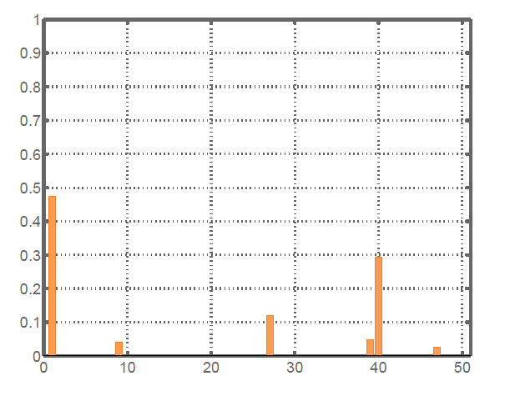
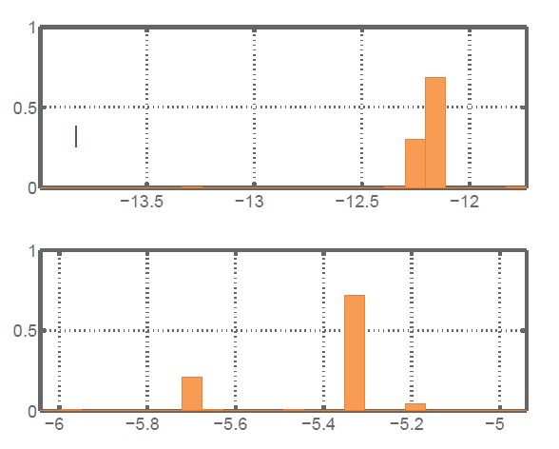
Kinetic parameter estimation
After 50 measurements, distribution of belief about vectors…
… distribution of belief about :

Slide 28
After 50 measurements, distribution of belief about vectors…
… distribution of belief about one parameter:
Collaboration with McAlpine Group

Slide 29
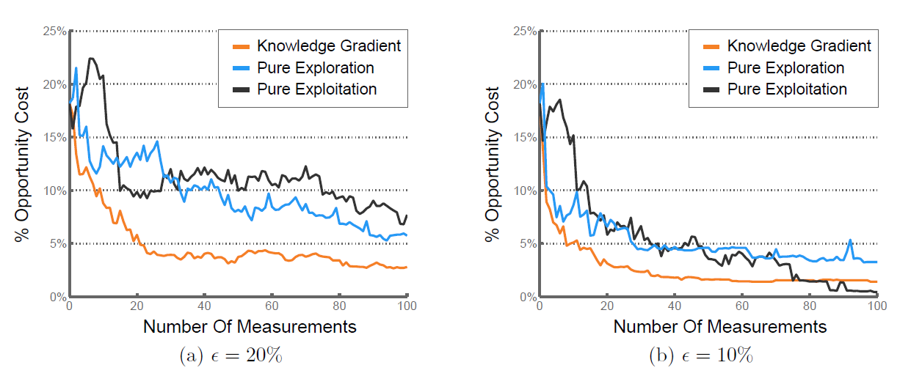
Opportunity Cost
Percentage opportunity cost: difference between estimated and true optimum value w.r.t the true optimum value

Slide 30
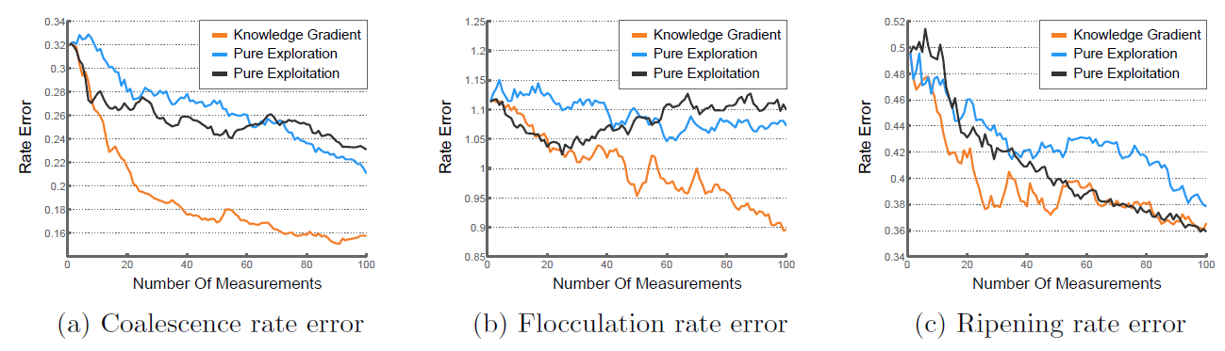
Rate Error
Rate error (log-scale): difference between the estimated rate and the true optimal rate

