Slide 1
Tutorial:
Optimal Learning in the Laboratory Sciences
Understanding the objective function
December 10, 2014
Warren B. Powell
Kris Reyes
Si Chen
Princeton University
http://www.castlelab.princeton.edu
Slide 1
Notes:
1

Slide 2
Lecture outline
Understanding the objective function
© 2010 Warren B. Powell
Slide 2
Notes:
This section needs work

Slide 3
Objective Function
Belief models describe our belief about the performance of an alternative (i.e. objective function)
Different types of objective functions
Performance metric (strength, length, quantity, …)
Finding the best fit (learning the kinetic parameters)
Utility function (mixing different objectives)

Slide 4
Performance metric
Performance metric: maximizing the nanotube length, minimizing the number of nanotube defects, maximizing strength, maximizing the current generated, etc.
Nanotube Length
Fe
Ni
PHN
Al₂O₃+Fe
Al₂O₃+Ni

Slide 5
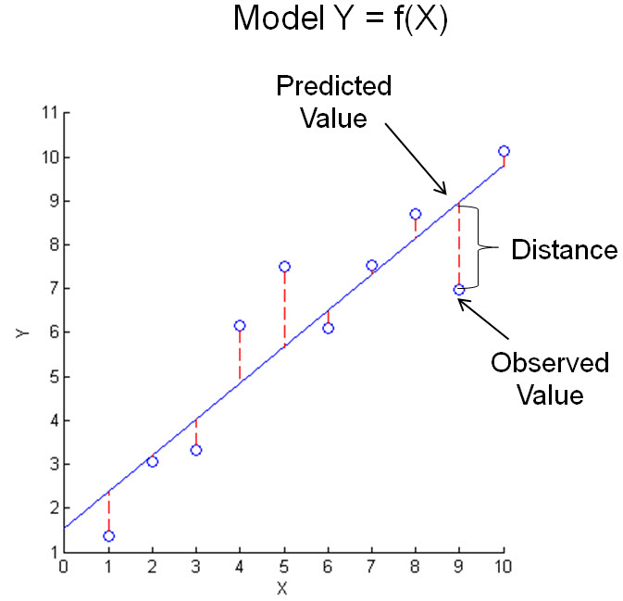
Finding the Best Fit
Goodness of Fit and Residual Analysis
Mean square error
Coefficient of determination (R²)

Slide 6
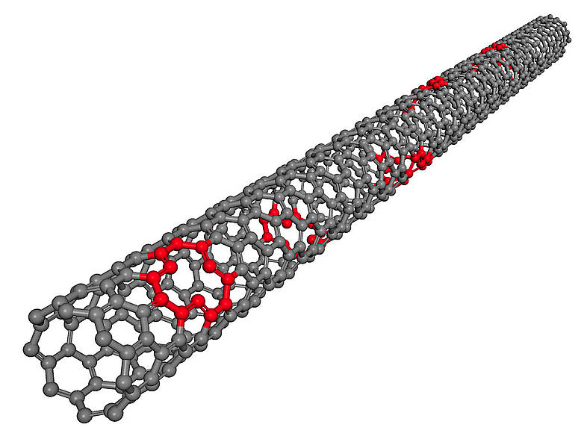
Utility Function
Utility function: combination of multiple objective
Maximizing the nanotube length
Minimize the number of defects
Minimize experimental complexity
Defects
Nanotube Length
Fe
Ni
PHN
Al₂O₃+Fe
Al₂O₃+Ni
Courtesy www.kintechlab.com

