Slide 1
Tutorial:
Optimal Learning in the Laboratory Sciences
Overview
December 10, 2014
Warren B. Powell
Kris Reyes
Si Chen
Princeton University
http://www.castlelab.princeton.edu
Slide 1
Notes:
1

Slide 2
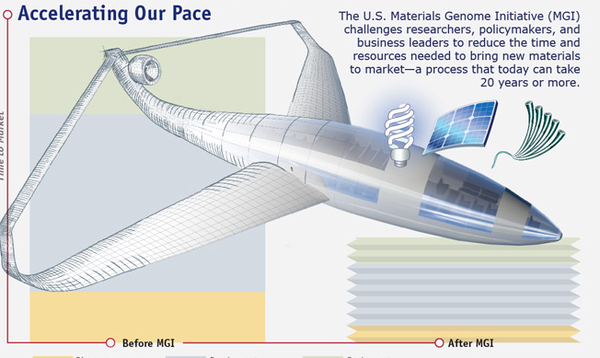
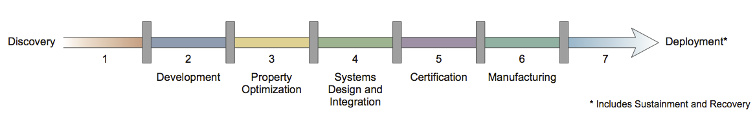
Materials design and optimization
A major goal of the Materials Genome Initiative and “Materials-by-Design” is the acceleration of materials property optimization.
Notes:
KR: Added slide.
Mention materials genome initiative here. Goal: accelerate the design and optimization of materials.
Source for image: Materials Genome Initiative white paper, whitehouse.gov

Slide 3
Learning properties of a material
Another important problem is to learn the underlying physics of a new material or system
Materials specific physical parameters
Dominant processes during fabrication or reactions to external stimuli.
Optimization and learning are two sides to the same coin. In order to do either, we need to perform experiments to obtain measurements that tell us information about the system.
Kinetic pathways of controlled release

Slide 4
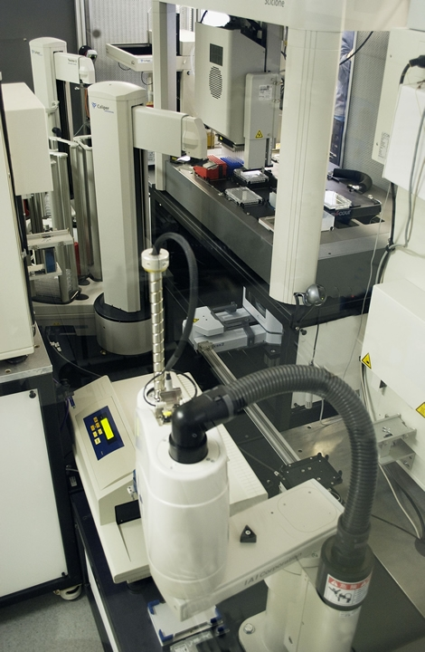
Robot Scientist
Autonomy in basic scientific exploration.
How can a robot decide on the next experiment to run, given some objective?
“Adam,” R. King et al. Aberystwyth University

Slide 5
Common theme
What experiments to run?
What are we learning?
How do we consider our ultimate objective when answering these questions?
How do we deal with uncertainty?

Slide 6
Experiments are expensive and uncertain
Experiments are expensive: A single experiment can take a day to as long as a month of laboratory time.
Experiments are noisy: repeated observations can produce different outcomes.
Experimental decisions are complex
E.g. select from among hundreds of catalysts, while simultaneously tuning temperatures, pressures and concentrations.
Set of experiments can become combinatorially large.
Double emulsion fabrication:
Vortex Speeds
PLGA & Solvent
Water
Water
HRP, BSA, Volume
PLGA, Volume
BSA, Volume
Notes:
The double emulsion fabrication schematic is meant to illustrate the tunable parameters (red) in that experiment.

Slide 7
Optimal Learning in the Laboratory Sciences
Machine Learning and Statistics
Goal: Adaptively design a sequence of experiments that efficiently achieve some objective, given an inherent uncertainty about the system being studied.
Bayesian Statistics
Decision Theory
Optimization
Optimal Learning
Fabrication
Characterization
Design of Experiments
Kinetics
Thermodynamics
Simulations
Physical Experiments
Mathematical Models

Slide 8
The challenge
Laboratory experimentation is expensive!
A single experiment can take a day to as long as a month of laboratory time
Experiments are noisy – repeated observations can produce different outcomes
Experimental decisions are complex – it may be necessary to select from among hundreds of catalysts, while simultaneously tuning temperatures, pressures and concentrations.
Scientists have to find the best combination of known choices in parameters (optimizing within the box) while recognizing that the solution may be outside of the box.
Notes:
KR: fixed typo

Slide 9
The goal: A systematic way to make decisions
The process of choosing experiments is largely ad-hoc.
Our goal is to provide a principled process to help guide experimentalists.
Central to our process is leveraging the domain knowledge of the scientists.
We will focus on identifying the decisions a scientist has to make, and helping to make better decisions.
But we need help identifying the points when a scientist faces real choices, versus taking well defined steps in a process.
We begin by identifying five fundamental elements to a learning problem.

Slide 10
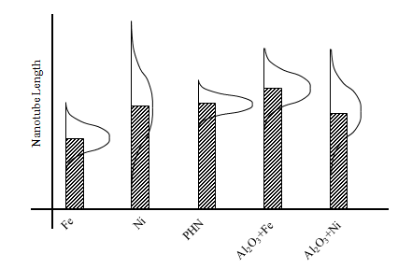
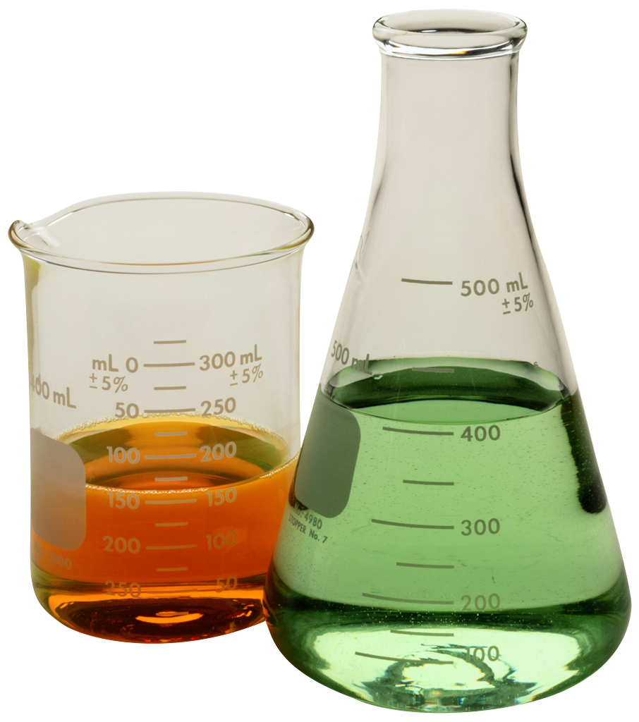
The five elements of a learning problem
Goal: What experiment (e.g. choice of pressure, concentration, etc.) will optimize a particular material property?
2. Belief Model
1. Identify experimental choices
3. Decide which experiment to run.
4. Observations
5. What did you learn?

Slide 11
The process
Step 1) Identifying your experimental choices
What are your material choices? Substrate, catalyst, solute, proteins, RNA sequence?
What are your process variables? Temperatures, pressures, concentrations, volumes?
What are your experimental protocols? How might you sequence the steps of an experiment?
Notes
Identifying all your choices can seem daunting, but it is fundamental to a principled experimental process.
It is important to think about your choices, even it is a large number. You are making these choices implicitly. These choices need to be transparent.

Slide 12
Steps in the process
Step 2) Building a belief model
What do you know about how a process will respond to changes in temperatures, concentrations, ratios, …?
What do you know about the behavior of a material or compound, and how well do you know it?
Strength
Concentration

Slide 13
The process
Step 3) What are you observing?
What information are you going to collect from an experiment? These can likely be divided between direct metrics:
Strength, reflexivity, output, ….
… and evaluations of experimental complexity:
Cost, time, effort?
Repeatability?

Slide 14
The process
Step 4) What did you learn from an experiment?
The information should change your original belief model (the prior) to produce an updated belief model (the posterior).
It is important to generalize:
The performance of different nickel-based catalysts may perform similarly.
The result at one concentration may update your belief about other concentrations.
Notes:
KR: changed some text

Slide 15
The process
Step 5) What decisions are you making with what you learn, and how did this improve your goals?
Ultimately, the goal is to design a material that accomplishes something.
How are you measuring how well you accomplish this goal?
What decisions are you making given your understanding of the performance of different compounds, mixtures, concentrations and ratios?
Notes:
This needs more examples

Slide 16
The process
So how are we going to help?
The five steps listed above help us understand our problem. We refer to this as a model of our experimental process.
If we are going to improve the process, we do so by making better decisions.
We make decisions using a policy. A policy is a rule for making decisions, and our goal is finding good policies.
Policies have to strike a balance between:
Exploring – Running experiments purely for the benefit of what you learn.
Exploiting – These are experiments where we are trying to do our best, hoping for the home run success!

