Slide 1
Tutorial:
Optimal Learning in the Laboratory Sciences
Richer belief models
December 10, 2014
Warren B. Powell
Kris Reyes
Si Chen
Princeton University
http://www.castlelab.princeton.edu
Slide 1
Notes:
1

Slide 2
Lecture outline
Richer belief models
Correlated beliefs
A parametric belief model

Slide 3
Correlated Beliefs
We start with a belief about each material
1
2
3
4
4
5
1.4 nm Fe
1 nm Fe
2nm Fe
2nm Ni
Ni 0.6 nm
10nm ALD AI203+1 nm Ni
10nm ALD AI203+1.2 nm 1BSFe
Notes:
3

Slide 4
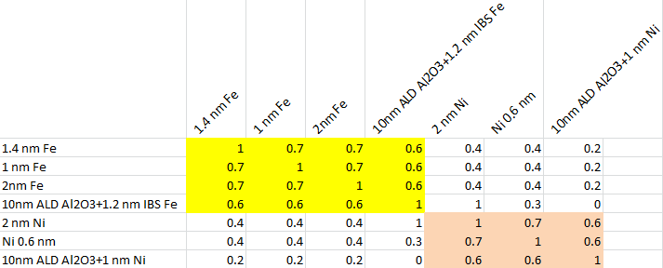
A Richer Belief Model
Correlations
Simple belief model assumes independence
Catalysts may share properties of materials
Scientists using domain knowledge can estimate correlations in experiments between similar catalysts.

Slide 5
Correlated Beliefs
Testing one material teaches us about other materials
1
2
3
4
4
5
1.4 nm Fe
1 nm Fe
2nm Fe
2nm Ni
Ni 0.6 nm
10nm ALD AI203+1 nm Ni
10nm ALD AI203+1.2 nm 1BSFe
Notes:
5

Slide 6
Correlated Beliefs
Testing one material teaches us about other materials
1
2
3
4
4
5
1.4 nm Fe
1 nm Fe
2nm Fe
2nm Ni
Ni 0.6 nm
10nm ALD AI203+1 nm Ni
10nm ALD AI203+1.2 nm 1BSFe
Notes:
6

Slide 7
Correlated Beliefs
Testing one material teaches us about other materials
1
2
3
4
4
5
1.4 nm Fe
1 nm Fe
2nm Fe
2nm Ni
Ni 0.6 nm
10nm ALD AI203+1 nm Ni
10nm ALD AI203+1.2 nm 1BSFe
Notes:
7

Slide 8
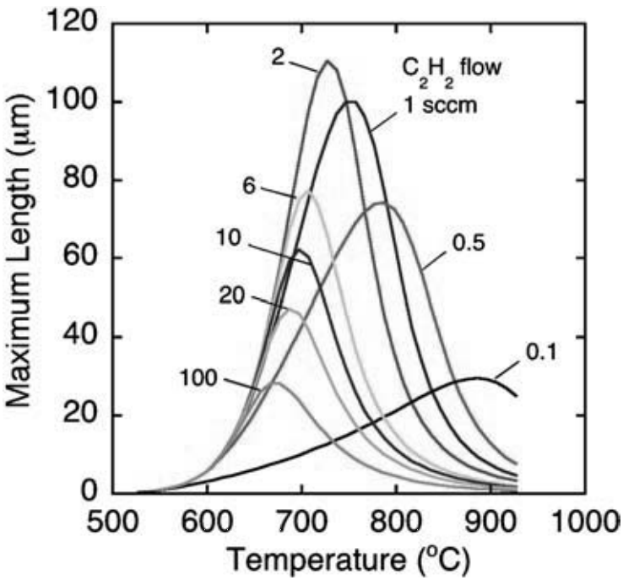
Correlated Beliefs
Nanotube lengths also depend on growth temperature
Continuous parameters: temperature
Correlation introduced by continuity
If the length is higher than we expected at one temperature, it is likely to be higher at slightly higher and lower temperatures.
Puretzky et al. Appl. Phys. A 81 (2005)
Notes:
Length doesn’t change much with a small variation of temperature.
Measuring the length at one choice of temperature tells us about nearby temperatures.
This is correlation (by continuity)

Slide 9
Parametric Belief Model
It is hard to quantify the behavior and uncertainty of length over both temperature and catalyst
An easier way:
The system can be described by a kinetic model
Characterize the relation between temperature, catalyst and length by a few kinetic parameters (but these are unknown)
Need to build belief model for kinetic parameters
Notes:
Asking domain expert about behavior and uncertainty of length over both temperature and catalyst may be unreasonable.
In this example, we have a kinetic model describing length versus temperature and catalyst in addition to additional a small number of kinetic parameters (e.g. energy barriers).
Say: we don’t have exact information about these parameters
It is more reasonable to ask the domain expert about the possible values and uncertainty of the kinetic parameters than of the entire function.
Say: By parameterizing our function we are parameterizing uncertainty.

Slide 10
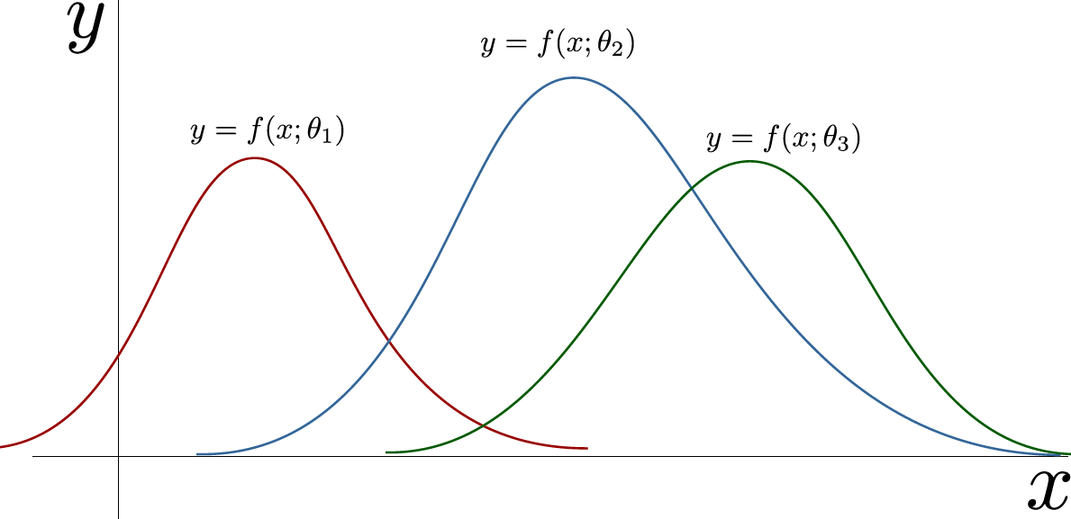
Priors Revised
Different types of priors
Simple belief model (lookup table)
Lookup table with correlated belief model
Parametric belief model
Discrete prior with probabilities
Notes:
Y=length
X=tempreture
There different sets of parameters
Equal probability of being the truth

Slide 11
Priors
Notes:
The more you know, the more efficient your experiments will be.
It is especially important to characterize what you do not know.
The best experiments are those that address the areas you are most uncertain about.
… but at the same time we want experiments that do the most to achieve your goals.
These ideas are very intuitive when using lookup table beliefs (e.g. testing the value of a catalyst teaches us about the value of the catalyst). Things get trickier when we depend on nonlinear models with uncertain parameters.

Slide 12
Kinetic Model
Concentration gradient driven
Langmuir adsorption model
Thermally activated coalescence
Becker-Doering aggregation

Slide 13
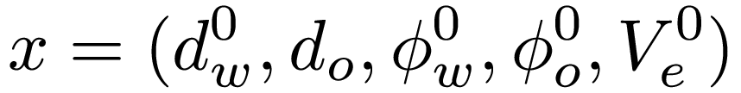
Tunable and Kinetic Parameters
Controllable parameters
Unknown kinetic parameters
Droplet diameters
External volume
Volume fractions
Ripening
Coalescence
Flocculation
Adsorption
Temperature independent rate prefactor
Activation energy barrier
Adsorption/desorption energy barrier difference

Slide 14
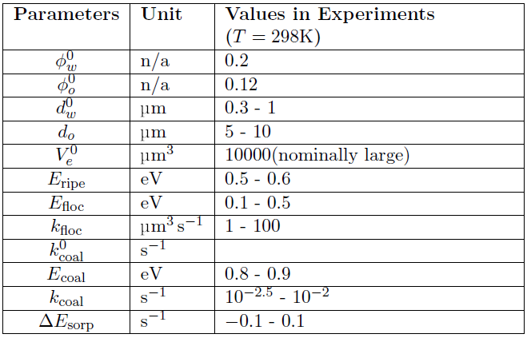
Tunable and Kinetic Parameters
Notes:
Prior information about kinetic parameters obtained from literature studying kinetics of similar systems and materials.

Slide 15
Tunable and Kinetic Parameters
Unknown parameters
Tunable parameters

Slide 16
Kinetic System
N_{Normal} and N_{Excited} are percent released under respective conditions.
Tunable parameters:
Droplet diameters
Volume fractions
Surfactant concentrations
Unknown
kinetic parameters
Rate prefactors
Energy barriers
Time scale:
Small for excited state
Large for normal state
Temperature:
Large for excited state
Small for normal state

Slide 17
Trade-off in stability
We would like emulsion to be stable under normal conditions (room temperature) over a long time scale.
However, we need the emulsion to destabilize under excited conditions (high temperature) over a short time scale.
Define utility to optimize:

Slide 18
Optimal droplet diameters
Utility
Use knowledge gradient to determine where maximum utility occurs.
Inner water droplet diameter (nm)
Oil droplet diameter (nm)

