Slide 1
Tutorial:
Optimal Learning in the Laboratory Sciences
Searching a two-dimensional surface
December 10, 2014
Warren B. Powell
Kris Reyes
Si Chen
Princeton University
http://www.castlelab.princeton.edu
Slide 1
Notes:
1

Slide 2
Lecture outline
Searching a two-dimensional surface

Slide 3
Two-dimensional surface
Searching a two-dimensional surface
Imagine you have two tunable parameters
Temperature
Pressure
You are trying to maximize the strength of a material.
You know that the surface is smooth, but nothing else.
We start with a “uniform prior” within a box which we think is the likely range of the parameters.

Slide 4
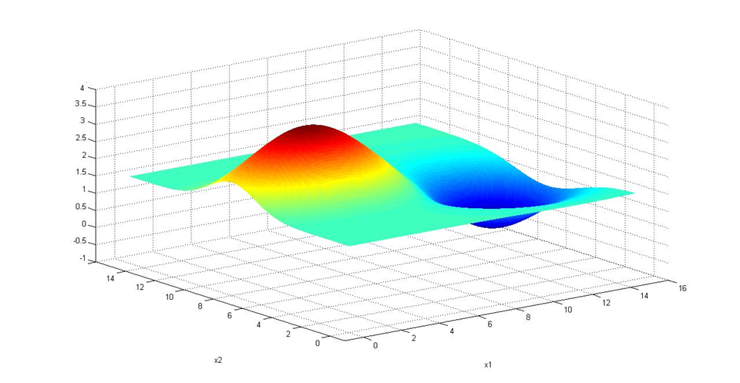
Two-dimensional surface
The true function (unknown to us)
Nanotube Length
Pressure
Temperature
4
Notes:
4
4

Slide 5
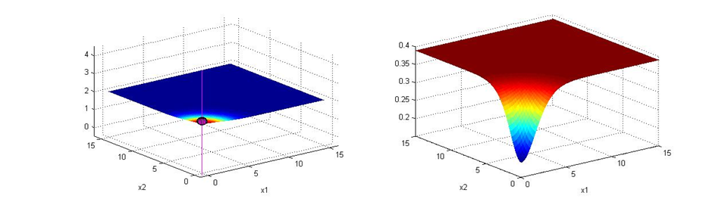
Measuring two-dimensional surfaces
Initially we think the nanotube length is the same everywhere:
We want to measure the value where the knowledge gradient is the highest. This is the measurement that teaches us the most.
Estimated length
Knowledge gradient
Notes:
5

Slide 6
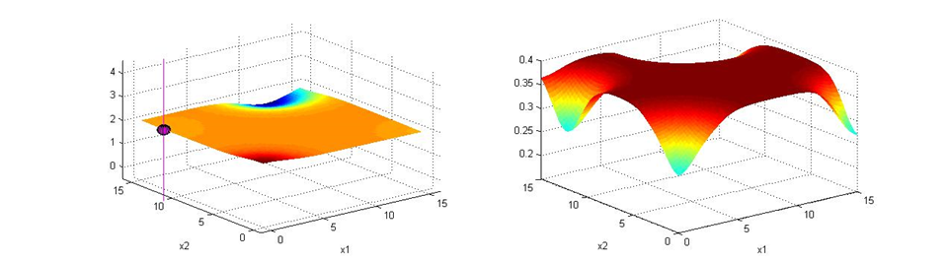
Measuring two-dimensional surfaces
After four measurements:
Whenever we measure at a point, the value of another measurement at the same point goes down. The knowledge gradient guides us to measuring areas of high uncertainty.
Estimated length
Knowledge gradient
Value of another measurement at same location.
Measurement
New optimum
Notes:
6

Slide 7
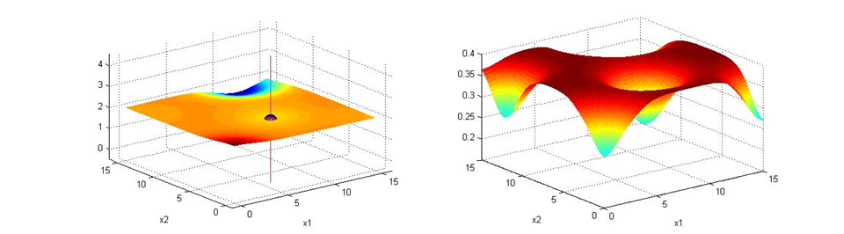
Measuring two-dimensional surfaces
After five measurements:
Estimated length
Knowledge gradient
Notes:
7

Slide 8
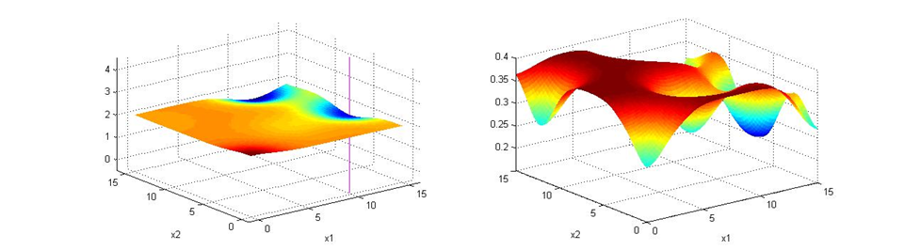

Measuring two-dimensional surfaces
After six samples
Estimated length
Knowledge gradient
Notes:
8

Slide 9
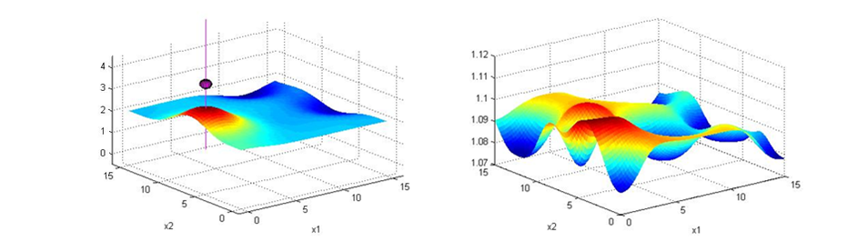
Measuring two-dimensional surfaces
After seven samples
Estimated length
Knowledge gradient
Notes:
9

Slide 10
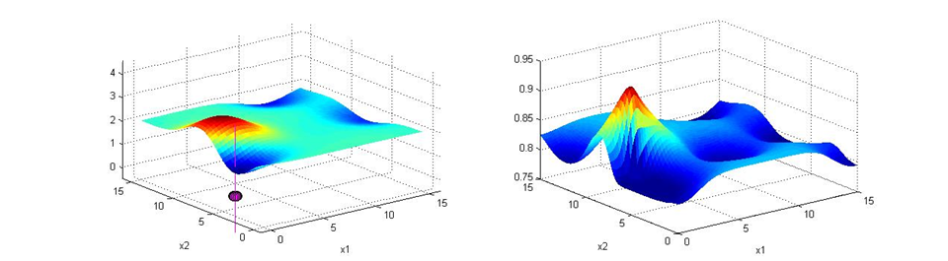
Measuring two-dimensional surfaces
After eight samples
Estimated length
Knowledge gradient
Notes:
10

Slide 11
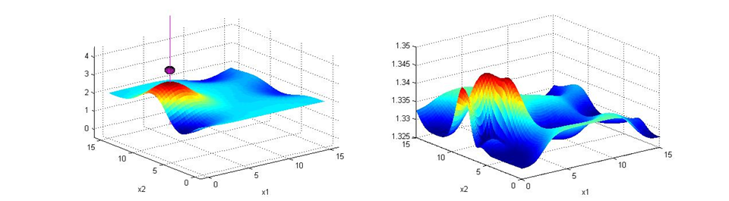
Measuring two-dimensional surfaces
After nine samples
Estimated length
Knowledge gradient
Notes:
11

Slide 12
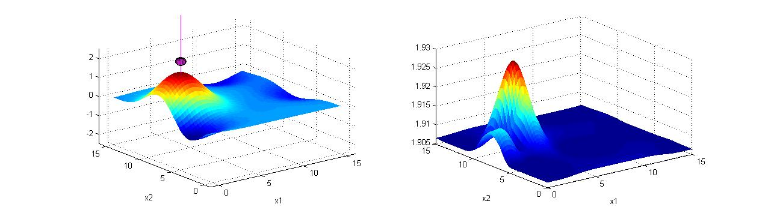
Measuring two-dimensional surfaces
After ten samples
Estimated length
Knowledge gradient
Notes:
12

Slide 13

Measuring two-dimensional surfaces
After 10 measurements, our estimate of the surface:
Estimated length
True length
Notes:
13

