Slide 1
Tutorial:
Optimal Learning in the Laboratory Sciences
The value of information
December 10, 2014
Warren B. Powell
Kris Reyes
Si Chen
Princeton University
http://www.castlelab.princeton.edu
Slide 1
Notes:
1

Slide 2
Lecture outline
The value of information

Slide 3
Value of Information
Best estimate: the maximum value of the utility function, e.g. the length of Al₂O₃+Fe
After one experiment, the belief changes
Marginal value of information
Best estimate before the experiment
Best estimate after the experiment
Nanotube Length
Nanotube Length
Fe
Ni
PHN
Fe
Ni
PHN
Al₂O₃+Fe
Al₂O₃+Ni
Al₂O₃+Fe
Al₂O₃+Ni

Slide 4
Value of Information
Truth and measurement noise are random
Truth is unknown: we have many possible truths
Measurements are noisy around the unknown truth
Nanotube Length
Fe
Fe
Fe
Possible truths about the performance of Fe

Slide 5
Average Marginal Value of Information
Truth and measurement noise are random
Truth is unknown: we have many possible truths
Measurements are noisy around the unknown truth
To calculate the average marginal value of information: average over all possible outcomes (truths + noise)
Fe
Ni
PHN
Al₂O₃+Fe
Fe
Ni
PHN
Al₂O₃+Fe
Al₂O₃+Ni
Al₂O₃+Ni
Fe
Ni
PHN
Al₂O₃+Fe
Fe
Ni
PHN
Al₂O₃+Fe
Al₂O₃+Ni
Al₂O₃+Ni

Slide 6
A Numerical Example
We want to calculate the average marginal information of growing nanotubes using Ni
Assumes we have 4 possible truths
These truths can be captured by our belief
8.5
9.8
9.0
8.6
10.01
9.6
7.1
7.1
5.2
3.7
10.0
Nanotube Length
7.4
8.7
9.1
Fe
Ni
PHN
Al₂O₃+Fe
Fe
Ni
PHN
Al₂O₃+Fe
Al₂O₃+Ni
Al₂O₃+Ni
5.8
Fe
Ni
Fe
Ni
Fe
Ni
PHN
PHN
Al₂O₃+Fe
Al₂O₃+Ni
PHN
Al₂O₃+Fe
Al₂O₃+Ni
Al₂O₃+Fe
Al₂O₃+Ni

Slide 7
A Numerical Example
We want to calculate the average marginal information of growing nanotubes using Ni
For each possible truth, we generate a random measurement around this truth and update beliefs
Calculate Marginal Value of Information
8.5
9.8
9.0
7.1
5.2
MVI
9.7
8.8
0.9
Nanotube Length
7.5
7.7
Nanotube Length
7.0
5.0
Fe
Ni
PHN
Fe
Ni
PHN
Al₂O₃+Fe
Al₂O₃+Ni
Al₂O₃+Fe
Al₂O₃+Ni

Slide 8
A Numerical Example
We want to calculate the average marginal information of growing nanotubes using Ni
For different measurements, we get different MVIs
8.5
9.8
9.0
7.1
5.2
8.8
0.0
Nanotube Length
7.5
7.7
Nanotube Length
7.8
7.0
5.0
Fe
Ni
PHN
Fe
Ni
PHN
Al₂O₃+Fe
Al₂O₃+Ni
Al₂O₃+Fe
Al₂O₃+Ni

Slide 9
A Numerical Example
We want to calculate the average marginal information of growing nanotubes using Ni
For different measurements, we get different MVIs
8.5
9.8
9.0
7.1
5.2
0.3
9.1
8.8
Nanotube Length
7.5
7.7
Nanotube Length
7.0
5.0
Fe
Ni
PHN
Fe
Ni
PHN
Al₂O₃+Fe
Al₂O₃+Ni
Al₂O₃+Fe
Al₂O₃+Ni

Slide 10
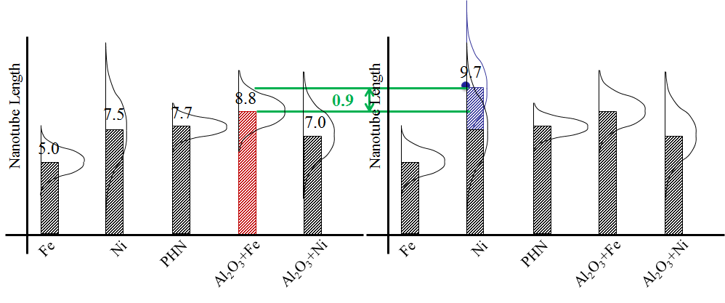
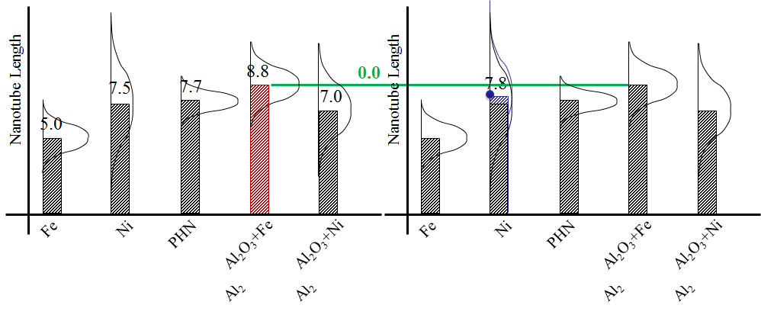
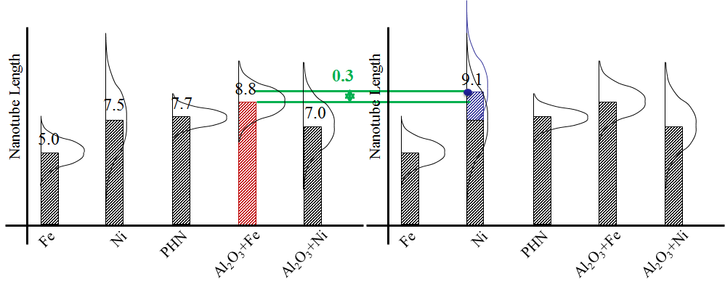
A Numerical Example
We want to calculate the average marginal information of growing nanotubes using Ni
For each possible truth, we generate a measurement
For different measurements, we get different MVIs
Average over 3 different observations: (0.9+0+0.3)/3=0.4
8.5
9.8
9.0
7.1
5.2

Slide 11
A Numerical Example
We want to calculate the average marginal information of growing nanotubes using Ni
For different truths, we repeat the process and get different averages over noisy observations, e.g 0.4, 1.3, 0.7, 1.6
8.6
10.01
9.6
7.1
3.7
10.4
8.8
1.6
Nanotube Length
7.5
7.7
Nanotube Length
7.0
5.0
Fe
Ni
PHN
Fe
Ni
PHN
Al₂O₃+Fe
Al₂O₃+Ni
Al₂O₃+Fe
Al₂O₃+Ni

Slide 12
A Numerical Example
We want to calculate the average marginal information of growing nanotubes using Ni
For different possible truths, we repeat the process and get different averages over observations, e.g 0.4, 1.3, 0.7, 1.6
We then average the results of the experiments, which combines variations in truths and noise , giving us:
MVI = (0.4+1.3+0.7+1.6)/4=1.0
Average marginal value of information of Ni is 1.0

Slide 13
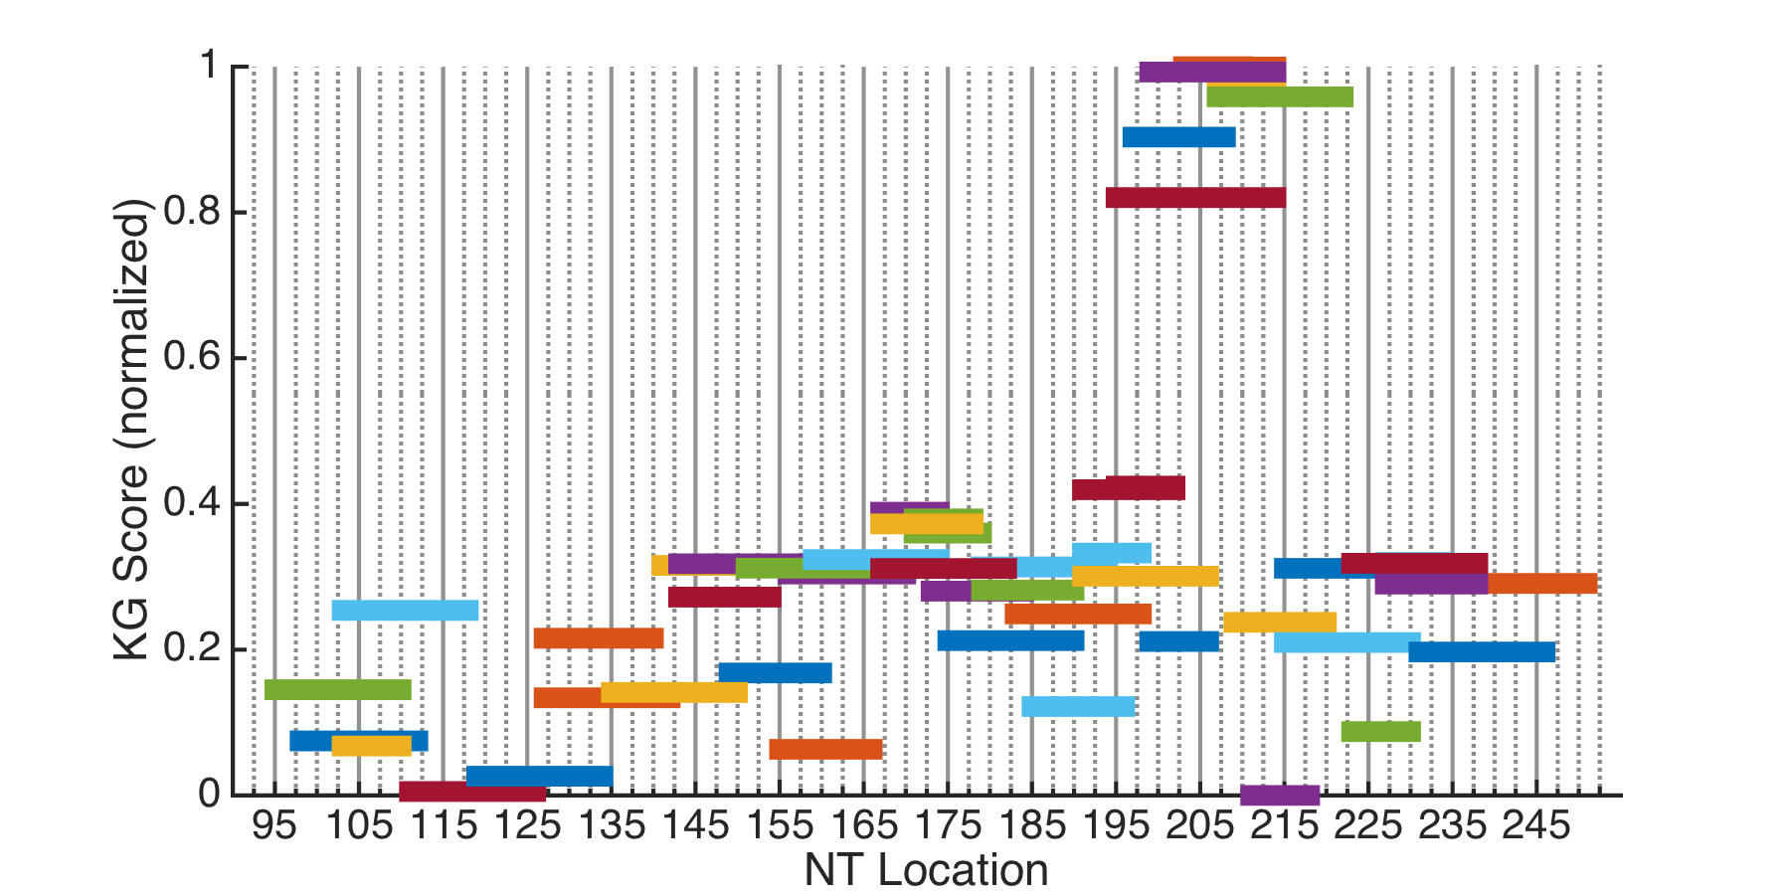
Knowledge Gradient scores
This plot tells us how much information can be gained from targeting each region.
Highest scoring regions = most information to be gained
Low confidence in prior DMS data

Slide 14
Knowledge Gradient scores
Use KG scores as a guideline to picking the next experiment.
The primer for this highest scoring probe need to be ordered
But we have this primer in stock, and it has a reasonably large KG value.

Slide 15
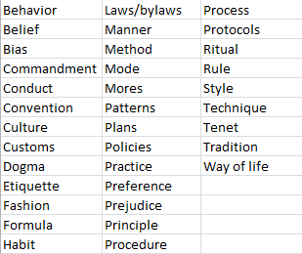
Policy function approximations
Lookup table policies arise in many settings in everyday life

