Slide 1


SPECFEM++
Git Development Workflow
CIG Meeting, Breckenridge, 2025
Rohit Kakodkar, Congyue Cui & Lucas Sawade
Research Computing/Geosciences Department

Slide 2
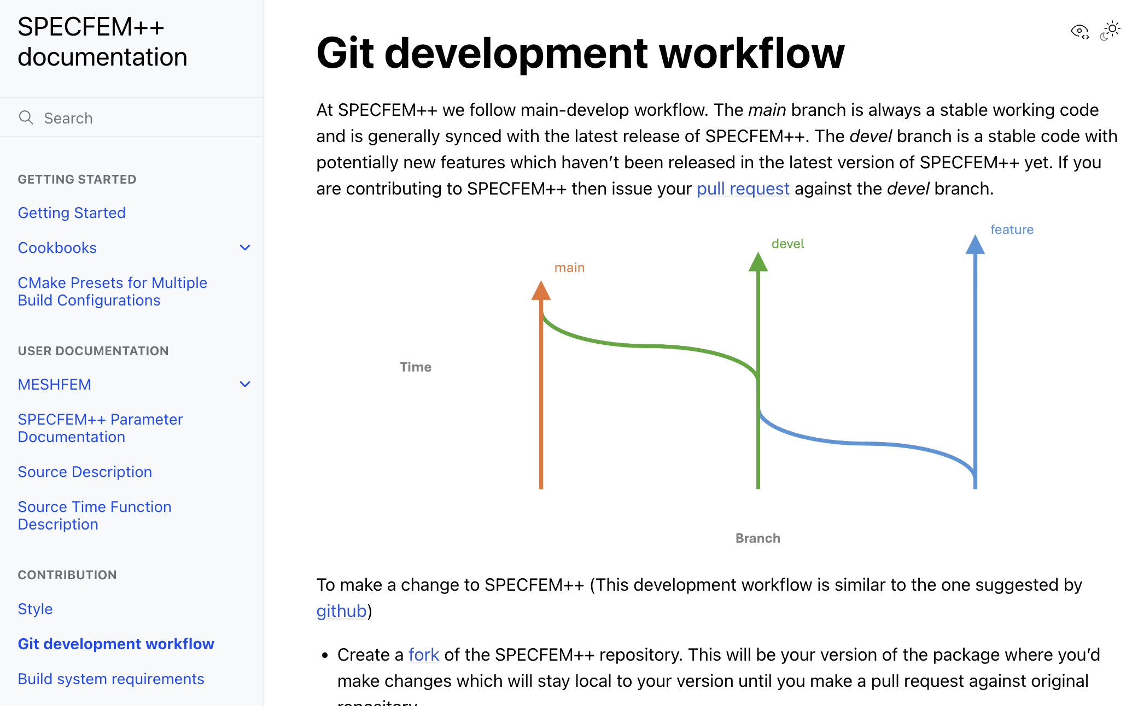
Documentation
Git Dev Workflow: Docs

Slide 3
Implementing a new medium
  Add tags
  Add properties
  Add mass matrix computation
  Add seismogram/wavefield computation
  Add source computation
  Add stress computation
  Update timescheme
  [Optional] Add integration test
Notes:
These tasks are largely independent and only as a final step (Update timescheme), they really all interact.
implement tests independently for each addition

Slide 4
Goal of this workflow
  Synchronizing work if multiple people work towards a single feature
  Minimizing merge conflicts
  Keep work that is otherwise lost to the Github fork void and out of sync with the original repo

Slide 5
Branch Structure in SPECFEM++
feature
devel
main
Time
Branch
Notes:
Main is our stable production branch that tracks releases
Devel is the development branch into which ne feature are merged once they are working.
Feature could be anything from new visualization tools, to new physics in our case this would be poroelastic media or electromagnetic media

Slide 6
Branch Structure in SPECFEM++
feature
devel
main
Time
Merge Working feature
Branch
Notes:
For the Hackathon the main branch really is unimportant.
The goal for us is on one branch (or two branches if time permits) to implement PE and merge it into devel once it’s working
And the same for EM

Slide 7
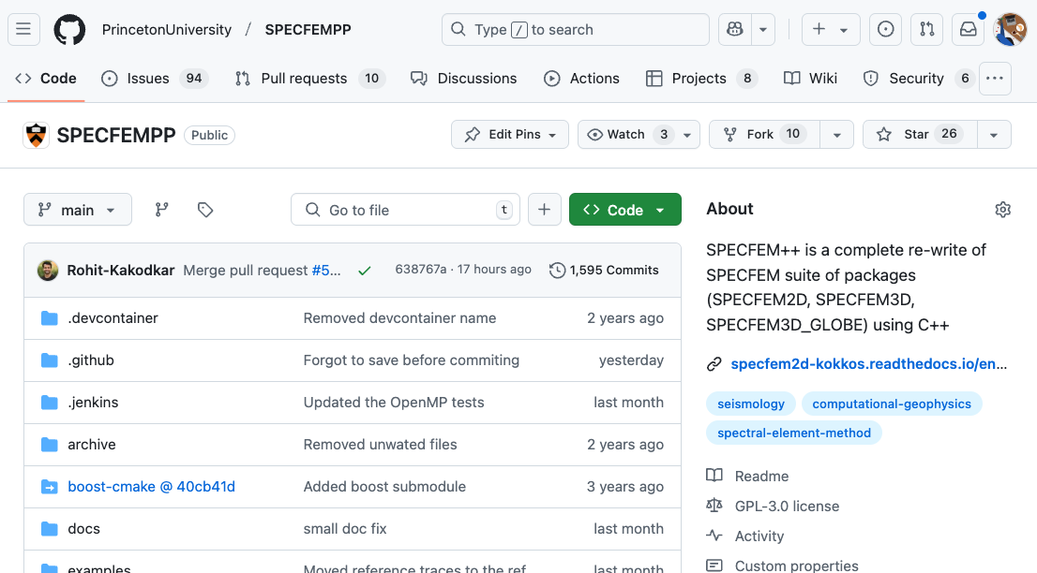
Get the code
Notes:
Everyone knows how to fork and clone a github repo to work on it locally?
Fork the code
Clone it
Checkout the PE branch

Slide 8
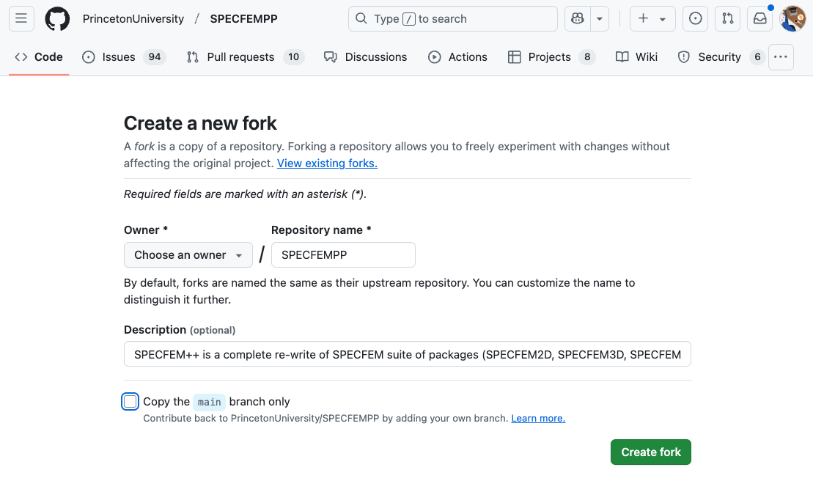
Get the code
Notes:
Everyone knows how to fork and clone a github repo to work on it locally?
Fork the code
Clone it
Checkout the PE branch

Slide 9
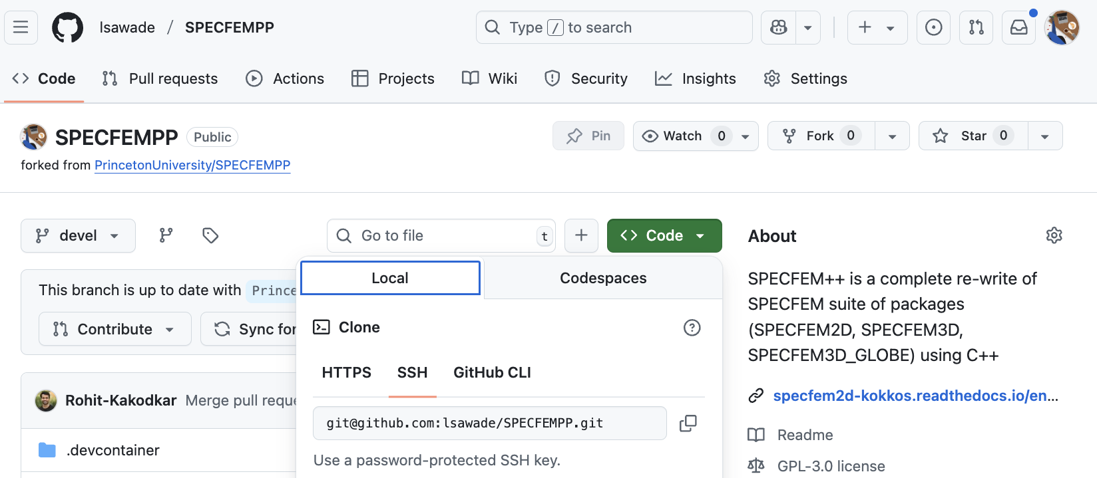
Get the code
# Get the repository
git clone git@github.com:<username>/SPECFEMPP.git
# to start from feature branch
git checkout feature
Notes:
Everyone knows how to fork and clone a github repo to work on it locally?
Fork the code
Clone it
Checkout the PE branch

Slide 10
The life of a task: Branches
feature
Time
Branch: | feature-test
Task: | update timescheme
Assignee: | optional
Branch: | feature-task-issue
Task: | Update README.md
Assignee: | optional
Branch
Notes:
Main is our stable production branch that tracks releases
Devel is the development branch into which ne feature are merged once they are working.
Feature could be anything from new visualization tools, to new physics in our case this would be poroelastic media or electromagnetic media

Slide 11
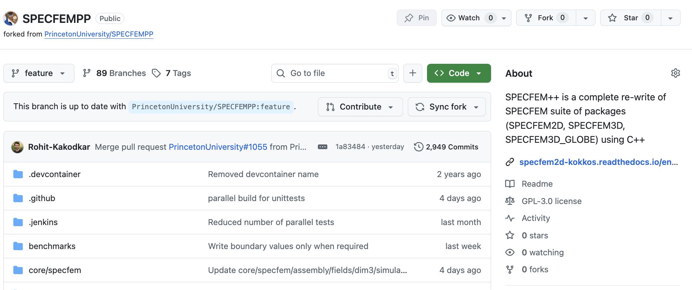
Always sync your fork
# Then in the terminal, update your local branch using
git pull origin feature
Notes:
Before you start working make sure to sync the fork of the branch you plan on working, so that you are up to date.

Slide 12
The life of a task: The work
feature
# [1] Start from feature branch and create new
# branch
git checkout –b feature-test-issue
# [2.1] Edit files
# [2.2] Add the new files to be tracked
git add <new file >
git commit –m ’New commit’
# [3] Push your updates to your fork on Github
git push origin feature-test-issue
# [4] Create pull request from your branch feature-task-2
# to the feature branch in the SPECFEMPP repo
feature-test-issue
[4]
[3]
[2]
[1]
Notes:
Everyone knows how to fork and clone a github repo to work on it locally?
Fork the code
Clone it
Checkout the PE branch

Slide 13
The life of a task: Merge conflict
feature
# [2] Edit files (see previous slide)
# [3] Sync fork again to get updates
git checkout feature
git pull origin feature
git checkout feature-test-issue
git merge feature
# [4] Push your updates to your fork on Github
git push origin feature-test-issue
# [5] Create PR from your feature-test-issue
# to the feature branch in the SPECFEMPP repo
[5]
feature-task-2
[4]
Other work
already merged into feature
[3]
[2]
[1]
Notes:
Everyone knows how to fork and clone a github repo to work on it locally?
Fork the code
Clone it
Checkout the PE branch

Slide 14
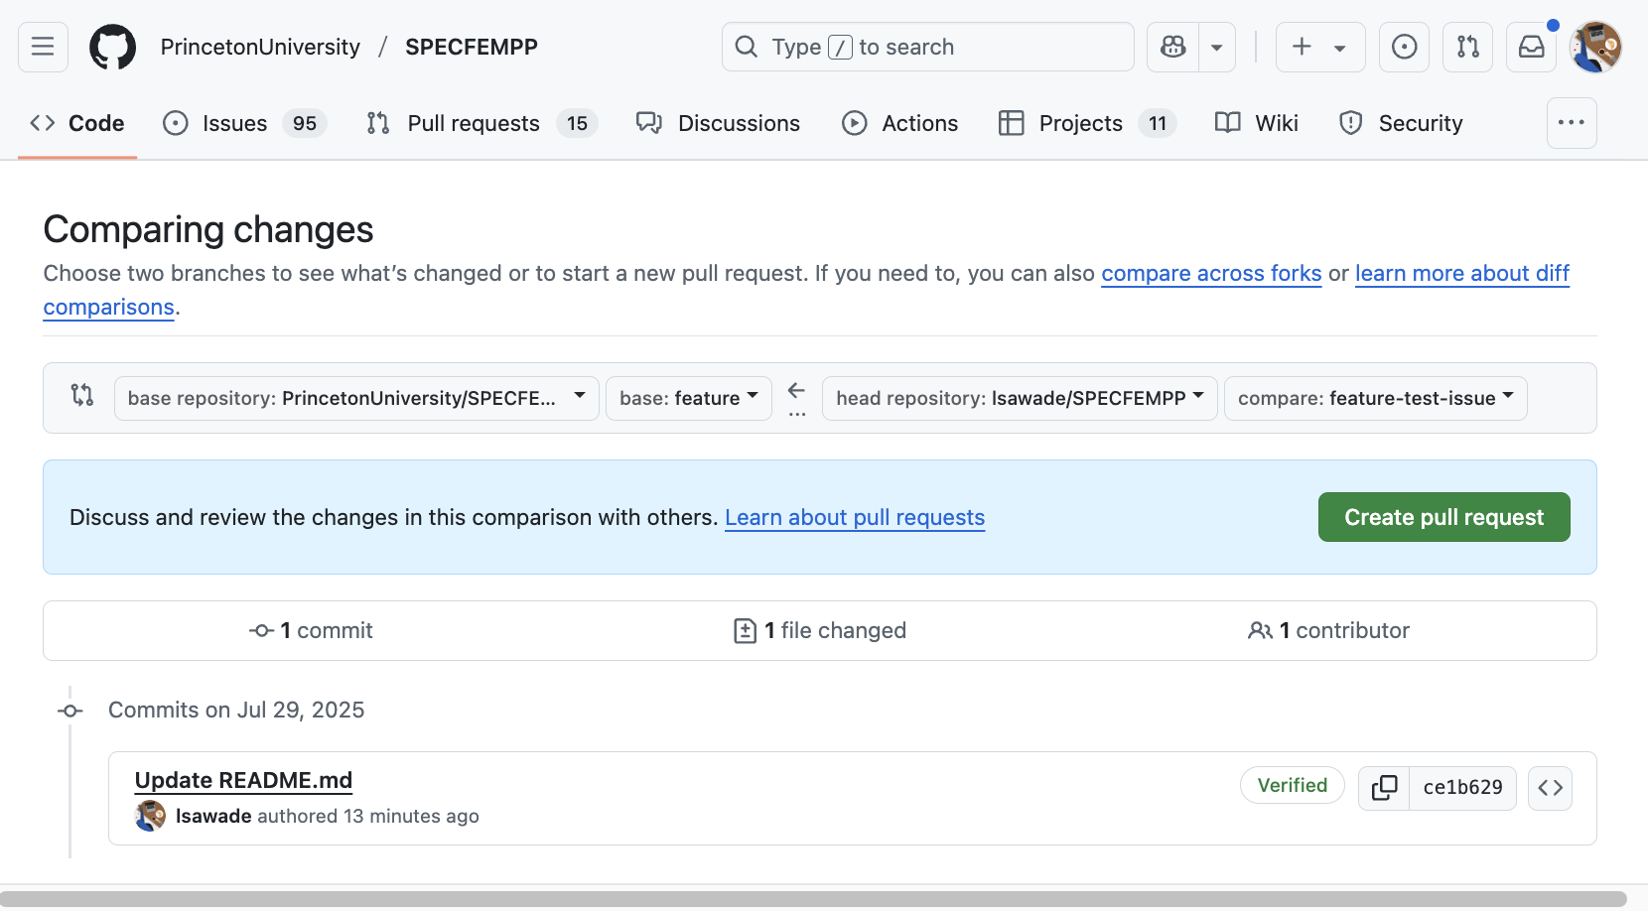
The life of a task: Pull request
Notes:
Everyone knows how to fork and clone a github repo to work on it locally?
Fork the code
Clone it
Checkout the PE branch

Slide 15
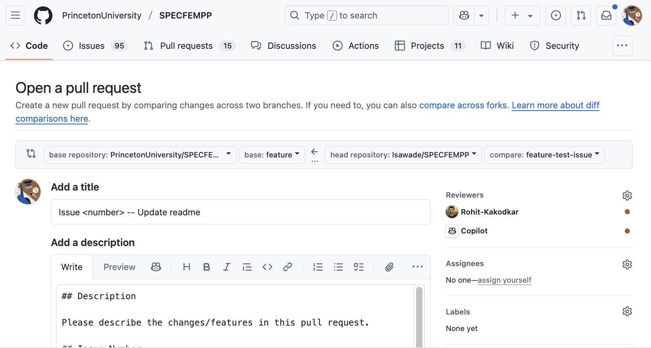
The life of a task: Pull request
Notes:
Everyone knows how to fork and clone a github repo to work on it locally?
Fork the code
Clone it
Checkout the PE branch

Slide 16
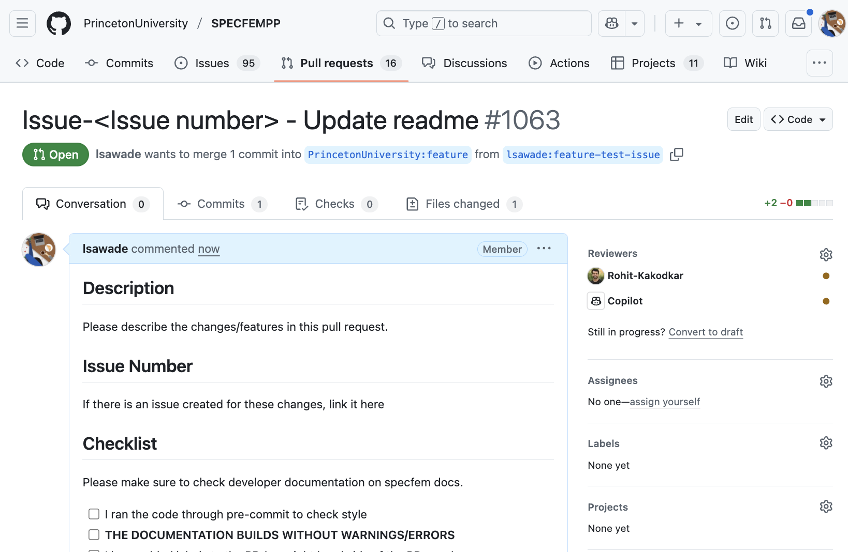
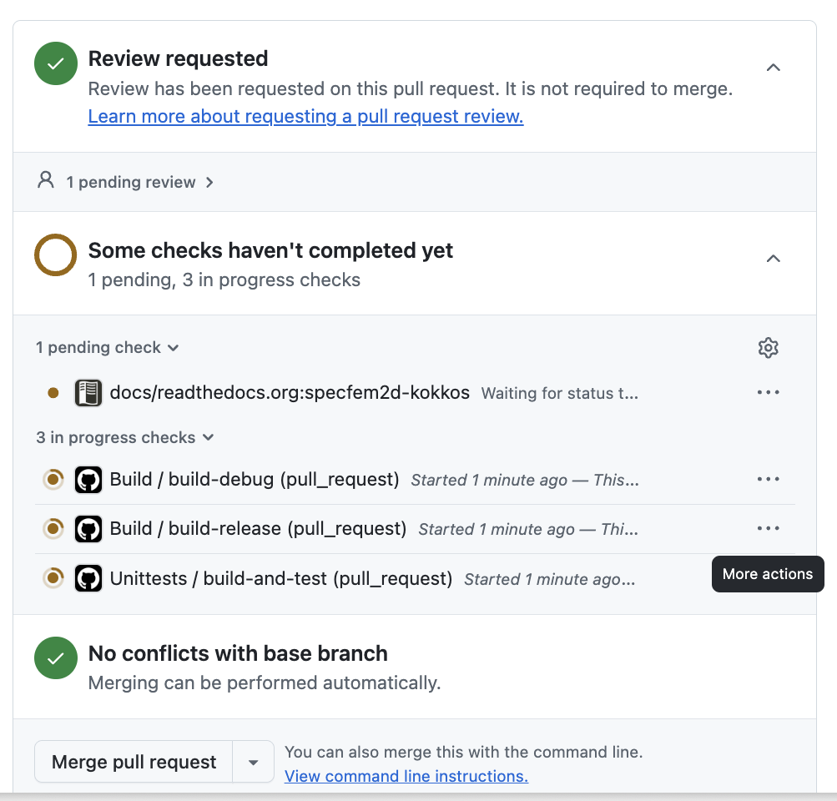
The life of a task: Pull request
Notes:
Everyone knows how to fork and clone a github repo to work on it locally?
Fork the code
Clone it
Checkout the PE branch

Slide 17
Again, sync your fork
# Then in the terminal, update your local branch using
git pull origin feature
Notes:
Before you start working make sure to sync the fork of the branch you plan on working, so that you are up to date.

Slide 18
Goal of this workflow
  How to develop a larger code enhancement with multiple people
  Minimize merge conflicts
  Effectively solve merge conflicts if they happen
  How to develop small edits
devel
fork:devel
or
fork:devel-small-edit
PR small feature
Small updates

