Slide 1
SPECFEM++ Development Workflow
Poro-Elastic & Electro-Magnetic Implementations
Hackathon March 2025

Slide 2
Branch Structure in SPECFEM++
main
devel
feature
Time
Branch
Notes:
Main is our stable production branch that tracks releases
Devel is the development branch into which ne feature are merged once they are working.
Feature could be anything from new visualization tools, to new physics in our case this would be poroelastic media or electromagnetic media

Slide 3
Branch Structure in SPECFEM++: Hackathon
main
devel
PE
EM
Time
Merge Working EM
Merge Working PE
Branch
Notes:
For the Hackathon the main branch really is unimportant.
The goal for us is on one branch (or two branches if time permits) to implement PE and merge it into devel once it’s working
And the same for EM

Slide 4
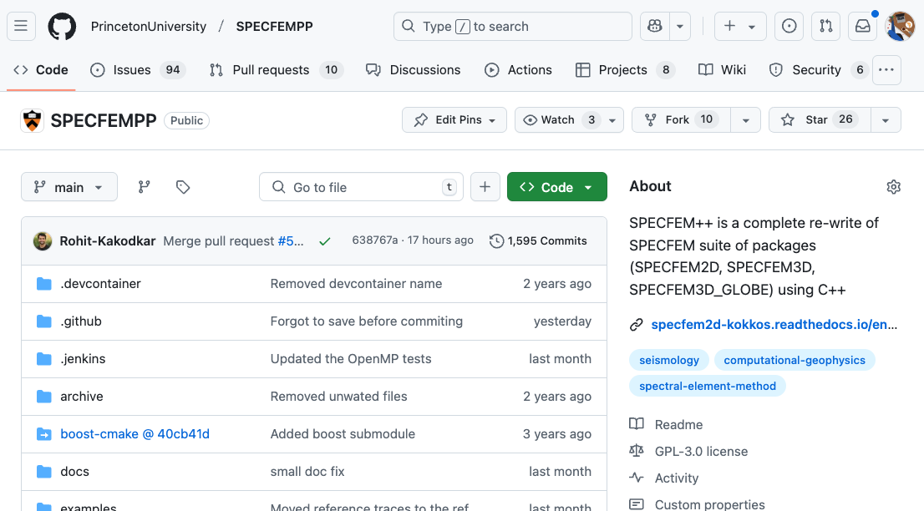
Get the code
Notes:
Everyone knows how to fork and clone a github repo to work on it locally?
Fork the code
Clone it
Checkout the PE branch

Slide 5
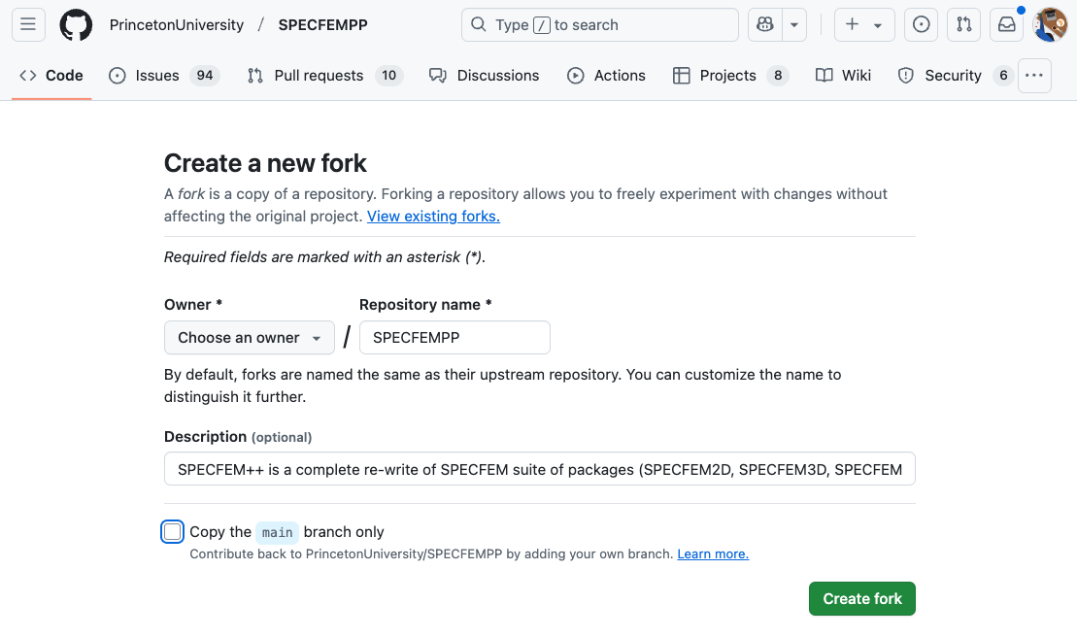
Get the code
Notes:
Everyone knows how to fork and clone a github repo to work on it locally?
Fork the code
Clone it
Checkout the PE branch

Slide 6
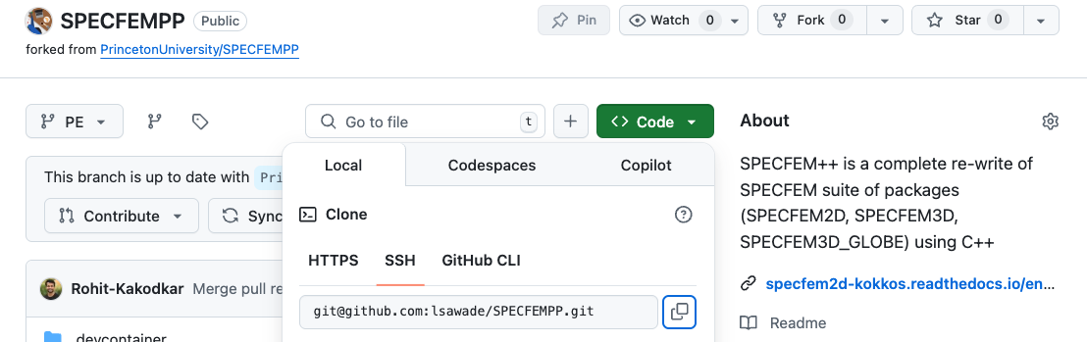
Get the code
# Get the repository
git clone git@github.com:<username>/SPECFEMPP.git
# to start from poroelastic branch
git checkout PE
Notes:
Everyone knows how to fork and clone a github repo to work on it locally?
Fork the code
Clone it
Checkout the PE branch

Slide 7
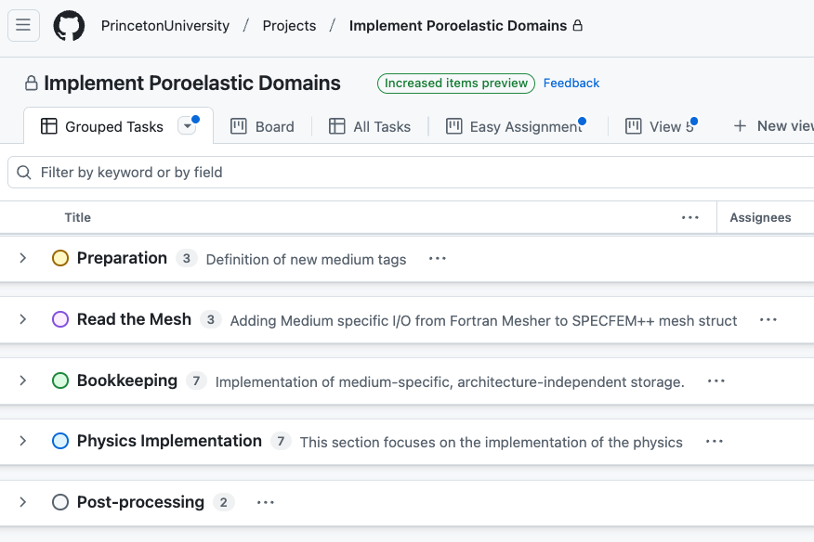

Project Setup

Slide 8
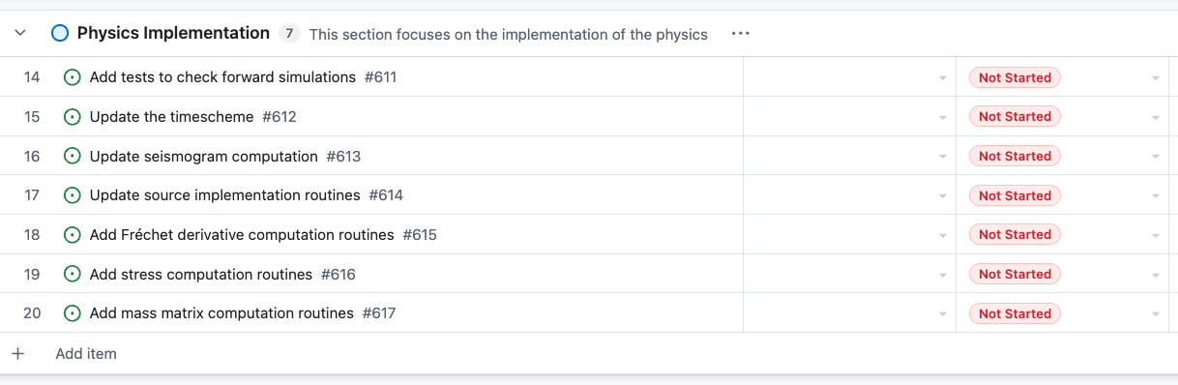
Task Group

Slide 9
The life of a task: Assignment
lsawade (Lucas)
cmorency1 (Chris)

Slide 10
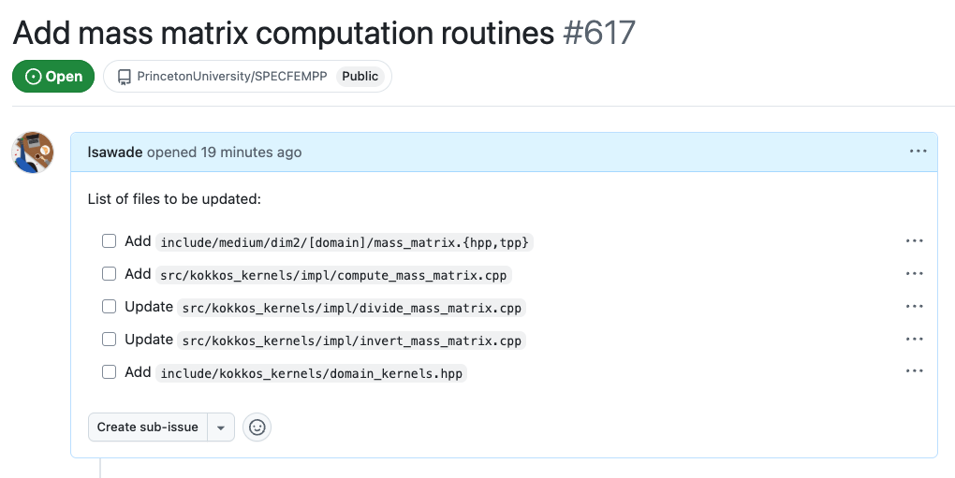
The life of a task: To-Do’s
Notes:
Here, all explicitly named files

Slide 11
The life of a task: Branches
PE
Time
Branch: | PE-15
Task: | Update Timescheme
Assignee: | lsawade
Branch: | PE-617
Task: | Add mass matrix computation
Assignee: | cmorency1
Branch
Notes:
Main is our stable production branch that tracks releases
Devel is the development branch into which ne feature are merged once they are working.
Feature could be anything from new visualization tools, to new physics in our case this would be poroelastic media or electromagnetic media

Slide 12
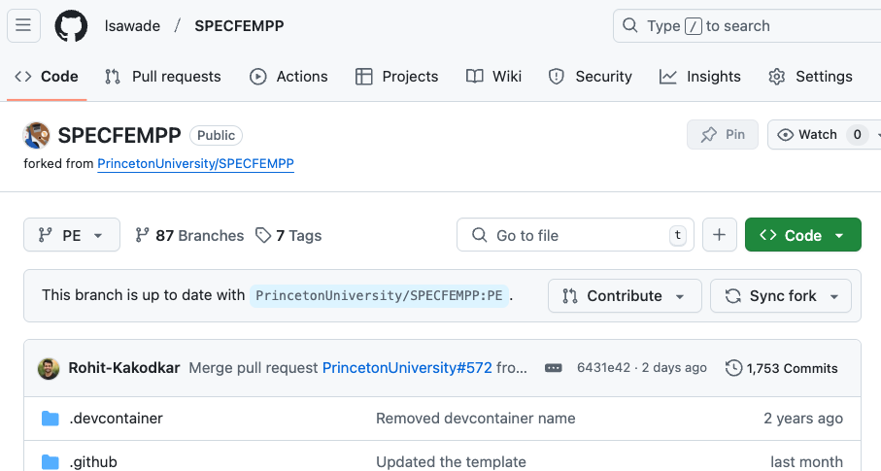
Interlude: Sync your fork before you start working
# Then in the terminal, update your local branch using
git pull origin PE
Notes:
Before you start working make sure to sync the fork of the branch you plan on working, so that you are up to date.

Slide 13
The life of a task: The work
PE
PE-617
[4]
# [1] Start from poroelastic branch and create new
# branch
git checkout –b PE-617
# [2.1] Do edits on files
# [2.2] Add the new files to be tracked
git add <new file >
# [3] Push your updates to your fork on Github
git push origin PE-19
# [4] Create pull request from your branch issue-19
# to the PM branch in the SPECFEMPP repo
[3]
[2]
[1]
Notes:
Everyone knows how to fork and clone a github repo to work on it locally?
Fork the code
Clone it
Checkout the PE branch

Slide 14
The life of a task: Merge conflict
PE
PE-617
[5]
# [1] Start from poroelastic branch and create new
# branch
git checkout –b PE-617
# [2.1] Do edits on files
# [2.2] Add the new files to be tracked
git add <new file >
# [3] Sync fork again to get updates
# [4] Push your updates to your fork on Github
git push origin PE-19
# [5] Create pull request from your branch issue-19
# to the PM branch in the SPECFEMPP repo
[4]
[3]
Other work
already merged into PE
[2]
[1]
Notes:
Everyone knows how to fork and clone a github repo to work on it locally?
Fork the code
Clone it
Checkout the PE branch

Slide 15
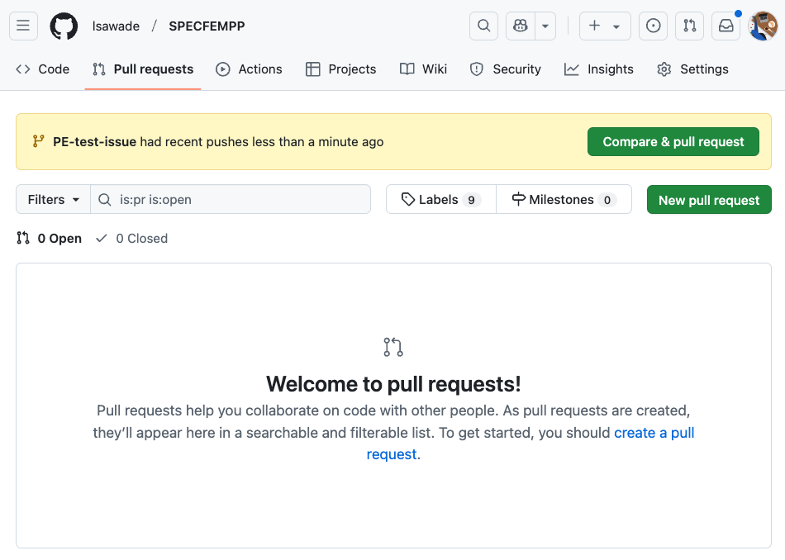
The life of a task: Pull request
Notes:
Everyone knows how to fork and clone a github repo to work on it locally?
Fork the code
Clone it
Checkout the PE branch

Slide 16
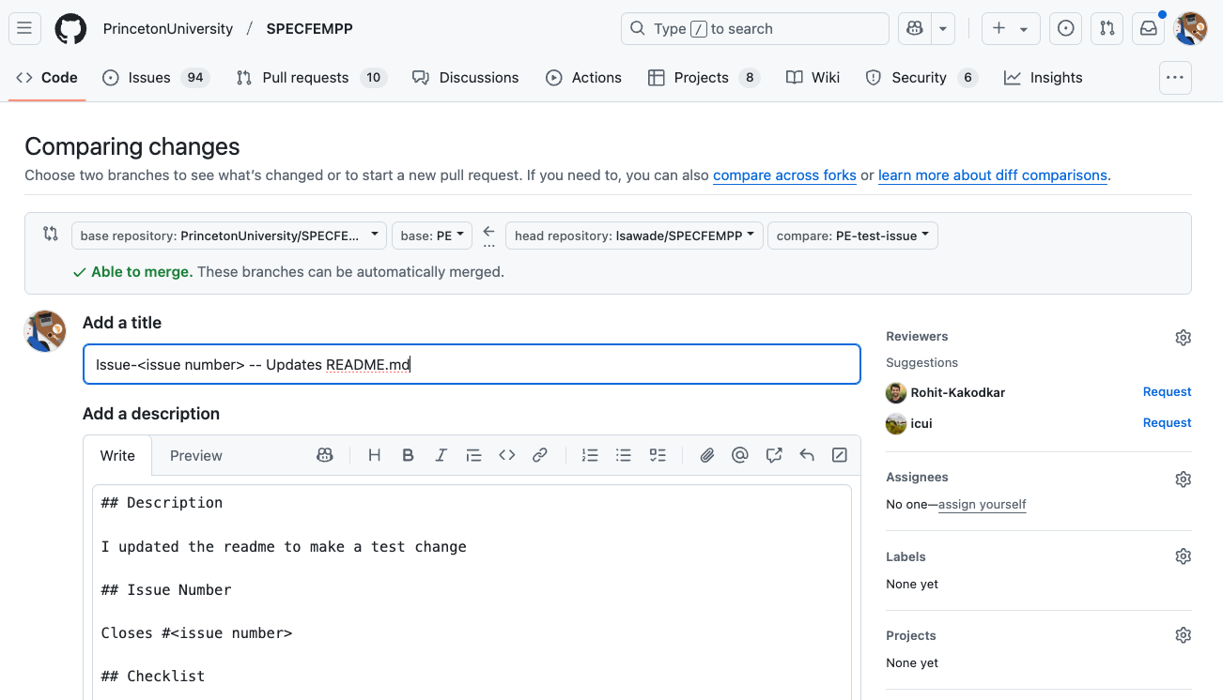
The life of a task: Pull request
Notes:
Everyone knows how to fork and clone a github repo to work on it locally?
Fork the code
Clone it
Checkout the PE branch

Slide 17
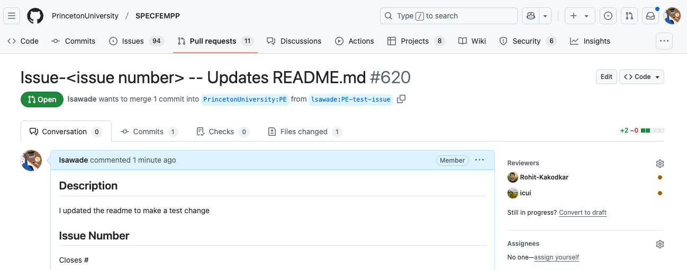
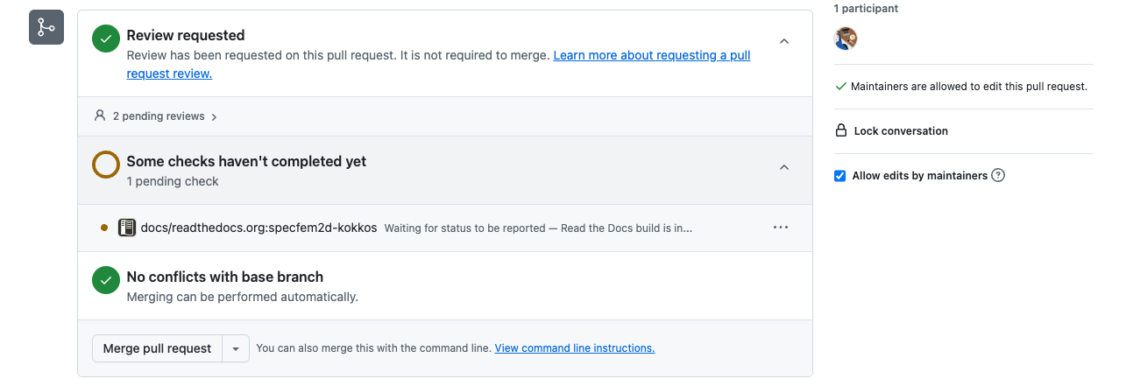
The life of a task: Pull request
Notes:
Everyone knows how to fork and clone a github repo to work on it locally?
Fork the code
Clone it
Checkout the PE branch

Slide 18
Sync your fork again before taking on the next task.
# Then in the terminal, update your local branch using
git pull origin PE
Notes:
Before you start working make sure to sync the fork of the branch you plan on working, so that you are up to date.

