Slide 1
Implementing new domains in SPECFEM++
Rohit Kakodkar
Research Software Engineer II
PICSciE / Geosciences

Slide 2
SPECFEM Algorithm
Start
Define parameter file
Define sources
Define receivers
Read the mesh
Generate assembly
for (int istep : nstep) {
apply_predictor_phase_forward();
compute_source_interaction();
compute_forces();
divide_by_mass_matrix();
apply_corrector_phase_forward();
}
Define global numbering scheme.
Define GLL level properties
Run solver
Execute the time loop
Time loop
Write output

Slide 3






SPECFEM++ Architecture
Dirichlet
Acoustic
Isotropic
Elastic
void compute_forces() {
compute_forces_elastic_isotropic_none();
compute_forces_acoustic_isotropic_none();
compute_forces_elastic_isotropic_stacey();
compute_forces_acoustic_isotropic_dirichlet();
.
.
.
}
Stacey
None
*This is a representative code

Slide 4
Outline
Preparation
Read the mesh
Bookkeeping
Physics implementation
Post-processing

Slide 5

Preparation
Define enumerations
Define properties
Define misfit kernels

Slide 6

Preparation
Define enumerations
medium.hpp
material_definitions.hpp
Define properties
Define misfit kernels

Slide 7
Preparation
Define enumerations
medium.hpp
material_definitions.hpp
enum class medium_tag {
elastic,
acoustic
};
Define properties
template <>
class attributes<dim2, elastic> {
public:
constexpr static int dimension() { return 2; }
// Number of components in field constexpr static int components() { return 2; }
};
Define misfit kernels

Slide 8
Preparation
Define enumerations
medium.hpp
material_definitions.hpp
#define ELEMENT_TYPES\
((DIM2, ELASTIC, ISOTROPIC, NONE))( \
(DIM2, ACOUSTIC, ISOTROPIC, NONE))( \
(DIM2, ELASTIC, ISOTROPIC, STACEY))( \
(DIM2, ACOUSTIC, ISOTROPIC, DIRICHLET))
Define properties
Define misfit kernels
void compute_forces() {
compute_forces_elastic_isotropic_none();
compute_forces_acoustic_isotropic_none();
compute_forces_elastic_isotropic_stacey();
compute_forces_acoustic_isotropic_dirichlet();
.
.
.
}

Slide 9
Preparation
Define enumerations
medium.hpp
material_definitions.hpp
#define ELEMENT_TYPES\
((DIM2, ELASTIC, ISOTROPIC, NONE))( \
(DIM2, ACOUSTIC, ISOTROPIC, NONE))( \
(DIM2, ELASTIC, ISOTROPIC, STACEY))( \
(DIM2, ACOUSTIC, ISOTROPIC, DIRICHLET))
Define properties
Define misfit kernels
void compute_forces() {
#define COMPUTE_FORCES(DIMENSION, MEDIUM, PROPERTY, BOUNDARY) \
compute_forces<DIMENTION, MEDIUM, PROPERTY, BOUNDARY>();
CALL_MACRO_FOR_ALL_ELEMENT_TYPES(COMPUTE_FORCES,
WHERE(DIM2)
WHERE(ACOUSTIC, ELASTIC)
WHERE(ISOTROPIC) WHERE(NONE, STACEY, DIRICHLET));
}

Slide 10
Preparation
Define enumerations
7 lines
Define properties
3 - 10 lines
Define misfit kernels
3 - 10 lines

Slide 11
Read the mesh
Reads the MESHFEM2D mesh binary file line-by-line
Update the mesh reader
80 lines

Slide 12
Bookkeeping
Define element types
Update data containers
Add new sources
Add new receivers
Define properties
Define misfit kernels
Add wavefields

Slide 13
Bookkeeping
Define element types
Update data containers
Add new sources
Add new receivers
CALL_MACRO_FOR_ALL_ELEMENT_TYPES(UPDATE_CONTAINER,
WHERE(DIM2)
WHERE(ACOUSTIC, ELASTIC)
WHERE(ISOTROPIC, ANISOTROPIC)
WHERE(NONE, STACEY, DIRICHLET, COMPOSITE));
Define properties
Define misfit kernels
Add wavefields

Slide 14
Bookkeeping
Define element types
Update data containers
Add new sources
Add new receivers
CALL_MACRO_FOR_ALL_ELEMENT_TYPES(UPDATE_CONTAINER,
WHERE(DIM2)
WHERE(ACOUSTIC, ELASTIC, POROELASTIC)
WHERE(ISOTROPIC, ANISOTROPIC)
WHERE(NONE, STACEY, DIRICHLET, COMPOSITE));
Define properties
Define misfit kernels
Add wavefields

Slide 15
Bookkeeping
Define element types
21 lines†
Update data containers
4 lines†
Add new sources
14 lines†
Add new receivers
6 lines†
Define properties
10 – 20 lines
Define misfit kernels
10 – 20 lines
Add wavefields
7 lines†

Slide 16
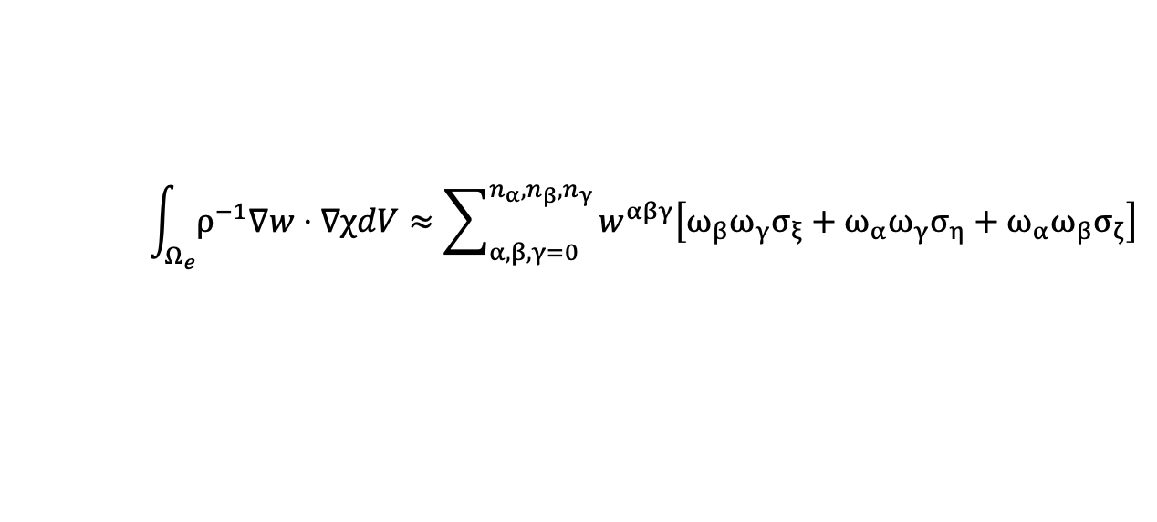
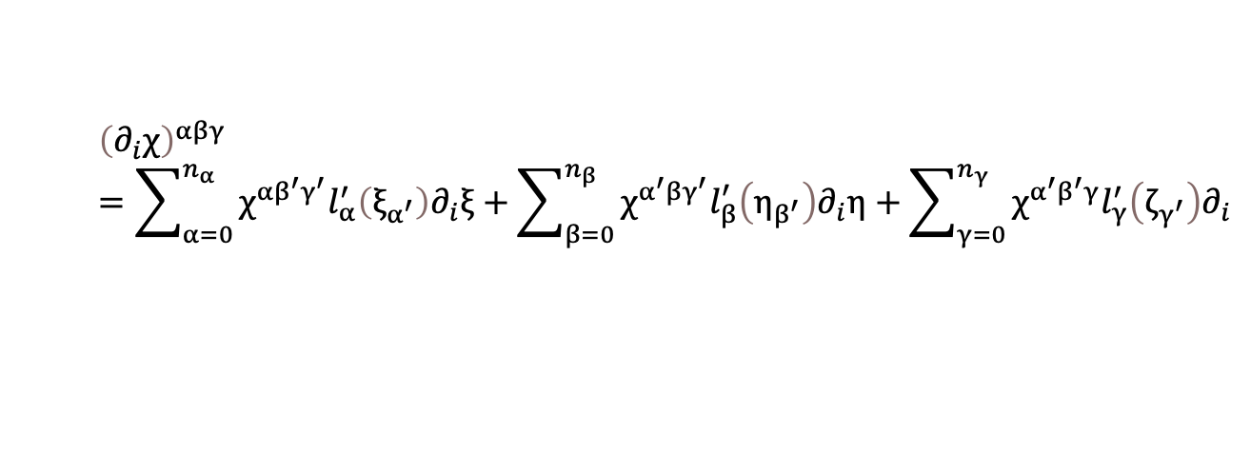
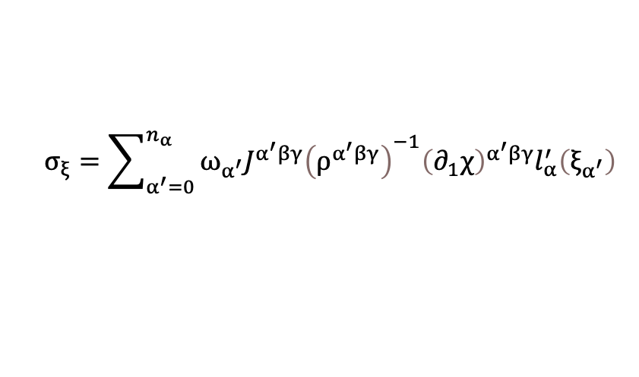
Physics Implementation
$$\int_{Ω_{e}}{ρ^{−1}∇w}⋅∇χdV≈\sum_{α,β,γ=0}^{n_{α},n_{β},n_{γ}}{w^{αβγ}\left[ω_{β}ω_{γ}σ_{ξ}+ω_{α}ω_{γ}σ_{η}+ω_{α}ω_{β}σ_{ζ}\right]}$$
$$σ_{ξ}=\sum_{α^{′}=0}^{n_{α}}{ω_{α^{′}}J^{α^{′}βγ}{\left(ρ^{α^{′}βγ}\right)}^{−1}{\left(∂_{1}χ\right)}^{α^{′}βγ}l_{α}^{′}\left(ξ_{α^{′}}\right)}$$
void compute_forces() {
for (int ispec : nspec){
for (int iz : ngllz){
for (int ix : ngllx){
s_grad = compute_gradients(s);
stress = compute_stress(s_grad);
sigma = compute_integrand(stress);
acceleration = divergence(sigma);
update_acceleration(acceleration);
}
}
}
}
$${\left(∂_{i}χ\right)}^{αβγ}=\sum_{α=0}^{n_{α}}{χ^{αβ^{′}γ^{′}}l_{α}^{′}\left(ξ_{α^{′}}\right)∂_{i}ξ}+\sum_{β=0}^{n_{β}}{χ^{α^{′}βγ^{′}}l_{β}^{′}\left(η_{β^{′}}\right)∂_{i}η}+\sum_{γ=0}^{n_{γ}}{χ^{α^{′}β^{′}γ}l_{γ}^{′}\left(ζ_{γ^{′}}\right)∂_{i}}$$

Slide 17
Physics Implementation
Compute mass matrix
specfem::datatype::VectorPointViewType<type_real, 2, 1, UseSIMD> T;
T(0, 0) = properties.rho_inverse * du(0, 0);
T(1, 0) = properties.rho_inverse * du(1, 0);
return { T };
Compute stress
Acoustic stress
datatype sigma_xx, sigma_zz, sigma_xz;
sigma_xx = properties.lambdaplus2mu * du(0, 0) + properties.lambda * du(1, 1);
sigma_zz = properties.lambdaplus2mu * du(1, 1) + properties.lambda * du(0, 0);
sigma_xz = properties.mu * (du(0, 1) + du(1, 0));
specfem::datatype::VectorPointViewType<type_real, 2, 2, UseSIMD> T;
T(0, 0) = sigma_xx;
T(0, 1) = sigma_xz;
T(1, 0) = sigma_xz;
T(1, 1) = sigma_zz;
Compute source interaction
Compute seismograms
Update the timescheme
Elastic stress

Slide 18
Post processing
Write properties
Write misfit kernels
Write seismograms

Slide 19
Summary
Preparation
Read the mesh
Bookkeeping
Physics implementation
Post-processing
400 lines
Electromagnetic implementation compute forces : ~300 lines

Slide 20

Damping
void compute_forces() {
for (int ispec : nspec){
for (int iz : ngllz){
for (int ix : ngllx){
s_grad = compute_gradients(s);
stress = compute_stress(s_grad);
sigma = compute_integrand(stress);
acceleration = divergence(sigma);
apply_damping(velocity, acceleration);
update_acceleration(acceleration);
}
}
}
}

