Slide 1




EXPENSEXCHANGE AI
Team Members
Prince Yadav, 50010----, -, AI&ML
Sparsh, 50010----, -, AI&ML
Dakshita Jindal, 50010----, - ,AI&ML
Anshu Singh , 50010---- , -,AI&ML

Slide 2



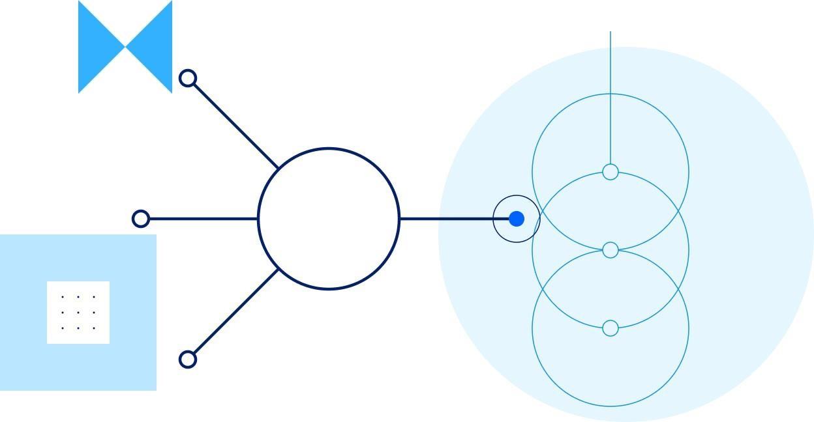

Content
Abstract
Introduction
Problem Statement
Objective
Methodology
LSTM model
GRU model
Applications

Slide 3

Abstract
This project presents a stock return analysis system that uses a Gated Recurrent Unit (GRU) model to forecast short-term returns based on historical price data. The system includes a deep learning model, a Flask-based backend, and a browser-accessible frontend. Users can upload their current holdings and receive return predictions along with basic investment suggestions. The model operates on log-returns and is trained using five years of historical data. Optuna tunes the model’s hyperparameters, and Huber loss guides training to reduce the impact of outliers. The system evaluates performance using standard regression and finance-specific metrics, including mean absolute error, root mean square error, R² score, and directional accuracy. While the system does not offer exact price predictions or guaranteed outcomes, it provides a working example of how machine learning can assist in financial decision-making.

Slide 4
Introduction
This project explores the use of deep learning, specifically Gated Recurrent Units (GRUs), to model short- term stock price movements based solely on historical closing prices. By excluding external data such as news or technical indicators, the system remains focused, reproducible, and easier to interpret. To improve predictive performance, key model parameters like sequence length, learning rate, and dropout are optimized using Optuna. Huber loss is employed during training to ensure robustness against market outliers.
The trained GRU models are deployed through a Flask backend and accessed via a user-friendly frontend. Users can upload their stock portfolios to receive short-term return forecasts, which are translated into simple action suggestions—buy, hold, or sell—based on predicted price trends. While the system is not intended to offer financial advice, it demonstrates a complete and functional machine learning pipeline, from raw data to practical output, in the context of stock analysis.
•

Slide 5

Problem Statement
Predicting short-term stock price movements is inherently challenging due to market volatility, limited data visibility, and the influence of unpredictable external events. Traditional models often rely on complex feature engineering or incorporate external indicators that reduce reproducibility. This project aims to address the problem of forecasting short-term log-returns of individual stocks using only historical price data. The goal is to build a reliable, lightweight deep learning system— based on Gated Recurrent Units (GRUs)—that can identify patterns in past trends and provide actionable insights to support basic portfolio decisions. The solution must be efficient, interpretable, and deployable as a complete end-to-end machine learning pipeline.

Slide 6

Objectives
Forecast short-term stock returns using a GRU-based model trained on historical price data and log- returns.
Translate predictions into simple portfolio actions—buy, hold, or sell—based on expected return
direction.
Provide a user-facing interface where users can upload their portfolio and receive model-based
feedback.
Demonstrate a complete and modular machine learning system that moves from raw financial data to interpretable output

Slide 7

Methodology
Data Preprocessing:
Loaded and cleaned historical stock data (say 7 years). Kept only 'Date' and 'Close' columns; sorted by date.
Normalized prices using MinMaxScaler.
Train-Test Split:
Split dataset into training (70%) and testing (30%) sets.
Model Selection:
Used LSTM model and GRU model with sequential architecture.
Model Training:
Trained separately for TCS, Infosys, and L&T using MSE loss.
Prediction Output:
Predicted future prices; recommended stock with highest expected growth. And predict the next 7 days stock prices.

Slide 8
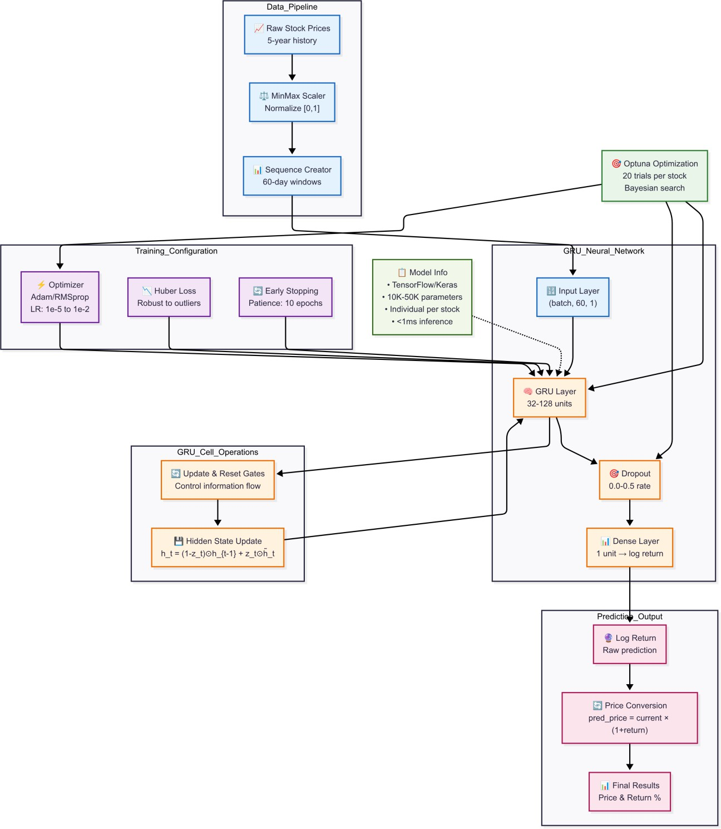
Model Architecture

Slide 9
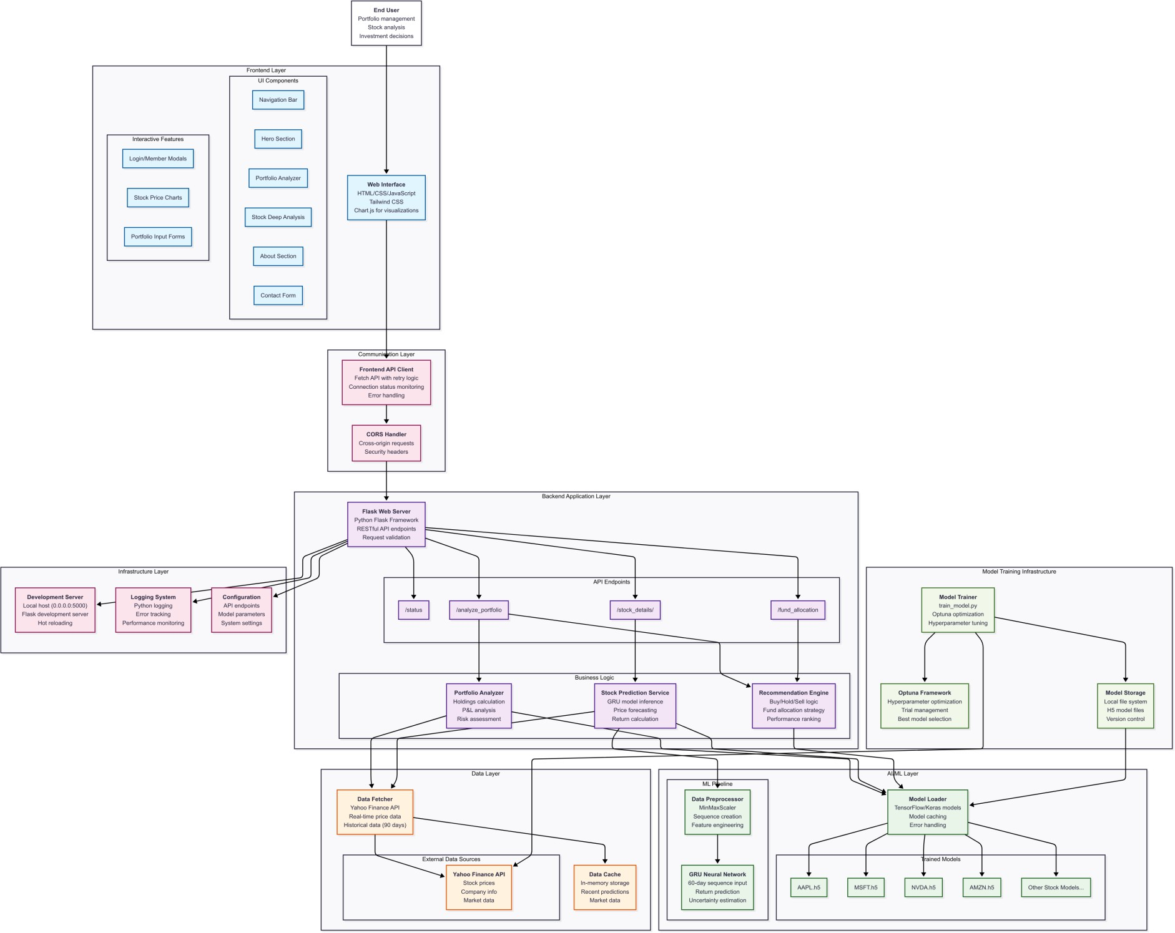
System Architecture Model

Slide 10
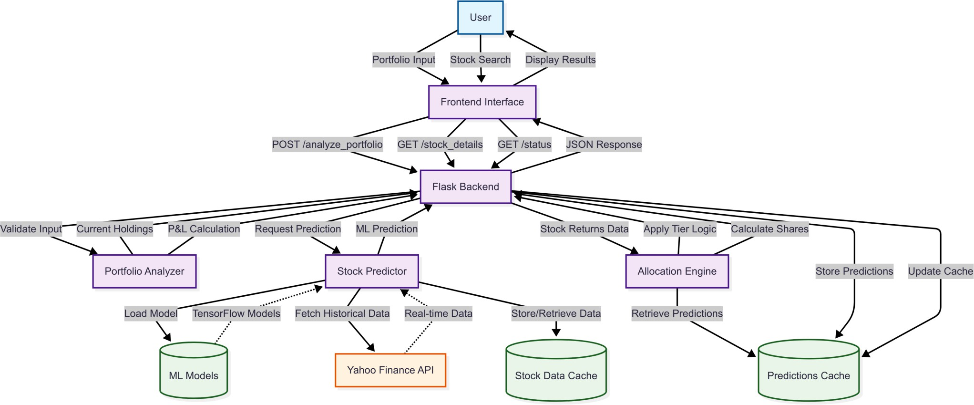
Data Flow Diagram

Slide 11
LSTM IN STOCK MARKET PREDICTION
LSTM is well-suited for stock price prediction as it captures time-based patterns in sequential data.
In this project, LSTM uses the past 60 days of closing prices to predict the next 7 trading days.
The model learns trends, fluctuations, and dependencies in price movement.
Stacked LSTM layers improve the model’s ability to detect complex patterns.
This approach enables more accurate and consistent short-term stock forecasts compared to traditional models.

Slide 12
ALGORITHM FOR LSTM MODEL
Start
Load and Clean Data
Import stock data from CSV files.
Convert date columns and remove invalid or missing values.
Keep only Date and Close price columns.
3.Preprocess Data
Sort data by date.
Normalize closing prices using MinMaxScaler.
Create sequences of 60 consecutive prices as input and the 61st price as the output label.
4.Split Data
Split the sequences into training and testing sets (e.g., 80%-20%).
5.Get the user input
Enter the amount to be invested on that day.
Enter the investment day for that initial amount.

Slide 13
ALGORITHM FOR LSTM MODEL (CONTD..)
Build LSTM model
Initialize a Sequential model using Keras.
Add the first LSTM layer with 50 units.
Add the second LSTM layer with 50 units.
Add a Dense layer with 1 unit to predict the next closing price.
Compile the model using mean_squared_error as the loss function and adam as the optimizer.
Fit the model on the training data for a defined number of epochs and batch size.
7.Make Predictions
For a given investment date:
Extract the last 60 days of prices before that date.
Predict prices for the next 7 trading days using a rolling input window.
8.Investment Summary
Calculate: Number of shares bought using investment amount and current price and expected profit or loss..
Best selling day within 7-day forecast (highest predicted price).
9.End

Slide 14
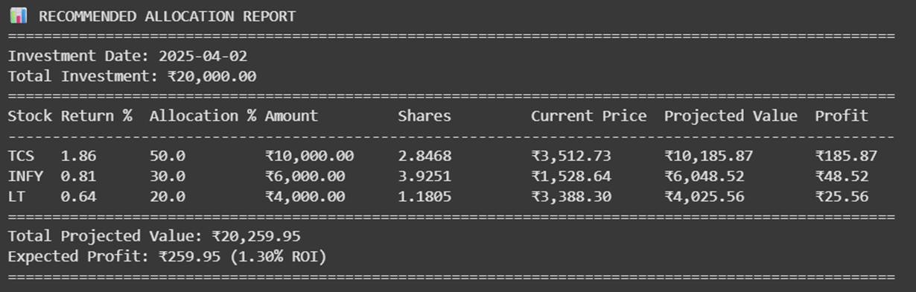
OUTPUT 1:RECOMMENDED ALLOCATION REPORT
Investment date: 2nd April 2025
Total investment: ₹20,000
Model allocates funds based on predicted 7-day
returns
TCS assigned 50%, INFY 30%, LT 20%
Number of shares calculated from current prices
Total projected value: ₹20,259.95
Expected profit: ₹259.95 (1.30% ROI)
Helps in making short-term, data-driven investment
decisions

Slide 15
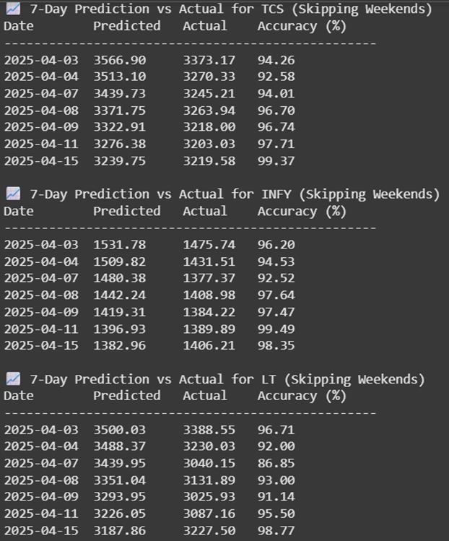
OUTPUT 2: 7 DAYS STOCK PRICE PFORECAST
Shows 7-day predicted vs actual closing prices for TCS, INFY, and LT
Accuracy consistently above 90% across all 3 companies
TCS: Highest accuracy reached 99.37%
INFY: Accuracy up to 99.49%, showing strong prediction stability
LT: Slightly more variation, but still up to 98.77%
Predictions skip weekends to match actual market trading days
Validates that the LSTM model performs well for short-term stock forecasting
High accuracy supports reliable decision-making for investors

Slide 16

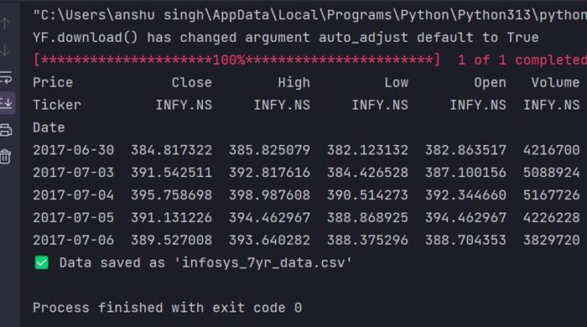
Dataset Acquisition
The yfinance API is especially useful for financial projects because it simplifies
the process of collecting clean, structured, and reliable stock market data without needing
any API key or paid subscription. It supports a wide range of stock tickers from
global exchanges and lets you fetch not just historical prices but also in-depth company
insights like sector, earnings dates, dividends, stock splits

Slide 17

Gated Recurrent Unit (GRU) Architecture
GRU is a variant of Recurrent Neural Network (RNN) specifically built for handling sequential data such as stock prices.
It is similar to LSTM but with a simpler structure and fewer gates, making it faster to train while still capturing essential temporal patterns.
Each GRU cell contains:
Update Gate – determines how much of the past information to carry forward.
Reset Gate – decides how much past information to forget.
Unlike LSTM, GRU combines the forget and input gates into a single update gate, reducing complexity.
Think of GRU as a streamlined memory unit that learns what to remember and what to ignore from the

Slide 18
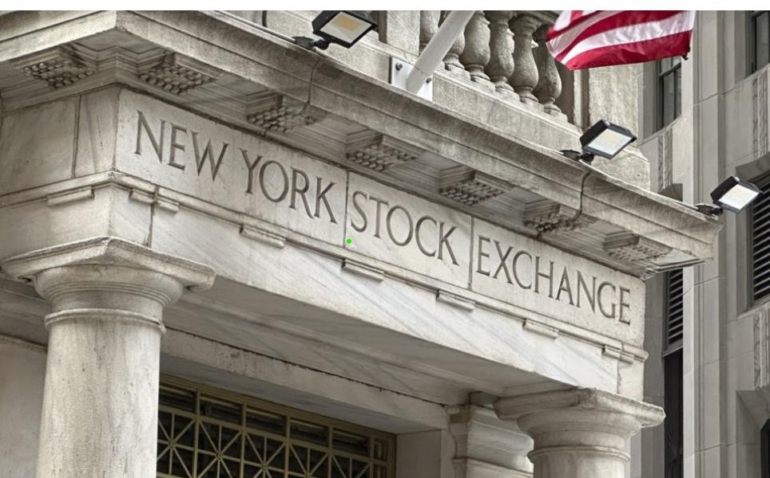
. GRU Algorithm
Model Construction
Initialize a Sequential model using Keras.
Add a GRU layer with 64 units (return_sequences=False).
Add a Dense layer with 32 units and ReLU activation.
Add a final Dense layer with 1 unit to predict the next closing price.
Compile the model using mean_squared_error as the loss
function and adam as the optimizer.
Train the model on 60-day sequences of past closing prices.
Price Prediction
Accept the investment date as input.
Extract historical closing price data up to the investment date.
Normalize the prices using MinMaxScaler.
Create a 60-day input window ending on the investment date.
Predict the next closing price using the trained GRU model.
Inverse-transform the prediction to obtain the real-world price.

Slide 19
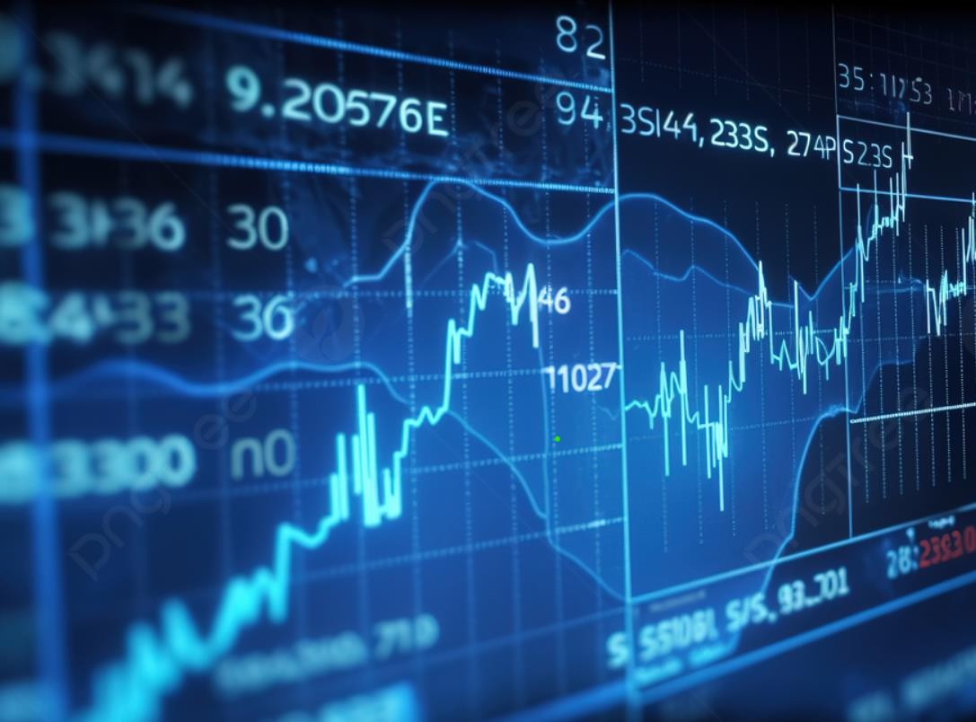
Return Estimation
Get the actual closing price on the investment date.
Calculate the predicted return using:
(Predicted_Price - Current_Price) / Current_Price × 100
Store each stock’s predicted return for comparison.
Portfolio Allocation
Rank all stocks by their predicted return (descending).
Allocate investment as follows:
40% to the top performer,
30% to the second-best,
20% to the third,
10% to the fourth.
Exclude any stocks with negative predicted returns (allocate 0%).
Reallocate any leftover amount to the top-performing stock.

Slide 20
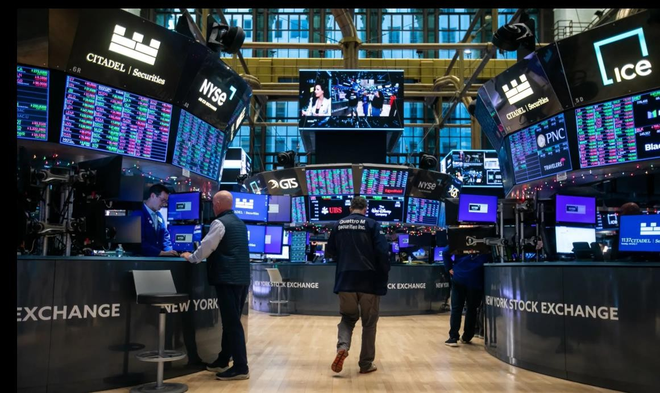
Investment Summary
For each allocated stock:
Calculate the amount invested and number of shares bought.
Estimate the future value using the predicted price.
Compute expected profit or loss.
Summarize the portfolio:
Total investment amount,
Total projected return,
Net gain or loss,
Return on Investment (ROI %).

Slide 21
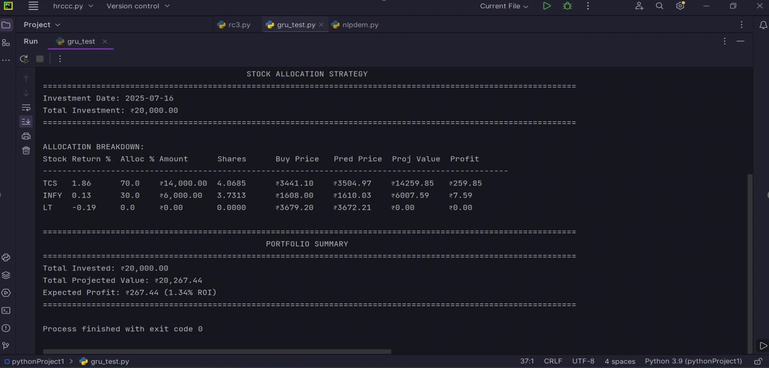
BACKEND OUTPUT

Slide 22
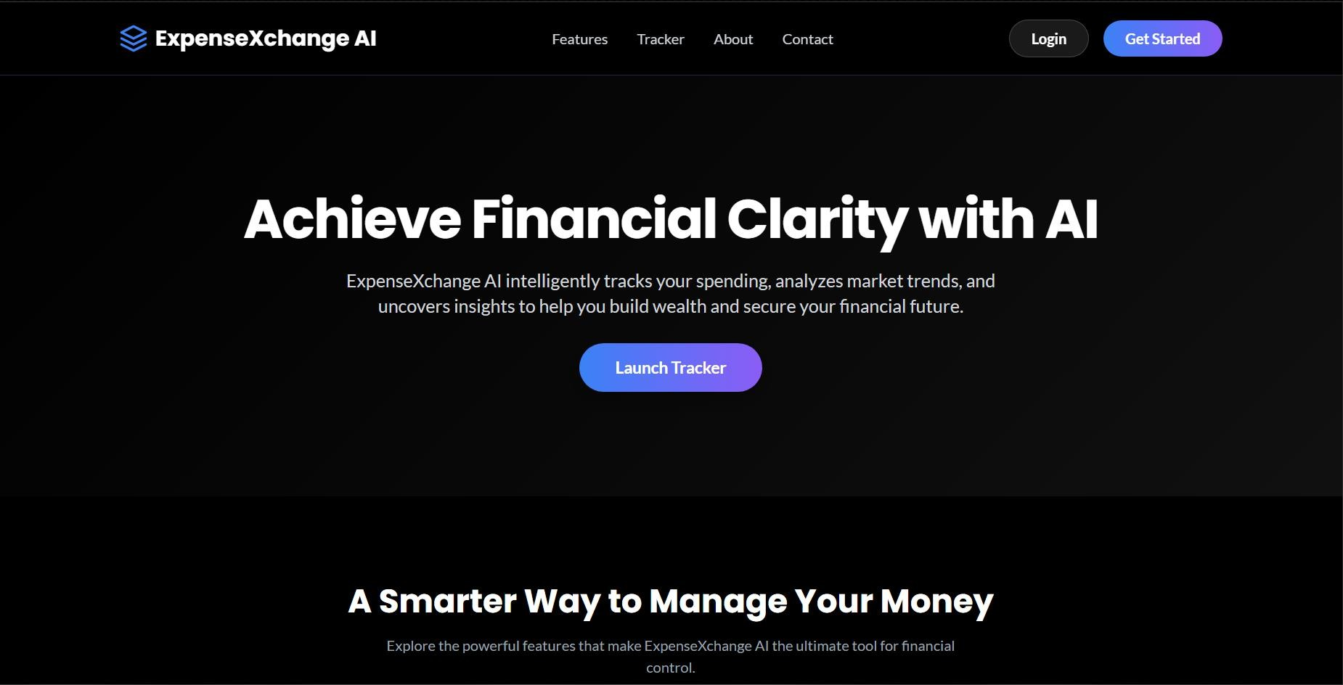
Frontend Output

Slide 23
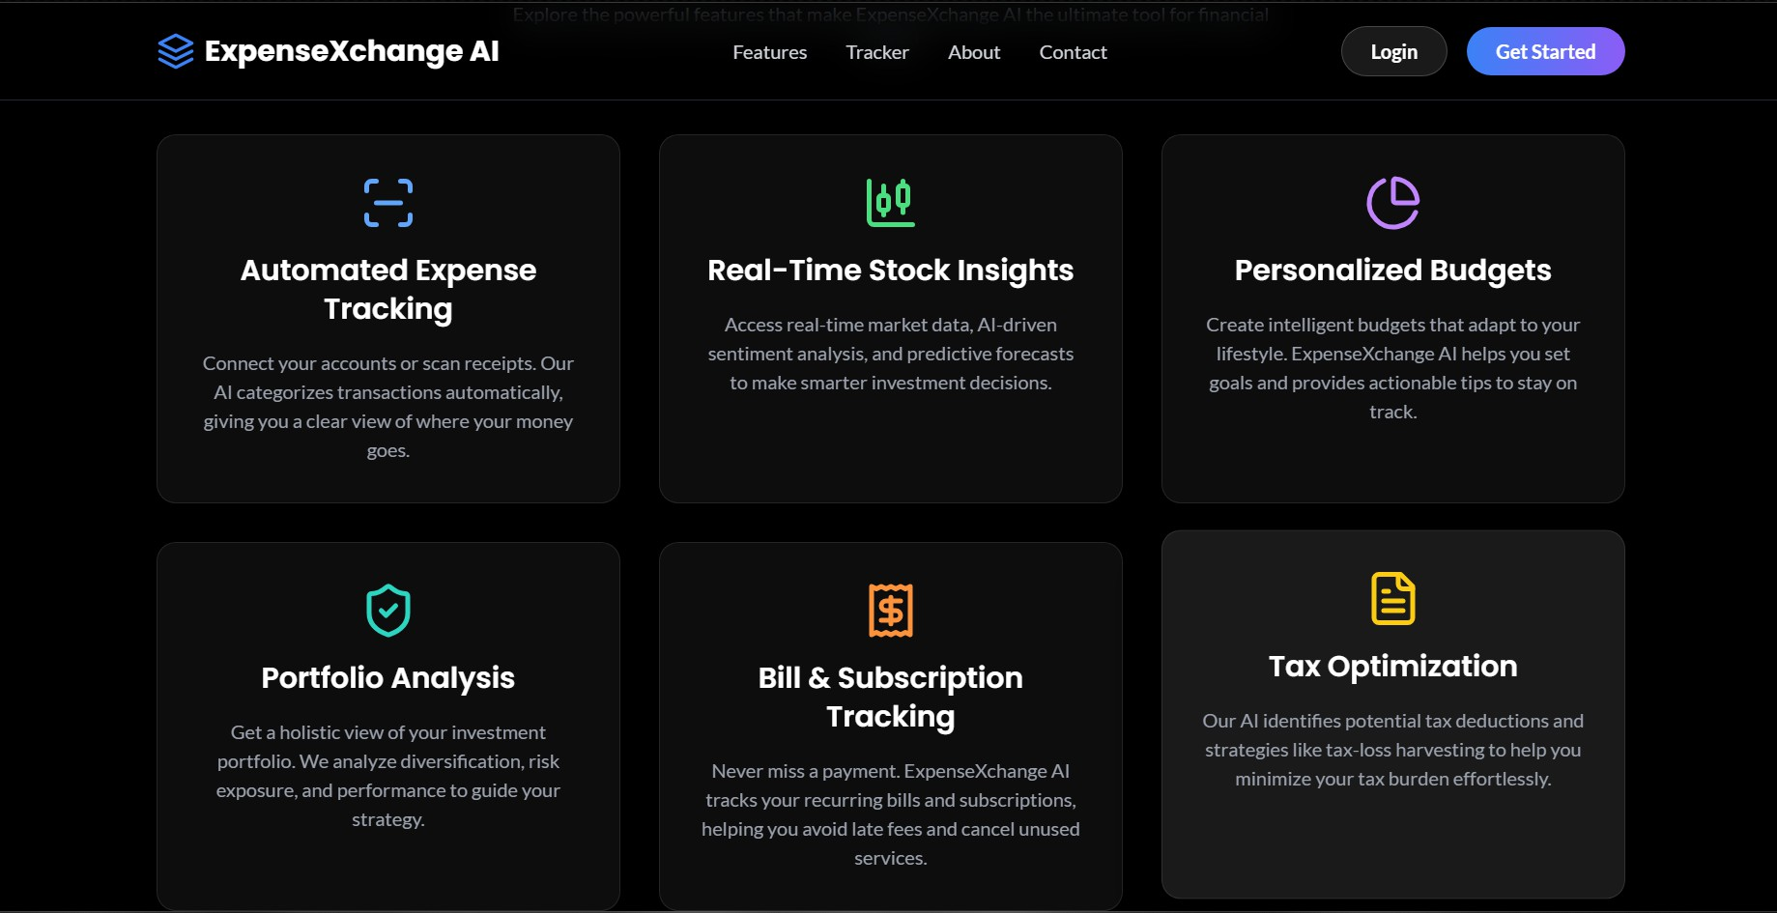

Slide 24
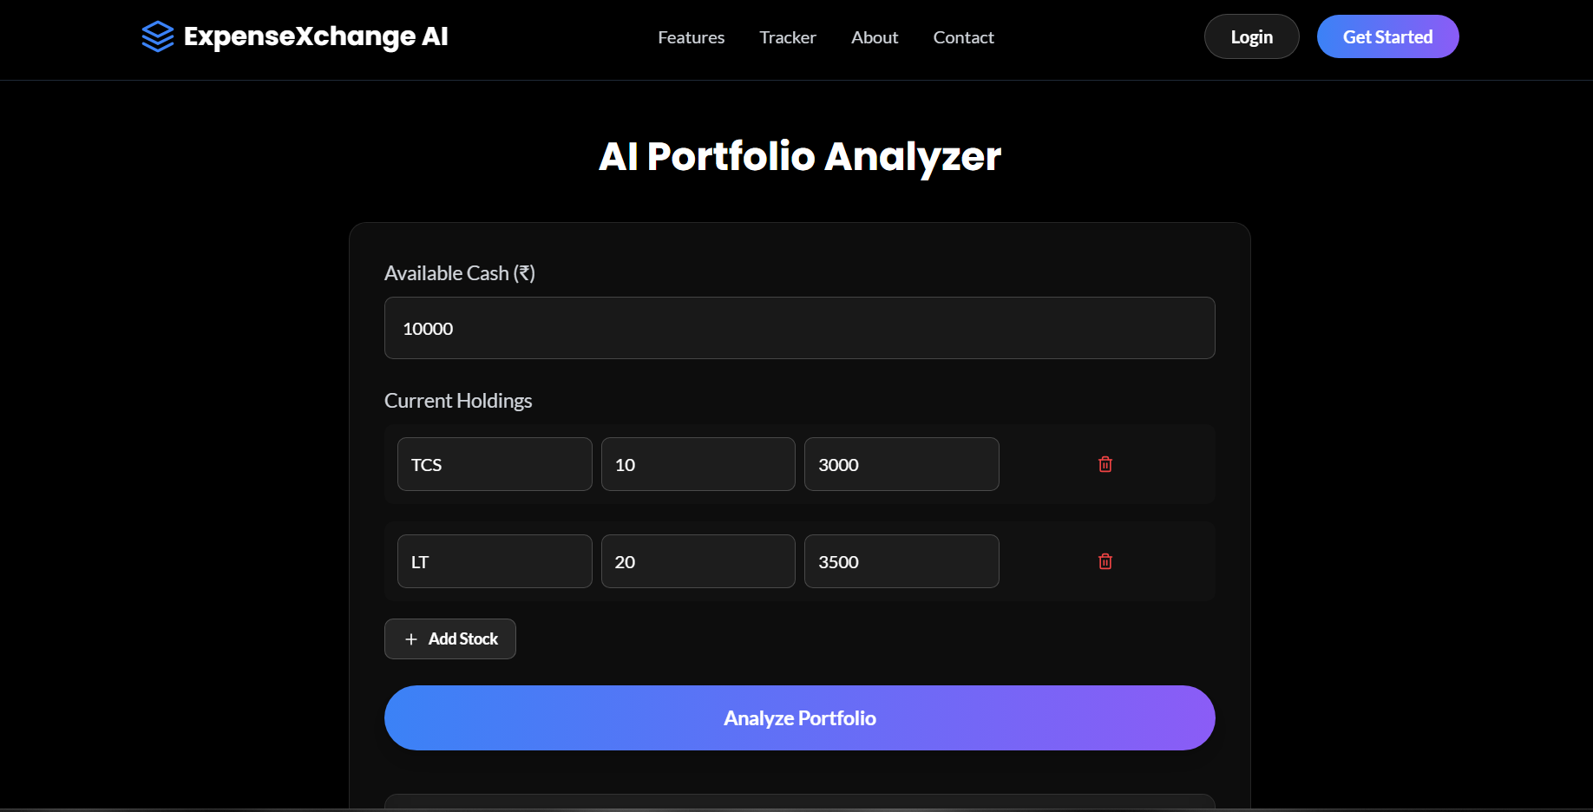

Slide 25
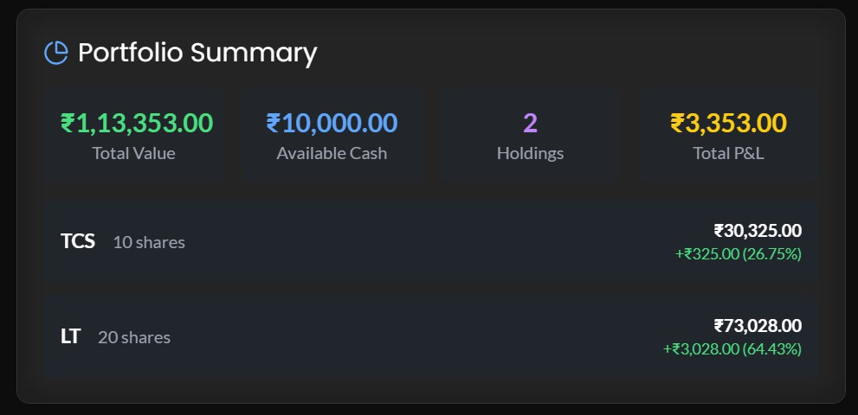
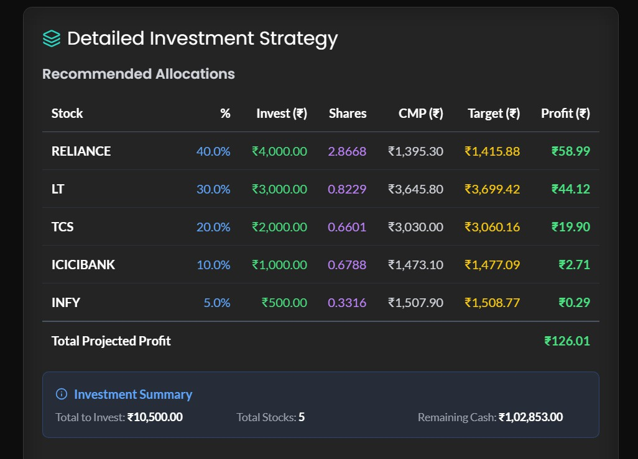
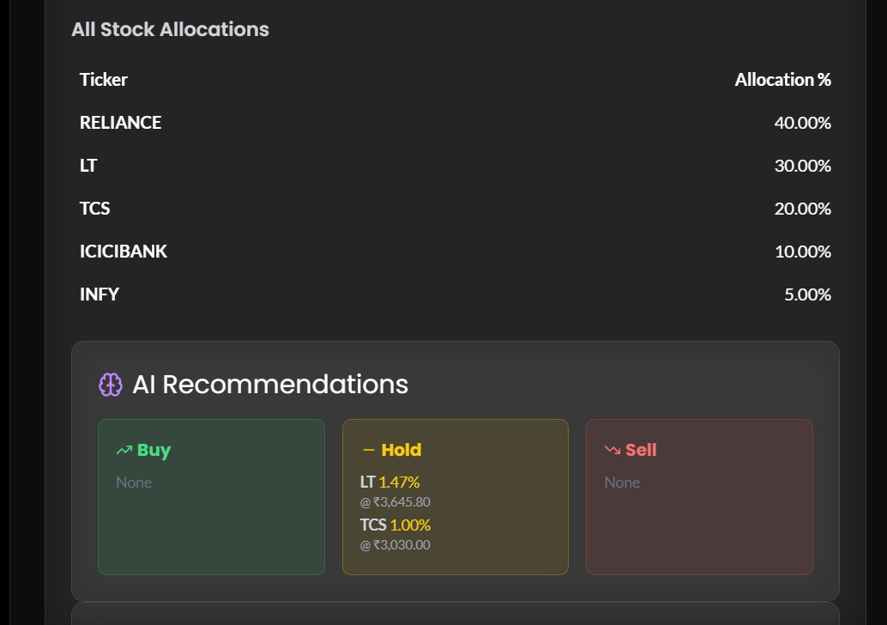

Slide 26
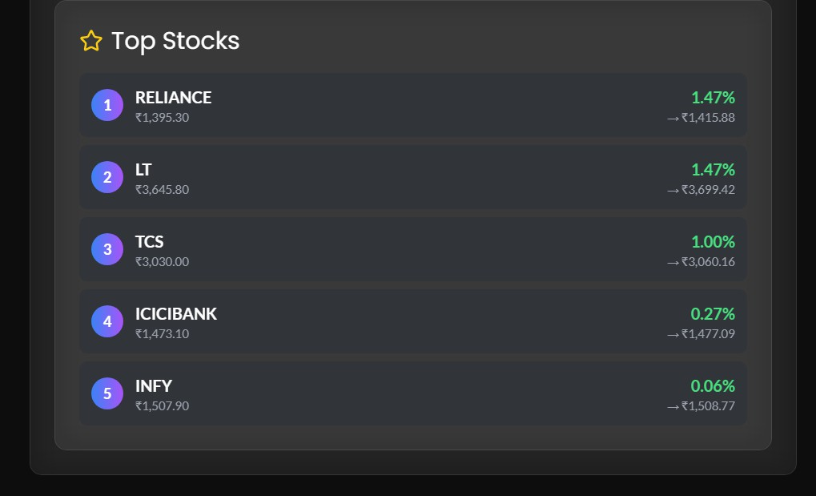

Slide 27
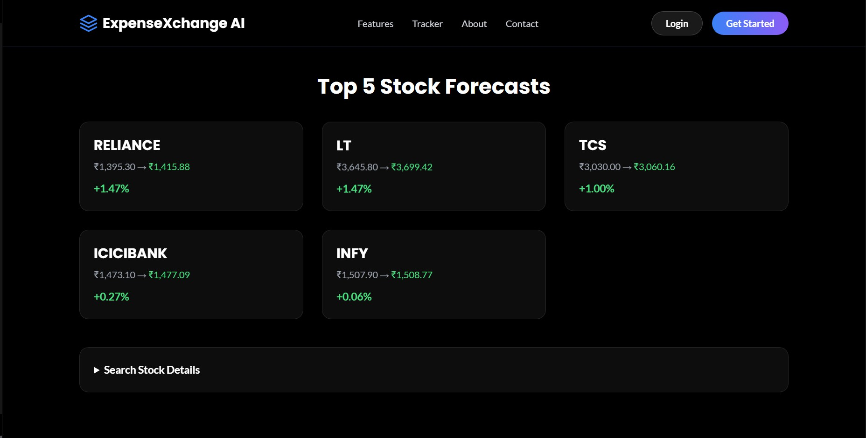

Slide 28
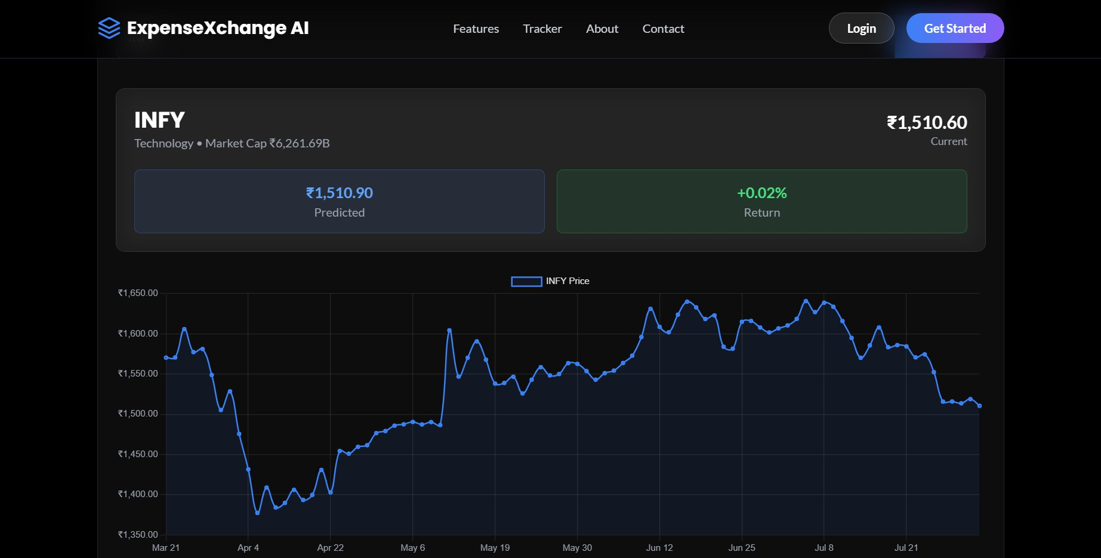

Slide 29

Thank You
https://github.com/DankEnigmo/expensxchange_AI

