Slide 1
Introduction to Algorithms
Lecturer: Yitong Wang

Slide 2

主要教学经历
算法设计与分析课程
C语言程序设计， 微积分
数据库新进展，社会网络大数据分析
主要研究方向
WEB数据挖掘及大数据关键技术研究
社会网络大数据分析
医疗大数据分析—精准医疗
金融大数据分析—数据流分析
推荐系统的研究
物联网工业数据分析
王轶彤 博士 副教授
yitongw@fudan.edu.cn
Tel: 1376343945

Slide 3
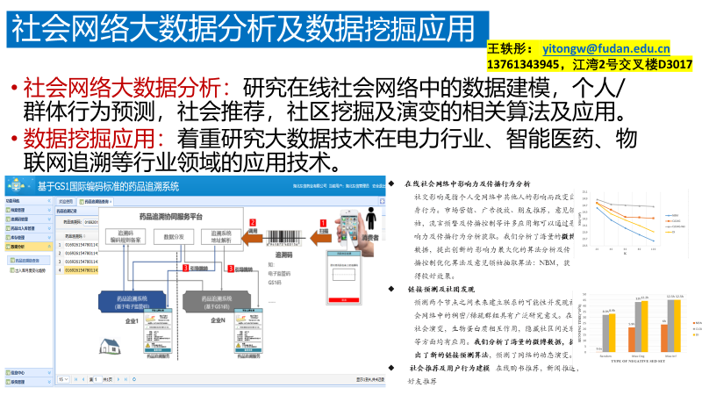

Slide 4
课程简介
算法设计与分析 (Design and Analysis of Algorithms)
任课教师: 王轶彤 (yitongw@fudan.edu.cn)
Tel: 13761343945
TA: 周芝帆(<20212010038@fudan.edu.cn >)
Tel: 13916847512
授课方式: 全英文教学, 3学时/周, 双周1次习题课
课件会在每周课后更新至E-learning上
上课时间: 每周三(6-8) , 习题课 (双周三:1-2)

Slide 5

课程目标
了解并掌握一些经典的算法(排序,搜索,图,最小生成树,最短路径等)和相关概念
了解并掌握主要的算法设计方法和技巧(分而治之, 动态规划,贪心)
了解并掌握算法的复杂度分析方法(渐进分析,平摊分析,递归分析)
培养设计算法解决实际问题的能力

Slide 6
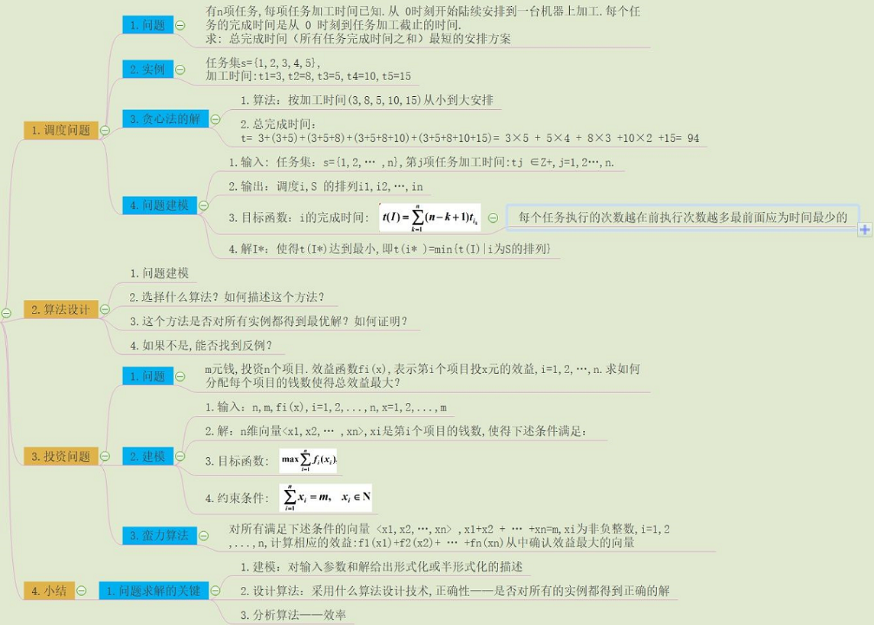

Slide 7
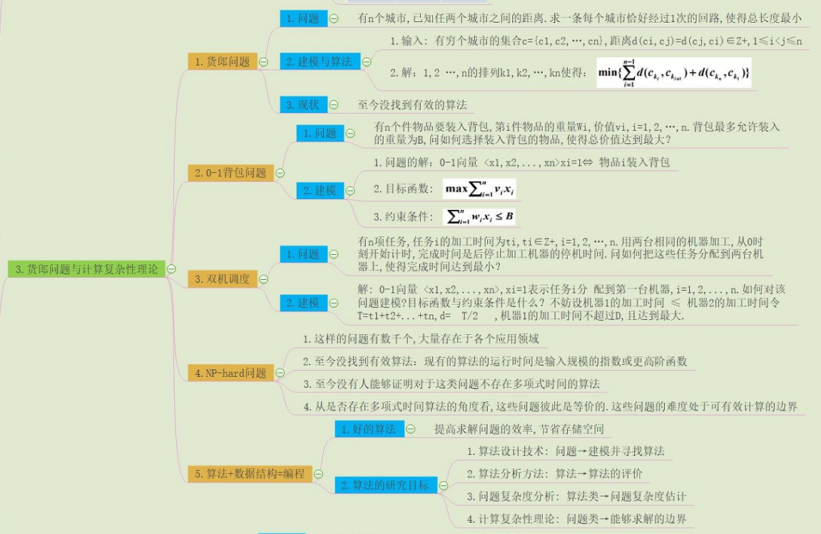

Slide 8
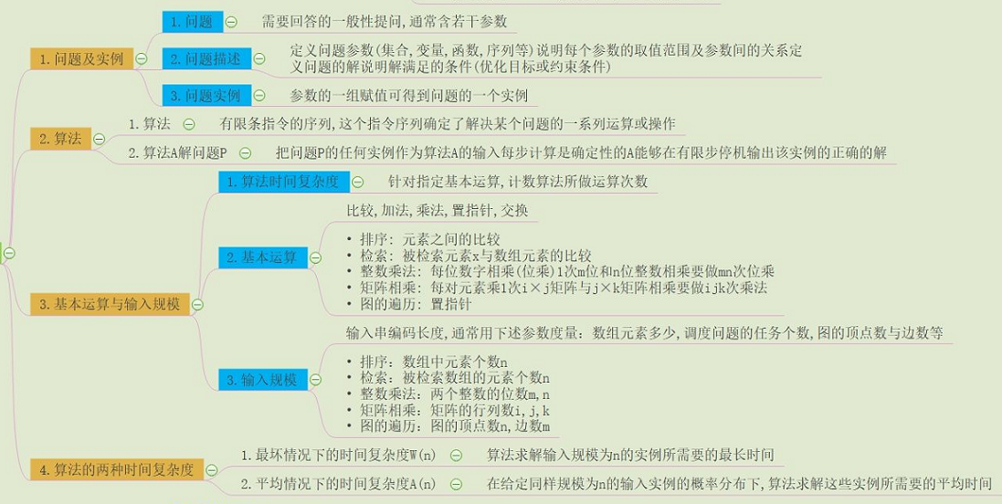
算法及其复杂度

Slide 9

评价算法的主要方面
正确性
  首要要求和标准
  正确性证明，程序测试
健壮性：可以处以异常或意外情形，正确的输入产生正确的结果，不正确的输入也可以处理
简单性：算法/程序的可读性比较好
高效性：时间/空间复杂度较低，特别是时间
最优性：同一类算法中最优的

Slide 10
主要内容
了解掌握一些基本的算法：排序，查找
基础部分(I) : 1-5章
排序部分(II) : 6-9章
数据结构(III): 12, 13章
高级设计分析技术(IV):
  15-17章
图算法(VI): 22-26章
其他主题(VII) : 34
学习算法设计技巧：递归，分而治之，动态规划，贪心
学习算法基本的分析技巧：渐进分析，统计分析，平摊分析
学习应用算法解决实际问题的能力：优化问题，最短距离，生成树，最大流

Slide 11
课程要求
本课程是必修课, 每周有作业;
另外准备1个练习本，有时会有课堂练习
课堂纪律: 不要迟到, 可以缺席, 会有随堂练习, 有问题请随时中断提问
中期会有课程报告和讨论
要求必须看英语原版教材。期中，期末试卷均是英文的，答题可用中文。

Slide 12
成绩评估
成绩考核: 作业成绩 (15%)+中期报告(15%) +期中考试(30-35%)+期末考试(35-40%)
平时成绩：作业上交+课堂表现
期中考试：在第9周
期末考试： 6月15日13：00-15：00

Slide 13
Schedule
Week | Content
1 | Chap1, 2, 3.1.
2 | Chap 3.2, Chap 4
3 | Chap 5, Class Exercise.1
4 | Chap6, Chap 7.1-7.2
5 | Chap7.3-7.4, Chap 8
6 | Chap 9, Class Exercise 2.
7 | Chap 12
8 | Chap 13 , Mid-term Review
9 | Mid-Term Exam
10 | Chap 15
11 | Chap 16
12 | Chap 17. Class Exercise 3
13 | Chap 22, Chap 23
14 | Chap 24, Chap 25.1-2
15 | Chap 25.3, Chap26
16 | Selected topic, Review
Final

Slide 14

参考书
教科书
Introduction to Algorithms
Second Edition （Third Edition）
以教科书为核心, 其他帮助理解的算法书籍都可以作为参考书
算法设计技巧与分析(M.H. Alsuwaiyel著)
算法设计（Jon Kleinberg著）

Slide 15
Chapter 1.
The Role of Algorithms in Computing

Slide 16
Analysis Of Algorithms
Theoretical study of computer program performance and resource usage
In programming, what is more important than performance?
Why we study algorithms and performance
  feasible vs. infeasible, study program behavior…
Correctness, simplicity, functionality, maintainability, stability, modularity, user-friendly

Slide 17
Outline
What are algorithms?
Why is the study of algorithms worthwhile?
What is the role of algorithms relative to other technologies used in computers?

Slide 18
Algorithms
Informally, an algorithm is any well-defined computational procedure that takes input and produces output.
A sequence of computational steps that transform the input into the output.
  The algorithm describes a specific computational procedure for achieving that input/output relationship.
  E.g.) sorting problem – sorting algorithm
An instance of a problem(input) vs. a solution to the problem (output).

Slide 19

Algorithm.
An algorithm is said to be correct if it halts with the correct output for every input instance.
  An incorrect algorithm might not halt at all or
  it might halt with an answer other than the desired one.
The specification of the algorithm must provide a precise description of the computational procedure to be followed.

Slide 20

Applications
  The Human Genome Project
    Determination of the sequences of the 3 billion chemical base pairs
  Management/Manipulation of the large volume of the internet data:
    Finding good routes – use the graph algorithm of the shortest path
    using a search engine to quick discovery of the information pages.
    – use the hash tables and the algorithm of string match,

Slide 21
Problems Solved
There are many candidate solutions, most of which are not what we want. Finding one that we do want can present quite a challenge.
There are practical applications and efficient solutions to them do have a very practical (financial) meaningfulness.

Slide 22

How to solve the problems?
Data Structures:
  A data structure is a way to store and organize data in order to facilitate access and modifications.
Efficient Algorithms:
  P-problems:
    problems that can be solved efficiently in polynomial time.
  NP-complete problems:
    it’s unknown whether efficient algorithm exist for NP-complete problems or not.
    If an efficient algorithm exists for any one of them, then efficient algorithms exist for all of them.

Slide 23
Algorithms as a Technology
Efficiency
Algorithms devised to solve the same problem often differ dramatically in their efficiency.
These difference can be much more significant than differences due to hardware and software.
Example
Suppose insertion sort and Merge sort are with running time as 2n² and 50nlgn
We consider sorting 1 million (10⁶ ) numbers using two algorithms on computer A&B respectively (10⁹ vs. 10⁷)
2000 seconds vs. 100 seconds=> 20 times!

Slide 24
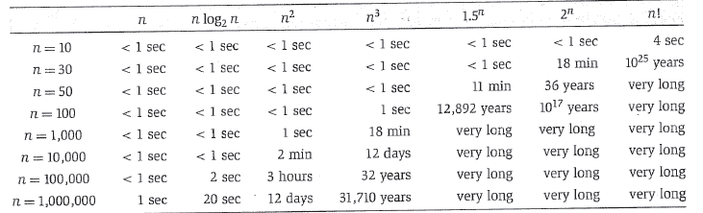

Efficient Algorithm

