Slide 1
Chapter 8.
Sorting in Linear Time

Slide 2
Types of Sort Algorithms
The only operation that may be used to gain order information about a sequence is comparison of pairs of elements.
Quick Sort -- comparison-based
Insertion Sort -- comparison-based
Heap Sort -- comparison-based
Merge Sort -- comparison-based

Slide 3


Lower bounds for sorting
Lower bounds
  Ω(n) to examine all the input.
  All sorts seen so far are Ω(n lg n).
  We’ll show that Ω(n lg n) is a lower bound for comparison sorts.
Decision tree
  Abstraction of any comparison sort.
  Represents comparisons made by
    a specific sorting algorithm
    on inputs of a given size.
  Abstracts away everything else: control and data movement.
  We’re counting only comparisons.

Slide 4
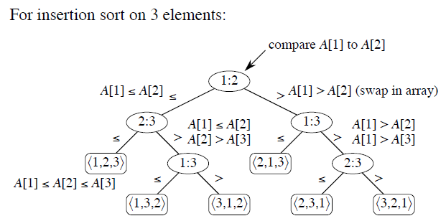

Slide 5
Decision Tree
How many leaves on the decision tree?
There are ≥ n! leaves, because every permutation appears
at least once.
For any comparison sort,
  1 tree for each n.
  View the tree as if the algorithm splits in two at each node, based on the information it has determined up to that point.
  The tree models all possible execution traces.
What is the length of the longest path from root to leaf?
  Depends on the algorithm
  Insertion sort: (n²)
  Merge sort: (n lg n)
Worst –case Running time

Slide 6

Lemma
Lemma
Any binary tree of height h has ≤ 2^{h} leaves.
In other words:
    l = # of leaves,
    h = height,
    Then l ≤ 2^{h} .
Theorem 8.1
Any comparison sort algorithm requires Ω(n lg n) comparisons in the worst case.
Corollary 8.2
HeapSort and Merge Sort are asymptotically optimal comparison sorts. (O(nlogn)

Slide 7
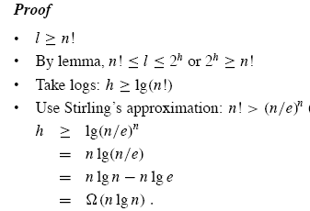
Proof

