Slide 1
Chapter 8.
Sorting in Linear Time

Slide 2
Types of Sort Algorithms
The only operation that may be used to gain order information about a sequence is comparison of pairs of elements.
Quick Sort -- comparison-based
Insertion Sort -- comparison-based
Heap Sort -- comparison-based
Merge Sort -- comparison-based

Slide 3


Lower bounds for sorting
Lower bounds
  Ω(n) to examine all the input.
  All sorts seen so far are Ω(n lg n).
  We’ll show that Ω(n lg n) is a lower bound for comparison sorts.
Decision tree
  Abstraction of any comparison sort.
  Represents comparisons made by
    a specific sorting algorithm
    on inputs of a given size.
  Abstracts away everything else: control and data movement.
  We’re counting only comparisons.

Slide 4
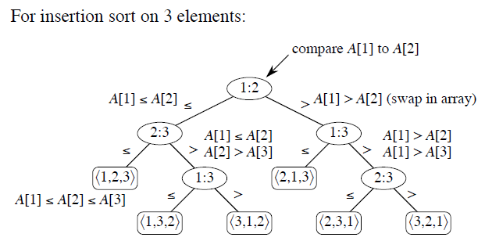

Slide 5
Decision Tree
How many leaves on the decision tree?
There are ≥ n! leaves, because every permutation appears
at least once.
For any comparison sort,
  1 tree for each n.
  View the tree as if the algorithm splits in two at each node, based on the information it has determined up to that point.
  The tree models all possible execution traces.
What is the length of the longest path from root to leaf?
  Depends on the algorithm
  Insertion sort: (n²)
  Merge sort: (n lg n)
Worst –case Running time

Slide 6

Lemma
Lemma
Any binary tree of height h has ≤ 2^{h} leaves.
In other words:
    l = # of leaves,
    h = height,
    Then l ≤ 2^{h} .
Theorem 8.1
Any comparison sort algorithm requires Ω(n lg n) comparisons in the worst case.
Corollary 8.2
HeapSort and Merge Sort are asymptotically optimal comparison sorts. (O(nlogn)

Slide 7
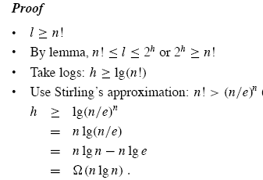
Proof

Slide 8
Sorting in Linear Time
Non-comparison sorts.
Counting sort
Depends on a key assumption: numbers to be sorted are integers in {0, 1, . . . , k}.
Input:
A[1 . . n], where A[ j ] ∈ {0, 1, . . . , k} for j = 1, 2, ..., n.
Array A and values n and k are given as parameters.
Output:
B[1 . . n], sorted. B is assumed to be already allocated and is given as a parameter.
Auxiliary storage: C[0 . . k]
Key idea: for each input element x, determine the number of elements less than x.

Slide 9
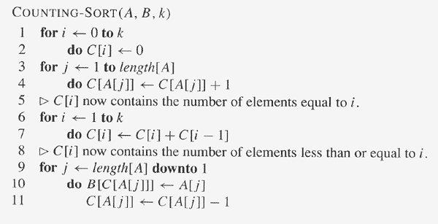

Slide 10
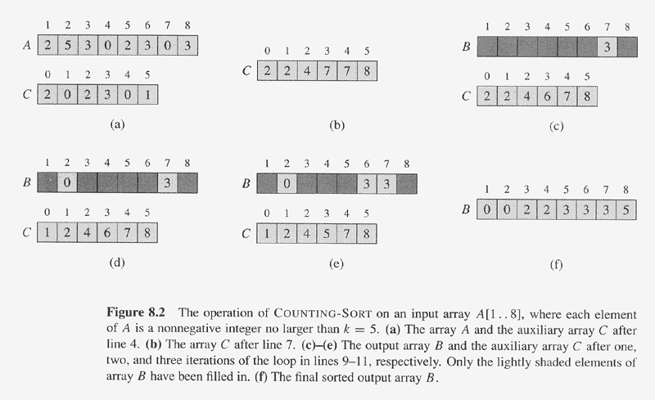

Slide 11
Analysis of Counting sort
Θ(n + k), which is Θ(n) if k = O(n).
How big a k is practical?
  Good for sorting 32-bit values? No.
  16-bit? Probably not.
  8-bit? Maybe, depending on n.
  4-bit? Probably (unless n is really small).
Counting sort will be used in radix sort.
Stable algorithm:
Numbers with the same value appear in the output array in the same order as they do in the input array;.

Slide 12
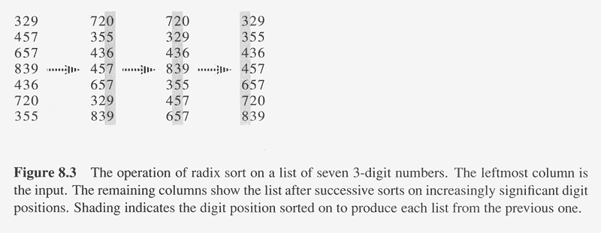
Radix Sort(1)
Key idea: Sort least significant digits first.
Why?

Slide 13
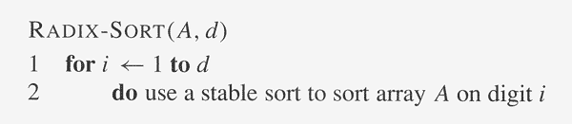
Radix Sort(2)
Correctness:
Induction on number of passes ( i in pseudocode).
Assume digits 1, 2, . . . , i-1 are sorted.
Show that a stable sort on digit i leaves digits 1, ..., i sorted:
  If 2 digits in position i are different, ordering by position i is correct, and positions 1, . . . , i-1 are irrelevant.
  If 2 digits in position i are equal, numbers are already in the right order (by inductive hypothesis). The stable sort on digit i leaves them in the right order.

Slide 14
Analysis of Radix Sort(1)
Lemma 8.3:
Given n d-digit numbers in which each digit can take on up to k possible values, RADIX-SORT correctly sorts these numbers in Θ (d( n + k)) time.
Assume that we use counting sort as the intermediate sort.
  Θ (n + k) per pass (digits in range 0, ... , k)
  d passes
  Θ (d(n + k)) total
  If k = O(n), time = Θ (d⋅n).

Slide 15
Analysis of Radix Sort(2)
Lemma 8.4
Given n b-bit numbers and any positive integer r ≤ b, RADIX-SORT correctly sorts these numbers in Θ (b/r (n+ 2^{r} )) time.
How to break each key into digits?
  n words.
  b bits/word.
  Break into r-bit digits. Have d = ⎡b/r⎤.
  Use counting sort, k = 2^{r} -1.
  Example: 32-bit words, 8-bit digits.
  b = 32, r = 8, d = ⎡32/8⎤ = 4, k = 2⁸ - 1 = 255.
  Time = Θ (b/r (n + 2^{r} )).

Slide 16
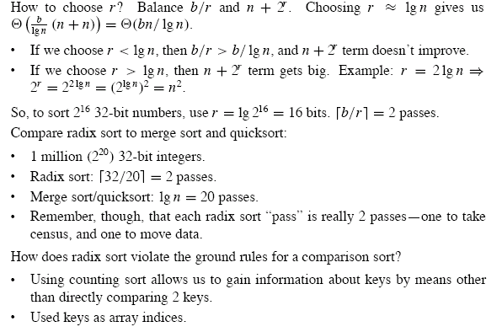

Slide 17
Bucket Sort
Assumes the input is generated by a random process that distributes elements uniformly over [0, 1).
Idea:
  Divide [0, 1) into n equal-sized buckets.
  Distribute the n input values into the buckets.
  Sort each bucket.
  Then go through buckets in order, listing elements in each one.
Input: A[1 .. n], where 0 ≤ A[i] < 1 for all i.
Auxiliary array: B[0 .. n-1] of linked lists, each list initially empty.

Slide 18
Correctness
Consider A[i ], A[ j ]:
Assume without loss of generality that A[i ] ≤ A[ j Then ⎣n·A[i ]⎦ ≤ ⎣n·A[ j ]⎦.
So A[i ] is placed into the same bucket as A[ j ] or into a bucket with a lower index.
  If same bucket, insertion sort fixes up.
  If earlier bucket, concatenation of lists fixes up.

Slide 19
Analysis
Relies on no bucket getting too many values.
All lines of algorithm except insertion sorting take Θ(n) altogether.
Intuitively, if each bucket gets a constant number of elements, it takes O(1) time to sort each bucket ⇒ O(n) sort time for all buckets.
We “expect” each bucket to have few elements, since the average is 1 element per bucket.

Slide 20
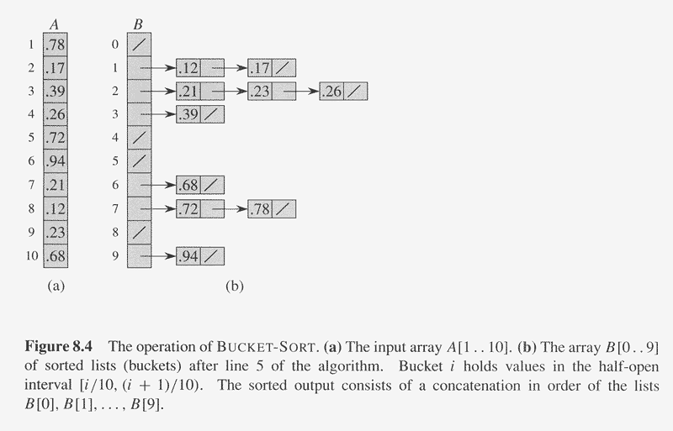

Slide 21
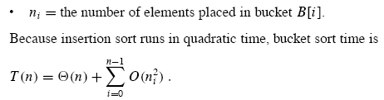
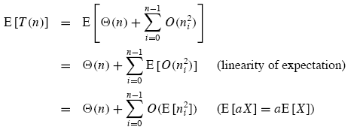
Detailed Analysis

Slide 22
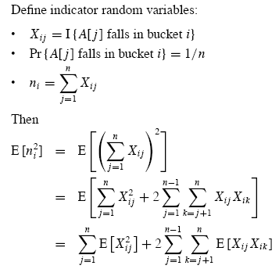

Slide 23
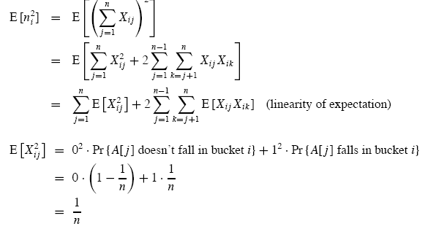

Slide 24

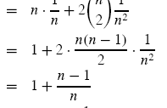

Slide 25
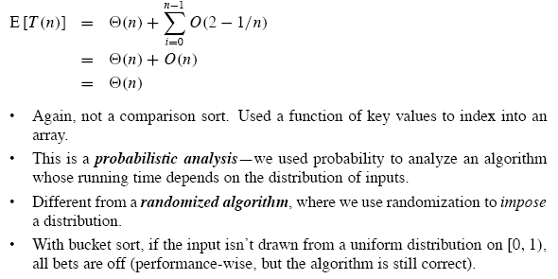
Conclusion

Slide 26
Important Features of Sort Algorithms
Sort Algorithm | Worst-case T(n) | Average-case T(n)
Insertion sort | Θ(n² ) | Θ(n² )
Quick sort | Θ (n²) | Θ (n lg n)
Merge sort | Θ (n lg n) | Θ (n lg n)
Heap sort | Θ (n lg n) | Θ(n lg n)
Counting sort Radix sort Bucket sort | Θ (n) Θ (n lg n) Θ(n² ) | Θ (n) Θ (n) Θ (n)

Slide 27
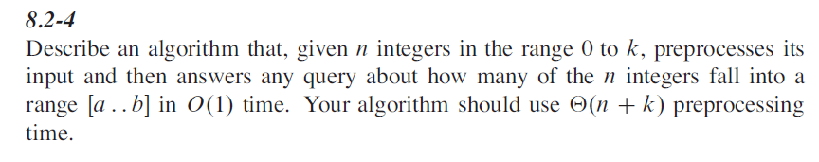

Homework
8.2-4, 8.3-4

