Slide 1
Chapter 23.
Minimum Spanning Trees

Slide 2
Problem
A town has a set of houses and a set of roads.
A road connects 2 and only 2 houses.
A road connecting houses u and v has a repair cost w(u, v).
Goal: Repair enough (and no more) roads such that
  1. everyone stays connected: can reach every house from all other houses, and
  2. total repair cost is minimum.

Slide 3
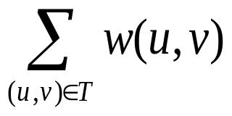
Model
Model as a connected graph:
Undirected graph G = (V, E).
Weight w(u, v) on each edge (u, v) ∈ E.
Let T be a minimum cost solution to the network design problem. Then T is a tree.
Find T ⊆ E such that
  1. T connects all vertices (T is a spanning tree), and
  2. w(T ) = is minimized.

Slide 4
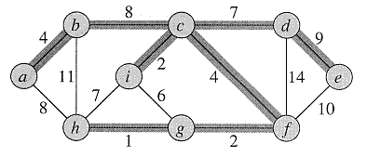
Definition
A spanning tree whose weight is minimum over all spanning trees is called a Minimum Spanning Tree, or MST.
In this example, there is more than one MST. Replace edge (b,c) by (a,h). Get a different spanning tree with the same weight.

Slide 5
Growing a Minimum Spanning Tree
Some properties of an MST:
  It has |V| -1 edges.
  It has no cycles.
  It might not be unique.
Building up the solution
  We will build a set A of edges.
  Initially, A has no edges.
  As we add edges to A, maintain a loop invariant:
    Loop invariant: A is a subset of some MST.
  Add only edges that maintain the invariant.
  If A is a subset of some MST, an edge (u, v) is safe for A
  if and only if A ∪ {(u, v)} is also a subset of some MST.
  So we will add only safe edges.

Slide 6
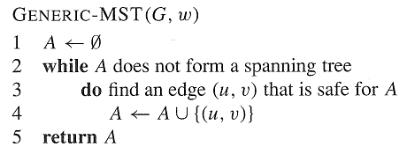
.. continued
Generic MST algorithm
  Use the loop invariant to show that this generic algorithm works.

Slide 8
Loop Invariant
Loop Invariant: Priori to each iteration, A is a subset of some minimum spanning tree
  Initialization:
  The empty set trivially satisfies the loop invariant.
  Maintenance:
  Since we add only safe edges, A remains a subset of some MST.
  Termination:
  All edges added to A are in an MST, so when we stop, A is a spanning tree that is also an MST

Slide 9
Finding a Safe Edge
Let’s look at the example. Edge (h, g) has the lowest weight of any edge in the graph. Is it safe for A = ∅?
  Intuitively: Let S ⊂ V be any set of vertices that includes h but not g (so that g is in V - S). In any MST, there has to be one edge (at least) that connects S with V - S. Why not choose the edge with minimum weight? (Which would be (h, g) in this case.)

Slide 10
Some definitions
Let S ⊂ V and A ⊆ E.
  A cut (S, V - S) is a partition of vertices into disjoint sets S and V - S.
  Edge (u, v) ∈ E crosses cut (S, V - S)
  if one endpoint is in S and the other is in V - S.
  A cut respects A if and only if no edge in A crosses the cut.
  An edge is a light edge crossing a cut if and only if its weight is minimum over all edges crossing the cut.
  For a given cut, there can be > 1 light edge crossing it.

Slide 11
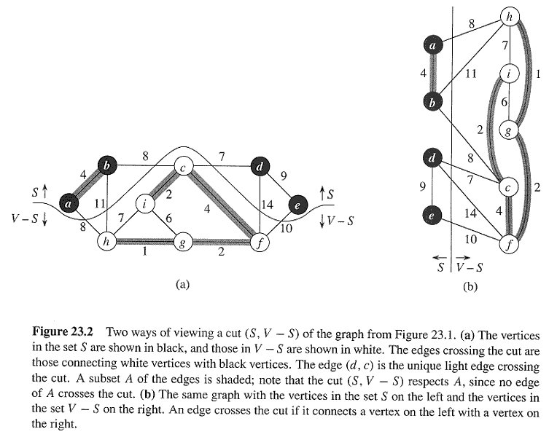

Slide 12
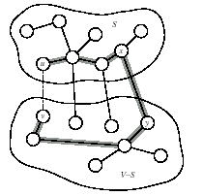
Theorem 23.1
Let A be a subset of some MST, (S, V - S) be a cut that respects A, and (u, v) be a light edge crossing (S, V - S). Then (u, v) is safe for A.
Proof Let T be an MST that includes A (i.e. A ⊆ T ).
  1) If (u, v) ∈ T, done. -- i.e. A ∪ {(u, v)} ⊆ T.
  2) So now assume that (u, v) ∉ T. We’ll construct a different MST T’ that includes A ∪ {(u, v)}: i.e. A ∪ {(u, v)} ⊆ T’.

Slide 13
Proof
Recall: a tree has unique path between each pair of vertices.
Since T is an MST, it contains a unique path p between u and v. Path p must cross the cut (S, V -S) at least once. Let (x, y) be an edge of p that crosses the cut. From how we chose (u, v), must have w(u, v) ≤ w(x, y).

Slide 14
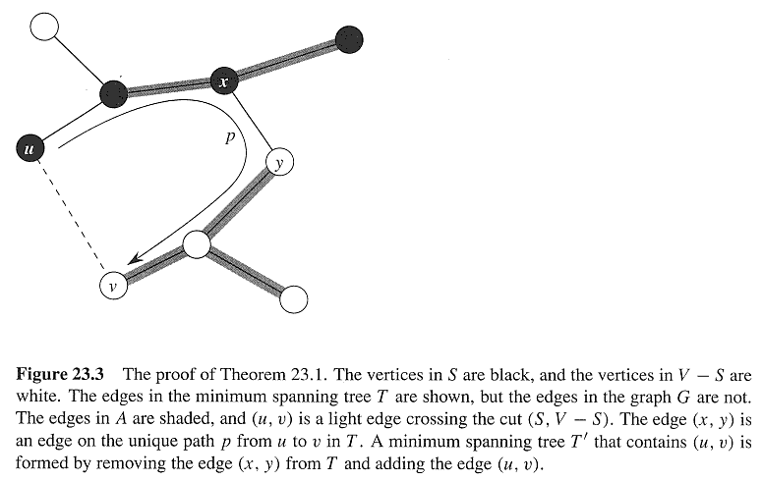

Slide 15
.. continued
Since the cut respects A, edge (x, y) is not in A.
  To form T’ from T :
    Remove (x, y). Breaks T into two components.
    Add (u, v). Reconnects.
  So T’ = T - {(x, y)} ∪ {(u, v)}, T’ is a spanning tree.
  w(T’) = w(T ) - w(x, y) + w(u, v)
  ≤ w(T) , since w(u, v) ≤ w(x, y).
Since T’ is a spanning tree, w(T’ ) ≤ w(T), and T is an MST,
  then T’ must be an MST.
  Need to show that (u, v) is safe for A:
    A ⊆ T and (x, y) ∉ A ⇒ A ⊆ T’ .
    A ∪ {(u, v)} ⊆ T’ .
    Since T’ is an MST, (u, v) is safe for A.

Slide 16
Some Facts
When is it safe to include an edge in the Minimum Spanning tree?
  Assume that all edge costs are distinct. Let S be any subset of nodes neither empty nor V, and let edge e=(v, w) be the minimum cost edge across the cut {S, V-S}. Then every MST contains e.
When can we guarantee an edge is not in the MST?
  Assume that all edge costs are distinct. Let C be any cycle in G, and let e=(v, w) be the most expensive edge in C. Then e does not belong to any MST of G

Slide 17
Greedy idea of MST
  Starts without any edges at all and builds a spanning tree by successively inserting edges from E in order of increasing cost. As we insert each edge e, it does not form a cycle.--→Kruskal’s Algorithm
  Starts with a root node s and try to greedily grow a tree from s outward. At each step, we simply add the node that can be attached as cheaply as possibly to the partial tree we already have. --→Prim’s Algorithm
Starts with the full graph (V, E) and begin deleting edges in order of decreasing cost. As we get to each edge e, we delete it as long as not disconnecting the graph.

Slide 18
Corollary
If C = (V_{C} , E_{C} ) is a connected component in the forest GA = (V, A) and (u, v) is a light edge connecting C to some other component in GA
  (i.e., (u, v) is a light edge crossing the cut (V_{C} , V – V_{C} )),
  then (u, v) is safe for A.
  Proof Set S = V_{C} in the theorem.
This naturally leads to the algorithm called Kruskal’s algorithm to solve the minimum-spanning-tree problem.

Slide 19
Kruskal’s Algorithm
G = (V, E) is a connected, undirected, weighted graph. w : E → R.
Starts with each vertex being its own component.
Repeatedly merges two components into one by choosing the light edge that connects them (i.e., the light edge crossing the cut between them).
Scans the set of edges in monotonically increasing order by weight.
Uses a disjoint-set data structure to determine whether an edge connects vertices in different components.

Slide 20
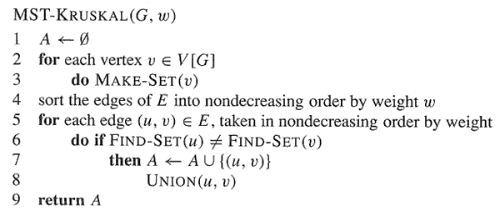

Slide 21
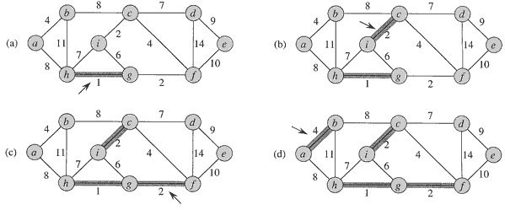
Example

Slide 22
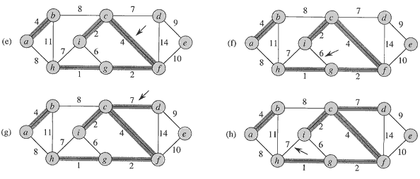
Continue…

Slide 23
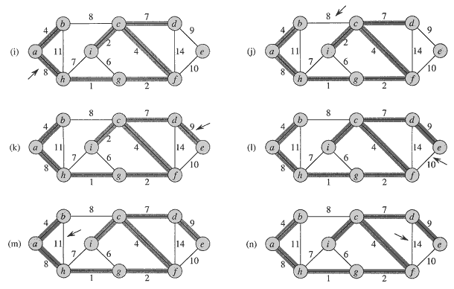

Slide 24
Analysis
Initialize A: O(1)
  First for loop: |V| MAKE-SETs
  Sort E: O(E lg E)
  Second for loop: O(E) FIND-SETs and UNIONs
Find(v) operation takes O(1) time, MakeUnion (A, B) takes O(n) time and an sequence of k Union operations that takes at most O(klogk)
Therefore, total time is O(E lg E).
|E| ≤ |V|² ⇒ lg |E| = O(2 lg V) = O(lg V).
Therefore, O(E lg V) time.

Slide 25
Prim’s algorithm
Builds one tree, so the edges in the set A always forms a single tree.
Starts from an arbitrary “root” r and grows until the tree spans all the vertices in V.
At each step, find a light edge crossing cut (V_{A} , V - V_{A}), where V_{A} = vertices that A is incident on. Add this edge to A, that is safe for A.
-- the edges in A form a MST when the algorithm terminates.
Greedy strategy since the tree is augmented at each step with an edge that contributes the minimum amount possible to the tree’s weight.

Slide 26
.. continued
How to find the light edge quickly?
Use a priority queue Q:
  Each object is a vertex in V - V_{A}.
  Key of v is minimum weight of any edge (u, v), where u ∈ VA.
  Then the vertex returned by EXTRACT-MIN is v
  such that there exists u ∈ V_{A} and (u, v) is light edge crossing (V_{A}, V ­ V_{A}).
  Key of v is ∞ if v is not adjacent to any vertices in V_{A}.

Slide 27
Continue…
The edges of A will form a rooted tree with root r:
  r is given as an input to the algorithm, but it can be any vertex.
  Each vertex knows its parent in the tree by the attribute π[v] = parent of v. π[v] = NIL if v = r or v has no parent.
  As algorithm progresses, A = {(v,π[v]) : v ∈ V -{r}- Q}.
  At termination, VA = V ⇒ Q =∅ , so MST is A = {(v,π[v]) : v ∈ V - {r}}.

Slide 28
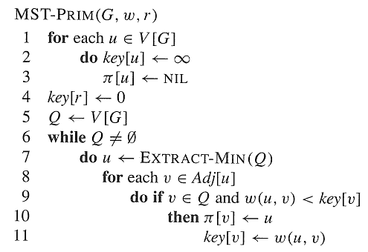

Slide 29
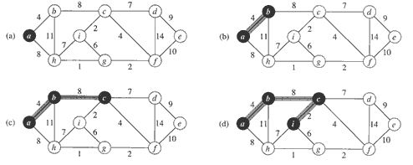

Slide 30
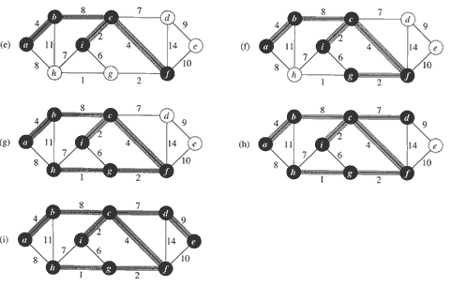

Slide 31
Example in Prim’s algorithm
a = source (v, key[v], π[v])
a) Q={(a,0), (b,∞), (c, ∞), …, (i, ∞)} V_{A}= ∅ u=(a,0)
b) Q={(b,4), (h,8), (c, ∞), …, (i, ∞)} V_{A}= {(a,0,nil)} u=(b,4)
c) Q={(c,8), (h, 8), …, (i, ∞)} V_{A}= V_{A} ∪{(b,4,a)} u=(c,8)
d) Q={(i,2), (f,4), (d,7), (h,8),…, (g, ∞)} V_{A}= V_{A} ∪{(c,8,b)} u=(i, 2)
e) Q={(f,4), (g,6), (d,7),(h,7),…, (e, ∞)} V_{A}= V_{A} ∪{(i,2,c)} u=(f,4)
f) Q={(g,2), (d,7), (h,7), (e,10)} V_{A}= V_{A} ∪{(f,4,c)} u=(g,2)
g) Q={(h,1), (d,7), (e,10)} V_{A}= V_{A} ∪{(g,2,f)} u=(h,1)
h) Q={(d,7), (e,10)} V_{A}= V_{A} ∪{(h,1,g)} u=(d,7)
i) Q={(e,9)} V_{A}= V_{A} ∪{(d,7,c)} u=(e,9)
j) Q= ∅ V_{A}= V_{A} ∪{(e,9,d)}=V

Slide 32
Analysis
Depends on how the priority queue is implemented:
Suppose Q is a binary heap.
Initialize Q and first for loop: O(V lg V) --BUILD-Min-Heap
Decrease key of r: O(lg V)
while loop: |V| EXTRACT-MIN calls ⇒ O(V lg V)
  |E| DECREASE-KEY calls ⇒ O(E lg V) **
  Total: O(E lg V) = O(V lg V + E lg V)
**Since the sum of the lengths of all adjacency list is 2|E|,
the 2nd for loop is executed O(E) times altogether.
**Key[v] ← w(u,v) involves an implicit DECREASE-KEY operation on the min-heap which can be implemented in O(lg V) time.

