Slide 1
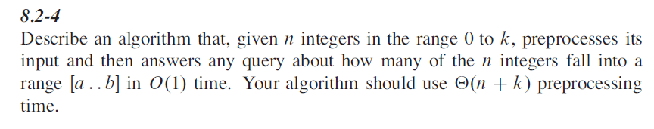


Homework on Chap8
8.2-4, 8.3-4

Slide 2
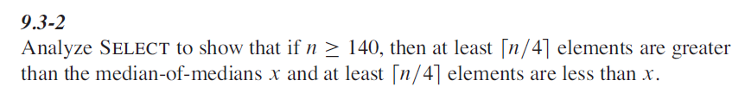
Homework on Chap9
9.3-2
Problem 9-1

