Slide 1
Chapter 26.
Maximum Flow

Slide 2
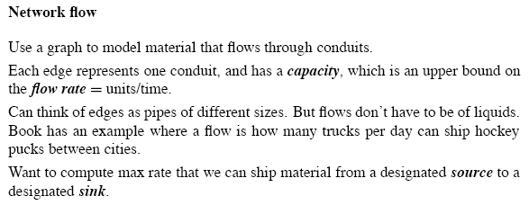
Outline

Slide 3
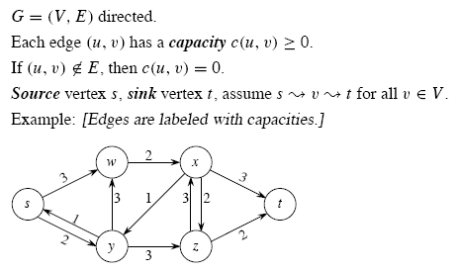
Flow Networks

Slide 4
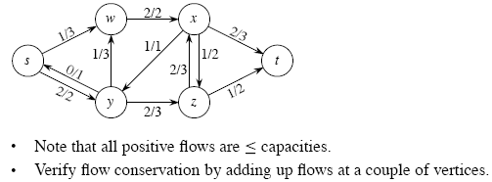
Example

Slide 5
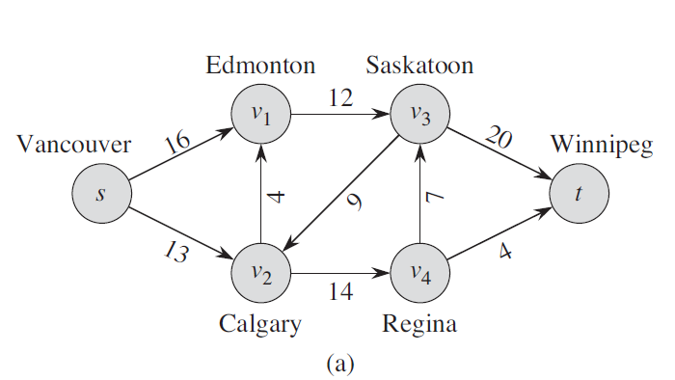
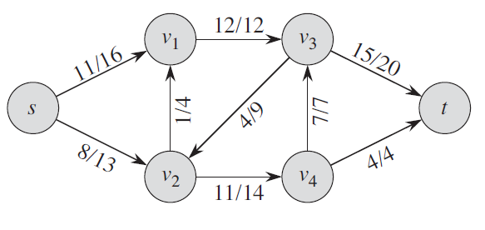

Slide 6
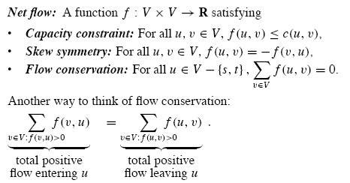
Net Flow

Slide 7
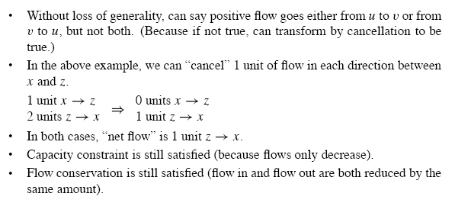
Cancellation

Slide 8
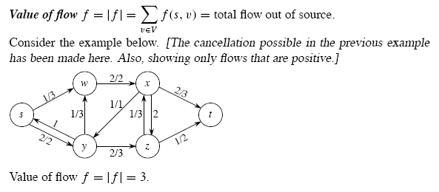
Value of flow f

Slide 9
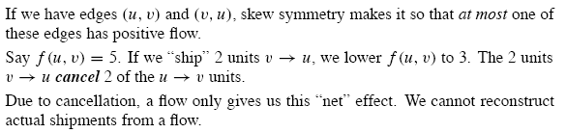
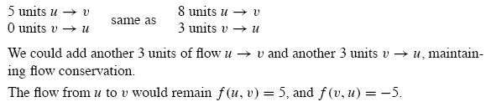
Cancellation

Slide 10
Max-Flow Problem
In the maximum-flow problem, we wish to compute the greatest rate at which material can be shipped from the source to the sink without violating any capacity constraint.
We define the total net flow at a vertex to be the total positive flow leaving a vertex minus the total positive flow entering a vertex.
In general, cancellation allows us to represent the shipments between two cities by a flow that is positive along at most one of the two edges between the corresponding vertices.

Slide 11
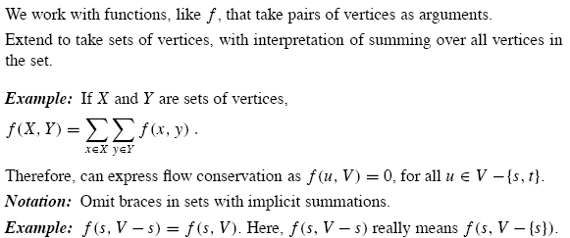
Working with flows

Slide 12
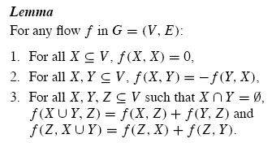
Continue…

Slide 13
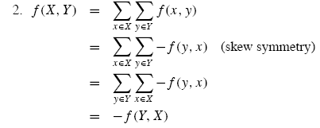

Proof

Slide 14
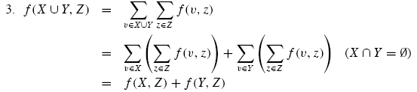
Proof (2)

Slide 15
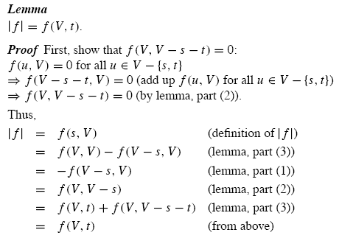
Proof (3)

Slide 16
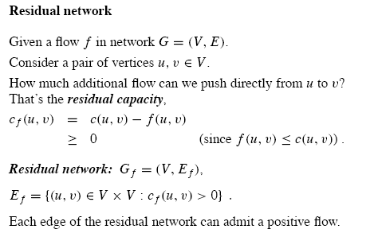
Residual networks

Slide 17
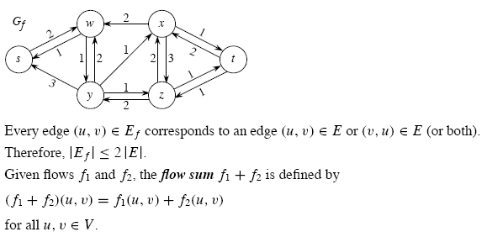
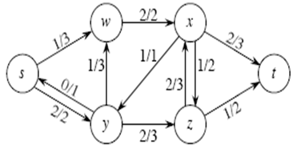
Example

Slide 18

Lemma
Observe that the residual network G_{f} is itself a flow network with capacities given b c_{f}. The lemma shows how a flow in a residual network relates to a flow in the original flow network.
The proof is based on three features of a flow in a flow network (capacity constraint, skew symmetry, flow conservation)

Slide 19
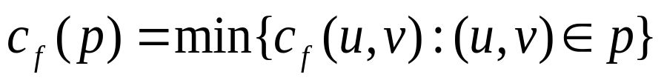
Augmenting paths(1)
Given a flow network G=(V, E) and a flow f, an augmenting path p is a simple path from s to t in the residual network G_{f}.
By definition of the residual network, each edge (u, v) on an augmenting path admits some additional posi-tive flow from u to v without violating the capacity constraint on the edge.
We call the maximum amount by which we can incre –ase the flow on each edge in an augmenting path p the residual capacity of p,

Slide 20
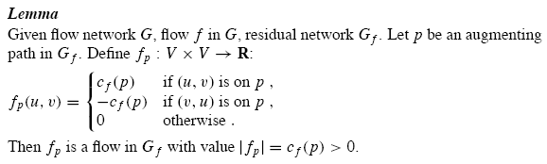

Augmenting paths(2)

Slide 21
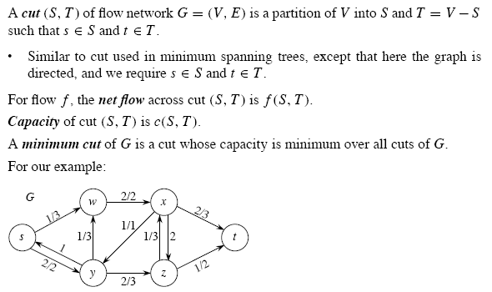
Cuts

Slide 22
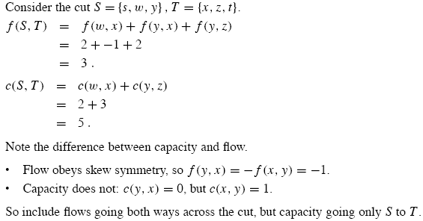
Continue…

Slide 23
Cuts of flow networks
Observe that the net flow across a cut can include negative flows between vertices, but that the capacity of a cut is composed entirely of nonnegative values.
The lemma shows that the net flow across any cut is the same and it equals the value of the flow.
Lemma26.5
Let f be a flow in a flow network G with source s and sink t and let (S, T) be a cut of G. Then the net flow across (S, T) is f (S, T)=|f|

Slide 24
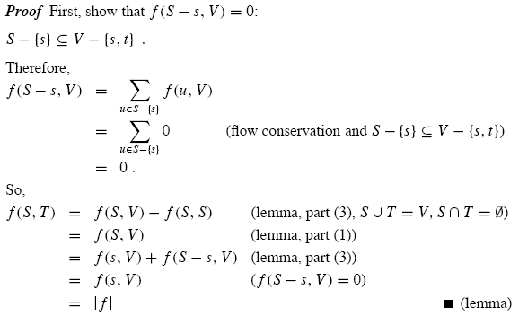
Proof

Slide 25

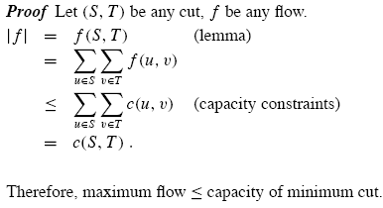
Corollary

Slide 26
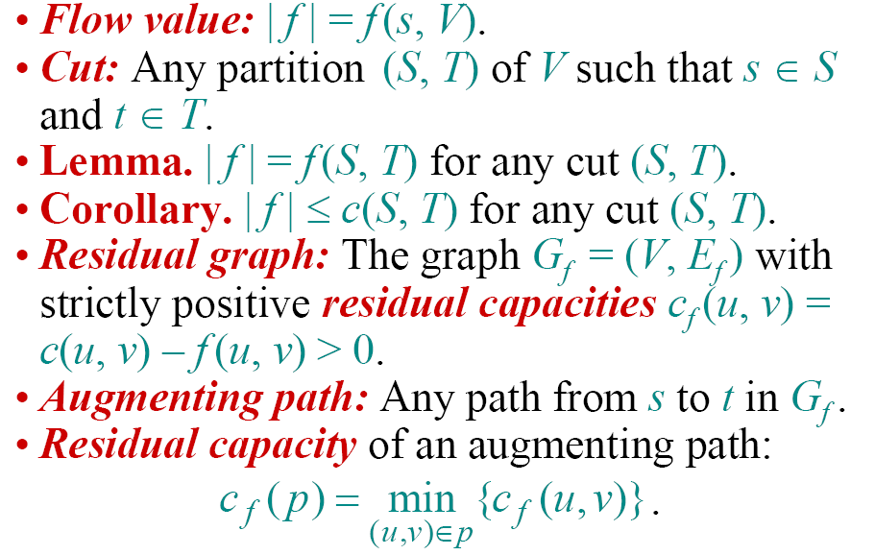
Review: Properties

Slide 27
Ford-Fulkerson Method
Ford-FULKERSON-METHOD(G, s, t)
  Initialize flow f to 0
  While there exists an augmenting path p
  do augmenting flow f along p
  Return f

Slide 28
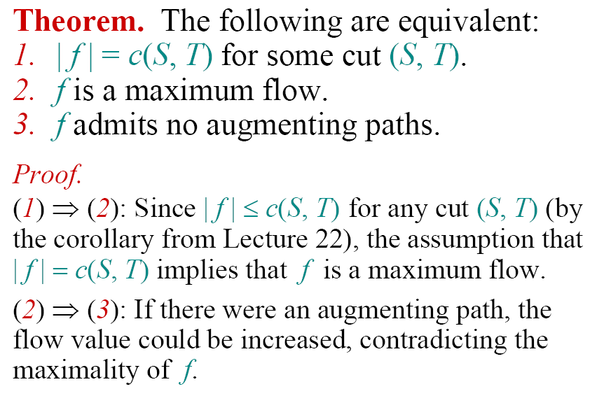
Max-flow, min-cut Theorem

Slide 29
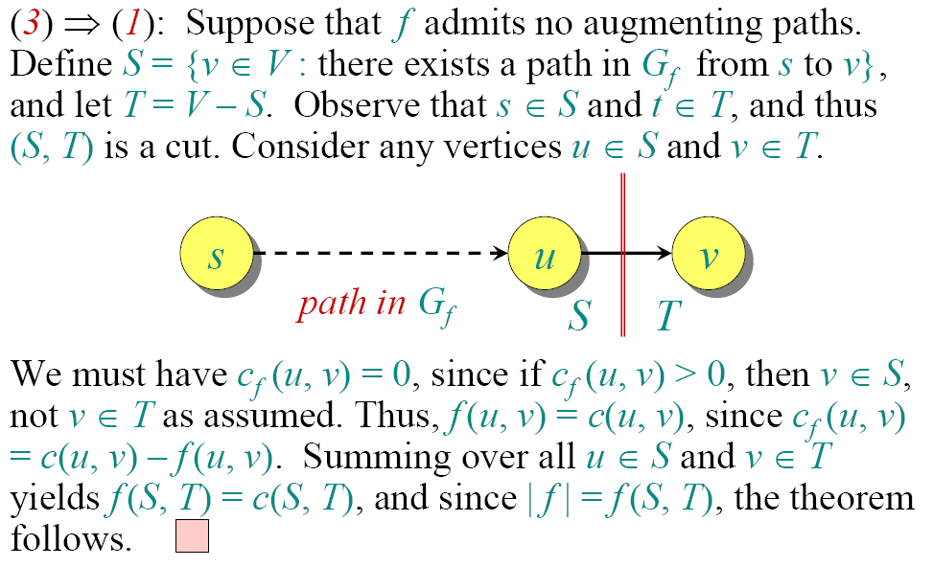
Proof (Cont.)

Slide 30
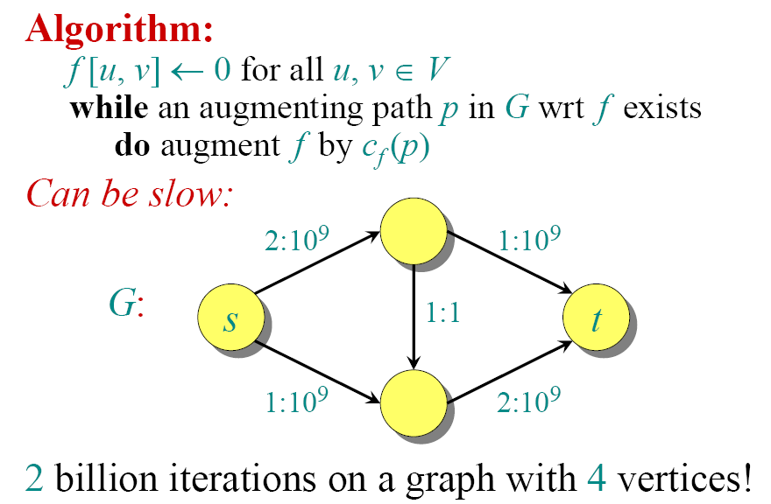
Ford-Fulkerson Max-flow Algorithm

Slide 31
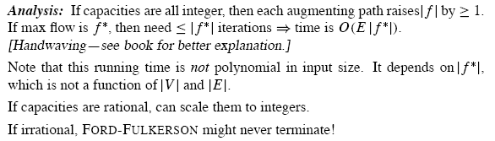
Analysis

Slide 32
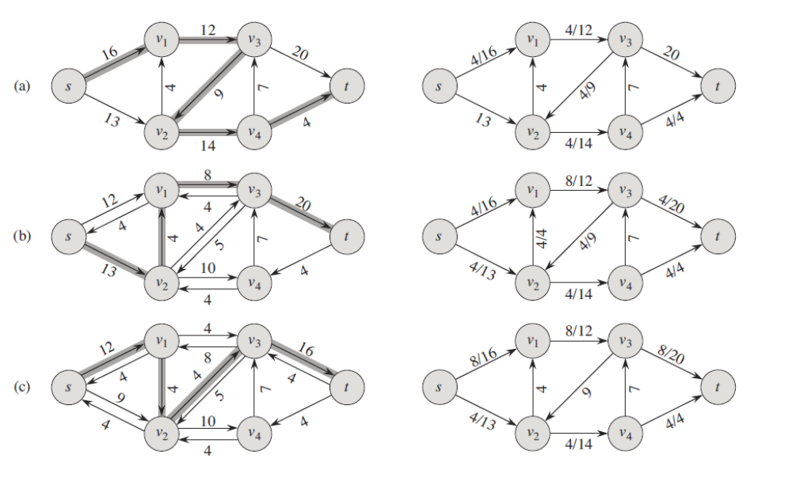

Slide 33
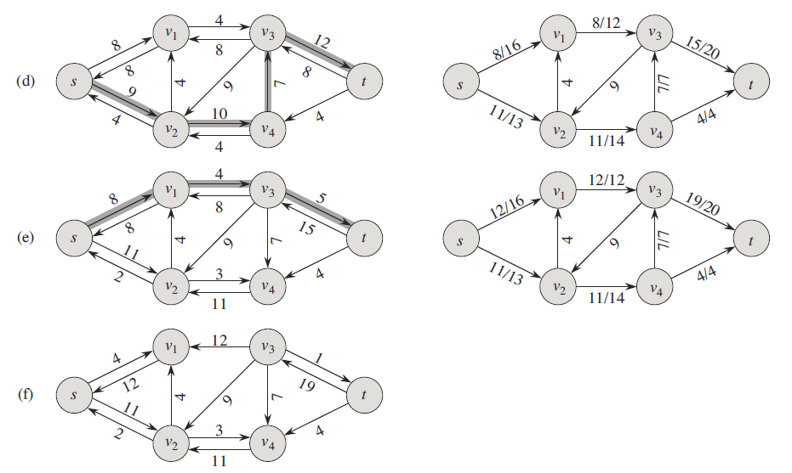

Slide 34
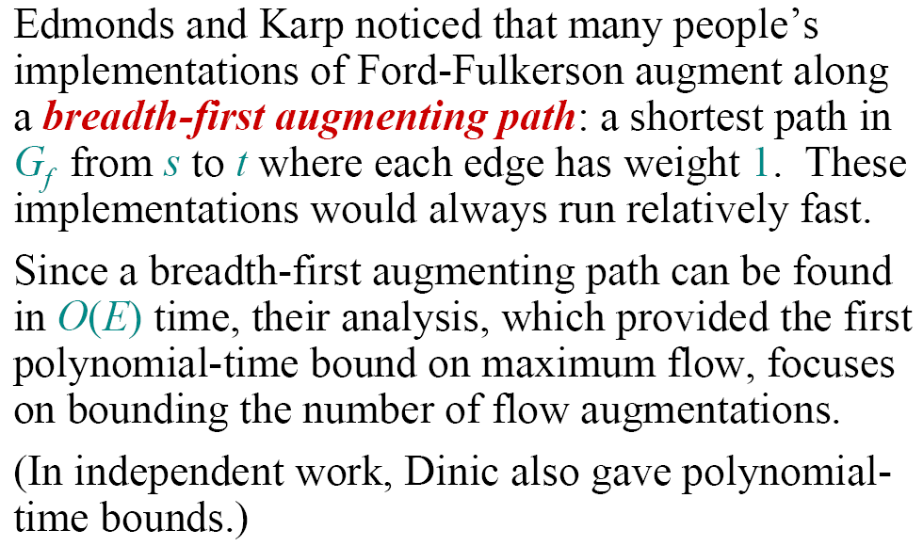
Edmonds-Karp Algorithm

Slide 35
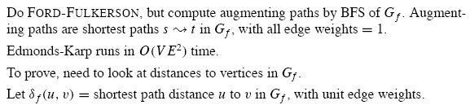
Continue

Slide 36
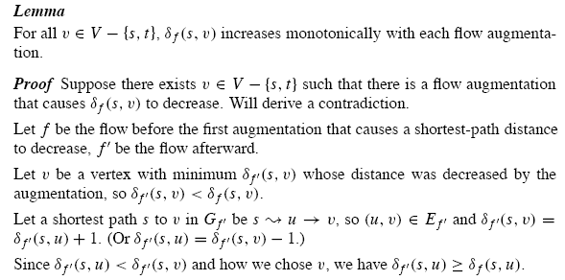
Monotonicity Lemma

Slide 37
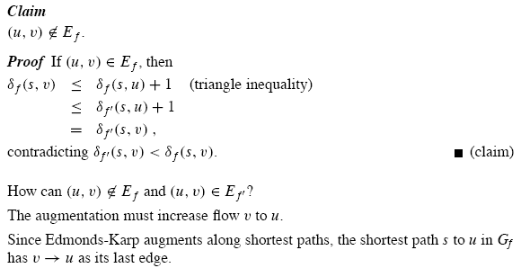
Continue…

Slide 38
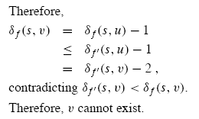
Continue

Slide 39
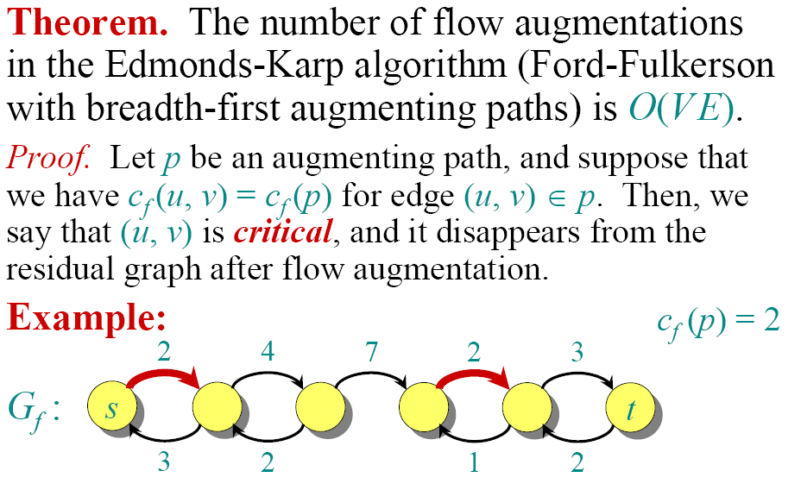
Counting Flow-Augments

Slide 40
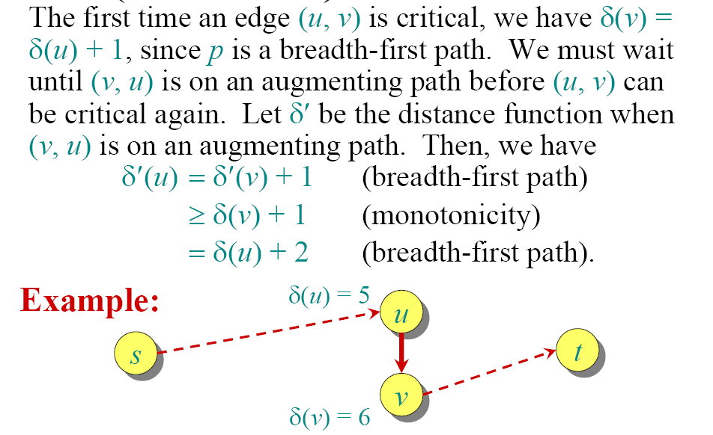
Counting Flow-Augments (Cont.)

Slide 41
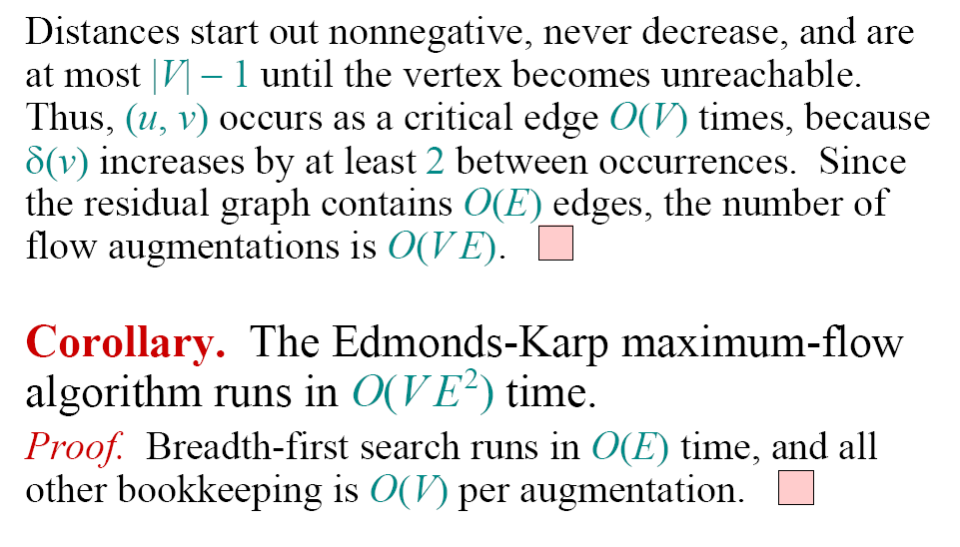
Running Time of Edmonds-Karp

Slide 42
Question
What is the minimum Cut?

Slide 43
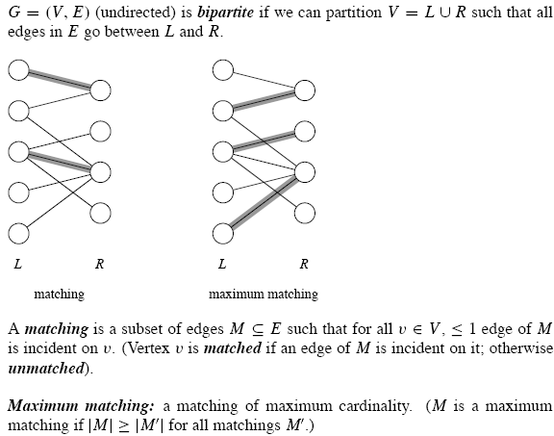
Maximum Bipartite matching

Slide 44
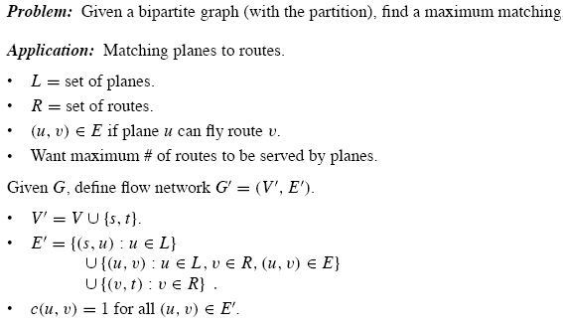
Problem

Slide 45
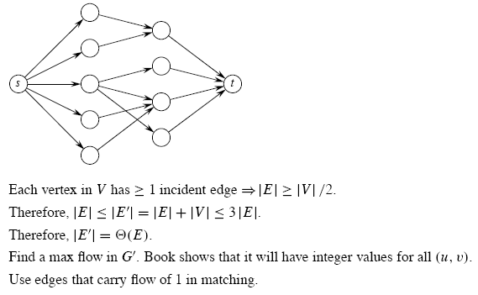
Continue

Slide 46
Lemma
This lemma shows that a matching in G corresponds directly to a flow in G’s corresponding flow network G’. We say that a flow f on a flow network G=(V,E) is integer-valued if f(u, v) is an integer for all (u, v).
Lemma: Let G=(V, E) be a bipartite graph with vertex partition {L, R} and let G’=(V’, E’) be its corresponding flow network. If M is a matching in G, then there is an integer-valued flow f in G’ with value |f|=|M|. Conversely, if f is an integer-valued flow in G’, then there is a matching M in G with cardinality |M|=|f|

Slide 47
Proof.
Define f as follows: if (u, v) in M, then f (s, u)= f (u, v)=f (v, t)=1. It is simple to show that f satisfies skew symmetry, the capacity constraint and flow conservation.
The path induced by edges in M are vertex-disjoint, except for s and t. The net flow across cut (L+s, R+t} is equal to |M|, so |f|=|M|
If f be an integer-valued flow in G’, then let M={(u, v): u in L, v in R and f (u, v)>0}. Each vertex u in L has only one entering edge, namely (s, u) and its capacity is 1.
Since f is integer-valued, the one unit of flow can enter on at most one edge and can leave on at most one edge.

Slide 48
Theorem
Integrality theorem
Corollary
  The cardinality of a maximum matching M in a bipartite graph G is the value of a maximum flow f in its corresponding network G’.
Given a bipartite undirected graph, we can find a maximum matching by creating the flow network G’, running the Ford-Fulkerson method and directly obtain a maximum matching M from the integer-valued maximum flow f found

Slide 49
Analysis
Since any matching in a bipartite graph has cardinality at most min (L, R)=O(V), the value of the maximum flow in G’ is O(V). We can then find a maximum matching in a bipartite graph in time O(VE’)=O(VE), since E’=⊙ (E)

Slide 50
Homework
26.1-6,26.2-4, 26.3-3

