Slide 1
Chapter 2.
Getting Started

Slide 2

Outline
Familiarize you with the framework to think about the design and analysis of algorithms
Introduce two sorting algorithms: insertion sort and merge sort
Start to understand how to analyze the efficiency of algorithms
We mainly concern about running time, or speed. Other issues could also affect efficiency, e.g. memory, storage.

Slide 3
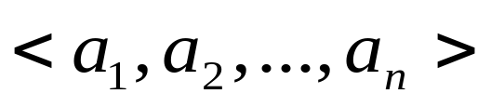
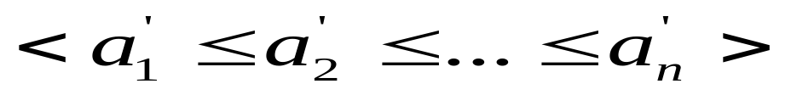
Example: Sorting Problem
Input: A sequence of n numbers
Output: A permutation (reordering) of the input sequence such that

Slide 4
Pseudocode
Describe algorithms as programs written in a pseudo code
Employ whatever expressive method is most clear and concise to specify a given algorithm
Not concerned with issues of software engineering, such as data abstraction, modularity and error handling
Difference Pseudo-code vs. a “real” code

Slide 5
Insertion Sort
It is an efficient algorithm for sorting a small number of elements
It works the way many people sort a hand of playing cards
In insertion sort, the input numbers are sorted in place: the number are rearranged within the array

Slide 6
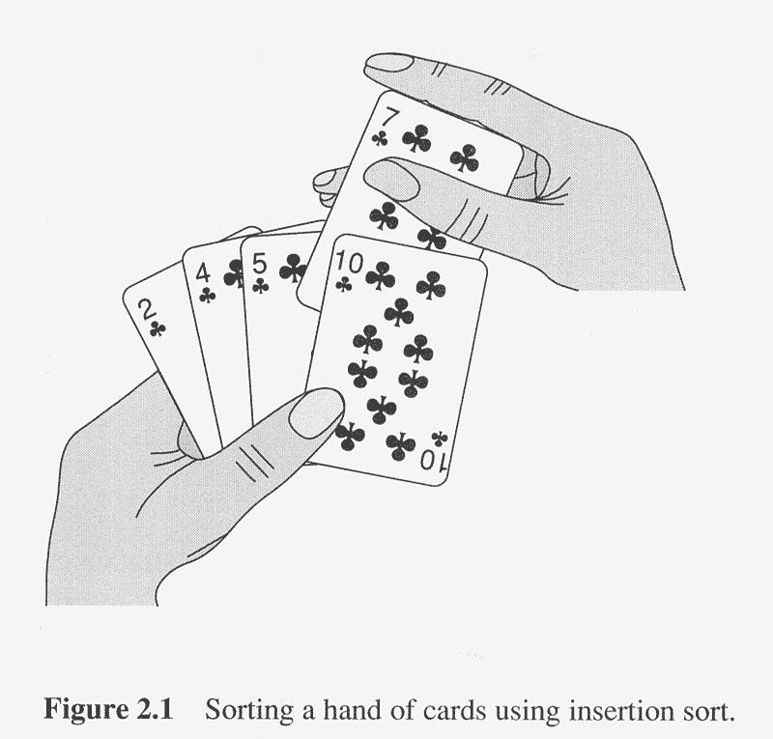
Insertion Sort
Find an correct position to insert the new card into sorted cards in hands

Slide 7
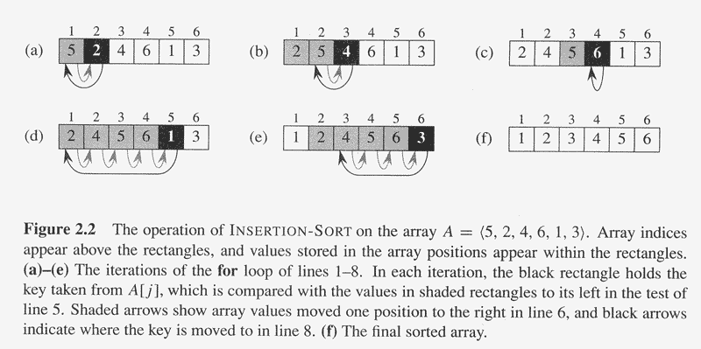

Slide 8
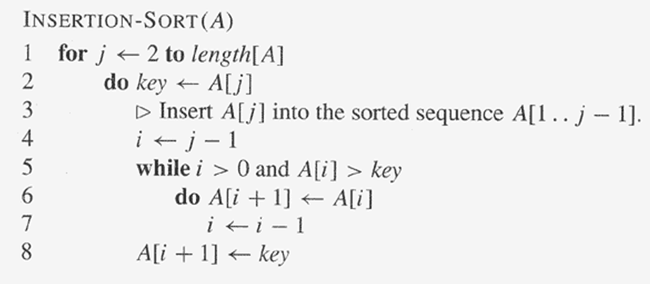
A[1] is trivially in order.
Comparing and exchange is in reverse order

Slide 9
Loop Invariant
To use a loop invariant to prove correctness, show three things about it: (similar to mathematical induction)
Initialization:
It is true prior to the first iteration of the loop.
Maintenance:
If it is true before an iteration of the loop, it remains true before the next iteration.
Termination:
When the loop terminates, the invariant—usually along with the reason that the loop terminated—gives us a useful property that helps show that the algorithm is correct.

Slide 10
Prove the Correctness
Design, Prove and Analyze
Often Use a loop invariant
How to define loop invariant is important
E.g. for insertion sort:
Loop invariant: At the start of each iteration of the “outer” for loop (line1-8)
-- the loop indexed by j --
the sub-array A[1 . . j-1] consists of the elements originally in A[1 .. j-1] but in sorted order.

Slide 11
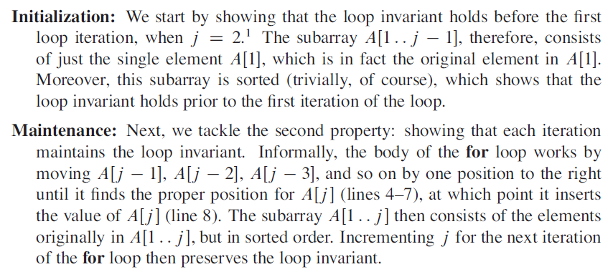
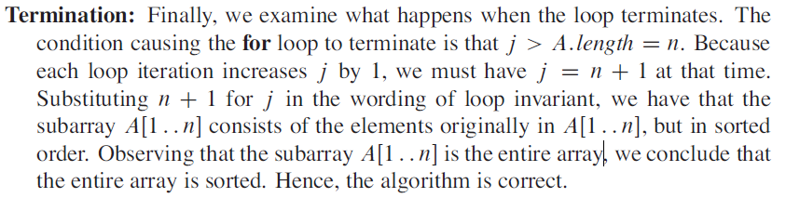

Slide 12
Analyzing algorithms
Random-access machine(RAM) model
How do we analyze an algorithm’s running time?
  The time taken by an algorithm depends on the input itself (e.g. already sorted)
  Input size: depends on the problem being studied. (parameterize in input size)
  Want upper bound (guarantee to users)
  Running time: on a particular input, it is the number of primitive operations(steps) executed.

Slide 13
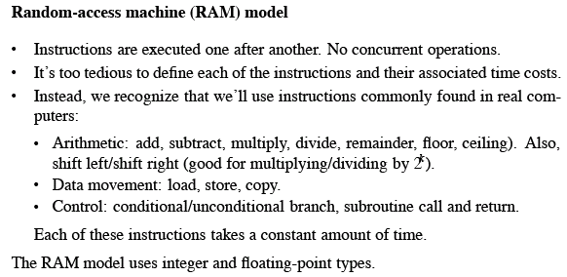
RAM MODEL
Do not model the memory hierarchy

Slide 14
Kinds of Analysis
Worst-case (Usually)
  T(n)=max time on any input of size n
Average-case (Sometimes)
T(n)=expected time over all input of size n
How do we know the probability of every particular input is?
We do not know. Make assumption of statistical distribution of inputs (what is the common assumption? )
Best-Case (bogus)
Some slow algorithms work well on some input , cheating.

Slide 15
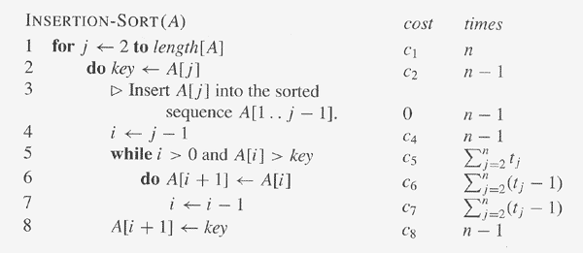
Detailed Analysis of Algorithm

Slide 16
Detailed Analysis of Running time
n : the number of inputs
t _{j} : the # of times the while loop test is executed
  t _{j} depends on the real input
  Min (t _{j} )=1, Max (t _{j} )=j
  Min(∑_{j=2 .. n} t_{j})=n-1, Max(∑_{j=2 .. n} t_{j})=(n²+n-2)/2
The loop test is executed one time more than the loop body.
Thus, the running time of the above Insertion-Sort algorithm is:
T(n) = c₁n + c₂(n-1) + c₄(n-1) + c₅ ∑_{j=2 .. n} t_{j}+ c₆ ∑_{j=2 .. n}(t_{j} -1) +
c₇ ∑_{j=2 .. n}(t_{j} -1) + c₈(n-1)
= (c5/2 + c6/2 + c7/2) n² + (c1 + c2 + c4 + c5/2 - c6/2 - c7/2 + c8) n – (c2+c4+c5+c8).
This worst-case running time can be expressed as an²+bn+c , it is thus a quadratic function

Slide 17

Analysis of Insertion Sort
The running time of the algorithm is:
  ∑ (cost of statement) x ( # of times statement is executed) all statements
  t_{j} = # of times that while loop test is executed for value j.
  Best case: the array is already sorted (all t_{j} = 1)
  Worst case:
    the array is in reverse order (t_{j} = j).
    The worst case running time gives a guaranteed upper bound on the running time for any input.
  Average case: (special version)
    On average, we assume that the key in A[ j ] is less than half the elements in A[1 .. j-1] and is greater than the other half. (t_{j} = j /2).
  Average case: (general version: consider every input)

Slide 18
Algorithm Analysis
Why worst-case analysis important
  Give us an upper bound on the running time for any input. Knowing it provides a guarantee that the algorithm will never take any longer.
  For some algorithms, the worst case occurs fairly often. E.g., Database search when the tuple does not present
  The “average case” is often roughly as bad as the worst case. E.g. for the average case (special version) of Insertion Sort , which [ j ] is less than half the elements in A[1 .. j-1] and is greater than the other half. The running time is quadratic in terms of n.

Slide 19

Order of Growth
  The abstraction to ease analysis and focus on the important features.
  Look only at the leading term of the formula for running time.
    Drop lower-order terms.
    Ignore the constant coefficient in the leading term.
  Example: an² + bn + c = Θ(n²)
    Drop lower-order terms ⇒ an²
    Ignore constant coefficient ⇒ n²
    The worst case running time T(n) grows like n²; it does not equal n².
    The running time is Θ(n²) to capture the notion that the order of growth is n².

Slide 20
Order of growth (2)
We usually consider one algorithm to be more efficient than another if its worst-case running time has a lower order of growth
Due to constant factors and lower-order terms, this evaluation may be error for small inputs, but for large enough inputs, it is true.

Slide 21
Designing algorithms
Divide and Conquer
Divide the problem into a number of subproblems.
Conquer the subproblems by solving them recursively.
Base case:
If the subproblems are small enough,
just solve them.
Combine the subproblem solutions to give
a solution to the original problem.
One advantage: Their running time is easily determined by recurrence
Cf.) Incremental method – insertion sort.

Slide 22
Merge Sort
A sorting algorithm based on divide and conquer.
The worst-case running time:
  T_{merge_sort} < T_{insertion_sort} in its order of growth
To sort A[p . . r]:
Divide by splitting into two subarrays A[p .. q] and A[q+1 .. r], where q is the halfway point of A[p .. r].
Conquer by recursively sorting the two subarrays
A[p .. q] and A[q+1 .. r].
Combine by merging the two sorted subarrays A[p .. q] and A[q+1 .. r] to produce a single sorted subarray A[p .. r].
To accomplish this step, we’ll define a procedure
MERGE(A, p, q, r).

Slide 23
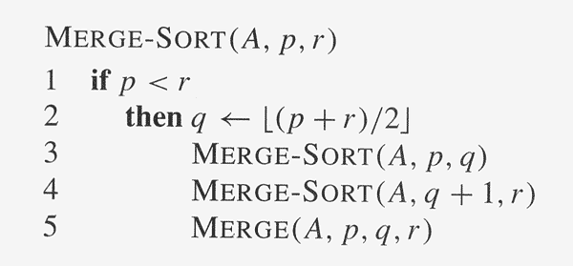
MERGE-SORT(A, 1, n)

Slide 24
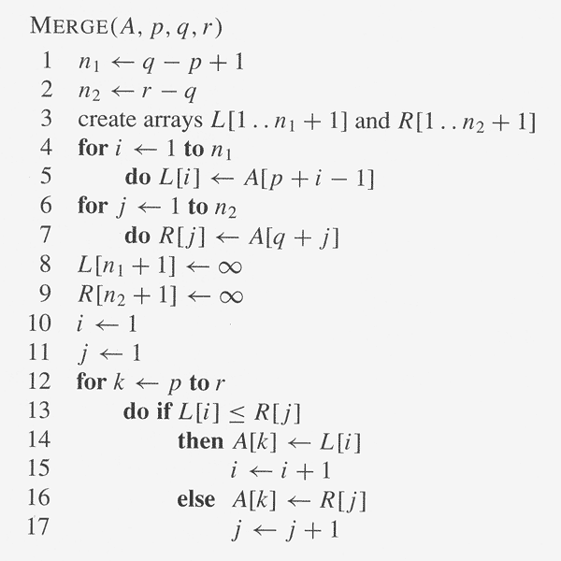
The two largest elements in two arrays are sentinels
Execute r-p+1 times

Slide 25
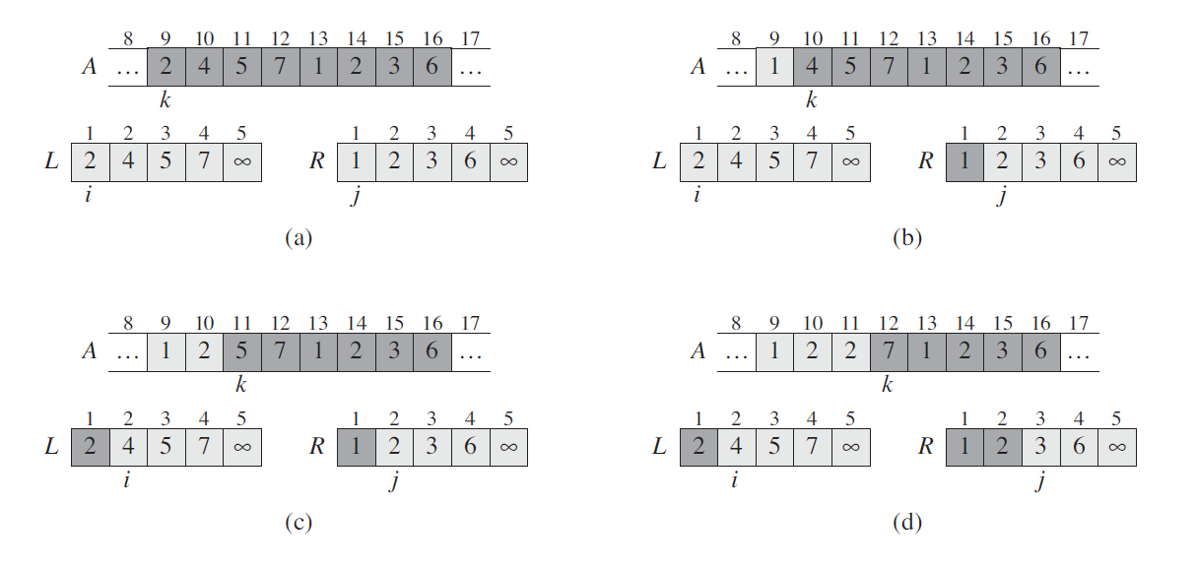
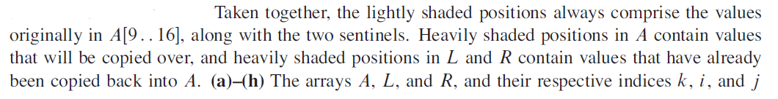
Example: MERGE(A, 9, 12, 16)
Explanation:

Slide 26
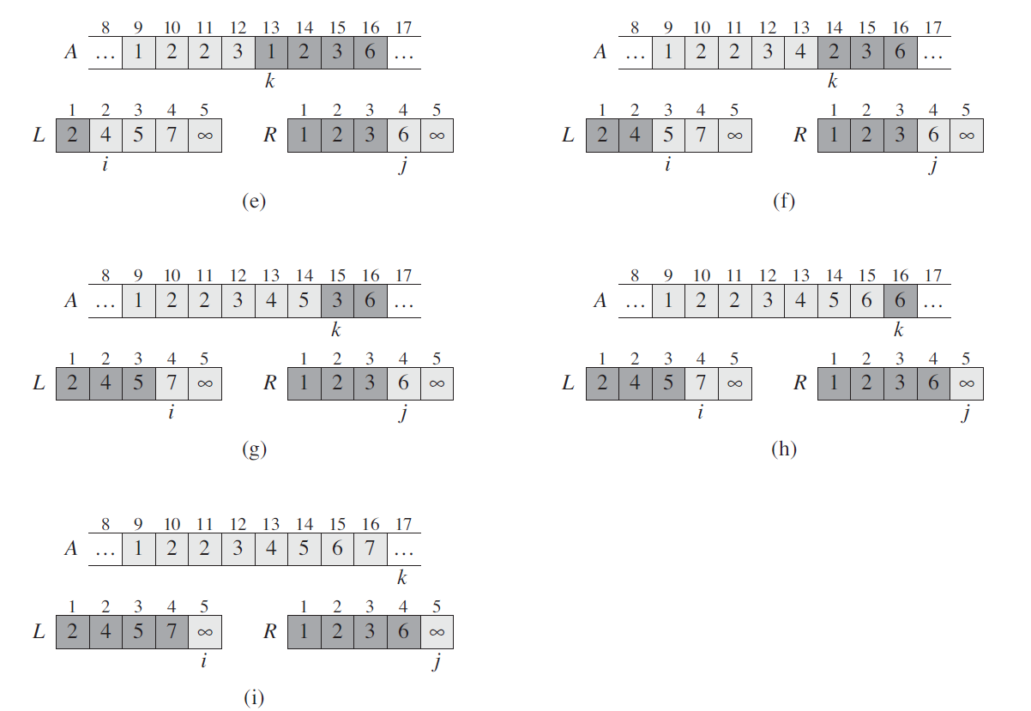

Slide 27
Merging: MERGE(A, p, q, r)
Input: Array A and indices p, q, r such that
  p ≤ q <r
  Subarray A[p .. q] is sorted and subarray A[q+1 .. r] is sorted.
  By the restrictions on p, q, r, neither subarray is empty.
Output: The two subarrays are merge into a single sorted subarray in A[p .. r].
T(n) = Θ(n), where n=r-p+1 = the # of elements being merged.
What is n ?
  The size of the original problem => the size of a subproblem.
  Use this technique when we analyze recursive algorithm
Line 1-3 and 8-11 takes constant time and for loop takes Θ(n1+n2) time

Slide 28
Loop Invariant of MERGE
Loop Invariant
At the start of each iteration of the for loop of lines 12-17, the subarray A[p…k-1] contains k-p elements of L[1..n₁+1] and R[1.. n₂+1],in sorted order. Moreover, L[i] and R[j] are the smallest elements of their arrays that have not been copied back into A.
Show correctness using loop invariant
We show this loop invariant holds priori to the first iteration of the for loop and each iteration maintains the invariant and the invariant show correctness when the loop terminates.

Slide 29
Loop Invariant
Initialization
Priori to the first iteration of the loop, we have k=p. A[p..k-1] is empty. i=j=1
Maintenance
We first suppose L[i]<=R[j]. Because A[p..k-1] contains k-p smallest elements, after line 14 copies L[i] into A[k], A[p..k] will contain the k-p+1 smallest elements. Increment k, i for next iteration.
Termination
At termination, k=r+1. By the loop invariant, the subarray A[p..k-1], which is A[p, r] contains the k-p=r-p+1 smallest elements in sorted order.

Slide 30
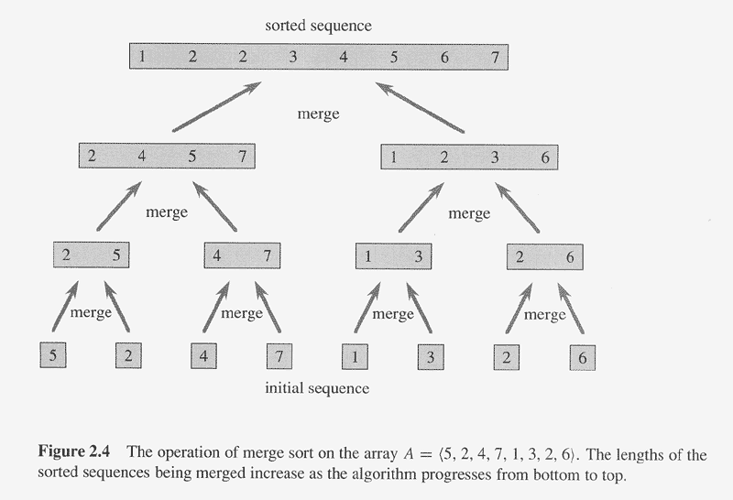

Slide 31
Analyzing Divide-and-Conquer Algorithms
Use a recurrence (equation) to describe the running time of a divide-and-conquer algorithm.
Let T(n) = running time on a problem of a size n.
  If the problem size is small enough(say, n ≤ c for some constant c),
  we have a base case – c(=Θ(1)).
  Otherwise, suppose that we divide into a sub-problems,
  each 1/ b the size of the original.
  (In merge sort, a=b=2.)
  Let D(n) be the time to divide a size-n problem.

Slide 32

Continue…
  There are a sub-problems to solve, each of size n/ b (the division may not be equally)
  ⇒ each sub-problem takes T(n/ b) time to solve
  ⇒ we spend aT(n/ b) time solving subproblems.
  Let C(n) be the time to combine solutions.
  We get the recurrence:
    T(n) = Θ(1) if n ≤ c
        aT(n/ b) + D(n) + C(n) otherwise.

Slide 33
Analyzing Merge Sort – Use a Recurrence.
For simplicity, assume that n=2^{k}
The base case: when n =1, T(n)=Θ(1).
When n ≥ 2, time for merge sort steps:
  Divide: Just compute q as the middle of p and r ⇒ D(n)=Θ(1).
  Conquer: Recursively solve 2 subproblems, each of size n/ 2 ⇒ 2T(n/2)
  Combine: MERGE on an n element subarray takes Θ(n) time ⇒ C(n)=Θ(n).
  Since D(n)+C(n)=Θ(1) + Θ(n) = Θ(n), the recurrence for merge sort running time is:
    T(n) = Θ(1) if n=1
        2T(n/ 2) + Θ (n) n>1.

Slide 34
Continue…
Solving the merge-sort recurrence: T(n) = Θ(n log2 n)
  Let c be a constant for T(n) of the base case and of the time per array element for the divide and conquer steps.
  Re-wirte the recurrence as
  T(n) = c if n=1
    2T(n/ 2) + c⋅n n>1.
Draw a recursion tree, which shows successive expansions of the recurrence. (n is exact power of 2)

Slide 35
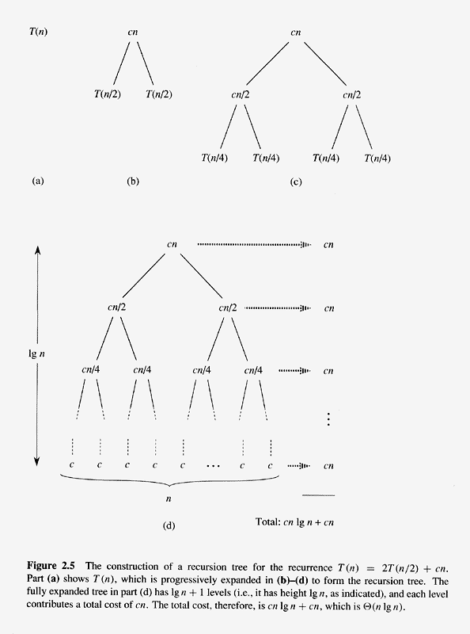
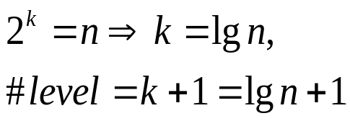
2⁰
2¹
2²

Slide 36
Merge Sort
The total cost is cn(lgn+1), which is Θ(n lg n)
Since the logarithm function grows more slowly than any linear function, for large enough input, merge sort with its Θ(n lg n) running time outperforms insertion soft, whose running time is Θ(n²), in the worst case.

Slide 37
A Related Recurrence
  T(n) = c if n=1
    2T(n/ 2) + c⋅n² n>1.
Our first guess is that the solution will be T(n)=O (n²logn) since it looks almost identical to that of Merge-Sort.
In fact, this upper bound is correct but not tight.
By drawing a recursion tree, we will find that total amount of work per level is decreasing (n², n²/2, n²/4, n²/8…)instead of remaining same.
Tight upper bound for the recurrence is Θ(n²)

Slide 38
Application of Divide-and Conquer: Counting Inversions
Background
  Collaborative Filtering: try to match your preference (for books, movies…) with those of other people on the Internet
  Meta-Search: execute the same query on many different search engines and try to synthesize the results by looking for similarity and differences among the various rankings that the search engines returns.
  A natural way is by counting the number of inversions.
How to compare two rankings?

Slide 39
Counting Inversions (1)
We say two indices i<j form an inversion if a_{i}>a_{j}, that is, if the two elements a_{i} and a_{j} are “out of order”.
We will seek to determine the number of inversions in the sequence a₁, a₂, …a_{n}.
What is the maximum number of inversions in a sequence a₁, a₂, …a_{n}?
What is the minimum number of inversions in a sequence a₁, a₂, …a_{n}?
Simplest Algorithm: We could look at every pair of numbers (a_{i}, a_{j}) and determine whether they constitute an inversion. This would take O(n²). →Any faster algorithm?

Slide 40
Counting Inversions (2)
Hint: Divide-and –Conquer-→O(nlgn)
We set m=n/2 and divide the list into two sub-arrays as Merge-Sort
We first count the number of inversions within each of these two halves separately;-→ recursive call
Then we count the number of inversions (a_{i}, a_{j}) , where the two numbers belong to different halves. The trick is we must do this part in O(n)
Crucial routine is MERGE-and-COUNT
  Just like Merge-Sort
  We do something extra during MERGE: count the number of inversions.

Slide 41
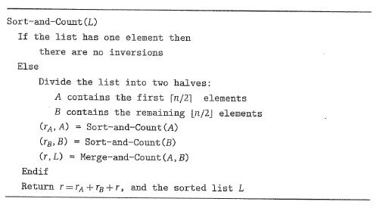
Counting Inversions (3)

