Slide 1
Chapter 9.
Medians and Order Statistics

Slide 2
Medians and Order Statistics
The ith order statistic of a set of n elements is the ith smallest element. Example: minimum and maximum
Median: lower median and upper median
Selection problem: selecting the ith order statistic from a set of n distinct numbers
Selection problem can be solved in O(nlgn)—faster algorithms?
Average Case- O(n)
Worst case -O(n)

Slide 3
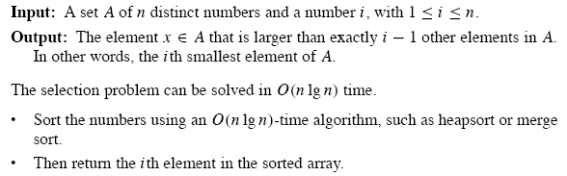
Selection Problem

Slide 4
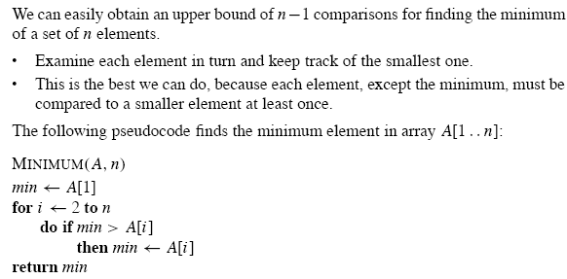
Maximum and Minimum

Slide 5
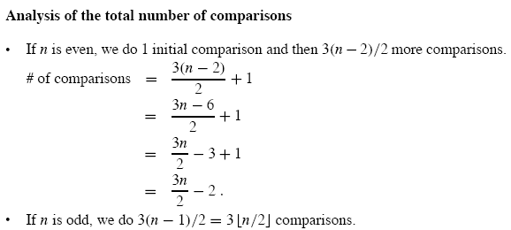
Simultaneously Maximum and Minimum

Slide 6
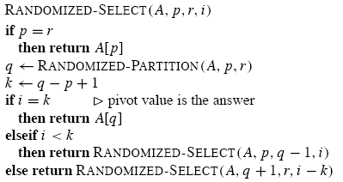
Selection in Expected Linear Time
Once position of pivot in A is fixed, it will not changed anymore

Slide 7

Analysis
Worst-case running time: Θ(n²)
  We could be extremely unlucky and always recurse on a sub-array that is only 1 element smaller than the previous sub-array
Expected running time: O(n)
  Randomized-select works well on average
  It is randomized, no particular input bring out the worst-case behavior
The running time of Randomized-select is a random variable T(n), we will obtain an upper bound on E[T(n)]

Slide 8
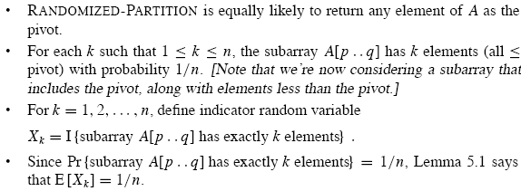
Expected Running Time(1)
Including pivot A[q]
With equal probability for all possible k

Slide 9
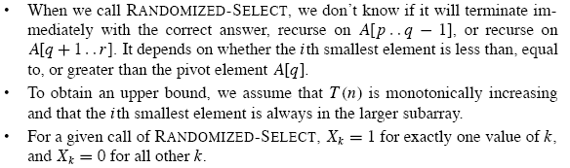
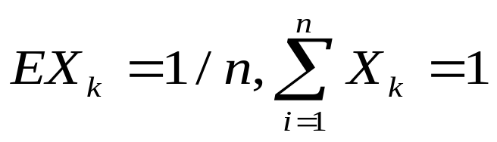
Expected Running Time(2)

Slide 10
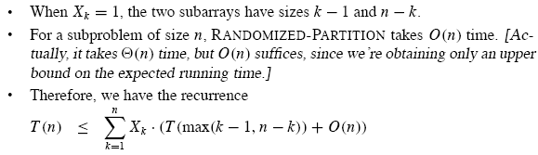
Expected Running Time(3)

Slide 11
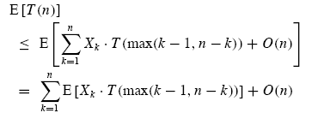
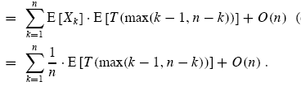
？

Slide 12
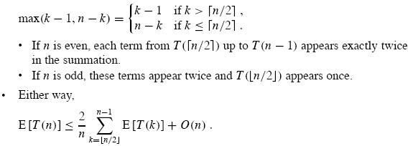
Expected Running Time(4)

Slide 13
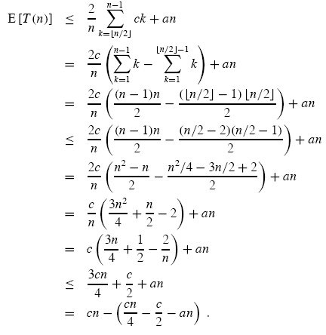
hypothesis
>0?

Slide 14
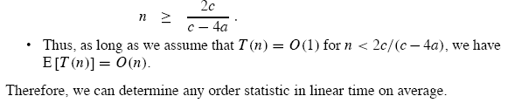
Linear Expected Running time

Slide 15
Selection in worst-case linear time
Select algorithm: its running time is O(n) in the worst case
It finds the desired element by recursively partitioning the input array
The main idea behind the algorithm, however, is to guarantee a good split
Select use deterministic PARTITION algorithm with pivot as input

Slide 16
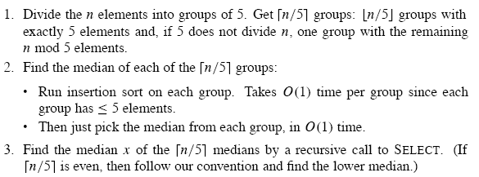
SELECT (1)
Median of median

Slide 17
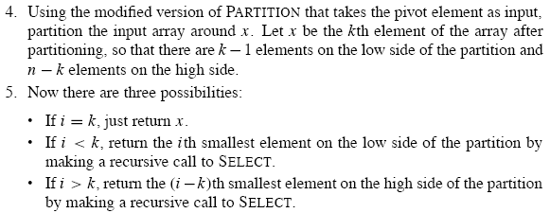
SELECT (2)

Slide 18
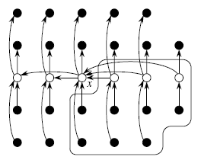
Analysis (1)

Slide 19
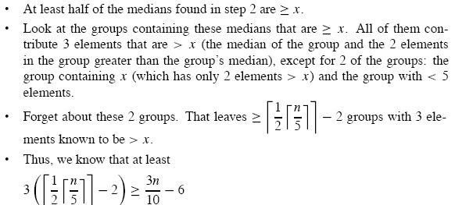
Analysis (2): #nodes greater than x
Both elements greater than and less than x are all at least 3n/10-6

Slide 20
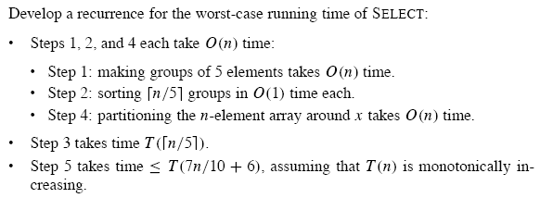
Analysis (3)
No matter recursively call on which sides of x, at most 7n/10+6 elements

Slide 21


Recurrence

Slide 22
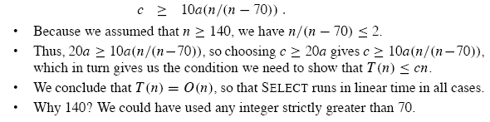
Constants 140?

Slide 23
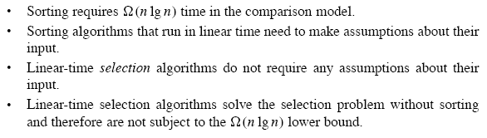
Conclusion

Slide 24
Homework
9.2-4, 9.3-5
Problem 9-1

