Slide 1
VI Graph Algorithms

Slide 2
Main Contents
Representation of a graph and the graph search algorithms: BFS, DFS
The computation of
    A minimum-weight spanning tree of a graph: the least-weight way of connecting all of the vertices together when each edge has an associated weight
  The shortest paths between vertices when each has an associated length or weight:
    From a given source vertex to all other vertices
    Between every pair of vertices
A maximum flow of material in a network (directed graph) having a specified source of material, a specified sink, and specified capacities for the amount of material that can traverse each directed edge.

Slide 3
Continue…
Description of the running time of a graph algorithm on G=(V, E), we measure the size of the input in terms of the number of vertices (|V|) and that of edges (|E|) of the graph.
Only inside asymptotic notation, the symbol V denotes |V| and the symbol E denotes |E|. E.g.) O(|V||E|) = O(VE).
V[G], E[G] : the vertex set or the edge set of a graph G, respectively

Slide 4
Chapter 22.
Elementary
Graph Algorithms

Slide 5
Graph Representation
Given graph G = (V, E).
  May be either directed or undirected.
  Two common ways to represent for algorithms:
1. Adjacency lists.
2. Adjacency matrix.
Expressing the running time of an algorithm is often in terms of both |V| and |E|.
Only in asymptotic notation - we’ll drop the cardinality. Example: O(V + E).

Slide 6
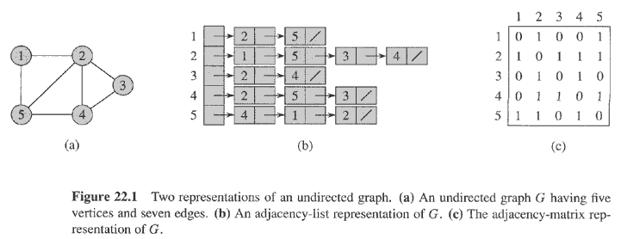
Array Ad_{j} of |V| lists, one per vertex.
Vertex u’s list has all vertices v such that (u, v) ∈ E. (It works for both directed and undirected graphs.)
Example: For an undirected graph:

Slide 7

Adjacency lists (2)
If edges have weights, can put the weights in the lists.
Weight: w : E → R
We’ll use weights later on for spanning trees and shortest paths.
Space: Θ (V + E).
Time: to list all vertices adjacent to u: Θ (degree(u))
Time: to determine if (u, v) ∈ E: O(degree(u)).

Slide 8
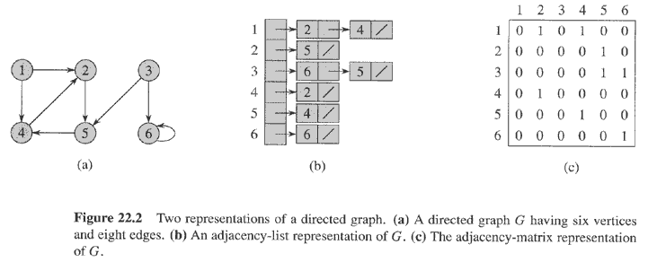
For a directed graph:
Same asymptotic space and time.

Slide 9

Adjacency Matrix
|V| × |V| matrix A = (a _{i j} )
a _{ij} = 1 if (i, j ) ∈ E ,
0 otherwise .
Space:
Time: to list all vertices adjacent to u: Θ (V).
Time: to determine if (u, v) ∈ E: O(1).
Can store weights instead of bits for weighted graph.
⊙(V²)

Slide 10
Breadth-First Search

Slide 11
Breadth-First Search
What is BFS mainly applied for?
Any other applications for BFS?

Slide 12
Breadth-First Search
Input:
Graph G = (V, E), either directed or undirected, and source vertex s ∈ V.
Output:
d[v] = distance (smallest # of edges) from s to v, for all v ∈ V.
Also π[v] = u such that (u, v) is last edge on shortest path
    u is v’s predecessor.
    set of edges {(π[v], v) : v = s} forms a tree.
Later, a breadth-first search will be generalized with edge weights.

Slide 13
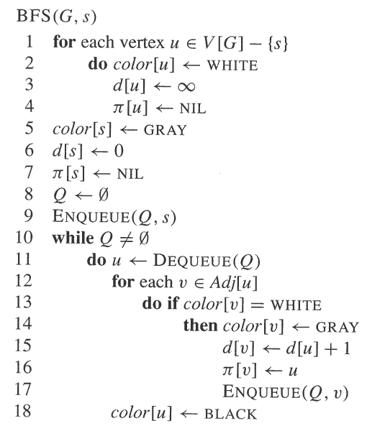

Slide 14
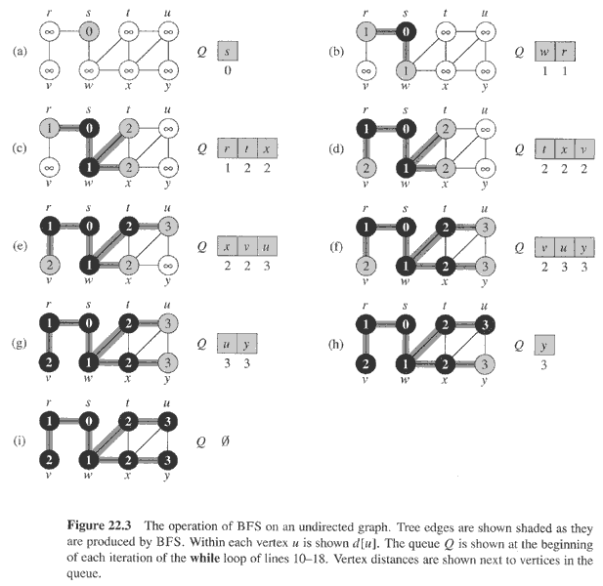

Slide 15

Directed Graph
Can show that Q consists of vertices with d values.
i i i . . . i i+1 i+1 . . . i+1
  Only 1 or 2 values.
  If 2, differ by 1 and all smallest are first.
Since each vertex gets a finite d value at most once, values assigned to vertices are monotonically increasing over time.

Slide 16
BFS
BFS may not reach all vertices.
Time = O(V + E).
  O(V) because every vertex enqueued at most once.
  O(E) because every vertex de-queued at most once and we examine (u, v) only when u is de-queued. Therefore, every edge examined at most once if directed, at most twice if undirected.

Slide 17





Correctness of BFS
Suppose: G=(V,E) be a directed or undirected graph, and BSF is run on G from a given vertex s in V
Lemma 22.1
For any edge (u,v) in E,
Lemma 22.2
Upon termination, for each v in V, d[v] satisfies:
Corollary 22.4
During BFS, if v_{i} is enqueued before v_{j},
Theorem 22.5
BSF discovers every v in V reachable from s
Upon termination,
For all , the path from s to v in the tree produced by BSF is a shortest path from s to v in G

Slide 18
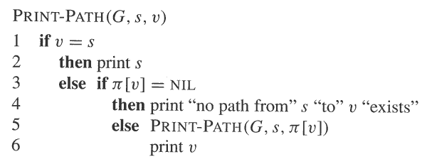
Definition: Predecessor subgraph
Lemma 22.6
When applied to a directed or undirected graph G=(V,E), BFS constructs so that its predecessor subgraph is a breadth-first tree

Slide 19

Depth-First Search
Input:
Graph G = (V, E), either directed or undirected. No source vertex given.
Output: 2 timestamps on each vertex:
    d[v] = discovery time.
    f[v] = finishing time.
    π[v] : v’s predecessor field.
Will methodically explore every edge.
  Start over from different vertices as necessary.
As soon as we discover a vertex, explore from it.
  Unlike BFS, which puts a vertex on a queue so that we explore from it later.

Slide 20
Continue…
As DFS progresses, every vertex has a color:
  WHITE = undiscovered
  GRAY = discovered, but not finished (not done exploring from it)
  BLACK = finished (have found everything reachable from it)
Discovery and finish times:
  Unique integers from 1 to 2 |V|.
  For all v, d[v] < f [v].
In other words, 1 ≤ d[v] < f [v] ≤ 2 |V|.

Slide 21
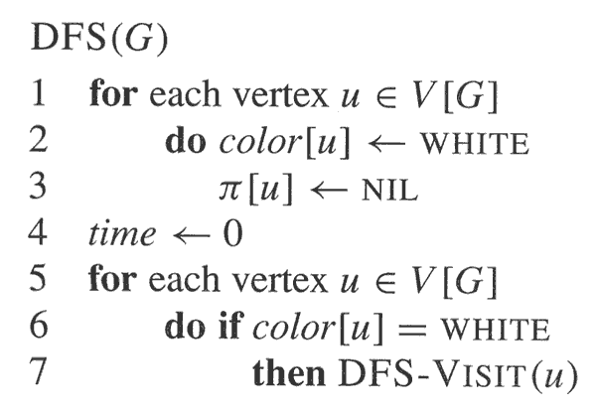
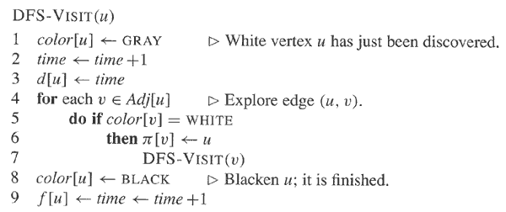

Slide 22
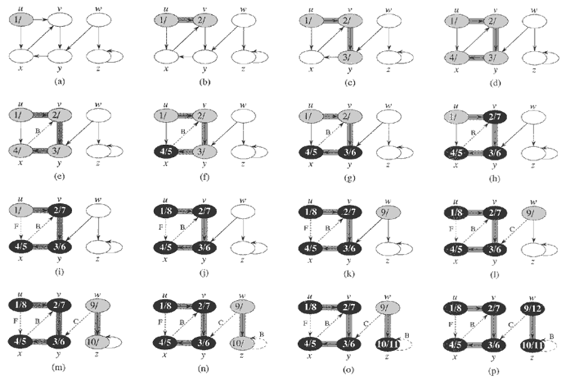

Slide 23
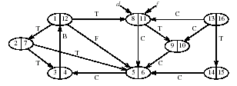
Time = Θ(V + E).
  Similar to BFS analysis
  Θ, not just O, since guaranteed to examine every vertex and edge.
DFS forms a depth-first forest comprised of > 1 depth-first trees. Each tree is made of edges (u, v) such that u is gray and v is white when (u, v) is explored.

Slide 24
Properties of Depth-First Search
Theorem (Parenthesis theorem)
For all u, v, exactly one of the following holds:
d[u] < f [u] < d[v] < f [v] or d[v] < f [v] < d[u] < f [u] and neither of u and v is a descendant of the other.
2. d[u] < d[v] < f [v] < f [u] and v is a descendant of u.
3. d[v] < d[u] < f [u] < f [v] and u is a descendant of v.
  So d[u] < d[v] < f [u] < f [v] cannot happen.
  Like parentheses:
  OK: ( ) [ ] ( [ ] ) [ ( ) ]
  Not OK: ( [ ) ] [ ( ] )

Slide 25
Property
Corollary
  v is a proper descendant of u if and only if
  d[u] < d[v] < f [v] < f [u].
Theorem (White-path theorem)
V is a descend of u if and only if at time d[u], there is a path consisting of only white vertices. [Except for u, which was just colored gray]
Notes:
v is a descendant of u if and only if at time d [u], there [u] ,there is a path consisting of only white vertices.
(Except for u, which was just colored gray.)

Slide 26
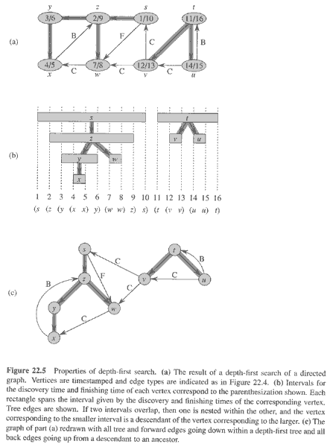

Slide 27
  Classification of edges
  Tree edge: in the depth-first forest. Found by exploring (u, v).
  Back edge: (u, v), where u is a descendant of v.
  Forward edge: (u, v), where v is a descendant of u, but not a tree edge.
  Cross edge: any other edge can go between vertices in same depth-first tree or in different depth-first trees.

Slide 28
Cont.
In an undirected graph, there may be some ambiguity since (u, v) and (v, u) are the same edge. Classify by the first type above that matches.
Theorem
In DFS of an undirected graph, we get only tree and back edges. No forward or cross edges.

Slide 29
Discussion
What are the results of BFS and DFS over G=(V, E) respectively?
What the difference between BFS tree and DFS tree for a given vertex u?
Main applications for BFS, DFS.
题目描述小鼠a与小鼠b身处一个m×n的迷宫中，如图所示。每一个方格表示迷宫中的一个房间。这m×n个房间中有一些房间是封闭的，不允许任何人进入。在迷宫中任何位置均可沿上，下，左，右4个方向进入未封闭的房间。小鼠a位于迷宫的(p，q)方格中，它必须找出一条通向小鼠b所在的(r，s)方格的路。请帮助小鼠a找出所有通向小鼠b的最短道路。

Slide 30
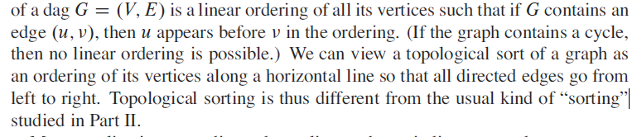
Topological Order/Sort
The Topological Sort/Order

Slide 31
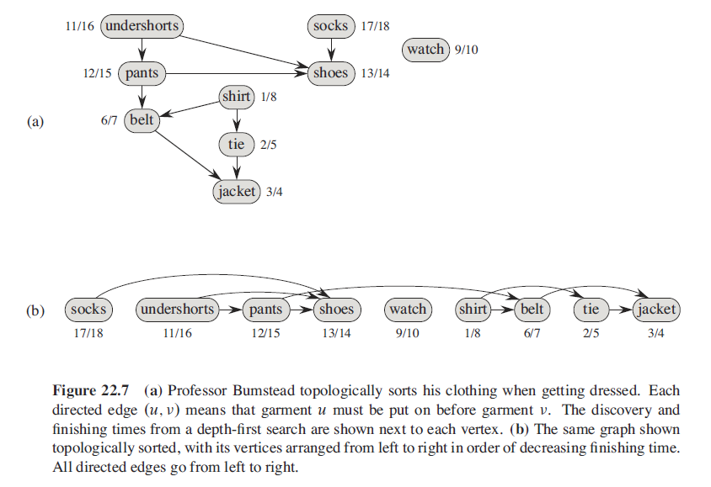
Example

Slide 32
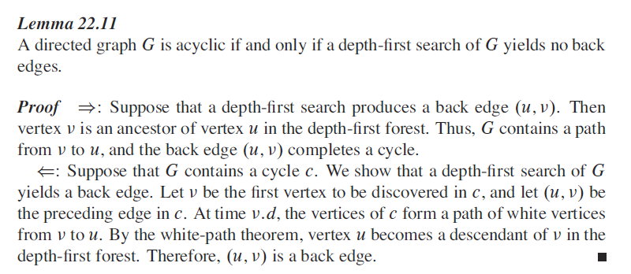
DAG and Topological Sort

Slide 33
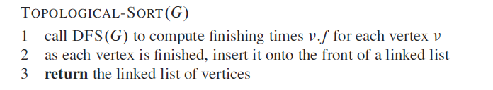

Topological Sort

Slide 34
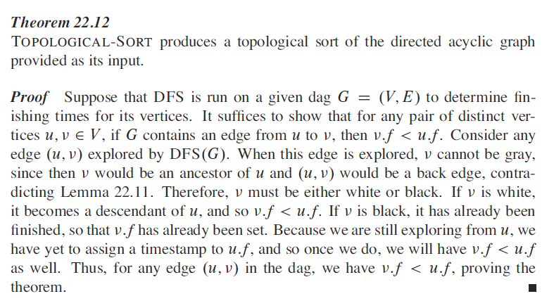
Correctness of Topological Sort

Slide 35
Application of Topological Order
Curriculum Design
  For a specific major, we have some pre-request-class relationships, e.g. statistics<algorithms, programming language<data structure, etc.
  Based on these relationship, decide a curriculum order

Slide 36

Strongly Connected Components
Given directed graph G = (V, E).
A strongly connected component (SCC) of G is a maximal set of vertices C ⊆ V such that for all u, v ∈ C, both
Example:

Slide 37
Continue…
Algorithm uses G^{T} = transpose of G.
  G^{T} = (V, E^{T}), E^{T} = {(u, v) : (v, u) ∈ E}.
  G^{T} is G with all edges reversed.
Can create G^{T} in (V + E) time if using adjacency lists.
Observation: G and G^{T} have the same SCC’s. (u and v are reachable from each other in G if and only if reachable from each other in G^{T}.)

Slide 38
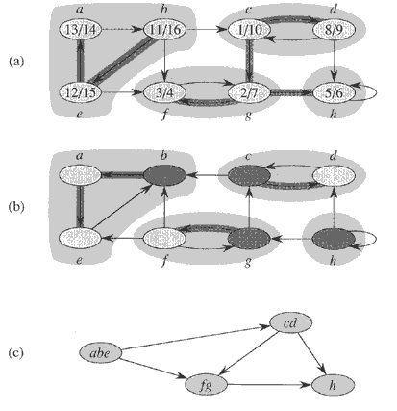

Slide 39
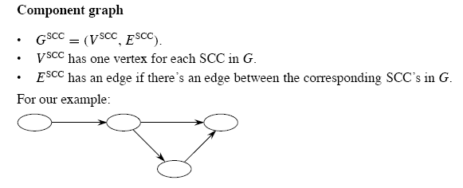

Slide 40
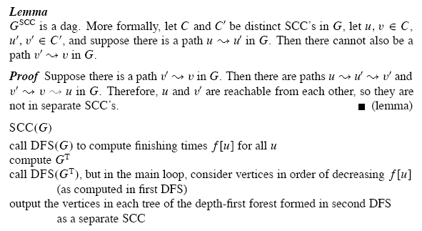

Slide 41


Analysis
Time: Θ (V+E)
Idea: By considering vertices in second DFS in decreasing order of finishing times from first DFS, we are visiting vertices of the component graph in topological sort order.
To prove that it works, first deal with 2 notational issues:
  Will be discussing d[u] and f [u]. These always refer to first DFS.
  Extend notation for d and f to sets of vertices U ⊆ V:
    d(U) = min u∈U {d[u]} (earliest discovery time)
    f (U) = max u∈U { f [u]} (latest finishing time)

Slide 42

Lemma
Let C and C’ be distinct SCC’s in G = (V, E). Suppose there is an edge (u, v) ∈ E such that u ∈ C and v ∈ C’.
Then f (C) > f (C’).
Proof Two cases, depending on which SCC had the first discovered vertex during the first DFS.
If d(C) < d(C’), let x be the first vertex discovered in C. At time d[x], all vertices in C and C’ are white. Thus, there exist paths of white vertices from x to all vertices in C and C’.
By the white-path theorem, all vertices in C and C’ are descendants of x in depth-first tree. By the parenthesis theorem, f [x] = f (C) > f (C’).

Slide 43
Continue…
If d(C) > d(C’), let y be the first vertex discovered in C’.
At time d[y], all vertices in C’ are white and there is a white path from y to each vertex in C’
⇒ all vertices in C’ become descendants of y. Again, f [y] = f (C’).
At time d[y], all vertices in C are white.
By earlier Lemma, since there is an edge (u, v), we cannot have a path from C’ to C.
So no vertex in C is reachable from y.
Therefore, at time f[y], all vertices in C are still white.
Therefore, for all w ∈ C, f [w] > f [y], which implies that f (C) > f (C’).

Slide 44
Collary:
Let C and C’ be distinct SCC’s in G = (V, E).
Suppose there is an edge (u, v) ∈ E^{T} , where u ∈ C and v ∈ C’.
Then f(C) < f(C’).
Proof
(u, v) ∈ E^{T} ⇒ (v, u) ∈ E.
Since SCC’s of G and G^{T} are the same, f (C’) > f (C).
Corollary
Let C and C’ be distinct SCC’s in G = (V, E), and suppose that f (C) > f (C’). Then there cannot be an edge from C to C’ in G^{T} .
Proof
It’s the contra-positive of the previous corollary.

Slide 45
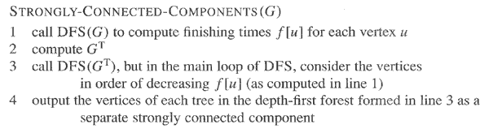

Slide 46
Intuition (1)
Now we have the intuition to understand why the SCC procedure works.
When we do the second DFS, on G^{T}, start with SCC C such that f (C) is maximum.
The second DFS starts from some x ∈ C, and it visits all vertices in C. Corollary says that since f (C) > f (C’) for all C’ ≠ C, there are no edges from C to C’ in G^{T} .
Therefore, DFS will visit only vertices in C, which means that the depth-first tree rooted at x contains exactly the vertices of C.

Slide 47
Intuition (2)
The next root chosen in the second DFS is in SCC C’ such that f (C’) is maximum over all SCC’s other than C. DFS visits all vertices in C’, but the only edges out of C’ go to C, which we’ve already visited.
Therefore, the only tree edges will be to vertices in C’.
We can continue the process.
Each time we choose a root for the second DFS, it can reach only
  vertices in its SCC — get tree edges to these,
  vertices in SCC’s already visited in second DFS—
  get no tree edges to these.
We are visiting vertices of (G^{T})^{SCC} in reverse of topologically sorted order.

Slide 48
Discussion
If we know the topological order of all nodes in G, is it possible to replace DFS with BFS in finding SCC?
Why execute the second DFS in topological order?
How to show the correctness of the algorithm to find SCC?

Slide 49
Homework
22.1-7, 22.3-7,22.4-3
Find all topological orders of the directed graph G={(a, b), (b, c), (c, f), (a, d), (d, e), (e, f)}

