Slide 1
Chapter 24
Shortest Paths Problem

Slide 2
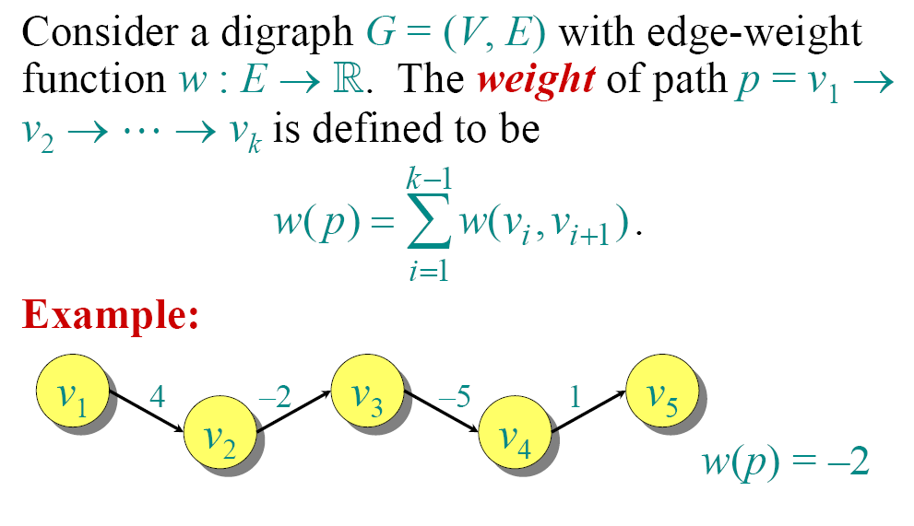
Paths in Graphs

Slide 3
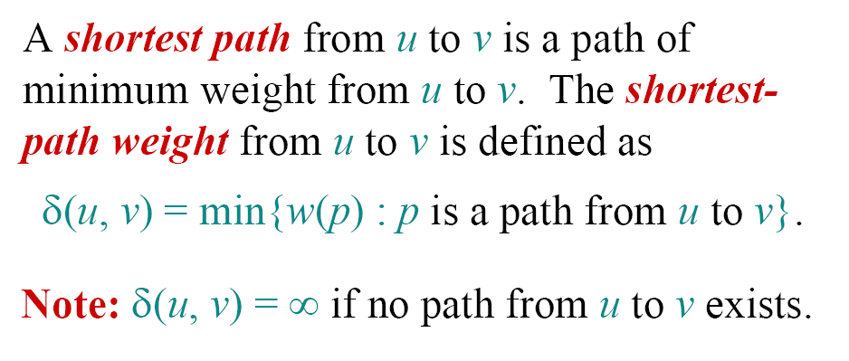
Shortest Paths

Slide 4
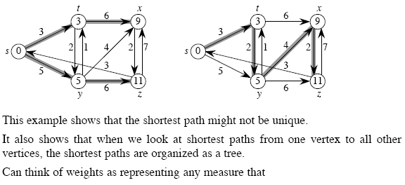
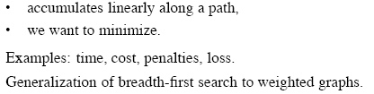
Example: Shortest Path from s

Slide 5
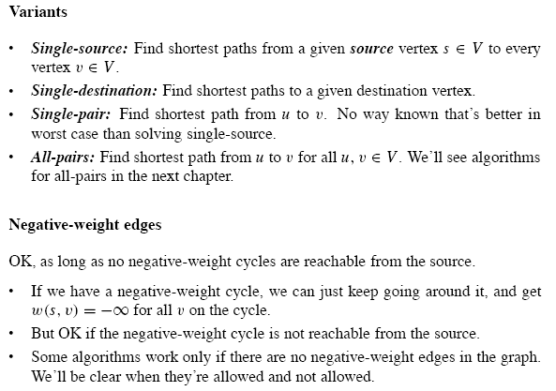

Slide 6
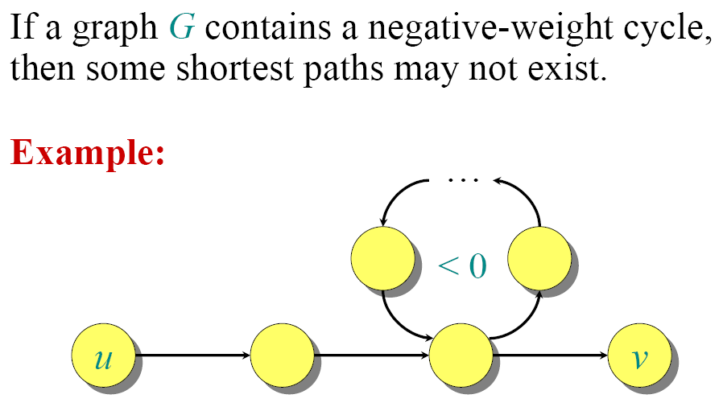
Well-definedness of Shortest Paths

Slide 7
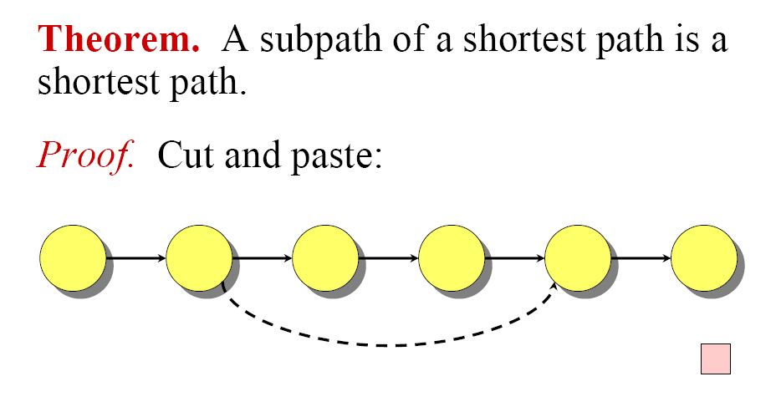
Optimal Substructure

Slide 8
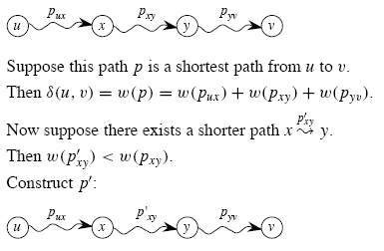
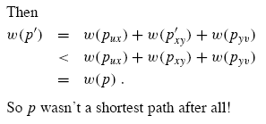
Continue…

Slide 9
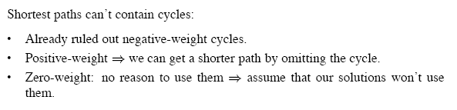
Cycle
Shortest paths do not contain cycles

Slide 10
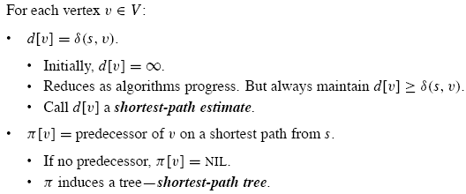
Representing shortest paths

Slide 11
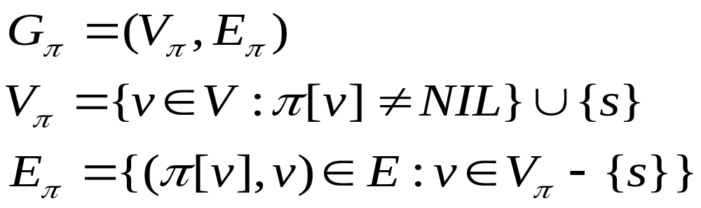
Predecessor Subgraph
We often wish to compute not only shortest-path weights, but the vertices on shortest path as well.
Predecessor subgraph defined above, informally, is a “shortest-paths tree” , a rooted tree containing a shortest path from the source s to every vertex reachable from s
Shortest paths are not unique, neither are shortest-paths trees.

Slide 12
Shortest-paths tree
A shortest-paths tree rooted at s is a directed subgraph G’=(V’, E’), where
  V’ is a subset of V and E’ is a subset of E
  V’ is the set of vertices reachable from s in G
  G’ forms a rooted tree with root s , and
  For all v in V’, the unique simple path from s to v in G’ is a shortest path from s to v in G

Slide 13
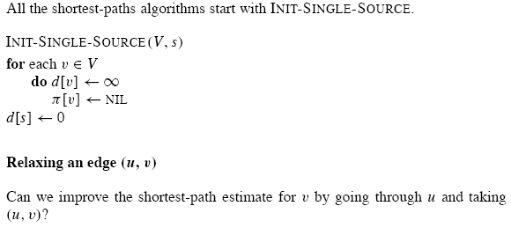
Relaxation

Slide 14
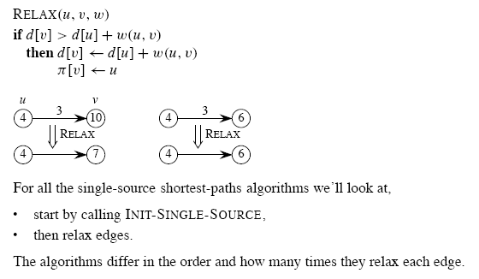
Continue…

Slide 15
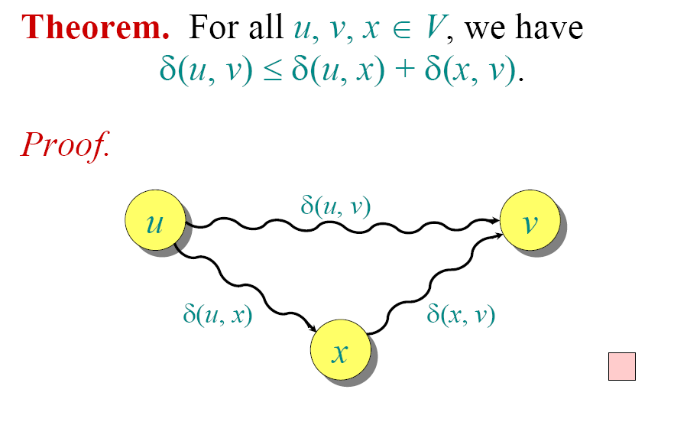
Triangle Inequality

Slide 16
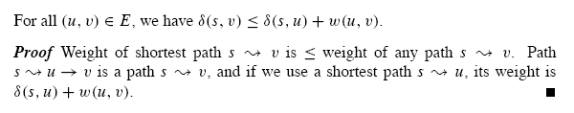
Continue…

Slide 17
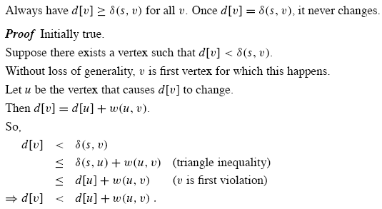

Upper-bound property

Slide 18
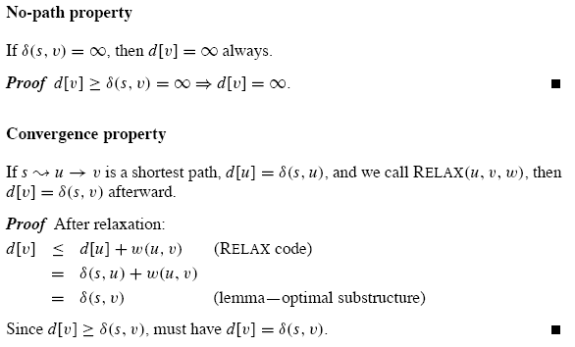

Slide 19
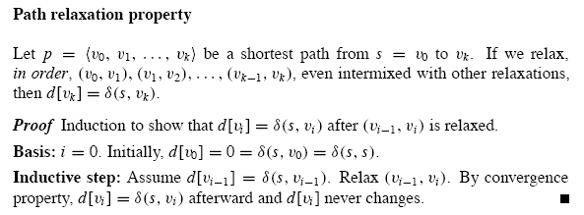
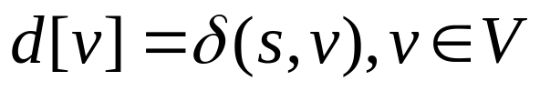
Properties of Shortest path and relaxation
Once , the predecessor subgraph is a shortest-paths tree rooted at s

Slide 20

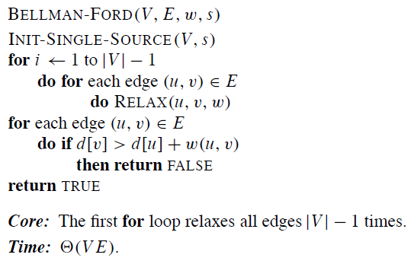
The Bellman-Ford Algorithm
Why need (n-1) passes?

Slide 21
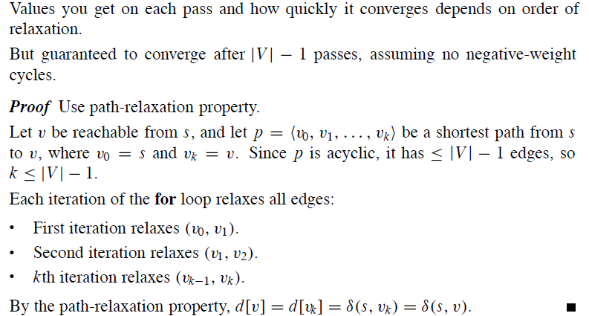
Lemma 24.2

Slide 22
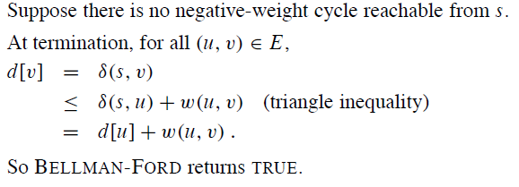
True/False value of Bellman-Ford Algorithm

Slide 23
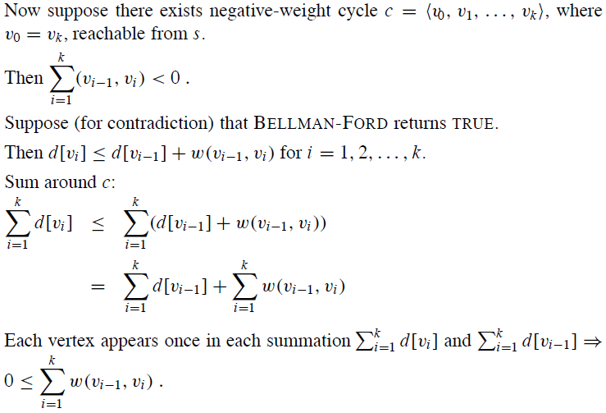
Cont.

Slide 24
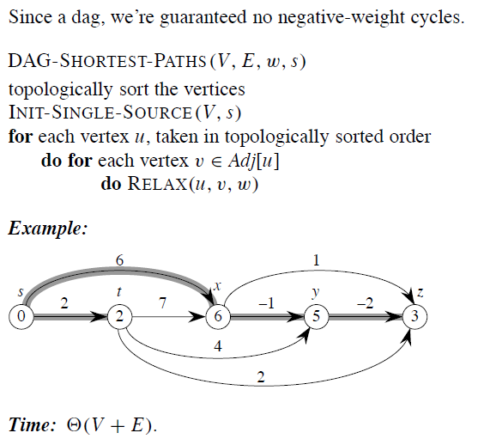
Single source shortest paths in DAG
Each edge is only relaxed once

Slide 25
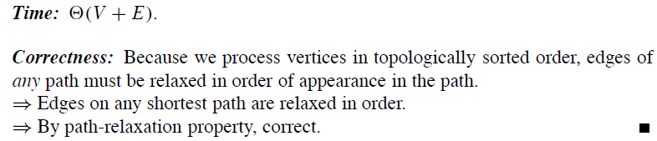
Correctness

Slide 26
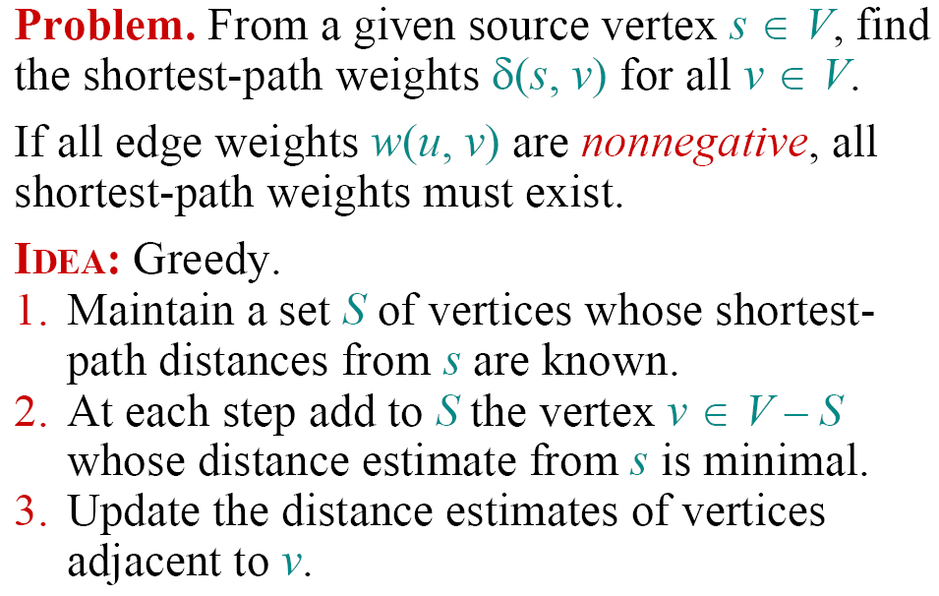
Single-Source Shortest Paths

Slide 27
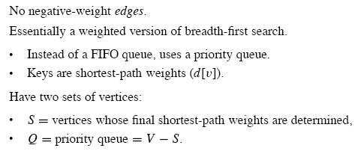
Dijkstra’s Algorithm(1)

Slide 28
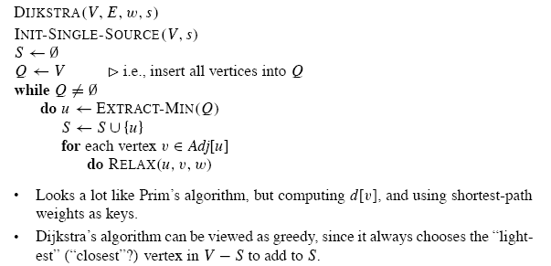
Dijkstra’s Algorithm(2)
When u is added to S, d[u]=δ[s,u], each edge is relaxed only once

Slide 29
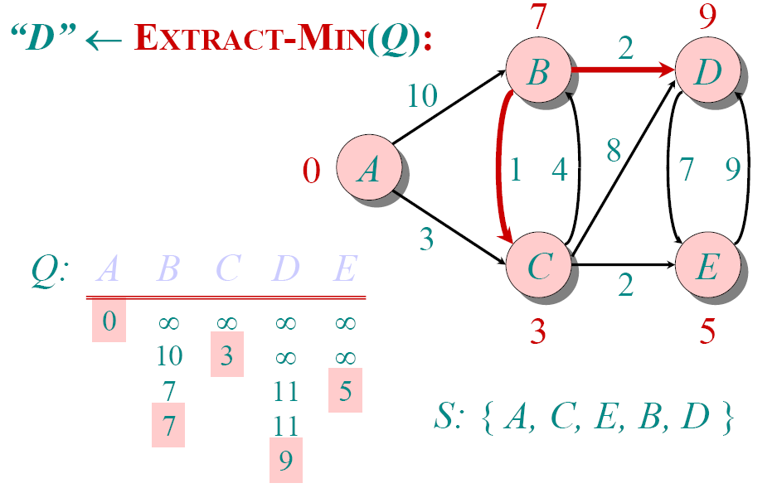
Example of Dijkstra’s Algorithm

Slide 30
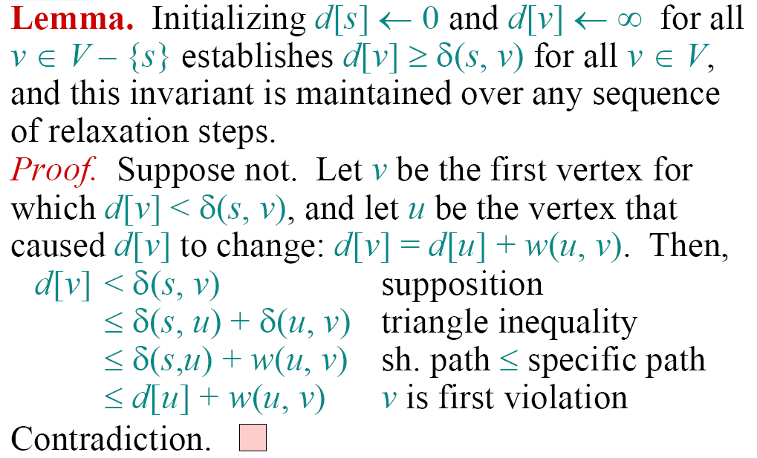
Correctness- Part I

Slide 31
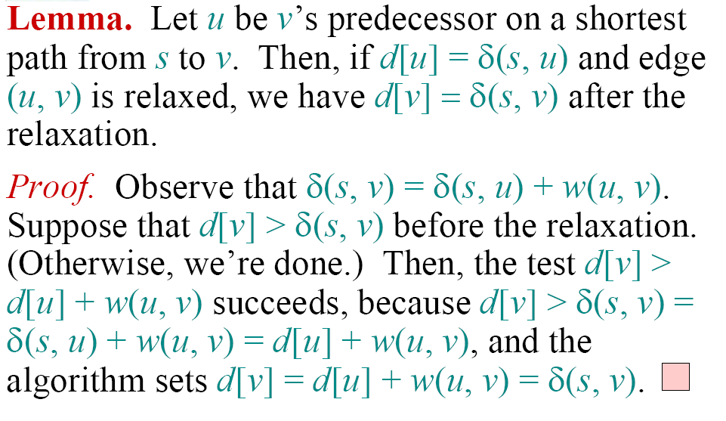
Correctness- Part II

Slide 32
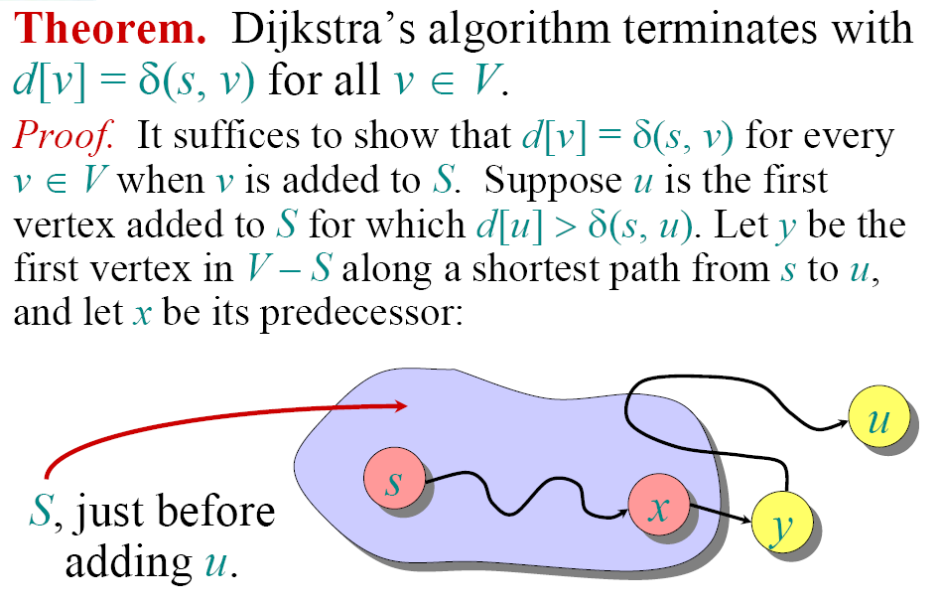
Correctness- Part III

Slide 33
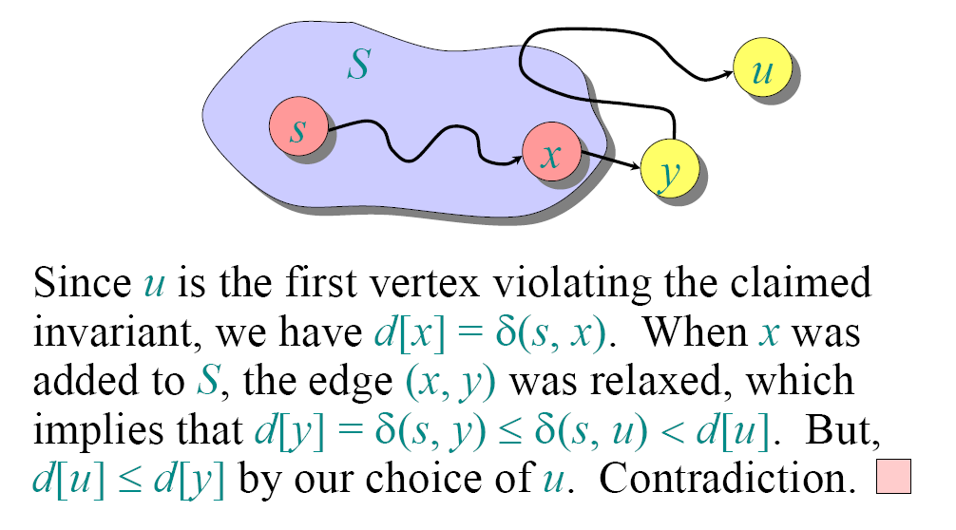
Continued…

Slide 34
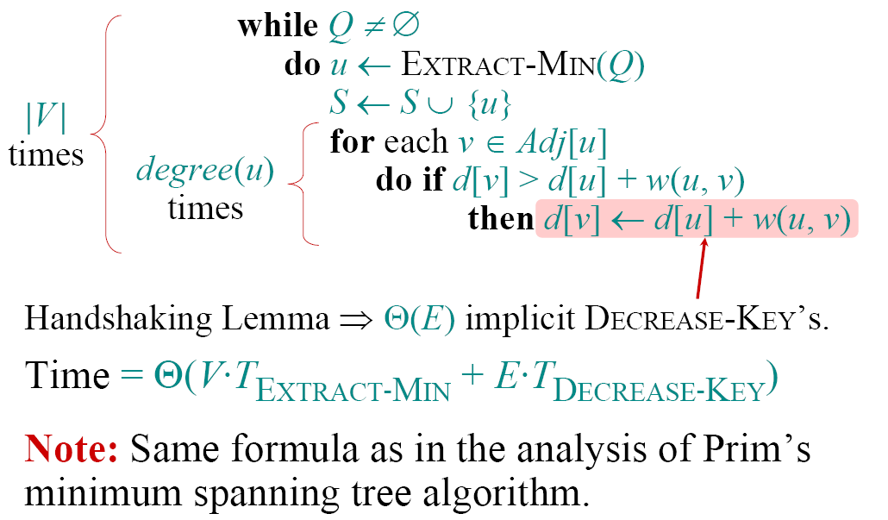
Analysis of Dijkstra

Slide 35
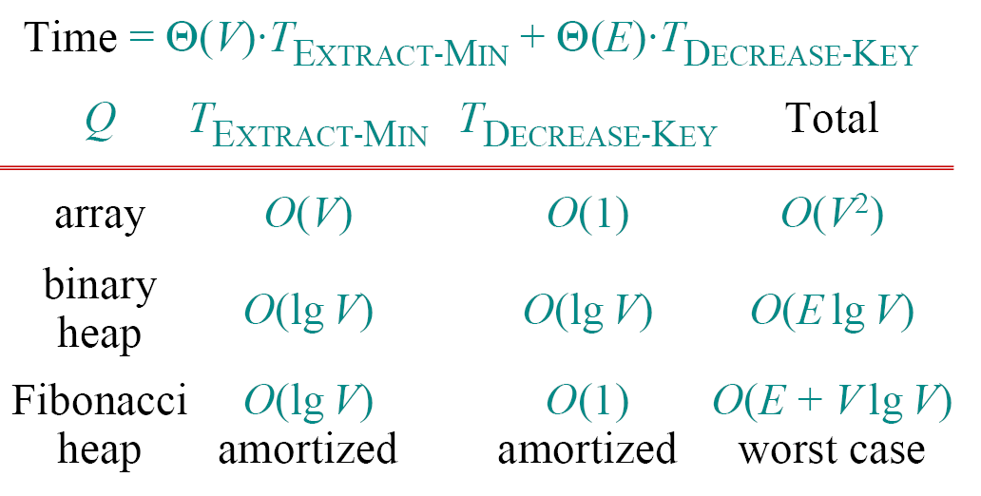
Continue…

Slide 36
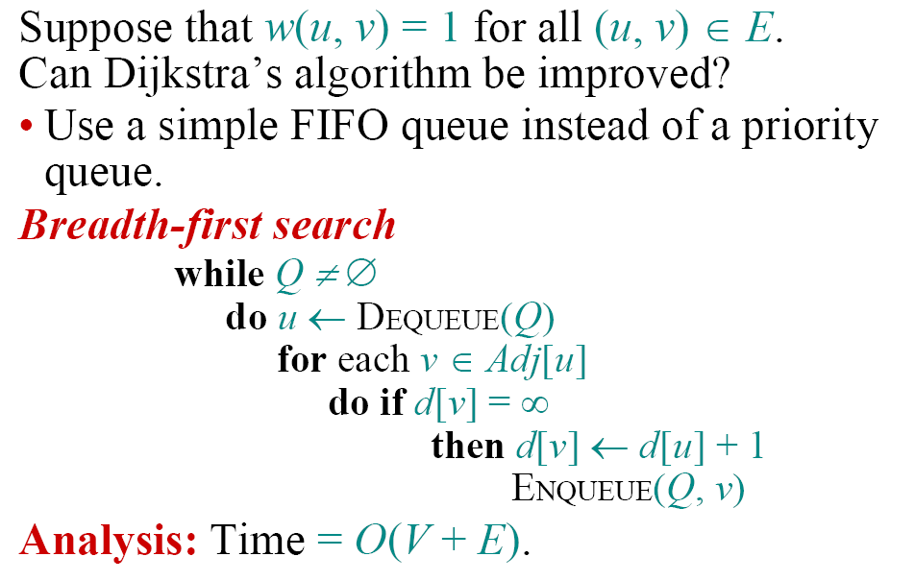
Unweighted Graphs

Slide 37
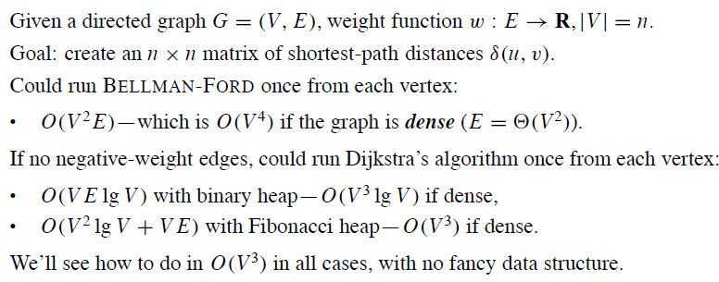
All Pairs Shortest Paths

