Slide 1

SMART INDIA HACKATHON 2026
NAWI-ReportPro: OIML R-76 Digital Platform
Problem Statement ID: 26035
Problem Statement Title:
Automated Test Report Generator for Non-Automatic Weighing Instruments (NAWI)
Theme: Smart Automation
PS Category: Software
Team ID: SIH2026-TEAM-NAWI
Team Name: Metrology Innovators

Slide 2
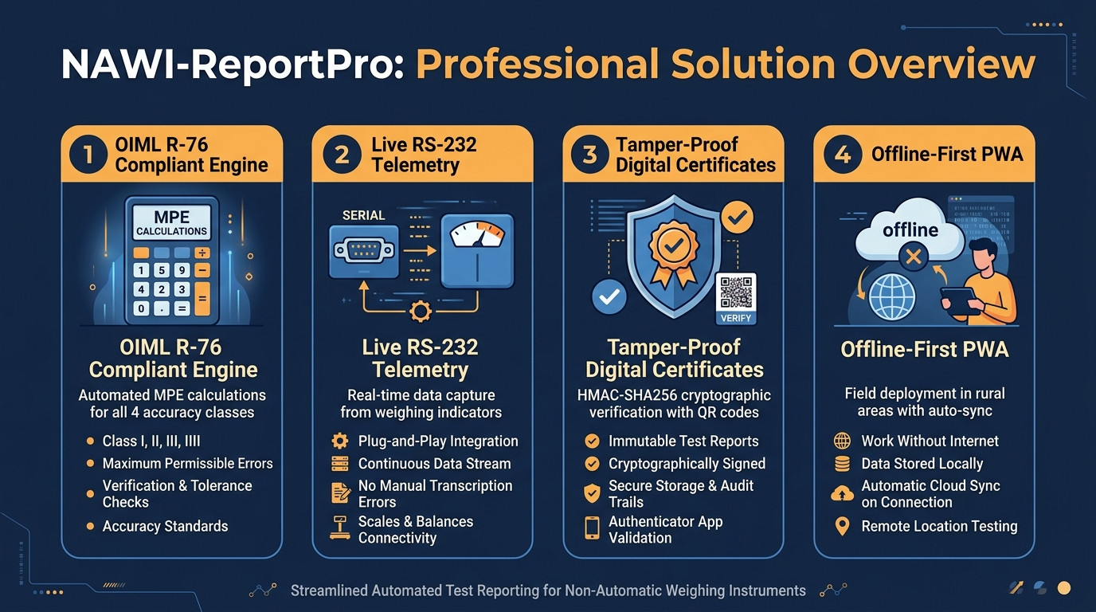
NAWI-ReportPro: Automated Digital Metrology Platform
Metrology
Innovators
Proposed Solution & Core Innovations
• Digital Transformation: Replaces manual paper verification for Non-Automatic Weighing Instruments (scales & truck weighbridges) with an end-to-end digital system.
• Direct Scale Telemetry: Connects directly to weighing indicators via browser Web Serial API (RS-232/USB) — live weight capture with zero manual typing errors.
• OIML R-76 Engine: Automates Maximum Permissible Error (MPE) calculations across all 4 accuracy classes (Class I to IIII) with multi-interval tare compensation.
• Tamper-Proof Certificates: Issues legal verification certificates secured with HMAC-SHA256 digital seals and instant QR code public verification.

Slide 3
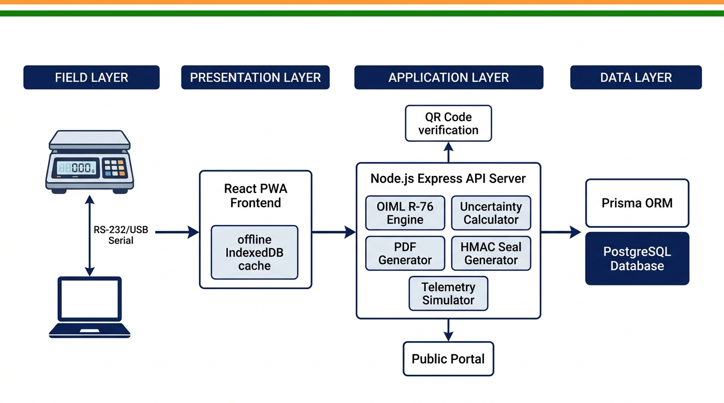
TECHNICAL APPROACH & SYSTEM ARCHITECTURE
Metrology
Innovators
• Hardware Layer: Browser Web Serial API reads continuous ASCII/HEX telemetry streams from Mettler Toledo (SICS), Avery Weigh-Tronix, and Essae indicators.
• Application Stack: React 18 PWA frontend + Node.js Express REST API + PostgreSQL 14 with Prisma ORM + PDFKit high-resolution certificate engine.
• Metrology & Offline Stack: OIML R-76 MPE computation engine, ISO GUM uncertainty budget (k=2), and IndexedDB queue with idempotent background sync for remote mandis.

Slide 4
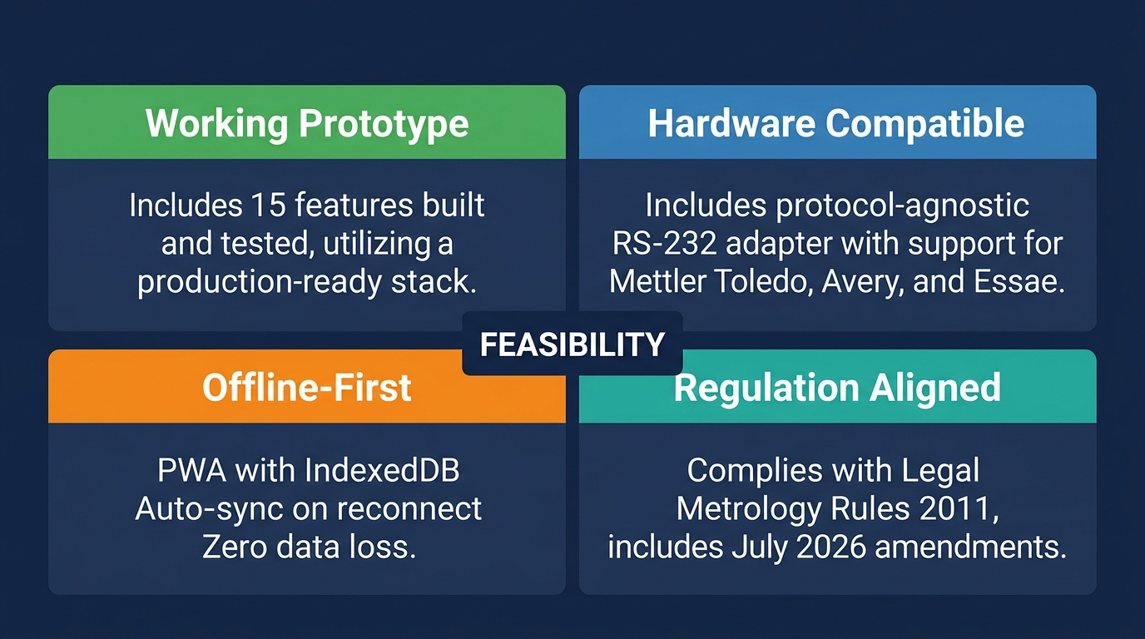
FEASIBILITY, RISK MITIGATION & VIABILITY
Metrology
Innovators
Key Feasibility Pillars & Risk Strategies
• Working Prototype Built: All 15 core metrological features fully implemented and validated with 100% automated test pass rate (129/129 test cases passing).
• Hardware Agnostic: Protocol-agnostic serial parser interfaces with diverse vendor hardware; virtual simulator enables pre-deployment field training.
• Remote Mandi Resilience: Offline-first PWA with IndexedDB local caching allows full inspections in zero-connectivity rural yards with auto-sync upon reconnection.
• Legal Metrology Compliance: Conforms to OIML R-76 (Edition 2006/E) and the Legal Metrology (General) Rules 2011, including July 2026 amendments for high-capacity scales.

Slide 5
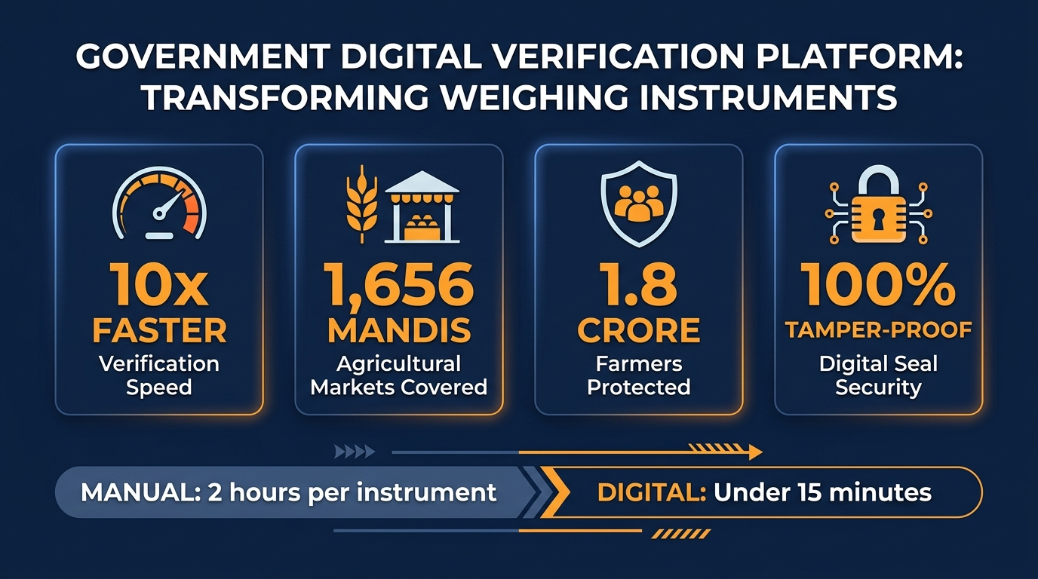
QUANTIFIED IMPACT & NATIONAL BENEFITS
Metrology
Innovators
• 10x Faster Field Verification: Automated calculations reduce inspection duration from 2 hours to under 15 minutes per instrument, eliminating backlogs.
• Protecting 1.80 Crore Farmers: Guarantees accurate weighing across 1,656 e-NAM agricultural mandis nationwide (DoCA/e-NAM official data, June 2026).
• 100% Tamper-Proof Legal Seals: HMAC-SHA256 digital seals with instant public QR validation completely eliminate forged paper calibration certificates.
• Paperless E-Governance: Replaces multi-page carbon inspection forms with centralized, cryptographically auditable digital records across all State Directorates.

Slide 6
RESEARCH FOUNDATION & REGULATORY REFERENCES
Metrology
Innovators
1. International Metrology Standards
• OIML R 76-1:2006: Non-automatic weighing instruments — Metrological & technical requirements; Table 3 MPE tolerance limits, Section 3.5.
• OIML R 76-2:2007: Non-automatic weighing instruments — Standardized test report format and repeatable testing procedures.
• ISO/IEC Guide 98-3:2008 (GUM): Guide to the Expression of Uncertainty in Measurement — Expanded uncertainty budget calculation (k=2).
• EURAMET cg-18 v4.0 (2015): Guidelines on Calibration of NAWI — Repeatability, eccentricity & temperature formulas.
2. Indian Legal Framework & Government Portals
• Legal Metrology Act, 2009 (Act 1 of 2010): Statutory mandates for verification & calibration of commercial weighing instruments.
• Legal Metrology (General) Rules, 2011: Seventh Schedule standards, including July 2026 amendments rationalizing verification norms for high-capacity scales (>=1 tonne).
• BIS IS 9281 (Parts 1-4): Bureau of Indian Standards specifications for electronic weighing systems and load cells.
• DoCA eMaap Portal (emaap.gov.in): Department of Consumer Affairs online enforcement and inspection tracking system.
• e-NAM Platform (enam.gov.in): National Agriculture Market official data: 1,656 mandis, 1.80 Cr farmers (June 2026).
• SIH Winner Benchmark: https://github.com/Aadiii00/SIH-Winners-PPt-and-Sources.

