Slide 1
BUS SATHI · TRACE INTELLIGENCE
Ground-Truthing the Kashmir Plan with Real Driver GPS
What 3.8 million real GPS points from working bus drivers verified, measured,
and corrected in the route-rationalisation plan — and what they honestly cannot tell us.
Kashmir Valley Route Rationalisation · companion to plan v3.4.5 · July 2026

Slide 2
THE RAW MATERIAL
Every 5 seconds, a real bus told us where it was
The Bus Sathi Android app (published on Google Play) logs a driver's position every ~5 s into Firebase.
180
volunteer drivers
self-registered via the public app
3.8M
GPS points
~5-second sampling, Feb–Jun 2026
1,213
recorded sessions
one session = hours of a working day
131
observed days
weekday + weekend service
The catch: a recorded “trip” is NOT a bus trip.
Drivers leave the app running in the background — one session bundles 3–10 real service runs plus hours of parking, meals and wandering. Used naively, this data gives absurd timings. So nothing is used raw.
Privacy by construction
Driver identities are SHA-256 hashed in every derived file; raw traces and credentials never leave the private data store; only aggregate, anonymised layers are published.

Slide 3
STEP 1 — CLEANING
From messy sessions to honest service runs
A dwell/gap segmenter cuts each session at terminals (≥12 min stationary) and app gaps (≥8 min), then trims idle heads and tails.
2,526
real service runs
extracted from 1,200 sessions
2,012 h
idle time removed
parking / breaks / background noise
63 min
median real run
vs 209 min raw session wall-time
13.3
km/h median run speed
realistic city-bus pace → sanity check passed
Then every run is snapped to the road network (OSRM map-matching) and quality-gated:
2,519 / 2,526 runs matched to roads raw-vs-matched length agreement used as the gate — median 0.99
2,426 runs pass as “clean” these are the only runs any downstream claim is built on
38,431 stop-dwell events kept each 40 s – 12 min stop becomes evidence for the stop inventory

Slide 4
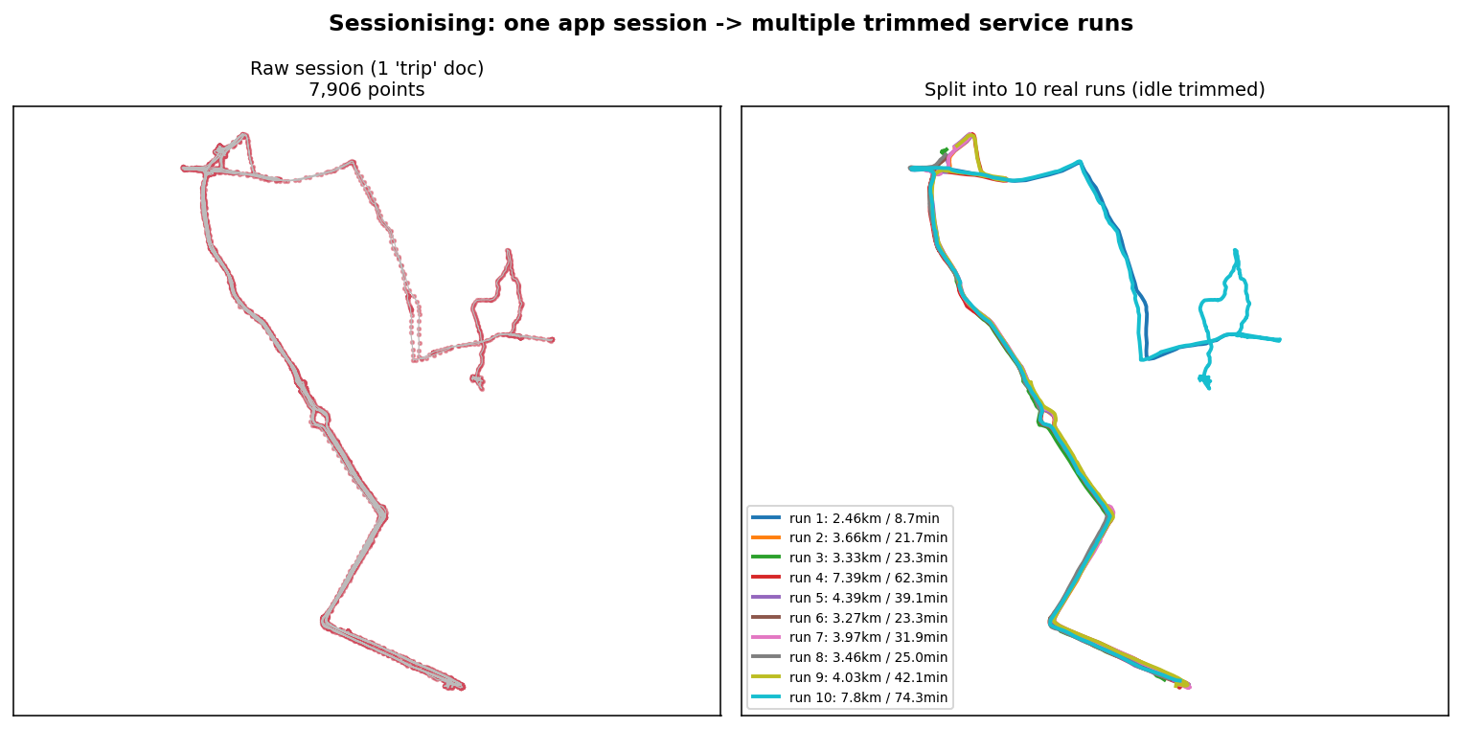
WHAT THE CLEANING LOOKS LIKE
One recorded session, ten real bus runs inside it
Left: one raw Firestore session (7,906 points — a whole working day). Right: the same session decomposed into 10 idle-trimmed service runs, each with its own realistic distance and duration.

Slide 5
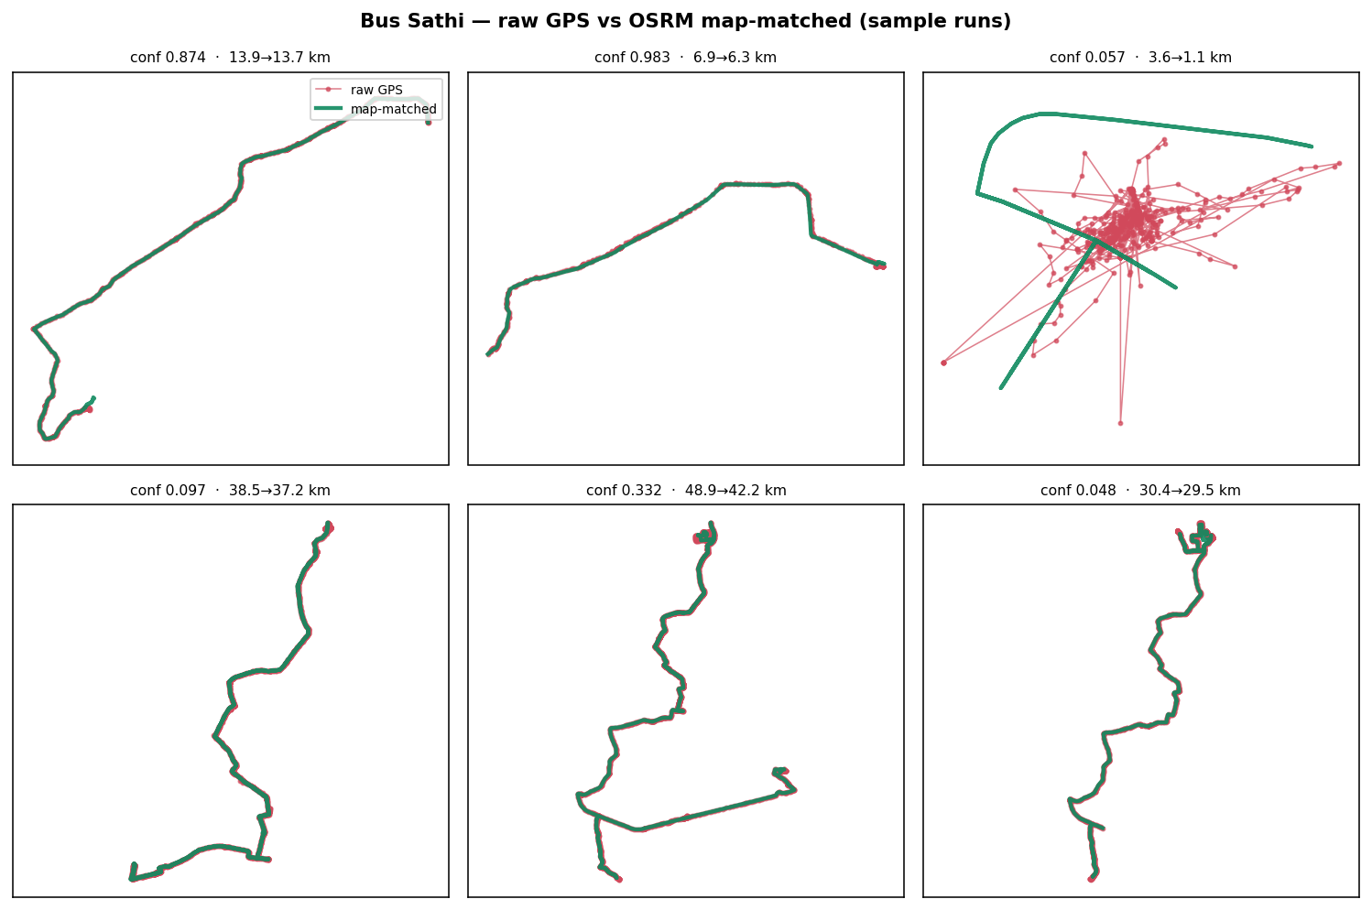
QUALITY GATE
Raw GPS (red) vs road-matched (green)
On genuine runs the matched line hugs the raw trace. The top-right panel is parked-vehicle GPS scribble — exactly what the agreement gate rejects before any analysis.

Slide 6
STEP 2 — VERIFICATION
18 observed corridors, each judged one by one
Endpoint clustering (≥3 distinct drivers per terminal) grouped the clean runs into 25 corridors; the 18 with real support (≥5 runs, ≥2 drivers) each got an evidence file and an individual AI-analyst verdict.
Verdicts vs the plan's routes
7
MATCH the plan
same corridor, same terminals — e.g. Soura–Lal Chowk = FDR-050 (211 runs)
0
informal / unpermitted routes
An early “under-permitted cluster” finding was RETRACTED after checking the raw 614-permit register — those areas are heavily permitted. The honest signal is geometry divergence, not illegal operation.
The audit trail (verdict + correction per corridor) ships with the repo.
8
geometry diverges
buses observably run a different alignment than the routed line → reconciliation list
2
outside Kashmir Division
NH-44 / Jammu traffic — correctly excluded by the district clip
1
data artifact
near-stationary terminal idling; excluded and the filter fixed

Slide 7
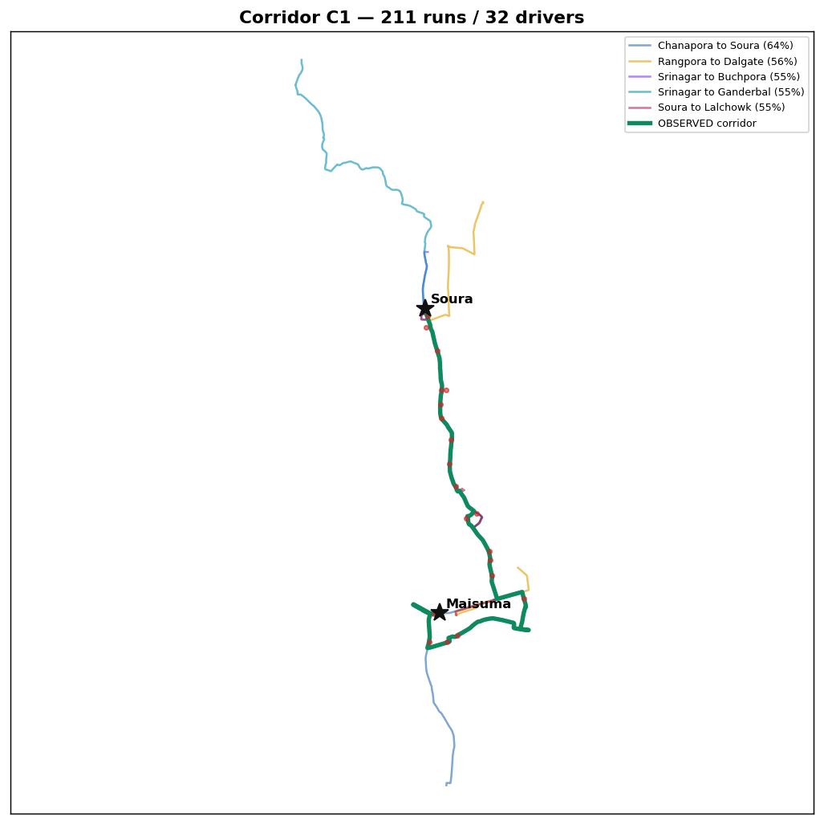
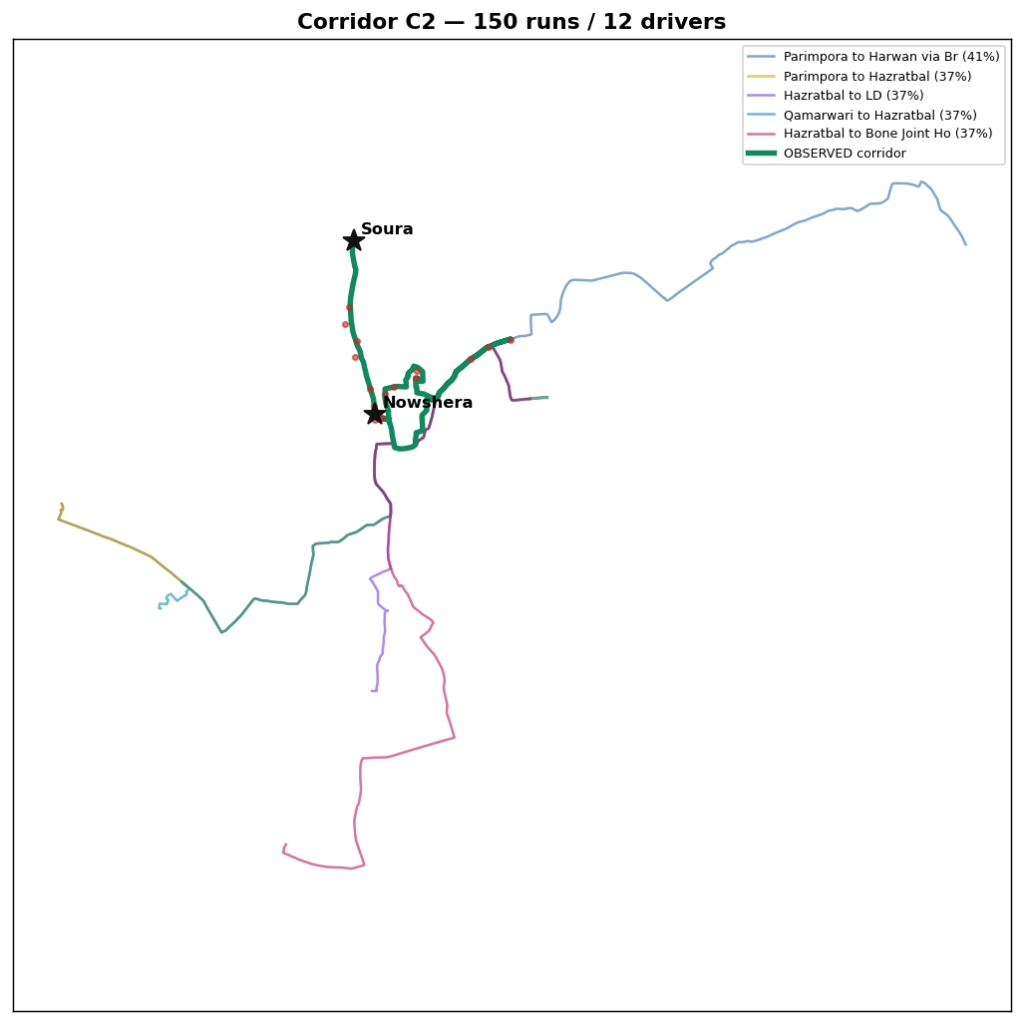
THE OVERLAY EVIDENCE
Observed corridor (green) laid over the plan's candidate routes
C1 — a MATCH: 211 observed runs ride exactly on permit FDR-050 (Soura–Lal Chowk).
C2 — a DIVERGENCE: 150 real runs (green) vs the routed lines — the alignment to reconcile.

Slide 8
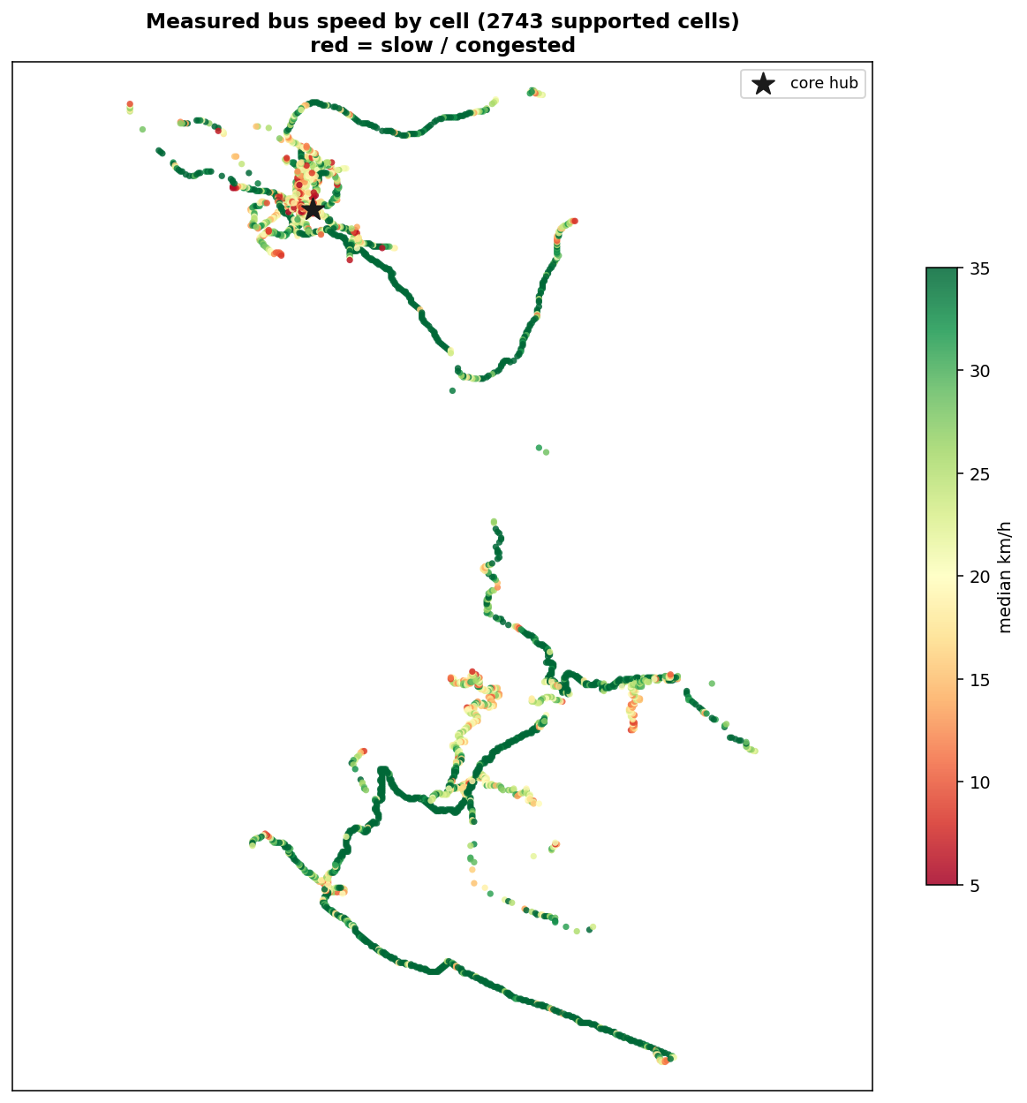
STEP 3 — MEASUREMENT
The first measured bus speeds for Srinagar
Not modelled, not assumed — computed from consecutive GPS fixes of buses in revenue service.
21 km/h
moving speed
median while the bus is in motion
12.5 km/h
effective speed
including every service stop
37%
of run time at stops
boarding + waiting dwell share
17 vs 24
core vs periphery km/h
10,600-cell congestion heatmap
Why it matters: the engine's drive times come from a CAR model (55–137 km/h “free flow” here). This layer replaces that assumption with measurement — per 100 m cell, per corridor.
Measured speed per cell — red = congested crawl.

Slide 9
STEP 4 — OPERATIONS
What a driver's day actually looks like
855 measured driver-days — duty spans, utilisation, terminal turnarounds and the shape of the service day.
7.9 h
duty-day span
4.8 h of it in service = 76% utilisation
24 min
median terminal turn
door-to-door incl. layover (n=1,178)
10:20–18:15
the typical service day
ramps from 8:00, peaks 14:00–17:00
~19:00
service collapses
the observed fleet stops by evening
Two operational takeaways
1. Evening service is the gap. Measured in-service time collapses after ~19:00 across the observed fleet — an enforced-headway evening tier would be a visible, cheap service win.
2. The 24-minute turn is what schedulers must plan for. It includes waiting-to-fill, so a scheduled service can beat it — but any timetable assuming near-zero recovery is fiction.

Slide 10
CLOSING THE LOOP
Measurement corrected the plan: v3.4.5
Five plan routes were confidently matched to observed corridors — enough evidence to re-anchor their cycle times to measured bus physics.
Planned one-way time ÷ measured one-way time
What was hiding it
4 of the 5 routes were pinned at the engine's per-km cycle CAP — a safety heuristic that quietly clamped their cycle times below what buses measurably need.
The fix: on directly-measured corridors, the measured moving speed replaces the car-model estimate, and the cap no longer clamps. Only those 5 routes changed.
Fleet 1,004 → 1,011
+7 buses, all on GPS-verified core corridors
Soura – Lal Chowk (FDR-050)
211 runs observed
0.50
5 → 7
Soura – Railway Stn (FDR-262)
93 runs observed
0.55
4 → 7
Srinagar – Pampore (FDR-370)
79 runs observed
0.51
4 → 5
Soura – Qamarwari (FDR-270)
47 runs observed
0.58
4 → 5
Safakadal – Jehangir Chowk (FDR-575)
40 runs observed
0.47
3 → 3

Slide 11
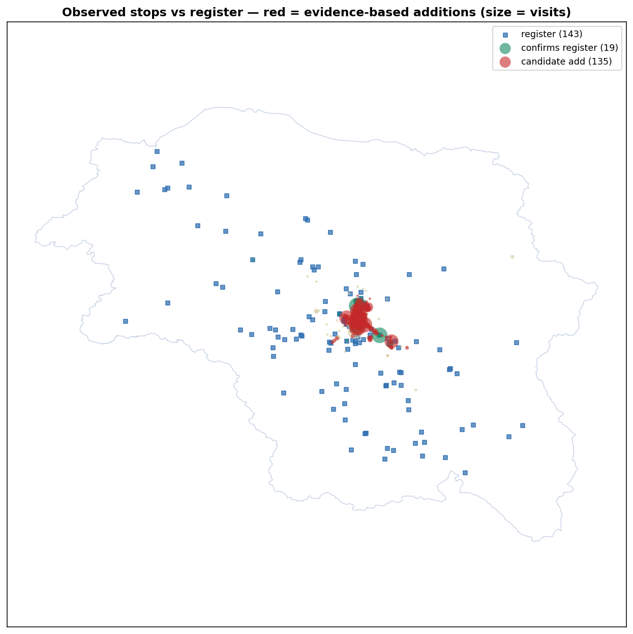
BONUS LAYER
An evidence-based stop inventory
Every 40 s – 12 min dwell is a vote for a real stopping place. Clustered, they map where buses actually stop.
352
candidate stops
from 38,431 observed dwell events
215
strong stops
≥3 distinct drivers and ≥10 visits
30%
register corroboration
of official stops in the observed footprint
135
enrichment candidates
observed stops the register doesn't list
Enrichment, not indictment
The register is endpoint-oriented, so mid-route stops are “new” by construction. Each candidate ships with coordinates, visits and driver support — ready for field validation.
Register (blue) vs observed stops — red = candidates.

Slide 12
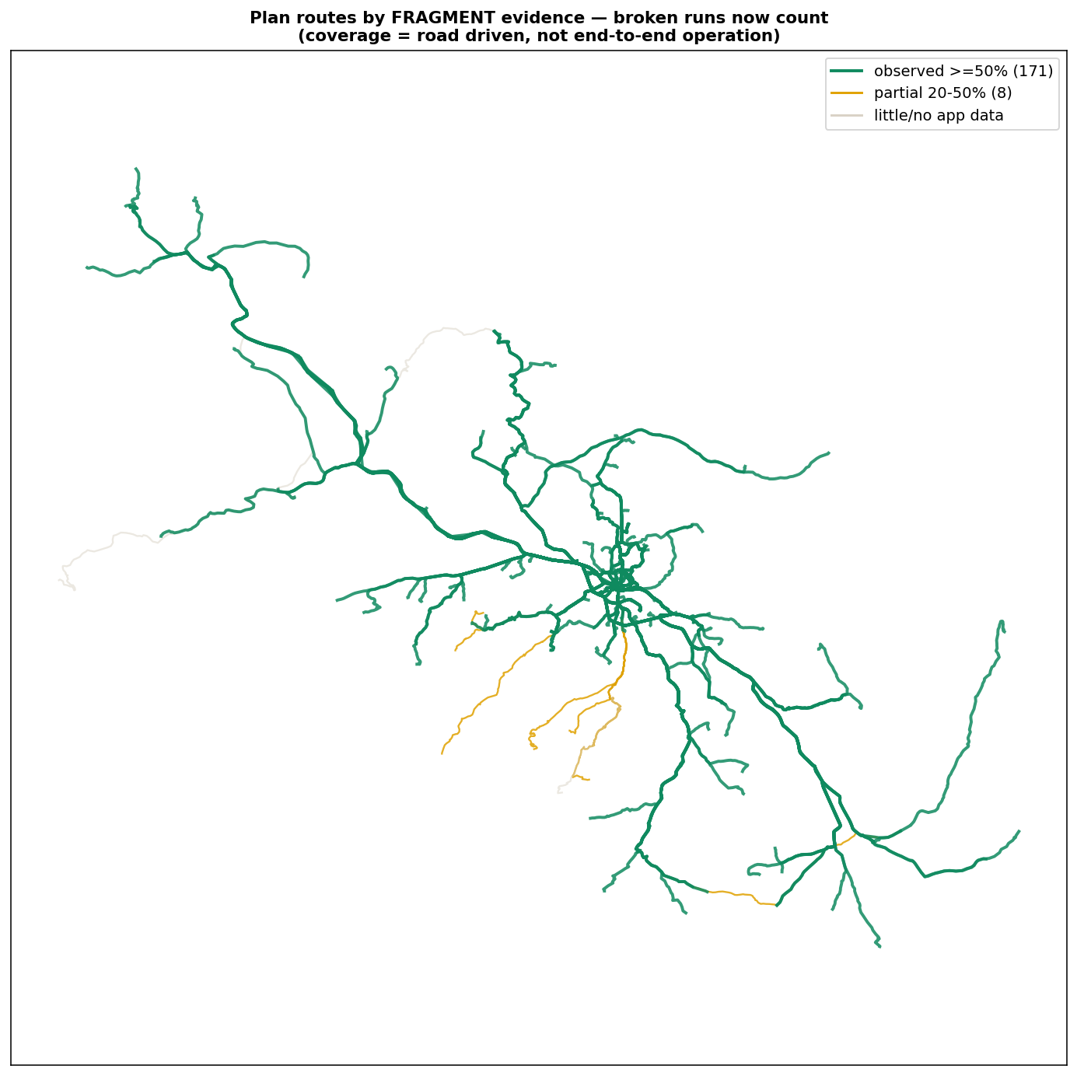
SECOND HARVEST
The whole valley, recovered from broken fragments
Long-haul runs exist only as fragments (the app gets toggled mid-journey) — so fragments now vote for road-km instead of whole runs.
172 / 186
plan routes evidenced
≥50% of alignment driven, ≥2 drivers
59 km
Anantnag–Srinagar
100% driven · 367 fragments · 24 drivers
64
Tier-2 rural stops
Anantnag 7 · Pulwama 7 · Ganderbal 3
7
honest gaps
little app data: Shopian/Kulgam + far NW
Caveat on every popup: this is ROAD-level evidence (“buses drive this alignment”) — not proof a specific permit operates end-to-end. Parallel routes share segment evidence.

Slide 13
CLOSING THE RECONCILIATION LOOP
Real driven paths fixed the plan's map lines
The plan's distances were corrected earlier, but 18 route map lines still traced a path nobody certified — the endpoint pins were wrong.
18
stale map lines found
drawn line >25% longer than the corrected km
15
geometries redrawn
re-anchored termini → real road path, in km band
3
honest holdouts
one-way systems — flagged, not guessed
The tell
Every stale line WAS OSRM's shortest path from its pins — so the pins were the defect, not the routing.
How each fix was accepted
Re-anchor the termini (stops register · observed GPS stop clusters · researched pins — JVC = SKIMS Bemina; Iskanderpora & Badran = Beerwah-belt Budgam villages) → OSRM re-route → accept ONLY inside the route's web-verified km band → prefer a real observed run between the pins. Numbers unchanged; only the geometry.

Slide 14
READ BEFORE CITING
What this data cannot tell us
Partial, self-selected adoption
~157 active drivers, Srinagar-concentrated. “No app data on a route” does NOT mean “no service”.
No demand, no ridership, no frequency
The app sees vehicles, not passengers. Observed run counts reflect who installed the app — never cited as service frequency.
Corridors cover 41% of clean runs
The other 59% was decomposed and shown to be noise, loops and out-of-division traffic — but the corridor findings describe the frequently-driven core only.
Observed times are an upper bound
They embody informal wait-to-fill practice; a scheduled, headway-enforced service should beat them.
Rural routes remain unvalidated
Measured corrections touch 5 Srinagar-core corridors; long rural lifeline cycle times still rest on the model.

Slide 15
SUMMARY
A validation layer the plan didn't have before
Verified
7 plan routes confirmed corridor-level + 172 of 186 evidenced at road level from fragments; 8 geometry divergences queued; 0 informal routes.
To make this decisive
1. Broader driver adoption — every new driver hardens every layer.
2. The RTO's surveyed stop register — to confirm the 135 candidates.
3. AFC / ticketing data — the missing demand half no GPS can supply.
Measured
First real bus speeds (21 / 12.5 km/h), duty cycles, 24-min turnarounds and a 10,600-cell congestion map for Srinagar.
Corrected
5 GPS-verified corridors re-anchored to measured physics → plan v3.4.5 (1,011 buses), with the audit trail published.
Repo: github.com/Princu-Babu/bus-sathi-trace-intelligence · full method, audit log and reality-check tables committed

