Slide 1
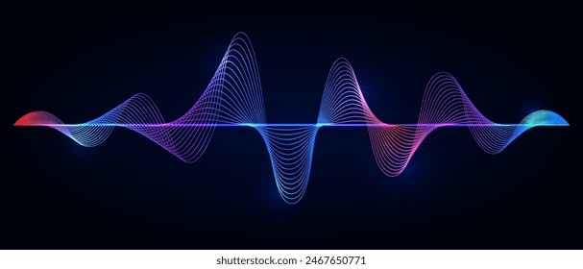

Analysis of Phoneme Recognition Models
Shreya Pandey (M24CSA030)
Princu Singh (M24CSA024)

Slide 2
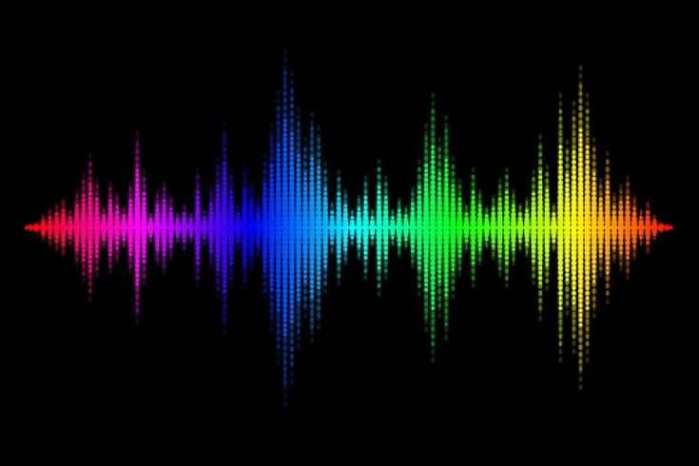
AGENDA
Introduction
Real-World Applications
State-of-the-Art Models
Open Problems and Future Opportunities
Conclusion

Slide 3

Introduction

Slide 4


Phoneme
Phonemes are the smallest units of sound in a language that can distinguish between words. They are the foundation of formal language systems.

Slide 5
Phoneme Recognition
Phonemes are like the building blocks of speech. The way you pronounce words depends on how you combine and articulate these phonemes.
Phonemes affect pronunciation:
Sound Variations
Word Differentiation
Accents and Dialects
Articulation
Phoneme recognition is a key component of Automatic Speech Recognition (ASR).
Crucial for speaker verification, speech separation, and diarization.

Slide 6
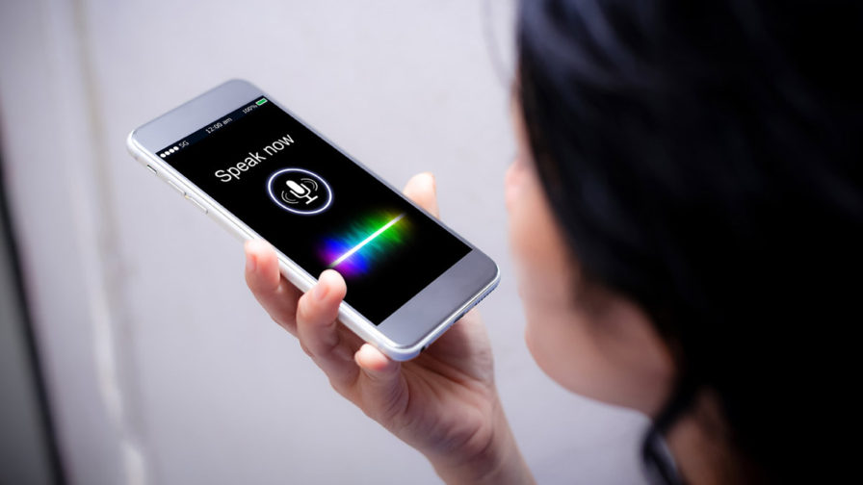
Real-World Applications
Voice Assistants
Transcript services
Language learning
Customer Services
Security

Slide 7
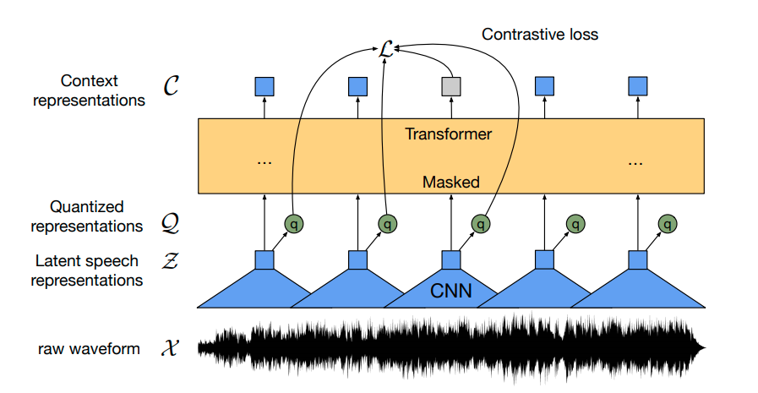
STATE OF ART MODELS

Slide 8
History of Phoneme Recognition
1950s-1960s: Early Research
Initial experiments in speech recognition focused on digit and vowel recognition.
Pioneering work by Bell Labs and other institutions.
1970s-1980s: HMMs and Statistical Models
Introduction of Hidden Markov Models (HMMs) for speech recognition.
Development of statistical models to capture phoneme sequences.
1990s: Large Vocabulary Systems
Advances in computational power and algorithms.
Emergence of large vocabulary continuous speech recognition systems.
2000s: Deep Learning Era
Application of Deep Neural Networks (DNNs) to phoneme recognition.
Significant improvements in accuracy and robustness.

Slide 9
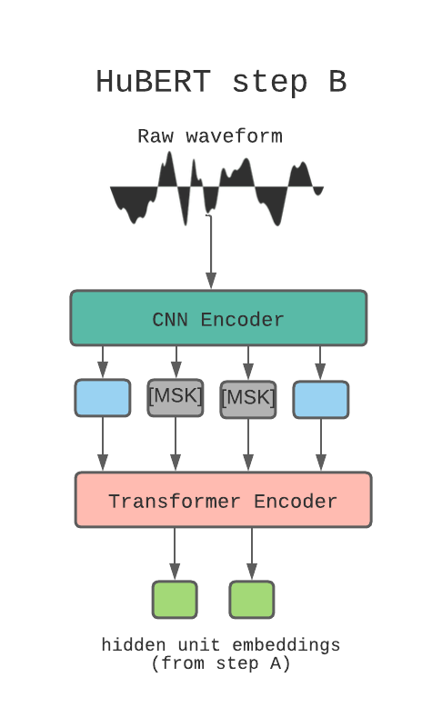
History of Phoneme Recognition
2010s: Self-Supervised Learning
Introduction of self-supervised learning methods like Wav2Vec and HuBERT.
Leveraging vast amounts of unlabeled data for training.
2020s: State-of-the-Art Models
Development of models like Wav2Vec 2.0, HuBERT, and WavLM.
Focus on improving efficiency, adaptability, and real-world robustness.

Slide 10
MODELS
Wave2Vec 2.0
HuBERT
WaveLM

Slide 11
Wav2Vec 2.0
Developer: Facebook AI
Key Features:
Self-supervised learning of speech representations
Learns from raw audio alone
Fine-tunes on transcribed speech
Applications:
Speech recognition
Improved performance on various speech tasks

Slide 12
Strengths and limitation
Strengths
Uses contrastive learning for raw speech waveform training.
Strong performance with minimal labeled data.
Scales effectively with more pre-training data.
Achieves state-of-the-art performance in ASR and phoneme recognition.
Limitation
High computational cost (128 GPUs for 5.2 days).
Primarily evaluated on English datasets.
Simple decoding mechanism compared to attention-based models.
Performance heavily relies on external language models.

Slide 13
HuBERT (Hidden-Unit BERT)
Developer: Facebook AI
Key Features:
Masked prediction of hidden units
Self-supervised speech representation learning
Achievements:
State-of-the-art performance on benchmarks like Librispeech and Libri-light

Slide 14
Strengths and limitation
Limitation
Requires significant computing power (256 GPUs).
Evaluated mostly on English datasets.
WER metric does not account for semantics.
K-means clustering is sensitive to initialization.
Strengths
Uses masked speech prediction with clustered hidden units.
Iterative clustering improves phoneme recognition.
Efficient training compared to contrastive loss methods.
Strong performance in low-resource settings.

Slide 15
WavLM
Developer: Microsoft
Key Features:
Large-scale self-supervised pre-training
Jointly learns masked speech prediction and denoising
Applications:
Enhanced performance across various speech tasks

Slide 16
Strengths and limitation
Limitation
Requires extensive computational resources (64 GPUs for 700k steps).
Overfitting observed in speech separation fine-tuning.
Evaluated primarily on English datasets.
Metric limitations such as WER and DER affecting evaluation.
Strengths
Extends HuBERT by incorporating masked speech denoising.
State-of-the-art performance in multiple speech-related tasks.
Robust in multi-speaker and noisy environments.
Trained on diverse data sources.

Slide 17
Evaluation metrics used
Word Error Rate (WER) provides standardized ASR evaluation.
Phone-Normalized Mutual Information (PNMI) evaluates clustering quality.
Cluster Purity measures phoneme cluster accuracy.

Slide 18
Open Problems and Future Opportunities
Improving low-resource language adaptation.
Reducing computational requirements for training.
Enhancing multilingual and domain adaptation.
Developing better evaluation metrics beyond WER.

Slide 19
Conclusion
Wav2Vec 2.0 excels in ASR.
HuBERT enhances phoneme learning.
WavLM is most robust for multi-speaker scenarios.
Future research should focus on efficiency, adaptability, and real-world robustness.

Slide 20
References
Baevski et al., "wav2vec 2.0: A framework for self-supervised learning of speech representations," 2020.
Hsu et al., "HuBERT: Self-supervised speech representation learning by masked prediction of hidden units," 2021.
Chen et al., "WavLM: Large-scale self-supervised pre-training for full-stack speech processing," 2022.

Slide 21

Thank you
Shreya Pandey M24CSA030 m24csa030@iitj.ac.in
Princu Singh M24CSA024 m24csa024@iitj.ac.in

