Slide 1
Travel planner agent
IBM AICTE PROJECT
Presented By: Princy Murugaraj
Student name : Princy Murugaraj
College Name & Department : Amity University(CSE)

Slide 2
OUTLINE
Problem Statement
Technology used
IBM Cloud Services Used
Wow factor
End users
Result
Conclusion
Future Scope
IBM Certifications
GitHub Link

Slide 3
Problem Statement
Challenge – Travel Planner Agent An AI-powered assistant that helps users plan trips efficiently and smartly.
Uses real-time data to suggest destinations, build itineraries, and recommend transport & stay options.
Understands user preferences, budgets & constraints to deliver personalized plans.
Integrated with maps, weather updates, and local guides.
Manages bookings, alerts users to changes, and optimizes schedules dynamically.
Transforms complex travel planning into a seamless experience.

Slide 4
Technology used
IBM Cloud (Granite Models)
Natural Language Processing (NLP)
APIs (for weather, maps, bookings etc.)

Slide 5
IBM cloud services used
IBM Cloud Watsonx AI Studio
IBM Cloud Watsonx AI runtime
IBM Cloud Agent Lab
IBM Granite foundation model
IBM Object Storage

Slide 6
Wow factors
Real-time Travel Magic: Instantly fetches live data to personalize destinations, routes, and stays.
AI That Gets You: Understands your budget, preferences & style – plans like a pro!
All-in-One Experience: Combines maps, weather, bookings, and local tips in one smart interface.
Chat with Your Trip Planner: Natural conversations to plan, modify, or cancel – like talking to a real
agent.
Smart & Adaptive: Reacts to changes (like delays or weather) and reschedules your plans
automatically.
No Stress, Just Trips: Turns travel chaos into a smooth, seamless journey.

Slide 7
End users
Frequent Travelers
Travel Planners/Agencies
Students planning group trips
Solo Travelers
Tourists visiting new places

Slide 8
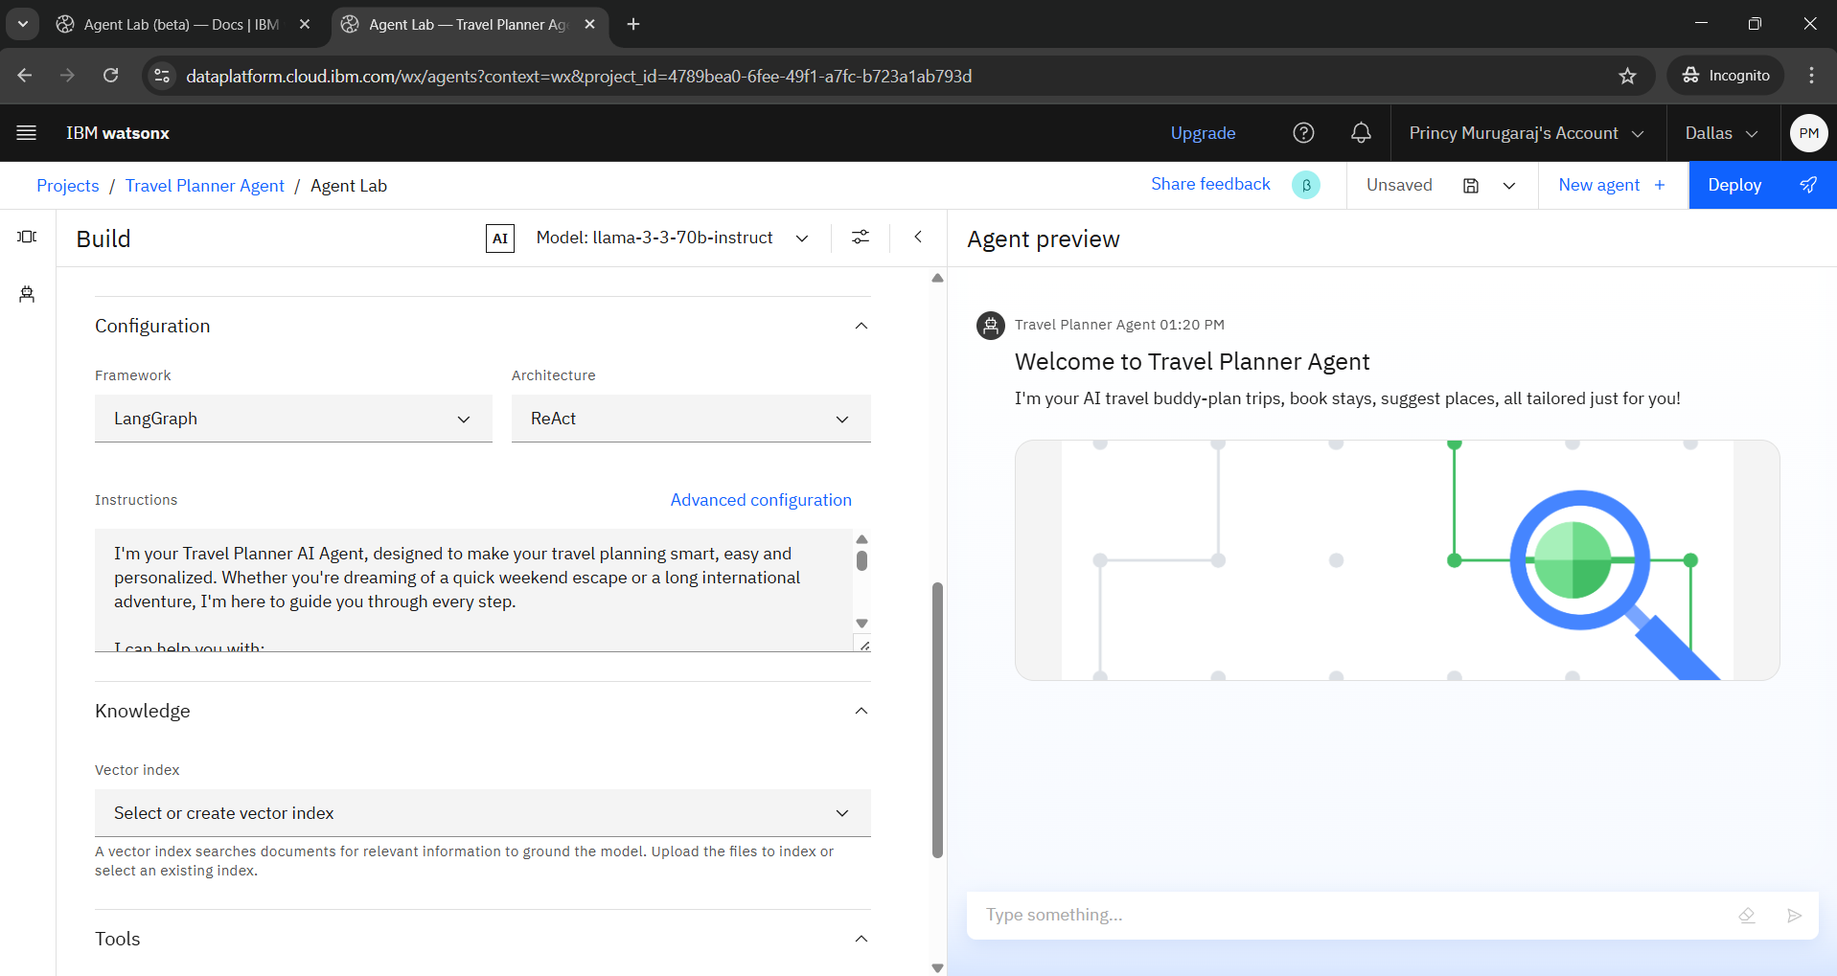
Results

Slide 9
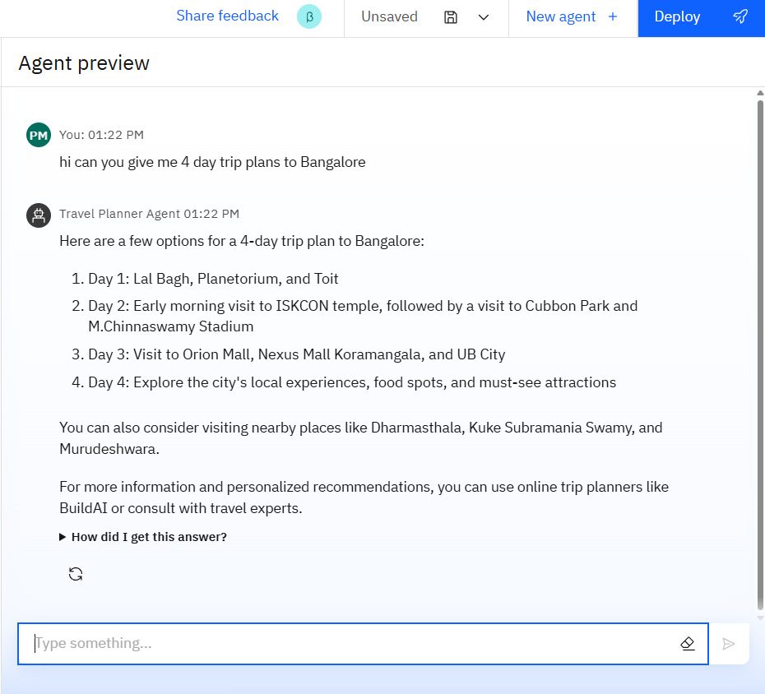
Results

Slide 10
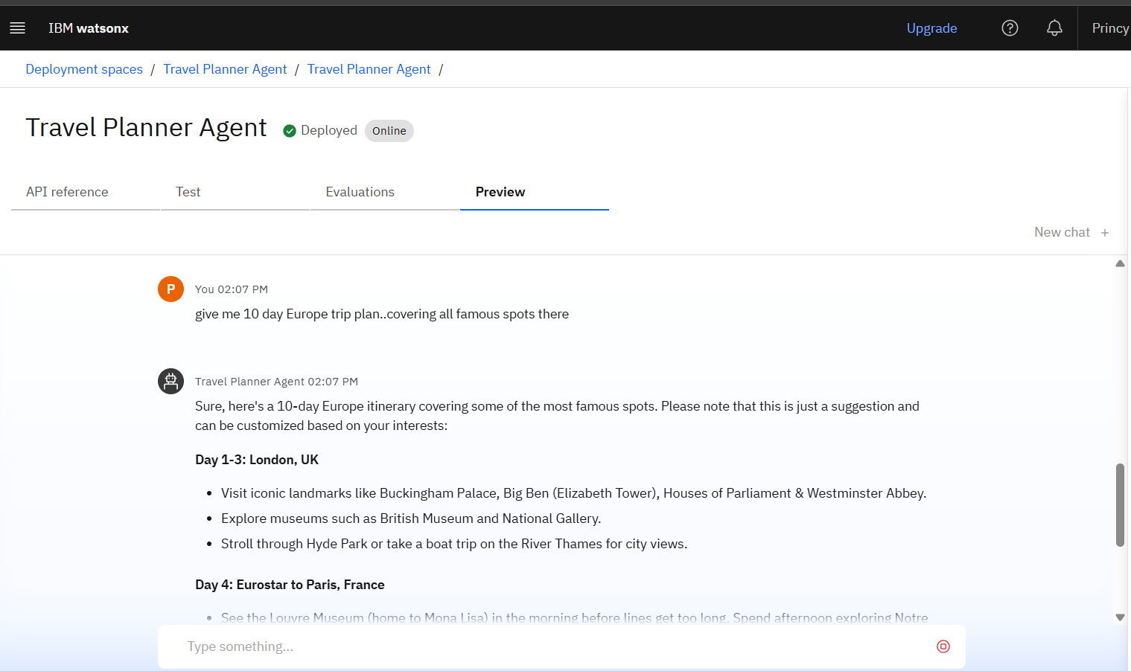
Results

Slide 11
Results
Successfully built and deployed an AI-powered travel planner using IBM Cloud and Granite models.
The agent can generate personalized itineraries, respond to travel queries, and suggest destinations
in real-time.
Demonstrated smooth integration of APIs (maps, weather, etc.) for dynamic travel recommendations.
Achieved interactive user experience through chat-based planning interface.

Slide 12
Conclusion
The AI Travel Agent revolutionizes trip planning by combining intelligence, speed, and personalization.
It transforms complex travel decisions into simple, conversational interactions.
Powered by IBM Cloud and Granite models, it delivers real-time, user-focused travel solutions.
A smart, scalable, and reliable assistant that’s ready to redefine how we explore the world.

Slide 13
Future scope
Voice-Enabled Assistant: Integrate voice commands for hands-free travel planning on the go.
Multi-Language Support: Make travel accessible across regions with localized language options.
Smart Group Planning: Coordinate group itineraries, shared bookings, and split budgets seamlessly.
AI-Powered Recommendations: Suggest hidden gems based on traveler behavior and preferences.
Integration with AR/VR: Enable virtual previews of destinations, hotels, and experiences.
Travel CRM for Agencies: Expand as a full-suite solution for travel businesses and tour operators

Slide 14
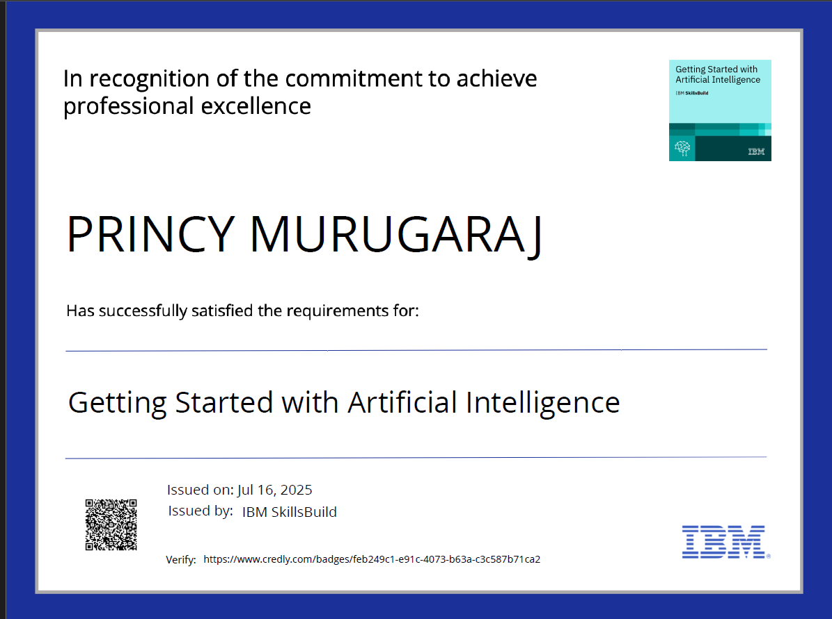
IBM Certifications
1.

Slide 15
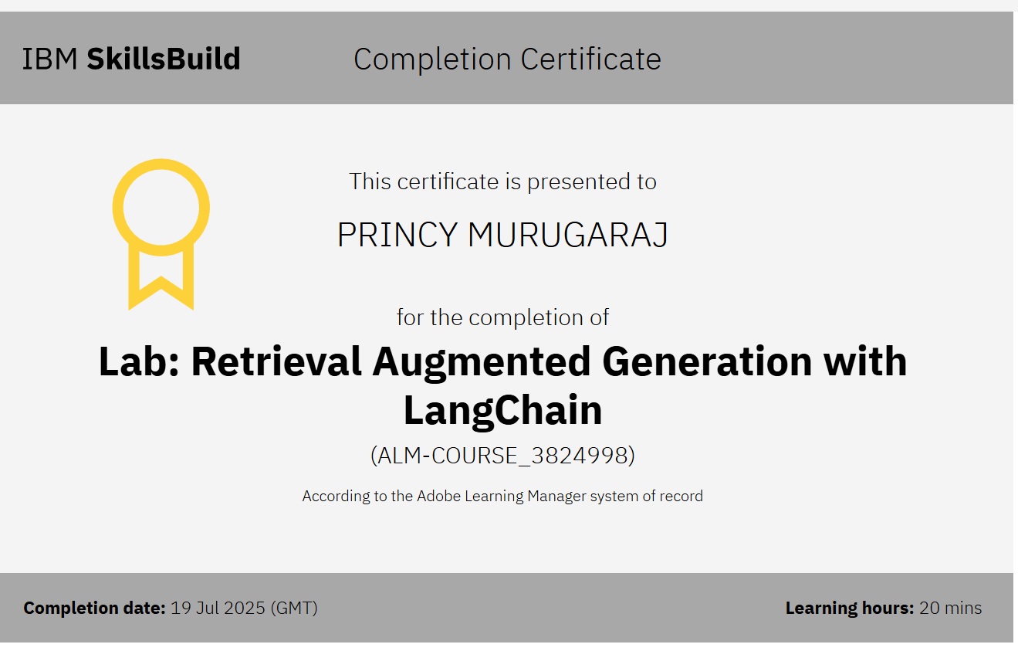
2.

Slide 16
GitHub Link
GitHub link: https://github.com/Princy-Murugaraj/Travel-AI-Agent.git

Slide 17
THANK YOU!!

