Slide 1
DYNAMICALLY ADAPTING KERNELS IN SUPPORT VECTOR MACHINES
Princy Gautam
(B20BB051)

Slide 2
KEY IDEAS
New efficient separability of non - linear regions that use ‘kernel functions’ : generalization of ‘similarity’ to new kinds of similarity measures based on dot products.
Use of quadratic optimization problem to avoid ‘local minimum’ issues with neural networks.
The resulting learning algorithm is an optimization algorithm rather than a greedy search.

Slide 3
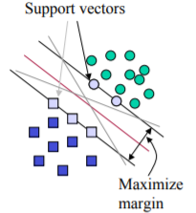
SUPPORT VECTOR MACHINE
SVMs maximize the margin around the separating hyperplane.
The decision function is fully specified by a subset of training
samples, the support vectors.
Support vectors are the data points that lie closest to the hyperplane.
This becomes a quadratic programming problem.

Slide 4
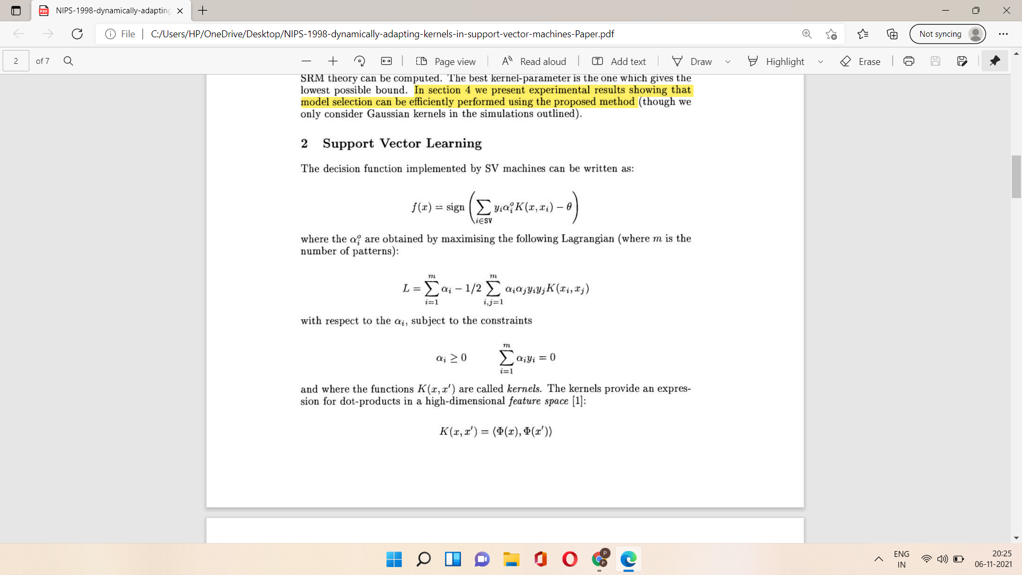
SUPPORT VECTOR LEARNING
The decision function implemented by SV machine can be written as:
Where the 𝛼_i are obtained by maximising the Lagrangian (where m is number of patterns):
subject to the constraints:

Slide 5
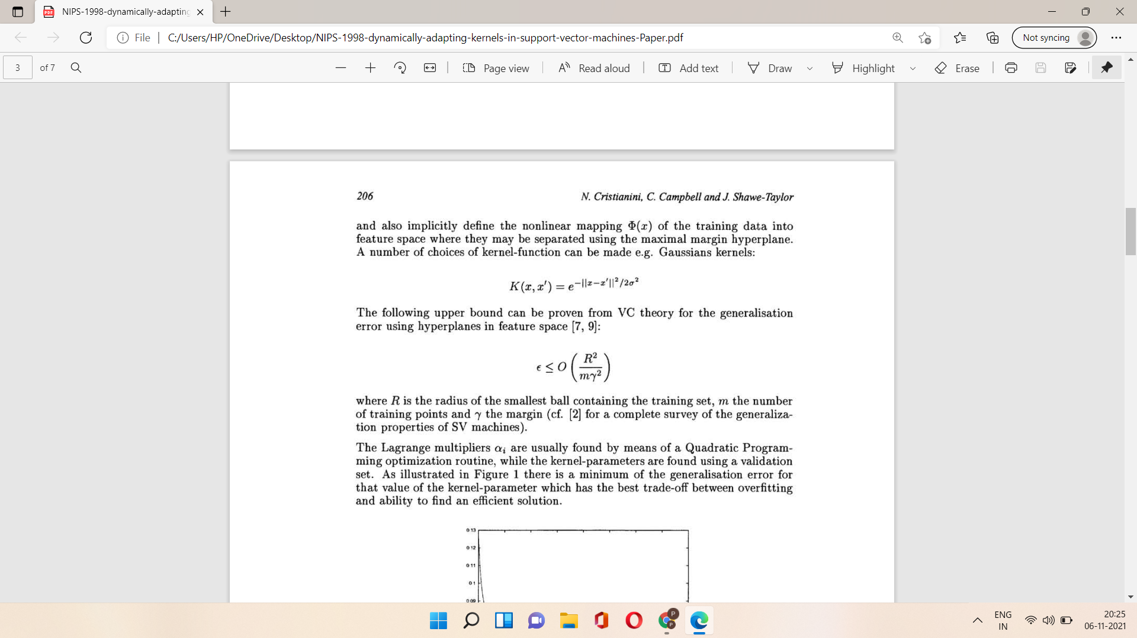
Where K(x,x’) are called kernels
A number of choices of kernel can be made e.g., Gaussian kernels:
The following upper bound can be proven from VC theory for the generalization error using hyperplane in the feature space:
R:the radius of smallest ball containing the training set
M: number of training points
𝛾: the margin

Slide 6
AUTOMATIC MODEL ORDER SELECTION
Kernel Selection Procedure:
Initialize 𝛔 to a very small value.
Maximize the margin, then
Compute the SRM bound ( or observe the validation error)
Increase the kernel parameter: 𝛔←𝛔+𝜹𝛔
Stop when a predetermined value of 𝛔 is reached else repeat step 2.
The theorems below shows that the margin of optimal hyperplane is a smooth function of the kernel parameter, as in upper bound on the generalization error.
Implicit function theorem
Theorem: The margin ℽ of SV machines depends smoothly on the kernel parameter 𝛔 .
Corollary: The bound n the generalization error is smooth in 𝛔 .

Slide 7
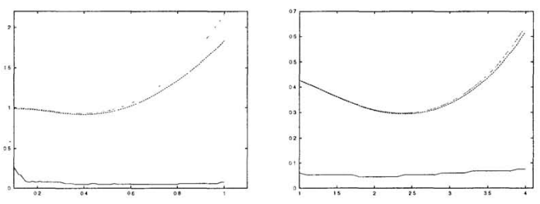
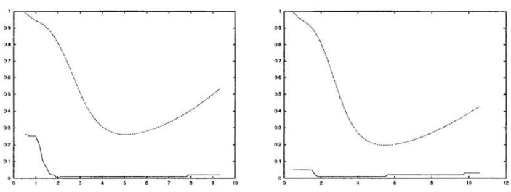

Slide 8
CONCLUSION
We presented an algorithm which automatically learns the kernel parameter with little additional cost.
Model selection takes place during the learning process itself.
This strategy provides a good estimate of the correct model complexity.
This way an optimal 𝜎 can be chosen without the need of additional validation set.

Slide 9
THANK YOU

