Slide 1
Document Classification and Data Extraction

Slide 2
Why this problem statement
Challenge Addressed- Everyday tons of documents are uploaded by customers and classification of these as an major task to solve. Digital storages can serve large amounts of items, it becomes difficult to categorize them manually.
Fields to which it applies-
Banking- applying loans, KYC etc
Goverment Registery- Births, Deaths, and Marriages
Healthcare industry -Digitizing medical reports and other records
Insurance Industry - processes tens of thousands of claims

Slide 3
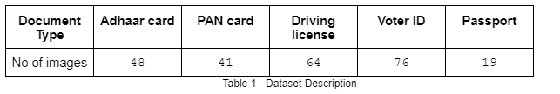
Data Collection
Available data on kaggle and Google images
Data provided by Ecell IITB
Manually scanned documents of one-self

Slide 4
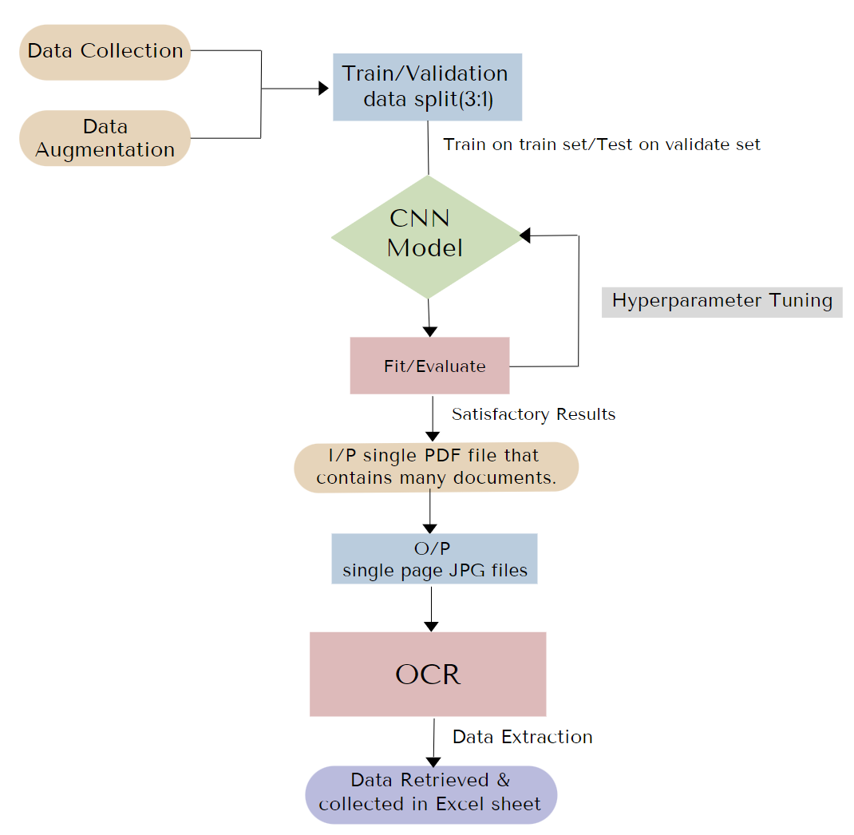
Flowchart
*
CNN : Text Detection
OCR : Text Extraction
*Data Available on github, kaggle etc and Data provided by Ecell IITB

Slide 5
CNN Model

Slide 6
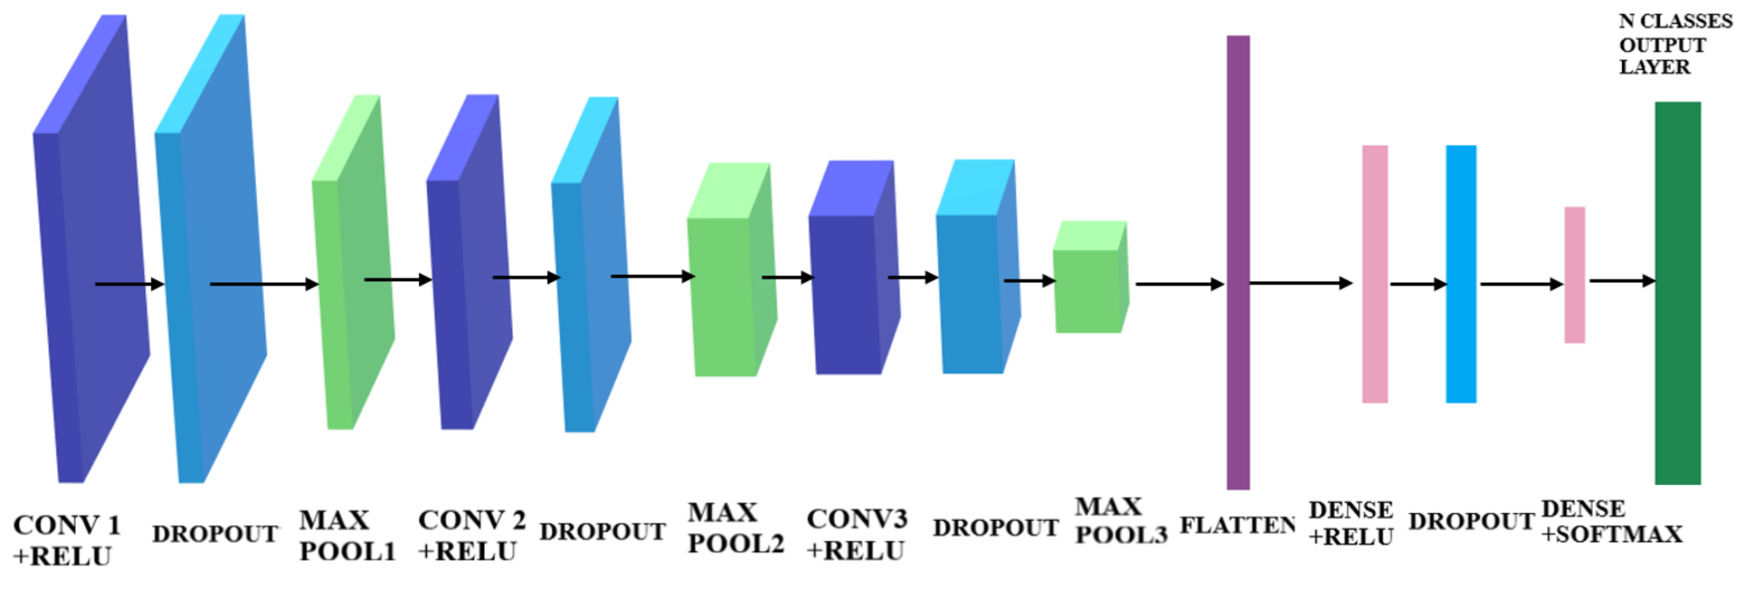
Model
I/P
Convolutional
Layers (5)
Activation : ReLu
Dropout : 0.10
Flatten
Dense
Layers (4)
Activation : ReLu
Dropout : 0.07
O/P Layer
Activation : Softmax

Slide 7
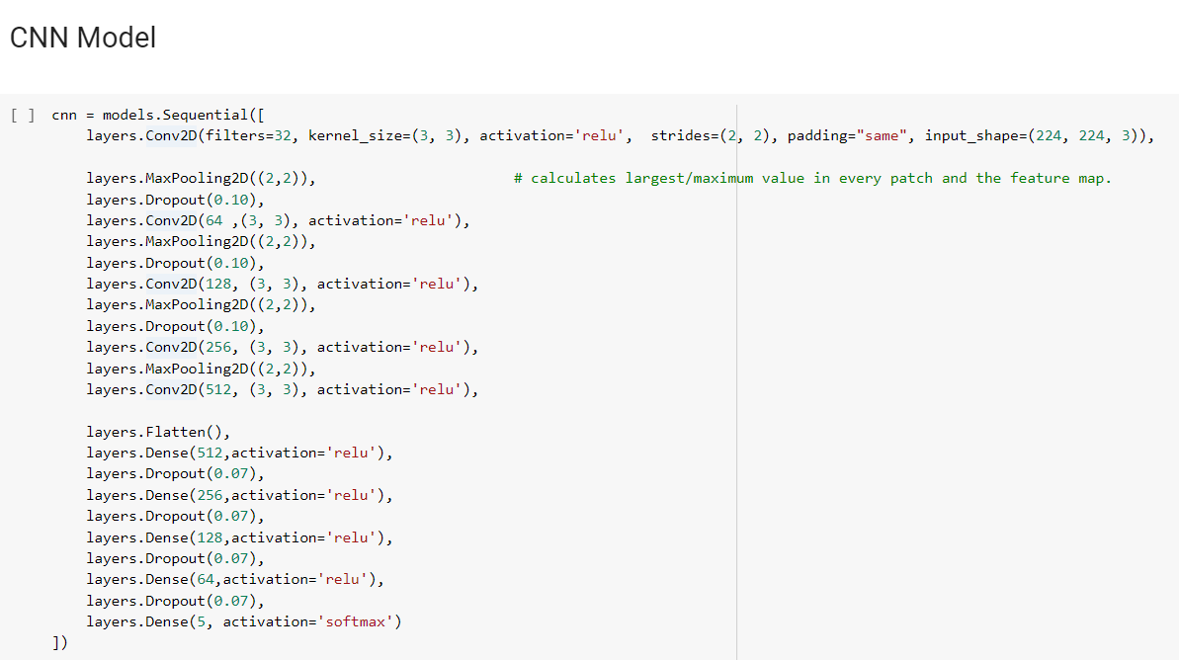

Slide 8
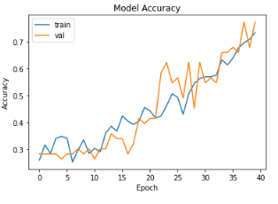
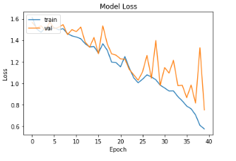
Graphical representation of results obtained :
Our data classification model achieved 0.6923 accuracy

Slide 9
Multi-Page Document to Single page Images

Slide 10
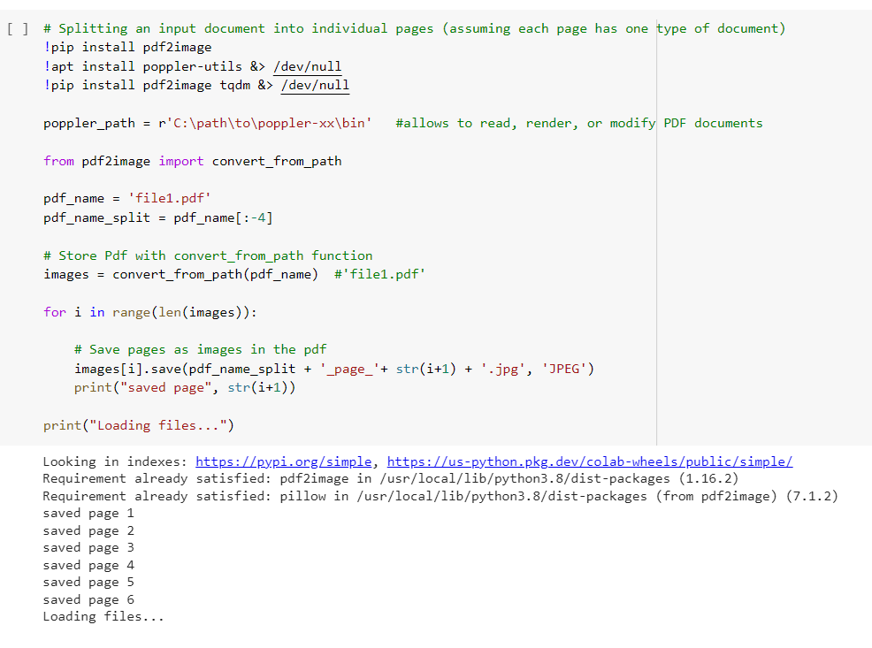

Slide 11
OCR - Optical Character Recognition

Slide 12
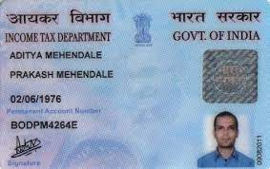
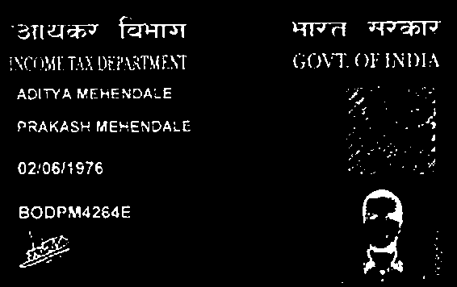
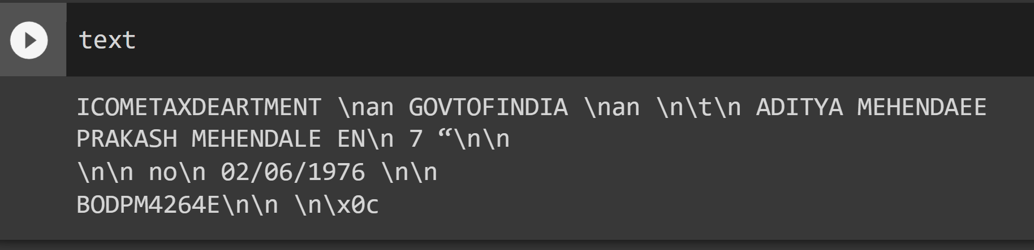
Optical Character Recognition
Predicting label using CNN model
Image Classification (TASK 1)
CNN will give label whether the given image is PAN card Adhaar card Driving Licence or Voter ID card
Image Processing
Image pre-processing reduces the error by a significant margin and helps to perform OCR better
Image Processing
Image pre-processing reduces the error by a significant margin and helps to perform OCR better
Resizing Image
Converting To grayscale
Laplacian Filter
Filter 2D
Resizing Image
Converting To grayscale
Laplacian
Filter 2D
Extracting all the textual information from the processed Image
Text Extraction
Image to string
Identified language - English

Slide 13
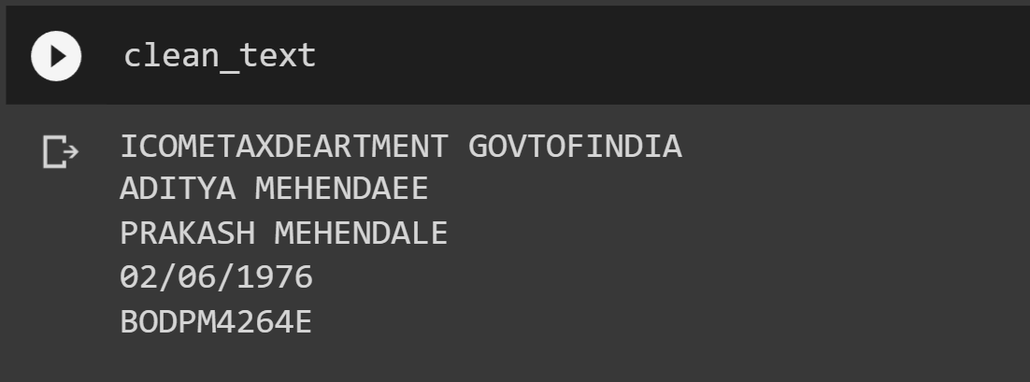
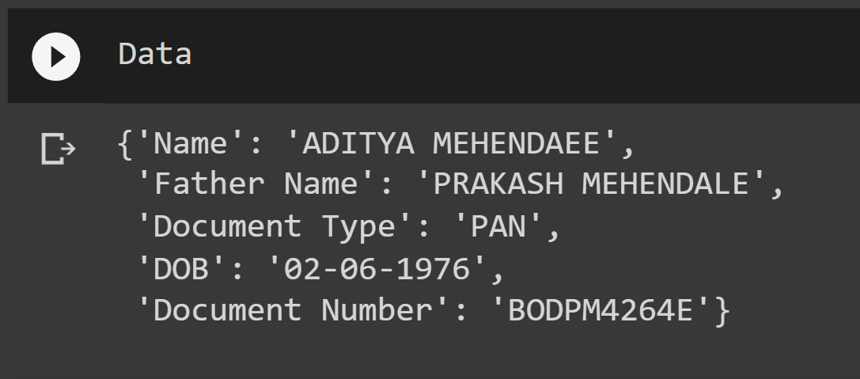
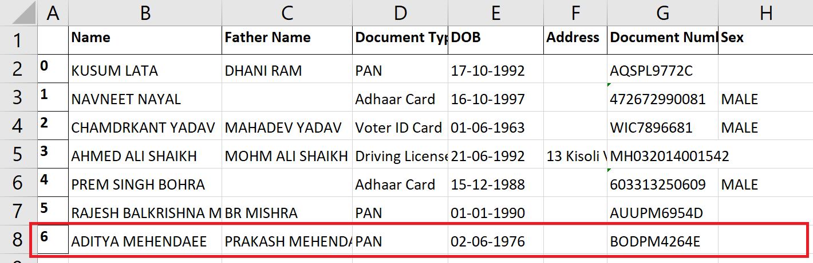
In text Preprocessing the extracted text is cleaned. Properly cleaned data will helps in text classification in OCR
Text Preprocessing
Convert factor column to character columns
Remove white spaces in these columns
Removing unidentified characters
Categorising the text within different parameters and later appending the data to excel
Classification and Appending
Categorising the text within different parameters and making a dictionary
Converting dictionary to dataframe and leaving blank to unidentified values
Appending the information to pre-existing excel sheet
Excel sheet

Slide 14
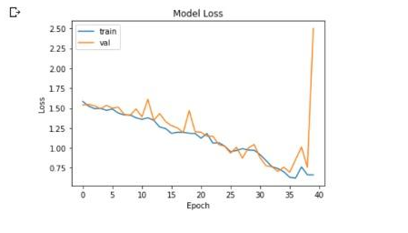
Challenges
Overfitting : reduced through Hyperparameter tuning

Slide 15
Why did we pick this specific technique to solve the problem
Hybrid model(Computer vision+OCR) is seen to work better for classification plus extraction problem.
CNN vs OCR
CNN does not retrieve data, it only analyses images through pixel structure. For the classification ie task 1 we went with it.
OCR still remains a challenge for complex documents that contain a mixture of different fonts, images, background artifacts, and words from various languages without a restricted vocabulary
We were aware of the CNN architecture through our course, so we wanted to implement it.

