Slide 1

Supply Chain Optimization for Health Commodity Shipment and Pricing
Princy Sutariya
Author:- Princy Sutariya
Affiliation:- Pace University
Email:- ps18386n@pace.edu
GitHub:-https://github.com/PrincySutariya19/CapstonProject

Slide 2

Objective: Using predictive modeling to optimize costs and efficiency in supply chains for HIV health commodities.
Motivation: Enhancing distribution systems in developing countries to ensure reliable, cost-effective delivery of critical health products.

Slide 3

Research Questions
How can supply chain costs be minimized for HIV-related health commodities?
What are the primary causes of delivery delays, and how can they be predicted?
How can pricing be optimized to improve cost efficiency across different regions?

Slide 4

Literature Review
The literature underscores the importance of clear demand forecasting, effective inventory management, and transparency to ensure timely, affordable access to essential health products.
This project applies these insights by using machine learning (XGBoost, RandomForest) to predict costs and delivery times for HIV-related shipments.
With tools like SHAP for explaining model predictions and Streamlit for real-time forecasting, this approach supports smarter, people-centered supply chains, aiming to make critical health products more accessible and cost-effective globally.

Slide 5
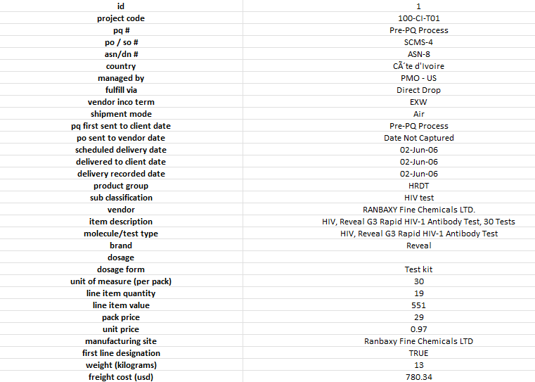
Dataset Overview
Dataset on ARV and HIV lab shipments includes 10,324 rows and 33 columns, detailing costs, logistics, and distribution for developing countries.
Key parameters cover geography, cost details (freight, insurance, unit price), and logistics management (vendor, shipment mode, weight) to enhance supply chain efficiency.
Image shows all the colums and the first entry of the dataset
Link: https://catalog.data.gov/dataset/supply-chain-shipment-pricing-data-07d29

Slide 6
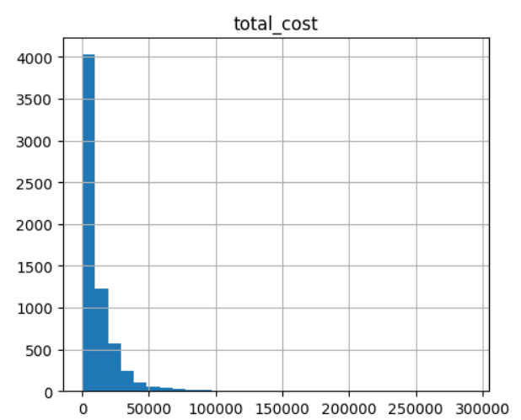
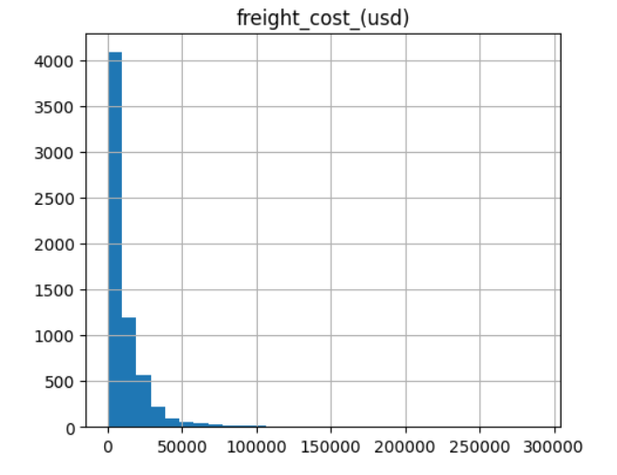
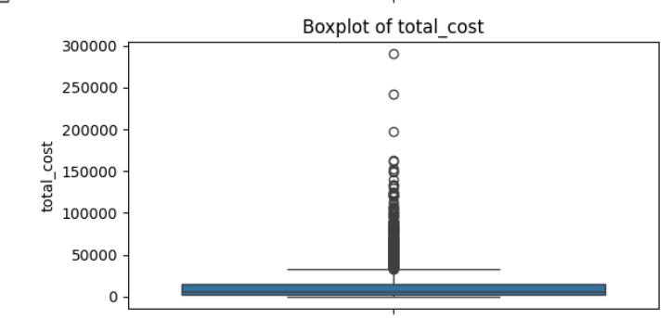
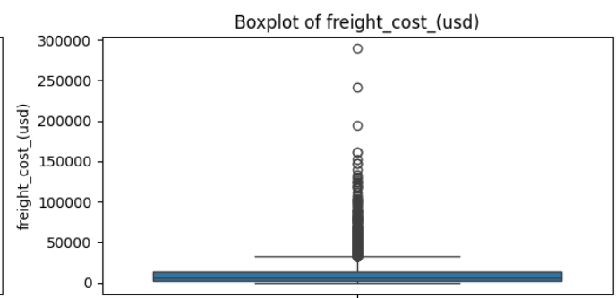
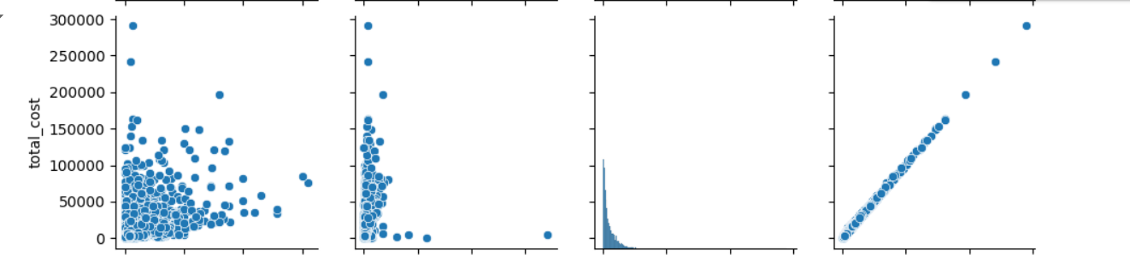
EDA & Methodology
Images shows the eda of the dataset.
Data Preprocessing:
Handle missing values, standardize features, and engineer key metrics (e.g., cost per unit weight).
Modeling Approach:
Freight Cost Prediction: Used Linear Regression, Ridge Regression, and XGBoost.
Optimization & Experimentation:
Tune model parameters (Grid & Random Search).
Optimize costs with Linear and Mixed-Integer Linear Programming.

Slide 7
Model Results & Evaluation
Cost Prediction:
Libraries & Models Used:
Scikit-Learn: Linear Regression, Ridge Regression
XGBoost: XGBoost Regressor
Evaluation Metrics:
Mean Absolute Error (MAE), Root Mean Squared Error (RMSE), and R-squared (R²)
Results:
Linear Regression: MAE = 150.25, RMSE = 200.13, R² = 0.72
Ridge Regression: MAE = 140.40, RMSE = 190.87, R² = 0.75
XGBoost: MAE = 130.12, RMSE = 180.45, R² = 0.78

Slide 8
Next Steps
Model Tuning:
Experiment with additional models (e.g., Gradient Boosting, Neural Networks).
Apply advanced hyperparameter tuning using techniques such as Bayesian Optimization for improved model accuracy.
Delay Prediction Expansion:
Extend current models to further predict delays in shipment by integrating additional features like historical delays, vendor performance, and seasonal factors.

Slide 9
References
Price Optimization in Supply Chain Agreements:- BMC Health Services Research
Effective Demand Forecasting in Health Supply Chains:- MDPI - Effective Demand Forecasting in Health Supply Chains
The procurement and supply chain strengthening project: improving public health supply chains for better access to HIV medicines, Uganda 2011–2016:- The procurement and supply chain strengthening project: improving public health supply chains for better access to HIV medicines, Uganda 2011–2016
HIV/AIDS related commodities supply chain management in public health facilities of Addis Ababa, Ethiopia:- HIV/AIDS related commodities supply chain management in public health facilities of Addis Ababa, Ethiopia
Study on Logistic Challenges in HIV/AIDS Supply Chain Management (Nigeria):- ResearchGate Article
Big Data Analytics in Supply Chain Management: A Review:- Big Data Analytics in Supply Chain Management: A Review - Wiley Online Library
Transportation Planning for Sustainable Supply Chain Network Using Big Data Technology:- Transportation Planning for Sustainable Supply Chain Network Using Big Data Technology – Elsevier
Optimizing Logistics and Supply Chain Efficiency with Data-Driven Approaches:- Optimizing Logistics and Supply Chain Efficiency - MDPI

